Slide 1

ONLINE TIME & EFFORT SYSTEM
Tana Hutchison
June 2011

Slide 2
Agenda
Rationale for Change
Roles
What's New
Review of Functionality
Timing
Next Steps
Notes:
This presentation is meant to give you a high level overview of our new online time and effort system, scheduled to be rolled out this summer. We will explain:
Why we are changing
Who is involved
What is different in the new system
We will show you some screen shots and talk about how it works
Then we’ll review the timing and plan

Slide 3


Why change?
Current Timesheet Process
Print & Distribute
Timesheets
Collect Timesheets
Chase them down
Make add’tl copies
Hand Deliver
Timesheets to Payroll
Payroll Data Entry &
Validation
Research Prior
Timesheet
(Retrieve Hard Copy)
Seek Leave Information
(Balances/History)
File Completed
Timesheets
Chase down
unsigned
or late timesheets
Too Many Manual Steps = Errors & Delays
Notes:
As you probably know – our current manual system is very labor intensive, involving both central office and directorate staff. There is a lot of time spent in our current “sneaker-net” process:
First the timesheets must be printed and distributed
Employees fill them in and supervisors approve, then local staff collect them, find those that are missing, make local copies, file the copies, then
Run them back over to payroll where
They are entered and validated
Those that need signature are flagged for follow up, necessitating a trip to payroll by the approver. Then
Payroll files the paper copies, until
A question comes up and we need to pull the copies
Or make inquiries about leave balances and activity
This is a very labor intensive process

Slide 4



Why change?
Online Timesheet Process
Employee Completes
Timesheet Online
Networked
Data
Supervisor (Designee)
Reviews, Approves &
validates Timesheet
Payroll Reviews,
Validates & Processes
Timesheets
Streamlined & efficient
Notes:
The future process will be much smoother
The employee completes the online timesheet via the web and attests to the accuracy of the time and effort
The Supervisor reviews and approves the timesheet on the web, considering the time worked, leave and charge numbers receiving the effort
Payroll runs routines to process the time/effort sheets; data is passed in to the Payroll system and is available for reporting

Slide 5

Why an online system?
Greater employee accountability and ownership
  Reduces risk
  Meets Cost Accounting Standards
Increases compliance with labor rules
  Stanford Policy
  State & Federal Laws
Eliminates time-consuming paper process
Increases efficiency
  Real-time delivery of information
  Reduces time to process payroll
  Simplifies researching
  and amending previous pay periods
Increases accuracy
  Employees enter their own activity
    Eliminates potential transcription errors
Notes:
The main reason to move to an online system is to improve accountability. This is key to our credibility as a multi- program lab so that we ensure the right funding source pays for the right effort – be it DOE or a “work for others” sponsor. This is reflected in the Lab’s core values of “one lab” and “playing to win” by keeping our commitment to our customers.
The automated system will also help us comply with Stanford policies and state and federal labor rules. As rules change the experts who maintain the system will make the changes.
You’ve already seen the comparison of the efficiency of the old and new processes. In addition, the data is maintained and retained in the online system – there is no worry about losing the paper.
And the accuracy will be improved – employees know what they meant to enter (and will see the charge number and title) – sometimes transcription errors are made in our current process and these will be eliminated, along with the time-consuming correction process we currently have. There is still a process to amend a prior timesheet, and it will provide better documentation of the reason for the change and the online approvals.

Slide 6
Why an online system? (cont.)
Additional System Benefits:
Interfaces with other payroll systems
Documents approval flow
Leave/Vacation can be requested & approved online
Email notifications
No Sensitive/Confidential data -- only work time, leave time and allocation of effort
Better enables project management tracking
Available anywhere web-based system
Notes:
In addition, the web-based system we selected can be interfaced with other payroll systems, giving us flexibility as we determine our long-term business system strategy.
The system documents the approvals, providing an “audit trail”
It offers the option of requesting and approving leave and vacation time online – units can adopt that when they wish. If you have an existing system that works you need not change, but the approval and reporting features of the system may be beneficial
The system will send targeted email reminders to employees and supervisors – and it will not send a reminder to those who have already completed a step!
The system will not contain any sensitive or confidential data such as pay rates – that remains in PeopleSoft – the system will only hold time, leave and effort
It will provide better information for projects
And as mentioned, it is available anywhere via the web – employees or supervisors can log on and submit and approve time/effort from anywhere – we won’t have to chase people down for subsequent signatures
For employees who do not have easy access to a computer they can use a shared computer to get to the system on the web

Slide 7
What are the roles?
Employee
  Exempt (full-time and part-time)
  Faculty and Grad Students (if paid by SLAC)
  Non-exempt Salaried
  Non-exempt Bargaining Unit
  Hourly
Note: The system will enforce rules for each identified ‘role’ in accordance with Stanford policies and State & Federal laws
Notes:
The system will be used by all employees paid by SLAC
- Exempt
- Faculty and Grad Students (if paid directly by SLAC)
- Non-exempt salaried staff
- Non-exempt bargaining unit staff
- and casual/hourly employees
Rules have been set up for each employee group in accordance with Stanford policies and federal and state laws

Slide 8
What are the roles? (cont’d)
Supervisor
  Administrative supervisor for each employee
Gatekeeper
  “Super-User”: knowledgeable local staff available to help, monitor submissions, run reports, make corrections
Financial Approver
  Authorized financial staff in the employee’s directorate available to run reports, make corrections to charge numbers, handle rejected transactions
CAM (Cost Account Manager)
  Able to run reports and identify necessary changes related to effort charged to their activities
Notes:
In addition to the employee role, some people will have other roles:
Supervisors will approve the time, leave and effort for their staff
Gatekeepers are local “super users” who will be available to help you learn the system, provide basic trouble-shooting, run reports, make corrections
Financial approvers will be business managers or financial planners who can run reports, initiate corrections and follow up on any rejected items
Cost Account Managers can run reports and identify necessary changes on their charge numbers

Slide 9
Who will not be using the system now?
Agency Temps
FAMIS and VIMA users (in this phase)
Those on Stanford payroll
  Note: A few may be approvers
Notes:
As we role the system out, we will NOT include everyone currently using a paper timesheet
Agency Temps will still use paper timesheets until we transition to the online Manpower system
Those employees already in the online FAMIS or VIMA systems will continue to use those systems. We will move them to “it’s About Time” in a future phase
People paid through Stanford will not use the system, unless they are a supervisor of SLAC employees, in which case they will use the system to approve

Slide 10
What will be new?
Greater Detail:
  Exempt Employees:
    Effort Percentages (%) entered for each work day
    Best Practice: Enter once a week, considering ALL effort expended
  NonExempt Employees:
    Daily Start & Stop Times
  Active entry of effort by charge number increases accountability
    Critical for a multi-program lab
Detailed Reporting: Employee, Organization and Charge number/WBS
Notes:
There will be a lot that stays the same:
- Timesheets periods are not changing – still semi-monthly
Administrative supervisors still review and approve the timesheet
Exempt effort is entered in percentages and “standard hours” will be calculated for other systems
What is different is the greater level of detail, reflecting our increased focus on accuracy and accountability
- Exempt employees will enter effort percentages for each work day. Best practice is to go in at the end of the week, or the following Monday, and enter your percentages for the week while your effort, including any weekend or other “non-standard” time, is fresh in your mind. Remember – just as is true today at SLAC and at Stanford - for regular exempt employees, including faculty, who are paid through the payroll system, pay is considered to be remuneration for ALL work which benefits SLAC. For full-time employees, this is 100% Full-Time Equivalence (FTE). For exempt employees, 100% FTE does not equate to any set number of hours, e.g., 40 or 50 hours per week; it equates to the totality of SLAC-compensated effort. Although many SLAC systems use standard hours of 40 to indicate 100% FTE, this does not mean that exempt employees who are 100% FTE, work only 40 hours per week.
When completing your effort/time sheet, you must record your effort distribution based on the total effort for the period, including any time in excess of 40 hours per week
- For non-exempt employees we will be reporting the daily start and stop times as well as elapsed hours. Schedules can be set up to make this simpler
The system requires a step to populate charge numbers and effort, increasing accountability
Copying charge numbers from previous period or week, validating they are still accurate
Entering the effort or hours to reflect the work performed (allows changes on a daily basis as effort shifts)
Can search for charge number or WBS (to select charge number)
Improved reporting will also be available

Slide 11

How do approvals work?
EMPLOYEE
Submits & Attests
Timesheet
SUPERVISOR
Reviews, Approves &
Validates
Employee Timesheet
PAYROLL
Validates
&
Processes Timesheets
Gatekeepers will oversee Employee Timesheet Troubleshooting & Act as Back-Up Approver for Supervisor
Notes:
Here is a quick overview of the approval process:
The employee fills out his own time/effort sheet, deals with any error messages and attests to its accuracy
His or her supervisor reviews it online, considers any warning messages generated by the system, approves it (approving the leave, time worked and charge numbers charged)
Payroll runs processes to validate the time./effort sheet and pull the data into PeopleSoft
Gatekeepers help with trouble shooting and are back up approvers – although with web-based access we believe supervisors will usually be able to log on and approve for their staff
Note, if anyone other than the employee amended his time/effort sheet, a message is sent to the employee informing him of the change to ensure it is accurate
Why do these approvals matter? - Times have changed! SLAC is a multi-program lab
SLAC’s funding comes from different areas of DOE as well as other sources
SLAC intends to expand its Work For Others portfolio
Each sponsor/funding source should only pay for effort that benefits it
Employees and their supervisors are responsible for knowing where to charge their effort

Slide 12
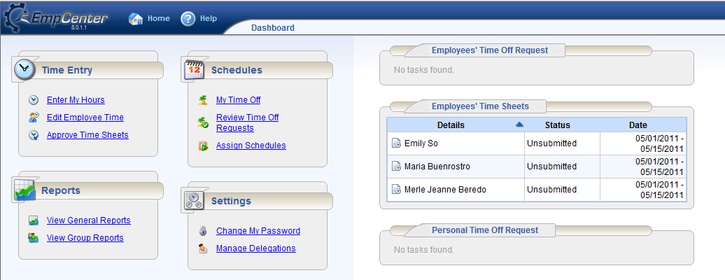
What will it look like?
Supervisor Access
(Time Entry / Reports / Schedules)
“At a Glance View” of Employee Requests & Timesheets
Supervisor Homepage / Dashboard
Notes:
A supervisor will have more selections on their home page than a typical employee. They will have the links to initiate their own time/effort entry but will also have links to review and approve their staff’s time/effort sheets and time off requests

Slide 13
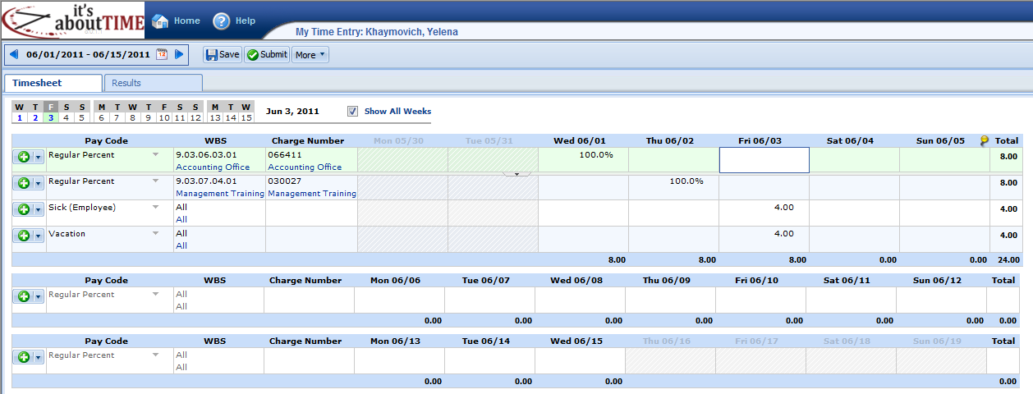
What will it look like?
Weekly Totals
Detailed Effort Entry
  Pay Codes
  WBS / Charge #
Detailed Daily Entry
Percentage & Total Hours
Exempt Employee Timesheet
Notes:
You can search on WBS number or title in order to find a charge number - the charge number and description will always show, improving accuracy as you can validate the charge number based on the description
Time off (vacation, sick, PTO, etc.) is entered in hours, just as we currently do, Work time is then charged out in percentages – 100% per day, reflecting the allocation of the effort expended
The system shows the “calculated” weekly hours, using a standard 40 hour week for a full time employee

Slide 14
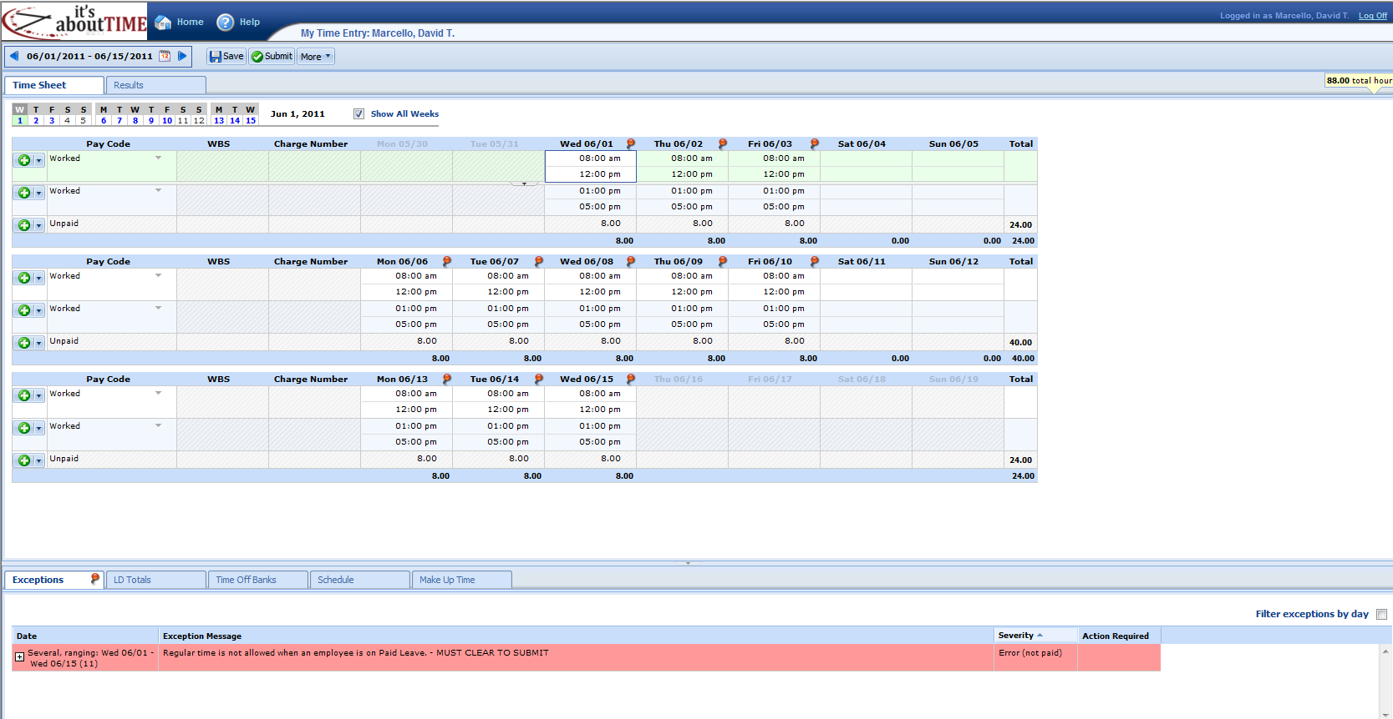
What will it look like?
Detailed Time Entry
Start & Stop Times
Accounts for Lunch Break
Non-Exempt Employee Timesheet
**all other Details are same as Exempt
Notes:
A nonexempt employee will adjust his start/stop times as needed and then enter the elapsed hours by charge numbers for each day

Slide 15
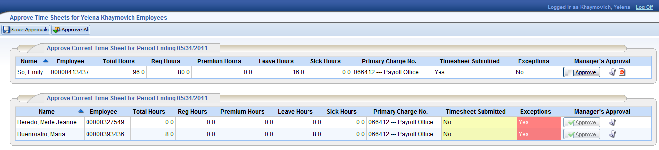
What will it look like?
High Level Summary of Hours
(Simply Double-Click to view Detailed Timesheet)
Primary Charge #
Approval/Reject Buttons
“At a Glance View” of any Action Required
(i.e., notify employee to submit / clear exceptions)
Supervisor Approval Screen
Notes:
When a supervisor goes to his approval screen he will have two sections – those where the employee has submitted the timesheet and those where it has not yet been completed. The high level summary will show the total hours, regular and overtime hours, leave and sick hours and will display the primary charge number for the employee. Around half of SLAC’s employees only charge one charge number per period – so for them, the supervisor could approve or reject the timesheet from this summary screen, without drilling in to the details.

Slide 16
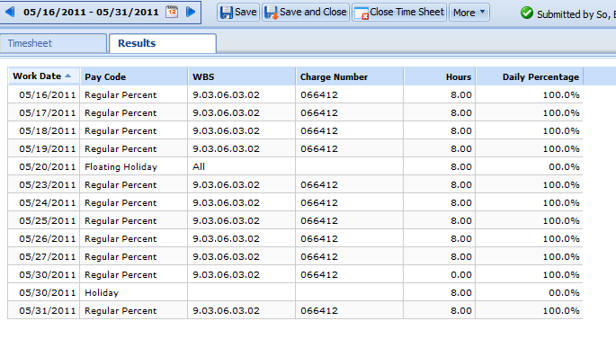
What will it look like?
Detailed Timesheet Tab
(Employee View)
Results Tab:
Detailed Summary of Employee Timesheet
Supervisor View of Employee Timesheet
Notes:
If the supervisor drills in to the employee’s time sheet, he can select from two tabs – one that shows the detailed timesheet as the employee entered it, and one that is called the results tab – it is presented in a table format, showing the hours (actual for non-exempt – calculated for exempt) by charge number by day.

Slide 17
What is the implementation timeline?
User Acceptance Testing Wrap-Up
Roll-Out
Pilot Training
Lab-wide Training
JUNE
JULY
AUGUST
16th
1st
16th
1st
16th
  Ongoing feedback for any needed changes to system, training or instructional material based on pilot experience
Begin Pilot:
3 pay periods w/
Cross-section
of SLAC
Notes:
We are just wrapping up our User Acceptance Testing. We’ve ha d32 people representing all the directorates involved in our testing
We will then move to pilot mode, again, encompassing a variety of staff in the lab. We will learn from our pilot participants, making any needed changed so the system or our training and instructional material
We will then move to lab-wide roll out
If any significant issues are found as we wrap up UAT or perform our pilot the roll out could be delayed slightly. We will not go live if we have concerns about the system or processes.

Slide 18
What do we need from supervisors?
Support the system and lead change management
Promote improved accountability, even though it means entering more detailed information
Review the accuracy of the time and effort entered for your employees
  Do not delegate this responsibility
Become an enthusiastic “early adopter”
  Lead by Example
  Enter your time and effort promptly
  Personally review and approve employee’s time/effort sheets by the deadlines
  Use reports to monitor activity
Notes:
As with any significant change, there will be people who are unhappy
We have heard “if this system takes longer than the current paper system – you will have failed”. Well – we know it will. Our paper system does not hold the employee accountable for their own time and effort – we need that accountability
We need to be sure that the review is carried out by the knowledgeable supervisor – this key control should not be delegated
We need the ALDs to be “early adopters”

Slide 19
Issues you may hear about
Some folks are just resistant to change
Custom reports need to be built
  Due to time constraints, we won’t have a chance to build a full suite of reports prior to the pilot
Notes:
We know that the increased level of detail will cause complaints – in addition to that, some folks just don’t like any change
We expect complaints for the first few pay periods, until people get used to the system. That has been the typical pattern at other companies using this system or at other DOE labs when they moved from a paper system to an online system.
In addition, we’ve not yet had time to complete the custom reports we want. They will not be available as we start the pilot, but will be ready before we go-live.

Slide 20

Questions?
Notes:
Optional comments:
Remember - SLAC is using a single tool for three distinct purposes
Time reporting for non-exempt staff (including overtime and other premium calculations)
Leave reporting for all employees
Effort distribution for non-leave pay for all employees
We didn’t build a custom system
Hosted Software as a Service model (upkeep is outsourced)
Agile, web-based system, available anywhere
Can easily interface with other payroll systems, keeping SLAC’s options open
However, customization possibilities are limited
We think, once you get used to it, you will like it!

Slide 21
Appendix

Slide 22
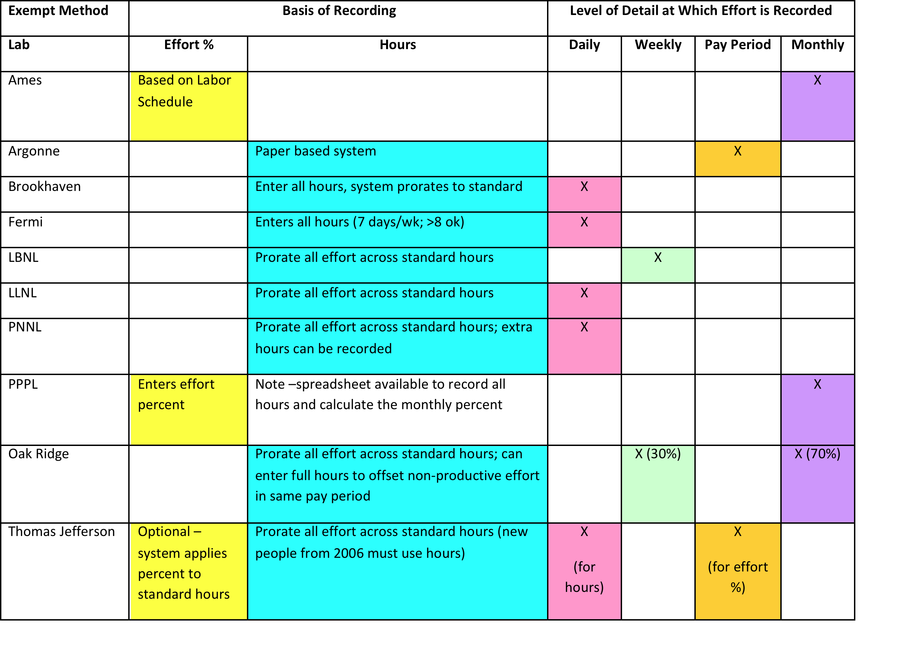
What do the others do?
DOE Office of Science labs (9) exempt effort methods:
Manual hours (1 Lab)
Online (8 Labs):
  (2) Monthly %
  (2) Daily total hours
  (4) ProRated standard hours
    Additional Notes About ProRated Standard Hours:
      Considering all effort but limited to standard (40) hours per week
      2 of the 4 allow extra hours to be recorded to offset later non-productive effort
      2 of the 4 record daily, 1 of the 4 records weekly, 1 of the 4 records weekly or monthly
Notes:
Of the nine other Science Labs, one still on paper, using hours
Eight online:
2 enter effort percent (on a monthly basis)
2 enter total hours (on a daily basis)
4 enter "prorated" standard hours
Considering all effort but limited to standard (40) hours per week
2 of the 4 allow extra hours to be recorded to offset later non-productive effort
2 of the 4 record daily, 1 of the 4 records weekly, 1 of the 4 records weekly or monthly
In addition, Livermore also records time in prorated hours, on a daily basis

