Slide 1
Department Heads Meeting June 16, 2011
David B. MacFarlane

Slide 2
Topics
Safety stand down
Slides available for department meeting before end of next week
PPA-Advisory Committee feedback [May 5-6]
Electronic time-effort reporting: Tana Hutchison
News
Phone outage Saturday 8:00-20:00: impact for yellow/red work
PPA All Hands [June 22 at 9:00am]
Theory program review [July 25-27]: written proposal submitted
DOE Site Visit [August 2 in Germantown]
Format will be a reverse site visit + video conference link
DOE requesting summary document in advance: high-level summary of programs, level of effort, major accomplishments, goals for the coming year [format under development, due July 15]

Slide 3
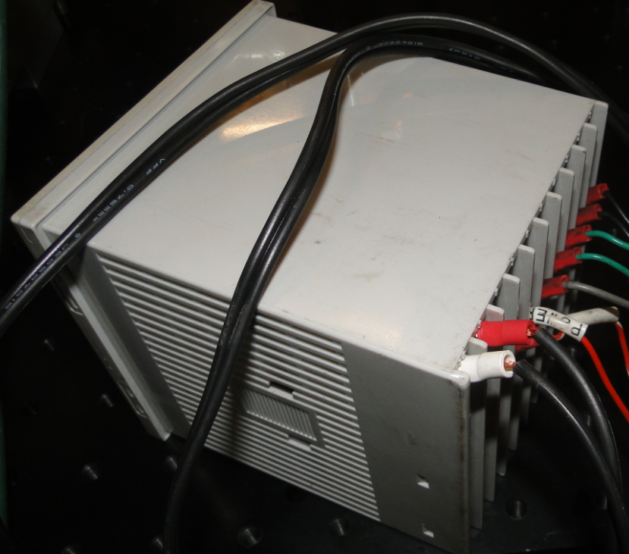
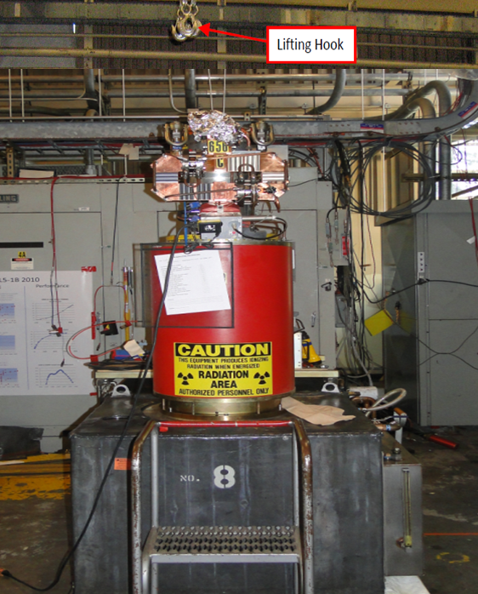
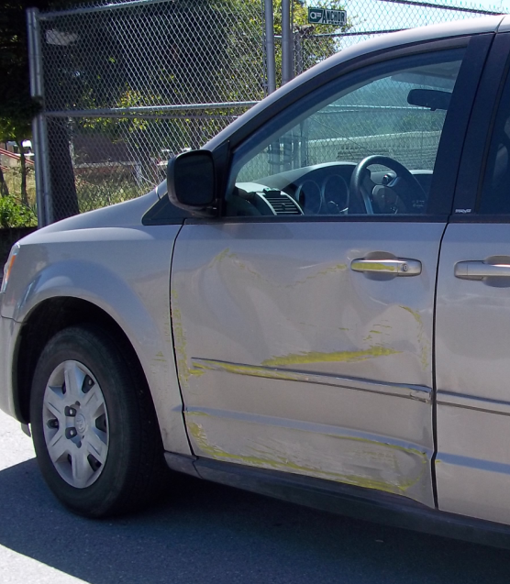
Are we becoming complacent?

Slide 4
Significant uptick in near misses!
We need to pause, reflect and redouble awareness
Brief review of recent incidents, near misses and related causal factors
Review the reasons mistakes are made
Review methods in use to mitigate or prevent errors
Participate in incident prevention brainstorming process
Notes:
We’re going to do the following today:
SLAC had made great improvements in it’s ES&H program over the past 5 years. We have well trained staff, excellent policies and procedures, a thorough incident investigation process, and an effective work planning and control process. Overall, we’ve seen significant improvements in our accident statistics. However, safety is an activity that requires everyone’s attention and we have to always be vigilant. We have recently been seeing an increase in incidents: for example, our recordable injury & illness cases has increased from 11 cases all of last year to 20 for the first 3 quarters of this year. Another example is we continue to have accidents involving GSA vehicles and SLAC electric carts that just should not be happening. The purpose of this safety briefing is to begin the process of focusing your attention back to Safety. Over the next ?? minutes, we’ll do the following:
- Briefly review recent incidents, near misses at SLAC and related causal factors because it’s important you know that these are occurring
- Review the typical reasons mistakes are made
- Review the methods our organization is currently using to mitigate or prevent errors
- Participate in incident prevention brainstorming process – because we need your help to improve

Slide 5
Review/Discuss Applicable Incidents
Sample of 5 recent incidents and near misses
Pick 1-2 that you feel are particularly applicable
Discussion each incident
What similar factors exist in your organization that can or have resulted in a triggering event?
What existing barriers does your organization deploy that may or have failed to prevent an event?
What could be done to reduce the probability and severity of a similar event from occurring in your organization?
Notes:
Based on these discussions:
- Within our organization, what error likely situations have occurred in the last few months?
- Which error precursors should we be paying more attention to?
- What additional error prevention/mitigation tools can we deploy or strengthen?
- What unsafe conditions or behaviors can we correct now, in the next week, next month?

Slide 6
Example: GSA Vehicle Accident
Employee initiated left turn at sector 30 and scrapped the yellow bollard. He had successfully made this left turn many times in the past.
Approximately 10% of GSA fleet damaged in past 2 years at SLAC
Notes:
This is an example of a recent vehicle incident. If you recall we had a stand down a few months back related to vehicle incidents. We saw a drop initially but are still seeing one to two incidents per month.
Approximately 10% of GSA fleet damaged in past 2 years at SLAC. While there haven’t been any injuries, we incur $2-5K in damage per incident and there is significant concern that luck could run out and instead of hitting a bollard, that a person will be hit.

Slide 7
Vehicle Accident Details
An employee was driving a GSA van going south on the south target road toward sector 30.
He stop at sector 30 gate and showed the officer his badge
He proceeded to move forward after approved by officer and make a left turn toward Counting House Road.
He initiated his left turn and heard a loud scraping noise and determined that his vehicle was causing it so he brought the vehicle to stop.
He exited the vehicle and he realized he had scraped the entire side of the vehicle against the yellow bollard.
Candidate Causal Factors and Error Precursors:
Repetitive action, monotony, overconfidence
Distraction
Inaccurate risk perception
Notes:
Here’s some details related to this specific incident and a list of candidate causal factors and error precursors. Are there any lessons learned from this accident that might apply to or benefit your organization?

Slide 8
Example: Crane Near Miss
The crane operator raised the Klystron tube assembly before 1 of the 3 sling hooks was disconnected
We’ve had 2 hoisting and rigging incidents in the past year at SLAC.
Notes:
There was a recent near miss involving a crane and a klystron. The communications error that contributed to this could have resulted in a costly incident ($500K). We have seen similar incidents and near misses related to hoisting and rigging activities at SLAC in the past few years.

Slide 9
Crane Near Miss Details
A two-man team was performing a routine lift following standard operating procedures to install a 5045 Klystron onto the square tank
The tube assembly is hoisted into position with use of a 10T wireless remote controlled bridge crane and a 3-leg wire rope sling
With the tube stabilized supervisor lowered the sling fixture slightly to provide slack for the technician to the remove the sling hooks
2 hooks were released but repositioning required to release the 3rd
A miscommunication occurred resulting in the crane raising the wire rope sling prior to the release of the 3rd hook, lifting the unit with only one sling. Had the unit toppled, extensive damage would result
Candidate Causal Factors and Error Precursors:
Inadequate/unclear communication
Time pressure
Imprecise communication habits
Notes:
Here’s some details related to this near miss and a list of candidate causal factors and error precursors. Are there any lessons learned from this near miss that might apply to or benefit your organization?

Slide 10
Example: Shock Incident
A worker was shocked when he contacted exposed copper wire on the control box on vendor-provided portable test equipment.
Second electric shock incident with portable test equipment in the past year
Notes:
This vendor–provided test equipment was not properly inspected resulting in an electric shock incident. We routinely use test equipment and have established inspection protocols in place. This is the second electric shock incident with portable test equipment in the past year.

Slide 11
Shock Incident Details
Portable test equipment was set up and in use in the KTL
When manipulating the control box, worker 1 felt a shock, called out to nearby worker 2, who assisted & had worker 1 report to medical
The test equipment was deenergized and secured by worker 2.
Upon inspection the control box was found to have inadequate insulation (small length of exposed copper wire visible in photo) on both 120 VAC power leads at the point of connection to the device.
Candidate Causal Factors and Error Precursors:
Test equipment not inspected (or inadequate inspection) by worker prior to use
Complacency or overconfidence
Short cut mentality
Unclear procedures or guidance (regarding inspection and EEIP requirements)
Notes:
Here’s some details related to this specific incident and a list of candidate causal factors and error precursors. Are there any lessons learned from this incident that might apply to or benefit your organization?

Slide 12
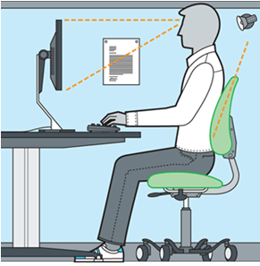
Example: Ergonomic Injuries
Multiple injuries and first aid cases related to poor ergonomics in office environments
Have also seen multiple strain injuries and first aid cases from incidents involving non- office workers
11 Recordable cases so far in FY11
Notes:
We’ve experienced some ergonomic-related injuries and near misses in the past few months. These are occurring in office environments as well as in industrial and field operations.

Slide 13
Summary of Ergonomic-Related Injuries
Non-office
Rigger felt back pain when lifting a 4 by 4 board (Ops)
Café worker felt lower back pain while working at grill (Ops)
Welder strained knee while working and moving materiel (AD)
Worker felt leg pain when positioning a pump (SSRL)
Worker felt back pain after lifting several small items (SSRL)
Worker felt pain after removing cables from overhead tray (AD)
Office
Arm pain when performing prolonged mousing (Ops)
Worker felt pain after performing standard office duties (Ops)
Pain in neck and upper back after prolonged computer use (AD)
Wrist, forearm, & hand pain from using key board and mouse (AD)
Shoulder and left index finger pain from computer-related work (AD)
Notes:
Here’s a list and brief description of specific ergonomics-related incidents. Does your organization have similar exposures and are there any lessons learned from these injuries that might apply to or benefit your organization?

Slide 14
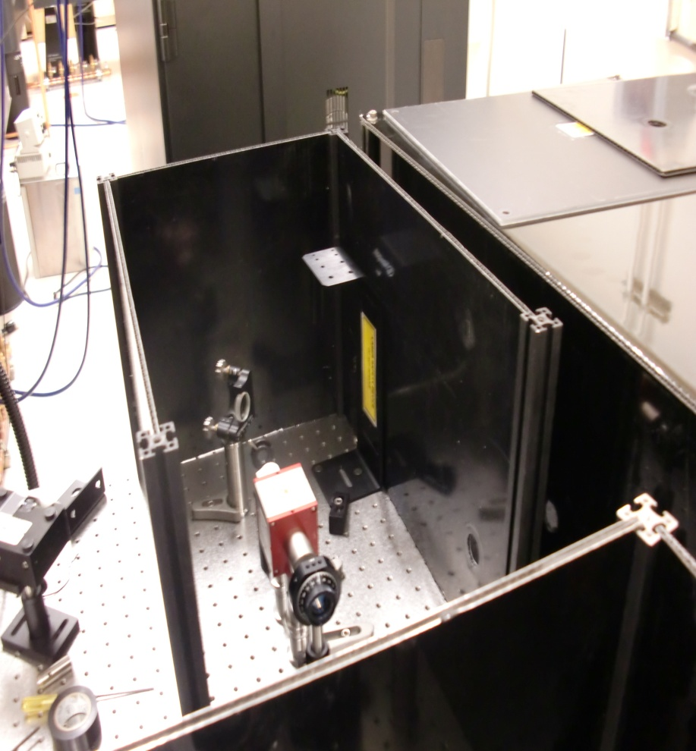
Example: Laser System Near Miss
Laser operator noticed red laser beam on shirt sleeve while moving an unused optic while the lab was in Class 1 laser operations mode (i.e., beam should have been totally enclosed)
Second laser event in past 2 years
Notes:
This incident is still under investigation. The incident summary is that a graduate student noticed a red laser beam on his shirt sleeve while moving an optic. This occurred while the lab was in a Class 1 laser operations mode where beams are required to be enclosed. This error could have resulted in a significant injury.

Slide 15
Laser System Near Miss Details
Day prior to incident, a safety shutter was removed from shutter enclosure during a configuration change to accommodate a new optic being installed
Laser system was then operated for an extended period in Class 4 mode (PPE required with laser beams enabled) with the safety shutter not relocated to restore its functionality. Two covers for shutter enclosure are also removed during this period.
At end of day the laser system is put to Class 1 operation mode, a common practice for this lab, but without the required safety shutter and 2 covers
Following morning, a laser operator enters to work in Class 1 mode without PPE (not required for this mode) when event occurs.
Notes:
Here’s some details related to this near miss and a list of candidate causal factors and error precursors. Are there any lessons learned from this near miss that might apply to or benefit your organization?

Slide 16
Laser System Near Miss Details
Candidate Causal Factors and Error Precursors:
Inadequate work planning and controls -- re. hazard analysis and controls required for safety configuration change
Inadequate safety configuration control for laser safety shutter
Failure to verify required Class 1 enclosures/barriers in place prior to setting Class 1 mode
Notes:
Here’s some details related to this near miss and a list of candidate causal factors and error precursors. Are there any lessons learned from this near miss that might apply to or benefit your organization?

Slide 17
Anatomy of an Incident
Errors
WPC Process
Policies/Procedures
Management Barriers
Sufficient Resources
Training
Triggering Event
Organizational Barriers
Hardware
Interlocks
Engineering Barriers
PPE
Actions
Individual Barriers
Event
Notes:
At SLAC we deploy many tools to help prevent or mitigate the severity of incidents. These can be broken up into the following:
Management Systems (WPC Processes and procedures)
Organizational Barriers (Having sufficient resources, qualified staff)
Engineering Barriers (Hardware and interlocks), and
Individual Barriers (Personal protective equipment and employee actions)
When the triggering event is able to proceed through gaps in our barriers, an event can result.

Slide 18
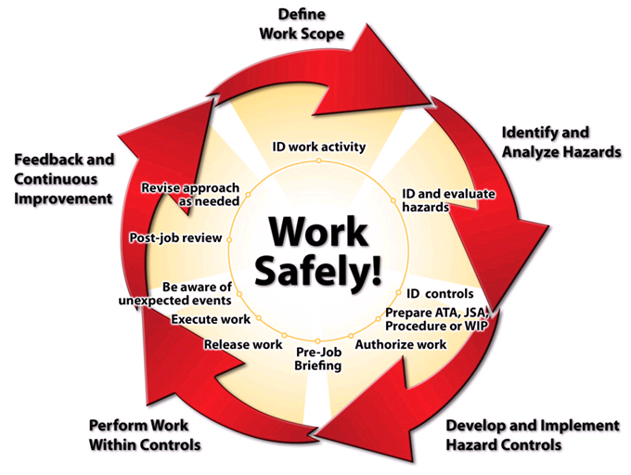
Integrated Safety & Environmental Management System (ISEMS)
Notes:
SLAC uses the integrated safety and environmental management system (ISEMS) to bring safety and environment into work practices at all levels.
ISEMS applies these Five Core Functions as steps to our work. Each of these play a role in preventing incidents
Define scope: What do I want to do? Determining the activity that I will be performing will determine all of the subsequent steps.
Analyze hazards: What are the risks of doing it? What are the hazards that I might encounter while I am doing the work?
Control for hazards: How can I control those risks? Are the right engineering controls in place? Are the right procedures in place? Have I been trained to do the work safely?
Perform work: Do it (controlling for risks). Am I performing the work within the scope that was defined in step 1, and am I employing the controls that will mitigate the hazards?
Feedback and Improvement: Evaluate performance. How can I do better next time? What Lessons have I learned from previous experience?

Slide 19
PPA Advisory Committee
Dual report to SLAC Director and PPA ALD
Membership (not attending)
Dan Akerib, Case-Western
Sergio Bertolucci, CERN
Sally Dawson, BNL
Werner Hofmann, MPI Heidelberg
Joe Incandella, UCSB
Ann Nelson, Washington
Steve Ritz, UCSC
David Spergel, Princeton
Paul Tipton, Yale
Harry Weerts, ANL (Chair)

Slide 20
Focus topics for committee advice
KIPAC future direction and role
Future B physics program
Development of a broader Intensity Frontier program
Future high-energy gamma-ray program
Computational cosmology program

Slide 21
KIPAC future direction and role
KIPAC plays a key role across SLAC and Stanford in particle astrophysics and cosmology
Encourage KIPAC to continue pursuit of its broad range of programs and seek to broaden DOE support in these areas.
Programs that address questions in the dark sector are clearly within the DOE mission
KIPAC should not hesitate to showcase its broader range of programs, including CMB research
Recommendations on future KIPAC faculty hires
KIPAC should look to hire a top faculty candidate in observational cosmology to advance leadership of the LSST science program.
As SLAC considers involvement in CTA a faculty hire in high-energy astrophysics presents another opportunity

Slide 22
B Physics and Intensity Frontier
Endorse PPA long-term planning principles:
Relative scientific merit of competing projects, match to core capabilities at SLAC, likelihood that a project will attain critical mass at SLAC, and size of impact that PPA participation will have
Strong physics case exists for a next-generation B-physics experiment
SuperB program is an exciting possibility, but with significant risk of not being completed in a timely fashion and finishing second
SLAC could potentially be of service to the US HEP community by managing the DOE capital investment in SuperKEKB, an opportunity that could grow depending on developments elsewhere

Slide 23
Comments on Intensity Frontier alternatives
US contribution to SuperKEKB is quite small with little prospect for real impact by the US community
At minimum we would argue for different roles on Belle II, which may or may not be possible at this late stage
LBNE already supported by Fermilab and BNL
Science interest will depend critically on value of θ₁₃
No particularly relevant technical expertise at SLAC
Rare kaon program was already considered a decade ago at BNL and not executed then
Nowhere near as rich a physics opportunity as Super B Factories
Mu to e conversion experiment may be an good option
Major advance in LFV sensitivity and overlap of technical capability

Slide 24
B Physics and Intensity Frontier
Upcoming DOE sponsored workshop where the US community will make the case for a compelling intensity/precision frontier program in the US
Final report of this workshop will most likely form the basis for the future US intensity frontier program
Program should have different components:
Project-X based experiments, but should also include B-physics, neutrinoless double beta decay and experiments such as a search for heavy photons
SLAC should take advantage of this workshop and articulate how it sees its contribution to the intensity frontier program in the US

Slide 25
Future high-energy gamma-ray program
Fermi has proven successful well beyond expectations, revealing a wealth of γ-ray sources and new phenomena
Extension of the Fermi program is well motivated
Encouraging to see that DOE HEP is taking credit for the spectacular results from Fermi
Unambiguous identification of a Dark Matter signal will require a very detailed understanding of the astrophysical background
CTA is the natural continuation and enhancement of the highly successful Fermi program
Participation in the R&D and prototyping of the dual-mirror telescope should be vigorously pursued
Overall strategy for US participation should be monitored and if necessary adjusted depending on R&D results and funding profiles.

Slide 26
Computational cosmology program
Computational cosmology initiative is timely and can play an essential role in enhancing the scientific return from the upcoming lensing and spectroscopic surveys
Recommend proposal become more focused in its science
Simulating the large-scale distribution of galaxies with a goal of providing precision inputs first to the current and future surveys
Encourage support of researchers who will create and analyze the simulations rather than devote resources to hardware
Recommend that the proposal broadly engage the community both within DOE and in the universities
Encourage KIPAC to host a workshop that engages the community and establishes both goals for a common set of simulations

