Slide 1
Compton Solenoid 101
2nd Measurements 7/2010

Slide 2
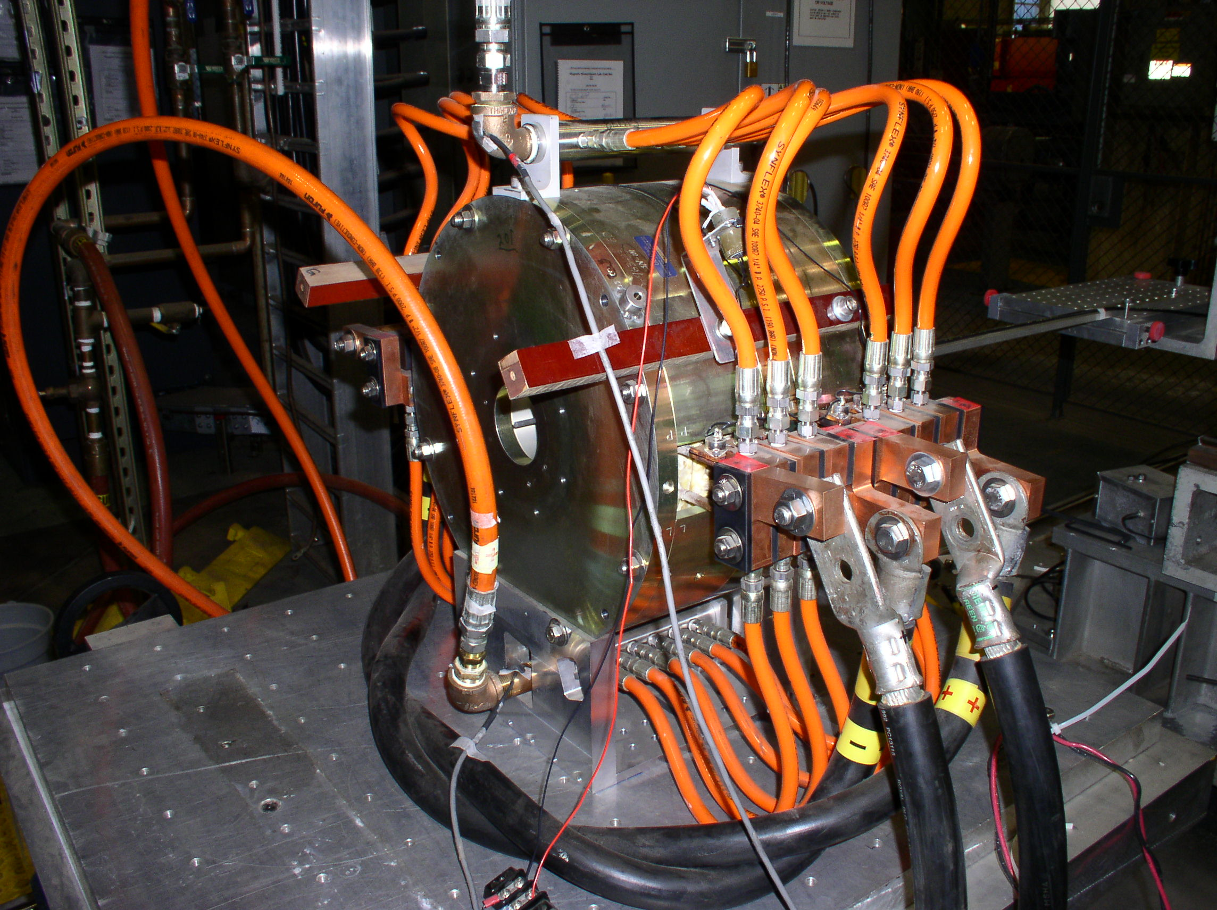
Axial Field Setup

Slide 3
Temperature
Water out – Water In ΔΤ = 10 deg C at 300 Amps for 3 hours
Inside Bore – Water In ΔΤ = 6.8 deg C.

Slide 4
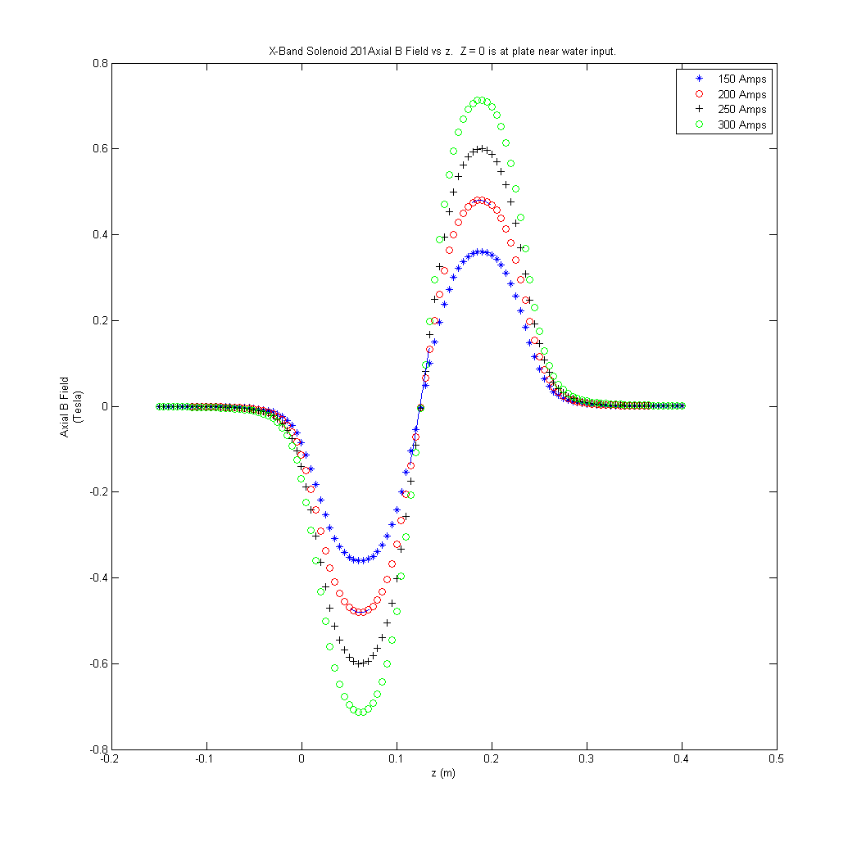
Axial Field vs z

Slide 5
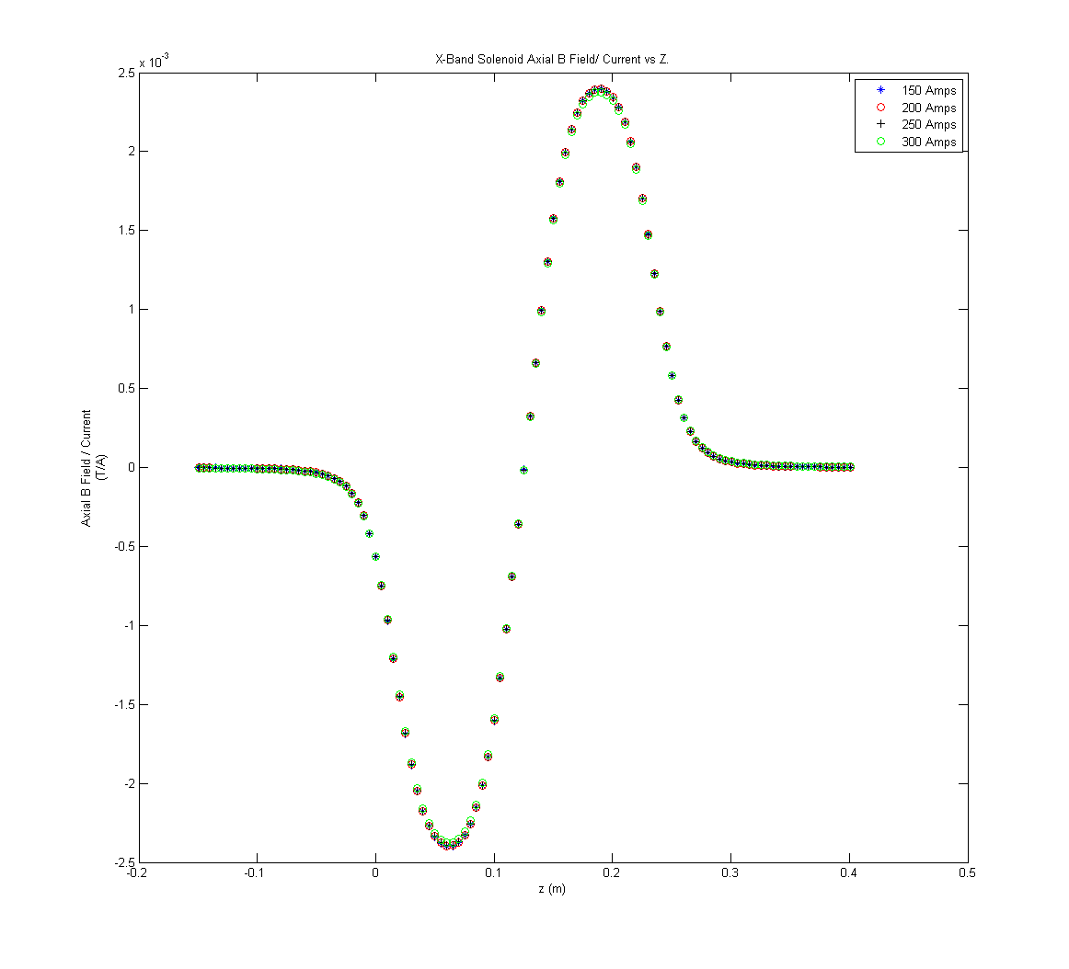
Axial Field over Current vs z

Slide 6
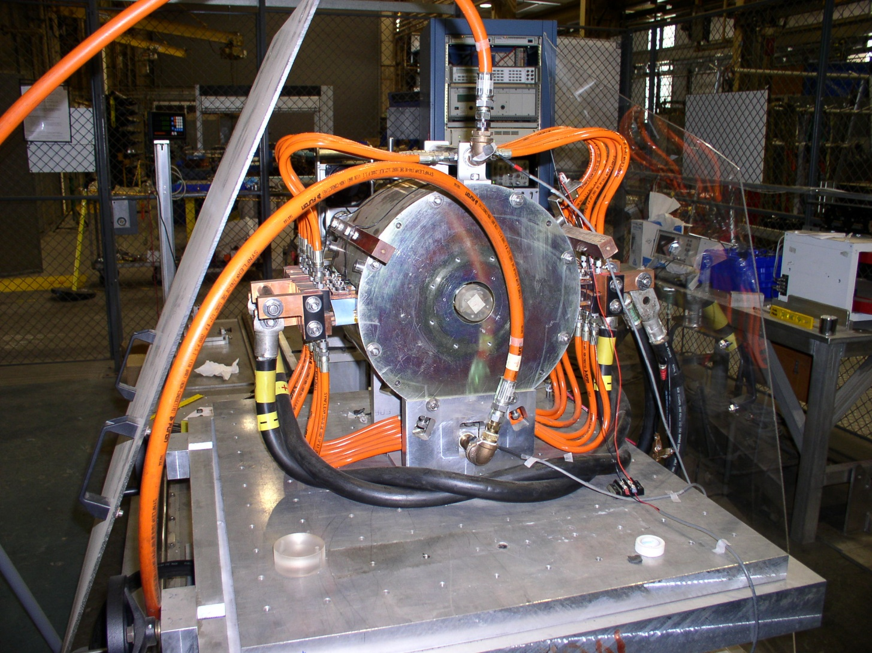
Short Coil Setup

Slide 7
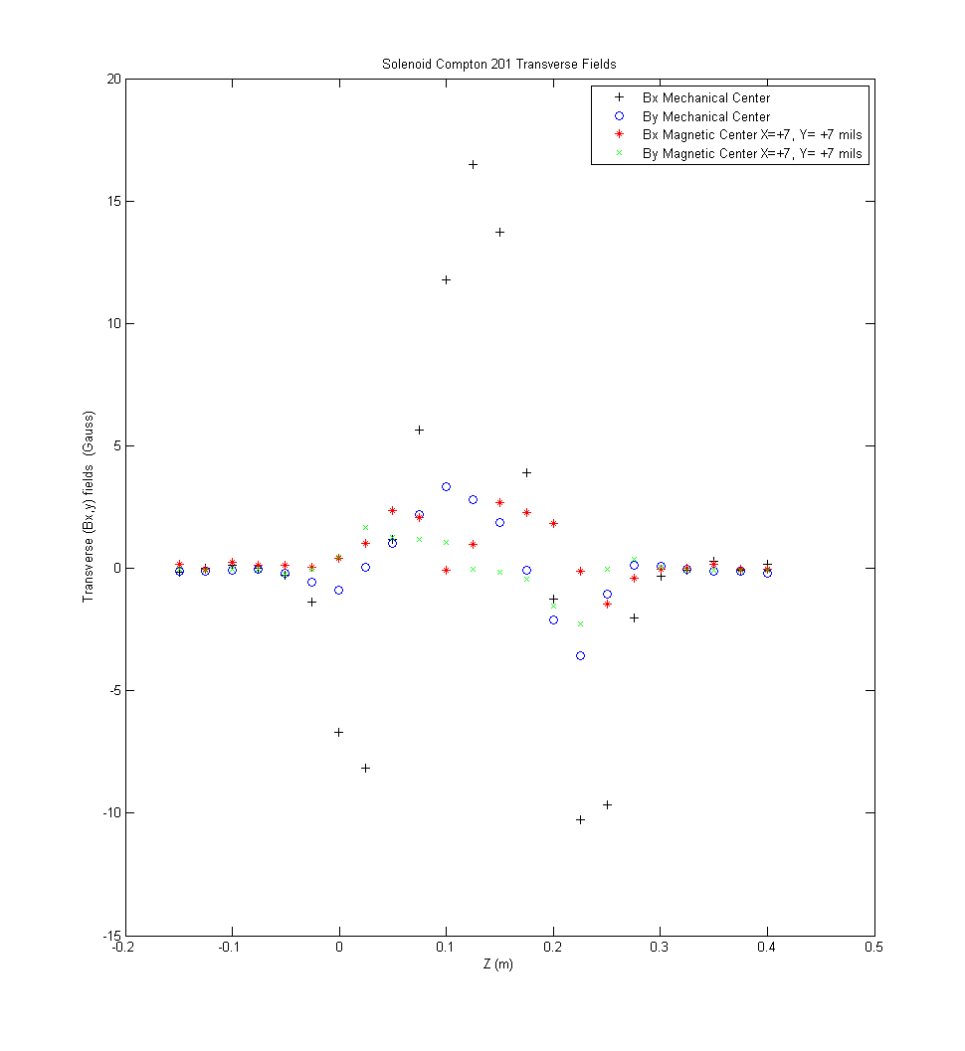
Dipole Field vs z

Slide 8
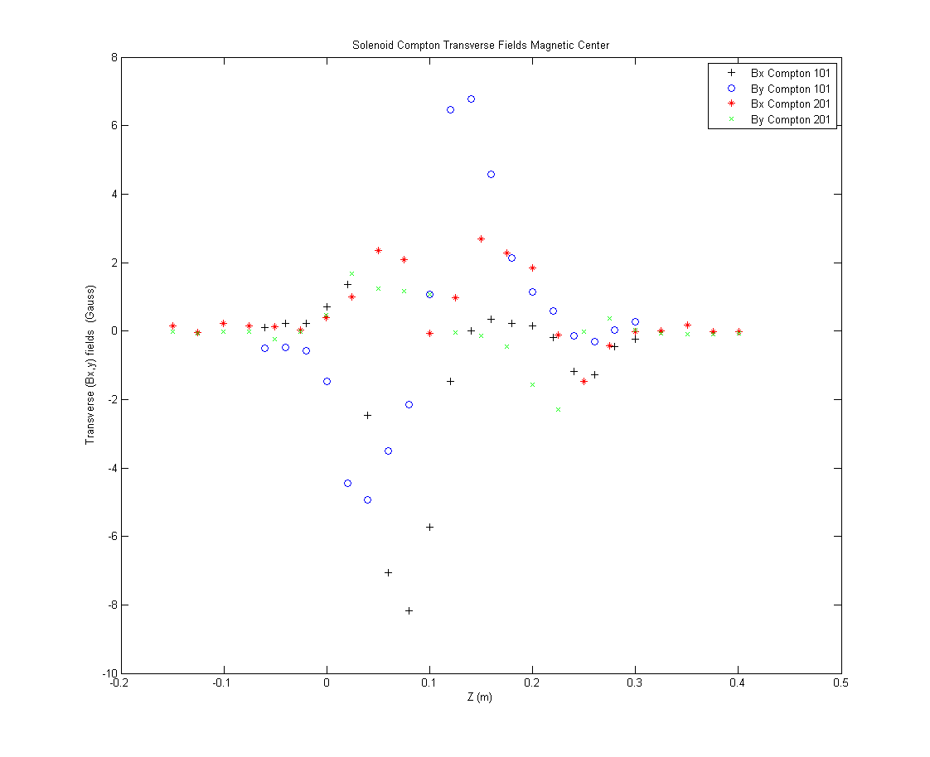
Compton 101 1st Set vs 101 2nd Set

