Slide 1
Delta 3.2 Quadrant tuning results

Slide 2
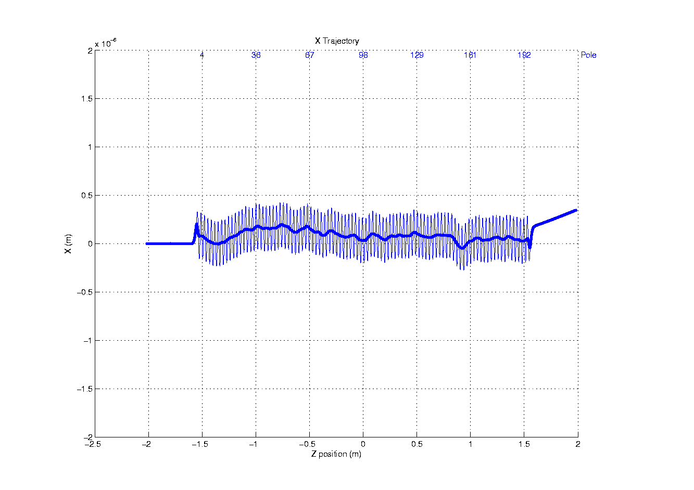
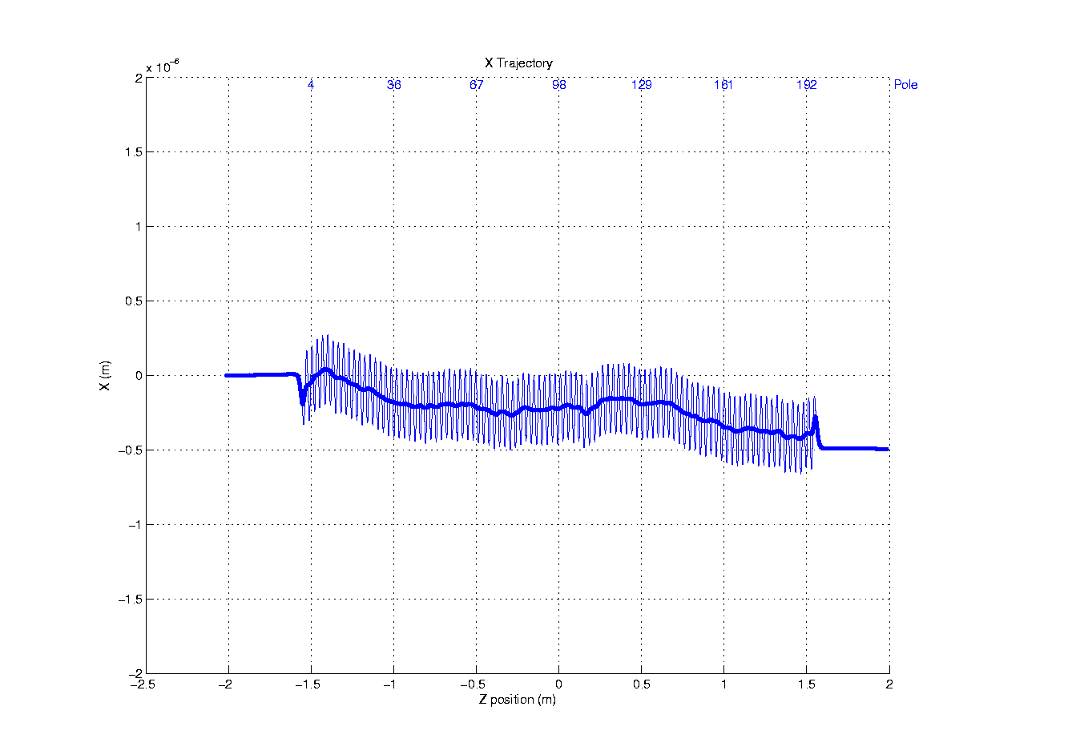
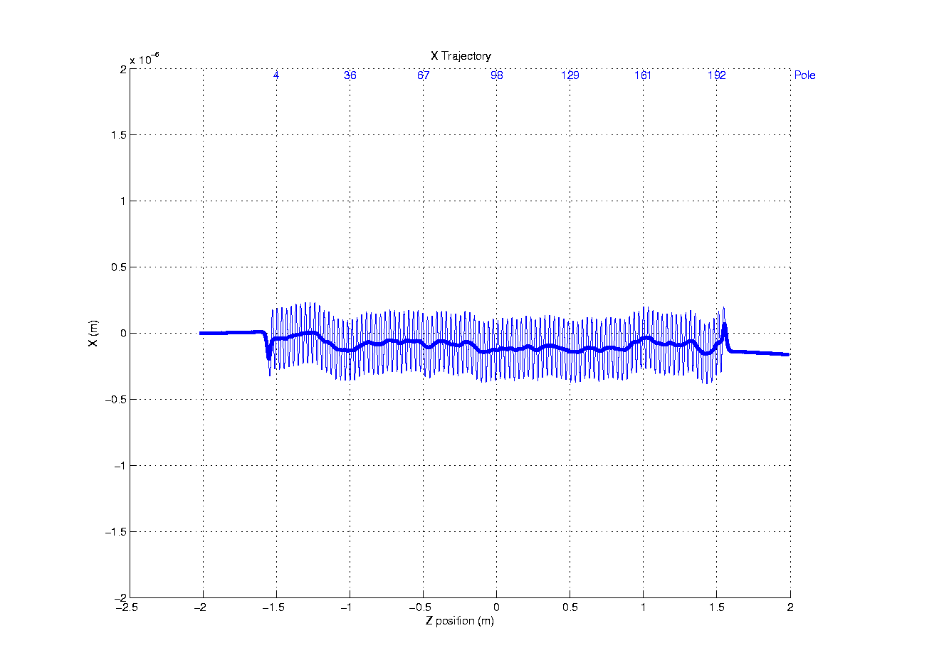
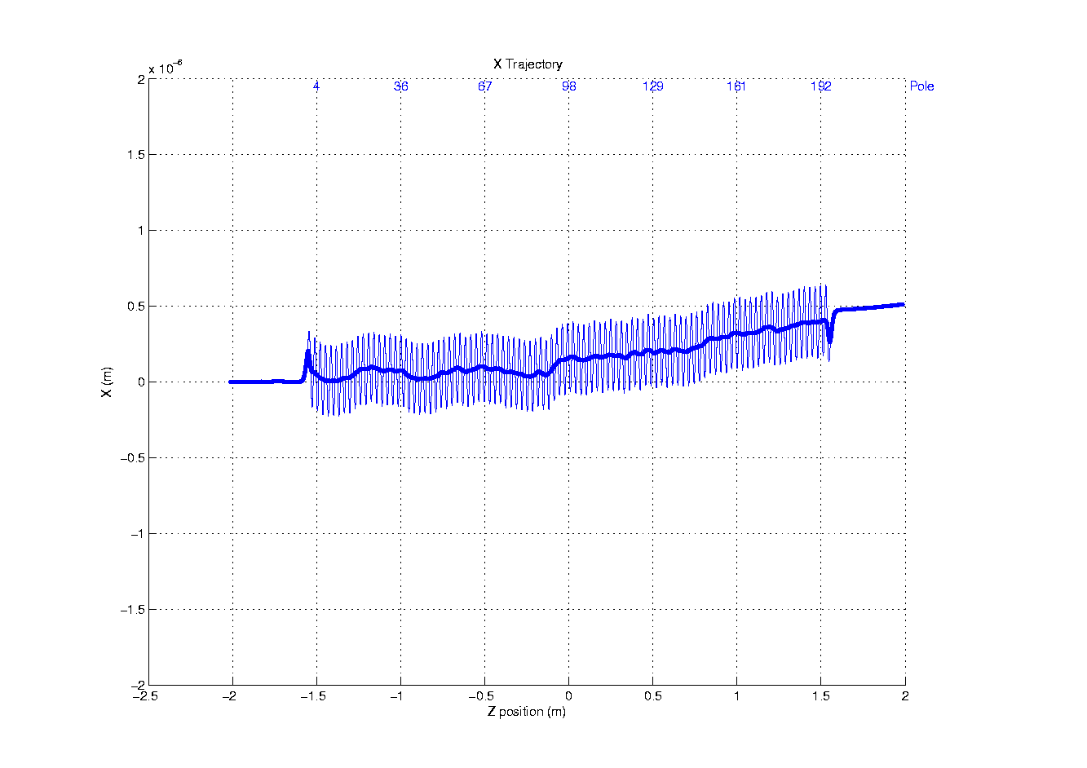
X – Trajectories
(γ = 26627)
Q1
Q2
Q4
Q3

Slide 3
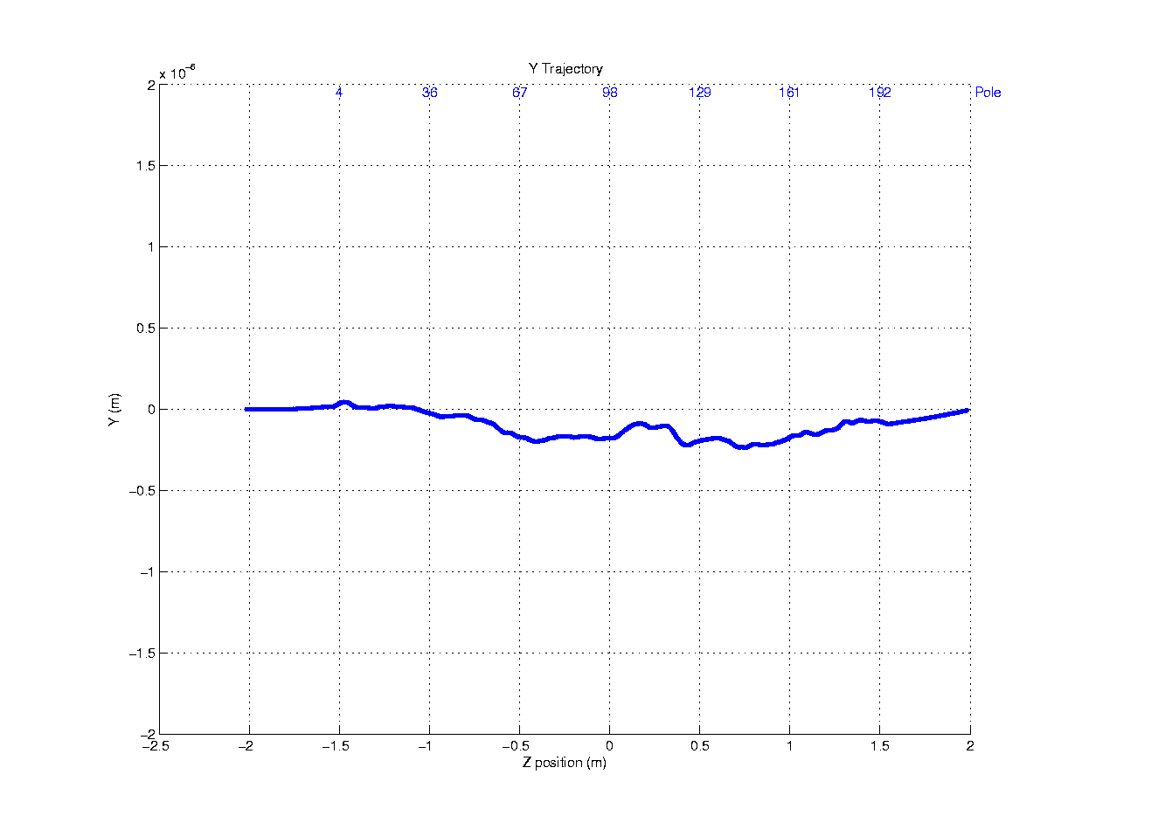
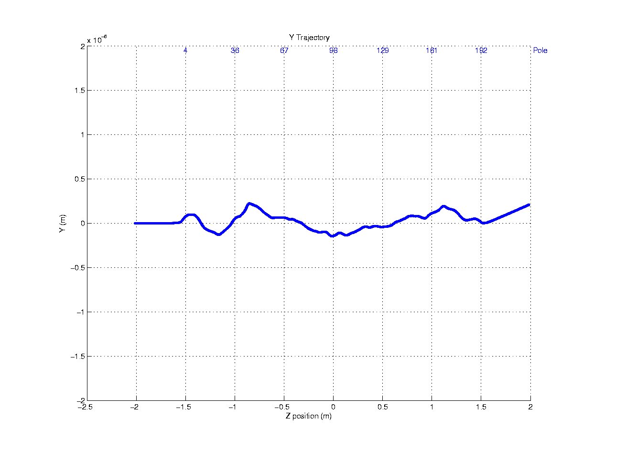
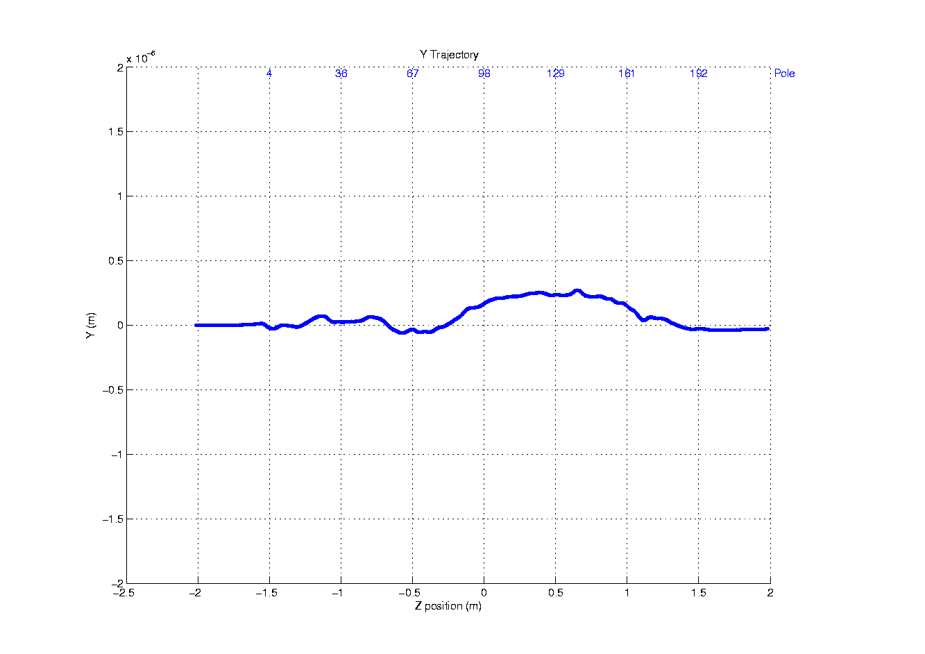
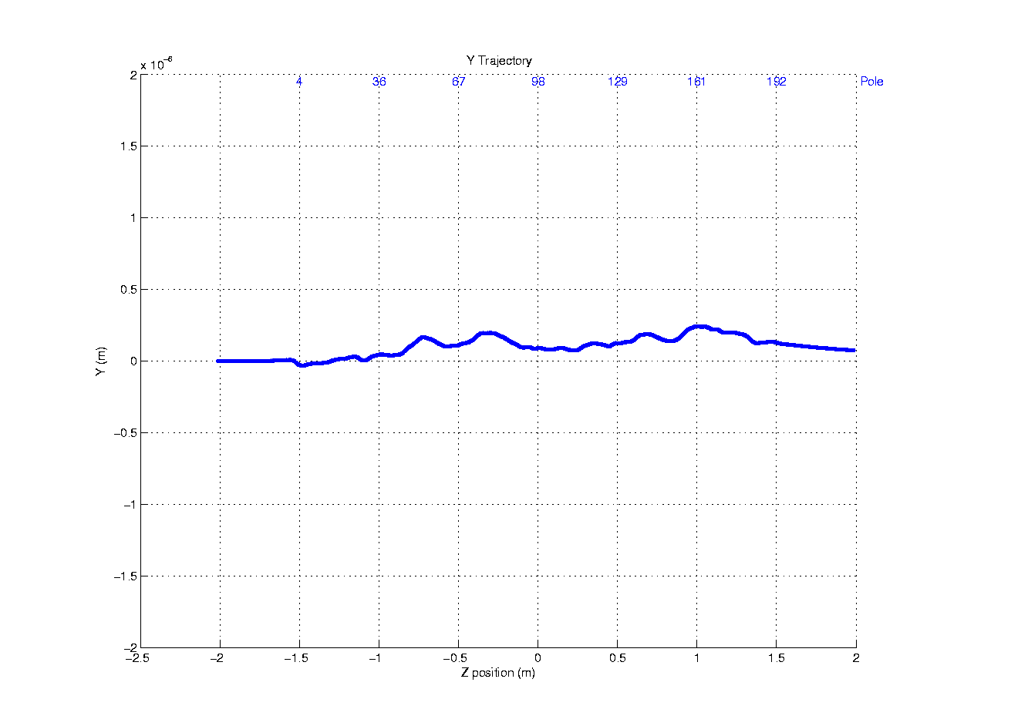
Y - Trajectories
Q1
Q2
Q4
Q3

Slide 4
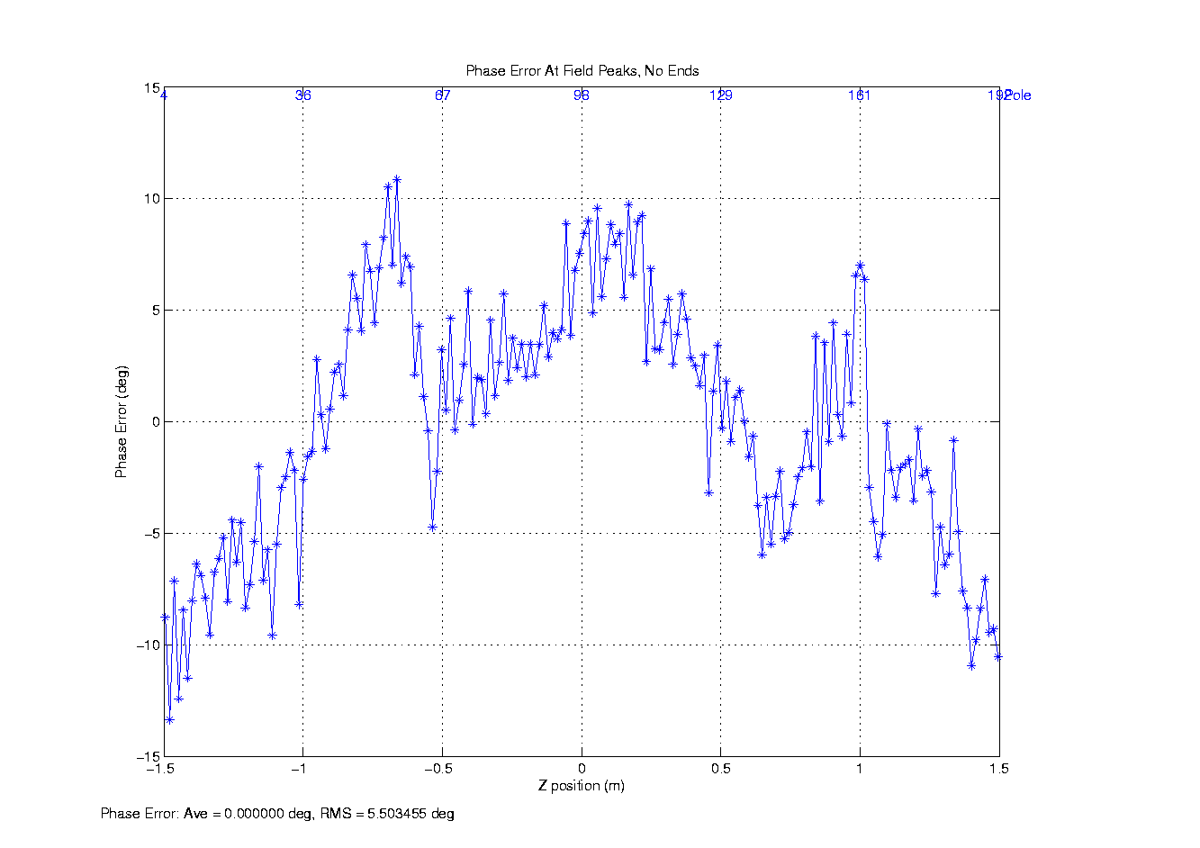
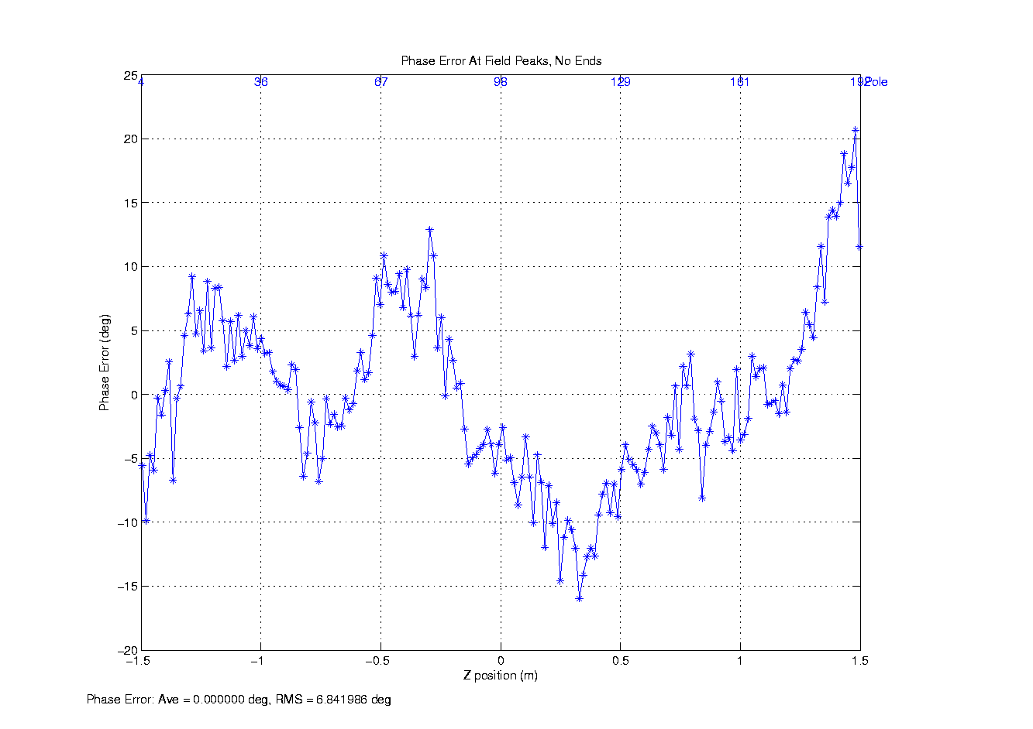
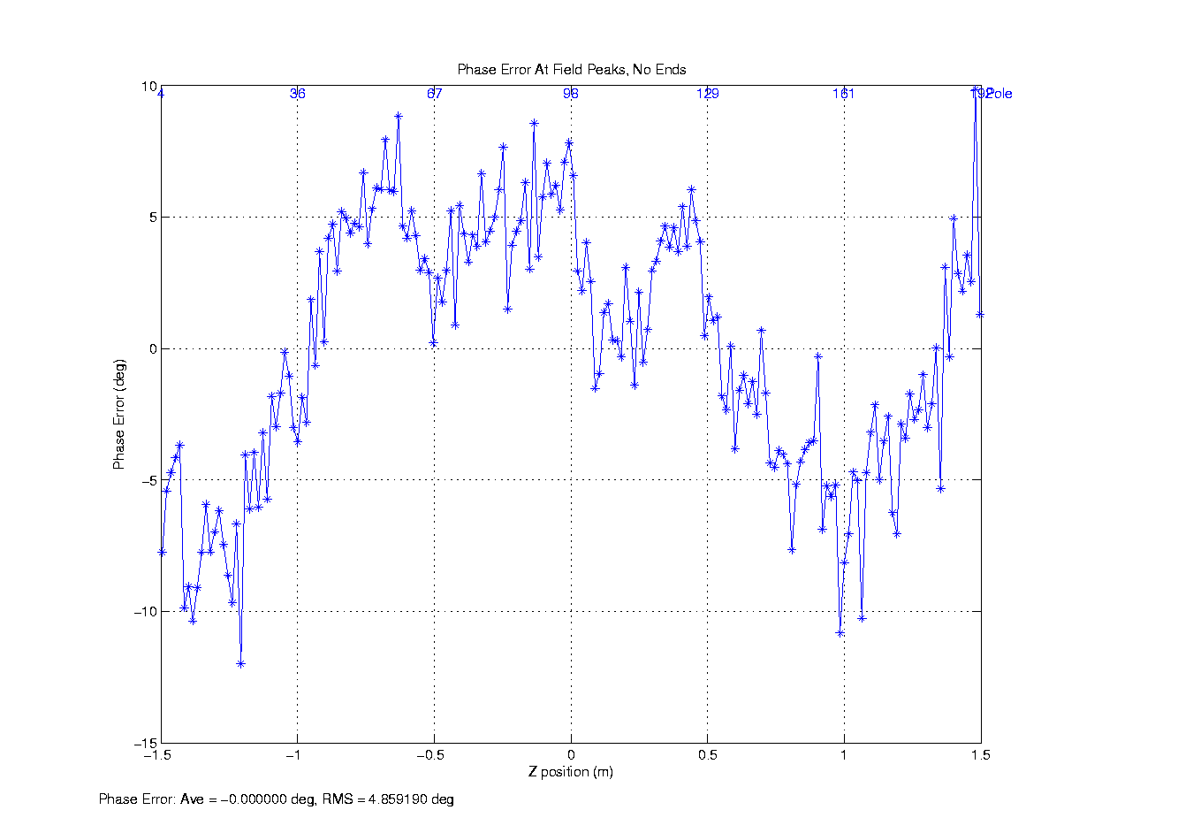
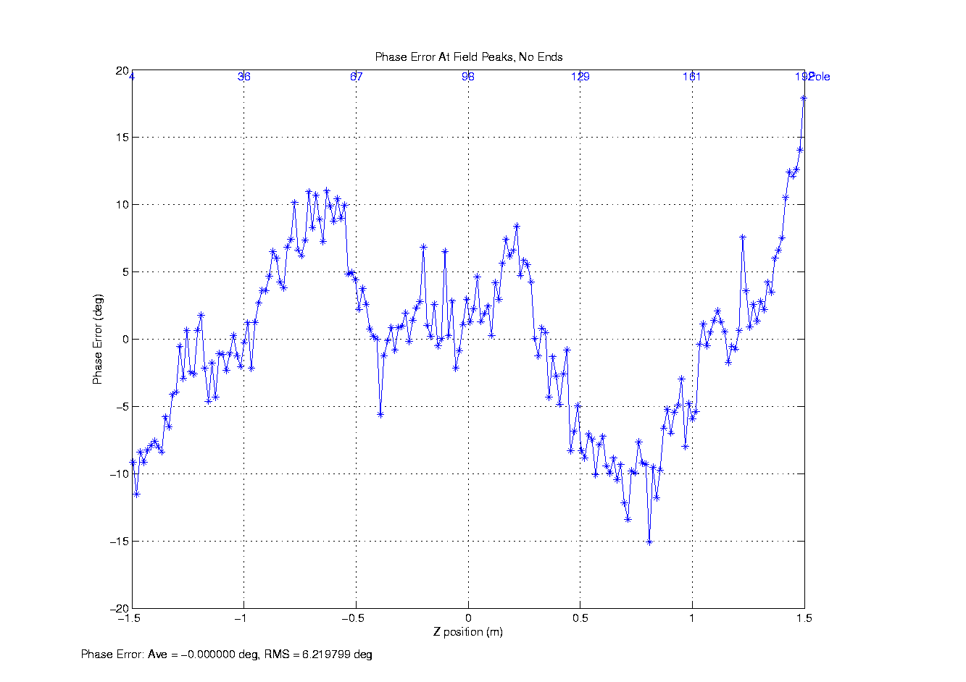
Phase Errors
Q1
Q2
Q4
Q3

Slide 5
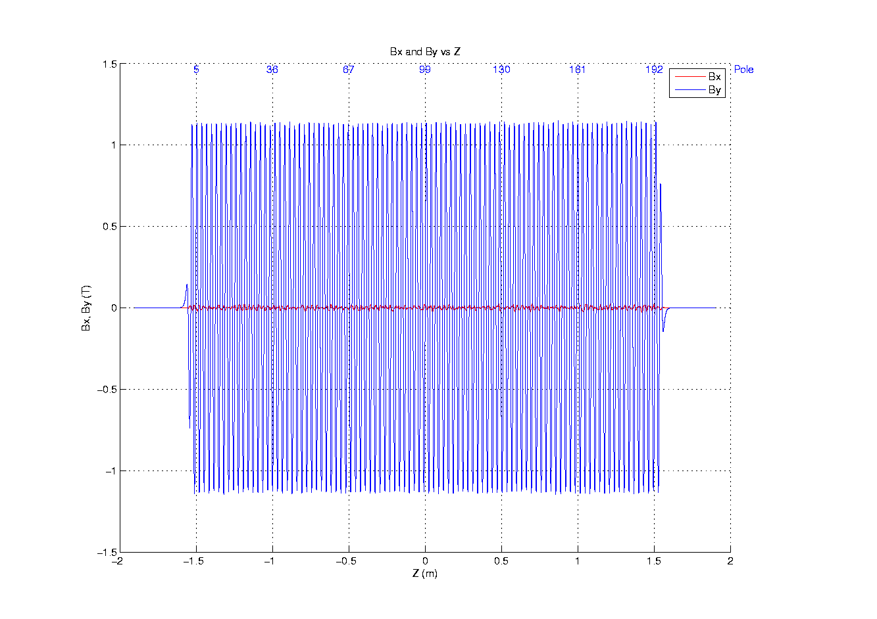
Superposed Quadrants.
Fields

Slide 6
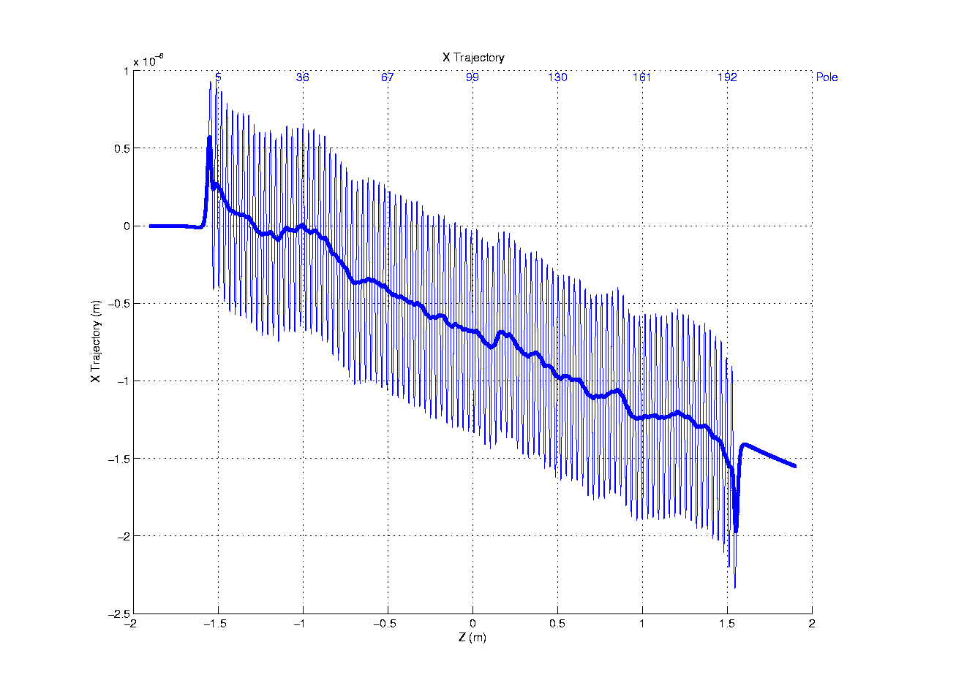
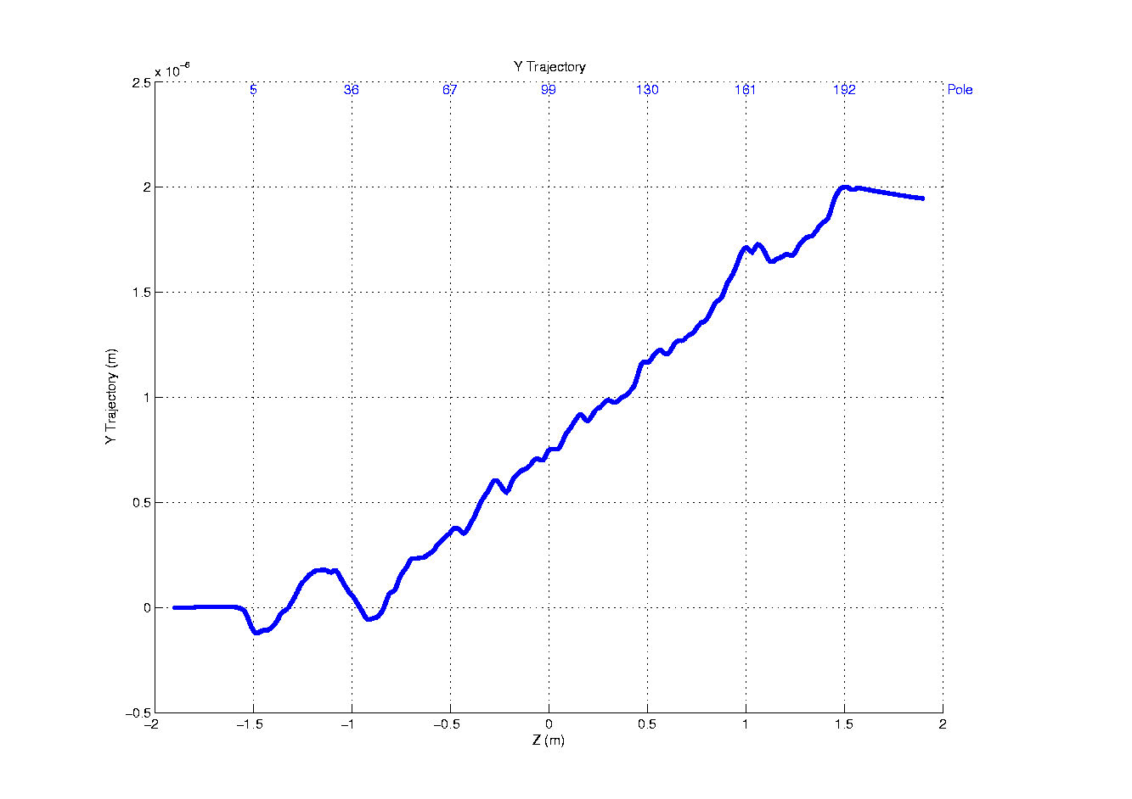
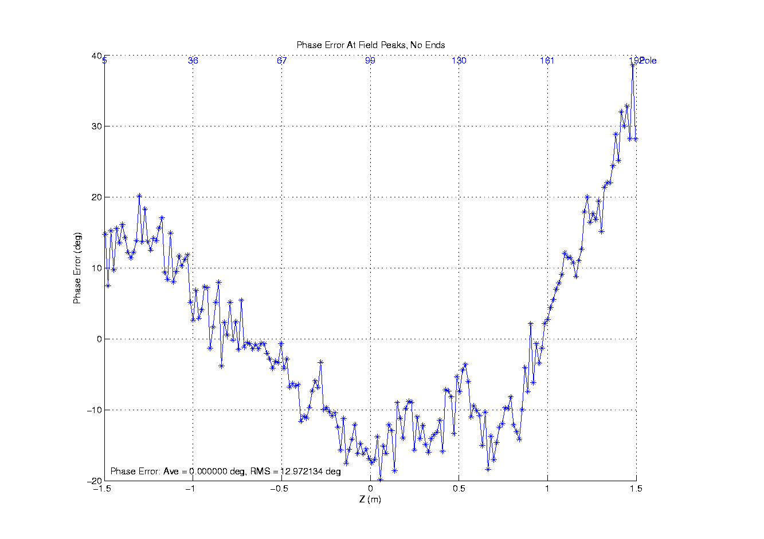
Superposed Quadrants.
Trajectories and phase errors
I1X = 6 μTm
I2x = -88 μTm²
I1Y = -20 μTm
I2Y = -70 μTm²
K = 3.4241 ( ~ 4% higher than needed)

Slide 7
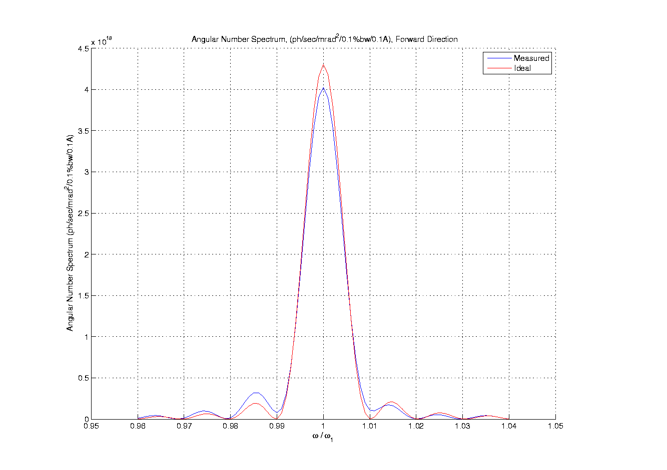
Expected light intensity
< 10% reduction

