Slide 1
DELTA Quadrant Tuning
Y. Levashov

Slide 2
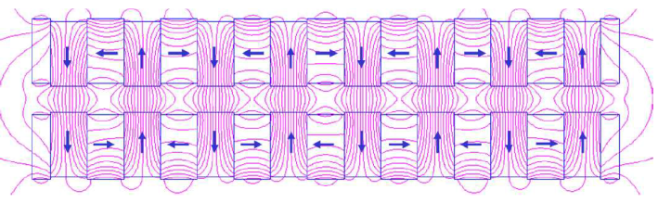










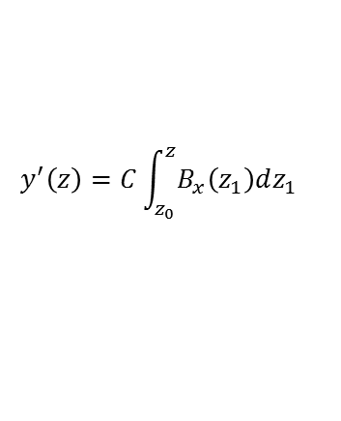

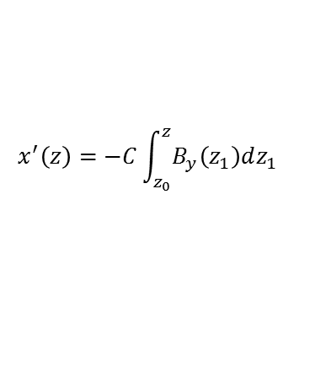

What to tune?
Beam axis:
$$B_{y} \left(z\right)=B_{0}\cos\left(k_{u}z\right);B_{x}=0; k_{u}=2π/λ_{u}$$
Y
X
Z
$$λ_{r}=\frac{λ_{u}}{2γ^{2}}\left(1+\frac{1}{2K^{2}}\right);$$
$$K=−\frac{e}{mck_{u}}B_{0}$$
$$S(z)=\frac{1}{2}\int_{0}^{z}{\left(\frac{1}{γ^{2}}+x^{′2}+y^{′2}\right)dz_{1}}$$
$$P(z)=\frac{2π∙S(z)}{λ_{r}}$$
$${ΔP}_{peak}=\frac{2π{∙ΔS}_{peak}}{λ_{r}}$$
$$λ_{u}$$
$$v_{z}$$
X
$$c$$
$$x′$$
$$ε_{peak}={ΔP}_{peak}−π∙n_{peak}$$
Z
Y
$$x^{′}\left(z\right)=−C\int_{z_{0}}^{z}{B_{y}\left(z_{1}\right)dz_{1}}$$
$$C=\frac{e}{γmv_{z}}$$
$$y^{′}\left(z\right)=C\int_{z_{0}}^{z}{B_{x}\left(z_{1}\right)dz_{1}}$$

Slide 3
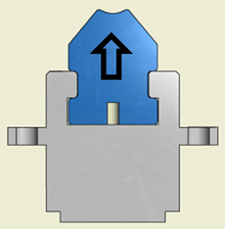




Fields from a single magnet array
No access to the magnets when assembled.
DELTA is PPM device:
Pros. – superposition works, field at each point is a sum of fields from all magnets. Quadrants could be tuned separately.
Cons. – no iron shims could be used for tuning, virtual shimming.
$$φ=φ_{0}cos⁡(k_{x}x)e^{−k_{y}y}cos⁡(k_{u}z)$$
$${ B}_{x}=−\frac{∂φ}{∂x}, B_{y}=−\frac{∂φ}{∂y}$$
Y
X
$$B_{x}={φ_{0}k}_{x}sin⁡(k_{x}x)e^{−k_{y}y}cos⁡(k_{u}z)$$
$$B_{y}=φ_{0}k_{y}cos⁡(k_{x}x)e^{−k_{y}y}cos⁡(k_{u}z)$$
$$if x=0, y=const; B_{x}=0, { B}_{y}= B_{0}\cos\left(k_{u}z\right)$$
- a single array could be treated as an undulator.
Challenge for tuning – probe positioning (setting K).
$\frac{ΔB}{B}=−k_{y}∆y; for \frac{ΔB}{B}=10\text{−}\text{4 }$and $k_{y}$ ≈ 200, $∆y$ < 0.5µm

Slide 4
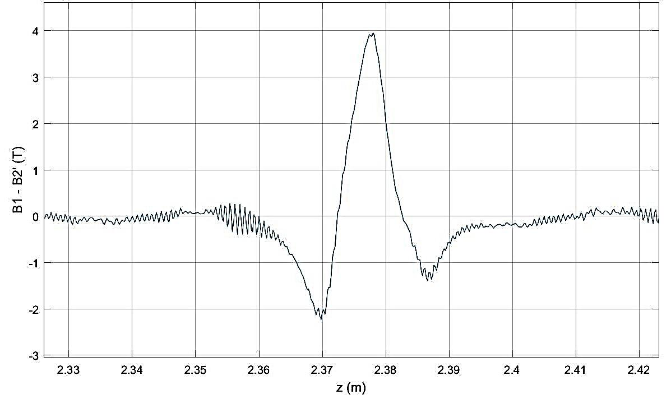
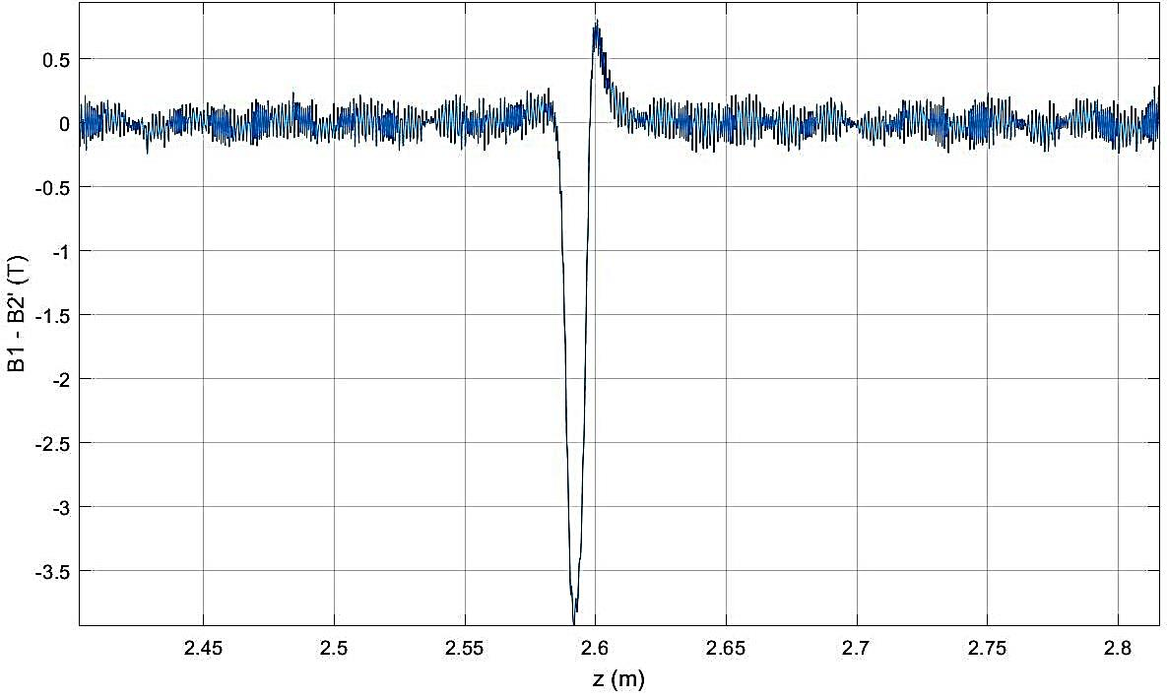
Field change from magnet motion
How to tune:
- Move Y-magnets at X-trajectory kicks’ locations up/down to correct X-trajectory.
- Move Y-magnets at Y-trajectory kicks’ locations left/right to correct Y-trajectory.
- Move Y-magnets in pairs or Z-magnets up/down to correct phase errors and K.
B_{x} field change from single block motion in X
B_{y} field change from single block motion in Y
0.025mm Y block shift in x → 4 µTm
Shim 0.025mm Y block → 12 µTm
0.125mm shift of a pair of Y blocks in y → 13 degrees of phase change
0.125mm shift of Z block in y → 4 degrees of phase change

Slide 5
Quadrant tuning process
Find magnetic axis location, place probe on the axis.
Move probe along the axis. Trigger DMMs at Δz interval.
Apply zero drift and offset corrections to the voltages.
Apply calibrations. Calculate fields.
Iterate
Calculate trajectories, phase errors and K value
Tune trajectories
Tune phase errors and K; make K the same for all four quadrants
Check magnet mechanical positions on CMM

Slide 6
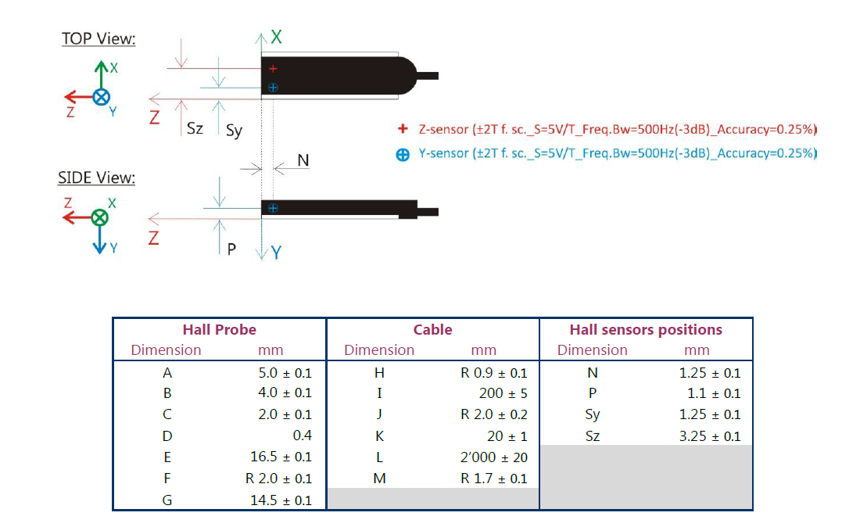
Senis 2-D probe
Ceramic pad
Plastic cover

Slide 7
Alignment to the bench (X & yaw)
Do Hall probe scan in X at each pole location
Truncate data ± 3mm from center
Fit parabola, find center
Fit a straight line through all pole centers, find x and yaw, correct yaw
if necessary.

Slide 8
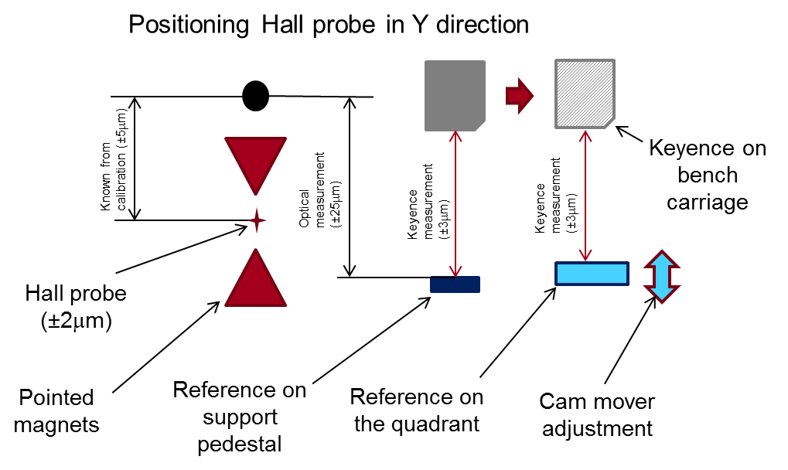
Alignment to the bench (Y)
Find center of fiducialization magnet with the Hall probe
Measure difference in height between the magnet and the reference block by optical tools.
Measure difference in height between the reference block and the quadrant by Keyence.
Set quadrant by using cam movers.
ΔY = 30μm → ΔB/B ≈ 0.5%, relative error quadrant-to-quadrant ≈ 0.1%

Slide 9
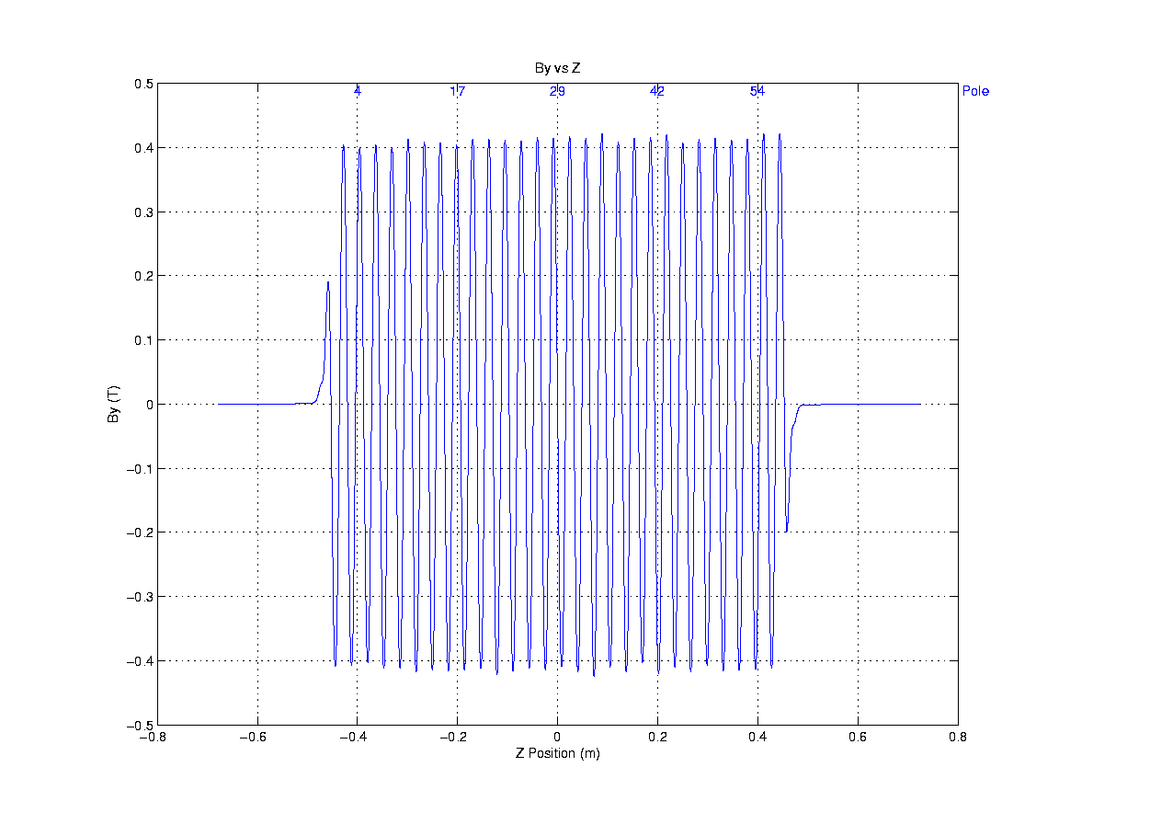
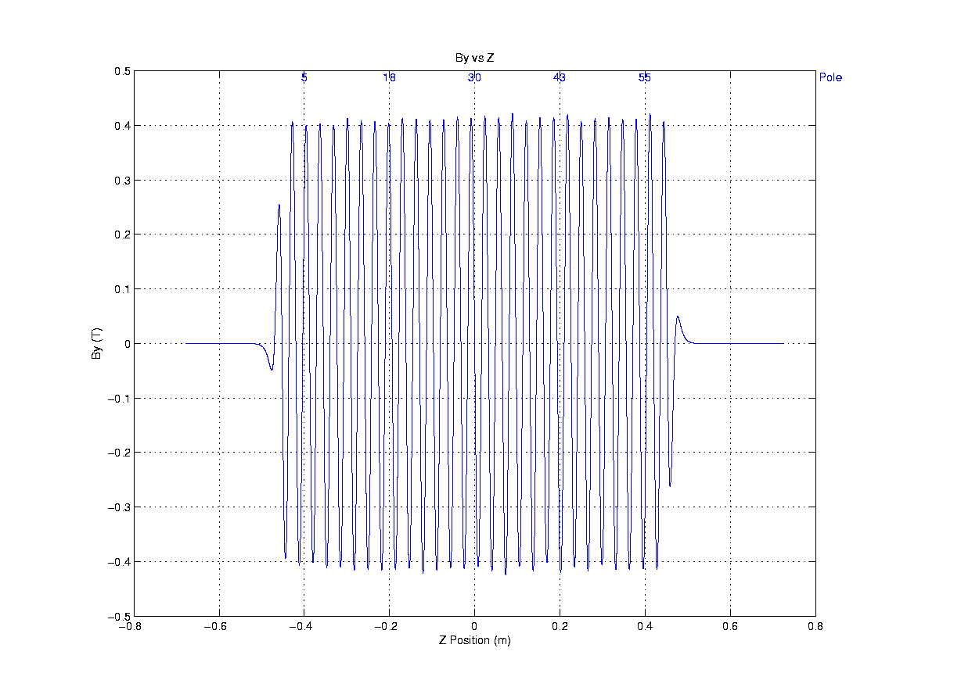
Check for assembly errors
Correct
X-blocks flipped 180 degrees

Slide 10
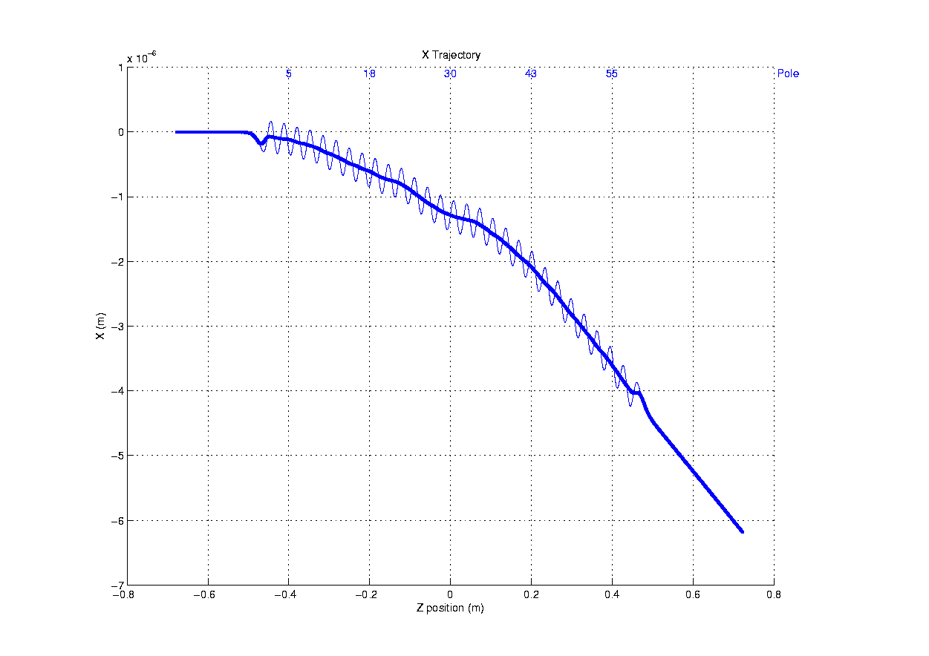
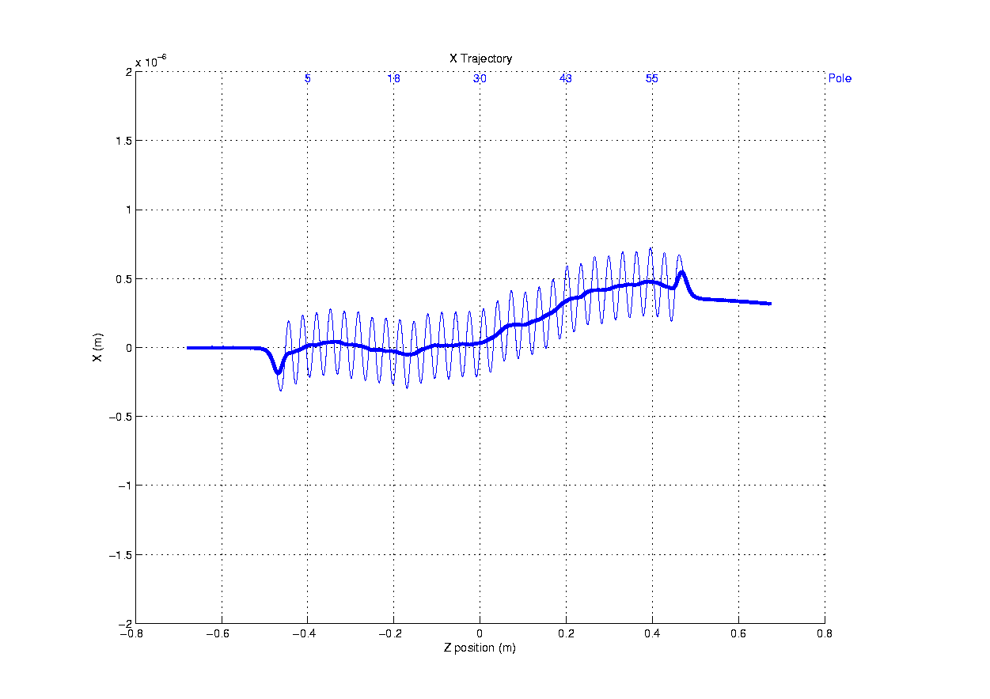
X-trajectory tuning
Before
After

Slide 11
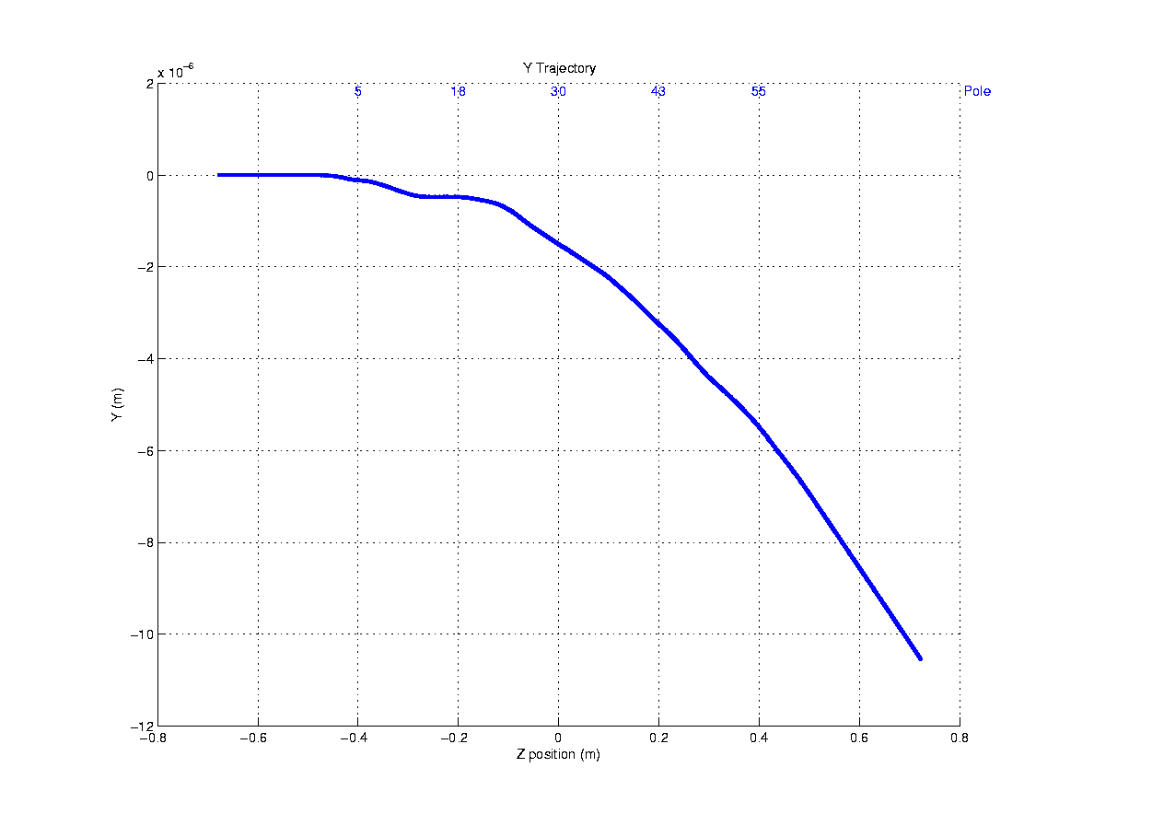
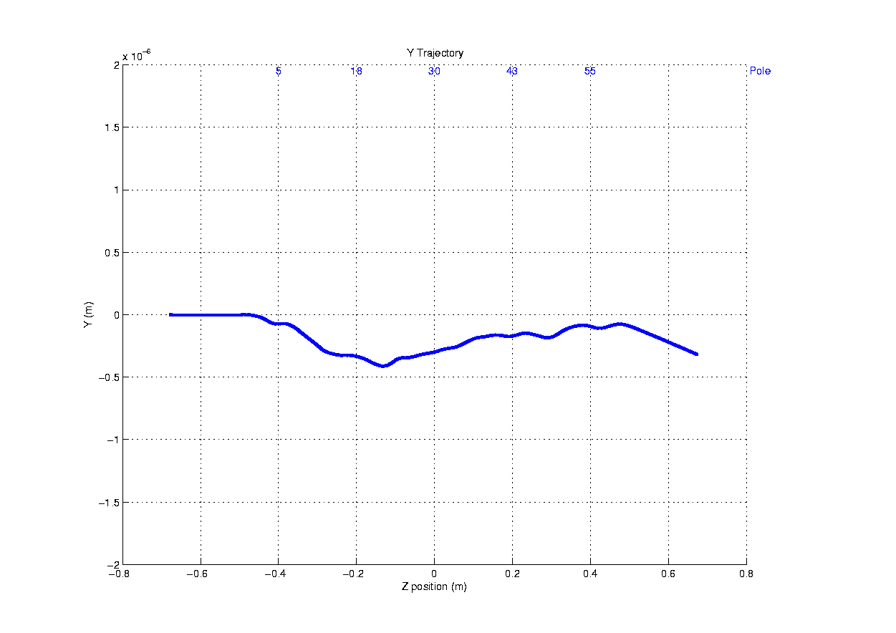
Y-trajectory tuning
Before
After

Slide 12
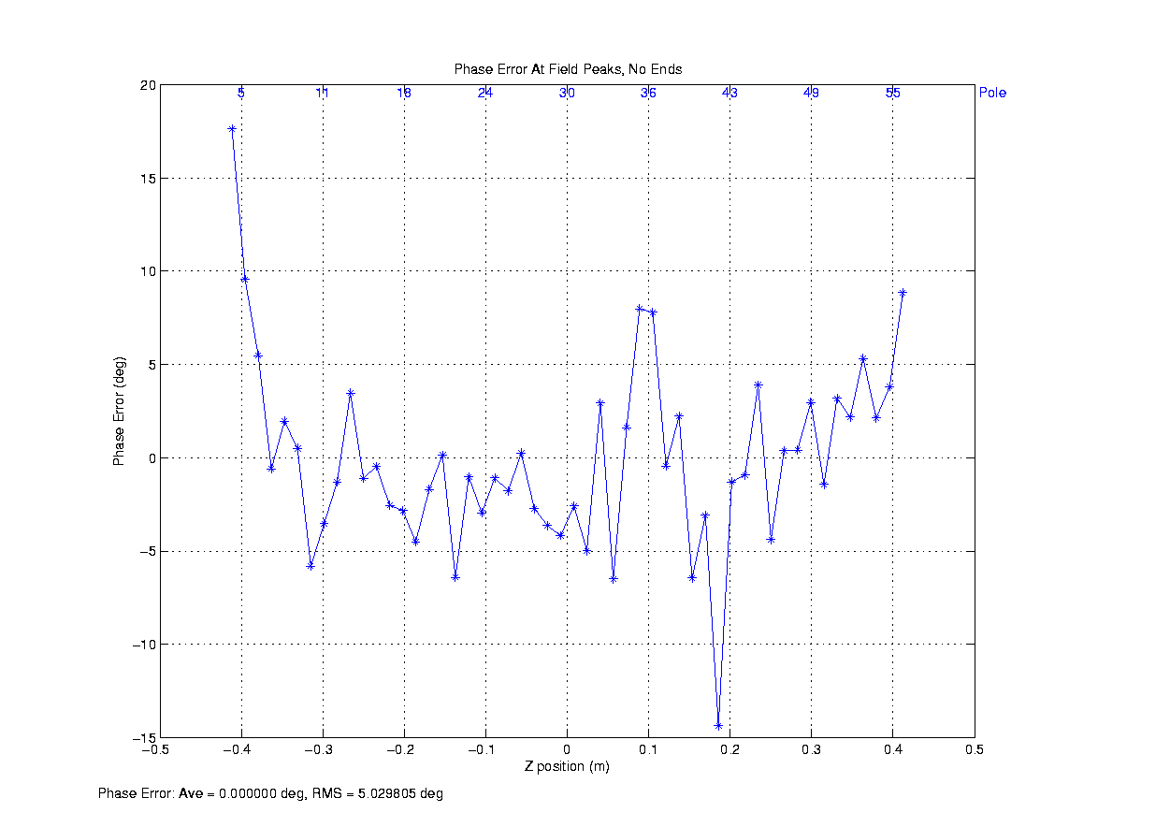
Phase tuning
Move block up
Move block down

Slide 13
3.2m DELTA tuning summary
Quadrants were not straight enough during the tuning, which resulted in big phase errors. Max bow of 18µm and max pitch of 8µm allowed to keep phase errors below 5 degrees. Straightening the quadrant strongback on the tuning bench is required.
Since two of the quadrants flipped during assembly, more attention to be paid to first integral tuning – to be set to zero as close as possible. Otherwise the first integral will result in big second integral for flipped quadrants.
Three iterations per quadrant required to complete the tuning. One iteration = 1 day, which adds to 3 weeks needed for tuning all the quadrants.
Number of field scans/iteration average:
Q1 – 11 (initial tuning, learning curve)
Q2 – 15 (more time spent to tune phase errors)
Q3 - 9
Q4 – 8
Wire measurements desirable to apply corrections for planar Hall effect.

