Slide 1
DELTA Quadrant Tuning Experience
Y. Levashov

Slide 2
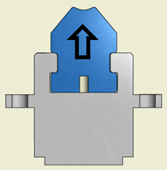
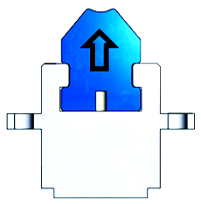




Fields from a single magnet array
DELTA is PPM device:
Pros. – superposition works, field at each point is a sum of fields from all magnets. Quadrants could be tuned separately.
Cons. – no iron shims could be used for tuning, virtual shimming.
For a single array :
Y
X
$$φ=φ_{0}cos⁡(k_{x}x)e^{−k_{y}y}cos⁡(k_{u}z)$$
Y
$${ B}_{x}=−\frac{∂φ}{∂x}, { B}_{y}=−\frac{∂φ}{∂y}$$
X
$$B_{x}={φ_{0}k}_{x}sin⁡(k_{x}x)e^{−k_{y}y}cos⁡(k_{u}z)$$
$$B_{y}=φ_{0}k_{y}cos⁡(k_{x}x)e^{−k_{y}y}cos⁡(k_{u}z)$$
$$if x=0, y=const; B_{x}=0, { B}_{y}= B_{0}\cos\left(k_{u}z\right)$$
- a single array could be treated as an undulator.
Challenge for tuning – probe positioning (setting K).
$\frac{ΔB}{B}=−k_{y}∆y; for \frac{ΔB}{B}=10\text{−}\text{4 }$and $k_{y}$ ≈ 200, $∆y$ < 0.5µm

Slide 3
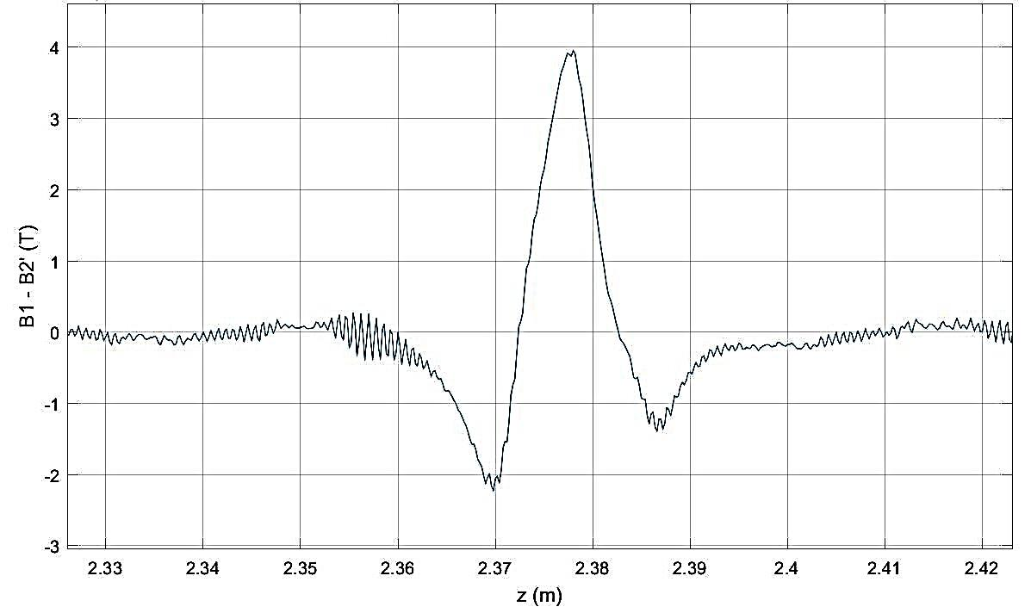
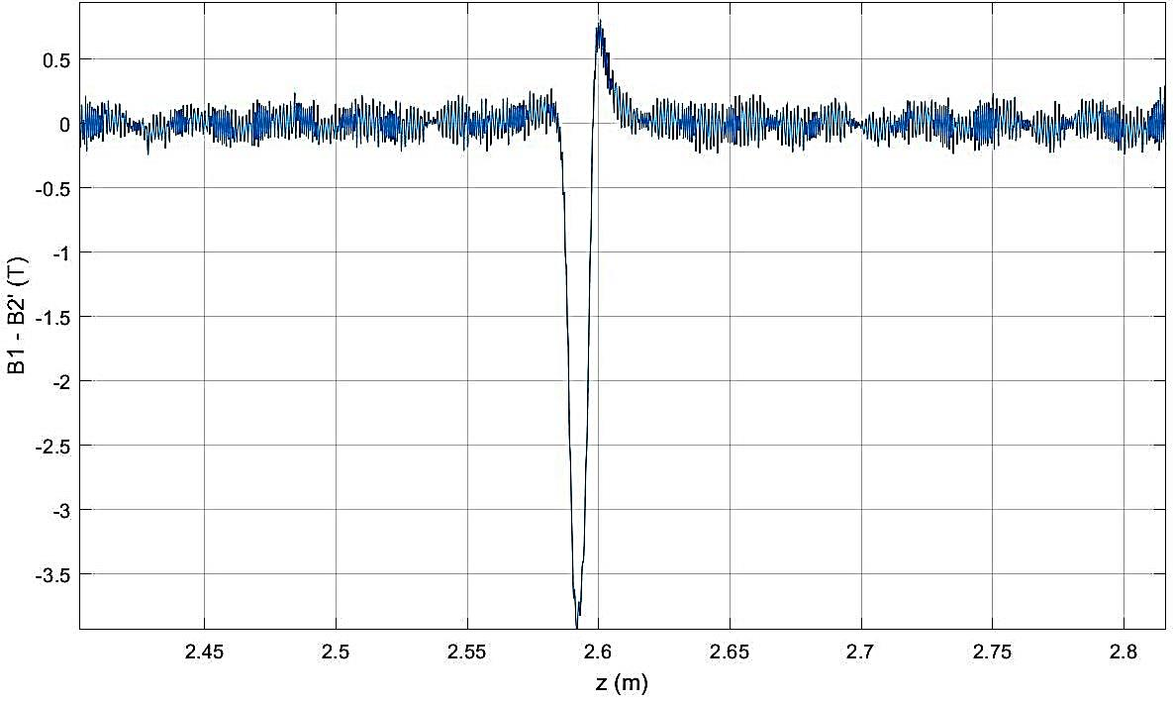
Field change from magnet motion
B_{x} field change from single block motion in X
B_{y} field change from single block motion in Y
0.025mm Y block shift in x → 4 µTm
Shim 0.025mm Y block → 12 µTm
0.125mm shift of a pair of Y blocks in y → 13 degrees of phase change
0.125mm shift of Z block in y → 4 degrees of phase change
How to tune:
- Move Y-magnets at X-trajectory kicks’ locations up/down to correct X-trajectory.
- Move Y-magnets at Y-trajectory kicks’ locations left/right to correct Y-trajectory.
- Move Y-magnets in pairs or Z-magnets up/down to correct phase errors and K.

Slide 4
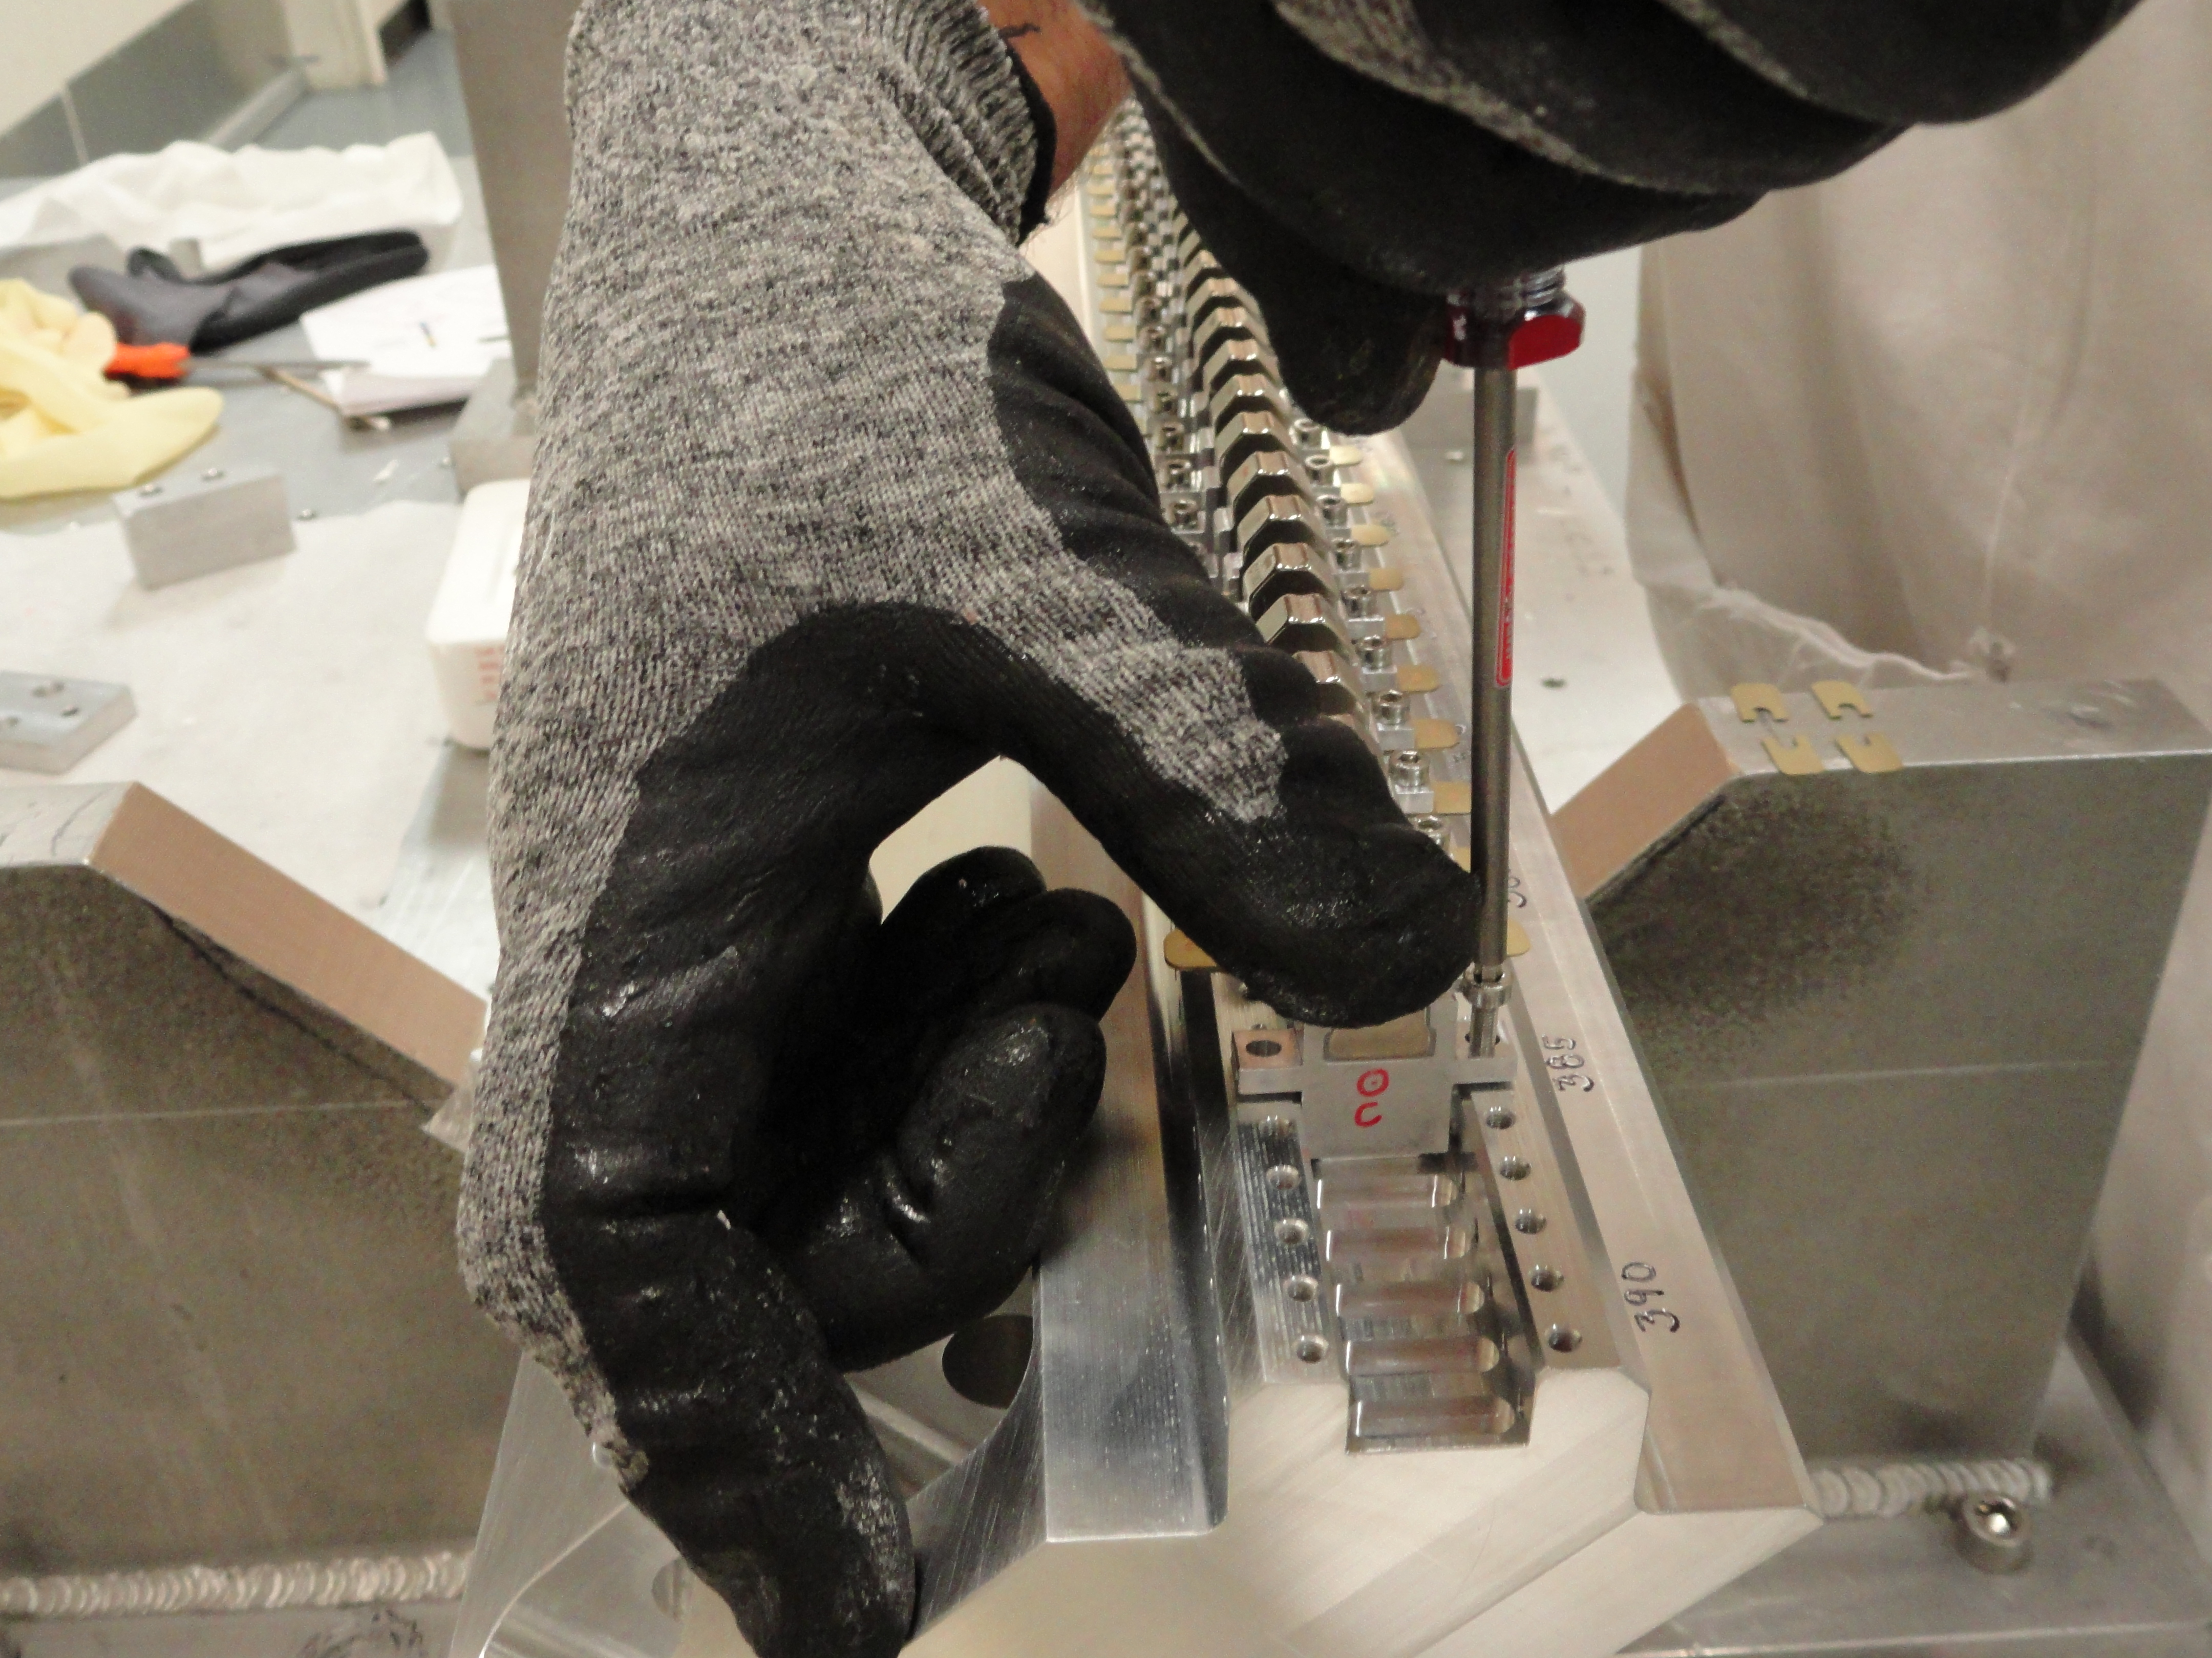
Assembly of the carriers
- Horizontal magnets with spacers glued on both sides go first. Vertical magnets are inserted later.
- Two 0.006” shims are installed on the each side of the magnet holder (4 shims per magnet). Two 0.010” shims will be enough.
Magnets roughly aligned in X using straight edge.
1 carried / day, 2 technicians. The first is looking for the proper magnet and gluing the spacers, the second is installing. Spacers were made of SS, aluminum would be better.
Challenge if blocks combined in pairs – more magnetic material, stronger magnetic forces, special tools needed.

Slide 5
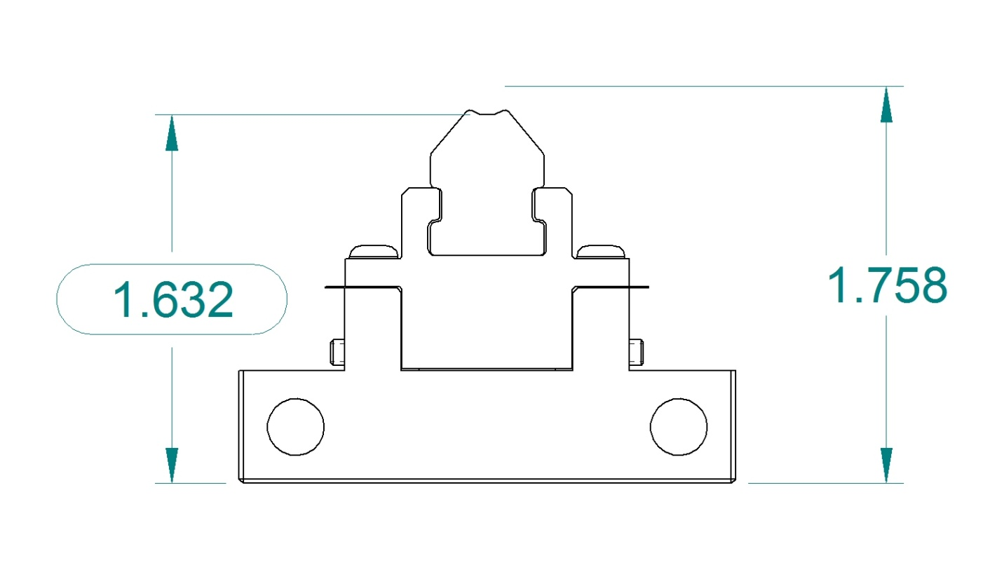
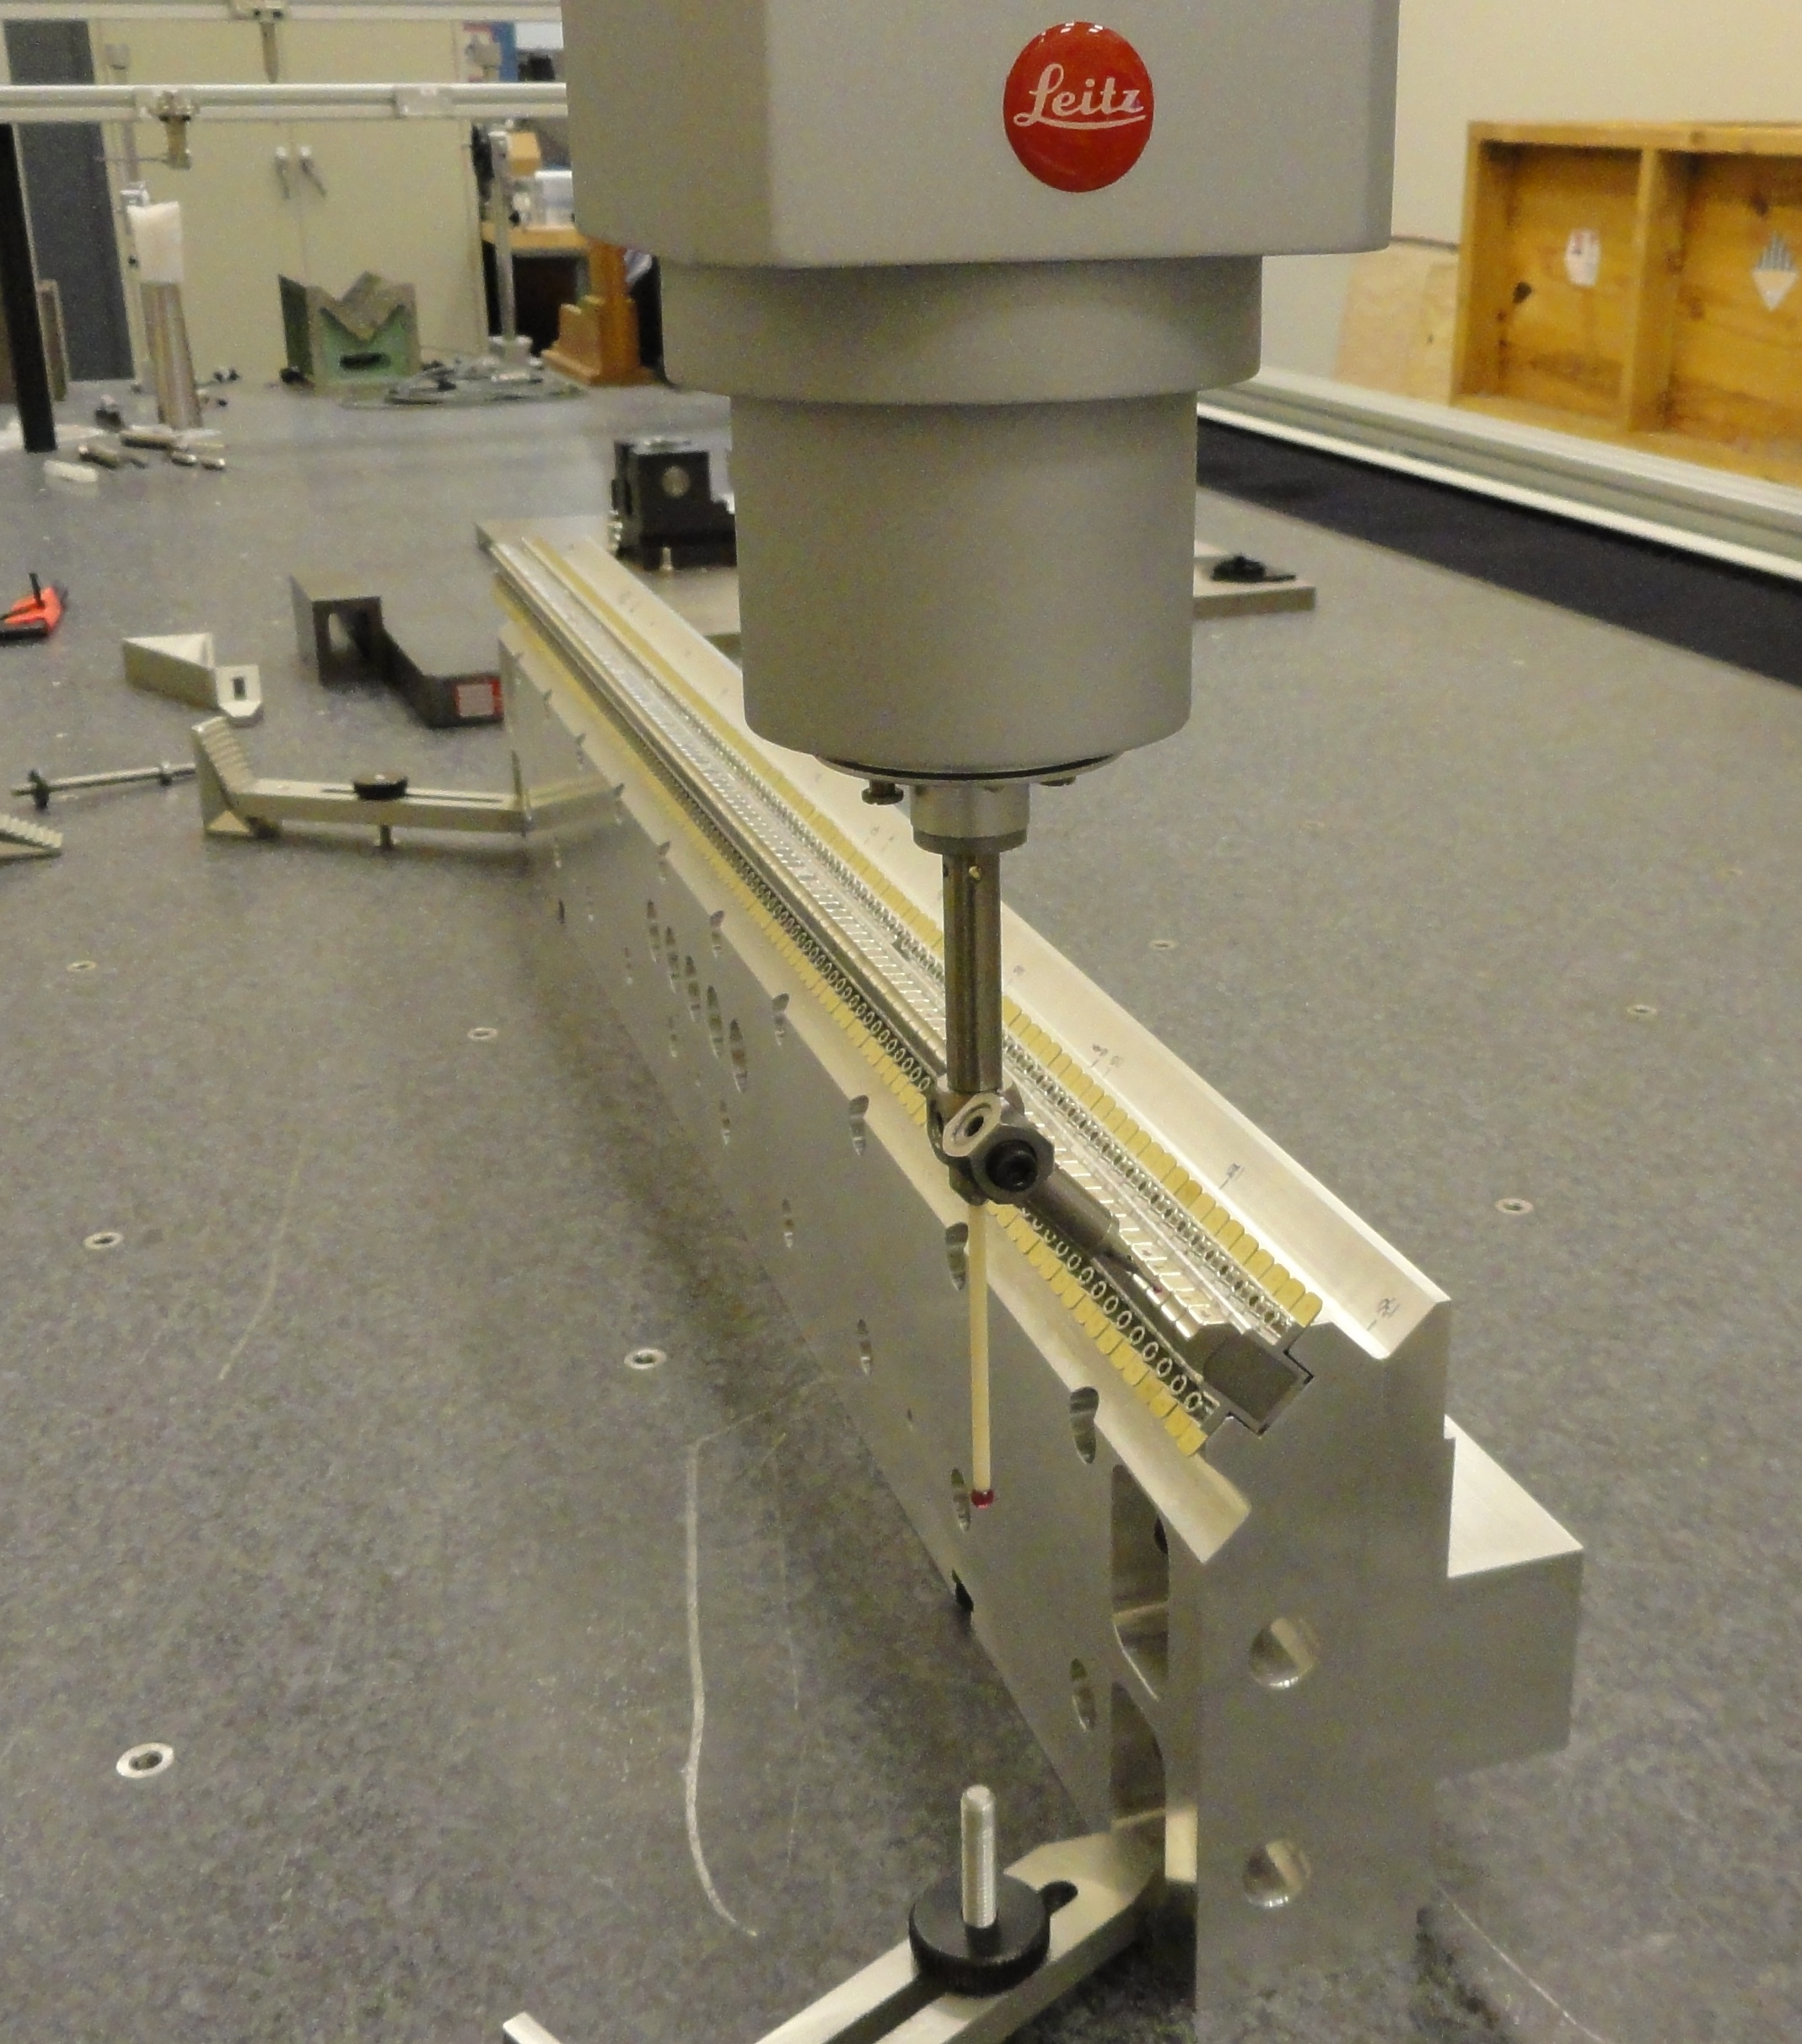
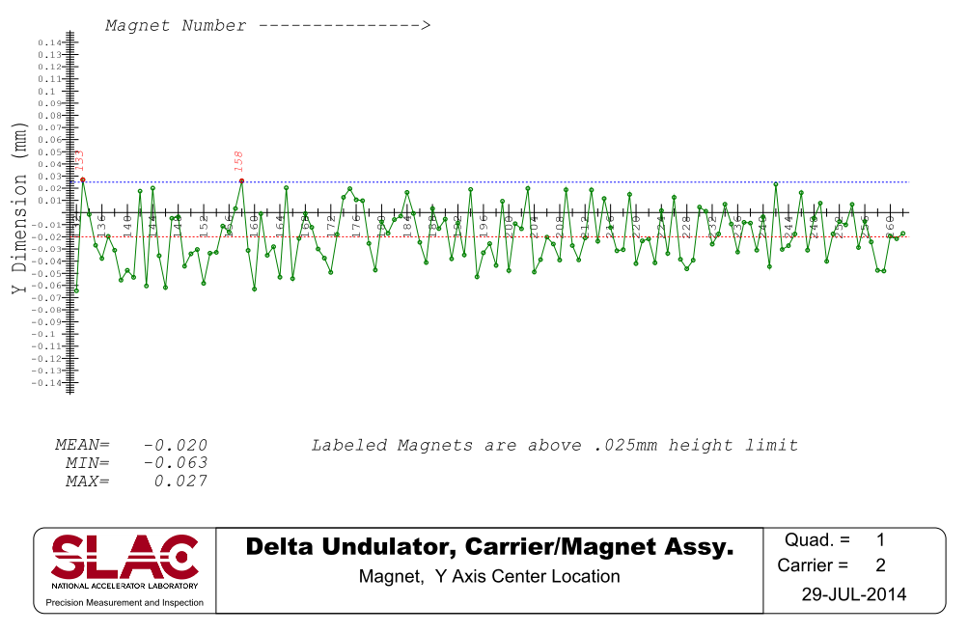
Magnets mechanical positioning
Mechanical axis
Shim for
Y- adjustments
Set screw for
X- adjustments
- Use CMM to control the magnet positions w.r.t. mechanical axis.
- Magnet position fine adjusted w.r.t. the carrier references.
1 carrier/ day, 1 technician + CMM time.
by Ed Reese

Slide 6
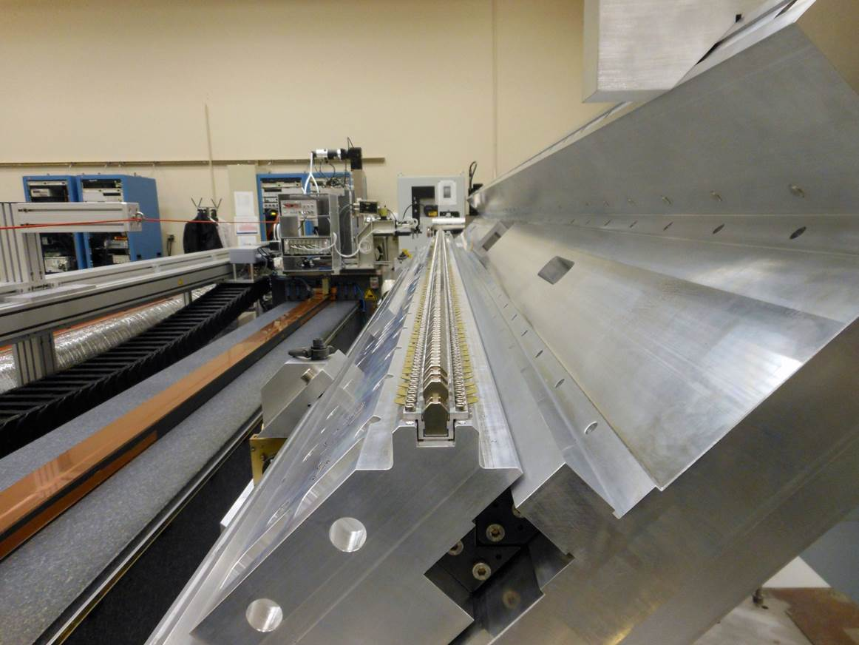
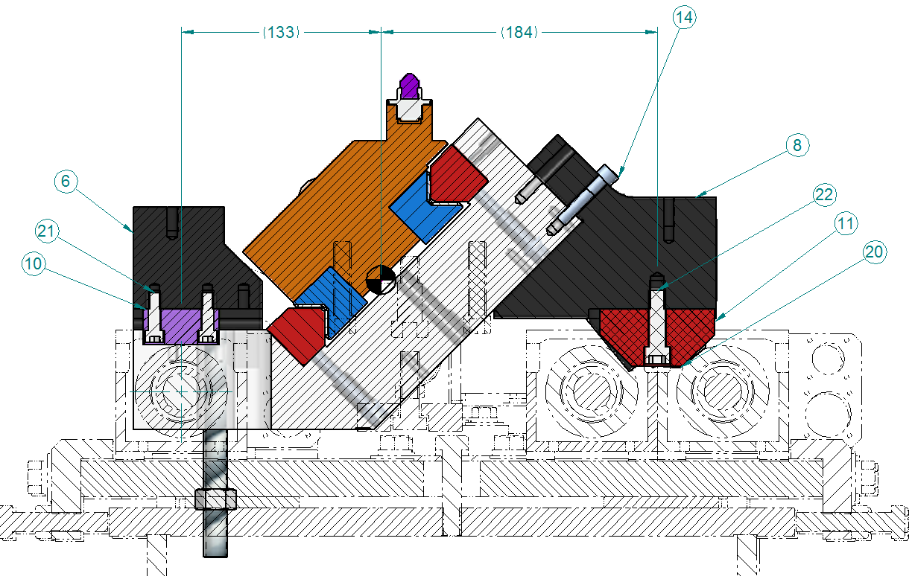
Quadrant on Kugler bench
No special tuning fixture.
Block for mounting bubble level
Blocks for mounting on cam movers
Y
X
Z
Reference surface for Y alignment

Slide 7
Quadrant tuning process
Find magnetic axis location, place probe on the axis.
Move probe along the axis. Trigger DMMs at Δz = 0.2mm intervals.
Apply zero drift and offset corrections to the voltages.
Apply calibrations. Calculate fields.
Iterate
Calculate trajectories, phase errors and K value
Tune trajectories
Tune phase errors and K; make K the same for all four quadrants
Check magnet mechanical positions on CMM

Slide 8
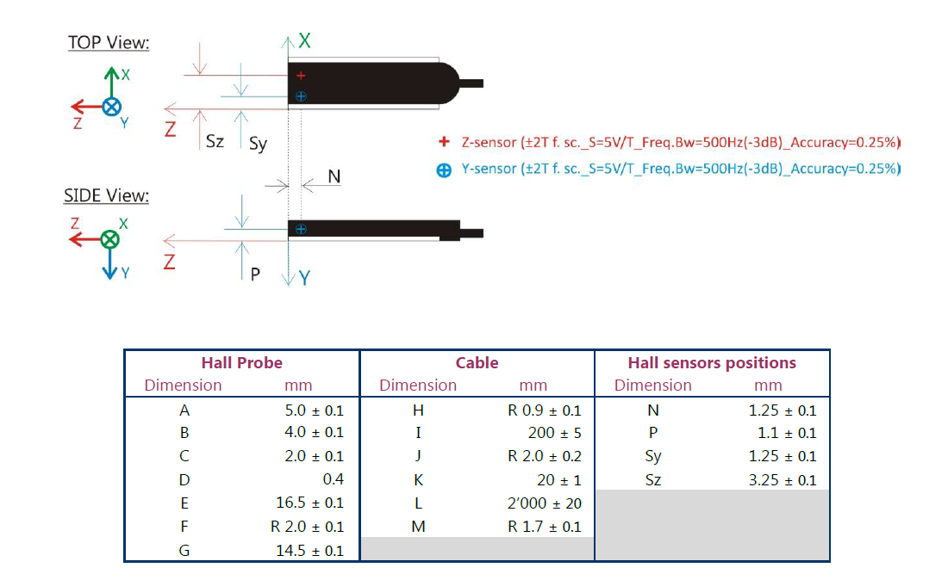
Senis 2-D probe
Ceramic pad
Plastic cover

Slide 9
Alignment to the bench (X & yaw)
Do Hall probe scan in X at each pole location
Truncate data ± 3mm from center
Fit parabola, find center
Fit a straight line through all pole centers, find x and yaw, correct yaw
if necessary.

Slide 10
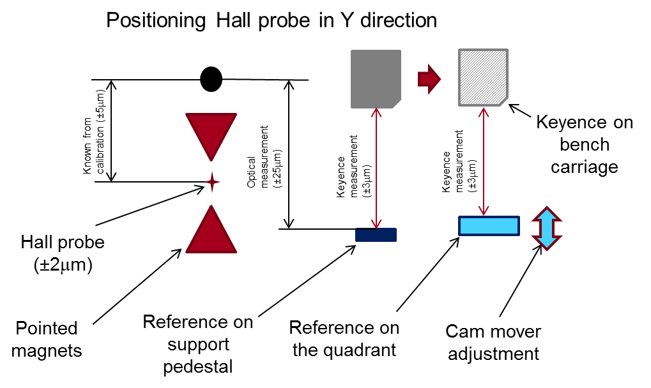
Alignment to the bench (Y)
Kugler bench granite is a reference, supposed to be “ideal” – perfectly straight.
Find center of fiducialization magnet with the Hall probe
Measure difference in height between the magnet and the reference block by optical tools.
Measure difference in height between the reference block and the quadrant by Keyence.
Set quadrant by using cam movers.
ΔY = 30μm → ΔB/B ≈ 0.5%, relative error quadrant-to-quadrant ≈ 0.1%

Slide 11
Tuning set-up on Kugler bench
Y
Keyence sensor :
Working distance 80 mm,
Range ± 15mm,
Accuracy 3μmK
X
Z-Stage
Bracket
Hall probe
0.5mm
Reference surface for Keyence and CMM
Granite
1m long removable bracket with mounting holes.
Second Keyence sensor used to control magnet motions, measures to the magnet side surface.

Slide 12
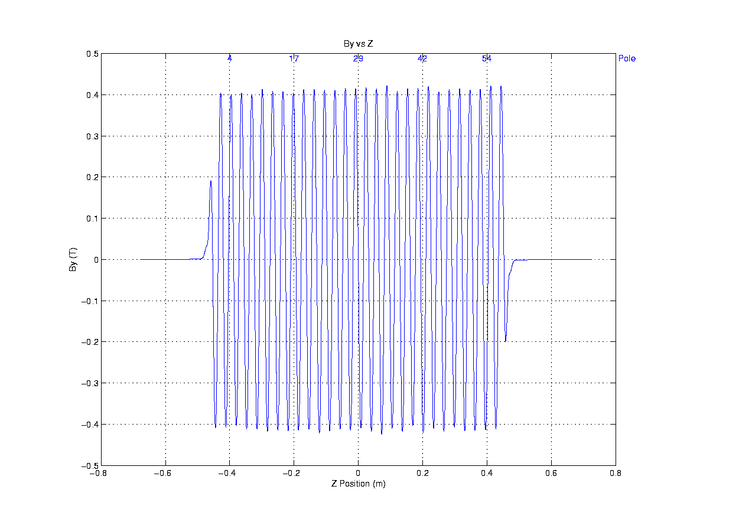
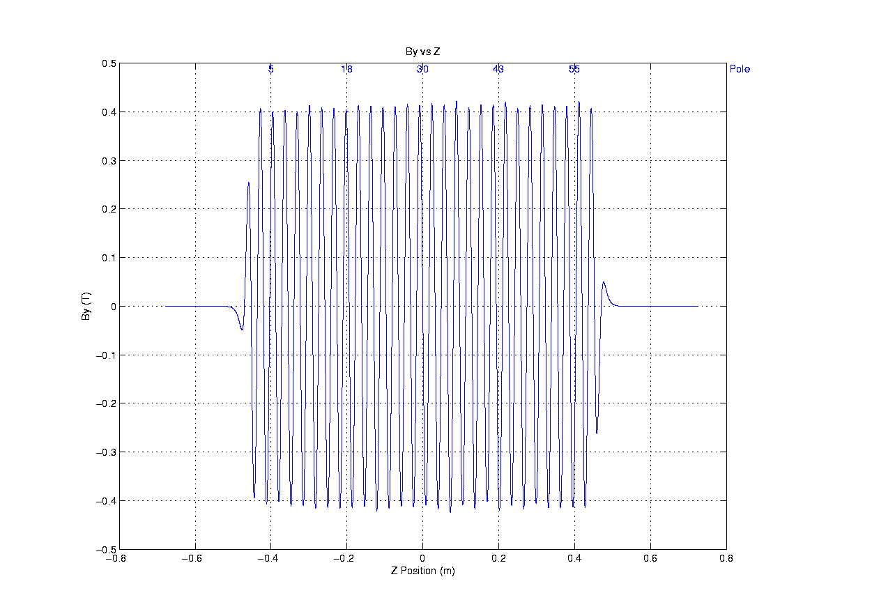
Check for assembly errors
Correct
X-blocks flipped 180 degrees

Slide 13
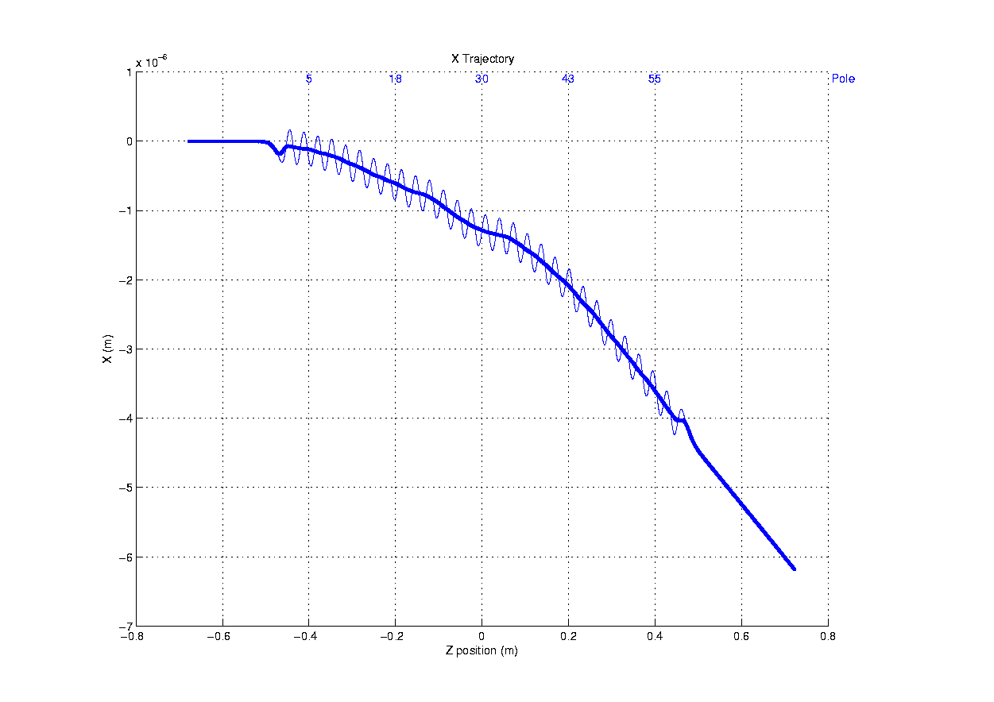
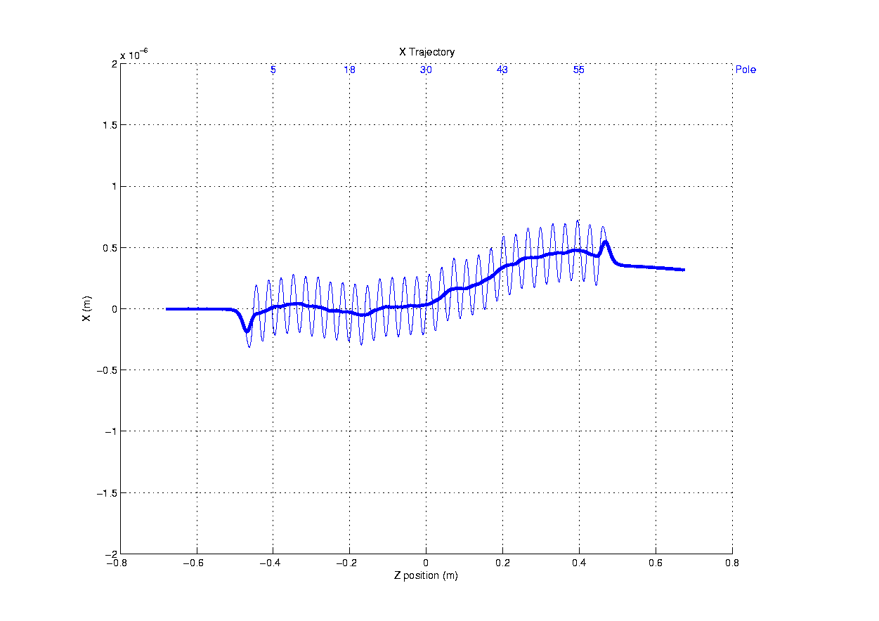
X-trajectory tuning
Before
After
Earth field effect .
10÷20 magnet position corrections to make trajectories straight.

Slide 14
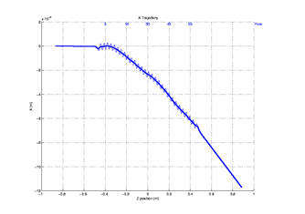
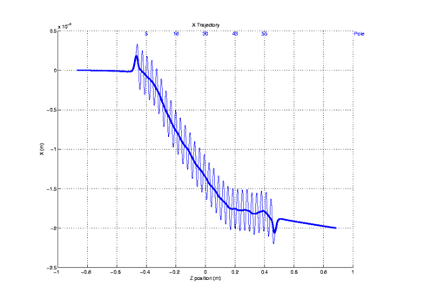
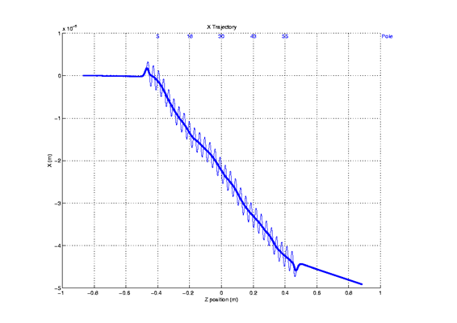
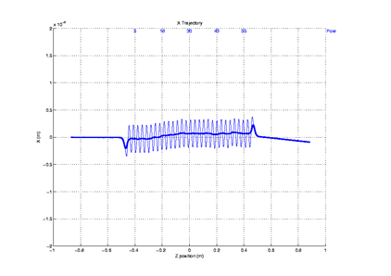
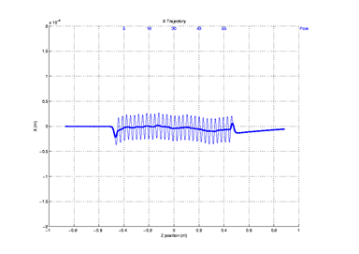
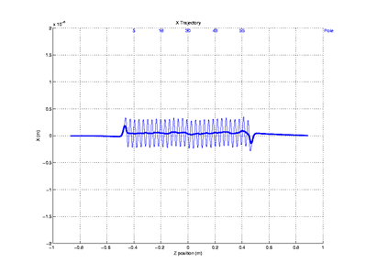
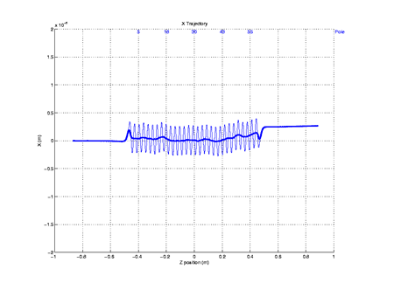
X-trajectories
Q1 | Q2 | Q3 | Q4
Before tuning
After tuning

Slide 15
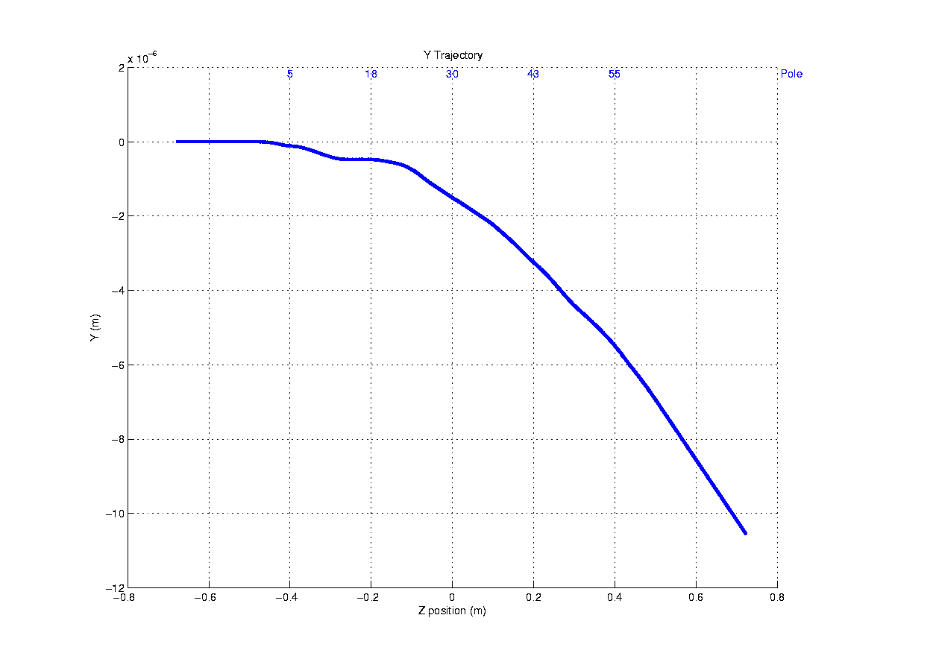
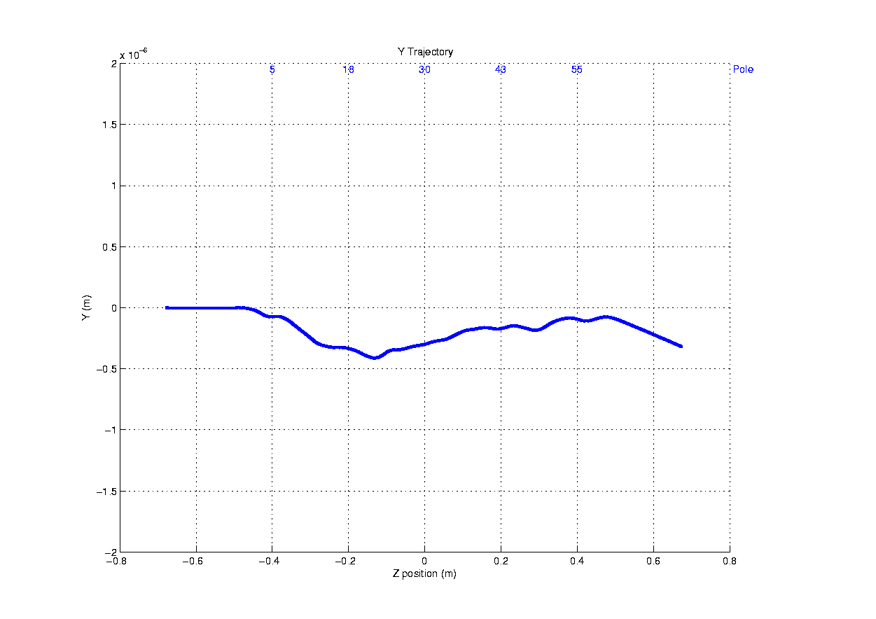
Y-trajectory tuning
Before
After

Slide 16
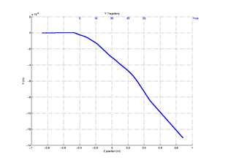
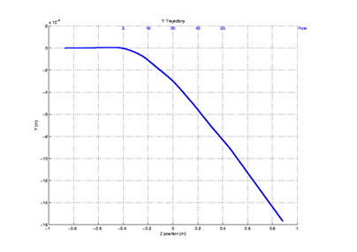
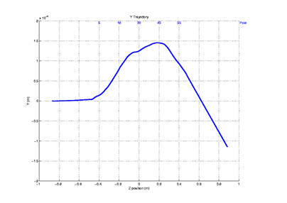
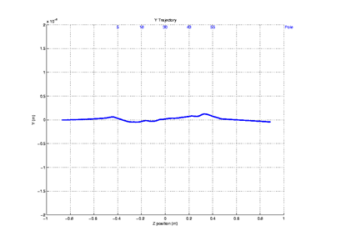
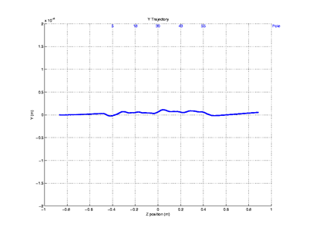
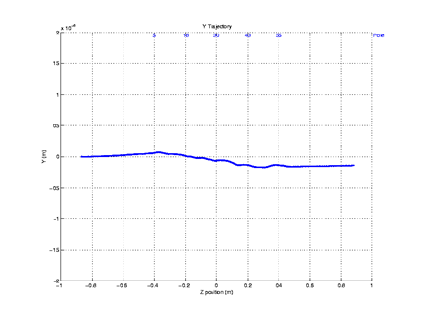
Y-trajectories
Q1 | Q2 | Q3 | Q4
Before tuning
After tuning

Slide 17
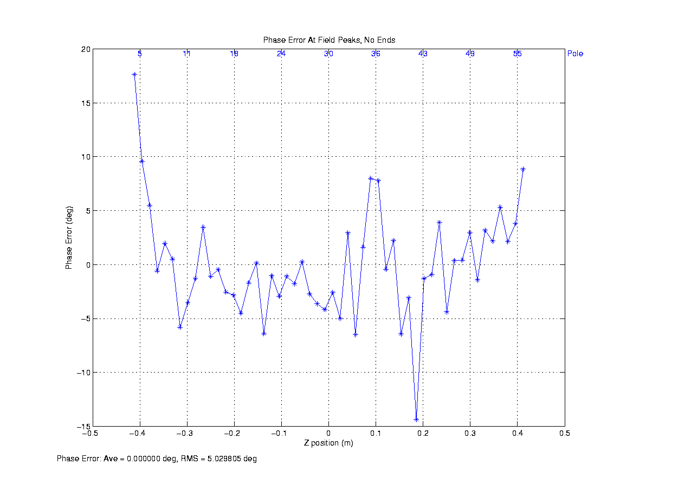
Phase and K tuning
Move block up
Move block down
Up to 100 corrections to tune phase errors and K.

Slide 18
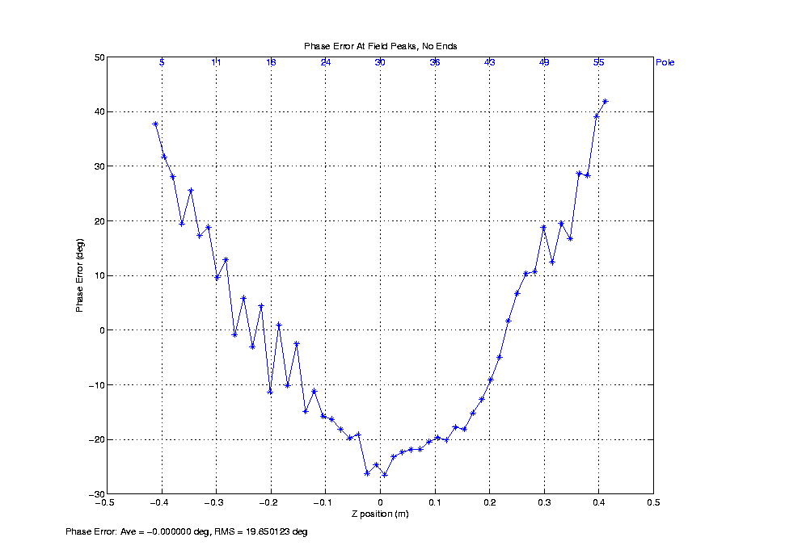
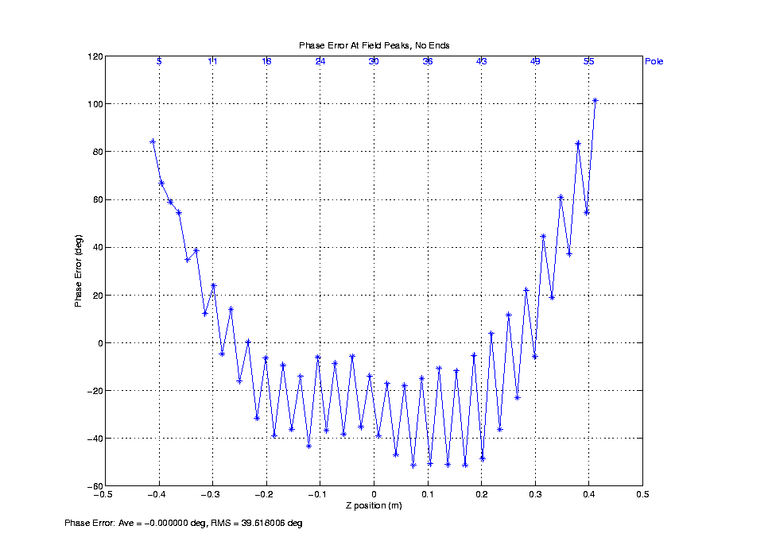
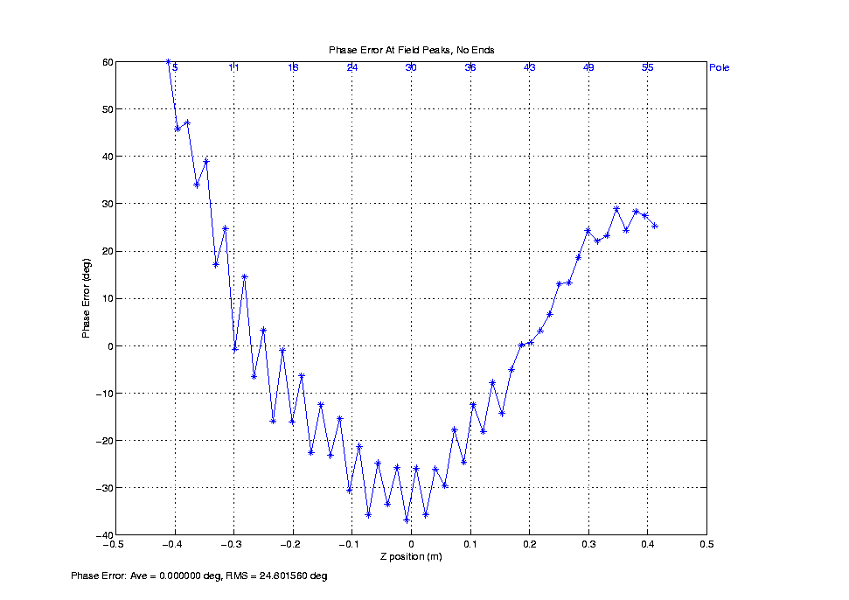
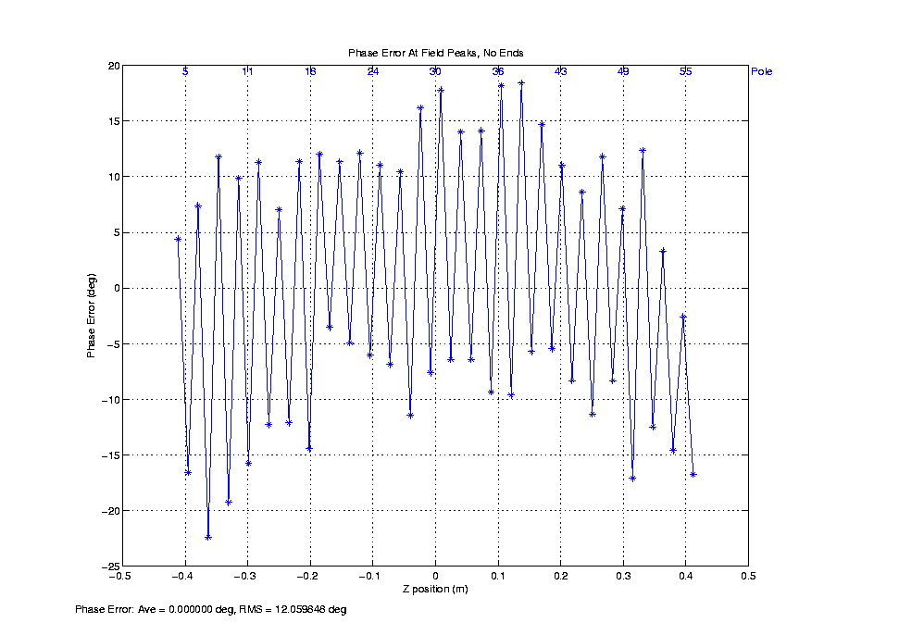
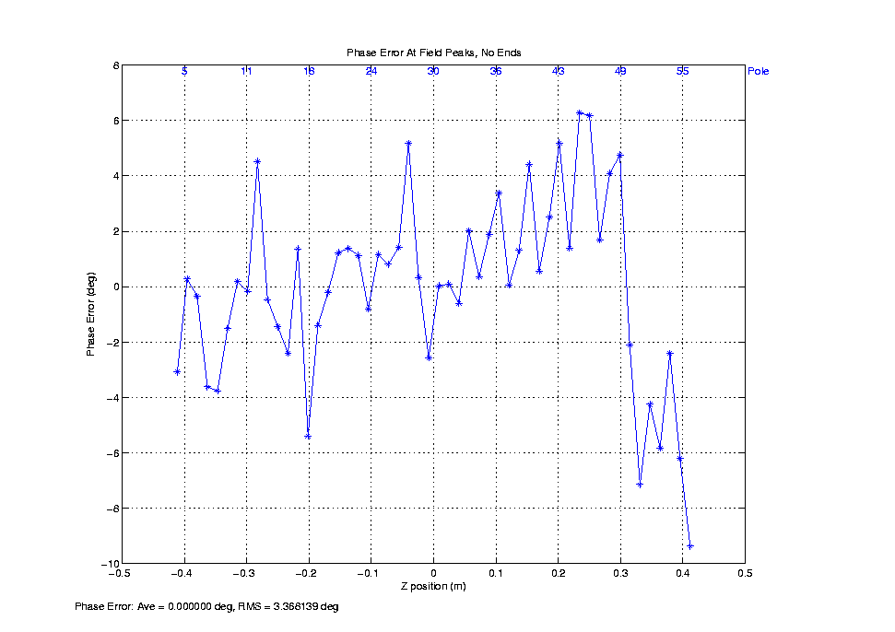
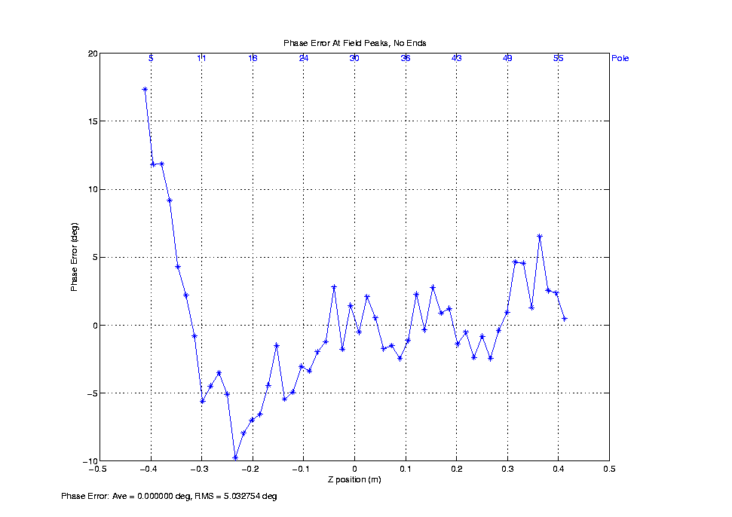
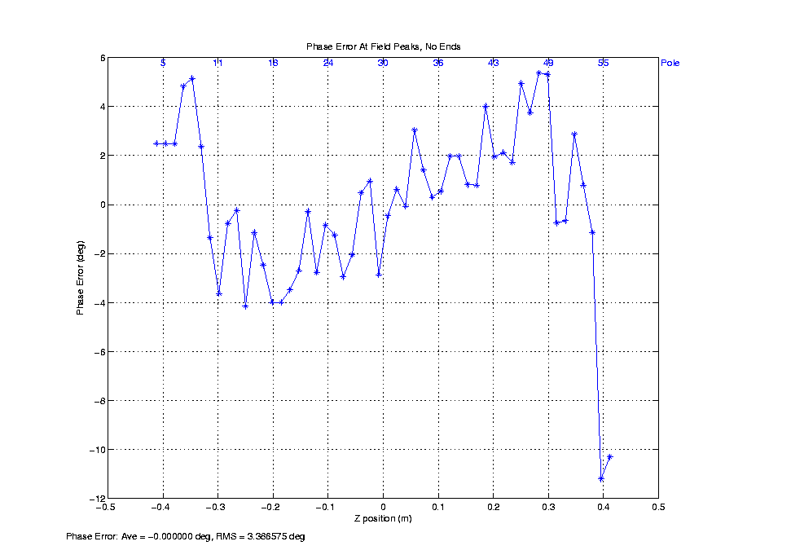
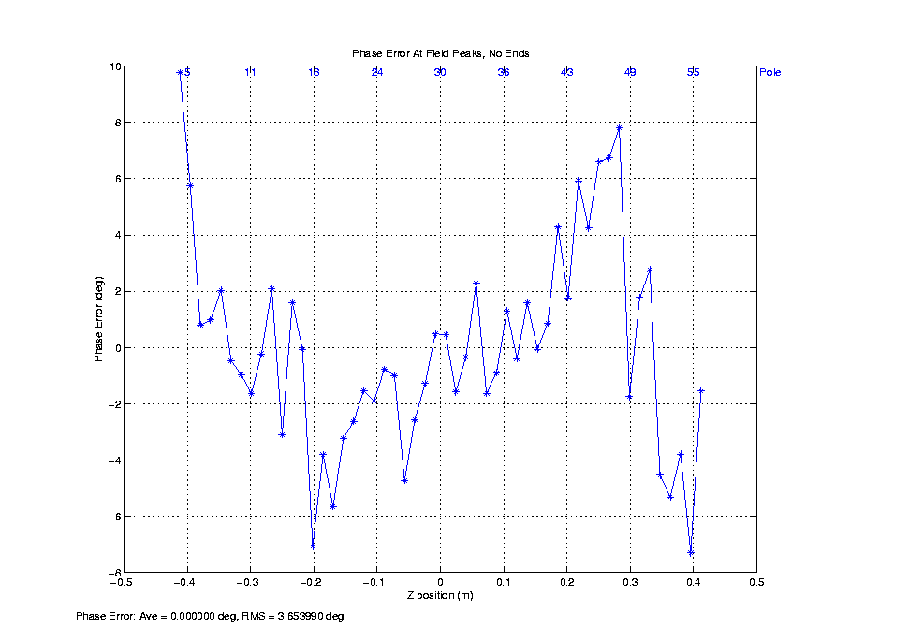
Phase errors
Q1 | Q2 | Q3 | Q4
Before tuning
After tuning
Strongback bow effect .
Could be done better if time permitted.

Slide 19
Summary of Quadrant tuning
Quadrant | I1x (µTm) | I2x (µTm²) | I1y (µTm) | I2y (µTm²) | K | Phase RMS (º)
Q1 | -11 | +0.3 | +20 | +16 | 1.2123 | 5.5
Q2 | -22 | -10 | -2 | -22 | 1.2200 | 6.8
Q3 | -1 | +1 | -3 | -7 | 1.2029 | 4.8
Q4 | +1 | -1 | +3 | +22 | 1.2106 | 6.5
ΔK/K = 1.4·10⁻²
Could be done better!

Slide 20
Tuning summary
Quadrant assembly done at reasonable time. A single 0.010” shim is enough for initial assembly.
Quadrants were not straight enough during the tuning, which resulted in big phase errors after assembly of the full device. Max bow of 18µm and max pitch of 8µm needed to keep phase errors below 5 degrees. Straightening of the quadrant strongback on the tuning bench or special tuning fixture is required.
Mechanical CMM measurements during and after the tuning are important for keeping enough clearance for vacuum chamber and for checking the quadrant straightness.
Since two of the quadrants flipped during assembly, more attention to be paid to the first integral tuning – to be set to zero as close as possible. Otherwise the first integral will result in big second integral for flipped quadrants.
Three iterations per quadrant required to complete the tuning. One iteration = 1 day, which adds up to 3 weeks needed for tuning all the quadrants.
Number of field scans/iteration average:
Q1 – 11 (initial tuning, learning curve)
Q2 – 15 (more time spent to tune phase errors)
Q3 - 9
Q4 – 8
Wire measurements desirable to apply corrections for planar Hall effect.
Enough time on the schedule for tuning and mechanical measurements is required.

Slide 21
End

Slide 22
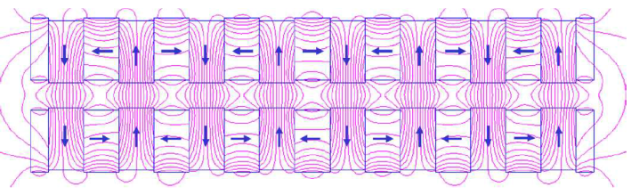










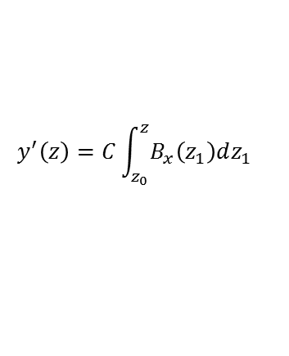

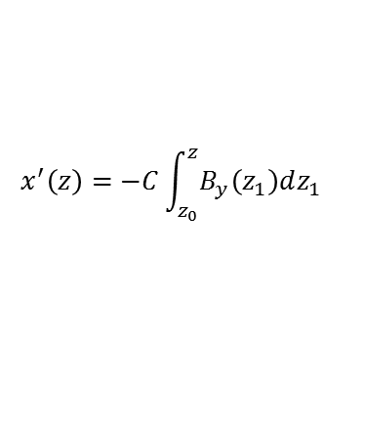

What to tune?
Beam axis:
$$B_{y} \left(z\right)=B_{0}\cos\left(k_{u}z\right);B_{x}=0; k_{u}=2π/λ_{u}$$
Y
X
Z
$$λ_{r}=\frac{λ_{u}}{2γ^{2}}\left(1+\frac{1}{2K^{2}}\right);$$
$$K=−\frac{e}{mck_{u}}B_{0}$$
$$S(z)=\frac{1}{2}\int_{0}^{z}{\left(\frac{1}{γ^{2}}+x^{′2}+y^{′2}\right)dz_{1}}$$
$$P(z)=\frac{2π∙S(z)}{λ_{r}}$$
$${ΔP}_{peak}=\frac{2π{∙ΔS}_{peak}}{λ_{r}}$$
$$λ_{u}$$
$$v_{z}$$
X
$$c$$
$$x′$$
$$ε_{peak}={ΔP}_{peak}−π∙n_{peak}$$
Z
Y
$$x^{′}\left(z\right)=−C\int_{z_{0}}^{z}{B_{y}\left(z_{1}\right)dz_{1}}$$
$$C=\frac{e}{γmv_{z}}$$
$$y^{′}\left(z\right)=C\int_{z_{0}}^{z}{B_{x}\left(z_{1}\right)dz_{1}}$$

