Slide 1
Magnetic tuning set-up for DELTA undulator
Y. Levashov
FDR, Dec. 11, 2013

Slide 2
Outline
The undulator can not be tuned when assembled. Each quadrant will be tuned individually to tight tolerances.
We use existing LCLS-1 fixtures as much as possible for set-up and measurements.
Tuning procedure for 3.2m long quadrants is the same as for the prototype. A few things will be done differently:
A special fixture designed to allow a quick accurate quadrant set-up on the measurement bench, magnets facing up.
Optical tools replaced by more accurate Keyence sensors for Hall probe positioning in vertical direction.
Stretched wire technique will be used for measuring field integrals.

Slide 3
Tuning tolerances
Parameter | Assembled Undulator | Quadrant
K | >3.4853 (Slot 33) | >1.2323 (± 1.5⋅10⁻⁴ )
Phase error R.M.S. | <10° | < 4°
First field Integrals | < 40 μTm (40 G-cm) | < 20μTm (20 G-cm)
Second field Integrals | < 50 μTm² (5000 G-cm²) | < 25μTm² (2500 G-cm²)
Magnet centers’ deviations (magnet blocks’ deflections) from a nominal center line < ± 100μm in X, <+50μm in Y, and <+100μm in Z (phase error < 1°).

Slide 4
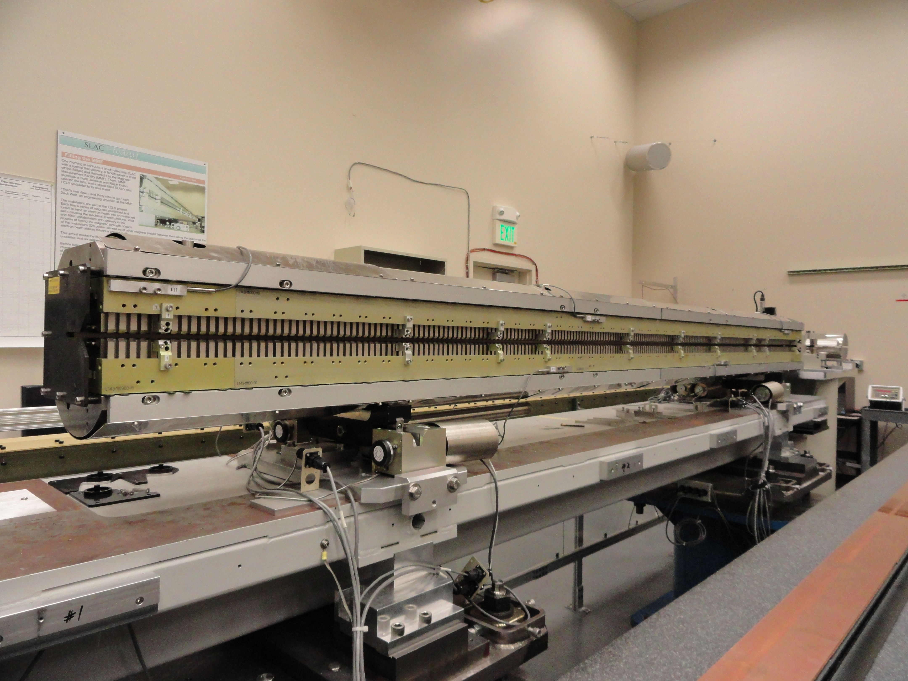
Set-up on LCLS-1 girder
Use existing LCLS-1 undulator tuning set-up on Kugler measurement bench.
3.4m
Stages
LCLS-1 girder
Kinematic supports
Cam movers
The quadrant tuning fixture will have kinematic supports. It will be mounted on existing LCLS-1 girder with cam movers.
The same set-up is used on magnet gap tuning stand, transport carts and on CMM.

Slide 5
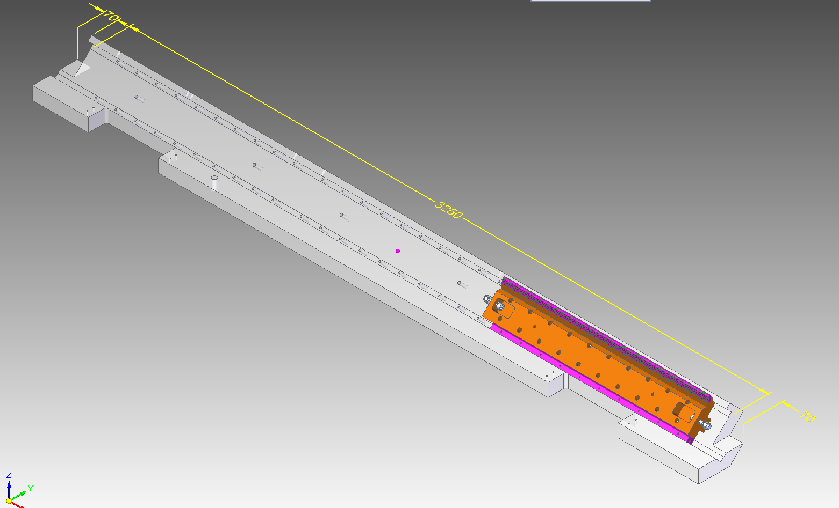
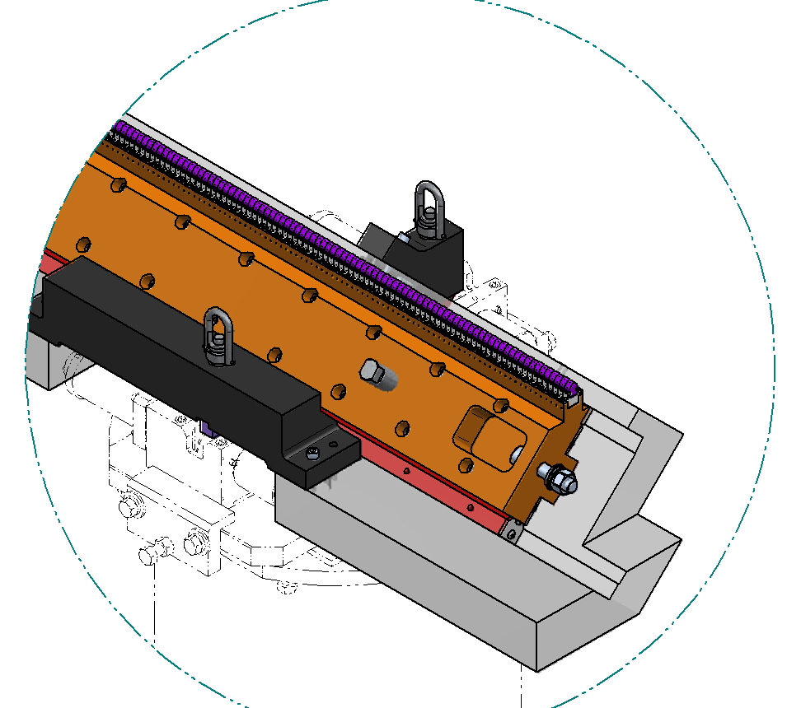
Tuning fixture
Y
X
Coordinate system: Z- along the beam axis, Y – up, X – makes right-hand system
Z
Kinematic support fixture. Lifting at the same points as supports.
3.39m
Reference surface for roll measurements
Three 1m long magnet arrays will be assembled on the tuning fixture with rails attached to make 3.2m quadrant with entrance and exit sections.
Mounting surfaces for rails
Existing cam movers

Slide 6
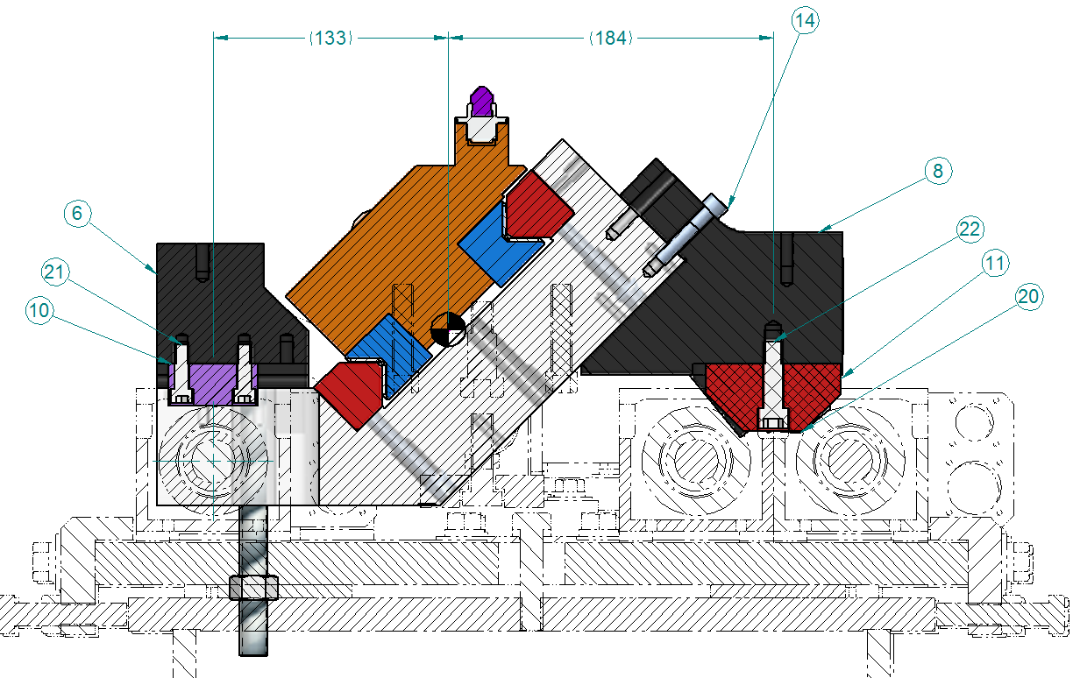
Tuning set-up on Kugler bench
Y
Keyence sensor :
Working distance 80 mm,
Range ± 15mm,
Accuracy 3μmK
X
Z-Stage
Bracket
Reference surface for Optical measurements
1m long removable bracket with mounting holes.
Reference surface for Keyence and CMM
Granite
Pitch and Y will be set to ±5μm using Keyence measurements.
Yaw and X will be set to ±30μm using optical tools.
Second Keyence sensor will be used to control magnet motions.

Slide 7
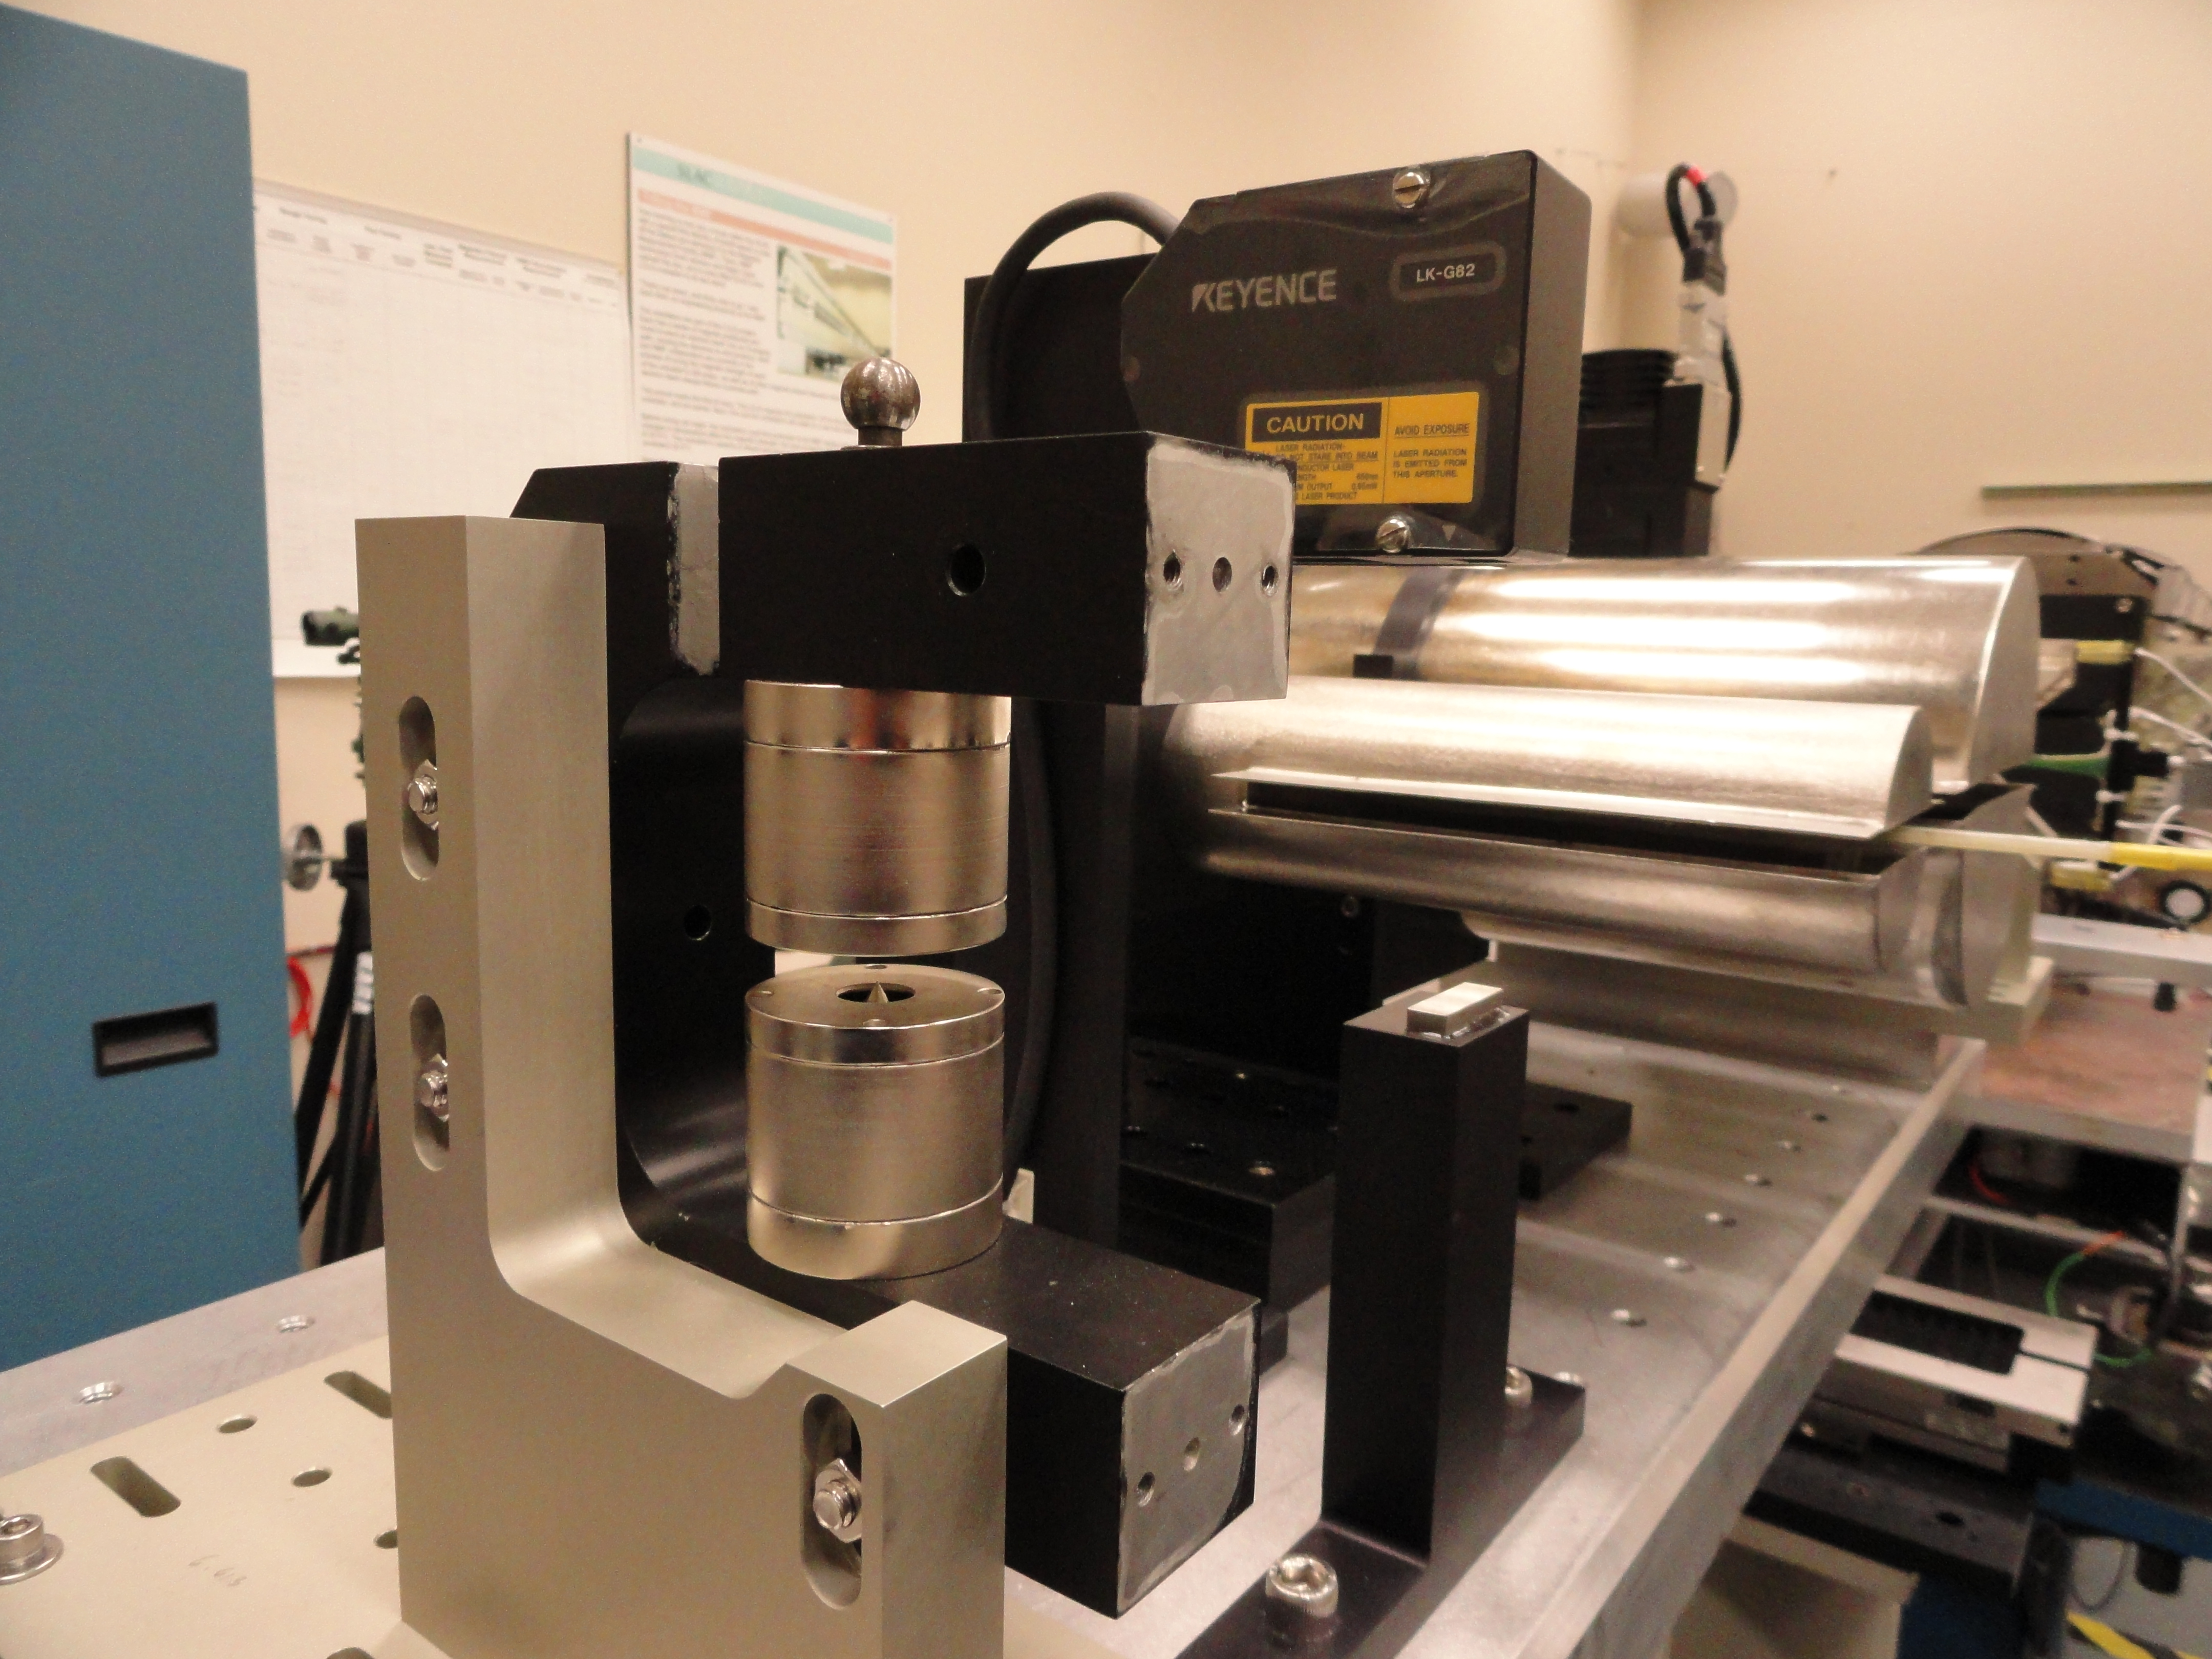
Positioning Hall probe in X and Y direction
Tooling ball
Keyence
Hall probe sensitive area is small and covered inside a plastic package. Location is known to ±100μm.
We will use LCLS-1 fiducialization magnets to find Hall probe center location w.r.t. outside fiducials.
Fiducialization magnet
Gauge block

Slide 8
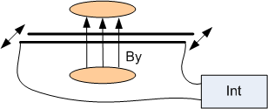
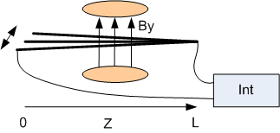
Field integral measurements
Moving wires
Moving end
fixed end
Fixed wires
Field integrals and trajectories will be initially tuned using Hall probe measurements.
We will use a single stretched wire and LCLS-1 stages to do accurate
(±20G·cm /2000G·cm²) measurements and do final corrections to field integrals by
moving magnets at entrance and exit.
It will have small effect on trajectories.

Slide 9
Tuning procedure
Initially align 1m long sections of magnets using CMM with ±50μm accuracy.
Mount 3 sections of the magnets on the tuning fixture to make a quadrant.
Align the quadrant on Kugler bench.
  Do Hall probe and stretched wire measurements and tune the quadrant using virtual shimming (re-positioning the magnets w.r.t. magnetic axis).
  Tuning procedure is the same as for the prototype.
Round 1:
Tune trajectories, field integrals and phase errors with the use of CMM data.
Measure K
- Check magnet positions w.r.t the quadrant references on CMM.
Round 2:
- Correct magnet positions to be within ±100μm in X and < +50μm in Y from the beam line.
Continue tuning trajectories , field integrals and phase errors with the use of CMM data.
Set K-value as close as possible to the average from Round 1.
Check magnet positions on CMM.
Round 3 ….

Slide 10
Summary
Tuning procedure for DELTA quadrants has been developed and tested on the prototype.
The quadrant tuning set-up utilizes existing LCLS-1 fixtures.
A new tuning fixture with kinematic supports has been designed.
High accuracy non-contact Keyence sensors are used for magnet positioning.
Field integrals are measured using stretched wire technique.

Slide 11
Back-up slides
Positioning Hall probe in X and Y direction
Known from calibration (±5μm)
Optical measurement (±25μm)
Keyence measurement (±3μm)
Keyence measurement (±3μm)
Hall probe
(±2μm)
Reference on tuning fixture
Cam mover adjustment

Slide 12
Alignment to the bench (X & yaw)
Do Hall probe scan in X at each pole location
Truncate data ± 3mm from center
Fit parabola, find center
Fit a straight line through all pole centers, find x and yaw, correct yaw
if necessary.

Slide 13
Second tuning fixture
A
B
B
D
C
Second (mirror) fixture will be made for quadrants B & D.
Magnet assembly, CMM checking and quadrant tuning will be done in parallel.

Slide 14

Tuning set-up on Kugler bench
Y
Keyence sensor :
Working distance 80 mm,
Range ± 15mm,
Accuracy 3μmK
X
Z-Stage
Bracket
Reference surface for Optical measurements
1m long removable bracket with mounting holes.
Reference surface for Keyence and CMM
Granite
Pitch and Y will be set to ±5μm using Keyence measurements.
Yaw and X will be set to ±30μm using optical tools.
Second Keyence sensor will be used to control magnet motions.

