Slide 1
Quadrant Tuning
Y. Levashov

Slide 2
Delta undulator prototype tuning
1. CMM measurements
2. Mechanical adjustments
3. CMM check
4. Magnetic measurements and tuning

Slide 3
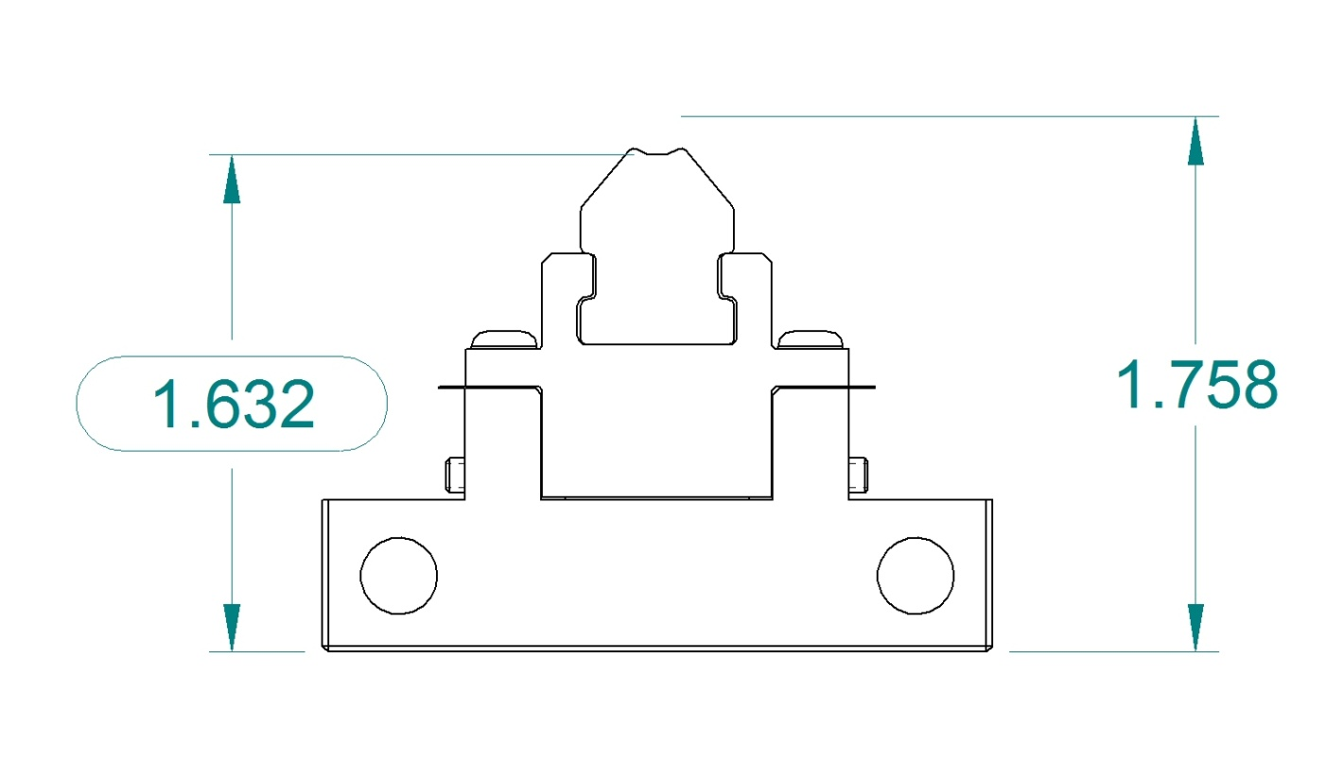
CMM measurements
Measure side points, find x center w.r.t. base
2. Scan along the curve, fit 3.2mm radius, find x & y
(1.760 – measured)

Slide 4
CMM measurements

Slide 5
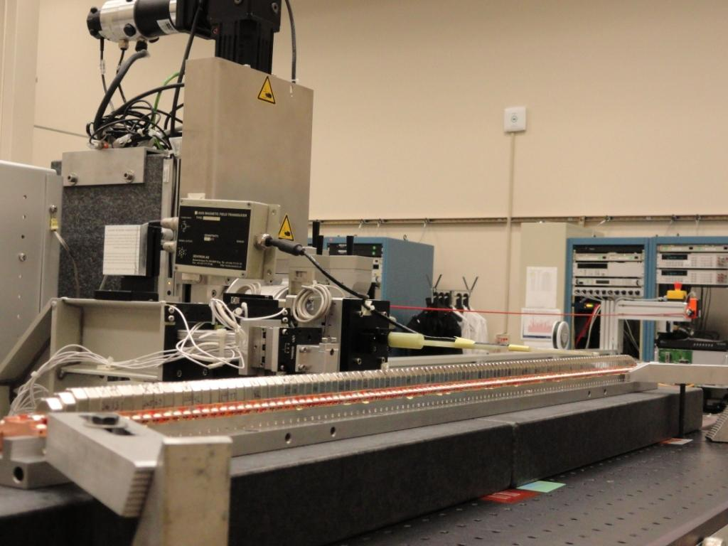
Kugler bench set-up
Hall probe
Granite blocks
Shims

Slide 6
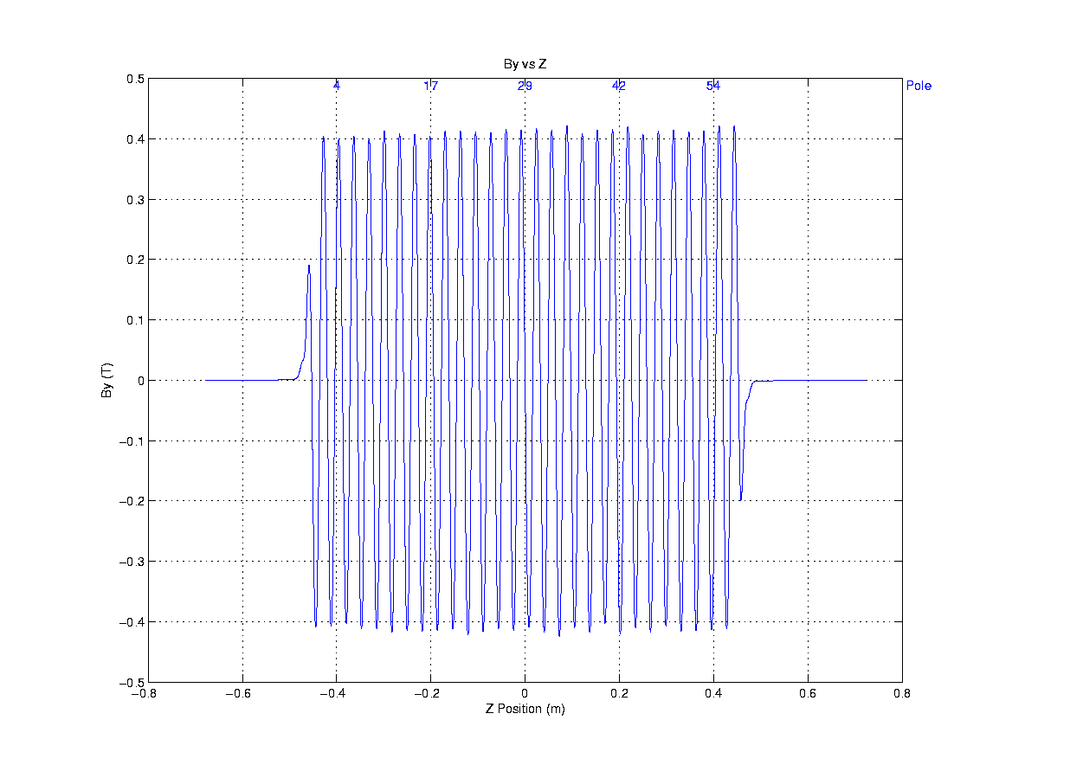
X-block flipped 180 degrees
X-block flipped 180 degrees

Slide 7
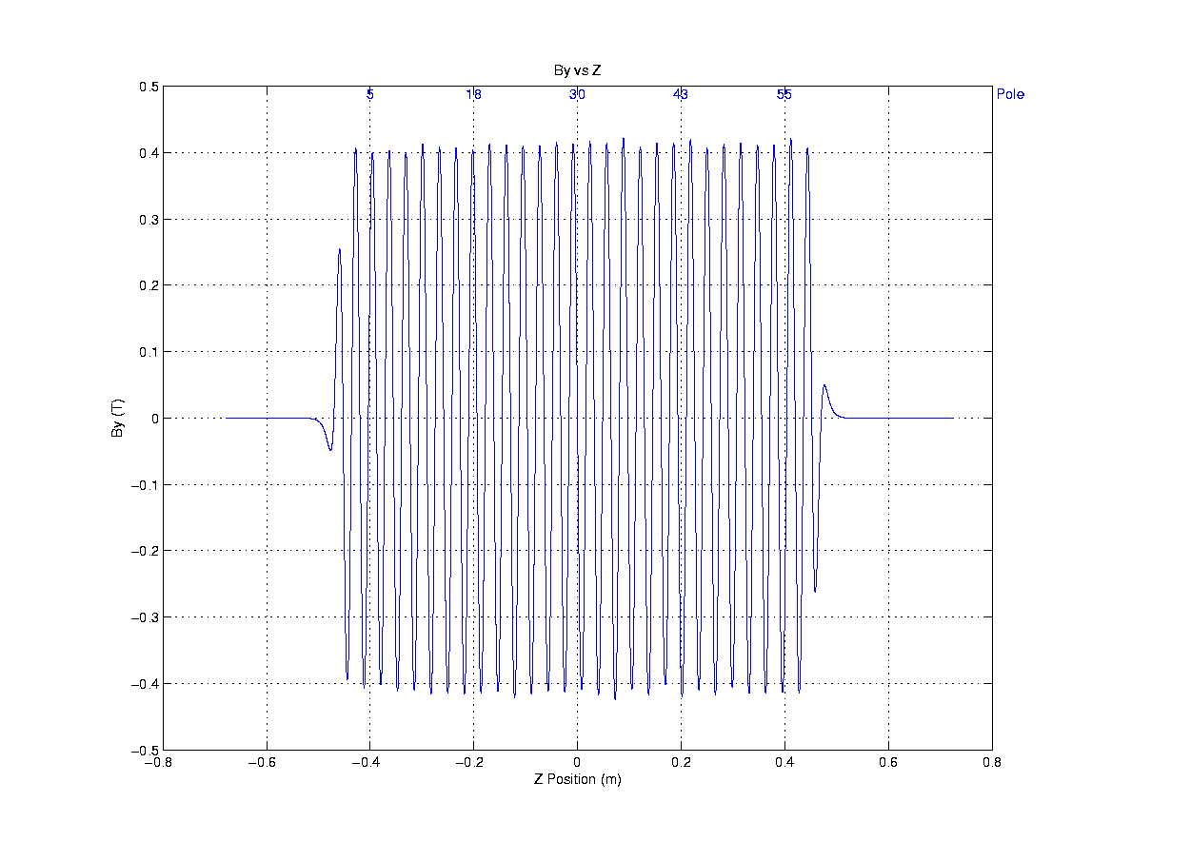

Slide 8
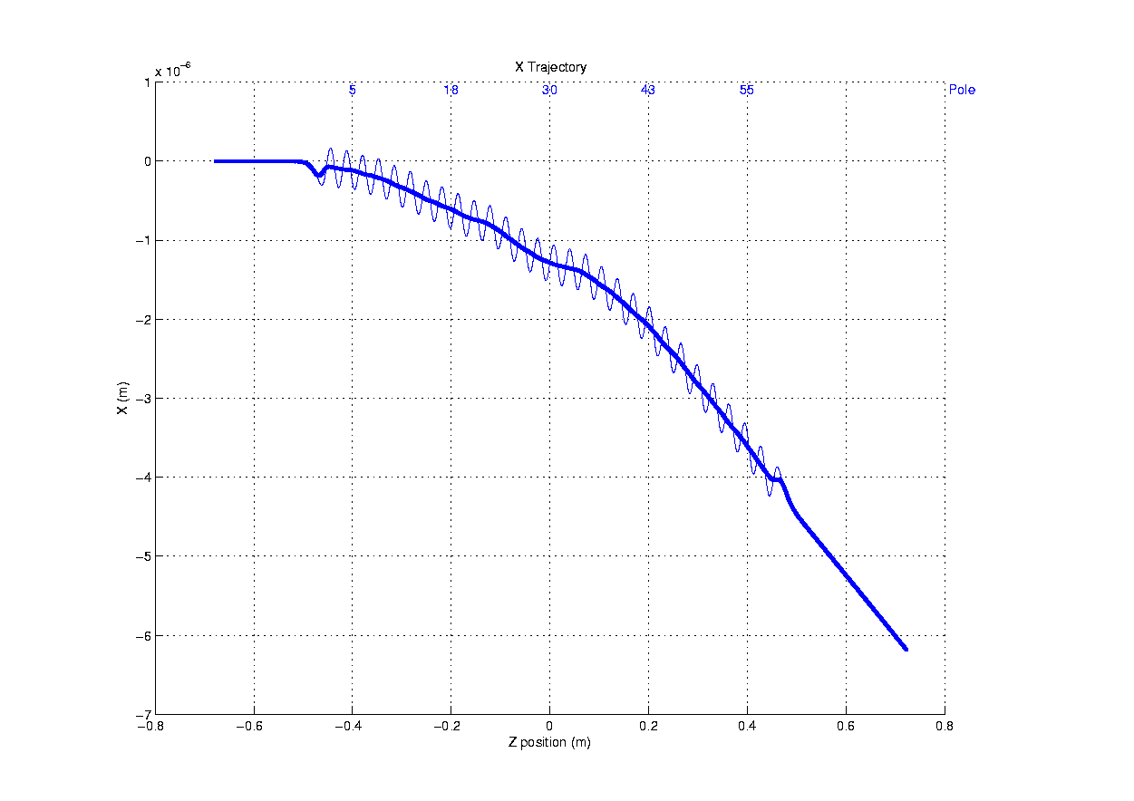
I1Y = -351µTm
I2Y = -281µTm²
Shim 0.025mm → 12 µTm

Slide 9
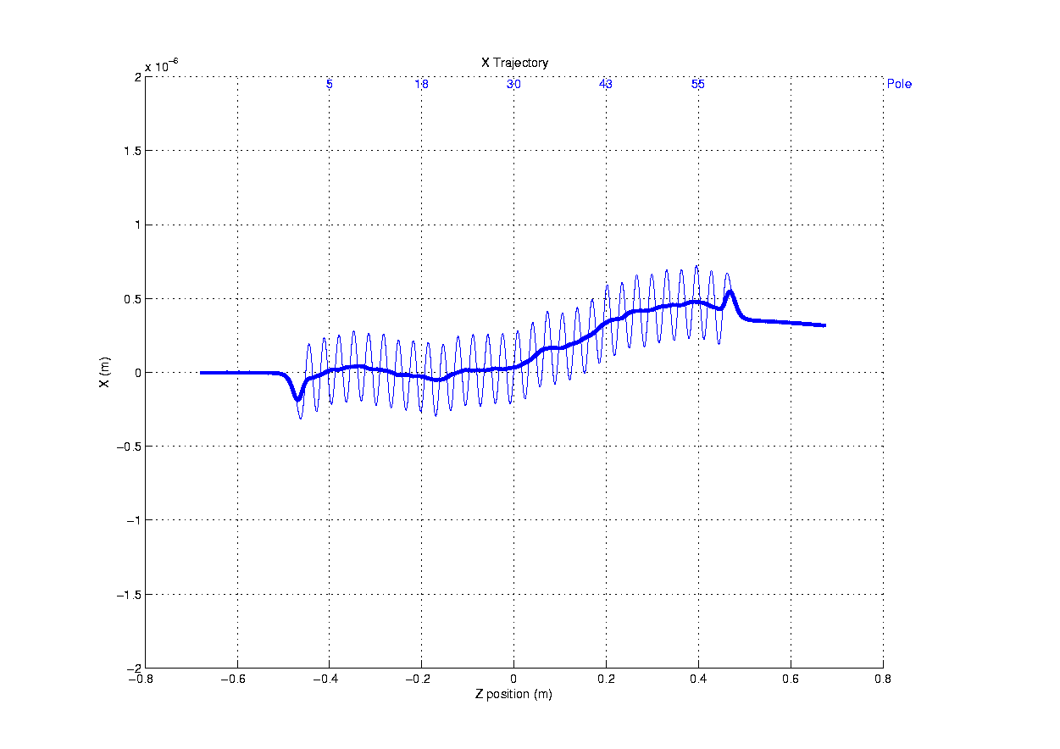
I1Y = -13µTm
I2Y = 14µTm²

Slide 10
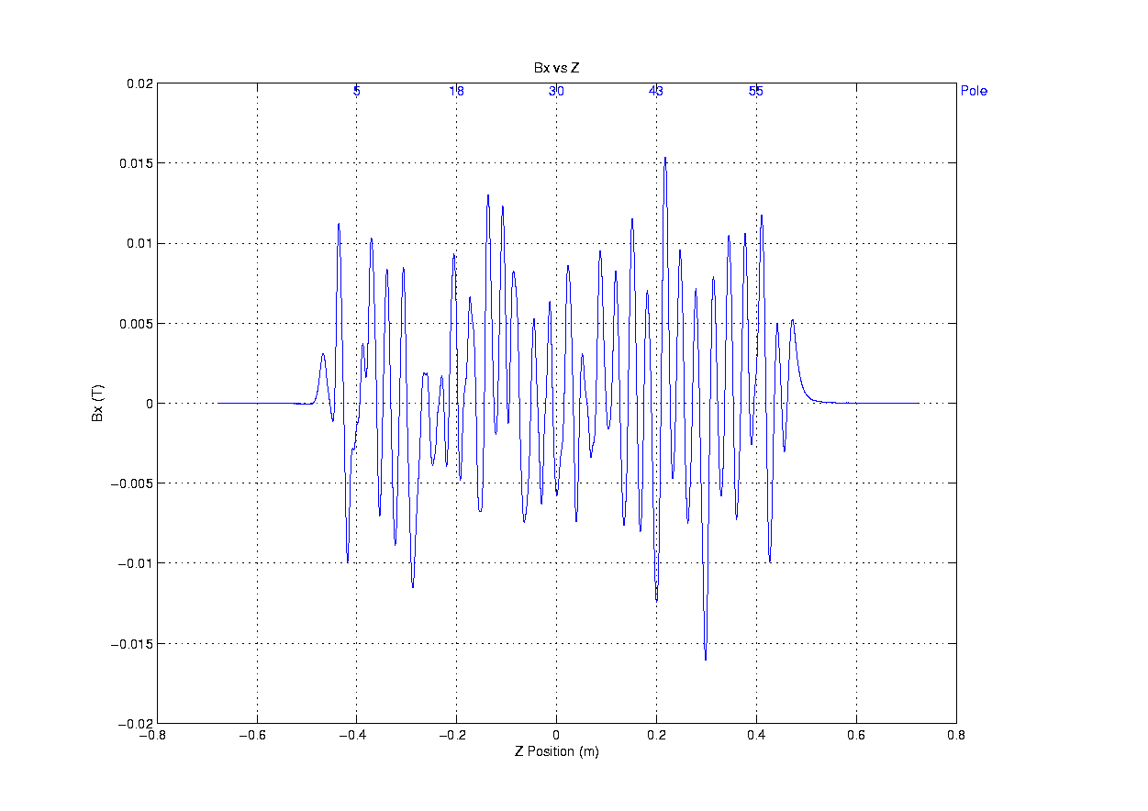

Slide 11
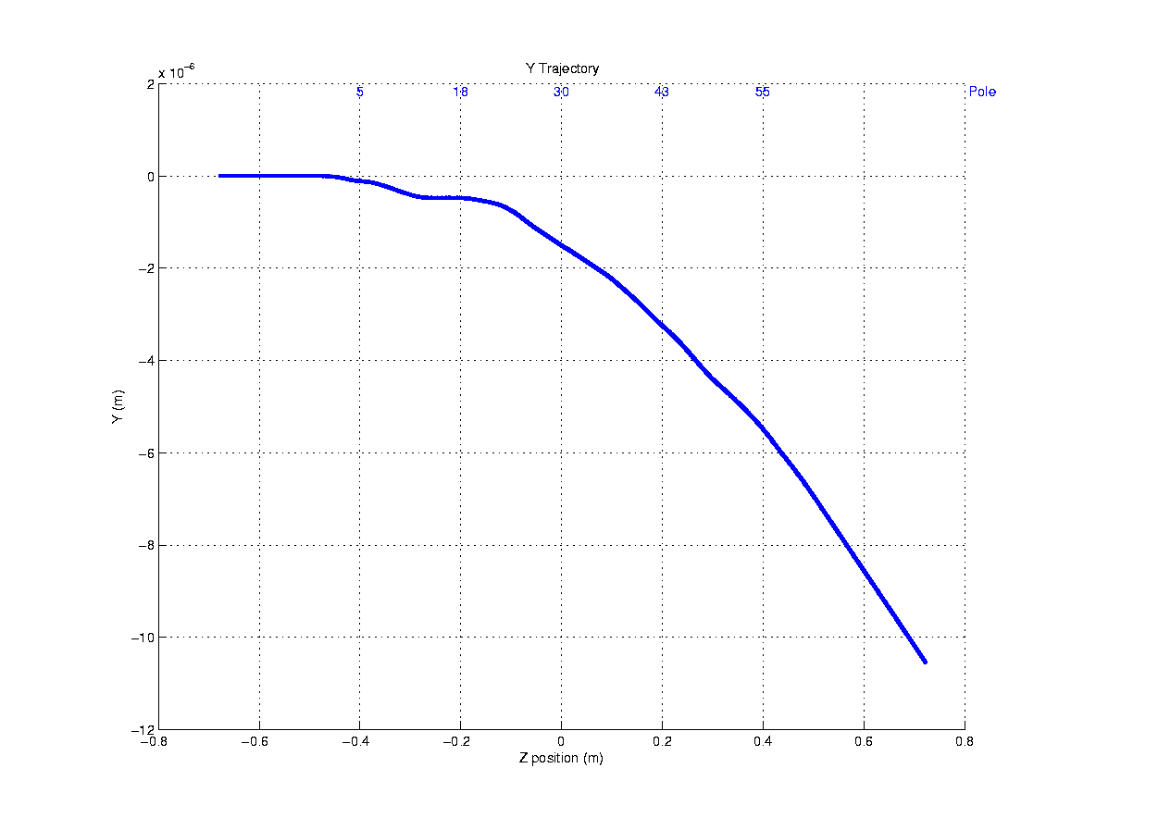
I1Y = 738 µTm
I2Y = 479µTm²
0.025mm Y block shift in x → 19 µTm

Slide 12
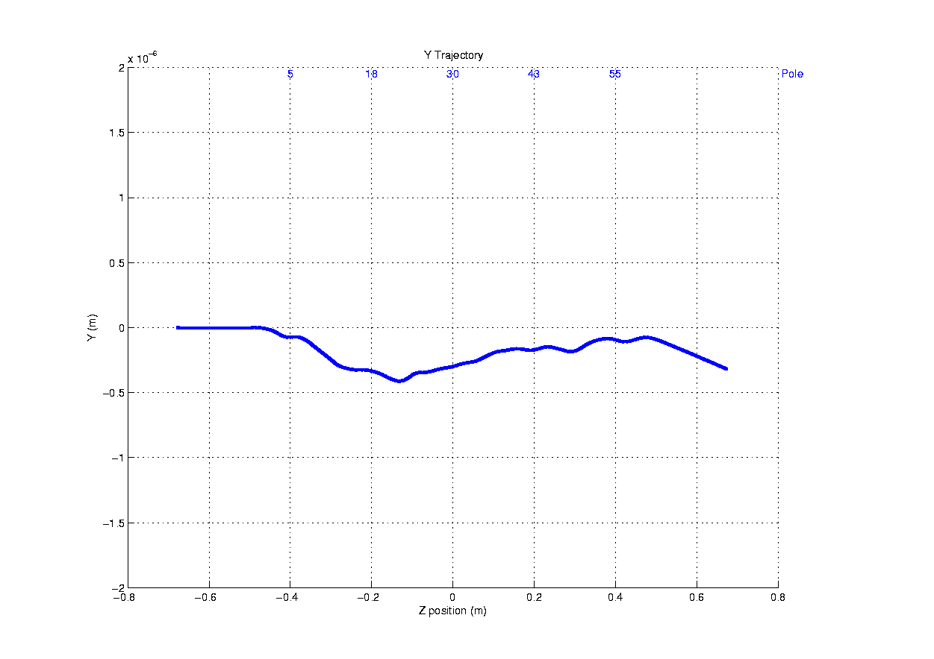
I1Y = 62 µTm
I2Y = 144 µTm²

Slide 13
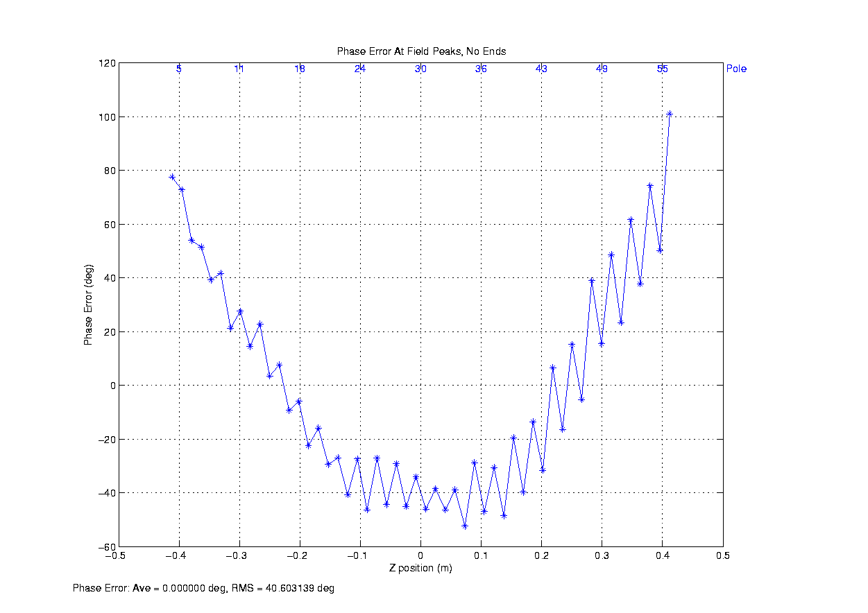

Slide 14
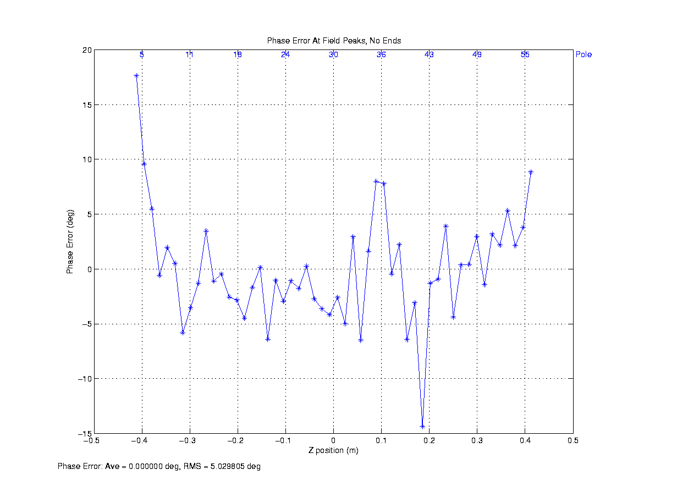
0.125mm shift of two Y blocks in y → 13 degrees of phase change
0.125mm shift of X block in y → 4 degrees of phase change

Slide 15
Summary
Mechanical tuning is useful as a start point
3- magnet end design works
Block motions of ±0.3mm in x and -0.3mm in Y are required for tuning
Undulator could be tuned to tolerances

