Slide 1
Tube Laser Alignment System
Georg Gassner

Slide 2
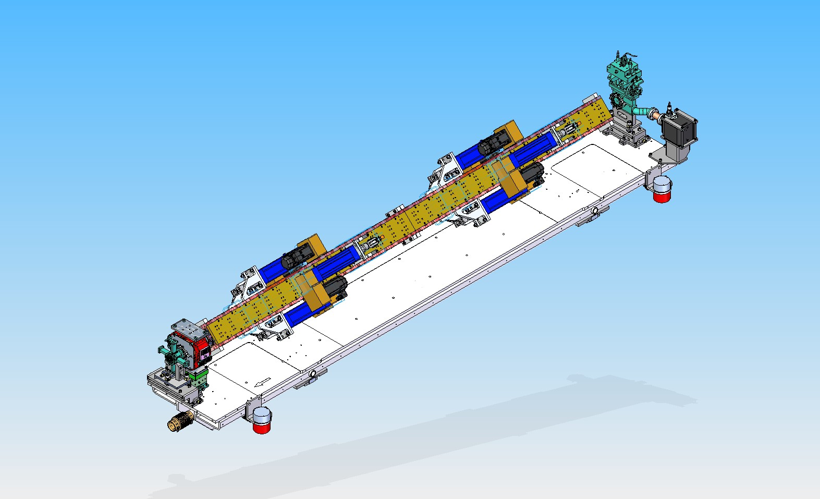
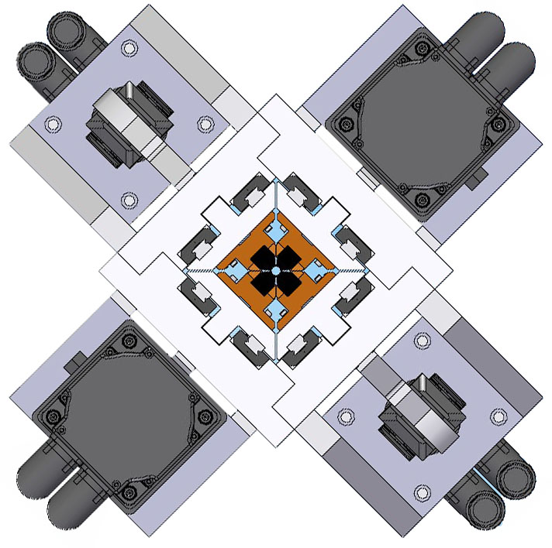
Delta Undulator Project
Period 32 mm, Length 3.2m
Gap (bore) 6.4mm
PM material NdFeB, grade N40UH
Vacuum
Chamber ID 5.0mm

Slide 3
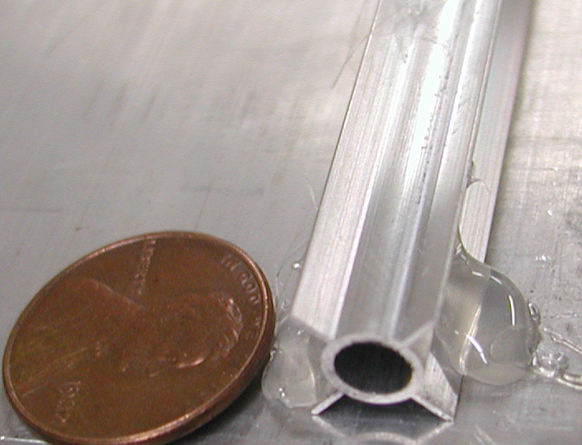
Alignment Scope
Determine the x- and y- location of a Hall probe assembly at different z-locations inside the vacuum tube allowing simultaneous position and magnetic measurement.

Slide 4
Concept: x-Position
a)
Laser
Retroreflector
Beam Splitter
CCD Camera
b)
Laser
Retroreflector moved by Δx
2Δx
Δx
Beam Splitter
2Δx
CCD Camera

Slide 5
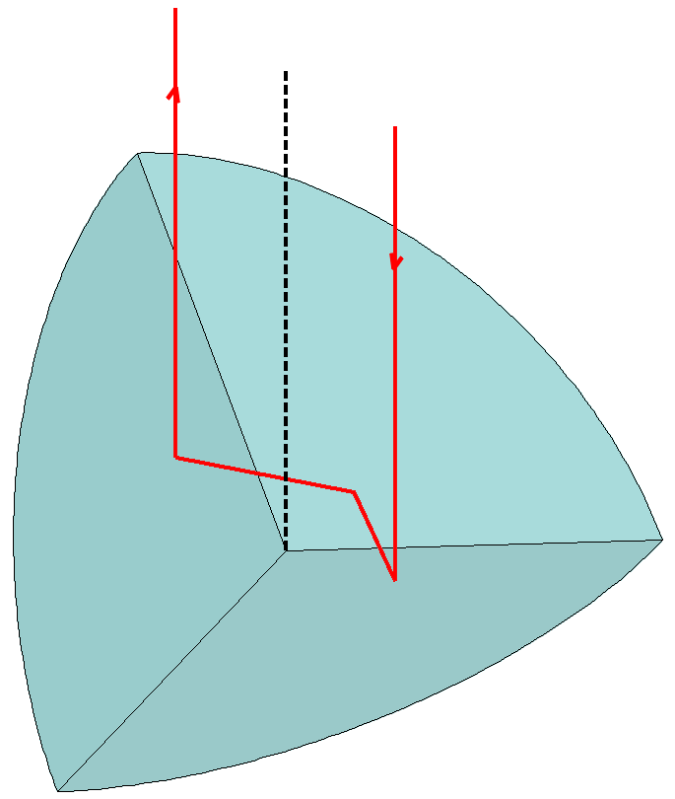
Concept: x-y-Position
Incoming beam: Δx
Δy
Outgoing beam: -Δx
-Δy

Slide 6
Concept: z-Position
We already use a laser and a retroreflector => replace laser head with interferometer laser and we get distance.
Interferometer
Laser Head
Retroreflector
Beam Splitter
Receiver
CCD Camera

Slide 7
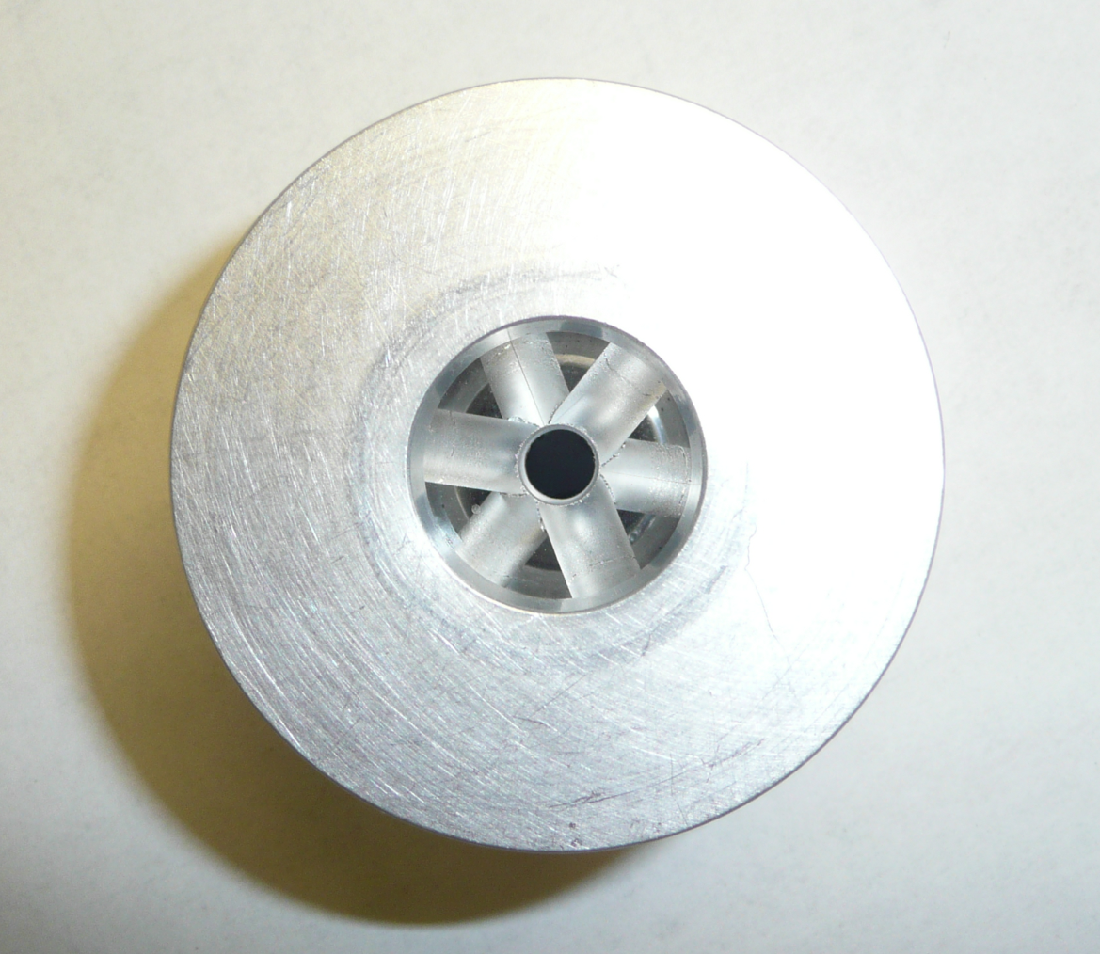
Retroreflector (1)
Prism cut from solid
1.5” CCR with
diamond core drill

Slide 8
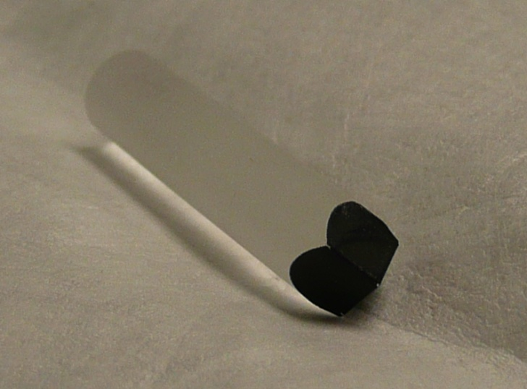
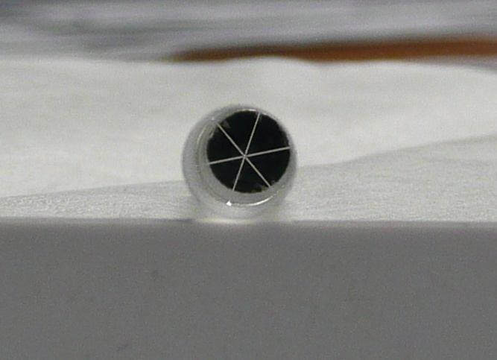
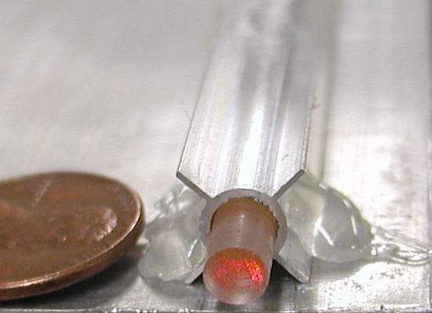
Retroreflector (2)
- Prism Ø 4.5mm
- Prism and Hall Probe might not be
centered => roll stability important
(carbon fiber tube pusher system)

Slide 9
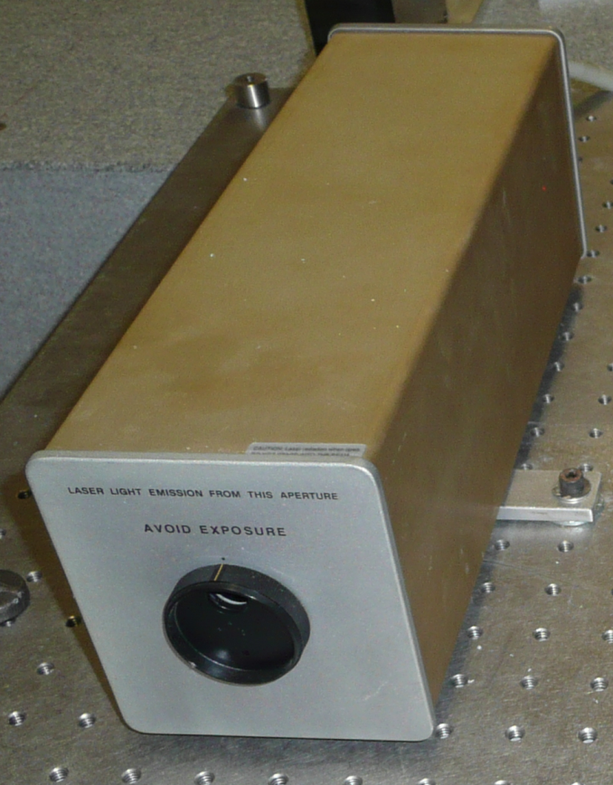
Laser - Hardware
Agilent 5517B Laser Head
  Helium-Neon (632nm), Continuous wave
  Beam diameter 6mm
  Beam divergence ~0.15mrad

Slide 10




Laser - Beam Size Reduction
θ1=0.15mrad
θ2=0.45mrad
d1=6mm
d2=2mm
f1=f2

Slide 11

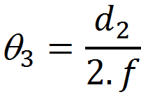
Laser - Beam Focusing
To move the waist of the laser beam out, add focusing lens or move one of the lenses
θ3
waist

Slide 12
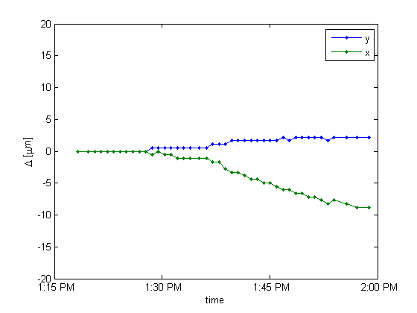
Laser Positional Stability

Slide 13
CCD Image
Point Grey - FL2-20S4M-C
  1624x1224 pixel (~7x5mm)
  4.4µm pixel size
Natural Density Filter (OD=2) to protect CCD

Slide 14
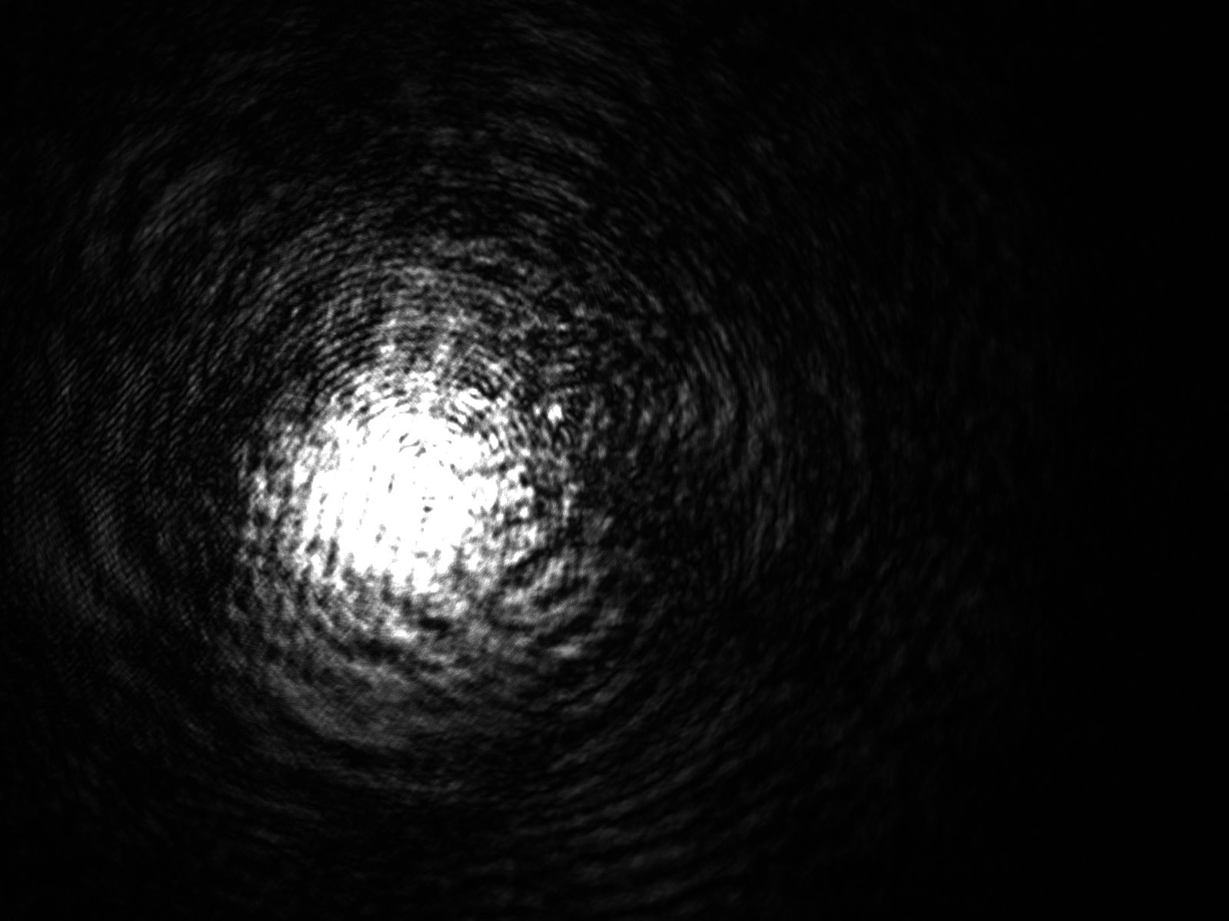
CCD Images

Slide 15
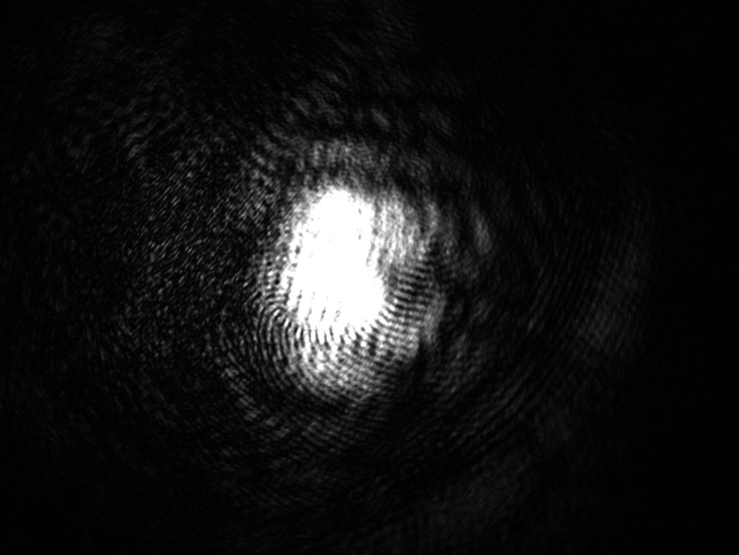

Image Processing (1)
Cross Correlation of two images =>ΔX, ΔY
Manuel Guizar-Sicairos, Samuel T. Thurman, and James R. Fienup, "Efficient subpixel image registration algorithms," Opt. Lett. 33, 156-158 (2008)

Slide 16
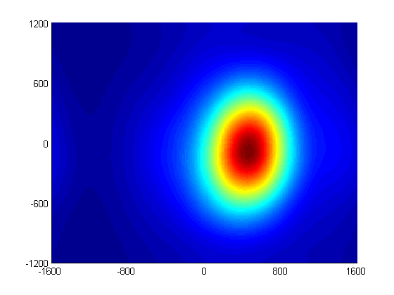
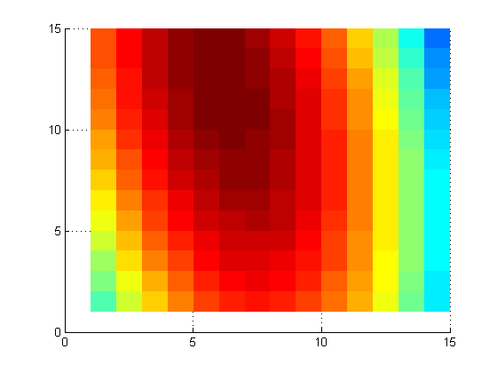
Image Processing (2)
ΔX=-0.2 pixel
ΔY=0.4 pixel

Slide 17
Measurement System (1)
Laser Head
Mirror
Interferometer
Hall Probe
Retroreflector
Mirror
3.2m vacuum tube
Ø4.8mm
Focusing
Lenses
Beam Splitter
Receiver
CCD Camera

Slide 18
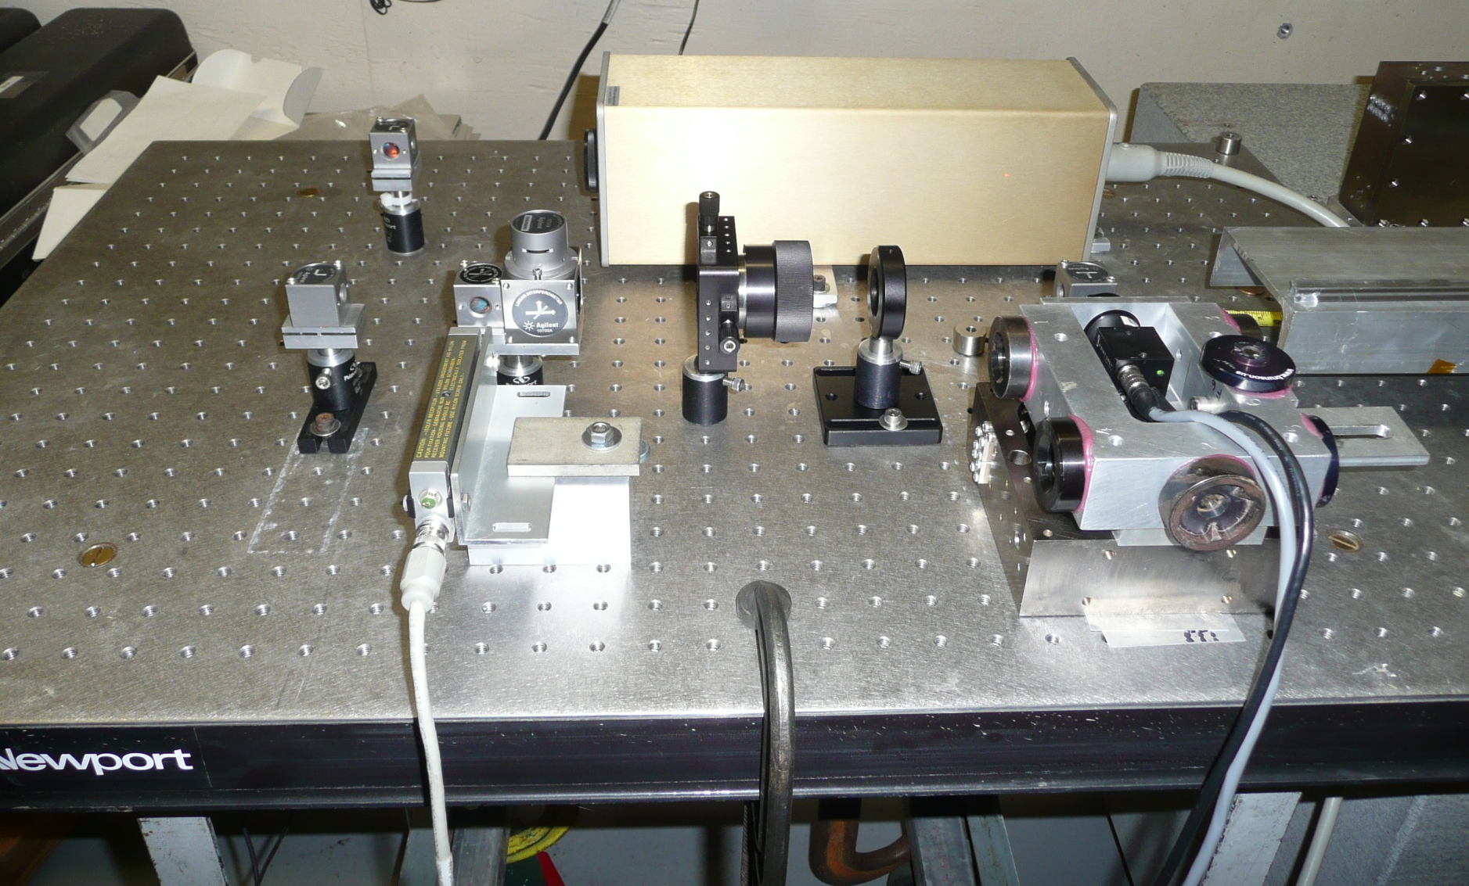
Measurement System (2)

Slide 19
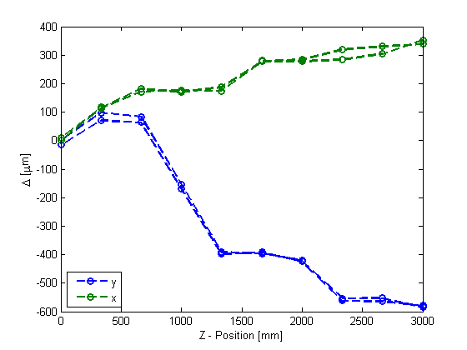
Results – Retroreflector Position
Move the retroreflector from 0-3000mm through the vacuum chamber and back

Slide 20
Summary
First tests indicate that sub 50µm accuracy is achievable.
Can be triggered together with magnetic measurements.
Effects of atmosphere need further investigation especially when system is moving.

