Slide 1
DELTA Quadrant Tuning
Y. Levashov
E. Reese

Slide 2
Tolerances for prototype quadrant tuning
The undulator can not be tuned when assembled.
Each magnet array was tuned individually then mounted on a quadrant actuator plate.
Parameter | Assembled Undulator | Quadrant
K | >3.4853 (Slot 33) | >1.2323 (± 1⋅10⁻³ )
Phase error R.M.S. | <10° | < 3°
First field Integrals | < 40 μTm (40 G-cm) | < 10 μTm (10 G-cm)
Second field Integrals | < 50 μTm² (5000 G-cm²) | < 10 μTm² (1000 G-cm²)
Magnet center deviations from a nominal center line < ± 50 μm in X and <+50 μm in Y.

Slide 3
Tuning procedure outline
Initial magnet alignment using CMM to ±50 μm from the beam axis.
Tuning with iterations based on virtual shimming(re-positioning the magnets w.r.t. magnetic axis).
Round 1:
Tune trajectories and phase errors with the use of CMM data.
Measure K
- Check magnet positions on CMM.
Round 2:
- Correct magnet positions to be within ±50 μm from the beam line.
Continue tuning trajectories and phase errors with the use of CMM data.
Set K-value as close as possible to the average from Round 1.
Check magnet positions at CMM.
Round 3:
- Correct magnet positions to be within ±50 μm from the beam line.
Do final adjustments to trajectories, phase errors, and K.
Check magnet positions at CMM.
Round 4(if necessary)….

Slide 4
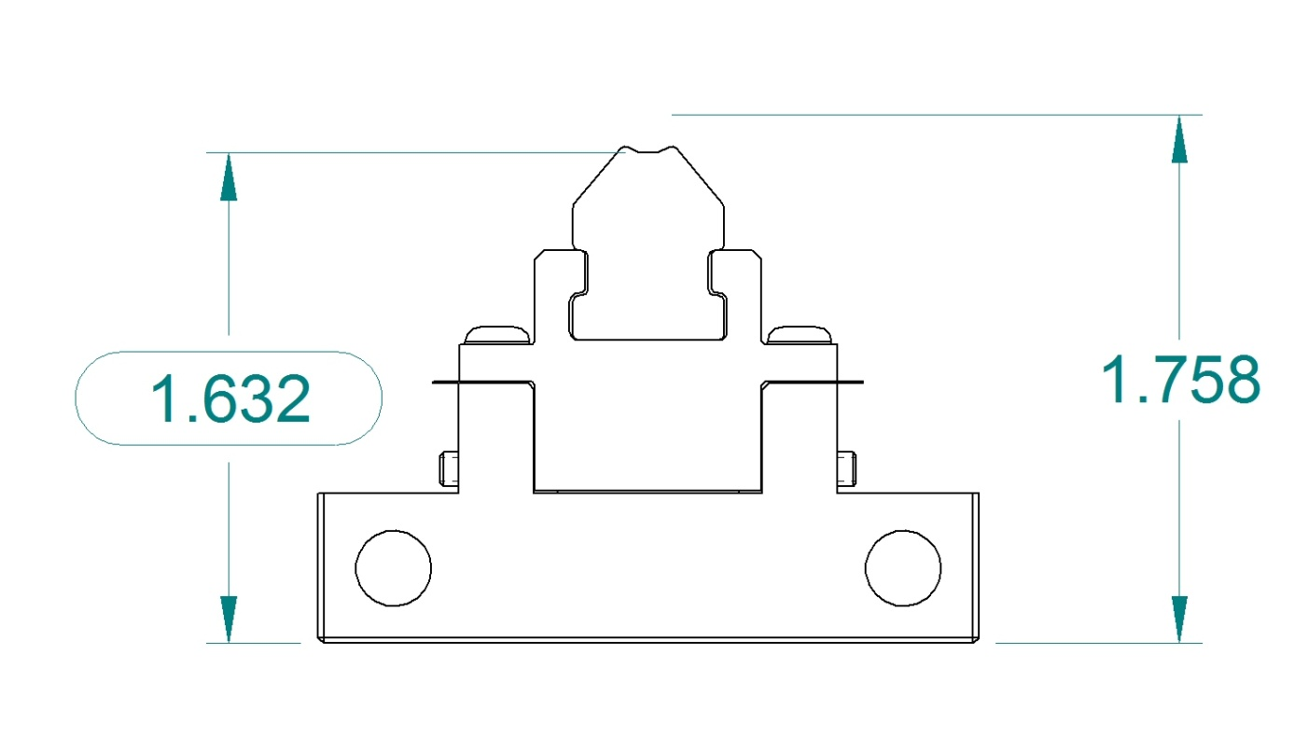
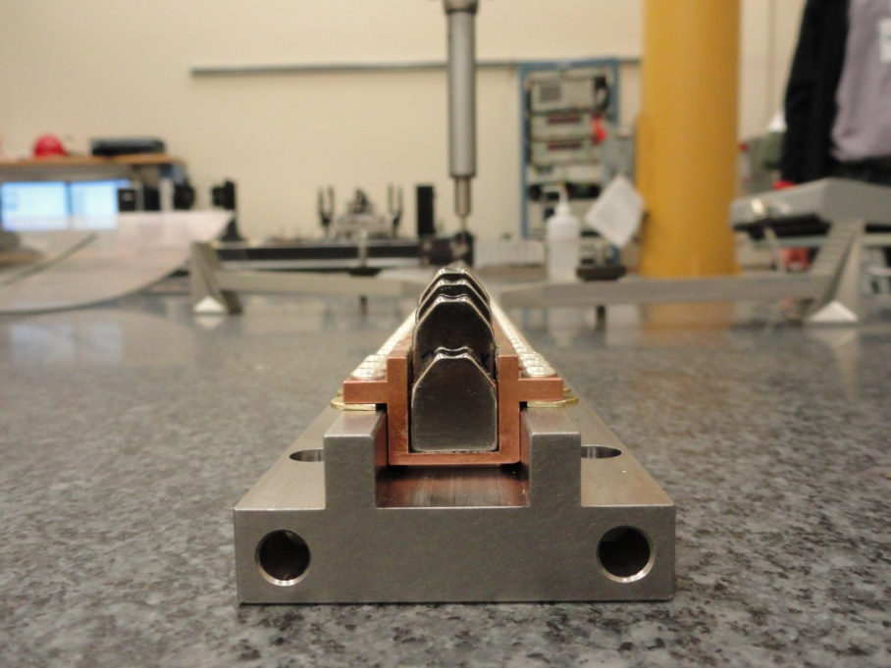
CMM measurements
Measure dowel pin holes on the bottom. Transfer x – axis on the side of the plate.
2. Scan along the curve surface on each magnet, fit circle of 3.2mm radius, for each magnet find x & y coordinates of the circle center.
3. Find deviations of magnet centers from the beam line in x and y.
Y
X
Beam axis
Shim for
Y- adjustments
Set screw for
X- adjustments
Dowel pin holes

Slide 5
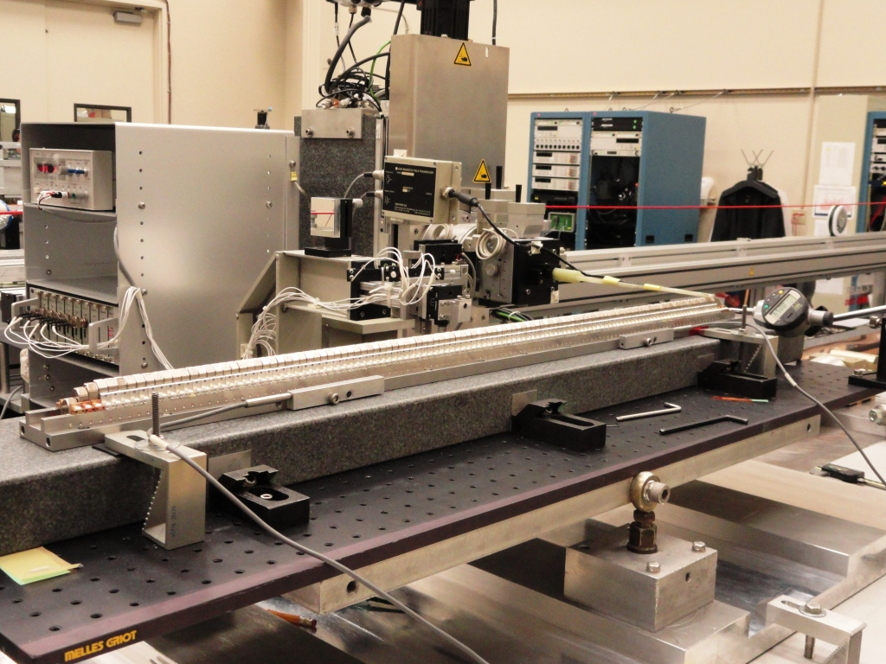
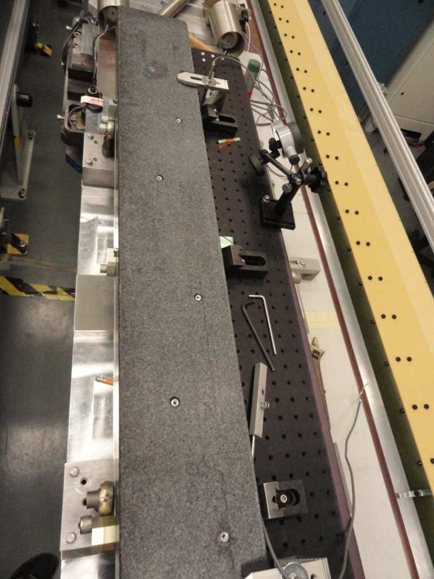
Set-up on measurement bench
6 threaded inserts
2 dowel pin
holes
Granite block
Alignment table
Thermistors
Hall probe
Micrometer

Slide 6
Alignment to the bench (X & yaw)
Do Hall probe scan in X at each pole location
Truncate data ± 3mm from center
Fit parabola, find center
Fit a straight line through all pole centers, find x and yaw, correct yaw
if necessary.

Slide 7
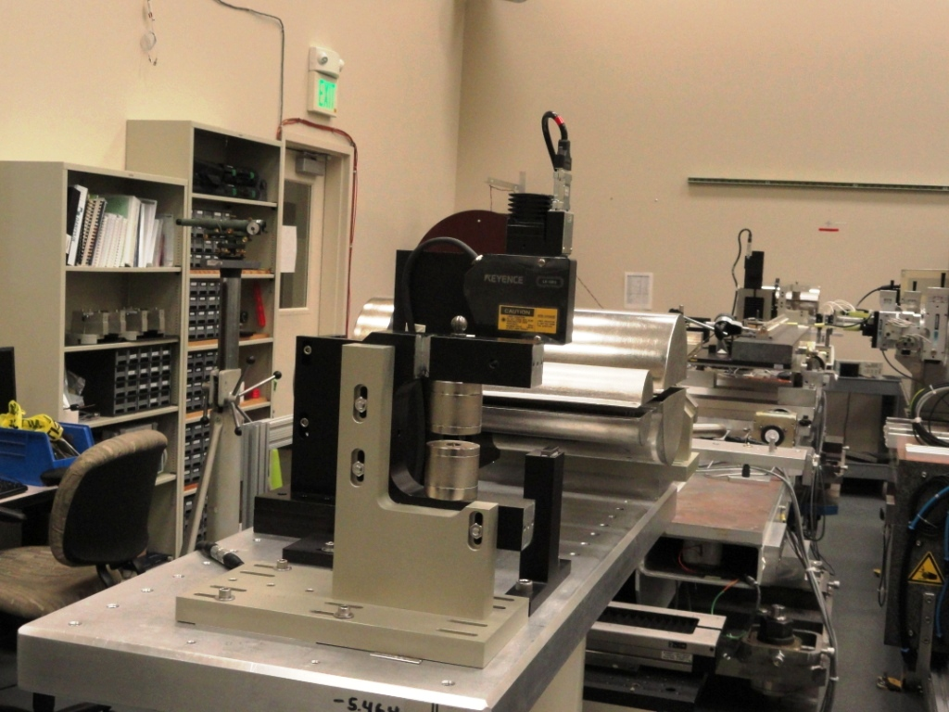
Alignment to the bench (Y)
Sight level
Granite
block
Fiducialization fixture
Bottom of the magnet array bottom to beam line = 44.653mm (1.758”)
Find center of fiducialization fixture with the Hall probe
Measure difference in height between the fixture and the granite by optical tools
Set Hall probe Y using bench vertical stage
ΔY = 30μm → ΔB/B ≈ 1%

Slide 8
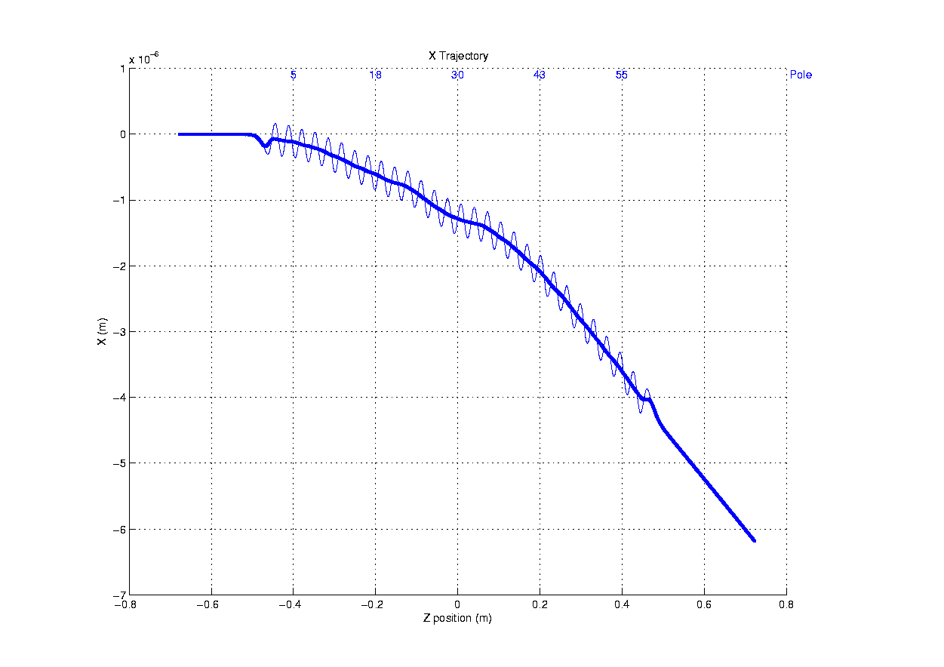
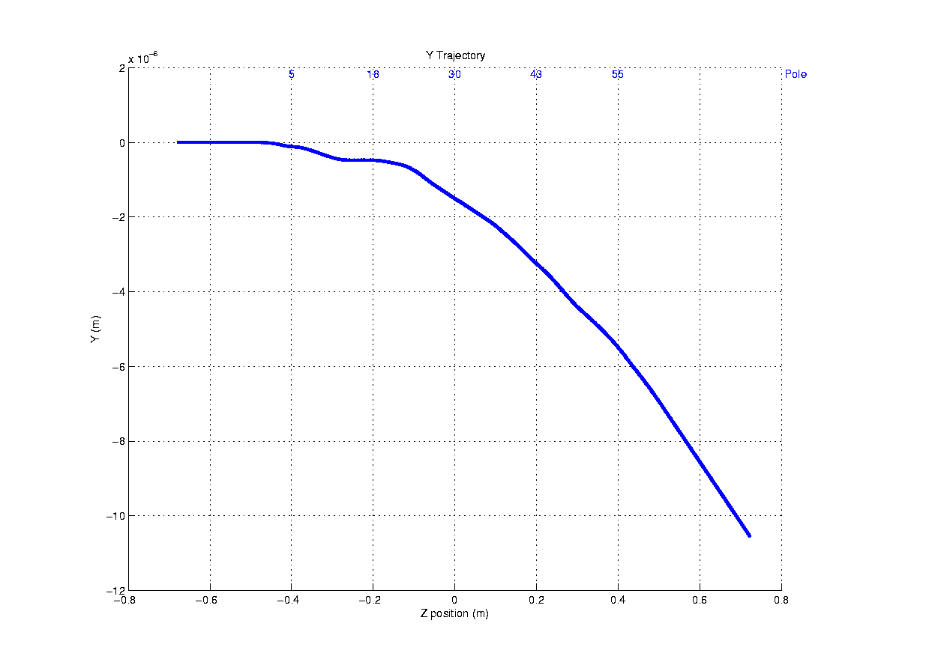
Trajectories (#3)
I1Y = -351µTm
I2Y = -281µTm²
I1X = +738 µTm
I2X = +479µTm²
I1X = +1 µTm
I2X = -8 µTm²
I1Y = +5µTm
I2Y = +5µTm²

Slide 9
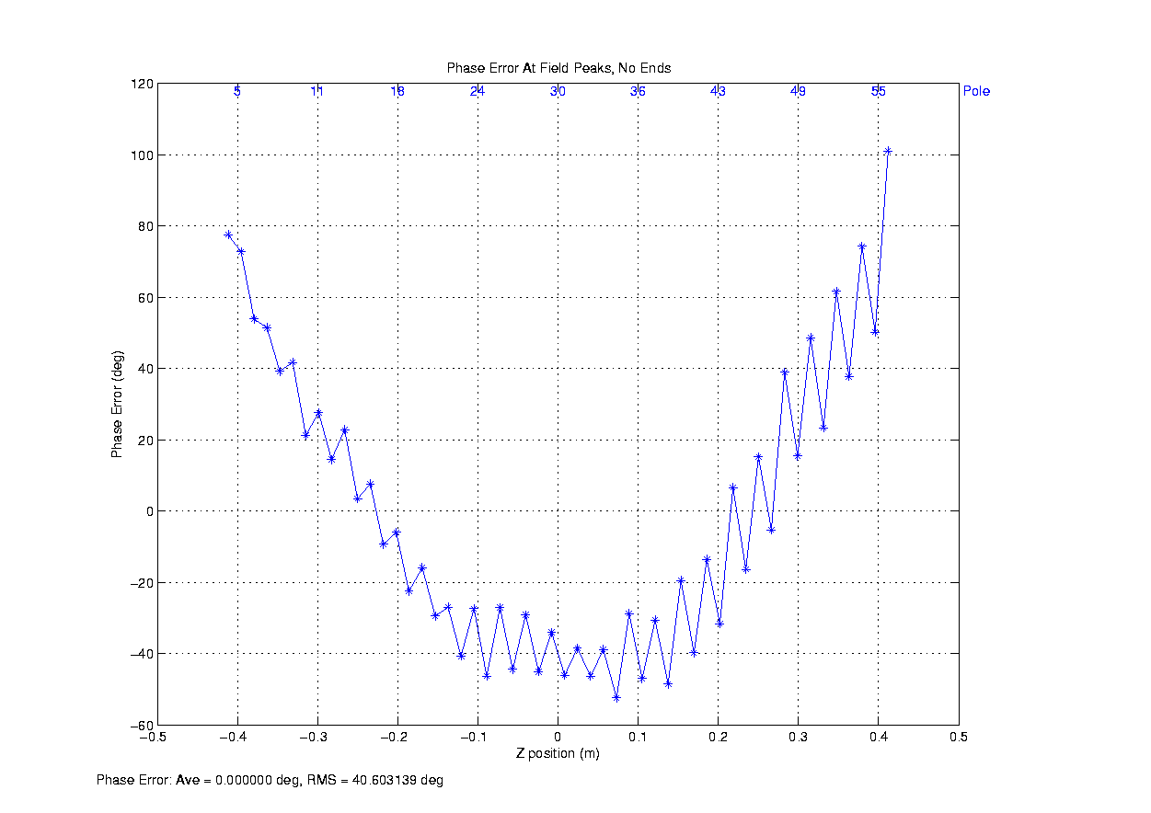
Phase Errors (#3)
After tuning the trajectories the R.M.S. phase error goes down to 10÷15 deg.
The rest is tuned out by virtual shimming
R.M.S = 40 deg.
R.M.S = 2 deg.

Slide 10
Tuning results
(ΔK/K ∼ +7%)

Slide 11
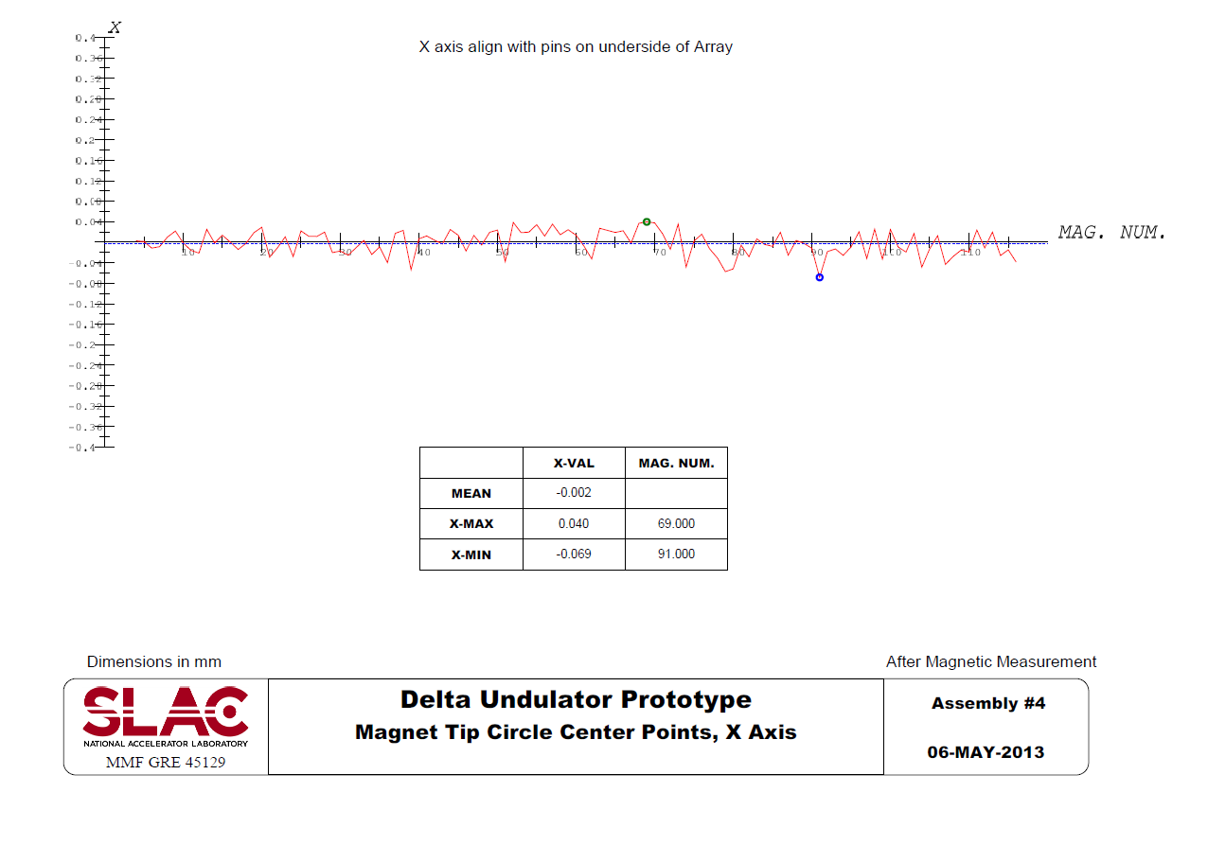
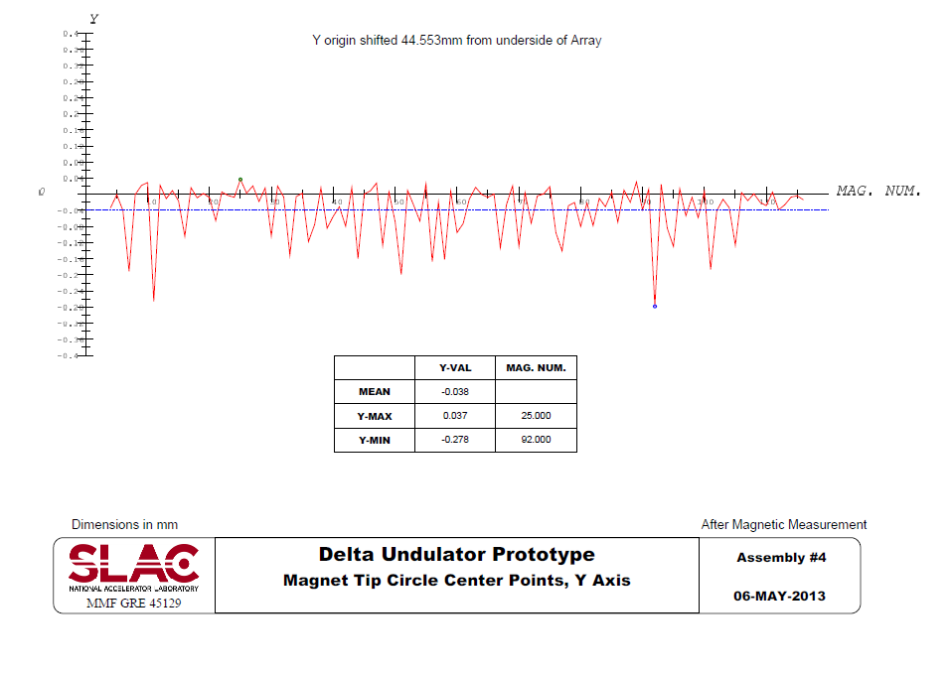
Final CMM Measurement results
Maximum deviation from center line is:
-69 μm in X and +37μm in Y

Slide 12
Issues for 3.2m device
A special fixture is required to allow a quick accurate quadrant set-up on the measurement bench, magnets facing up.
The Hall probe has to be set at the same height for all quadrants with accuracy better than 10μm. Optical tools to be replaced by micrometers or Keyence sensor.
Larger screws for magnet X adjustment.
A provision to mount a micrometer to control magnet motion.
Since vacuum chamber has no fins, magnet alignment tolerance in X direction could be ± 100μm. It will reduce number of iterations.

Slide 13
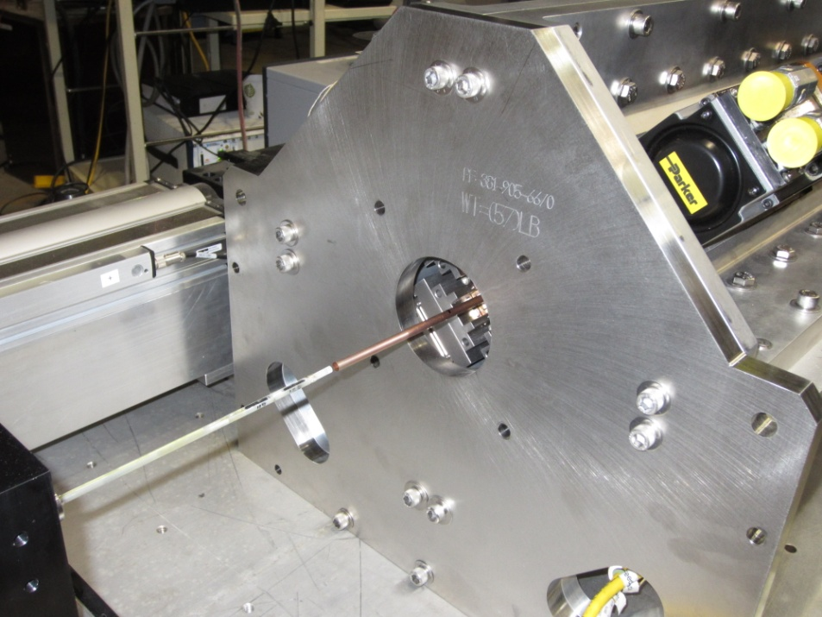
Current Status
Retro-reflector
Hall probes
5mm ID, 6.3mm OD copper tube
stage
1.2 m long G-10 rod
Measurement system for the 1m long prototype is in place and ready.
First measurements done to check the system.
Relative roll angles and displacements are measured for X and Y probes.
Prototype mechanical and controls’ issues to be solved before measurements continue.

Slide 14
Conclusion
Tuning procedure has been developed for DELTA quadrants.
Four quadrants have been successfully tuned to tolerances in 12 days (3 days/quadrant).
Simulations show that the assembled device should meet the tolerances.
Measurements system for assembled prototype is in place and it’s functionality tested.
Magnetic measurements are in progress.

Slide 15
Back-up slides

Slide 16
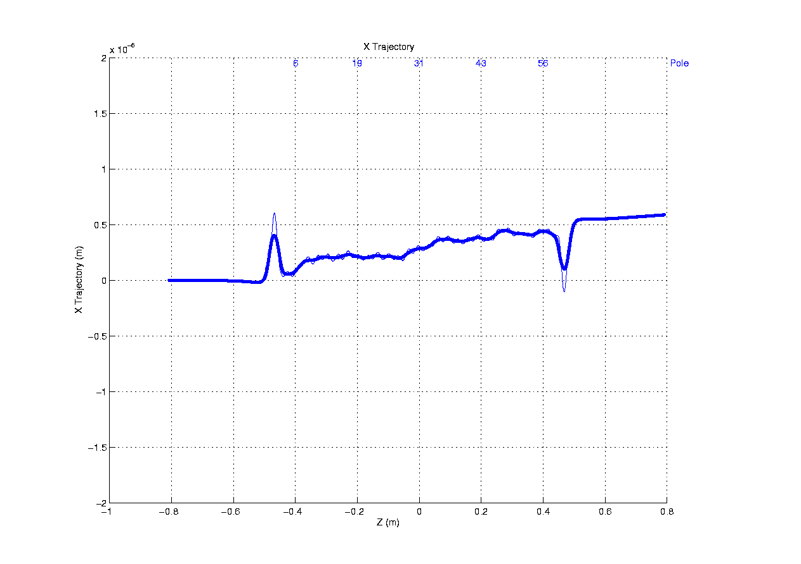
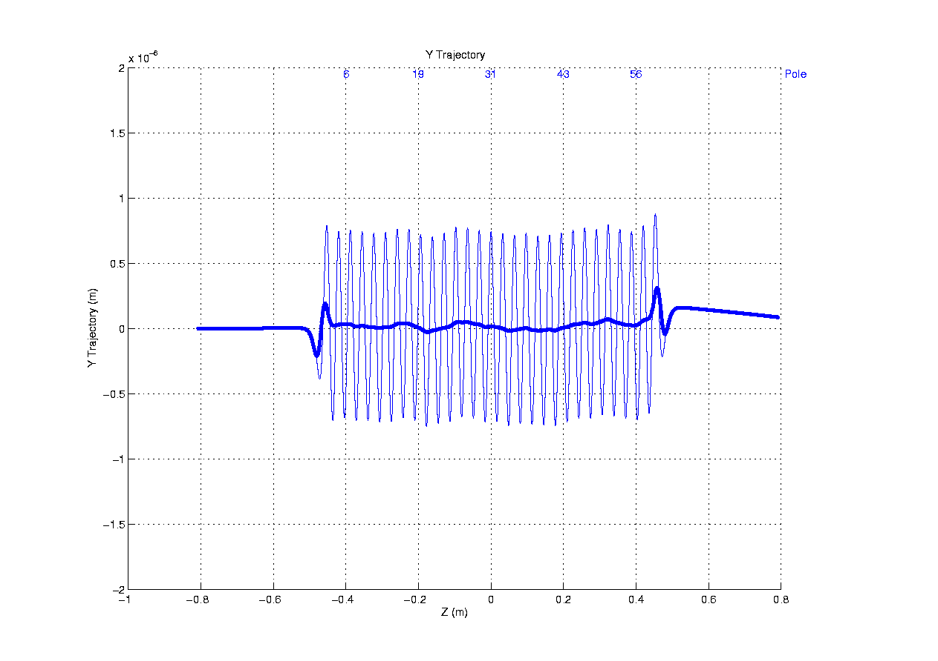
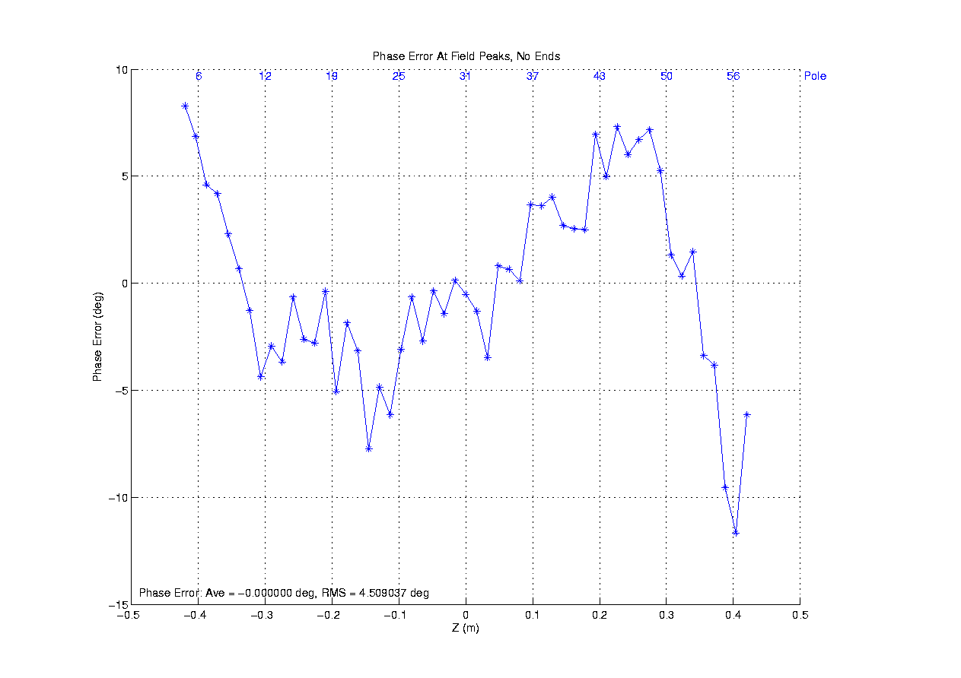
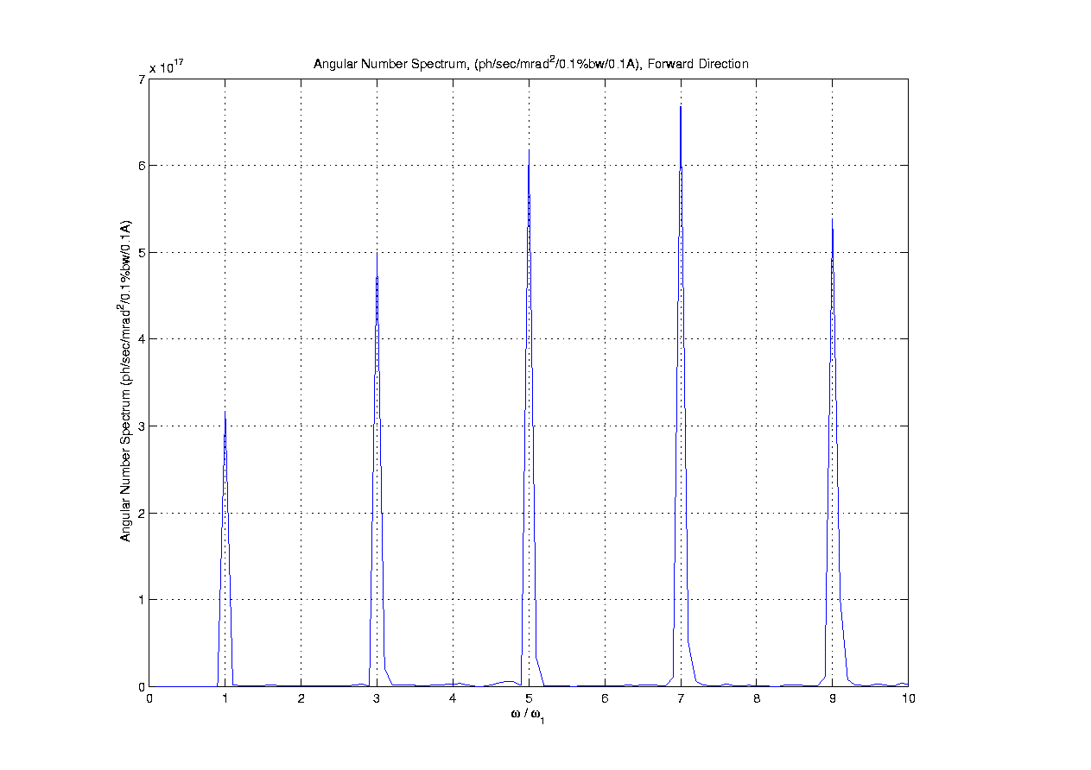
Field superposition, Linear Horizontal

Slide 17
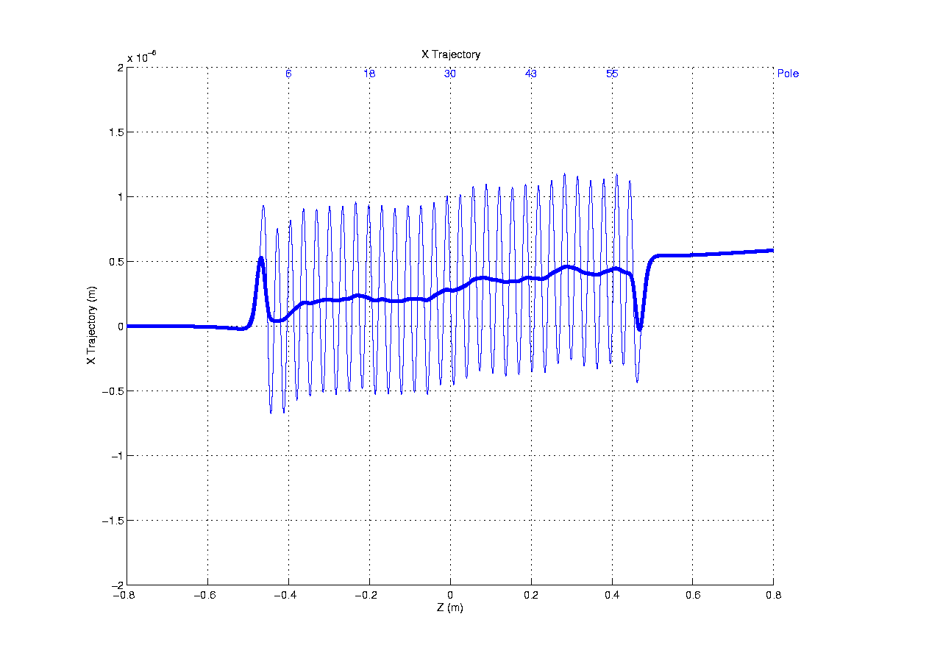
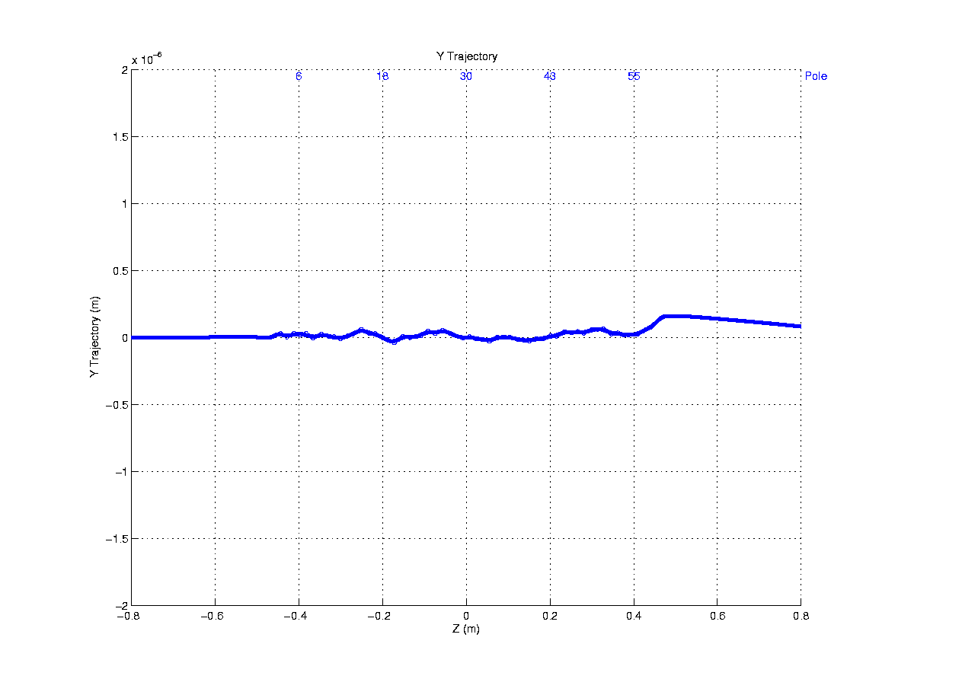
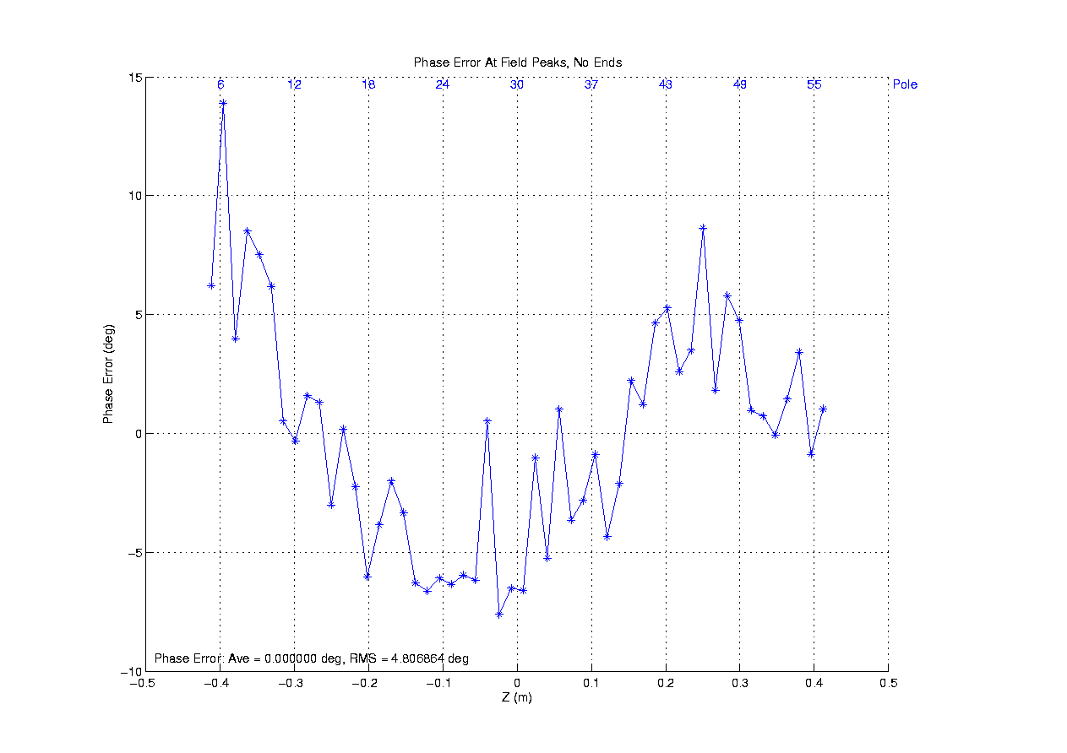
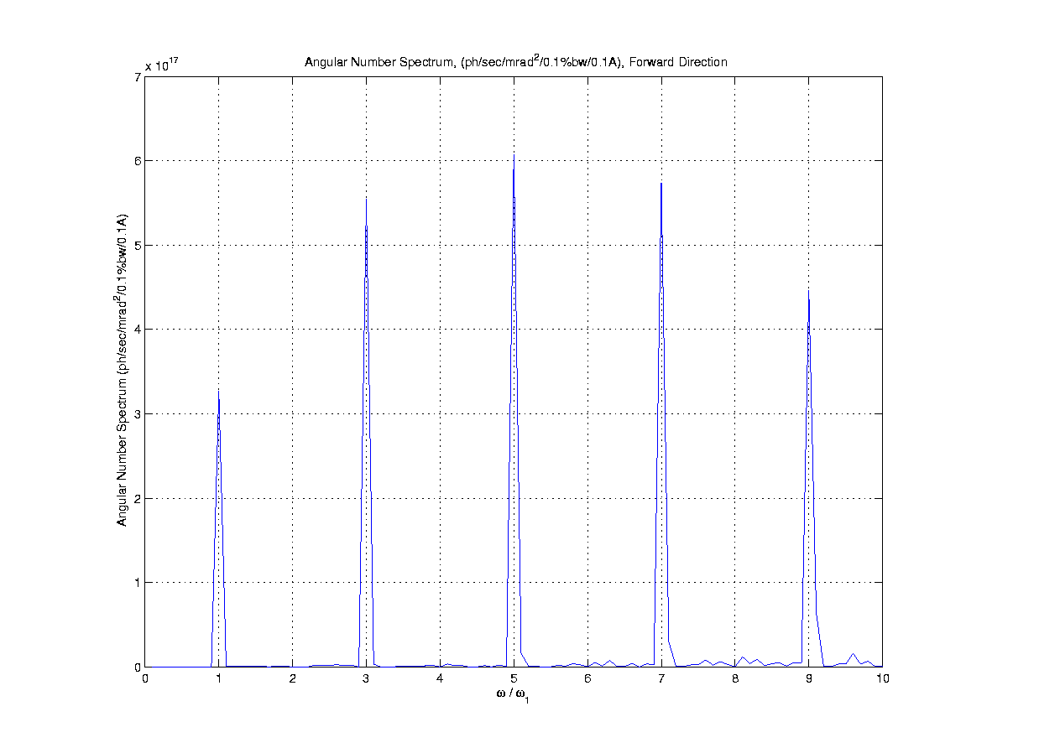
Field superposition, Linear Vertical

Slide 18
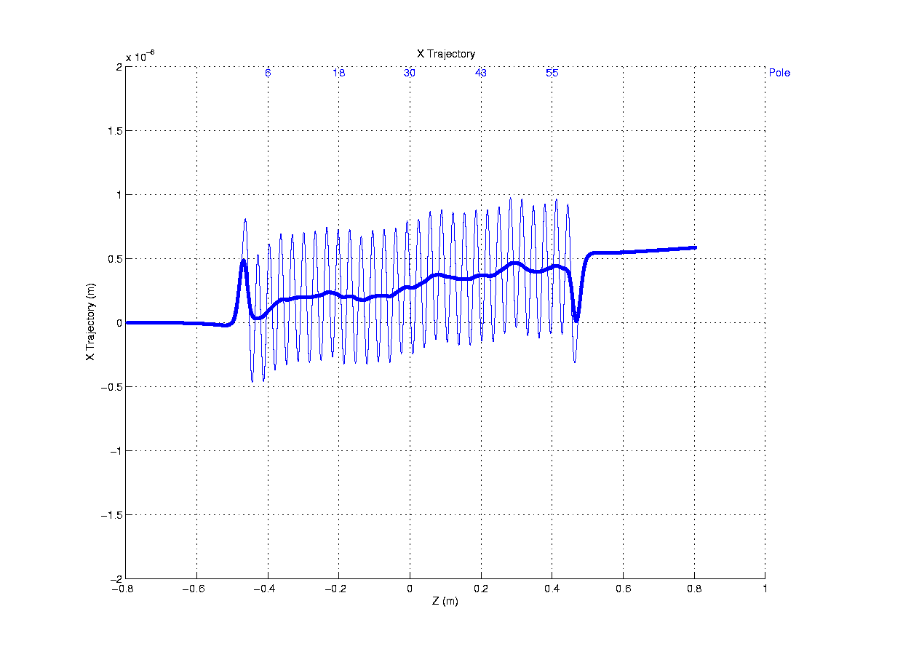
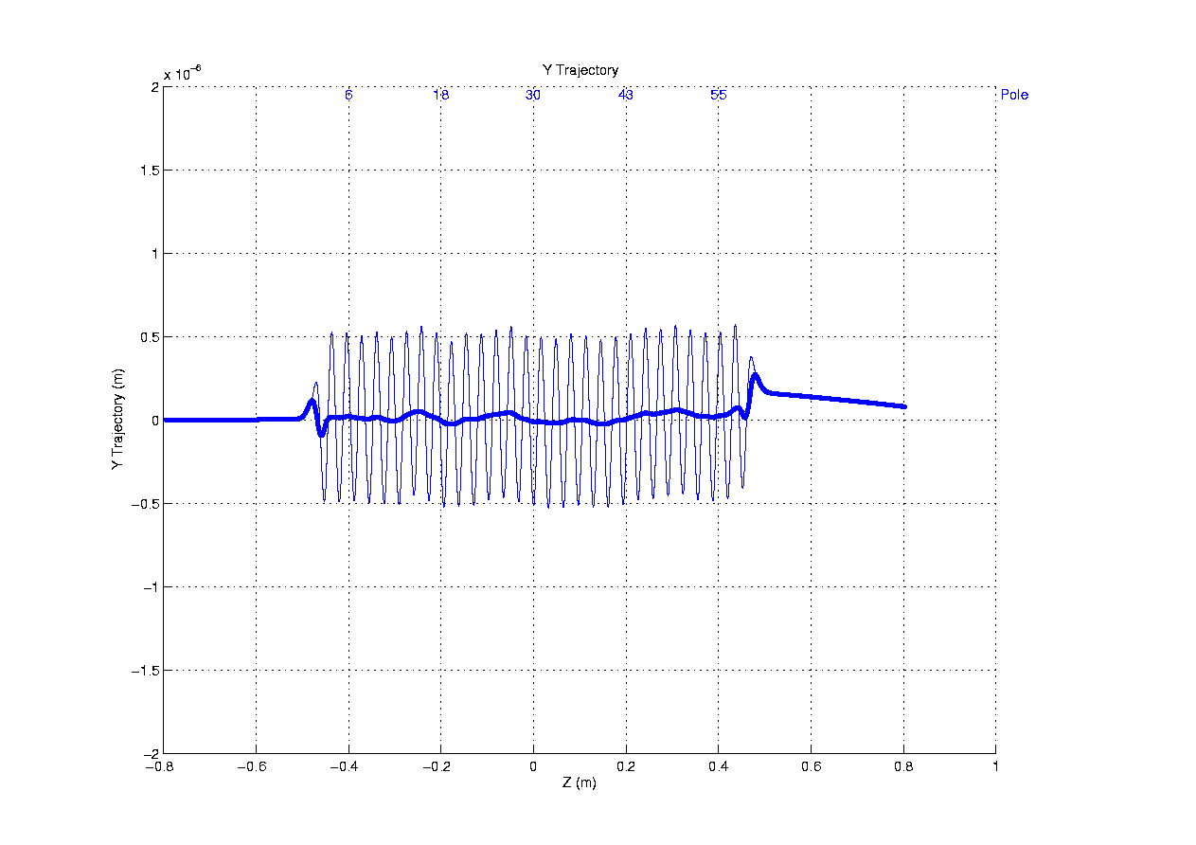
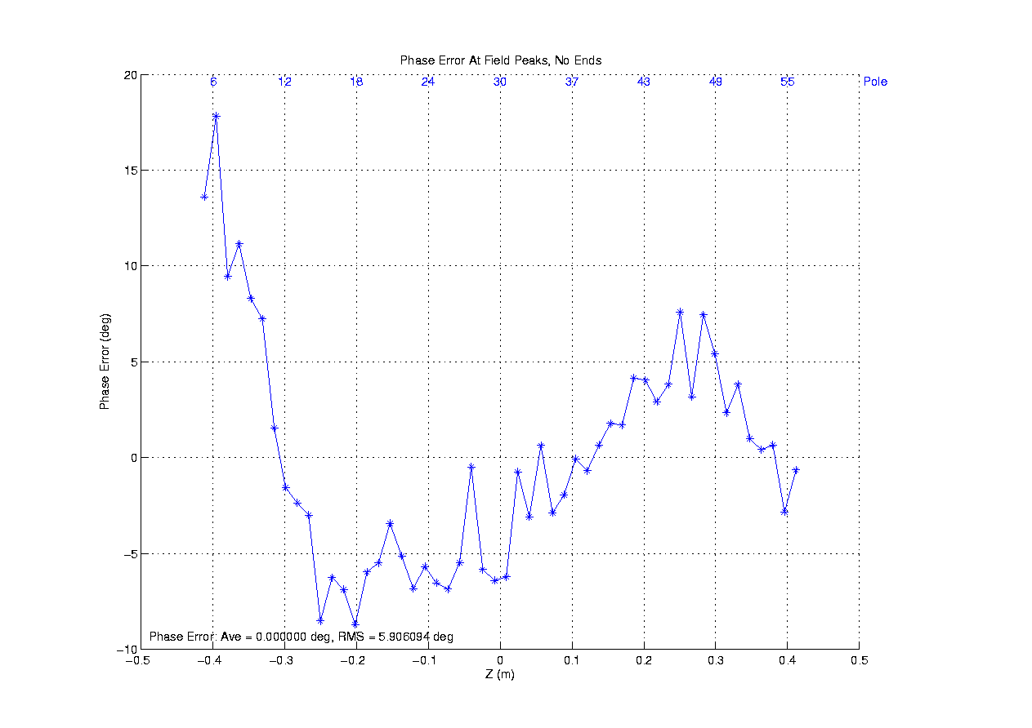
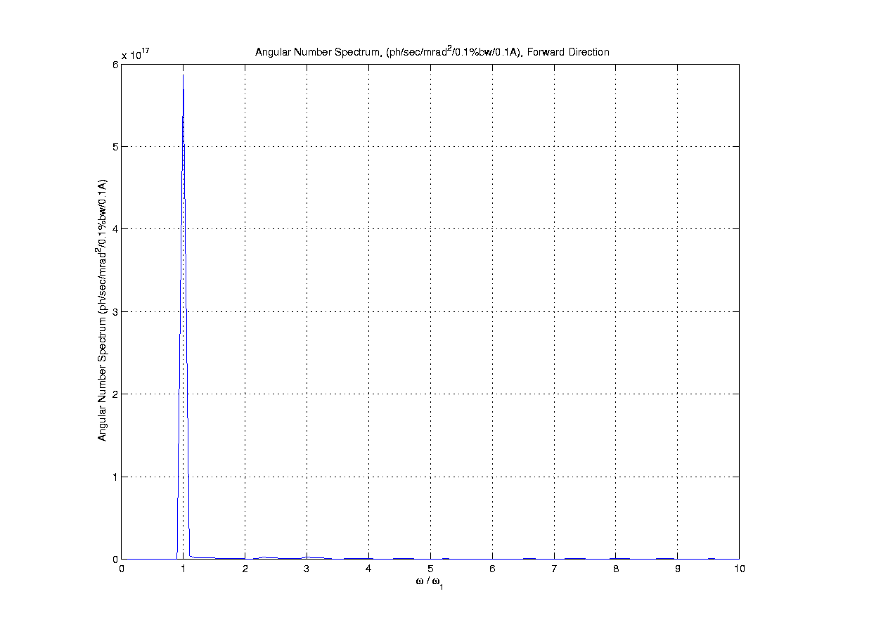
Field superposition, Circular left

