Slide 1
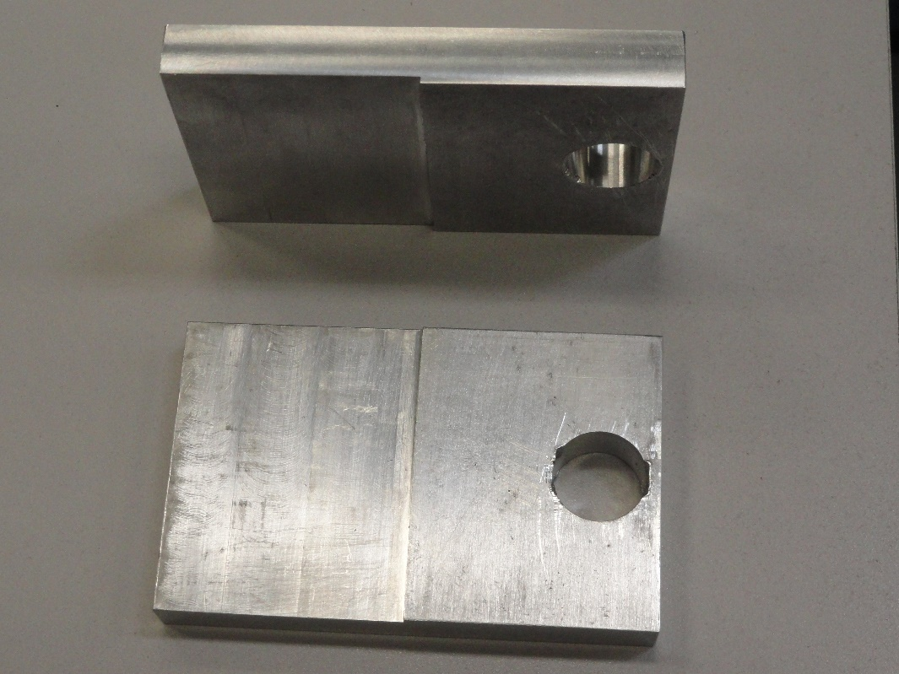
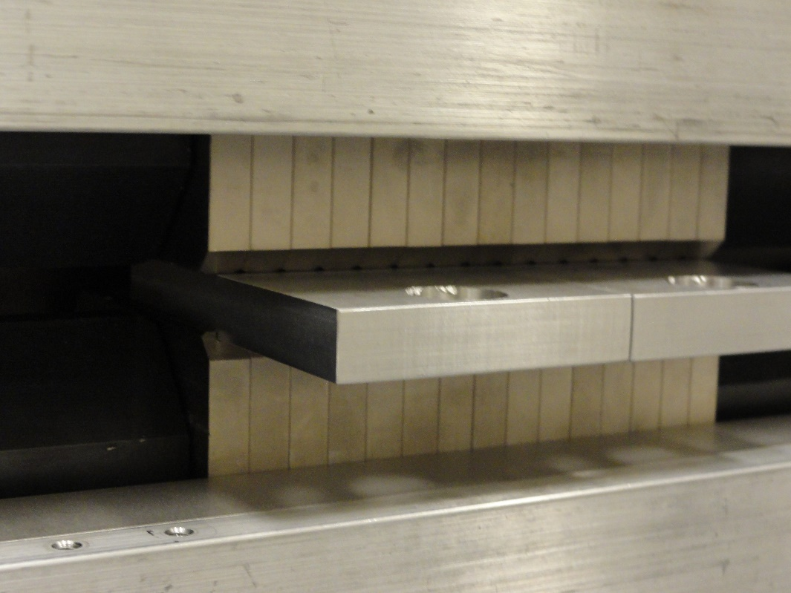
11.45 mm
Fit into 11 places, 2 places does not fit. Make thickness 11.3mm.
Epoxy could be applied with a dispenser without rotating the wiggler (put tape on top of epoxy)
Options: 1. Hysol EA9360-EN used at SSRL for gluing shims; 1 hour work time, 4 days to full cure.
2. 3M DP-190; 90 minutes work time, 10 hours to cure.

