Slide 1
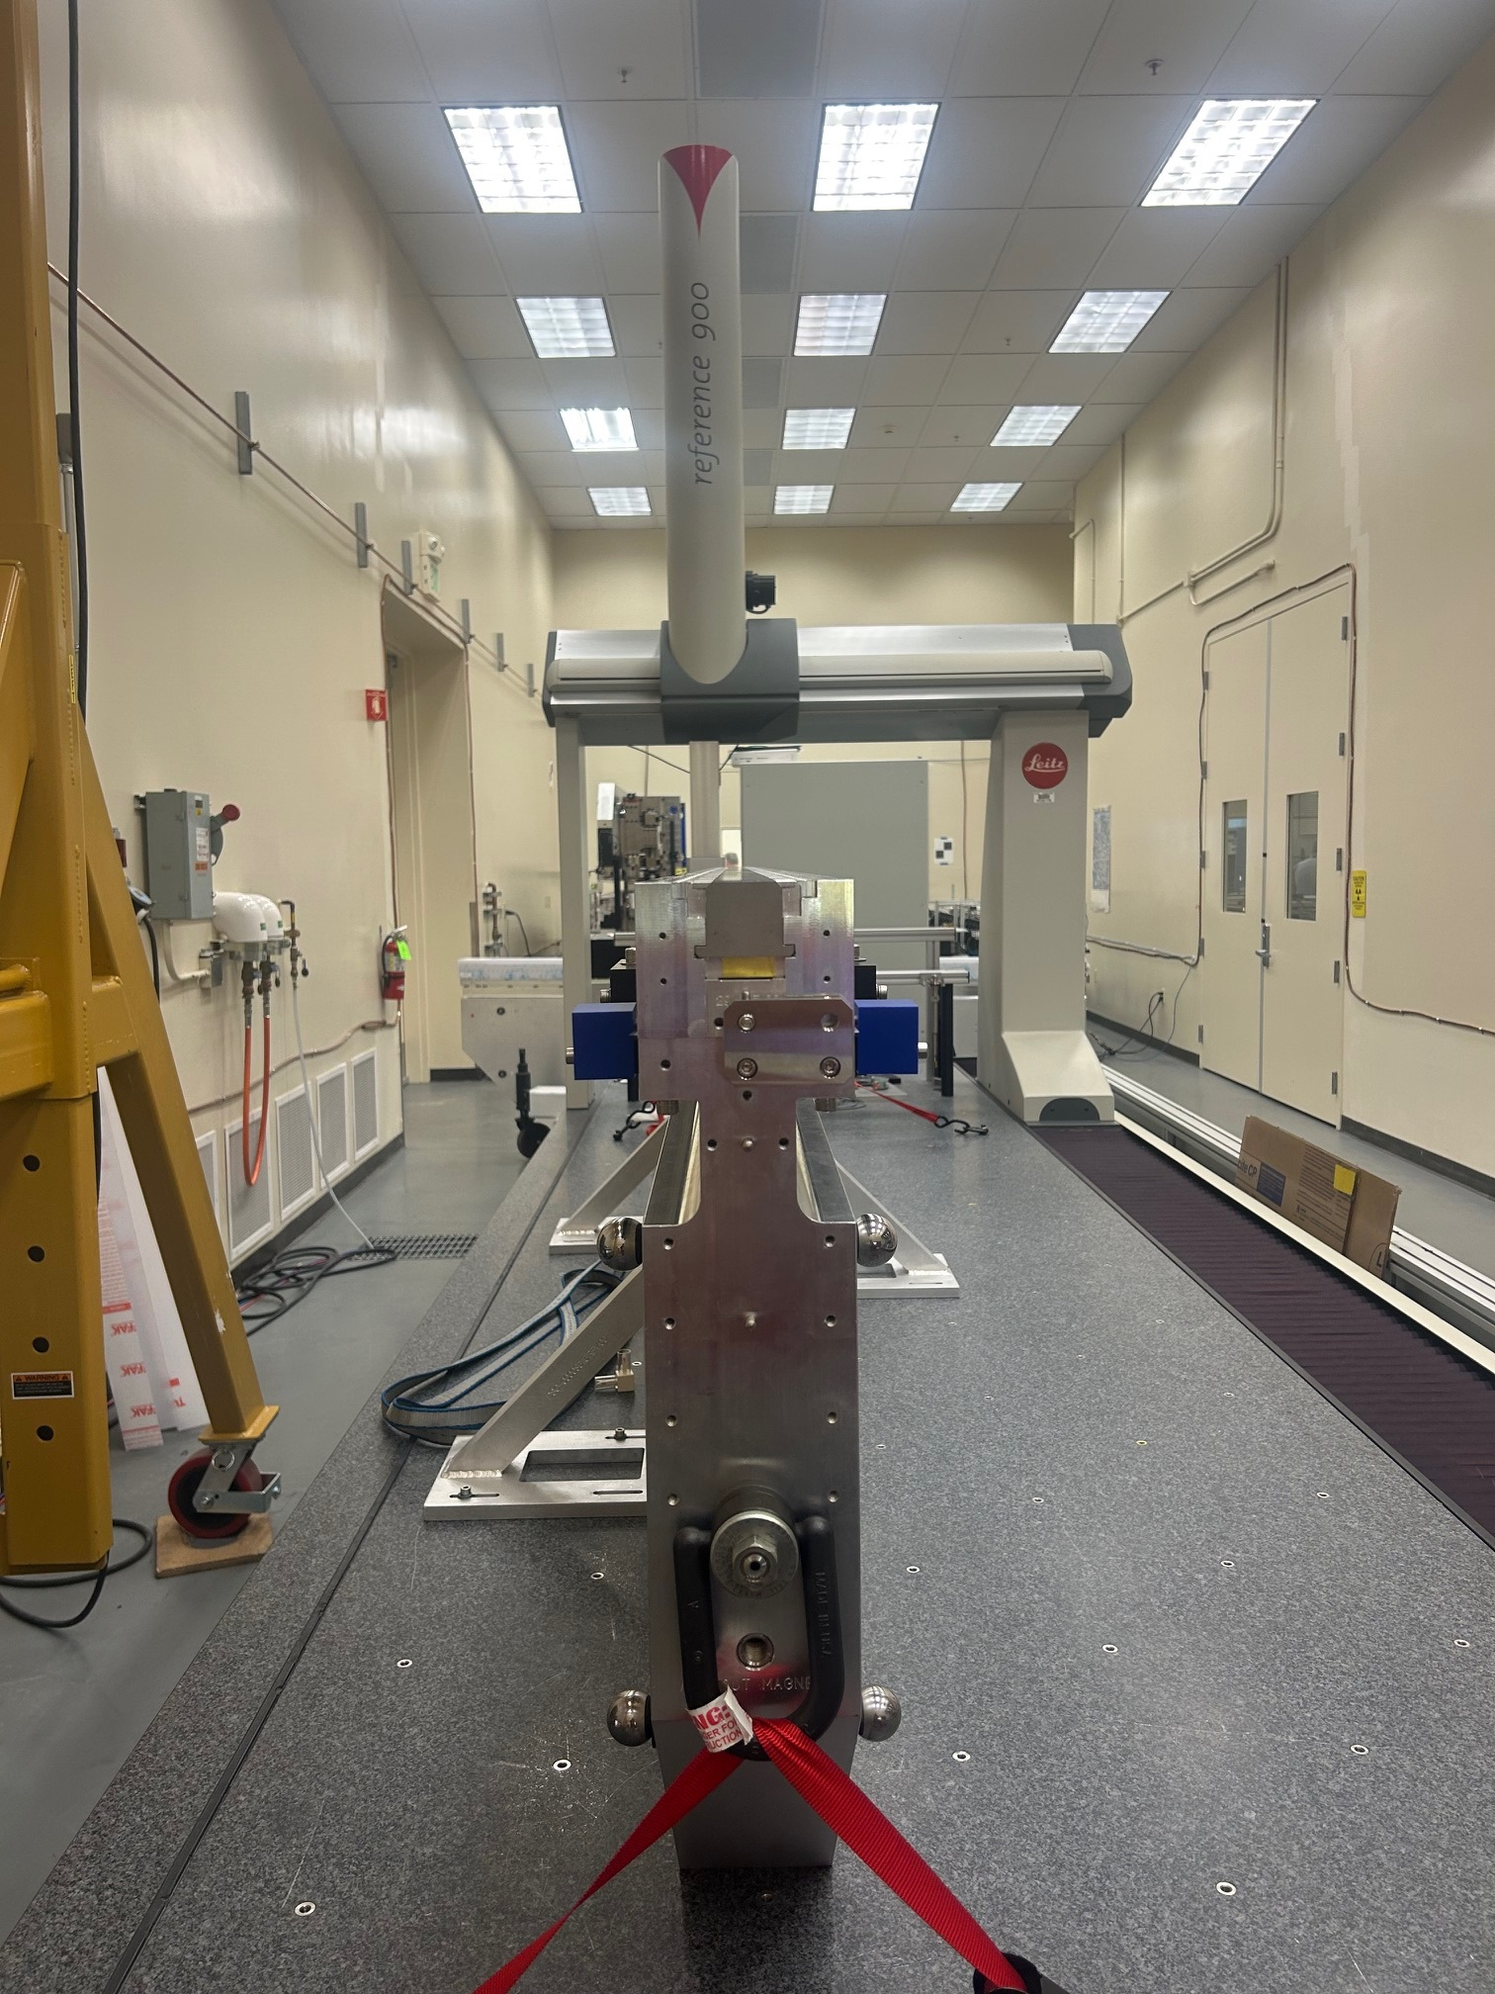
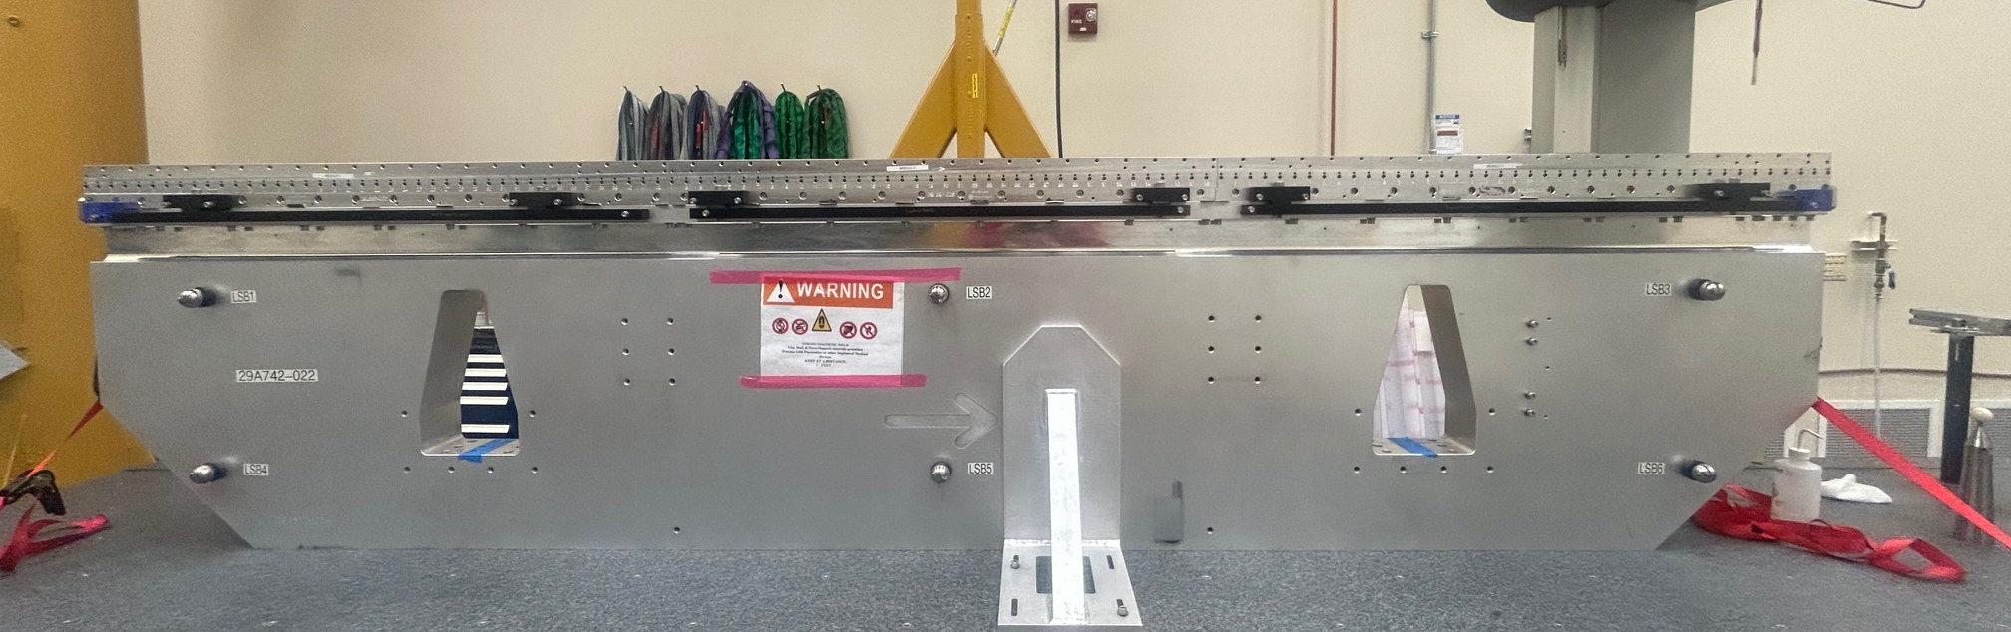
+X
+Y
+Y
+Z

Slide 5
Encoders’ Offsets are the same:
US DS
DS1 228.1079 228.1481
DS2 228.108 228.148
Average Gap:
DS1 = 9.9962mm
DS2 = 9.9755mm

