Slide 1
LCLS-II-HE SXU short prototype measurements
Yurii Levashov, Engineer
LCLS-II-HE 2022 Director’s Status Review​
February 8-11, 2022

Slide 2
Outline
Measurement set-up
Requirements
Tests:
  Evaluate magnetic structure design. Measure the prototype with calibrated Hall probe, analyze the fields. Measure field integrals vs. gap.
  Study shim signatures and saturation effects. Evaluate if shims are adequate for tuning.
  Study Hall probe measurements at Kugler bench and Hall probe calibration. Make sure the measurement accuracy meets the tolerances on undulator K (<20% of total tolerance).
  Study magnet crosstalk between SXU-HE undulator and new SXR-HE phase shifter. Find the minimum distance at which the change in field integrals is insignificant (< 3G-cm).
Summary
*ALS-U Technical Note: AL-1008-7760, Revision: A

Slide 3
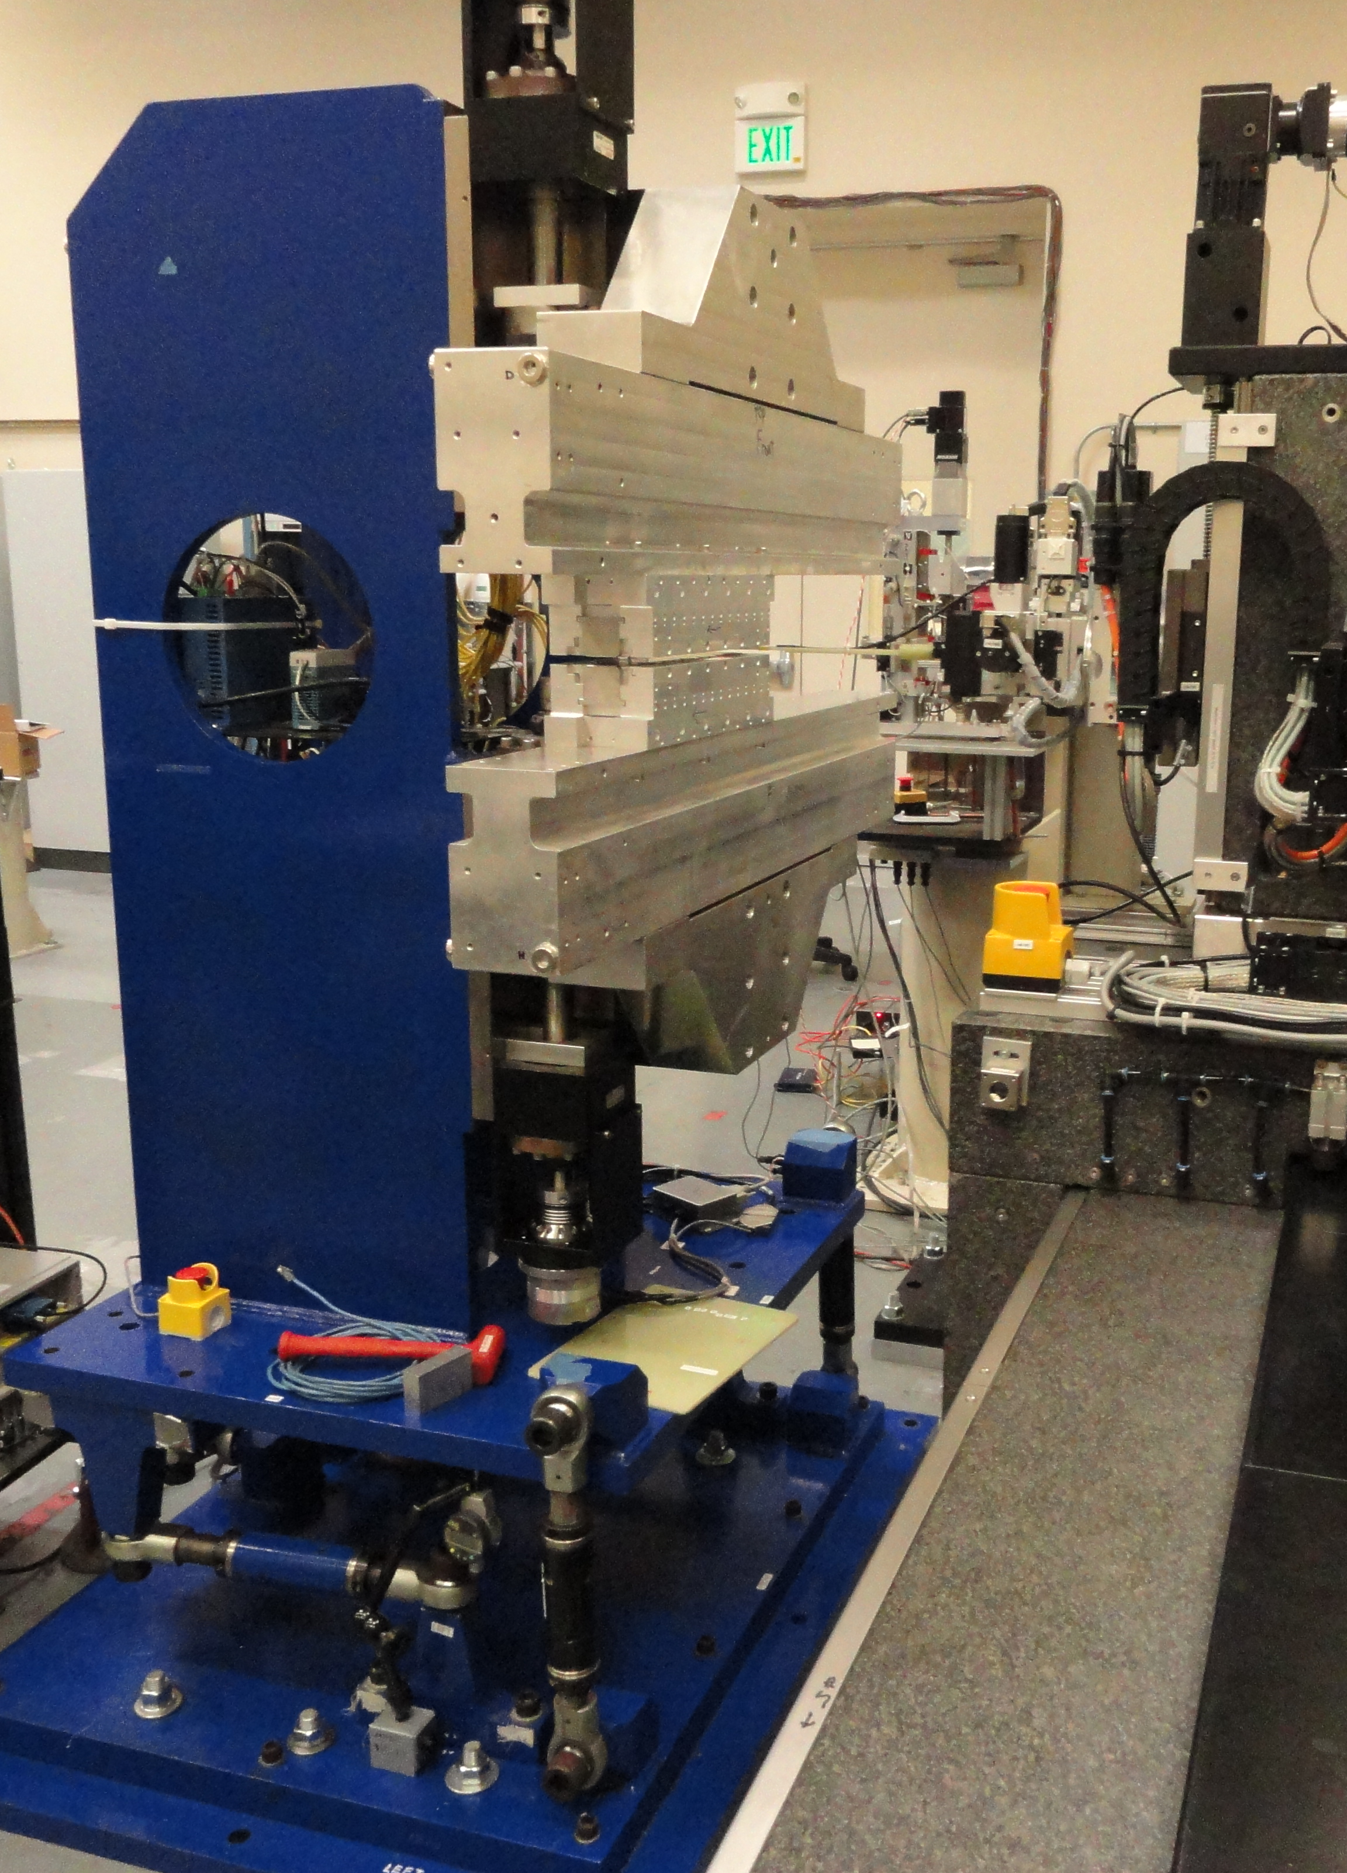
Measurement Set-up
Shims
Two 14 poles, 36cm long magnet structures.
1m long prototype frame, leftover from LSLC-II project.
No gap encoders.
SXR measurement bench.
Laser tracker for alignment.
Magnetic taper corrected with shims.
The same equipment as for LCLS-II project:
  Sentron 2-D Hall probe to measure fields.
  Stretched wire to measure field integrals (long coil, 150 turns).

Slide 4
Evaluation of magnetic structure design, requirements.
Requirement # | Parameter | Unit | Requirement | Verification | Test Results
PRD0049.4014 | Undulator period length | mm | 56 | Test | 56.031
PRD0049.4024 | Minimum operational magnetic gap | mm | 7.2 | Inspection
PRD0049.4025 | Maximum operational magnetic gap | mm | 33 | Inspection
PRD0049.4026 | On-axis vertical effective field at min. oper. gap | T | >1.76 | Test | 1.85
PRD0049.4027 | Keff at minimum operational gap | - | >9.21 | Test/ Analysis | 9.69
PRD0049.4033 | Undulator parameter tolerance ΔKeff/Keff | - | ±5.5×10⁻⁴ | Test/ Analysis
PRD0049.4029 | Minimum operational K values | - | 1.51 | Test/ Analysis | 1.538 at 33mm gap
PRD0049.4034 | Horizontal K sextupole | 1/mm² | <5×10⁻⁴ | Test/ Analysis | 3.5×10⁻⁴
PRD0049.4038 | Phase shake (rms) over L_{cell} | deg Xray | <5.0 | Test/ Analysis | 2.4
PRD0049.4040 | First field integral of By per cell (abs) | μTm | <50 | Test/ Analysis | 20
PRD0049.4041 | Second field integral of By per cell (abs) | μTm² | <200 | Test/ Analysis
PRD0049.4042 | First field integral of Bx per cell (abs) | μTm | <50 | Test/ Analysis | 20
PRD0049.4043 | Second field integral of By per cell (abs) | μTm² | <200 | Test/ Analysis

Slide 5
Measurements with Hall probe
  First measurement results (before tuning):
  Average Undulator Period = 0.056031 m ± 0.000070 m
  The K at 7.2mm gap = 9.69 ( 9.21 PRD); 5% stronger!
  Saturation starts at gaps below 8mm and is small.
  B_{x} field is small, below 10G:
  No large magnetization errors in the magnets,
  pole alignment is good,
  magnet sorting is good.

Slide 6
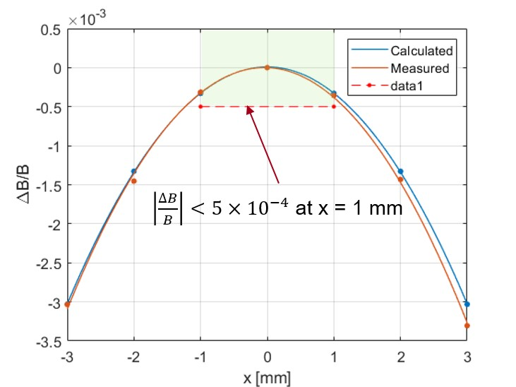
Measurements with Hall probe; continue
by D. Arbelaez
  Phase shake = 2.4° (<5°)
  Magnetic field roll-off = 3.5·10⁻⁴ 1/mm² (< 5·10⁻⁴ )
  ~25µTm² jumps after each end section in the same direction, 50µTm² in total, agree with simulations done by LBNL (<200µTm²).

Slide 7
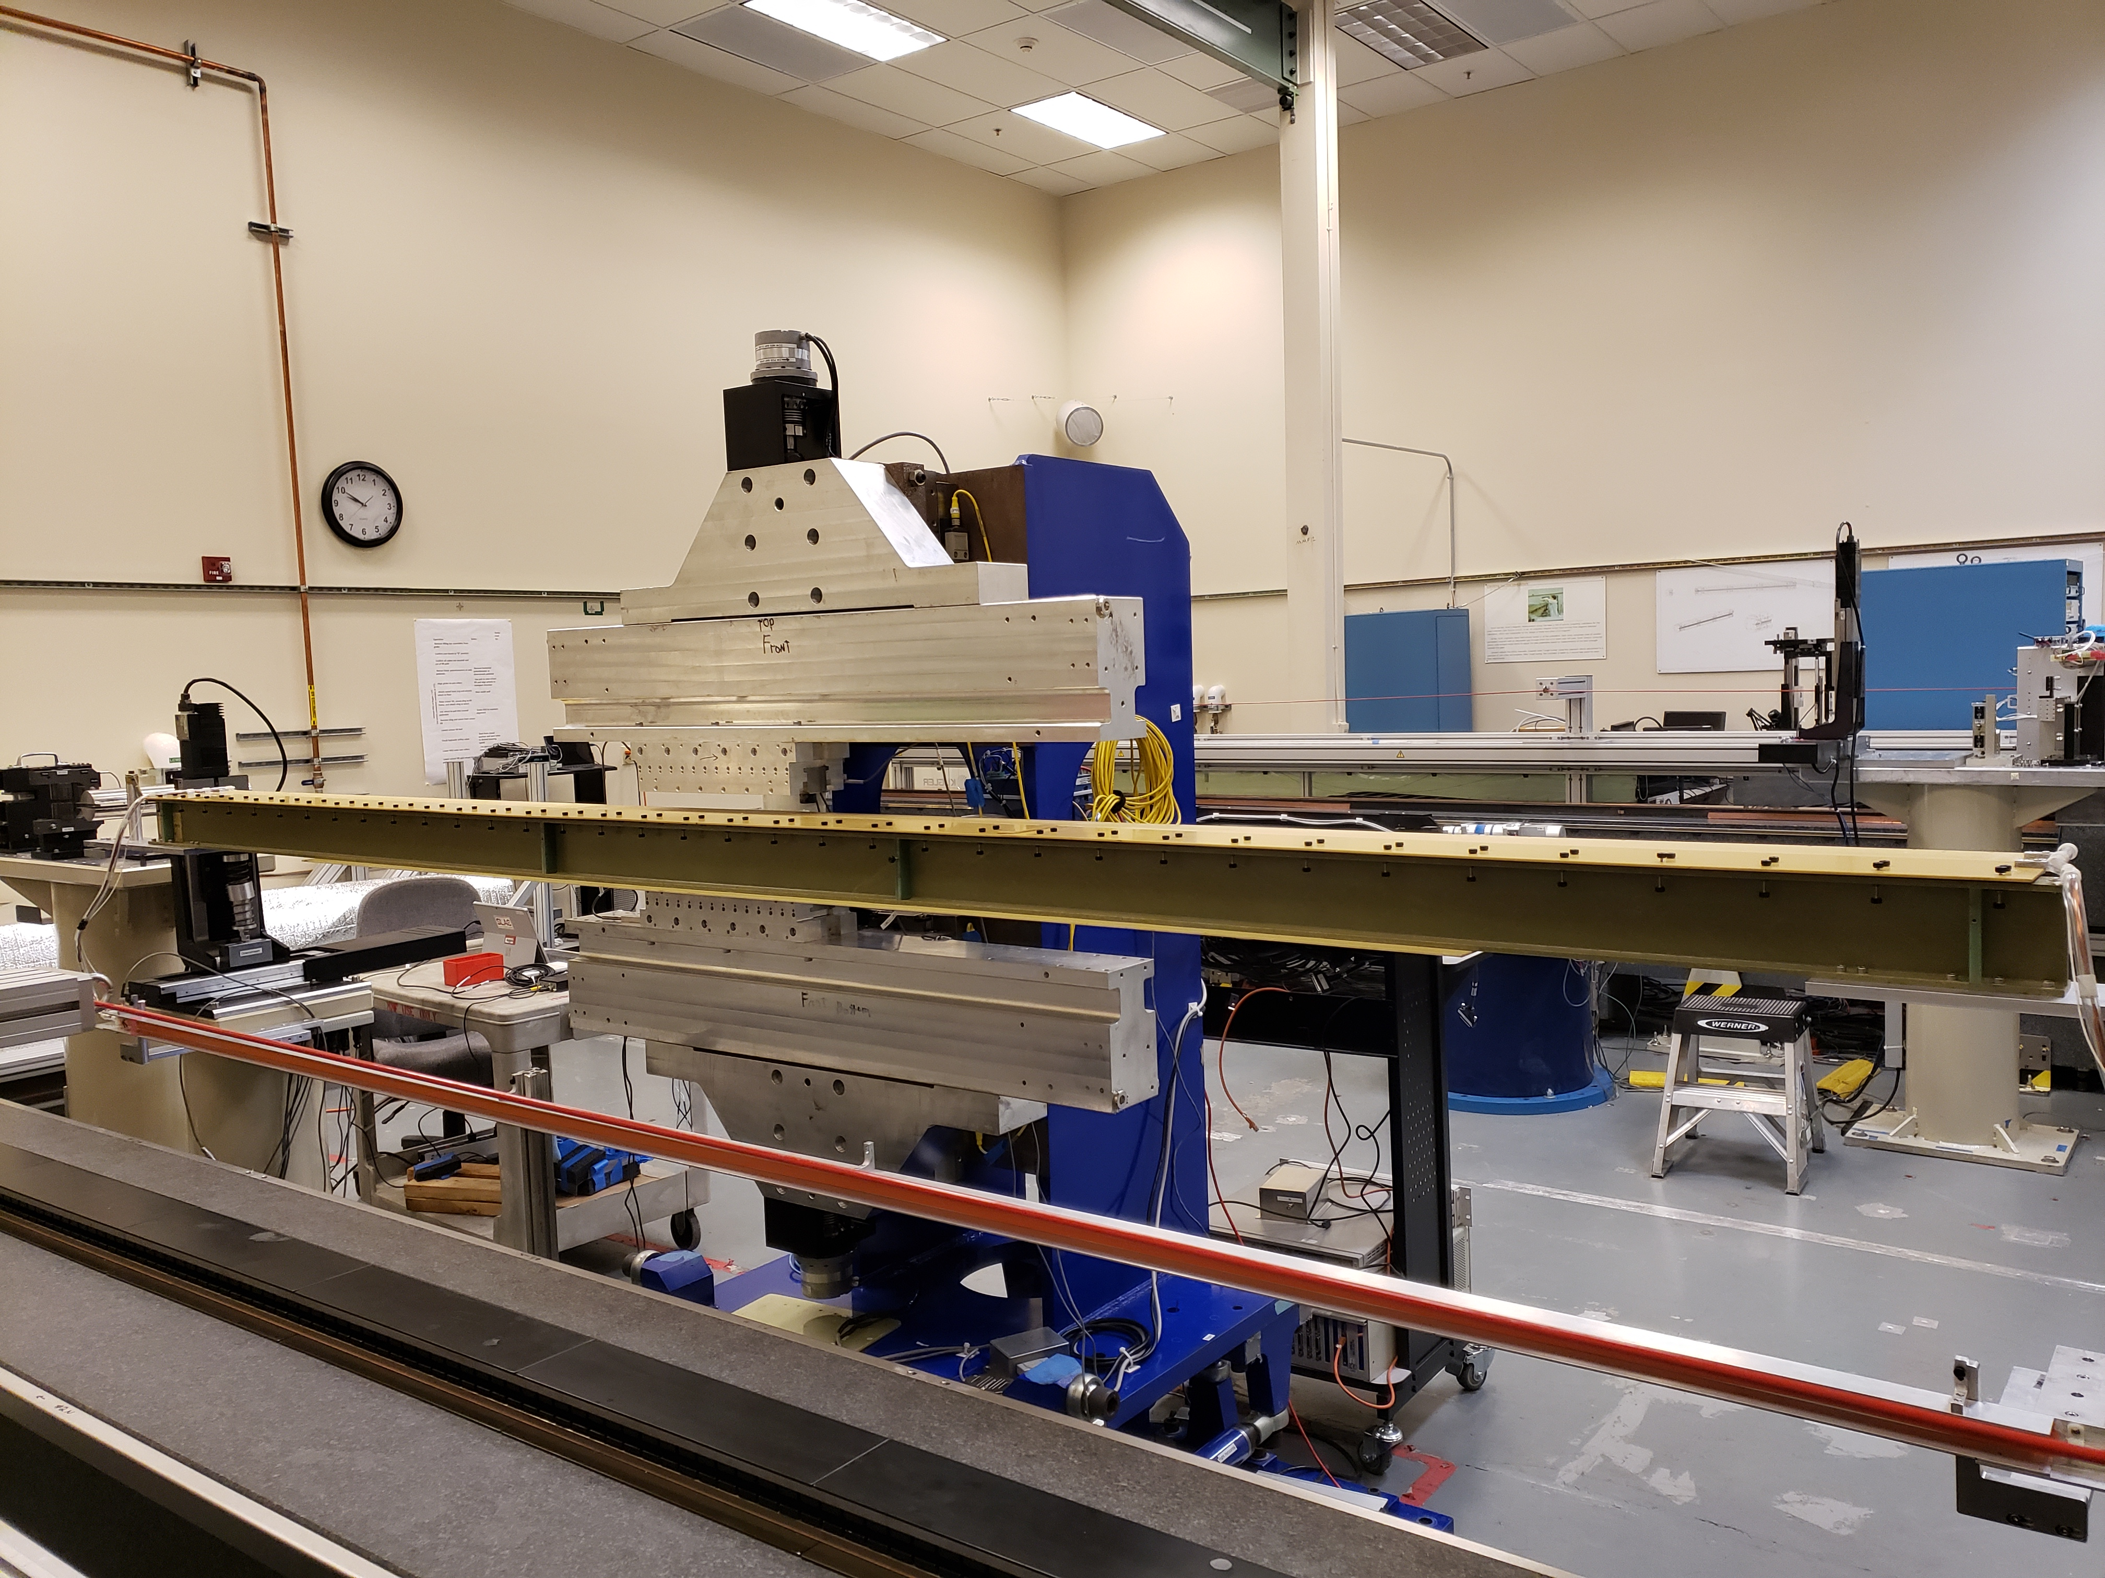
Field integrals vs Gap
Only the first field integrals measured.
Background field integrals subtracted from all measurements.
Measurement error 3G-cm.
The sharp change in B_{y} field integral at ~ 9mm gap is due to pole saturation effects and magnetization errors.
Goal: Find shim signature with a similar shape.

Slide 8
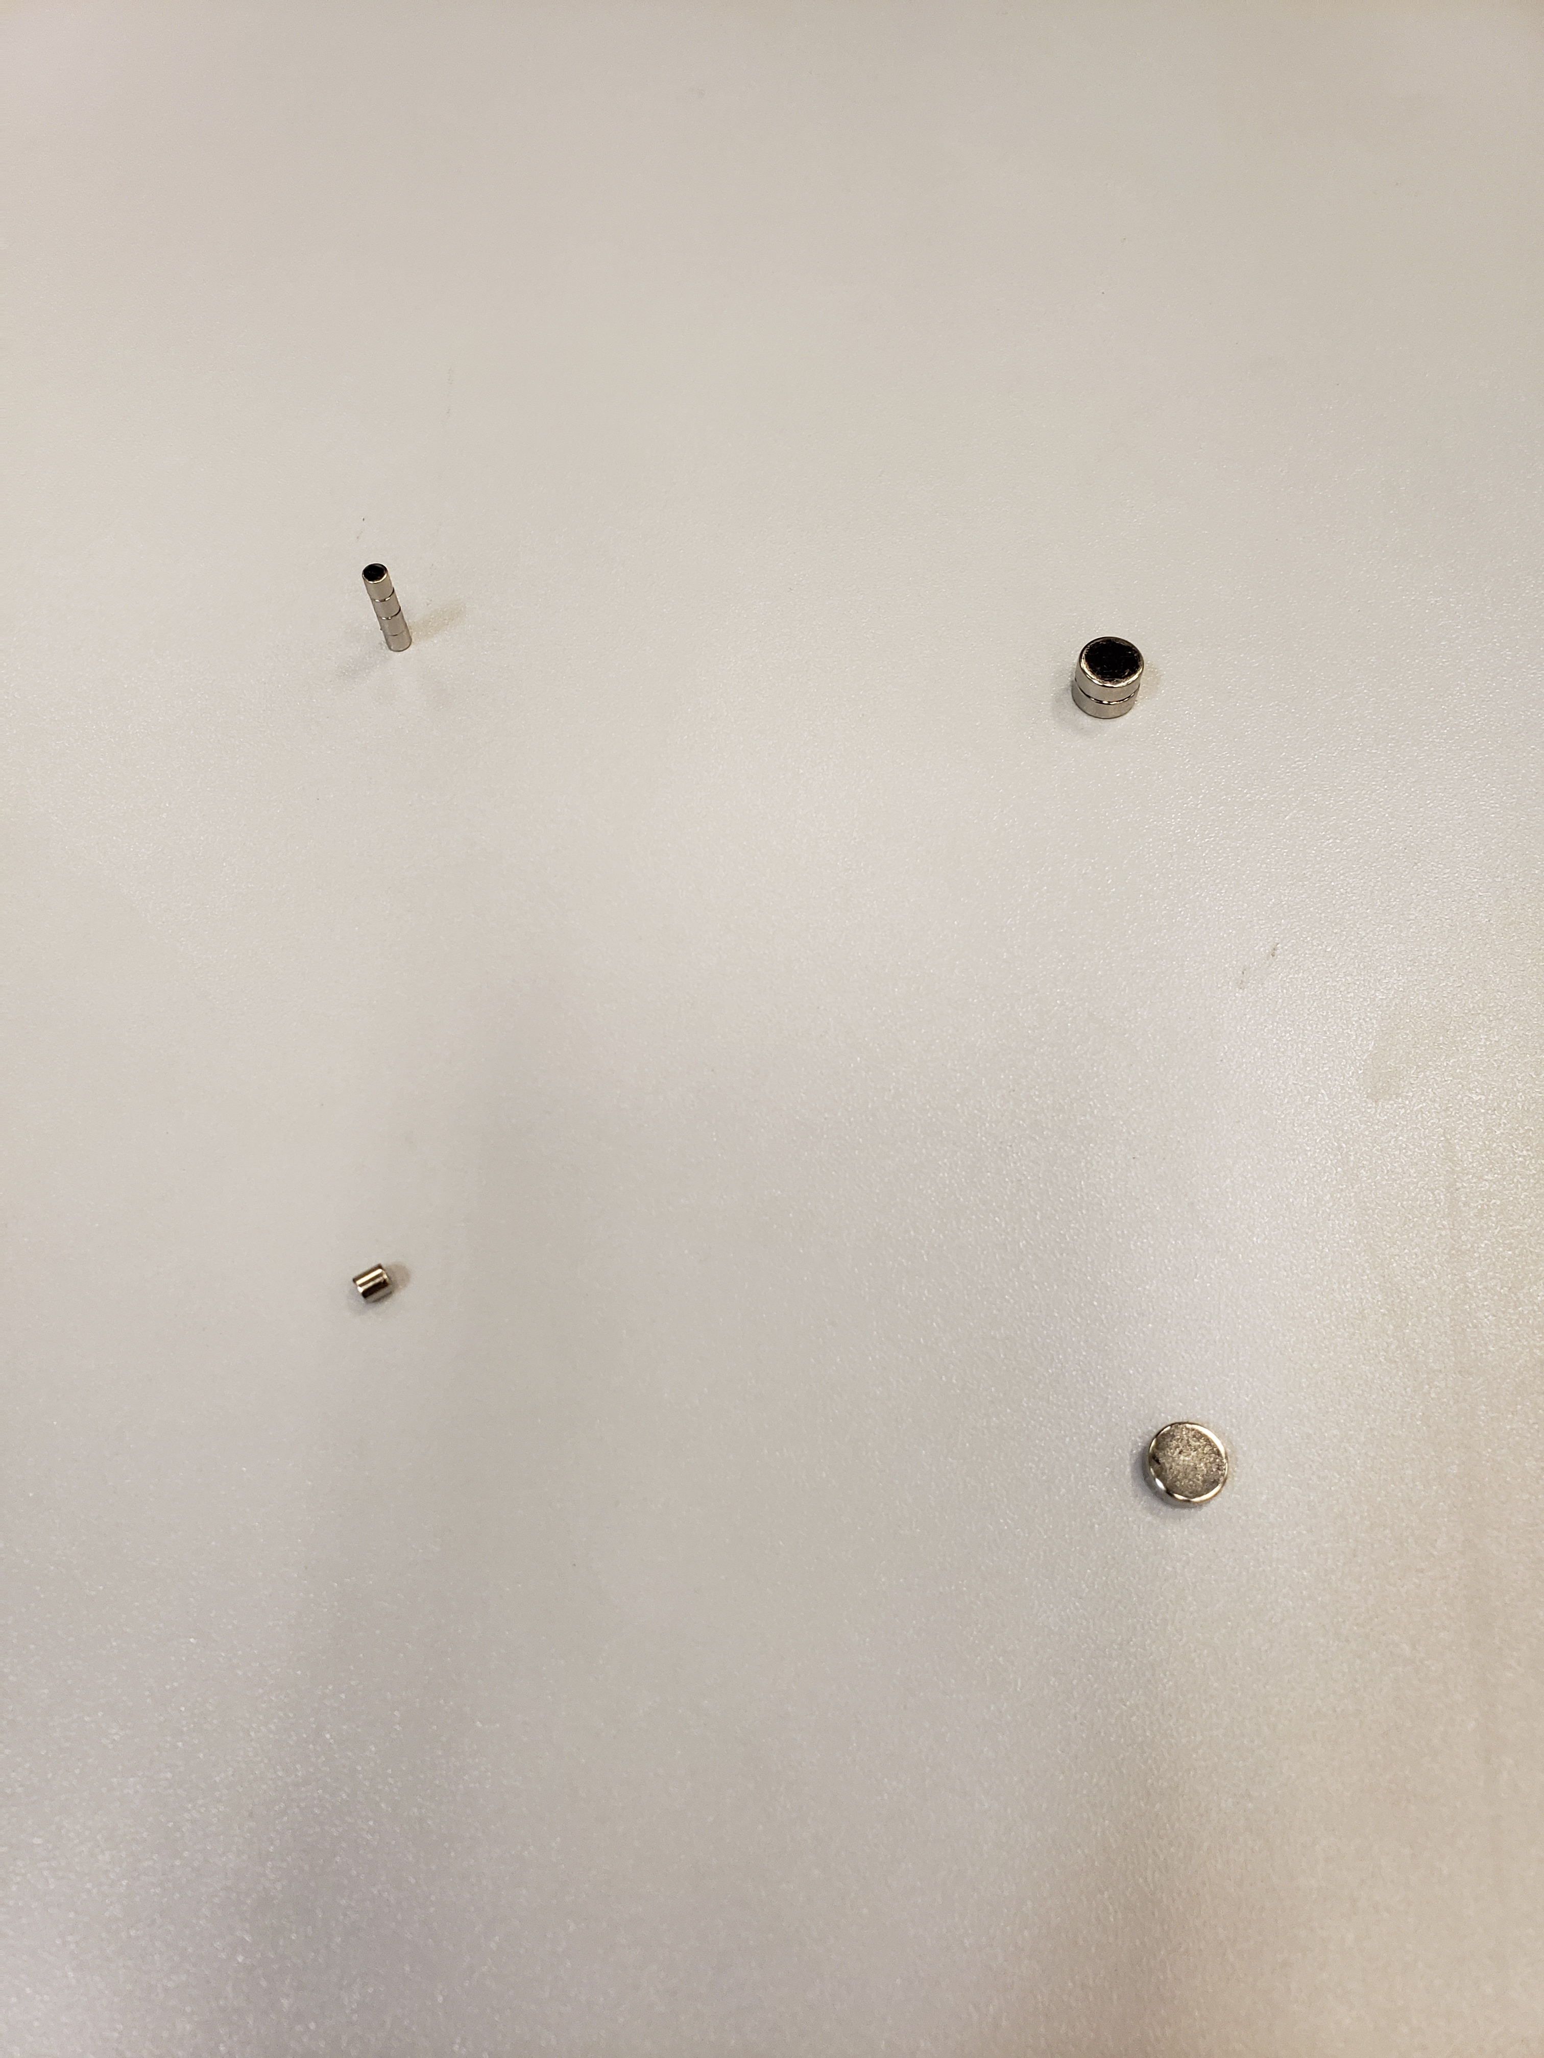
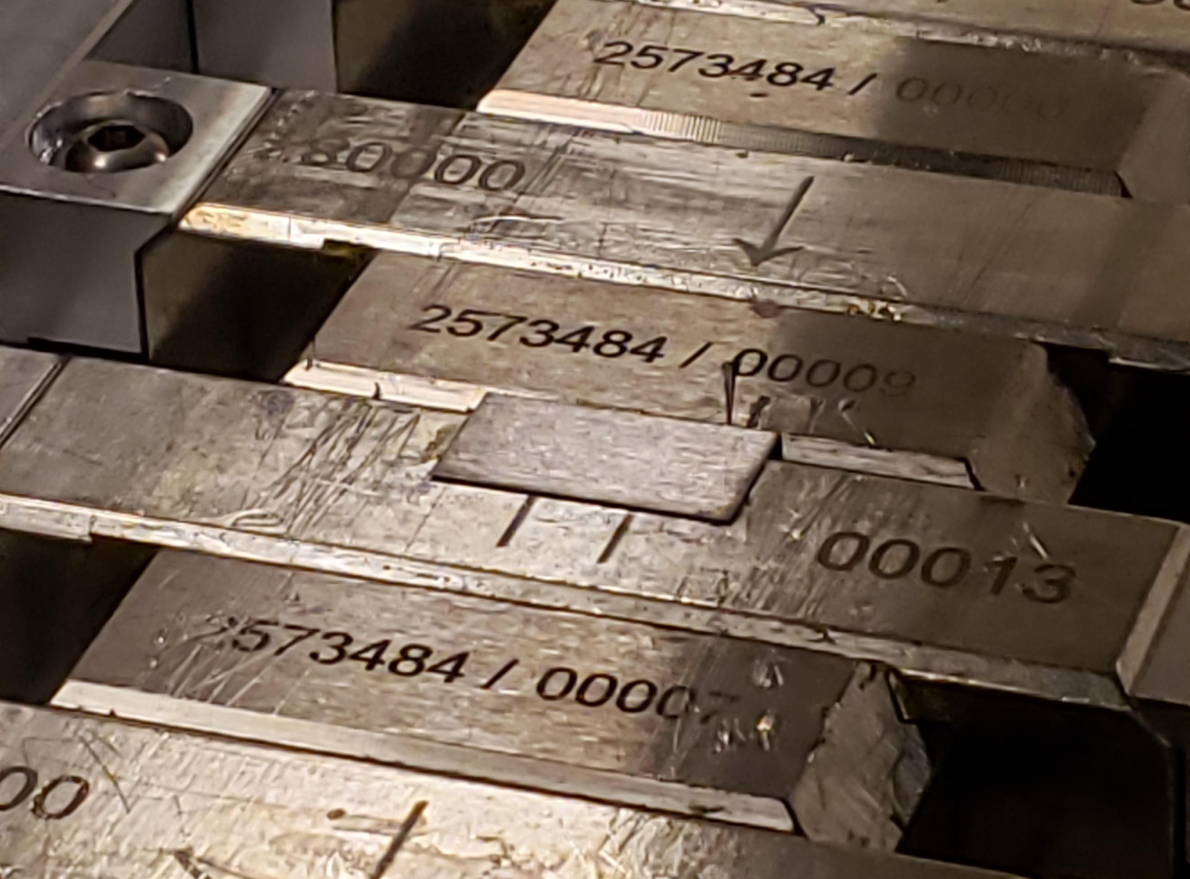
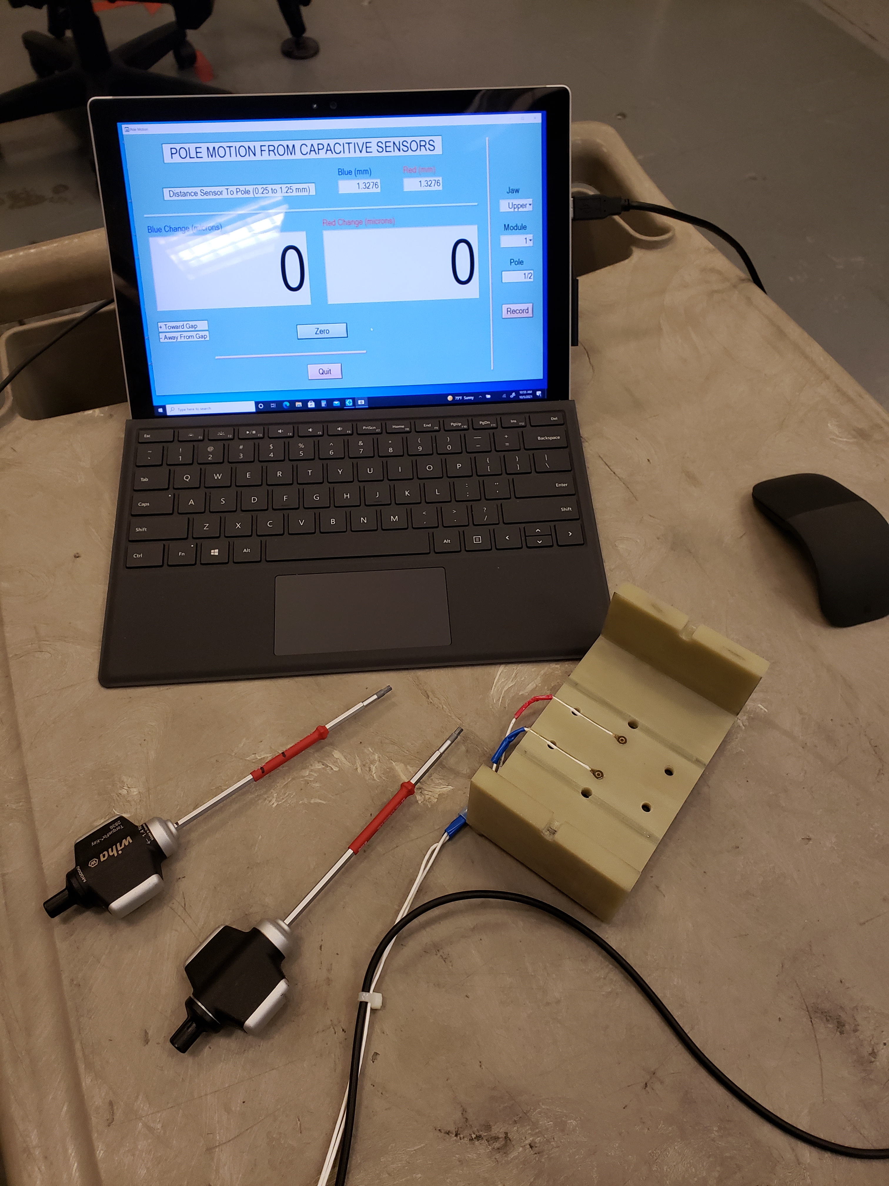
Shim signatures; options for tuning
Move poles vertically
Add magnet material
Ferromagnetic shim
Small ∅ 3mm
x 3mm slugs
Large ∅ 8mm
x 3mm slugs
Two capacitive sensors
Steel shim 7.5 x 15 x 0.17mm glued on top of a magnet
Pole motion: The main dipole, the transverse dipole and normal quadrupole.
Slugs = pole motion + Skew quadrupole.
Ferromagnetic shims = slugs + Sextupole components.
Combinations of different types of shims used to get the correct shim signature.

Slide 9
Main field signatures
Combination of pole motion with ferromagnetic shim produces a signature closest to the required field shape.
No saturation effect visible at gaps < 8mm

Slide 10
Shim signatures for other field components.
Magnetic slugs are very weak.
Pole roll and ferromagnetic shims will be used.

Slide 11
Magnet/pole recess
Pole
CMM measurements
Magnet
Magnet recess 0.14mm
Needs to be ≥ 0.3mm
Steel shim 0.17mm thick + glue
Poles moved by 0.150mm; checked on CMM.
The main field reduced by ~0.5% from 1.85T to 1.84T (4%).
No change in phase shake or field integrals.
Magnet/pole recess in the magnetic structure increased from 0.140mm to 0.300mm (LC-1006-3187).

Slide 12
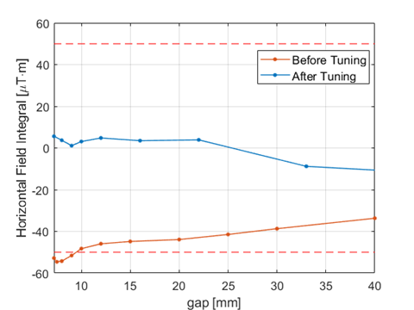
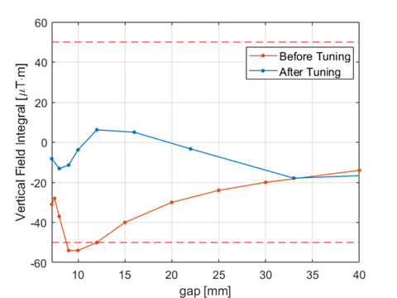
Prototype tuning
The prototype field integrals were tuned to ±20µTm by applying combinations of shims.

Slide 13
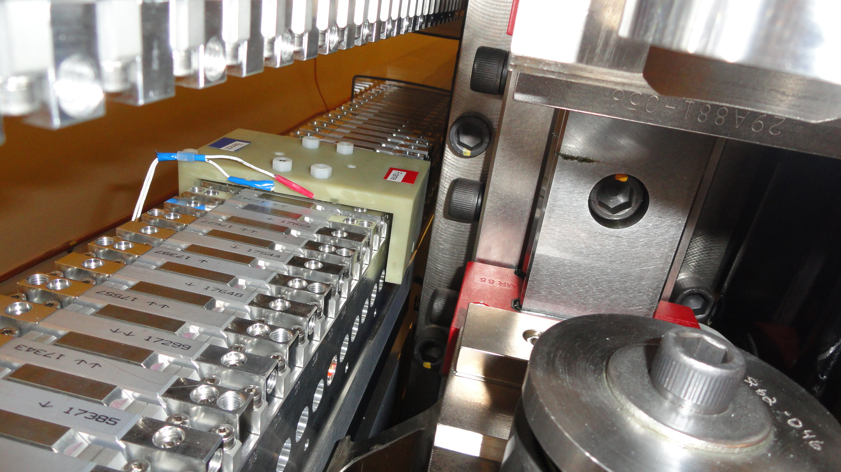
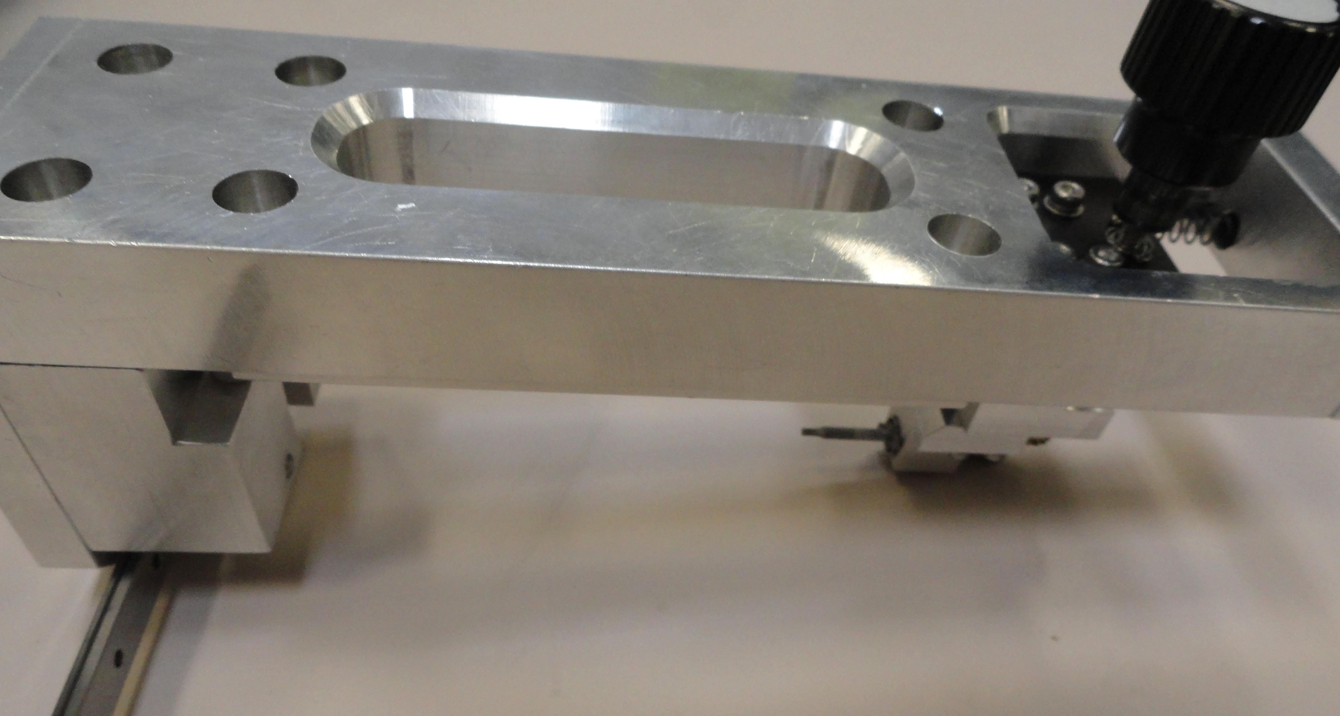
Tuning challenges
Knob
Locking screw
90° Gear
Hex Tip
The pole adjustment works fine.
No access to the side screws near the frame vertical supports (~2 x 0.46m top & bottom).
A special tuning fixture is needed, like a fixture for HXUs.
No issues with small slugs’ installation.
Large slugs are very difficult to work with; slug diameter should be reduced.

Slide 14
Hall probe calibration accuracy.
Project | B_{und}(T) | B_{calib}(T)
LCLS-I | 1.25 | 1.5
LCLS-II | 1.62 | 1.7
LCLS-II-HE | 1.86 | 1.9
The Hall probe has to be calibrated to higher field levels.
Two challenges:
  Probe output is very non-linear at fields above 1.5T. Cubic splines used to fit the calibration data.
  The calibration magnet saturates reducing the good field region. Probes to be positioned with high accuracy.
The calibration accuracy is ±5·10⁻⁵ T.

Slide 15
Hall probe measurement accuracy
The measurement accuracy checked by measuring the prototype repeatedly. The test consists of alternate Hall probe recalibrations and the prototype re-measurements.
Gap of the prototype set to 7.3mm.
Ambient temperature variations (±0.1C°).
First few measurements during the gap initial drift ignored.
The deviations from the linear fit ±9∙10⁻⁵, r.m.s.
Hall Probe calibrations
The Hall probe measurement accuracy meets the LCLS-HE requirements (<1∙10⁻⁴).

Slide 16
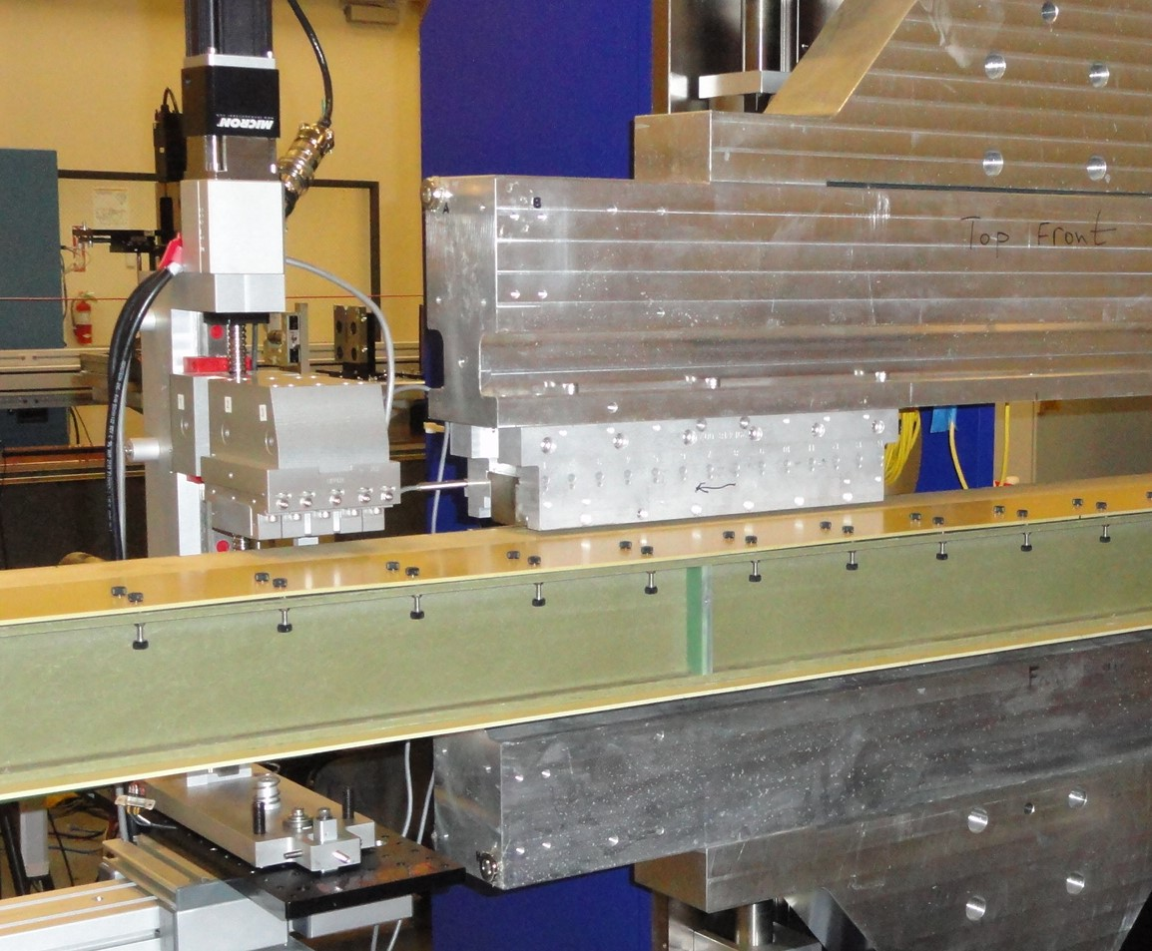
Crosstalk between undulator and the phase shifter.
SXHEPS prototype
13cm
Rail
Slide
Undulator gap = 7.2mm
Phase shifter gap = 35mm
Distance Undulator/Phase shifter in tunnel = 14.4cm.
Insignificant cross-talk expected (< 2G-cm).

Slide 17
Summary.
The magnetic structure design meets the requirements. (The short prototype does not represent the full scale device. Satisfaction is only partial).
Pole saturation is small.
Shim signatures measured. Field shimming options are sufficient for tuning the field integrals to tolerances.
Magnet/pole recess increased from 0.140mm to 0.300mm for ferromagnetic shim installation.
Hall probe measurements accuracy is <1∙10⁻⁴ , meets the requirements on K measurements.
Undulator/phase shifter cross-talk starts at 13cm. No cross-talk in the tunnel (14.4cm).
Next – Full scale prototype:
    Tune
    Measure full final dataset
    Temperature calibration
    Beam pipe corrector calibration

