Slide 1
Recent Undulator Work At SLAC
Zachary Wolf
SLAC
June 18, 2015

Slide 2
Outline
LCLS-I
Undulator measurement repeatability
Radiation damage studies
Delta Undulator
Construction
Tuning
Magnetic measurements
Phase shifter
LCLS-II
Component spacing studies
Undulator development
Phase shifter development

Slide 3
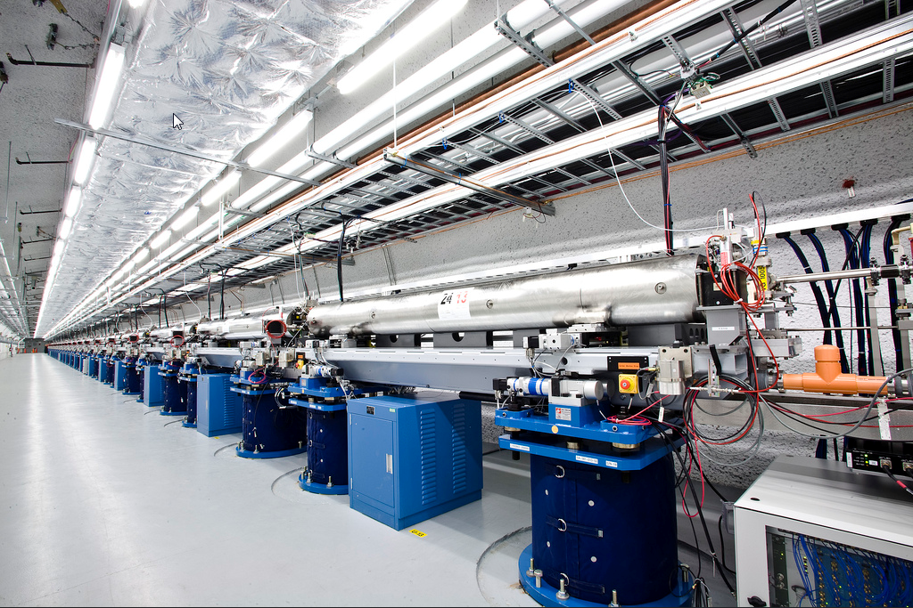
LCLS-I

Slide 4
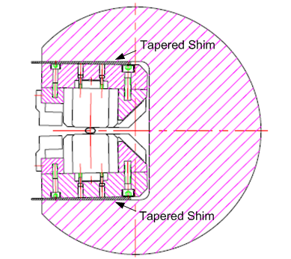
Undulator Cross Section
ANL Design
Joachim Pflueger idea to use
tapered shims
Tapered shims give the pole a cant angle
and are used to set the gap.

Slide 5
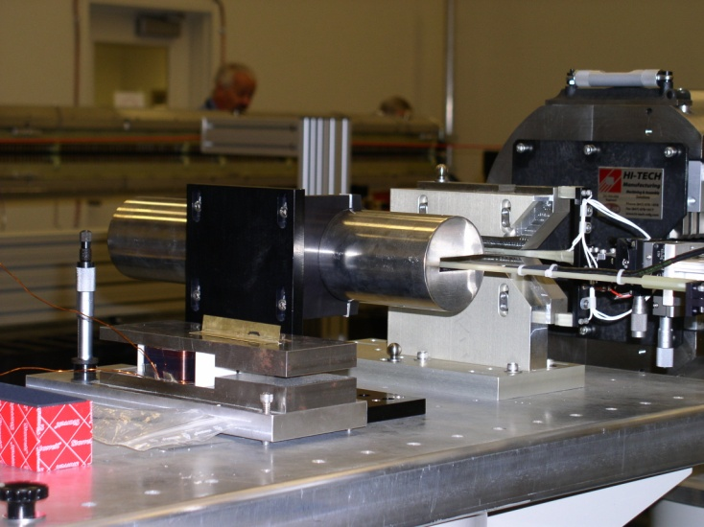
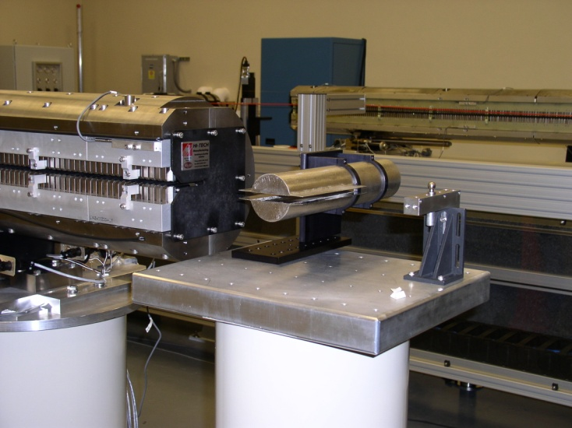
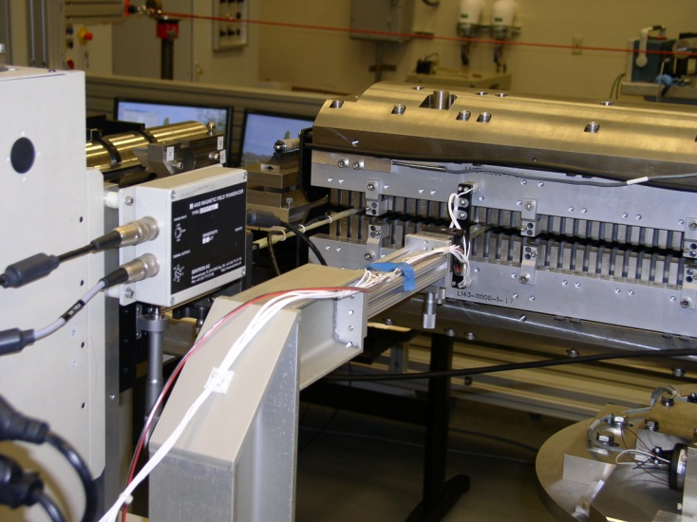
Undulator Measurements Hall Probe
Beginning
zero field
measurement
Ending
zero field
measurement
Senis Hall probe
Capacitive sensors used to align undulator to bench
Zero offset correction assumes linear
offset dependence on time. Want low
drift Hall probe.

Slide 6
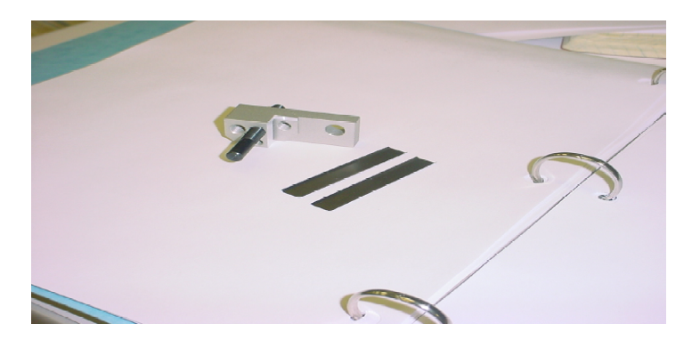
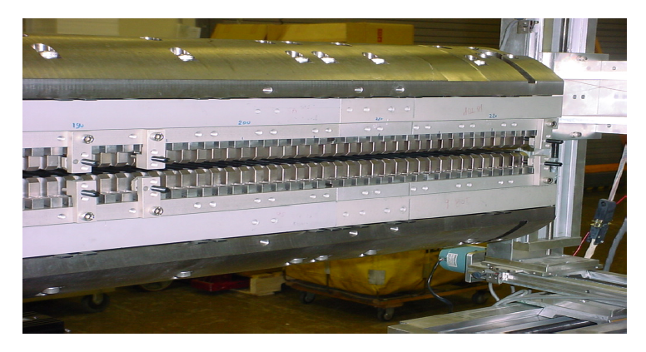
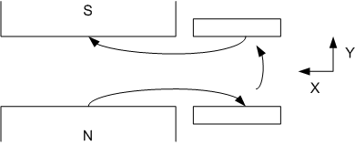
X Trajectory Shims
Isaac Vasserman’s Ideas
ANL/APS/TB-48
ANL/APS/TB-48
Apply shims to top and bottom poles
Shims weaken By, don’t cause Bx
Can’t strengthen pole, instead place shims on next pole to reduce deflection in other direction
Developed software to automate shim placement
LCLS-TN-04-7

Slide 7
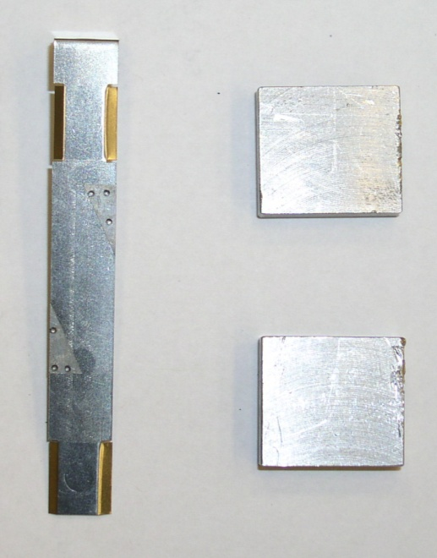
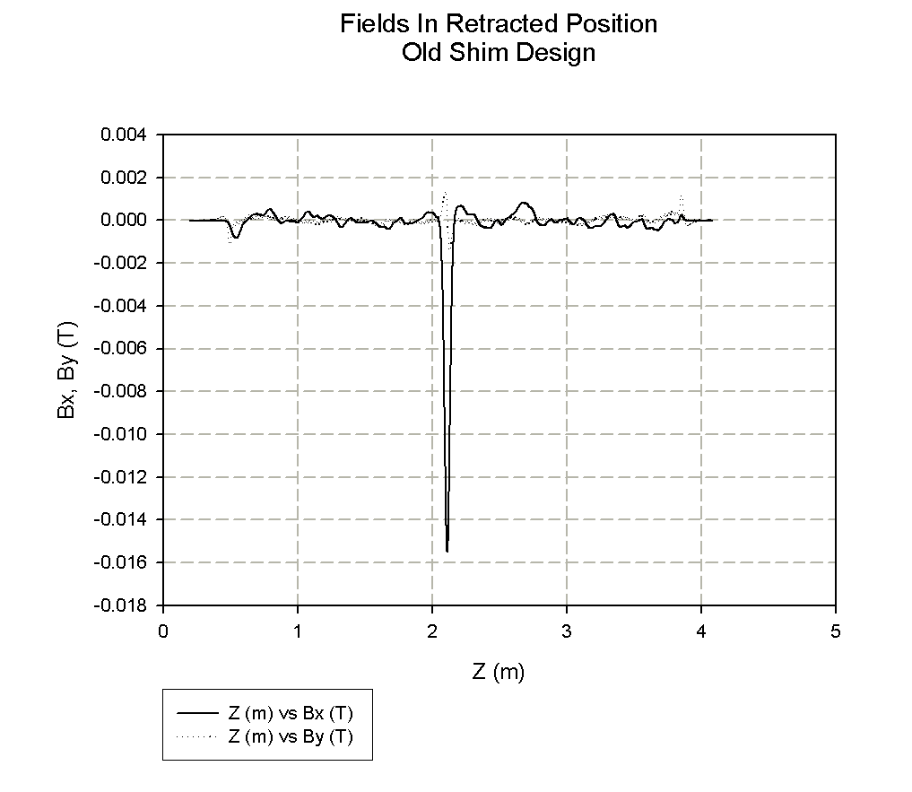
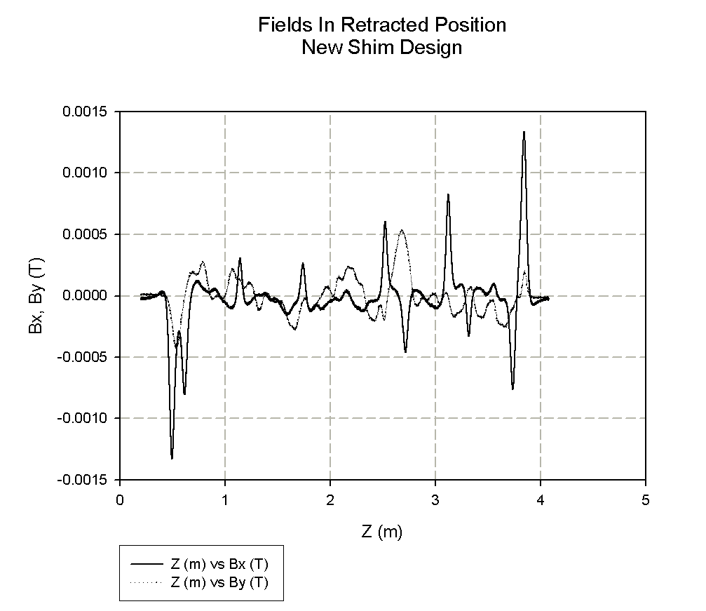
Y Trajectory Shims
Bx Shim
New Design
Smaller external fields
Uniform Bx field in gap
Old
Shim
Design
Inconel
Steel
Spot weld
Yurii Levashov

Slide 8
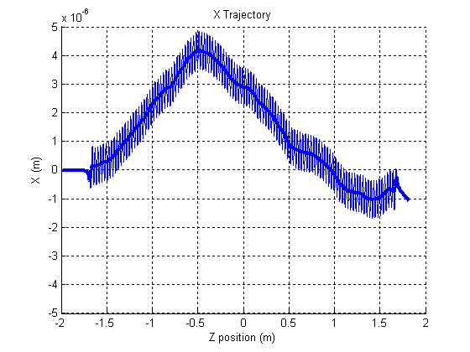
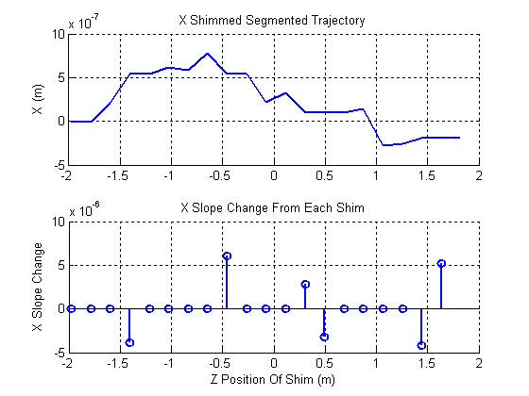
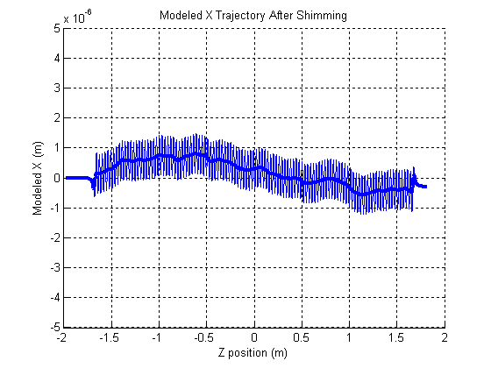
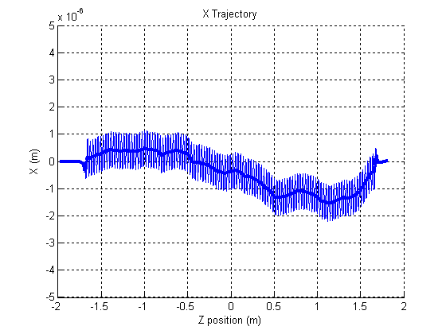
Automated X And Y Trajectory Shimming
Measured
X
Trajectory
Calculate
Shims
Modeled
X Traj
With
Calc
Shims
Measured
X Traj
After Calc
Shims
Applied
LCLS-TN-06-8

Slide 9
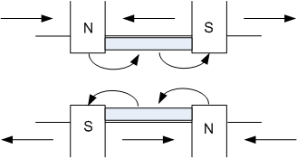
Phase Shims
LCLS-TN-04-7
ANL/APS/TB-48
Measure By with a Hall probe
Calculate phase error
Calculate shims to correct error
Apply shims, repeat
Developed software to automate
shim placement
We don’t have shims to strengthen
a magnet, only weaken
Must locally reduce the gap to
increase phase shift

Slide 10
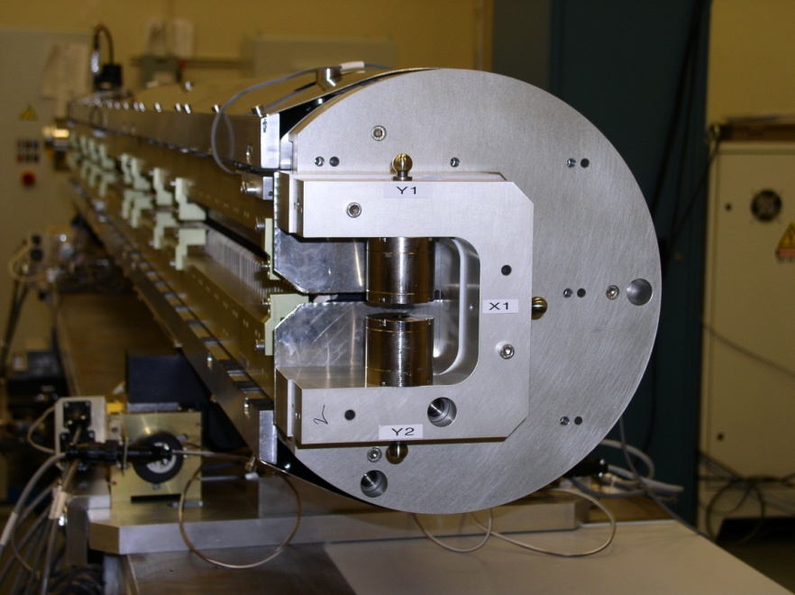
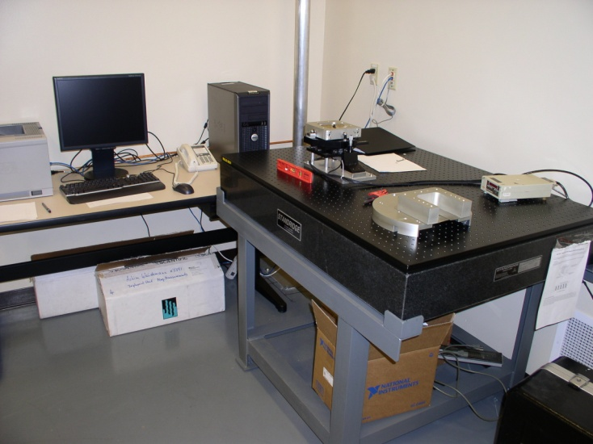
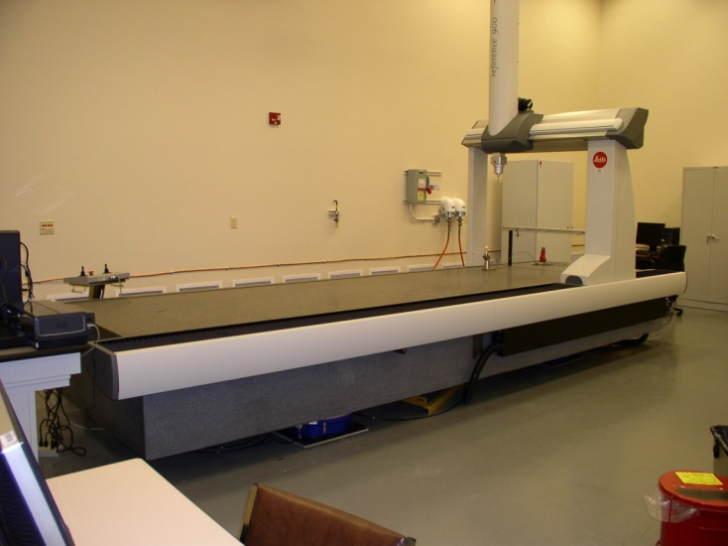
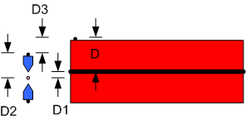
Fiducialization
LCLS-TN-07-7

Slide 11
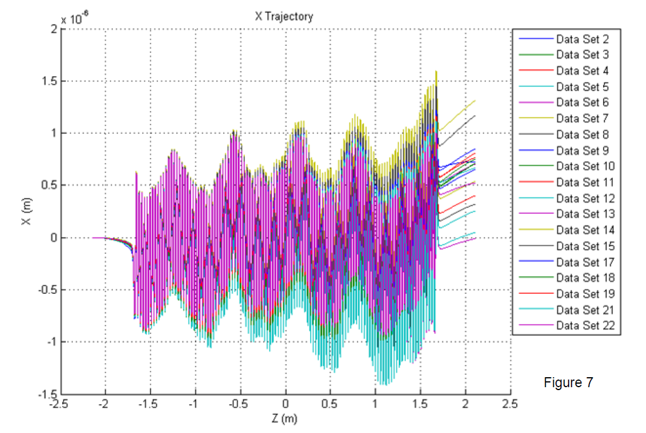
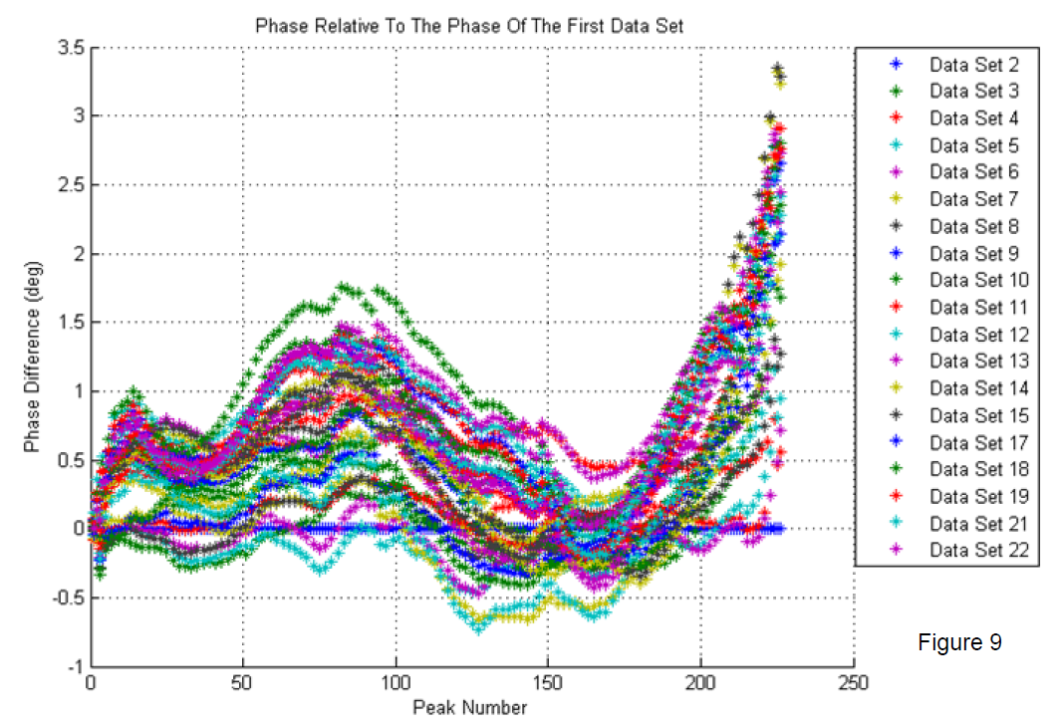
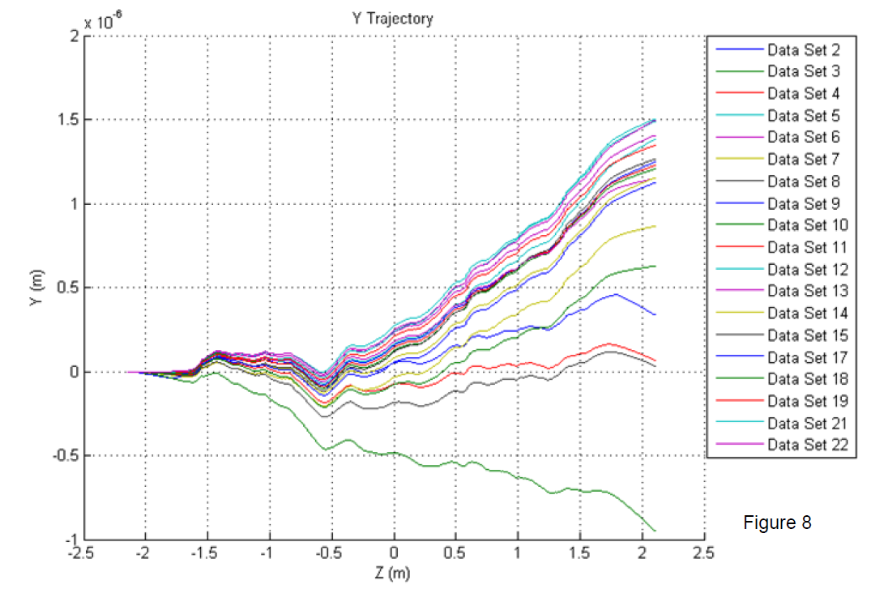
Measurement Repeatability, Reference Undulator
X-Trajectory,
Y-Trajectory,
Phase vs Z
LCLS-TN-09-3

Slide 12
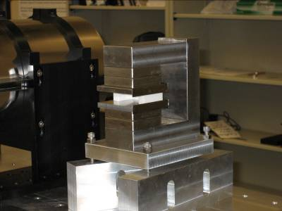
Reference Dipole
Reference Dipole,
uniform field,
NMR measurements

Slide 13
Reference Undulator K Measurement Repeatability
±1.5x10⁻⁴
Measurement repeatability allows
long term radiation damage studies.

Slide 14
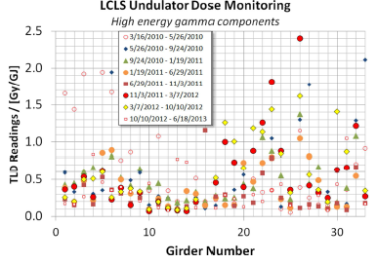
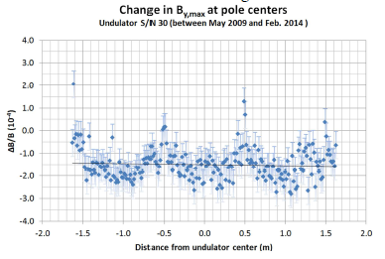
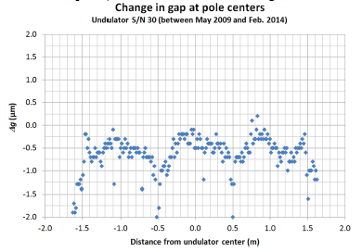
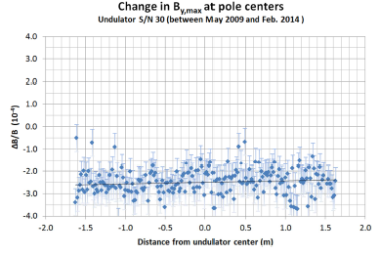
Radiation Damage Studies
H-D Nuhn, FEL2014

Slide 15
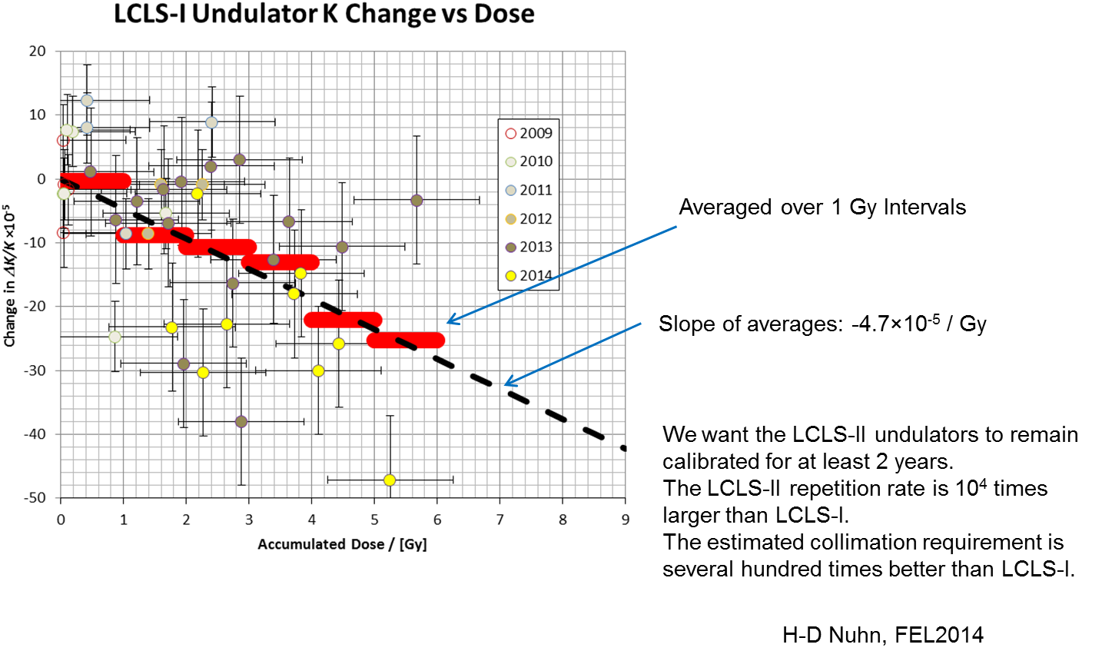
Radiation Damage Studies

Slide 16
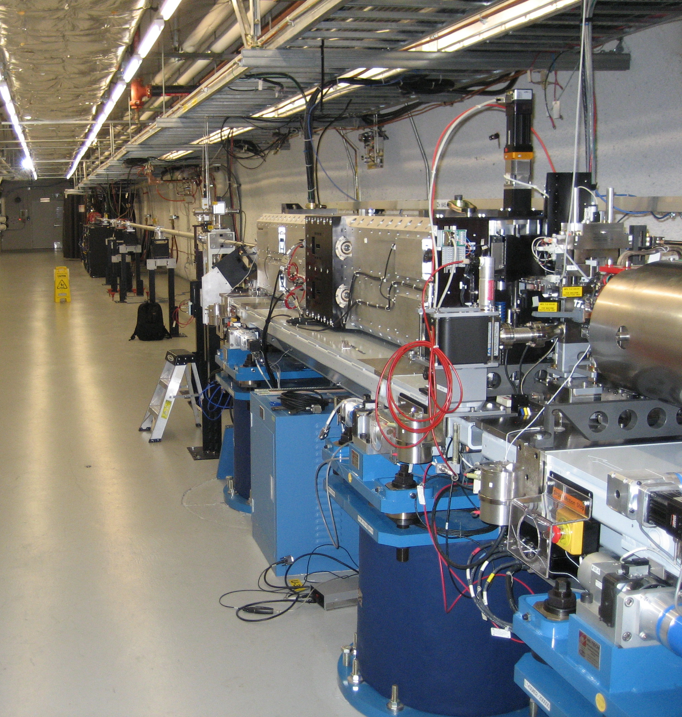
Delta Undulator
Placed at end of LCLS.

Slide 17
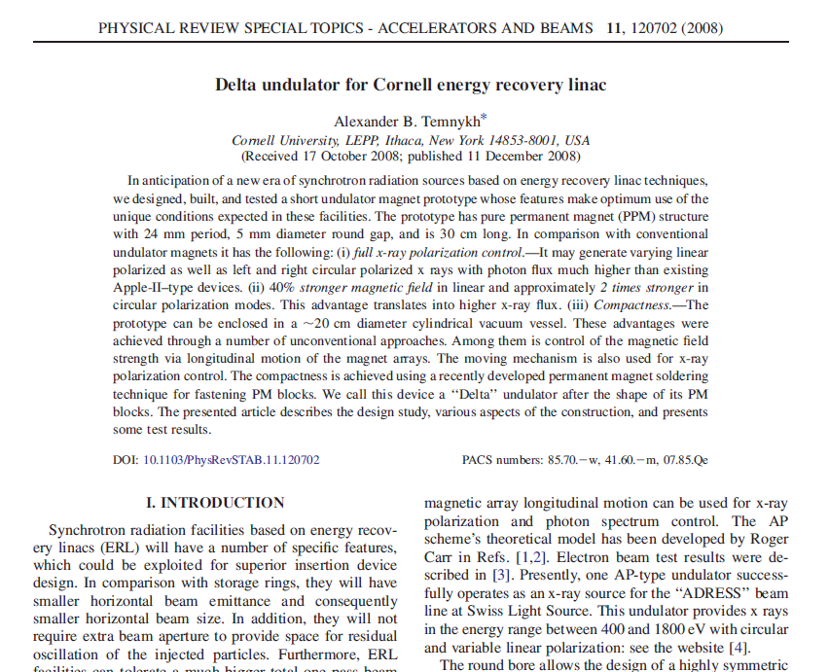
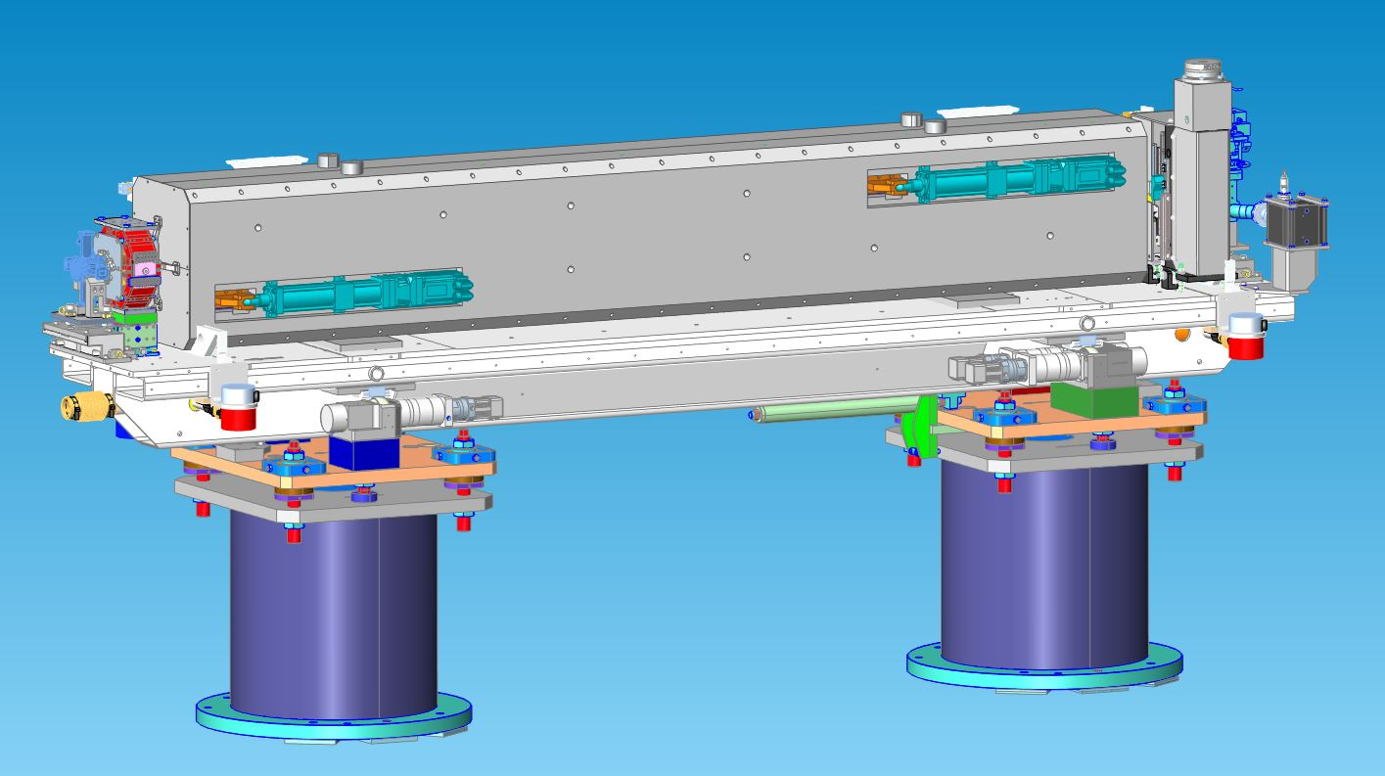
Delta Undulator
EPU in a package compatible with LCLS
Use same alignment strategy. Undulator
and quadrupole on the same girder.

Slide 18
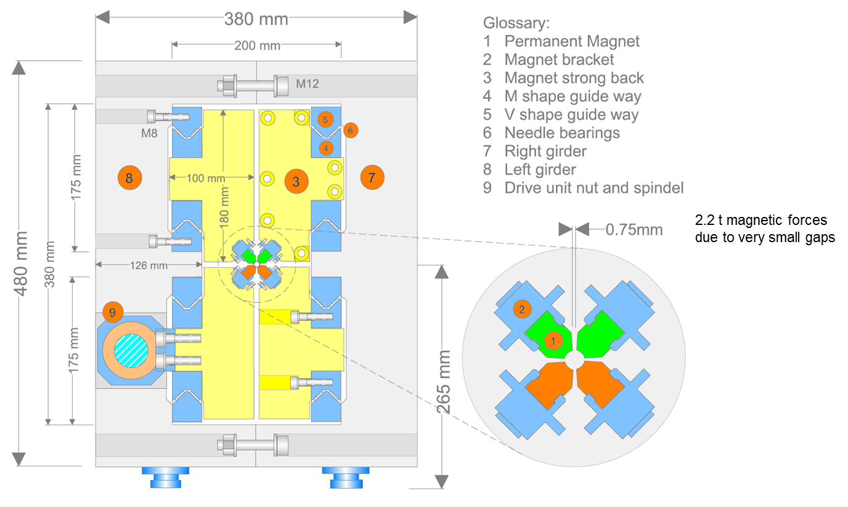
Delta Cross Section
Franz Peters

Slide 19
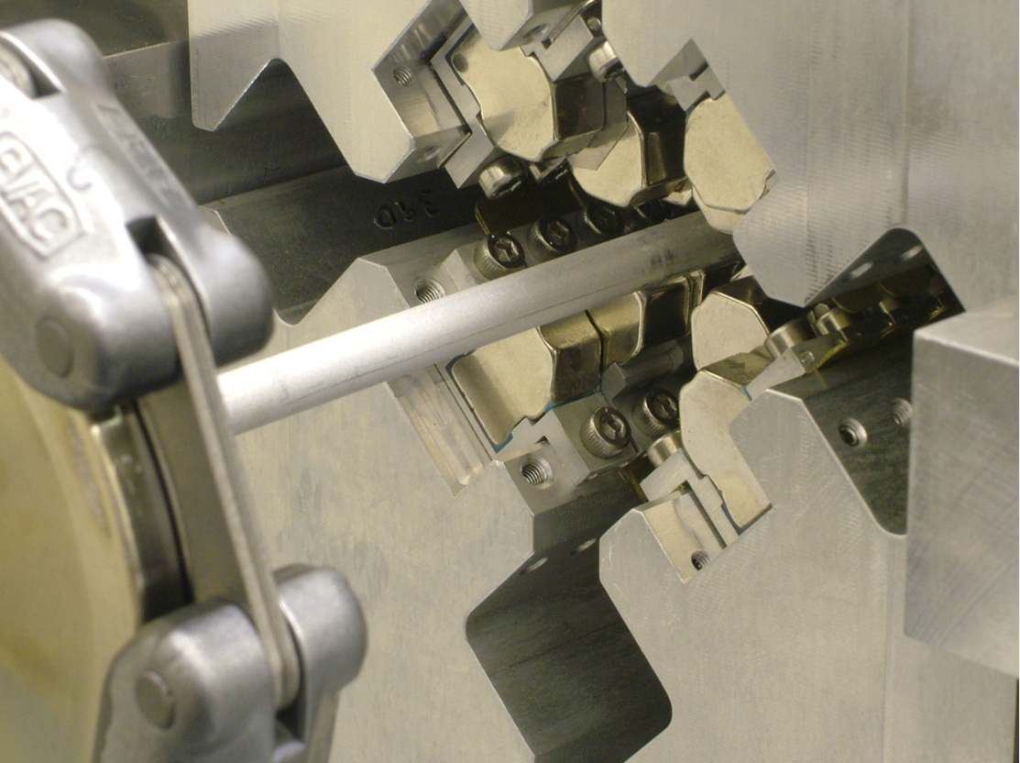
Delta Magnetic Measurements
LCLS-TN-13-4
The measurements of the Delta undulator are difficult.
The only access to the field is from the end of the 6.6 mm diameter
bore of the 3.2 m long undulator. There is no side access.
We work toward making an FEL from Delta undulators in the future.
We measure on the curved path of a guide tube in the assembled
undulator, not on the beam axis. Must make corrections.
We can only tune quadrants. The assembled undulator can only
only be measured. Do as much tuning as possible before assembly.
The field varies exponentially away from a quadrant. The quadrants
must be straight when tuning. Quadrant assembly must be done
with the quadrants straight and parallel.
The only access is at the ends, through the beam pipe.

Slide 20
Tuning Plan
Measure the magnetic moment of each block
Sort the blocks to minimize field errors and to make tuning easier, and to
make sure errors are within the tuning motion range (small) of the blocks
Assemble the quadrants
Tune the quadrants by moving blocks (works well for Delta’s fixed gap)
Numerically superpose the quadrant fields to estimate the field in
the assembled undulator, re-tune if necessary
Assemble the undulator
Measure the fields
Disassemble the undulator and re-tune the quadrants if required
Determine the magnetic center line (the beam axis)
Calculate trajectories, phase, K on the beam axis from the measurements
Fiducialize the beam axis

Slide 21
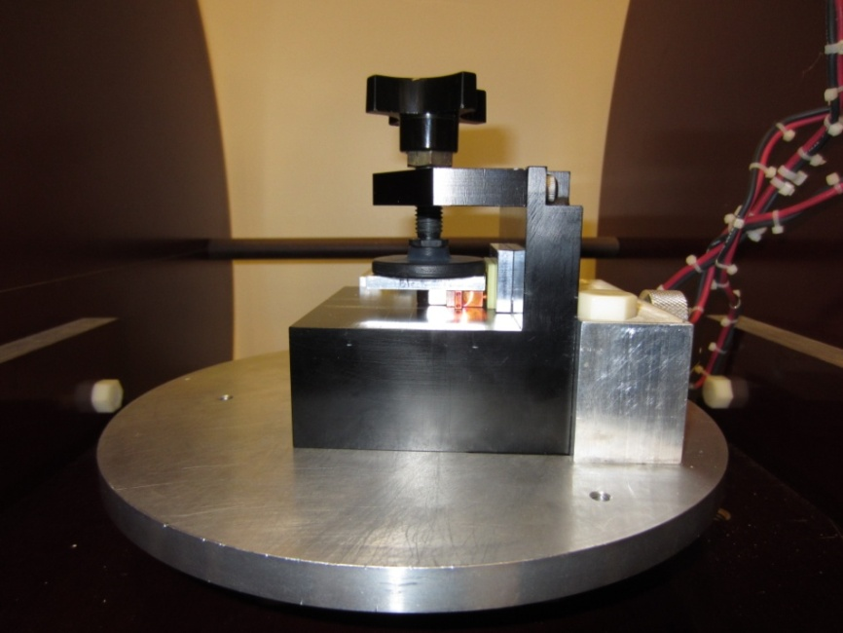
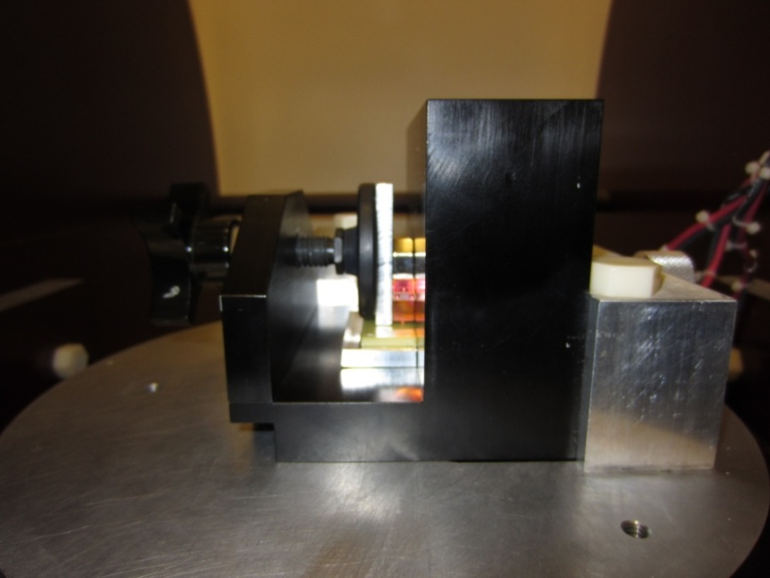
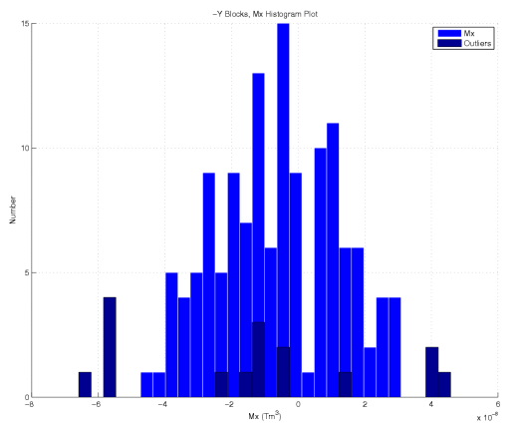
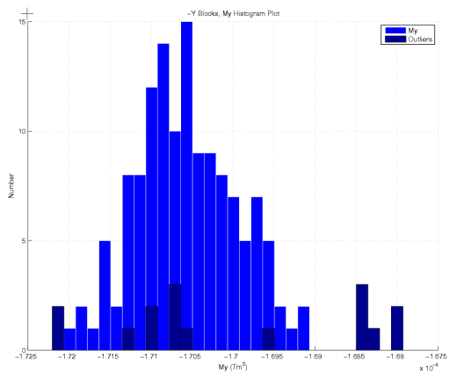
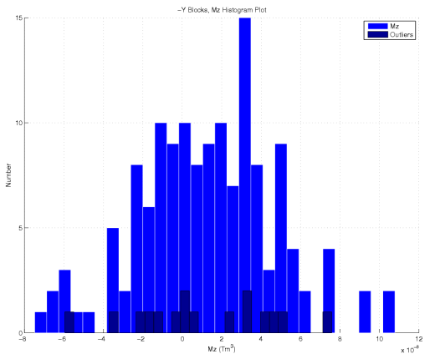
Magnet Block Measurements
Helmholtz Coil
Measure:
Mx
My
Mz
Prototype blocks

Slide 22
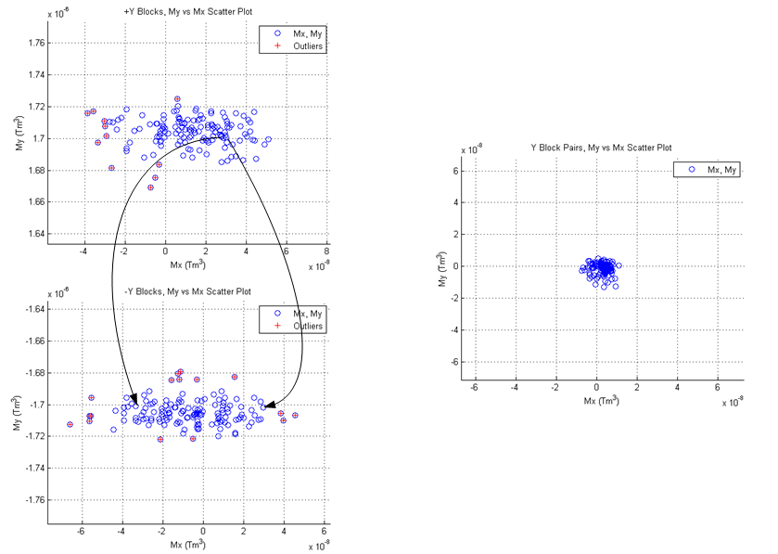
Block Sort, Vertical Blocks
The goal of sorting is to allow the quadrants to be tuned using the very limited allowed block motions.
Pair blocks and put pairs into periods to match My (no steering in a period)
and cancel Mx (no vertical kicks in a period).
Put pairs into quadrants so quadrants can be tuned. Place strong pairs in a period
next to weak pairs to minimize phase errors.
(all plots have same scale)
These plots are for the 1 m prototype,
but they illustrate the sorting algorithm.
LCLS-TN-13-1

Slide 23
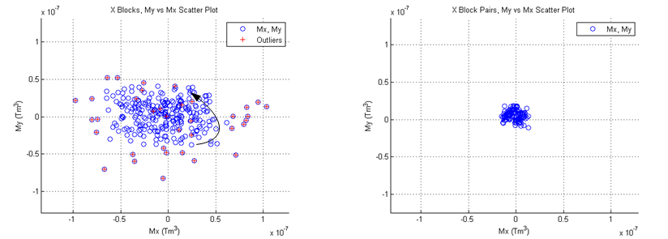
Block Sort, Horizontal Blocks
Horizontal blocks are paired to cancel My and Mx. Pairs are put into undulator
periods. The periods are assembled to make the quadrants.
(both plots have same scale)
These plots are for the 1 m prototype,
but they illustrate the sorting algorithm.
LCLS-TN-13-1

Slide 24
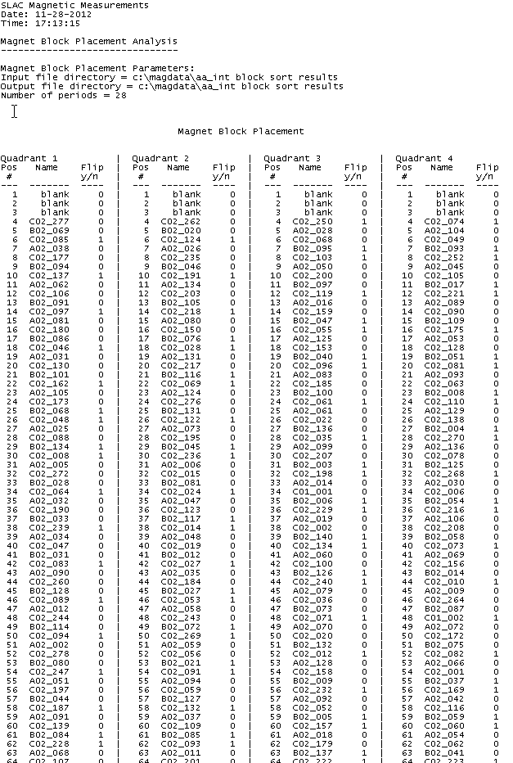
Assemble Quadrants
Use matched pairs in each period to minimize local errors and overall field integrals
Use strong pair, then weak pair to minimize phase errors
Produce printout of what block goes in each slot, indicate block flips

Slide 25
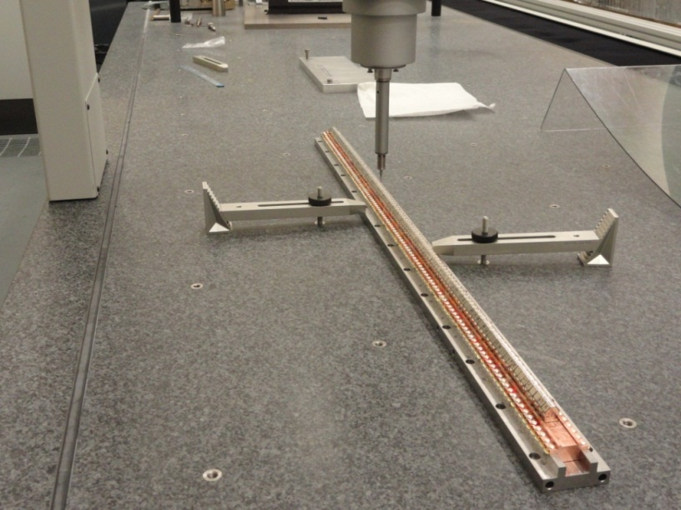
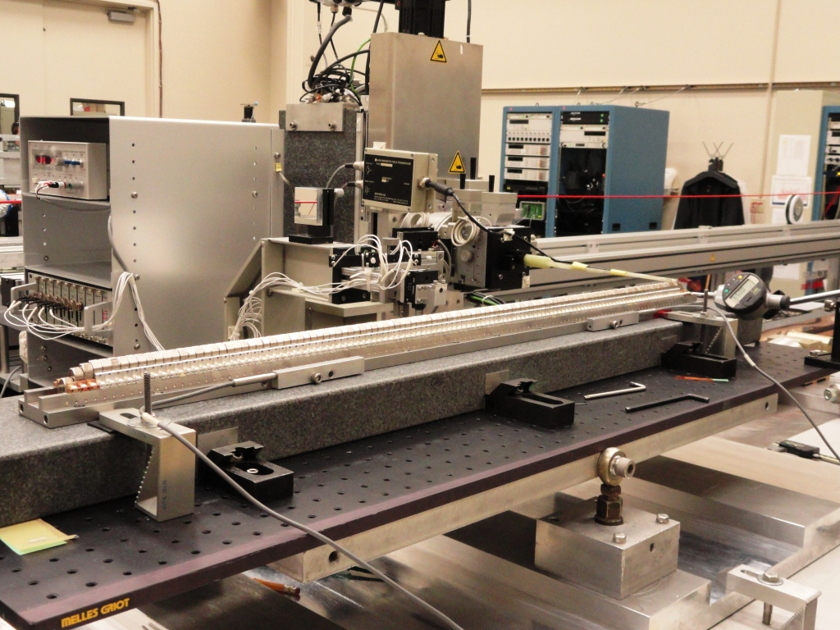
Delta Quadrant Assembly And Tuning
Mechanically align blocks
using CMM.
Move blocks using magnetic
measurements to straighten
trajectories and minimize
phase errors.
(Photos of prototype)

Slide 26
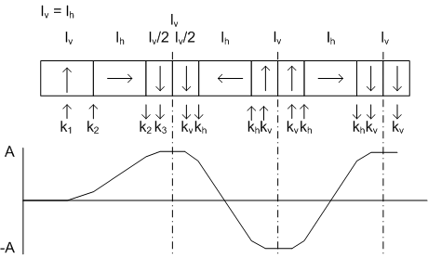
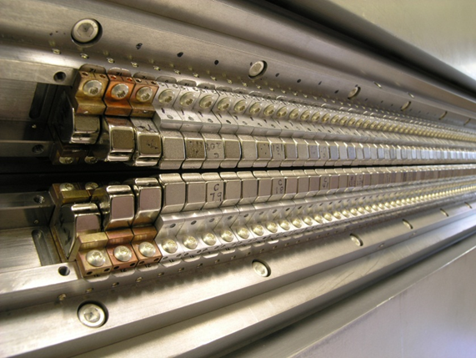
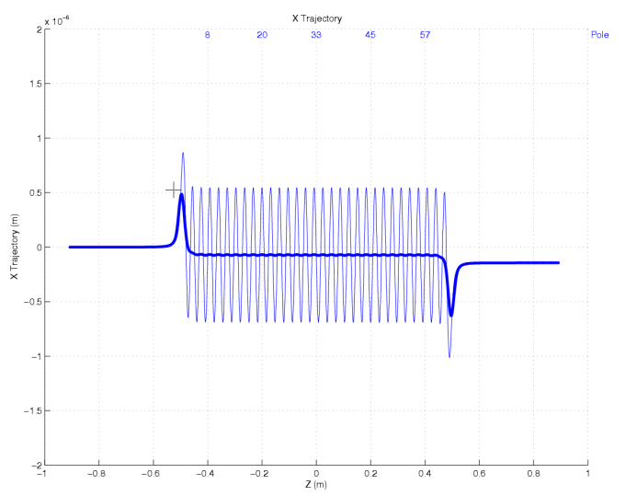
Delta Ends
Steering free
No offset
Scott Anderson
If K_{v} is kick from full vertical block
and K_{h} is the kick from a full
horizontal block:
k₁ = (3/14)K_{v}
k₂ = (1/2) K_{h}
k₃ + k_{v} = (5/7) K_{v}
Simulation
Block 3 homogenizes the two half
blocks, this leaves a small trajectory
offset. Correct by shifting block 2.
LCLS-TN-13-2

Slide 27
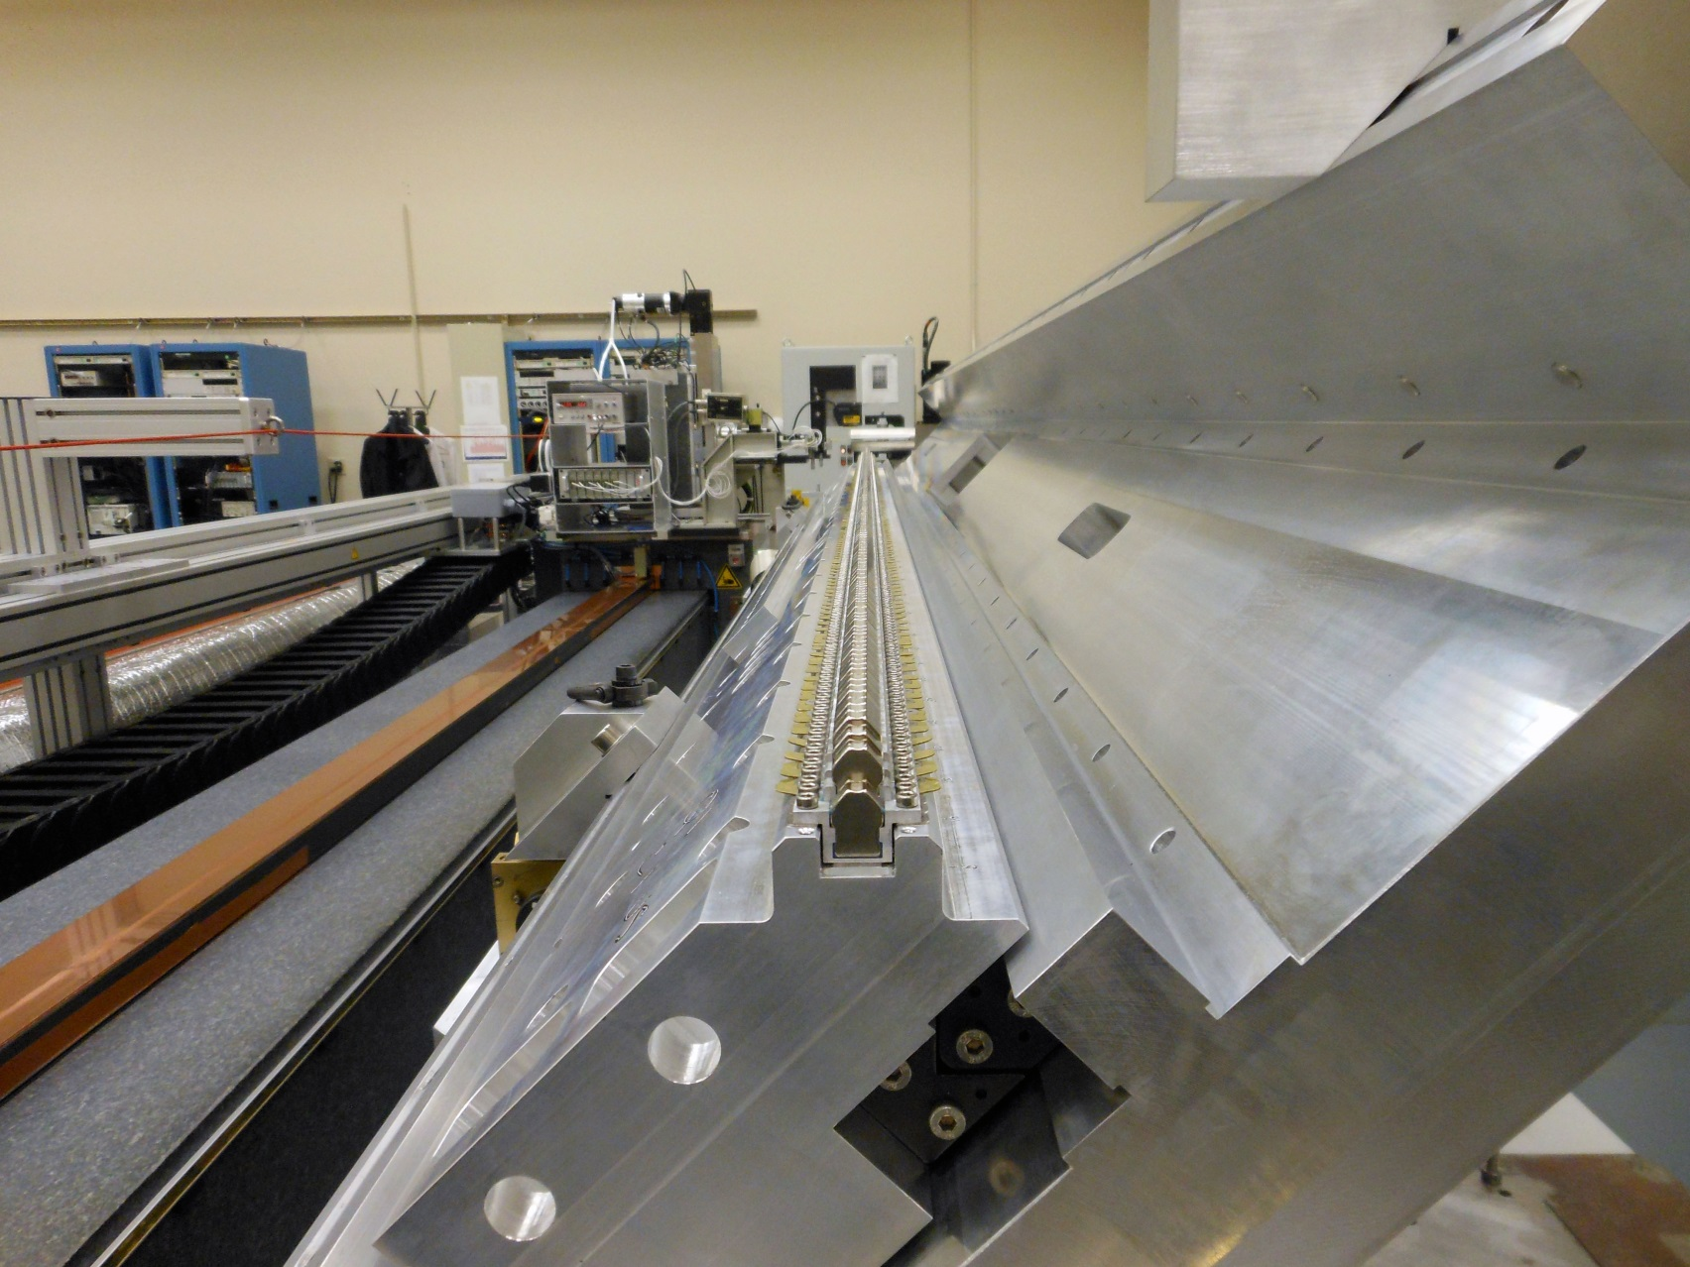
3.2 m Quadrant Tuning
3 Carriers
Nd₂Fe₁₄B Magnets
Linear Bearings

Slide 28
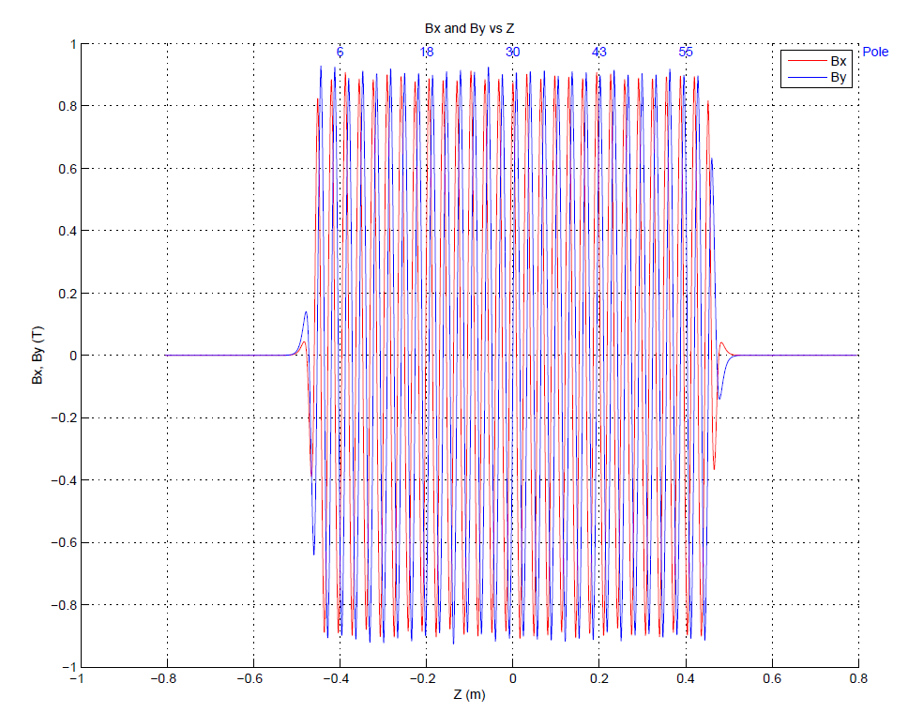
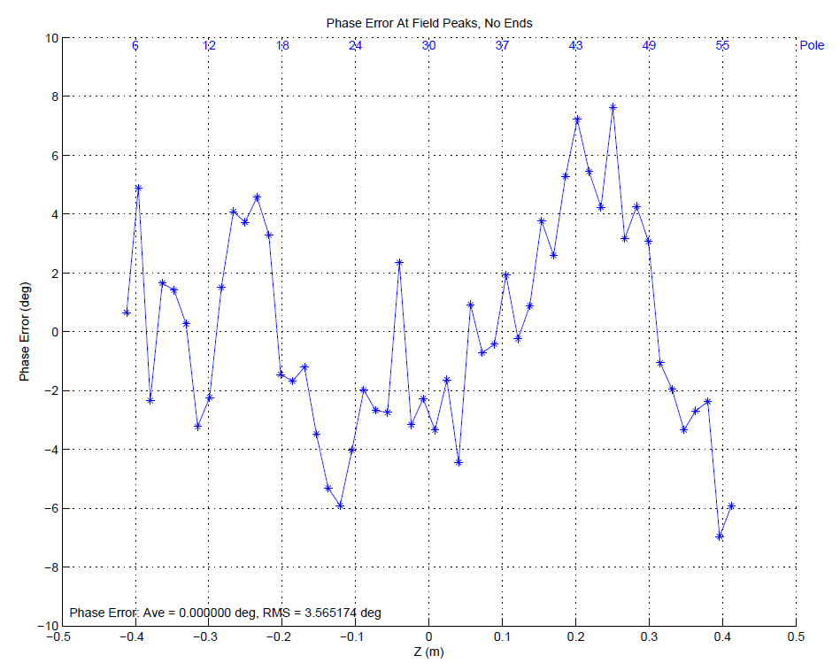


In Software Superpose Quadrant Fields To Simulate Assembled Undulator, Correct If Necessary
Example CP+. Expect undulator within tolerance, but no permeability effects in superposition.
(Prototype)

Slide 29

Delta Assembly

Slide 30


Delta Field Integrals
Moving Wire
Pulsed Wire

Slide 31

Hall Probe Measurements
Each probe measures Bx, By, and Bz.
2 Senis probes
Small planar hall effect
Accurate measurements
∆y = 200 microns
Take out ∆z in software
LCLS-TN-13-4, LCLS-TN-13-9
Measure 3 field components at two points
Measure probe position relative to straight line
Determine probe position relative to fiducialized line
Determine magnetic center relative to probes
Determine magnetic center relative to fiducialized line
Determine beam axis relative to fiducialized line
Calculate trajectories, phase, K on beam axis
Fiducialize beam axis

Slide 32

Hall Probe Measurements
The only access for measurements is
through the end of the beam pipe.

Slide 33
Want Fields On Beam Axis, Not Probe Location
LCLS-TN-13-11

Slide 34




Measure Probe Position
Transverse location from corner cube. Longitudinal location from interferometer.
Georg Gassner

Slide 35


Probe Position Measurements

Slide 36


Locate Magnetic Center
Center relative to probes.
Use linear field mode.
Measure Bx and By.
Can rotate probes to measure
at two points along x or y.
Assume field shape
is first term in field
expansion near the
center.
LCLS-TN-13-9

Slide 37



Result: Delta Works Well
Heinz-Dieter Nuhn
Delta works in all polarization modes.
A DESY group measured the amount
of polarization.
A corrector can deflect the electron
beam a small amount so the Delta
light can be separated from the
LCLS light.
Phase shifter scan.
In linear vertical magnetic field mode
mix Delta light with LCLS light.
Resonance occurs at the expected K value.

Slide 38
Improvements This Summer Phase Errors From 3.2 m Measurements
Estimate 40 µm taper
LCLS-TN-15-1
LCLS-TN-15-2

Slide 39

Delta Phase Shifter

Slide 40

Permanent Magnet Phase Shifter
A PPM phase shifter can be put in the fringe field of the undulator. It must be
designed so its fringe fields do not enter neighboring steel components.

Slide 41


Phase Shifter Design
Two parameters l_{v} = l₁ and l_{h} = l₂.
LCLS-TN-11-2
To simplify the design, I took l_{v =} l_{h}. So one parameter, use to adjust phase integral.
Efficient. Always adding phase.

Slide 42







Used Charge Model To Simulate Phase Shifter For Design Studies

Slide 43


Phase Integral vs Block Height and Length
Phase integral vs block height
Phase integral vs block thickness
Equal length l_{h} = l_{v}.
Taller blocks make larger phase integral,
up to a point.
Thicker (longer) blocks make larger
phase integral.

Slide 44


Magnetic Length vs Block Height
Gap = 7 mm
Gap = 100 mm
Minimize block height in order to minimize magnetic length.

Slide 45



Final Design
L = 9 mm
H = 25 mm
W = 66 mm

Slide 46



Field, Trajectory, Phase
By
X Trajectory
Phase

Slide 47
Tuning Studies Virtual Shims
LCLS-TN-12-3
Errors were put into the modeled blocks
The first integral of the error field was determined as a function of error size
Shim motions were put into the blocks
The first integral of the shim field was determined as a function of shim size
All this was done at minimum gap
At minimum gap, errors could be corrected exactly by shims
The correction was not exact at all gaps and the gap dependence was studied
Very interested in your results
with steel shims.

Slide 48



Sample Error
Magnetization direction error
Block 3 magnetization rotated by 20 mrad

Slide 49


Virtual Shims

Slide 50



Sample Shim
Horizontal block motion
At tuning gap, determine slope change
as a function of block motion
Fix trajectory at tuning gap

Slide 51

Add Error, Add Shim, Study Gap Dependence
Block magnetization error:

Slide 52

Add Error, Add Shim, Study Gap Dependence
Block magnetization direction error:

Slide 53

Test Shimming The Magnet Assembly

Slide 54
Field Integrals vs Gap
I1x and I1y  0 at min gap
Vary by ~ 25 µTm
I2x and I2y  0 at min gap
Vary by ~ 10 µTm²
Only 10 blocks of each
type for the sort

Slide 55
Trajectories
10⁻⁷ m
E = 8.5 GeV

Slide 56
Phase Integral, Magnetic Length
At 10 mm gap, PI = 8.893e-06 T²m³
Magnetic length is defined as the distance
between end points where the measured
fringe field is greater than 0.4 G.

Slide 57



Delta Phase Shifter
Slides and strongback
take up moment
Motor, gear box
Spring takes force
off leadscrew
Scale measures gap,
accommodates any small
jaw deflections
Machined screw,
(replace with ball screw)

Slide 58
LCLS-II
Use existing undulator tunnel
Replace LCLS-I with two undulator lines
HXR undulators
Variable gap, PM hybrid
Vertical or horizontal gap
32 segments
3.4 m segment length
26 mm period
SXR undulators
Variable gap, PM hybrid
Horizontal gap
21 segments
3.4 m segment length
39 mm period
Add superconducting linac

Slide 59

LCLS-II Interspace Spacing Test
LCLSII-3.2-EN-0358-R0

Slide 60

Interspace Spacing Test
LCLSII-3.2-EN-0358-R0
The edge of the phase shifter must be 14 cm from the last pole
of the undulator (using the 3 Gcm criterion, no mirror plates).

Slide 61

Component Spacing
LCLSII-3.2-EN-0358-R0
Initial test,
more studies
of mirror
plates needed

Slide 62



LCLS-II Undulator And Phase Shifter
LBNL
Will build SXR undulators,
possibly HXR undulators.
(Added rotors for tuning.)
Danfysik
Building prototype
phase shifter.
ANL
Possibly will build
HXR undulators.

Slide 63

End

