Slide 1
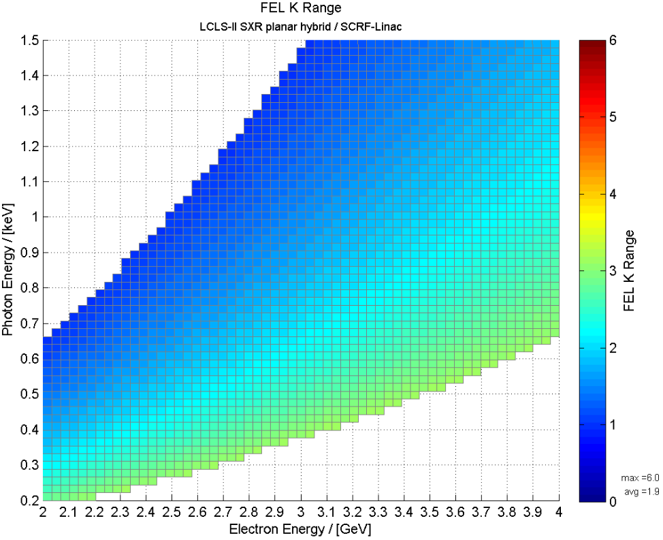
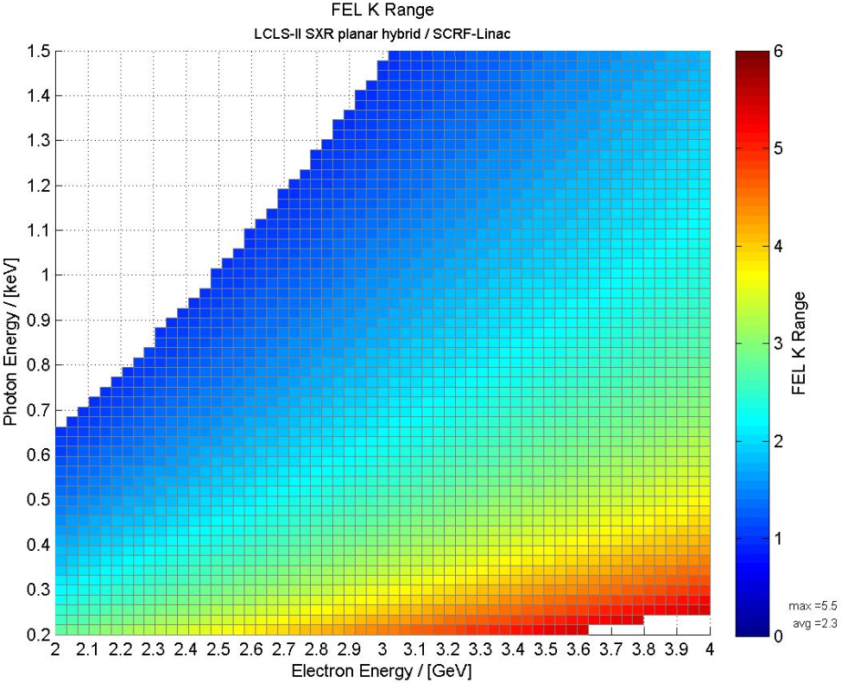
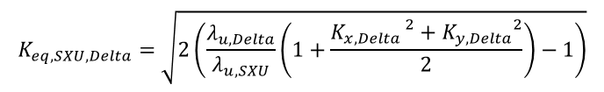
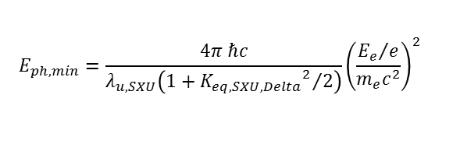
DELTA-II K Range Requirements
LCLS DELTA
LCLS-II SXU
LCLS-II DELTA
LCLS Delta
K_{eq,max}=3.18
λ_{u} =32 mm
SXU
K_{max}=5.48
λ_{u} =39 mm
$$E_{ph,min}=\frac{4π ℏc}{λ_{u,SXU}\left(1+{{K_{eq,SXU,Delta}}^{2}}/2\right)}{\left(\frac{{E_{e}}/e}{m_{e}c^{2}}\right)}^{2}$$
$$K_{eq,SXU,Delta}=\sqrt{2\left(\frac{λ_{u,Delta}}{λ_{u,SXU}}\left(1+\frac{{K_{x,Delta }}^{2}+{K_{y,Delta}}^{2}}{2}\right)−1\right)}$$
To match ranges: increase $λ_{u,Delta}$ (32 mm to 42 mm) and $\sqrt{{B_{x,max,Delta }}^{2}+{B_{y, max,Delta}}^{2}}$ (1.19 T to 1.34 T)

Slide 2
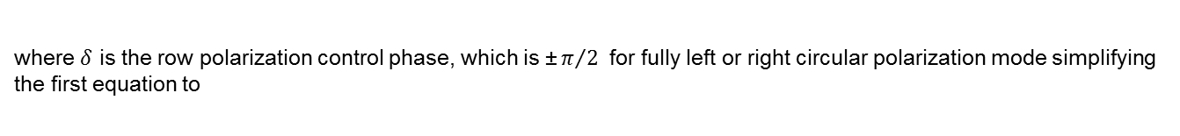
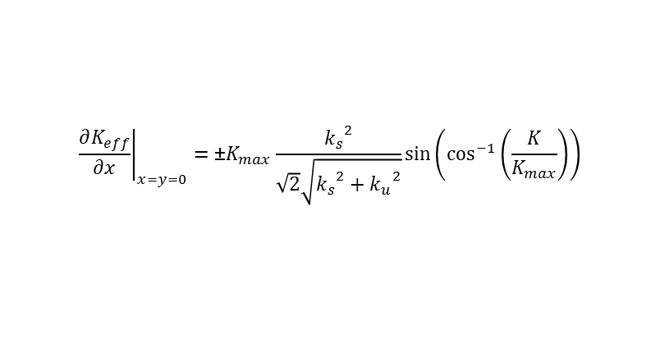
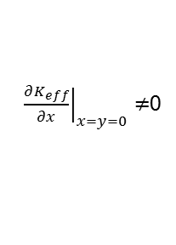
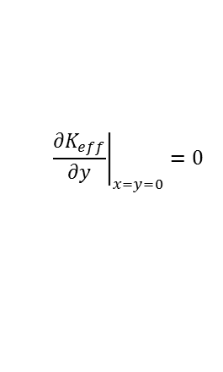
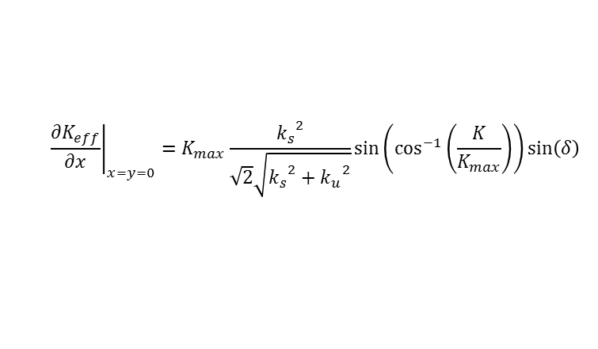
Delta K Gradient in Circular Mode
A gradient of K vs x was found on the magnetic axis in APPLE-II undulators in circular mode when K is controlled by row phases. [1]
${\left.\frac{∂K_{eff}}{∂x}\right|}_{x=y=0}≠$0
It was shown that the Delta undulator exhibits the same behavior [2]. To first order, the on-axis gradient can be expressed as
$${\left.\frac{∂K_{eff}}{∂x}\right|}_{x=y=0}=K_{max}\frac{{k_{s}}^{2}}{\sqrt{2}\sqrt{{k_{s}}^{2}+{k_{u}}^{2}}}sin\left(\cos^{−1}\left(\frac{K}{K_{max}}\right)\right)sin\left(δ\right)$$
$${\left.\frac{∂K_{eff}}{∂y}\right|}_{x=y=0}=0$$
where $δ$ is the row polarization control phase, which is $\text{±}π/{2 }$ for fully left or right circular polarization mode simplifying the first equation to
$${\left.\frac{∂K_{eff}}{∂x}\right|}_{x=y=0}=\text{±}K_{max}\frac{{k_{s}}^{2}}{\sqrt{2}\sqrt{{k_{s}}^{2}+{k_{u}}^{2}}}sin\left(\cos^{−1}\left(\frac{K}{K_{max}}\right)\right)$$
The parameter $k_{s}$ depends on the transverse structure of the pole tips. For the present Delta undulator, it has been measured magnetically to $k_{s}=\text{186 }{\text{m}}^{\text{-1}}$. Reduction of this parameter is possible to some degree but reducing it to zero seems not to be possible without loosing most of the undulator strength.
[1] T. Schmidt, M. Calvi, T. Schmitt, V.N. Strocov, D. Zimoch, “Operation experience of the UE44 fixed gap APPLE II at SLS”, (SRI 2012) Journal of Physics: Conference Series 425 (2013) 032020 doi:10.1088/1742-6596/425/3/032020
[2] Z. Wolf, "Position Dependence of the K Parameter in the Delta Undulator." LCLS-TN-16-1 (January 2016)

Slide 3
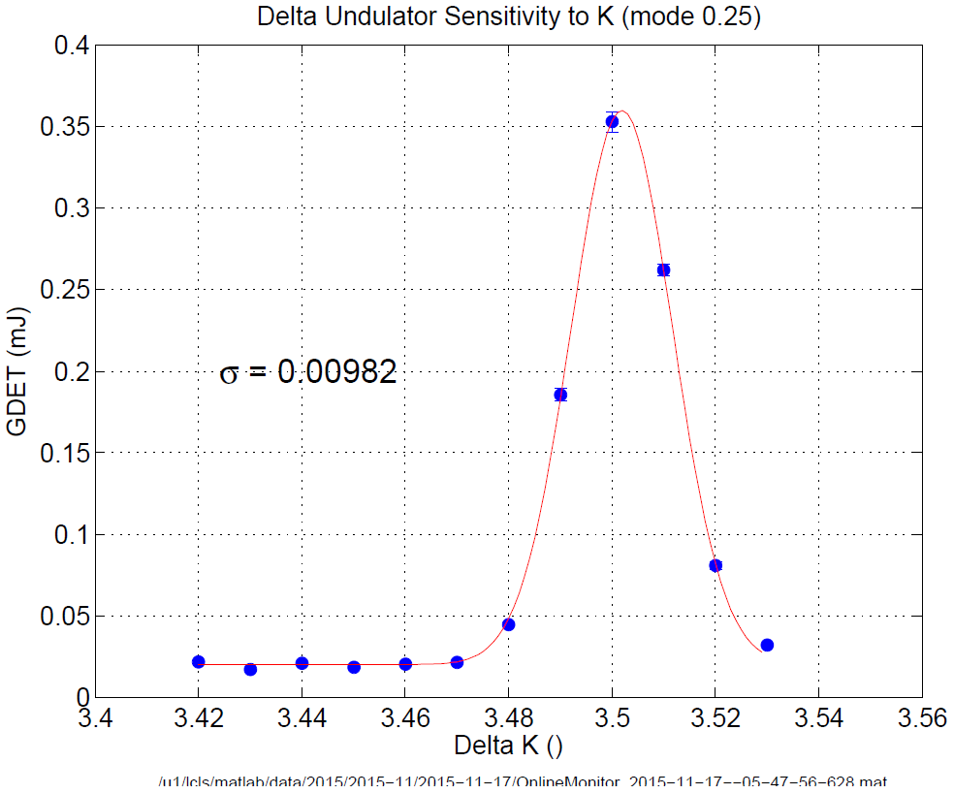
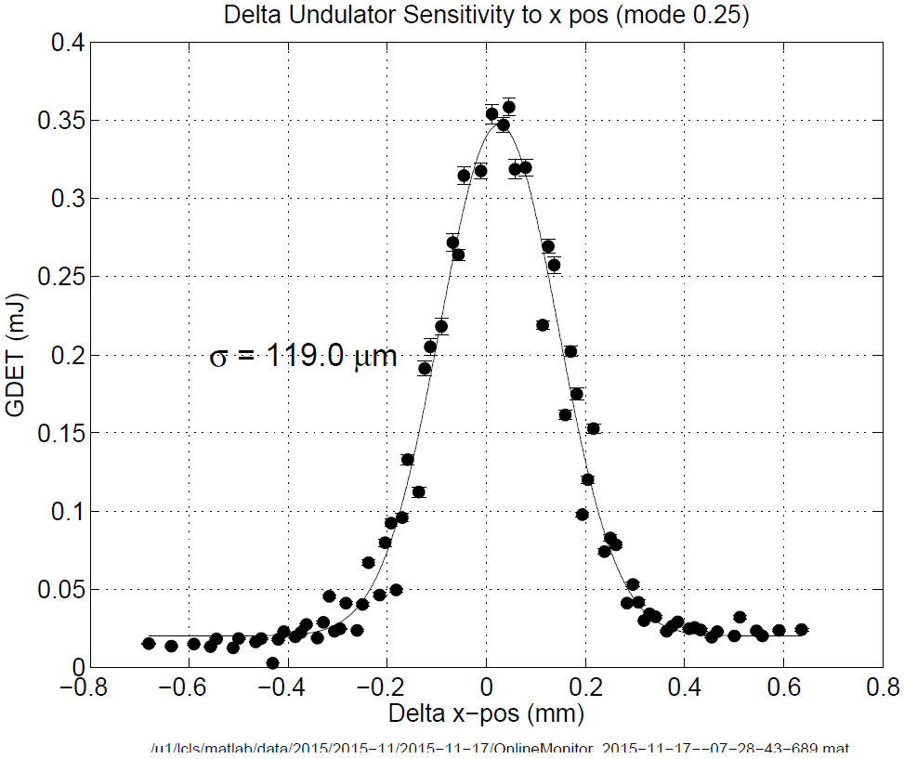


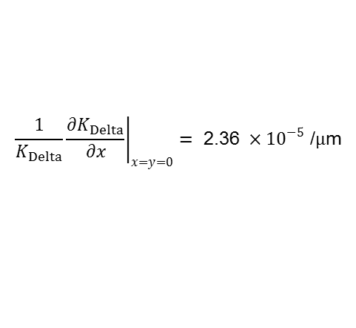

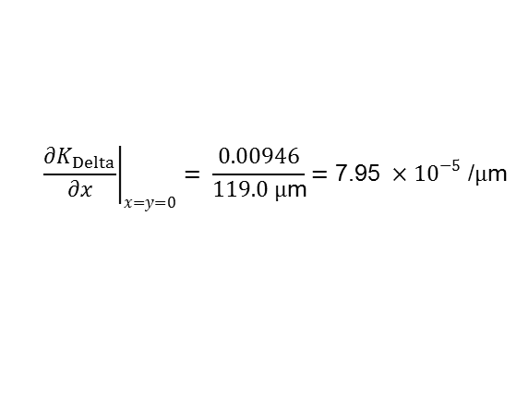

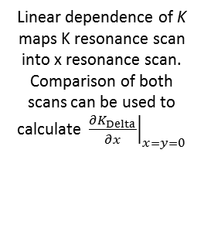


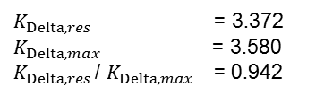
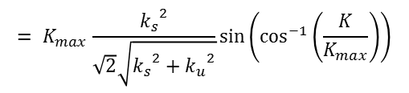

Beam Based Measurement of Delta Undulator K Gradient
$$E_{ph}=\text{530 }\text{eV}$$
Right Circular Polarized Radiation
Right Circular Polarized Radiation
Linear dependence of K maps K resonance scan into x resonance scan.
Comparison of both scans can be used to calculate ${\left.\frac{∂K_{Delta}}{∂x}\right|}_{x=y=0}$
Delta K Resonance Scan
Delta x Position Scan
$$GDET={GDET}_{max}e^{−\frac{{\left(K−K_{res}\right)}^{2}}{{2\text{s}}^{2}}}$$
$$GDET={GDET}_{max}e^{−\frac{{\left(x−x_{res}\right)}^{2}}{{2\text{s}}^{2}}}$$
σ = 0.00946
$$\frac{\text{s}}{K_{res}}=\text{2.8} ×{10}^{−3}$$
$$ρ_{1D}=\text{2.4} ×{10}^{−3}$$
$$\frac{\text{1}}{N_{per}}=\text{10} ×{10}^{−3}$$
3.27 3.29 3.31 3.33 3.35 3.37 3.39 3.41 3.43
$K_{Delta,res}$ = 3.372
$K_{Delta,max}$ = 3.580
$K_{Delta,res}$ / $K_{Delta,max}$ = 0.942
$${\left.\frac{∂K_{Delta}}{∂x}\right|}_{x=y=0}= \frac{0.00946}{119.0 μ\text{m}}=\text{7.95 }×{10}^{−5}\text{ /}μ\text{m}$$
Note: Off-axis micro-bunched beam radiates less instead of adjusting wavelength
$${\left.\frac{1}{K_{Delta}}\frac{∂K_{Delta}}{∂x}\right|}_{x=y=0}=\text{ 2.36 }×{10}^{−5}\text{ /}μ\text{m}$$
$${= K}_{max}\frac{{k_{s}}^{2}}{\sqrt{2}\sqrt{{k_{s}}^{2}+{k_{u}}^{2}}}sin\left(\cos^{−1}\left(\frac{K}{K_{max}}\right)\right)$$
with $k_{s}=\text{152} {\text{m}}^{\text{−1}}$

Slide 4
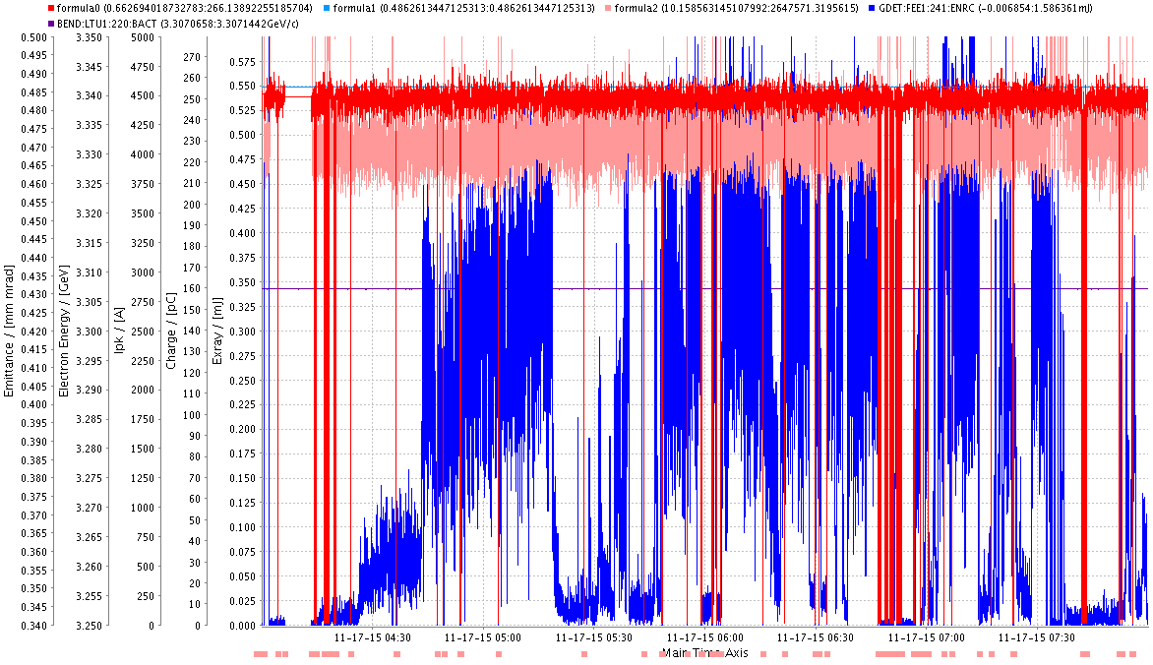
LCLS Experimental Parameters

Slide 5
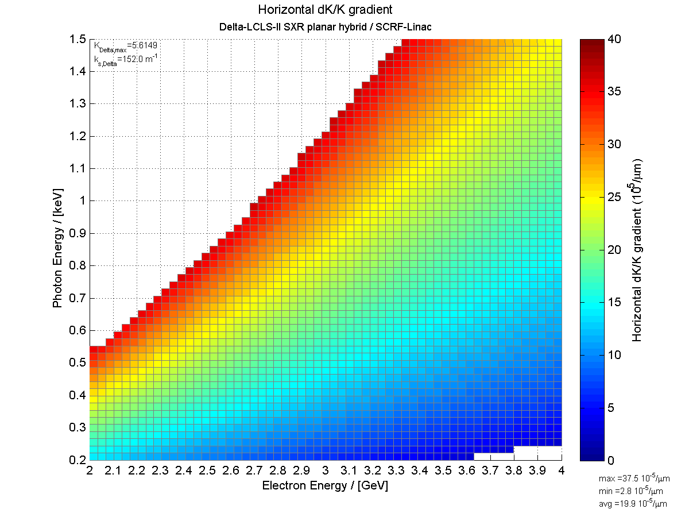

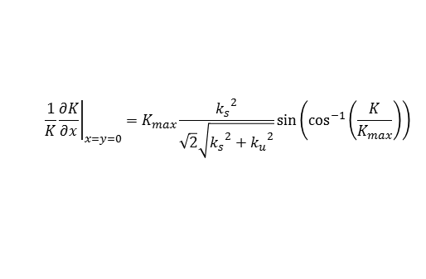
Predicted DELTA-II Horizontal Gradients
$${\left.\frac{1}{K}\frac{∂K}{∂x}\right|}_{x=y=0}=K_{max}\frac{{k_{s}}^{2}}{\sqrt{2}\sqrt{{k_{s}}^{2}+{k_{u}}^{2}}}sin\left(\cos^{−1}\left(\frac{K}{K_{max}}\right)\right)$$
$λ_{u,DELTA−II}$ = 42 mm
Right Circular Polarized Radiation

Slide 6
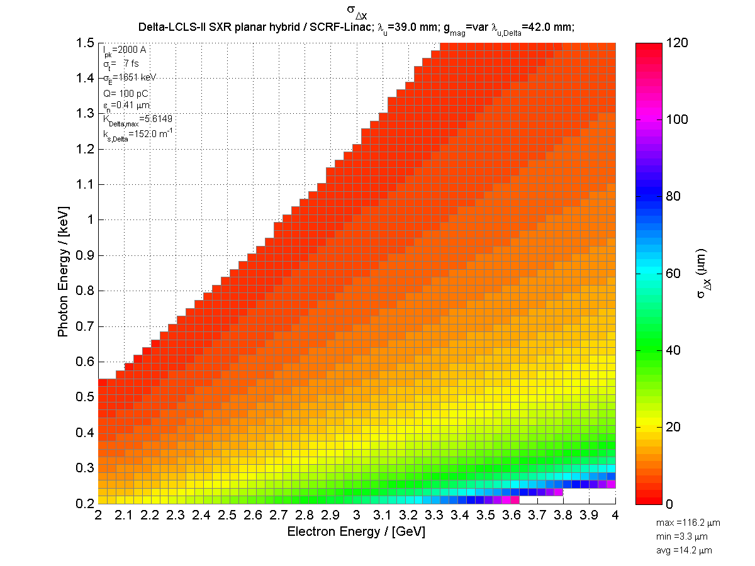
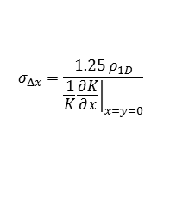
Predicted DELTA-II RMS X-Resonance Width
$$σ_{Δx}=\frac{1.25 ρ_{1D}}{{\left.\frac{1}{K}\frac{∂K}{∂x}\right|}_{x=y=0}}$$

