Slide 1
Hall Probes And Measurements
Zack Wolf
3/29/2016

Slide 2
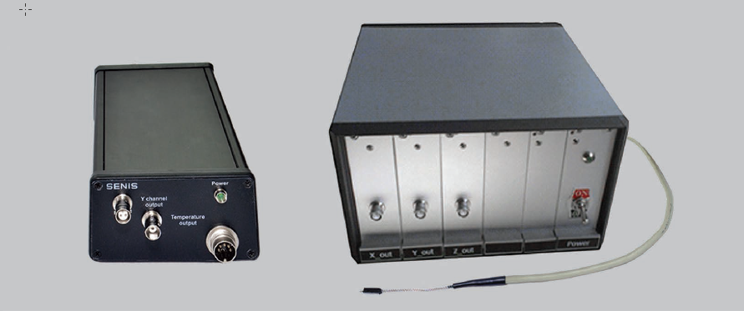
Senis Hall Probe Box Styles

Slide 3
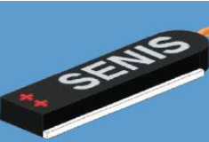
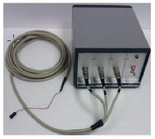
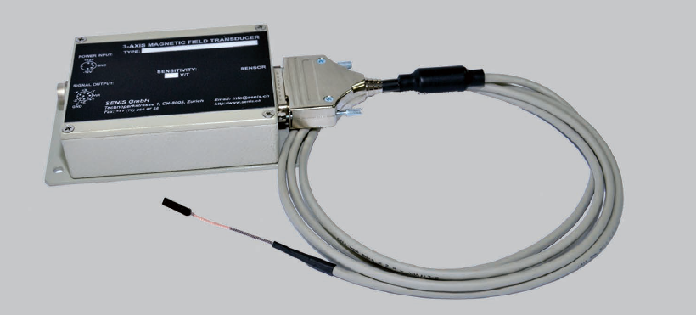
Senis Hall Probe Boxes Continued

Slide 4
Box Weights
Weight of large box: ~7 pounds
Weight of small box: ~2 pounds
For now, we need the large box because it avoids errors
due to temperature variations in the box.

Slide 5
Potential Problem
Heinz-Dieter
From last meeting
But what if the E has
reference surfaces that
are not flat?

Slide 6
Quadrant Bow
LCLS-TN-15-1
We need the reference surfaces on the E’s to be flat to
18 microns in order to keep phase errors below 5 degrees.

Slide 7

End

