Slide 1
Delta Phase Errors
Zack Wolf
3/8/16

Slide 2
Slippage
T₁
T₂
T₃
B correct
Z
B too large
v_{z} too small
B too small
v_{z} too large

Slide 3
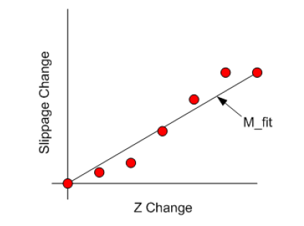
Linear Fit To Slippage vs Z
B high
Slippage high
Linear fit
Gives K
Slippage residuals
Give phase errors
B low
Slippage low

Slide 4









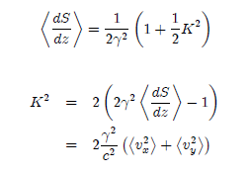


Slippage, Phase, K, Phase Errors

Slide 5
Example 1: Undulator Not Resonant
Slippage too high
K too high
Field too high
K correct
Add photons
coherently to
light wave
Field to low
Slippage too low
K too low

Slide 6
Example 2: Linear Taper
High dS/dz
High field
Low dS/dz
Fitted line
Fit residuals
Low field
Proportional to
fit residuals

Slide 7
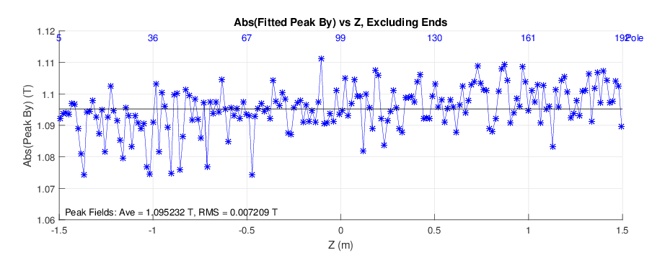
Delta Measured Peak Fields, LPVMF mode, Krel = 0.9
By is increasing with Z

Slide 8
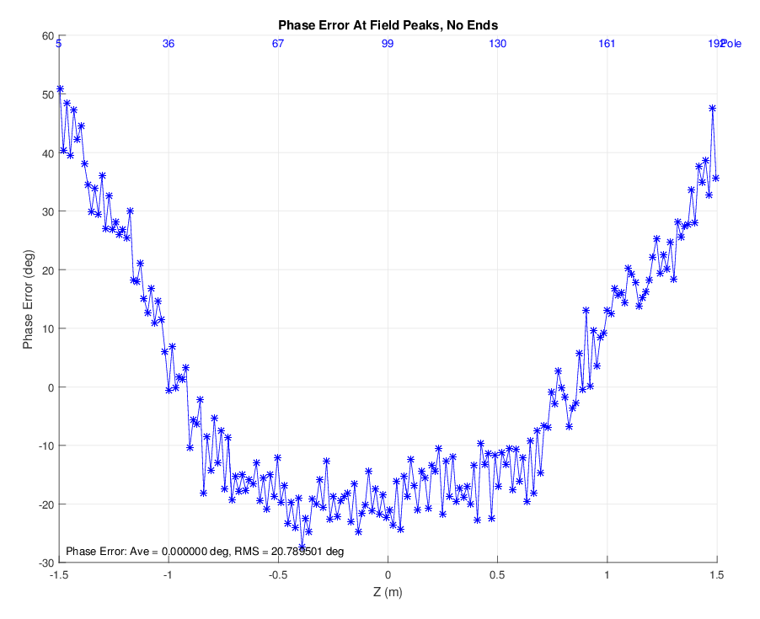
Delta Measured Phase Errors, LPVMF mode, Krel = 0.9

Slide 9
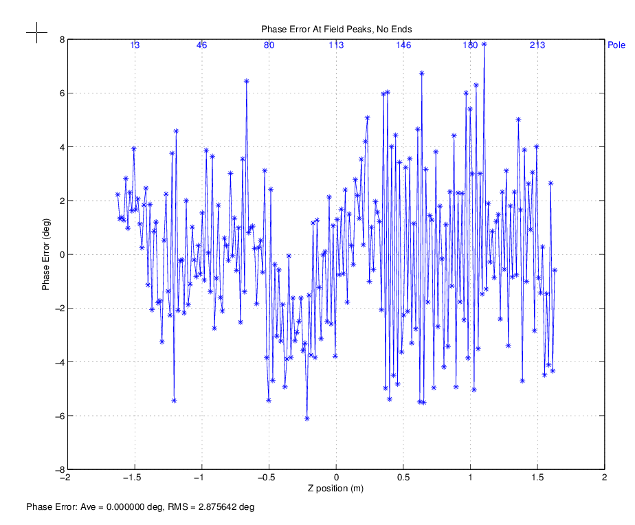
Compare To LCLS Undulator 12

Slide 10
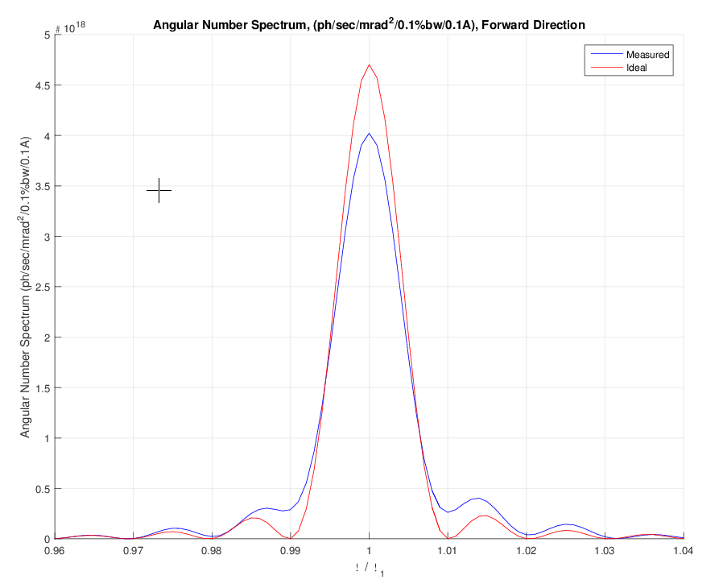
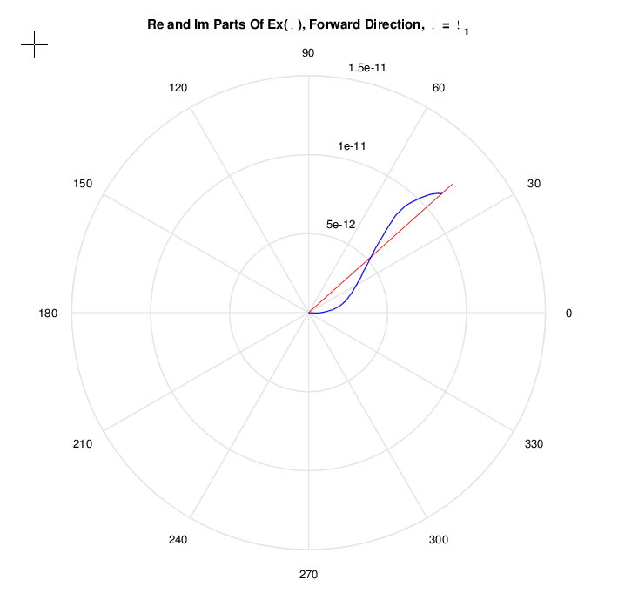
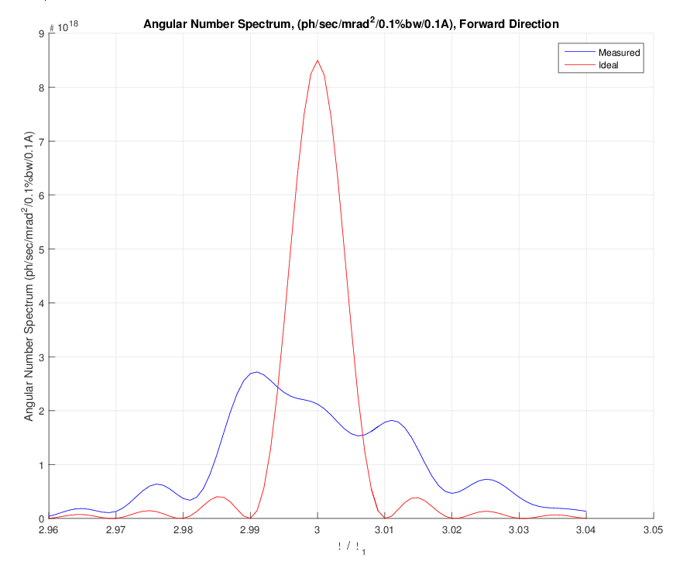
Phase Error Effect On Radiation

Slide 11
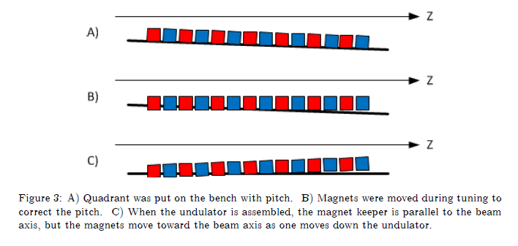
Phase Errors Can Come During Tuning Or Assembly

Slide 12
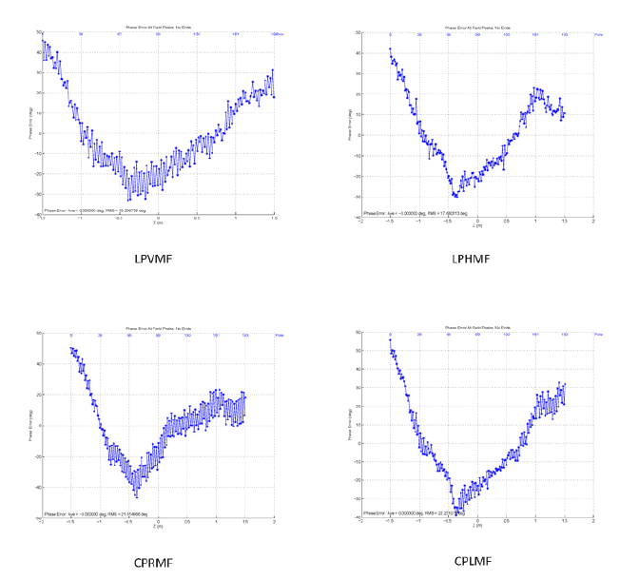
Delta Phase Errors In Primary Modes

Slide 13
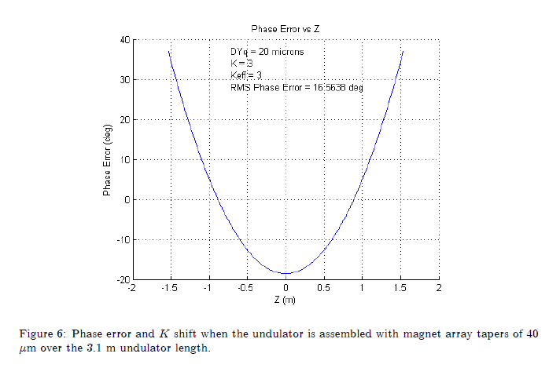
Simulation Phase Error With Undulator Taper
LCLS-TN-15-2

Slide 14
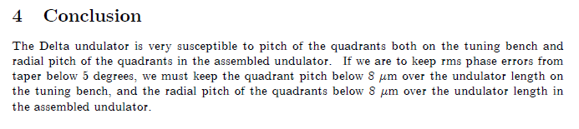
Undulator Taper Conclusion
LCLS-TN-15-2

Slide 15
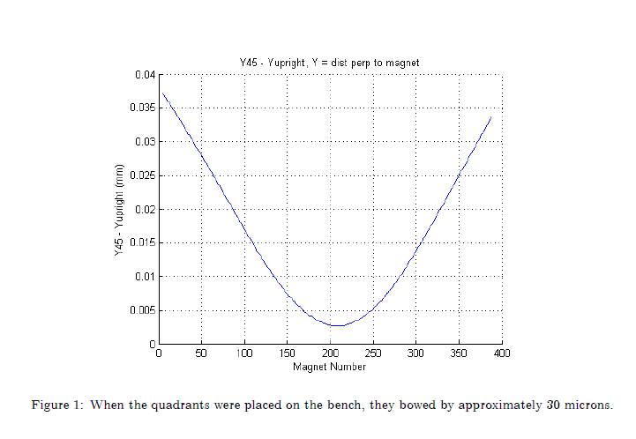
Quadrant Bow
LCLS-TN-15-1

Slide 16
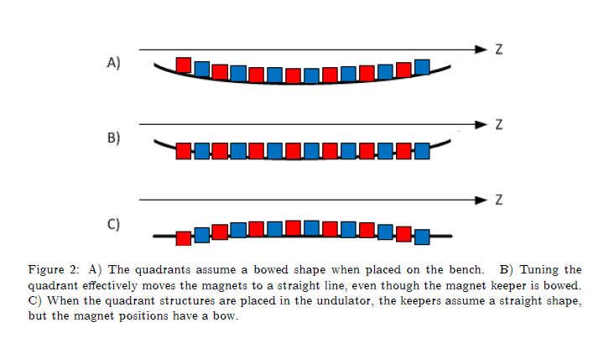
Magnet Position Errors From Quadrant Bow

Slide 17
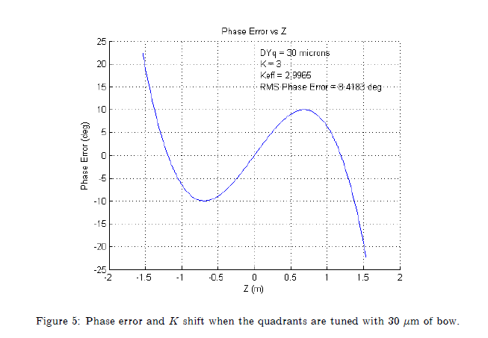
Simulation Phase Errors From Quadrant Bow

Slide 18
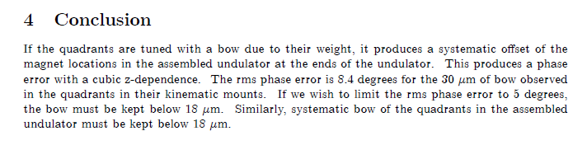
Quadrant Bow Conclusion
Summary:
Quadrant bow must be limited.
Taper in the undulator is the more problematic phase error source.

Slide 19

End

