Slide 1
Magnetic Measurements And Magnet Fiducialization At SLAC
Zachary Wolf
SLAC
August 25, 2015

Slide 2
Overview
Field harmonics in a multipole magnet
Rotating coil
Field maps
Hall probe, NMR probe, pulsed wire, short rotating coil
Field integrals
Moving wire
Fiducialization
Dipoles
Quadrupoles, Sextupoles, etc.
How to locate a wire
Solenoids
Undulators
How to locate a Hall probe

Slide 3
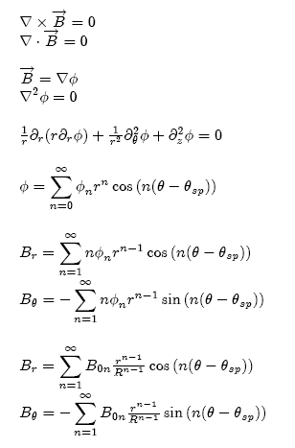
Field In A Multipole Magnet
Assume ∂_{z} = 0
R = ‘reference radius’

Slide 4
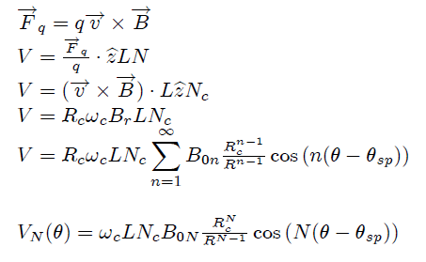
Voltage From A Rotating Coil
Main harmonic

Slide 5
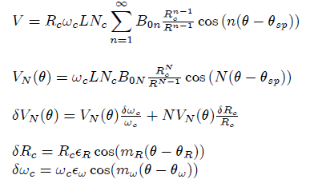


Effect Of Rotation Errors
Eg. Bad bearing
Eg. Speed variations
Coil motion error signals look like harmonics
Solution: integrate voltage to remove speed variation effects (use flux vs angle),
buck out main harmonic, only measure small harmonics

Slide 6
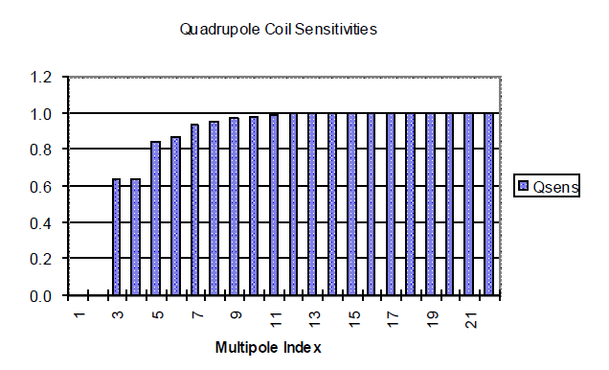
Bucking Coil
Example from Tanabe, “Iron Dominated Electromagnets”

Slide 7
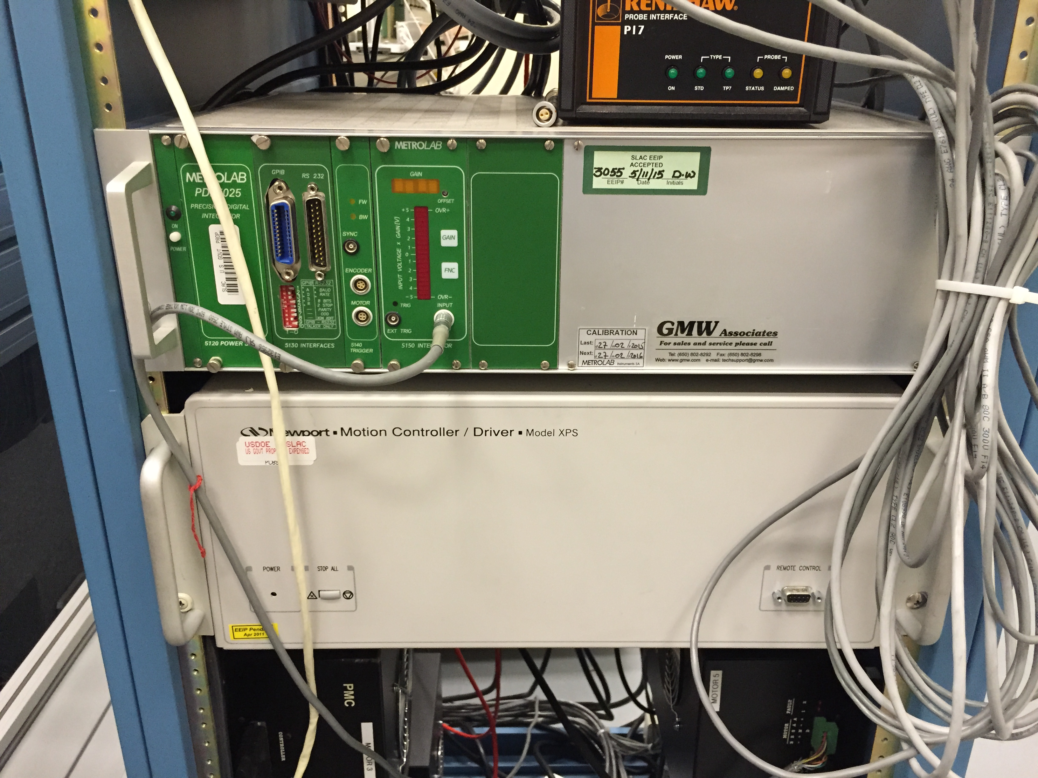

Integrator
Digital integrator
Trigger with encoder.
Measure Φ(θ).
No coil speed dependence.
Calculate field harmonics
From flux harmonics.

Slide 8
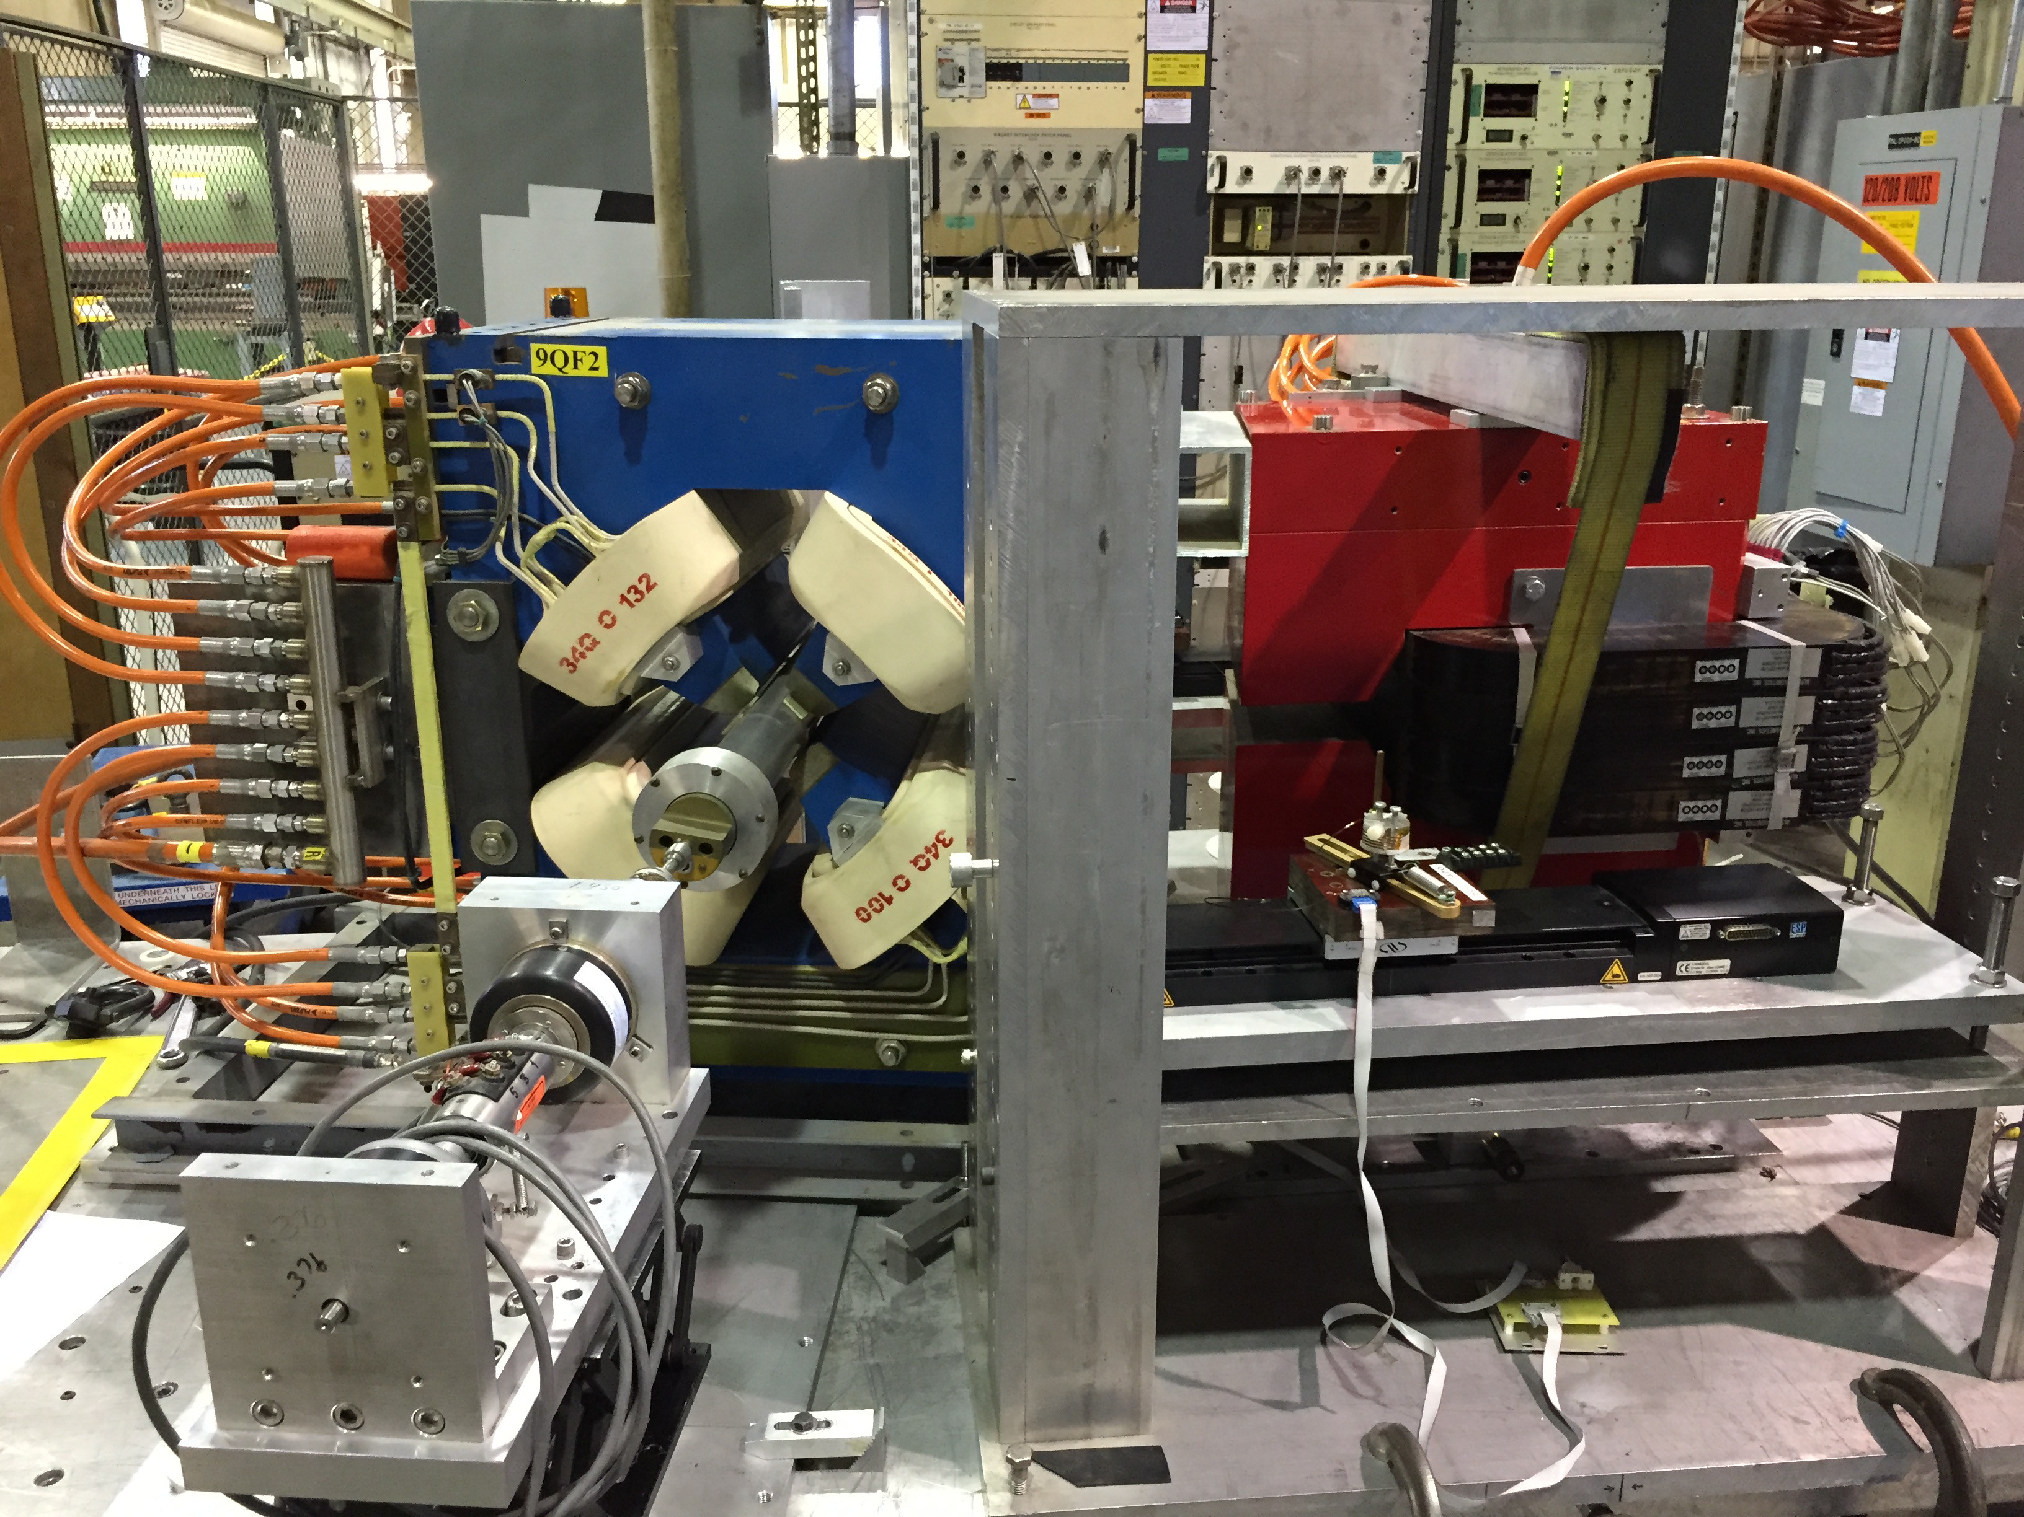
Rotating Coil Measurements
Bucking Coil
Encoder
Slip Rings
Motor
S. Anderson
Measuring magnetic crosstalk between magnets

Slide 9
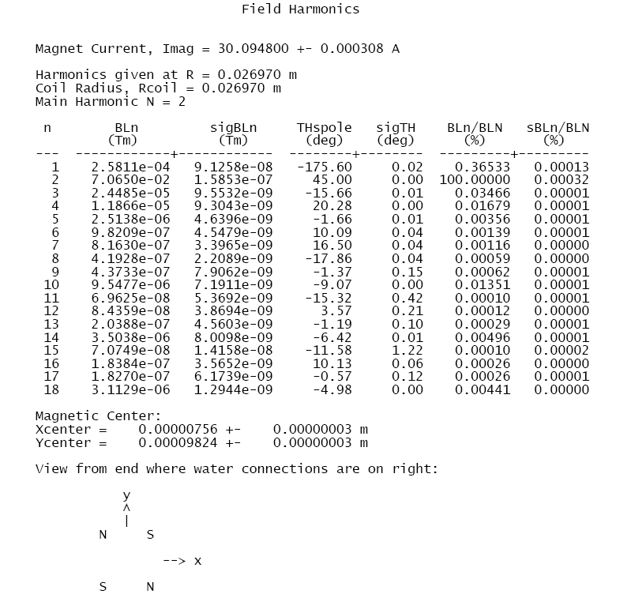
Example: Harmonics Measurement Of A Quadrupole

Slide 10
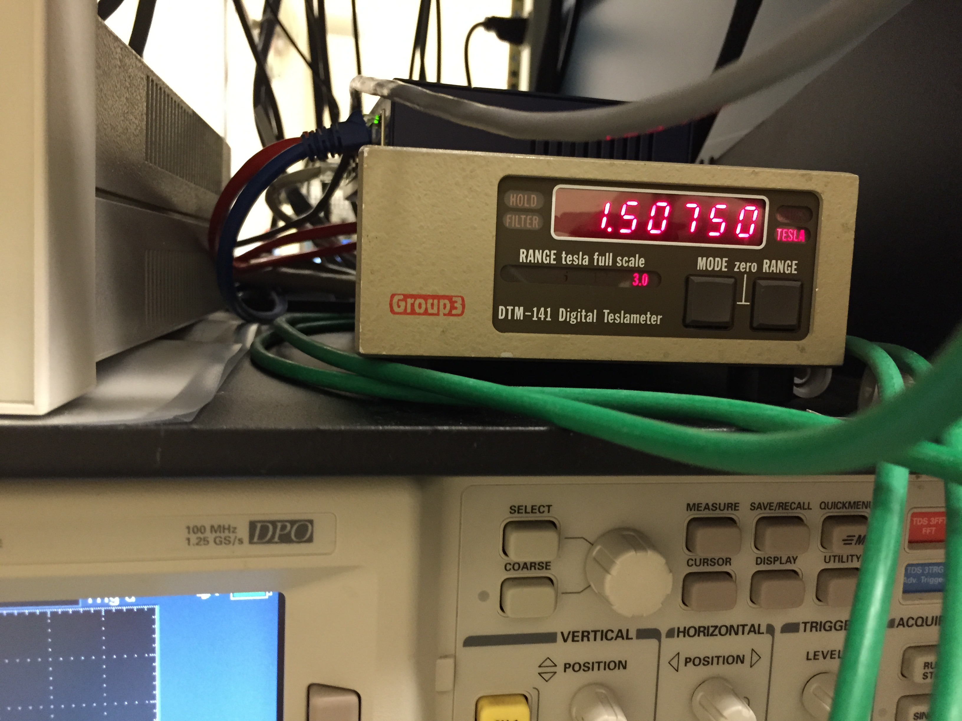
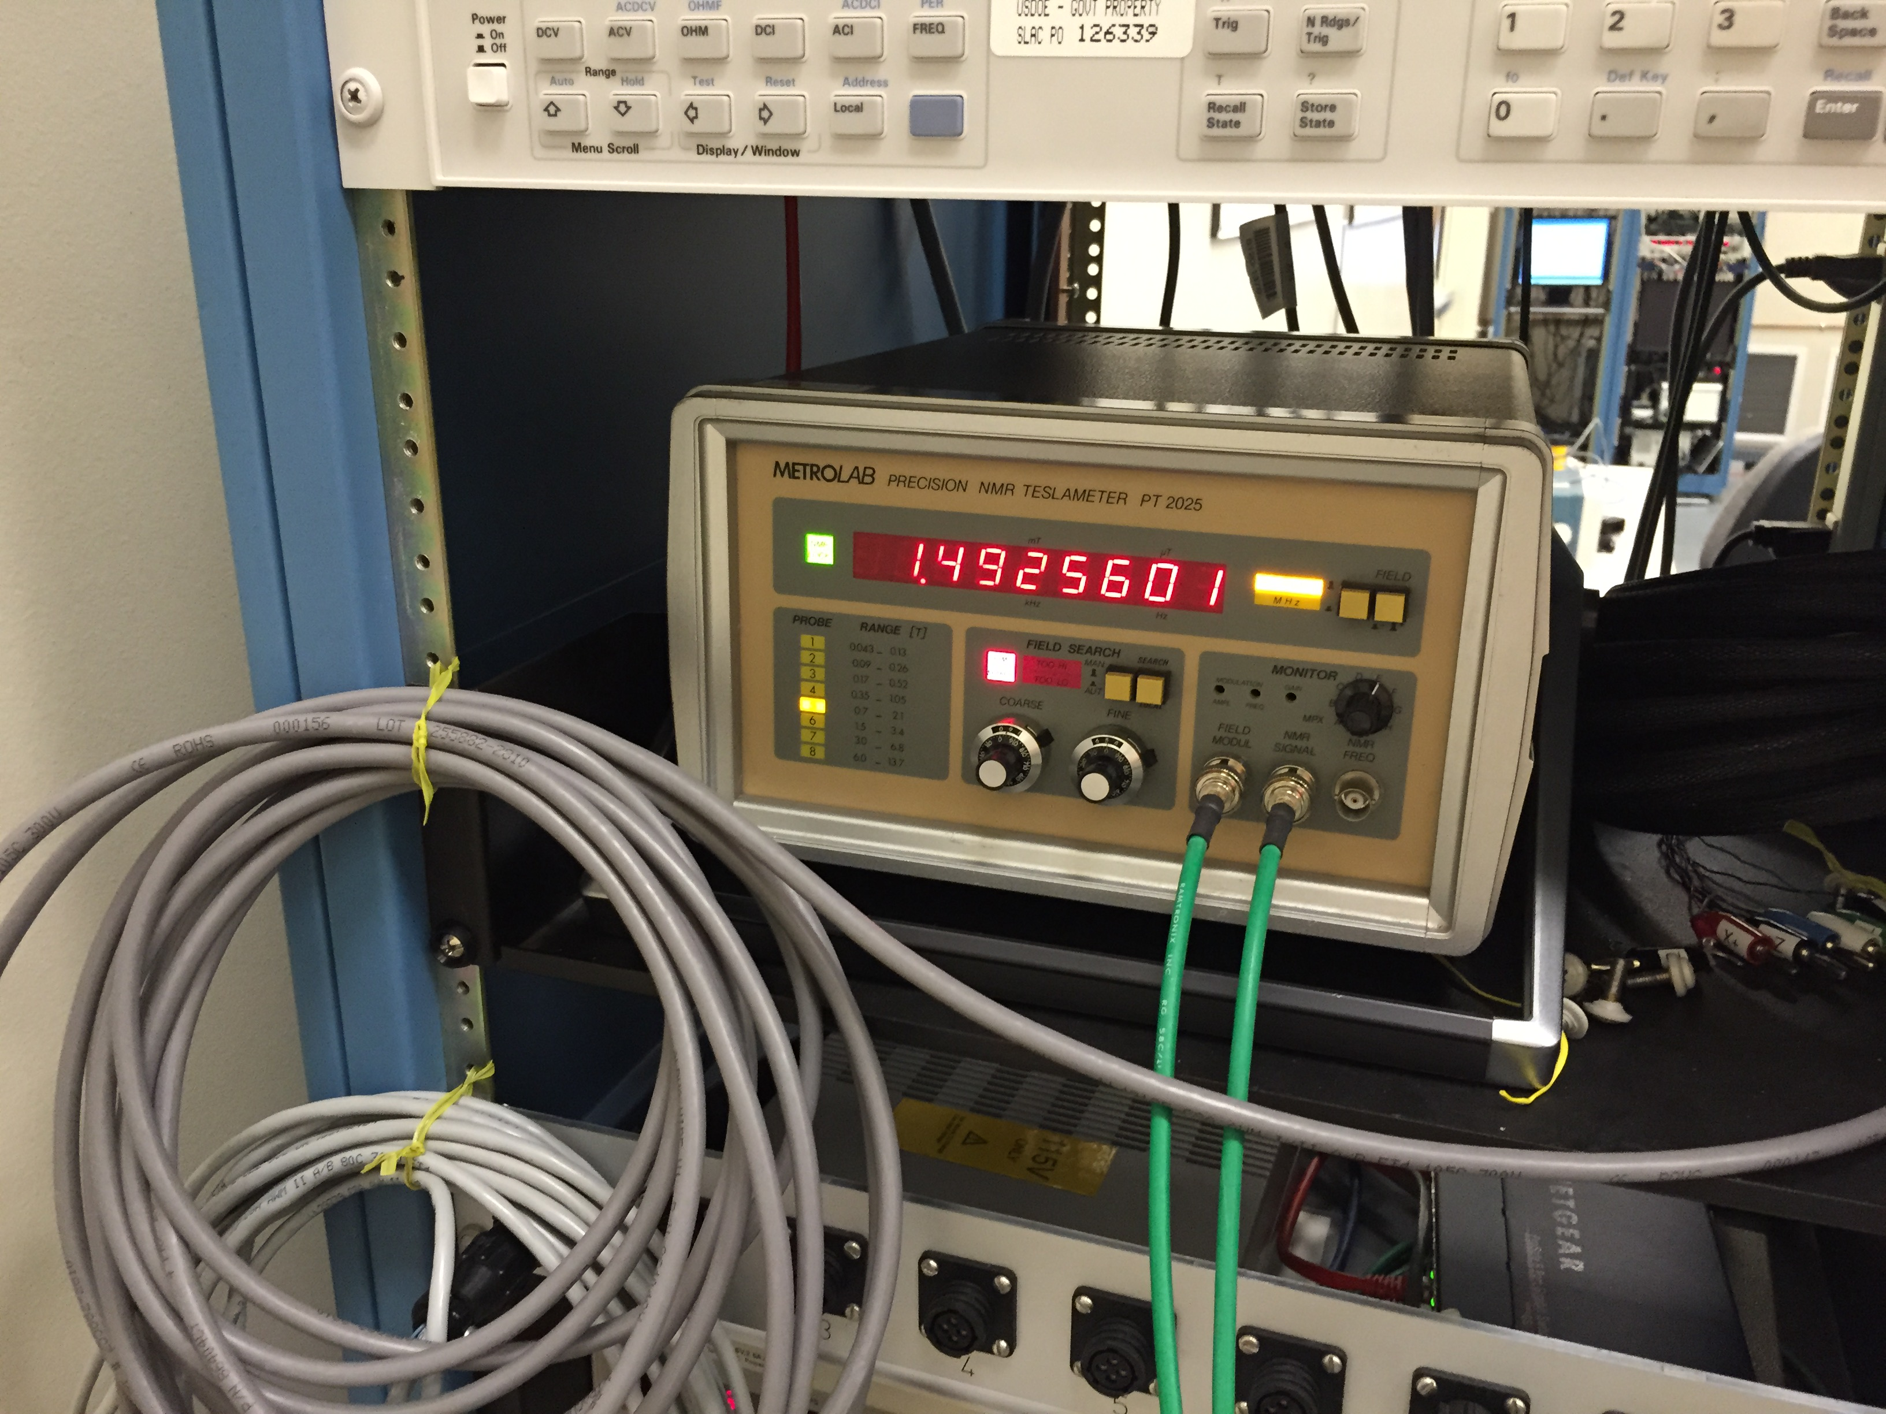
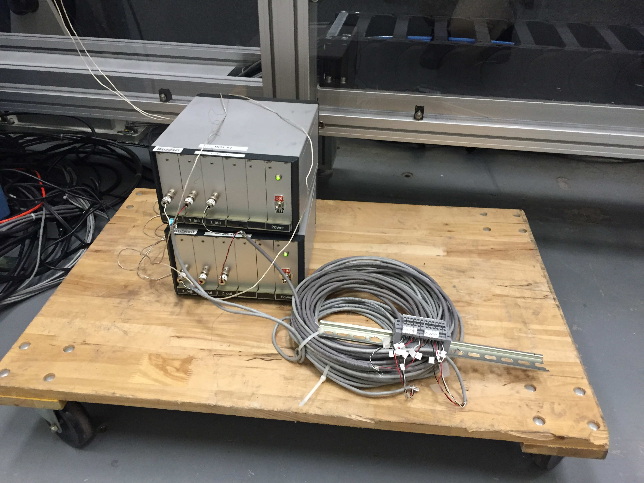
Hall Probes, NMR Probes
General Purpose Hall Probe
NMR
NMR
accurate,
large sample size,
requires uniform field
Hall Probe
small sample size
nonlinear, offset drift, gain drift, …
needs lots of calibration
Custom Hall probe for Delta undulator

Slide 11
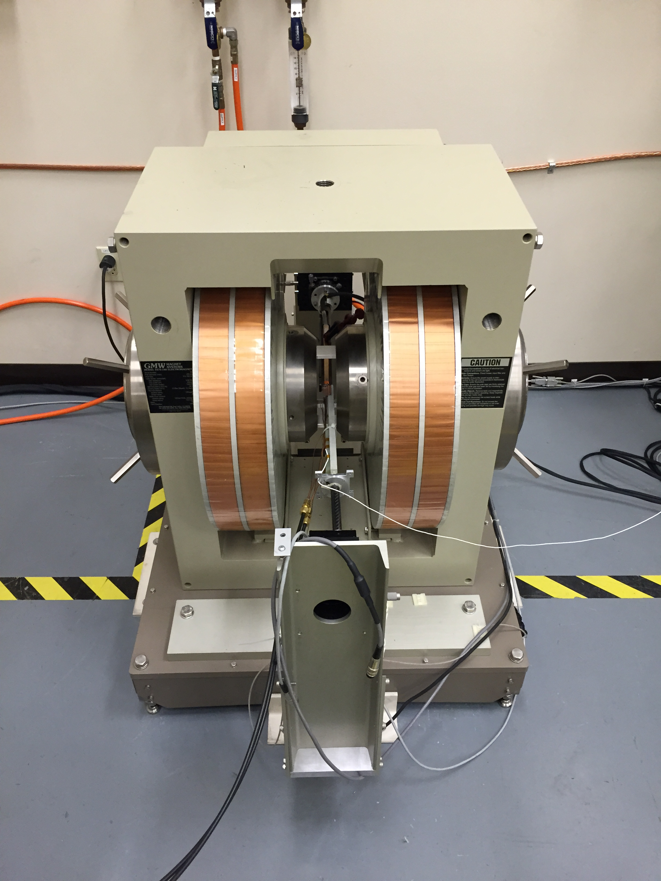
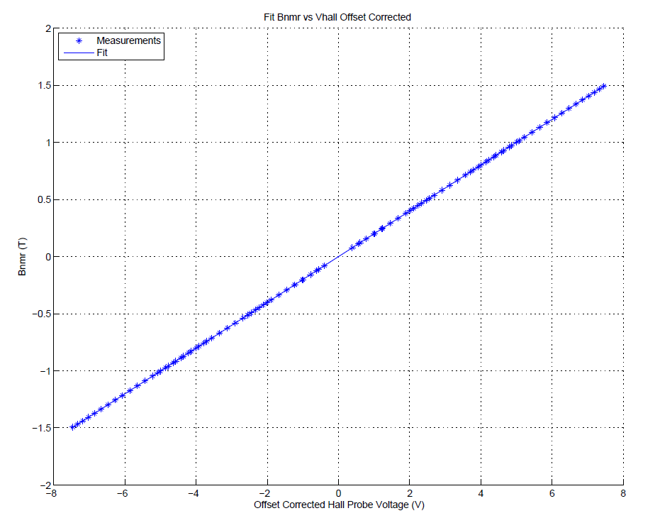
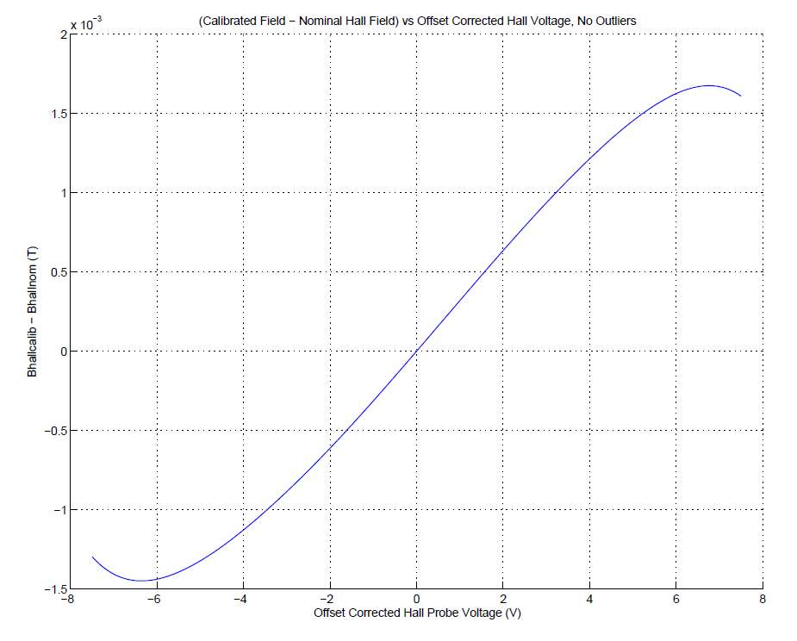
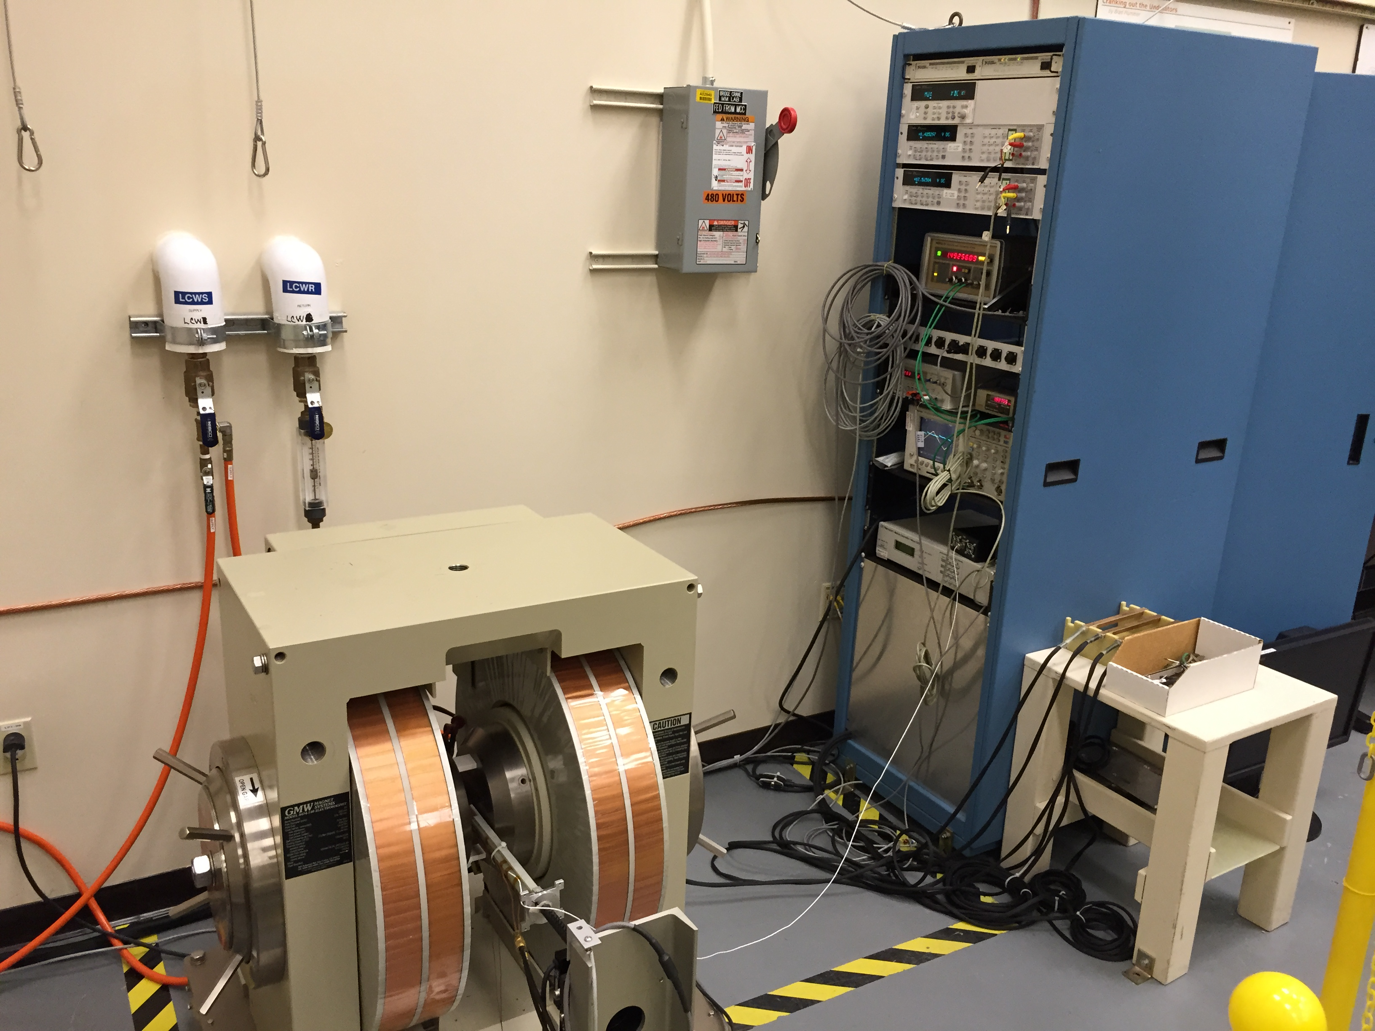
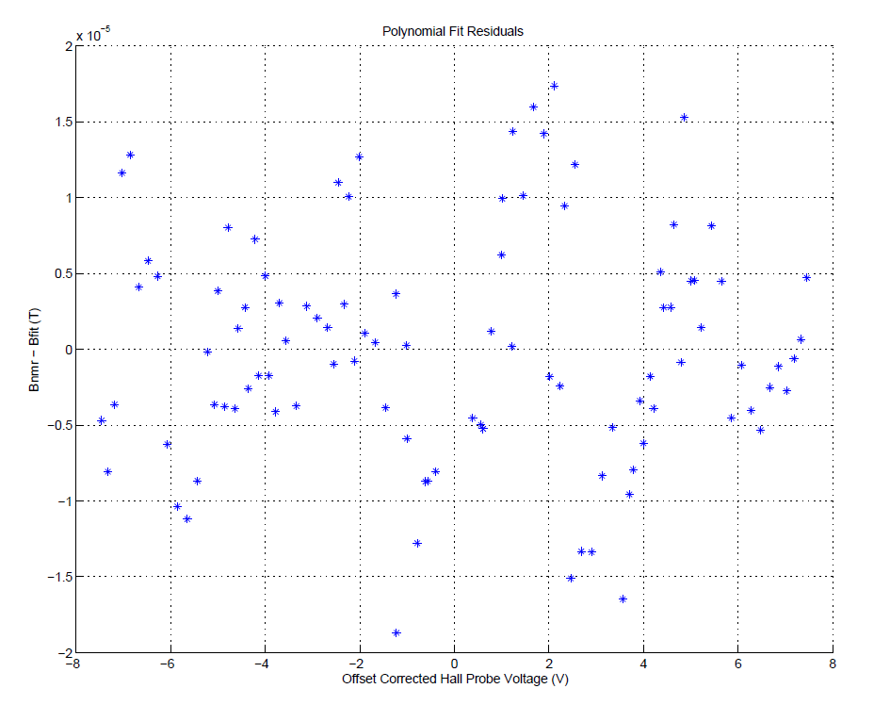
Hall Probe Calibration
Y. Levashov

Slide 12
Field Maps With Hall/NMR Probes
Dipole magnet.
Use Hall probe at ends.
Use NMR in center.
Apply small correction
to end fields using NMR
in center.

Slide 13
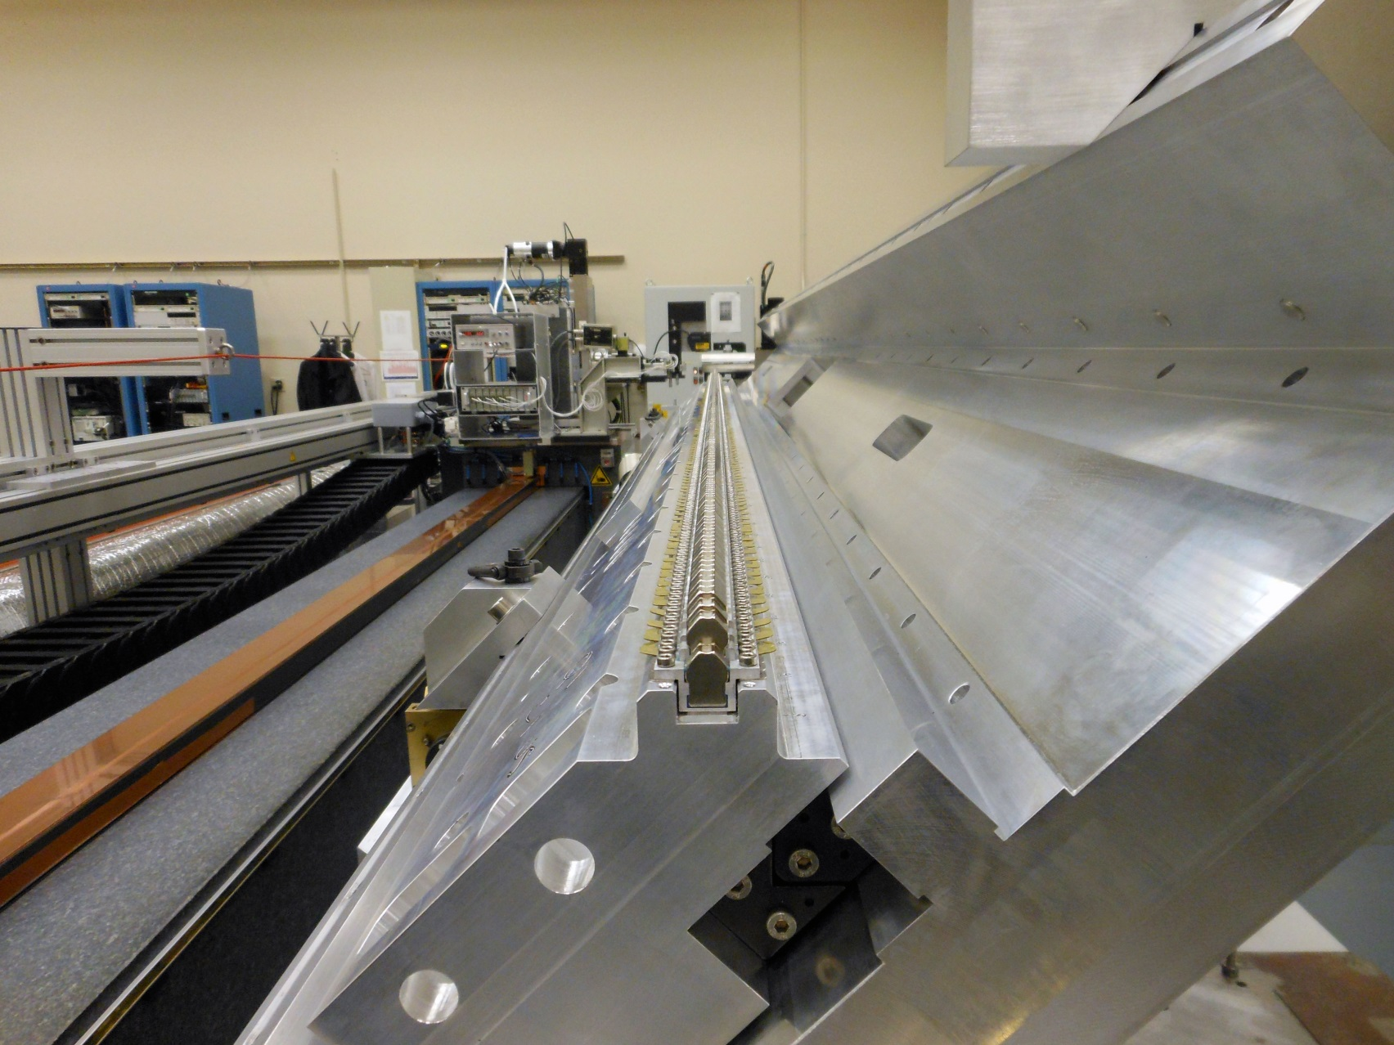
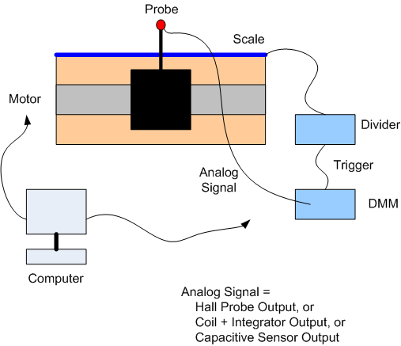
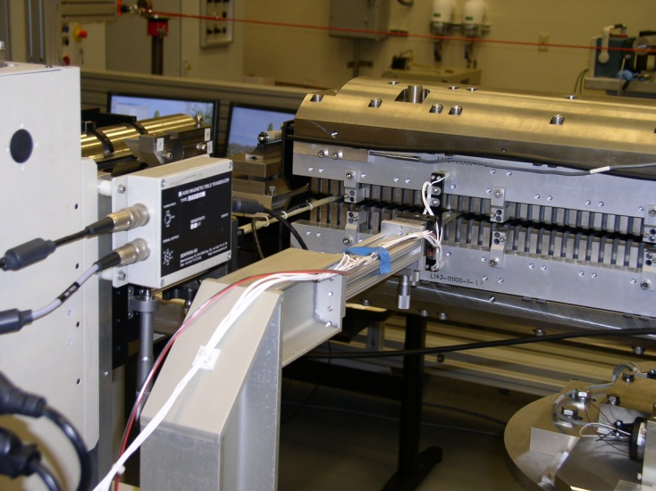
Undulator Hall Probe Measurements
Delta undulator quadrant
LCLS undulator

Slide 14











Pulsed Wire
Initial impulse
Travelling wave
Derivative of wire position
signal gives field

Slide 15
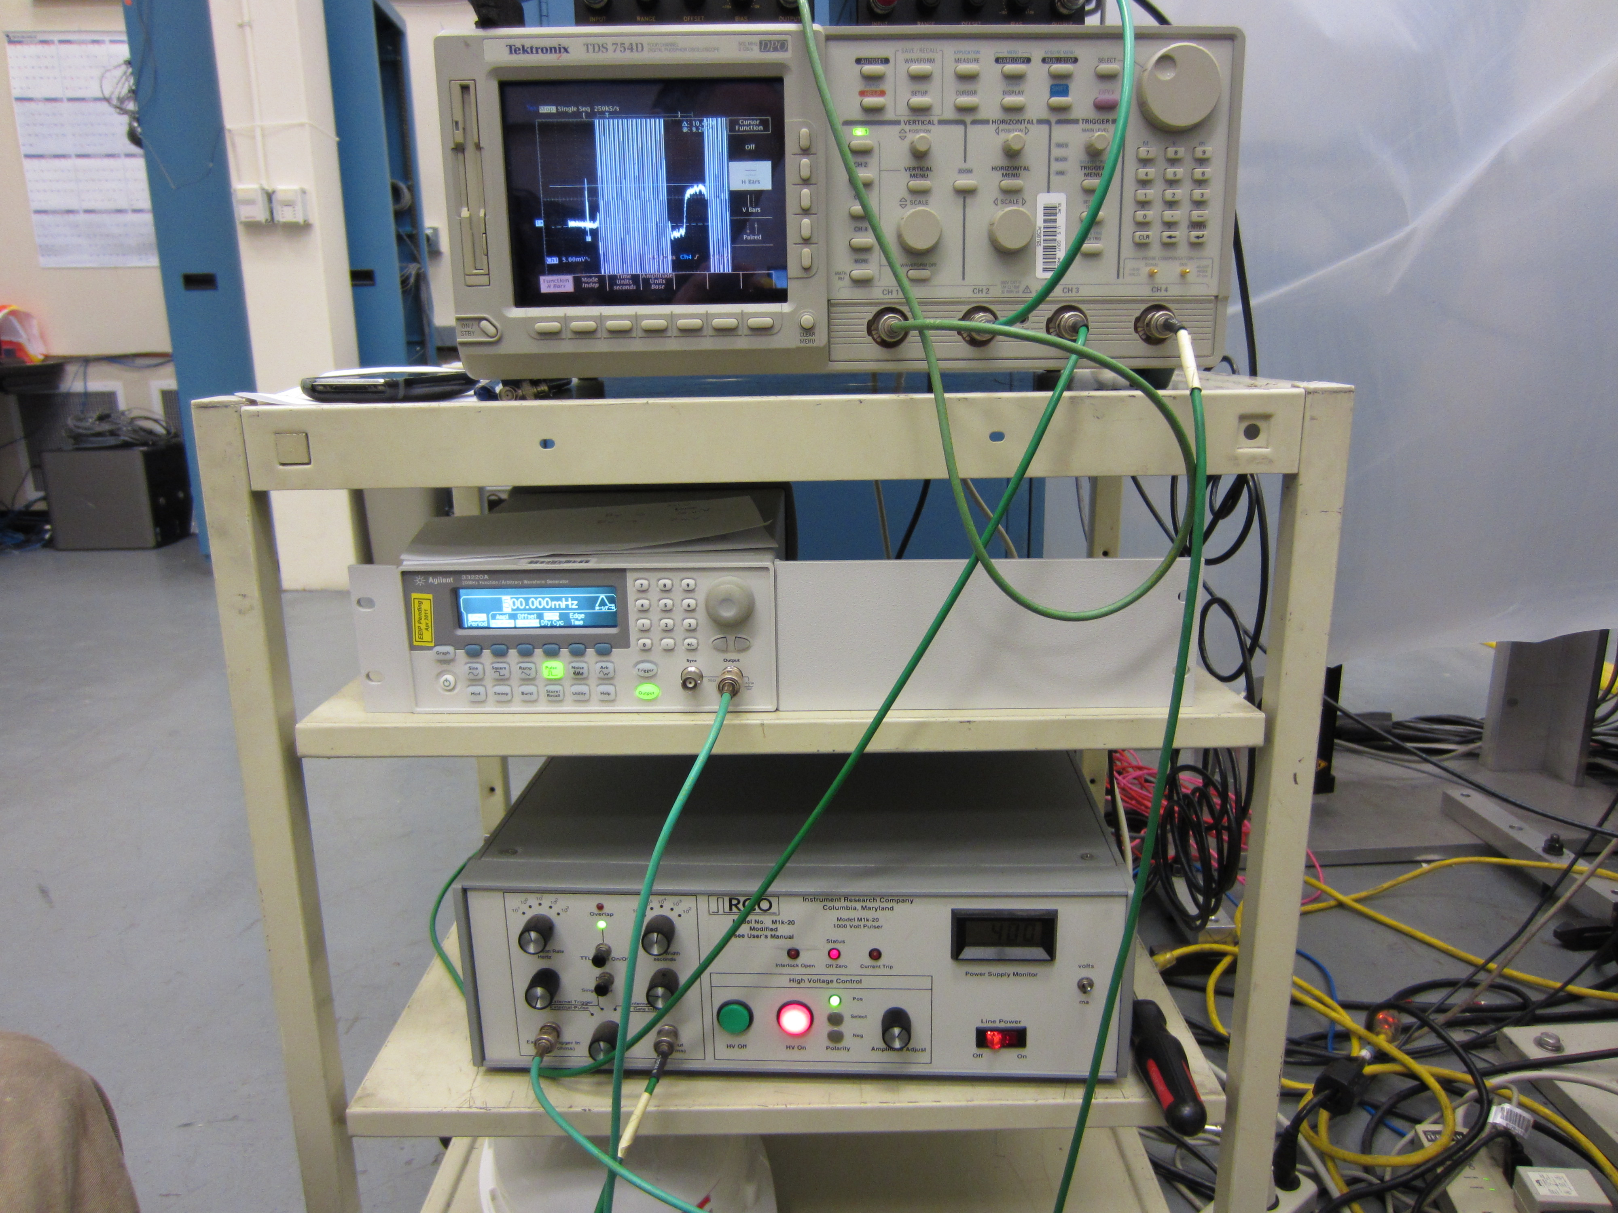
Field Map From A Pulsed Wire
Signal from an undulator.
Calibration magnet puts in
step at the end.
When the wave hits the
end of the wire, it reflects.
S. Anderson

Slide 16
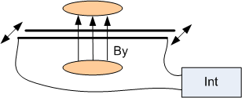
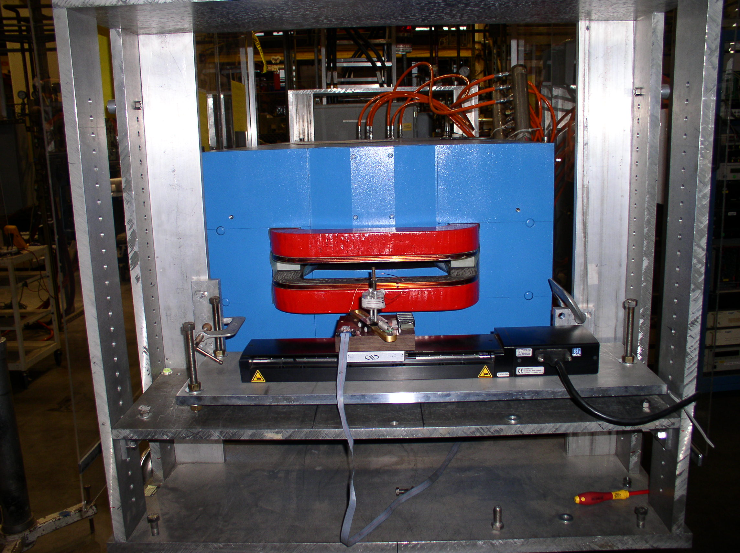

Field Integrals From A Moving Wire
Take out thermal emf:
V₊ = dΦ/dt + V_{t}
V₋ = -dΦ/dt + V_{t}
VT = (VT₊ - VT₋) / 2
= ΔΦ

Slide 17
Fiducialization
Suppose we know the beam line coordinates X_{b} and Y_{b}
in the telescope’s coordinate system.
We know Δx₁, Δx₂, Δy₁, and Δy₂ from the fiducialization.
We put the tooling balls at X_{b}+ Δx₁, X_{b}+ Δx₂, Y_{b}+ Δy₁, Y_{b}+ Δy₂
in order to place the magnet on the beam line.
In this way, we don’t need to know the details of the magnet’s
magnetic field in the tunnel.

Slide 18
Dipoles Mechanical Fiducialization
In steel magnets, the magnetic field shape is
‘determined’ by the steel.
Steel dipoles can be fiducialized mechanically.
A CMM can measure the position of the poles
and relate the pole positions to the tooling ball
positions.
Typically the CMM can only touch the poles near the ends and the middle
is ignored. Adequate for short magnets. Also, the poles have some roughness.
Roll accuracy estimate: ~25 µm / 5 cm = 5 x 10⁻⁴ rad

Slide 19
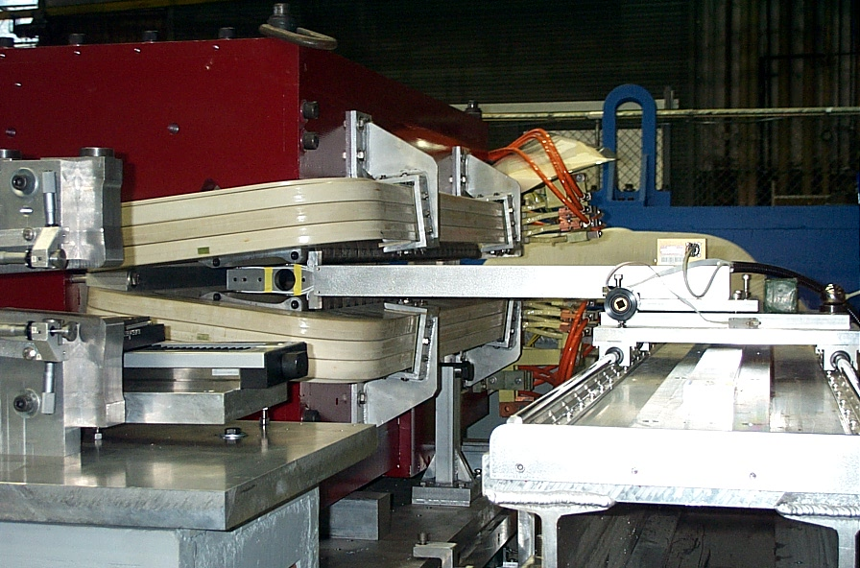
Dipoles Mechanical Fiducialization
Capacitive sensors can measure a reference pole
that has been fiducialized, and then measure the
magnet. Tooling balls on the magnet can be related
to tooling balls on the reference pole.
Measures over entire length of C-magnets. Need to correct for
sensor position and roll.
Roll accuracy estimate: ~10 µm / 10 cm = 1 x 10⁻⁴ rad
Sensors
Reference Pole
Position Detector
Electronic Level

Slide 20
Dipoles Magnetic Measurement, Moving Wire
Roll
X
Move wire
vertically,
measure ΔΦ.
Rotate magnet
until ΔΦ=0.
Move wire
horizontally,
measure ΔΦ.
Move magnet
until ΔΦ profile
is centered on
wire.
Similar for finding
vertical center.
Roll accuracy estimate: ~10 µTm / 1 Tm = 1 x 10⁻⁵ rad
Relate magnet position to wire.

Slide 21
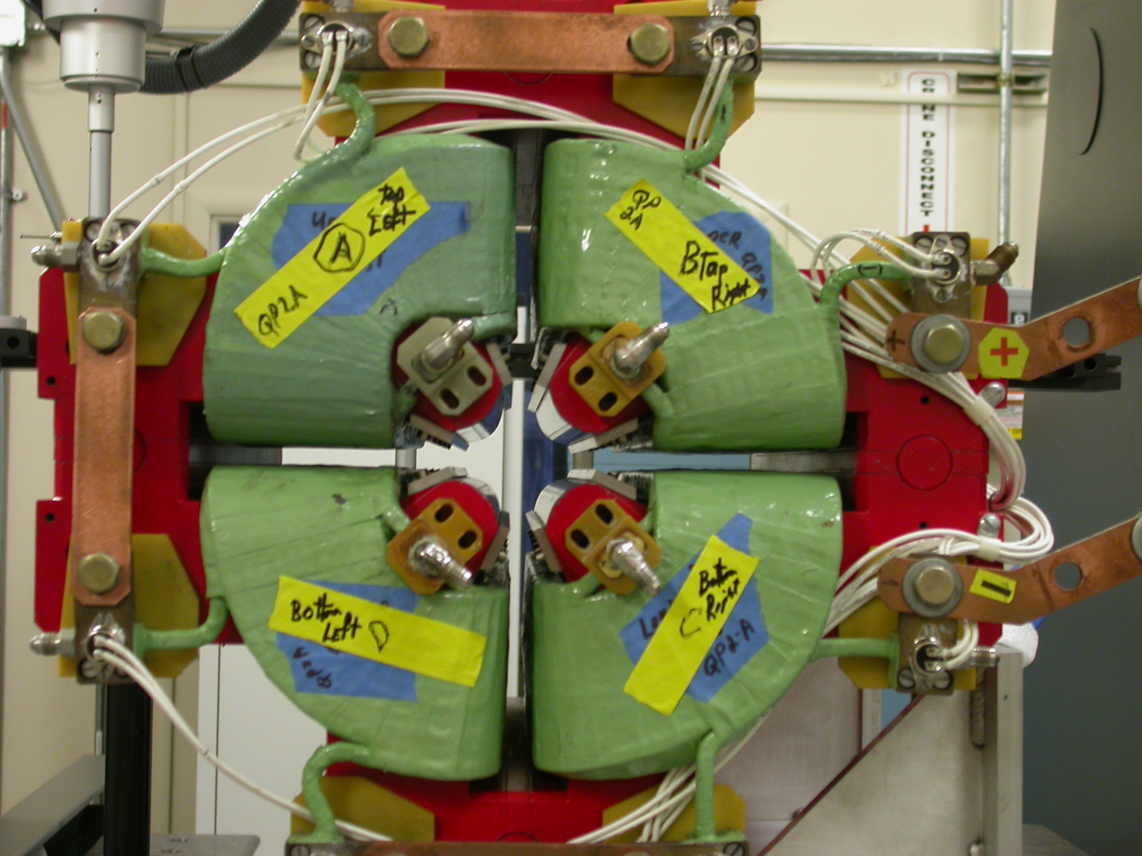
Quadrupoles And Higher Multipoles Mechanical Fiducialization
CMM probe touches poles
to measure point locations
on the poles.
An algorithm finds the mechanical
center from the sample points.
The mechanical center is related to
tooling balls on the magnet.
Touch poles at quadrupole ends. The middle is ignored. The poles have a roughness.
Quadrupole center position accuracy estimate: ~50 µm.

Slide 22
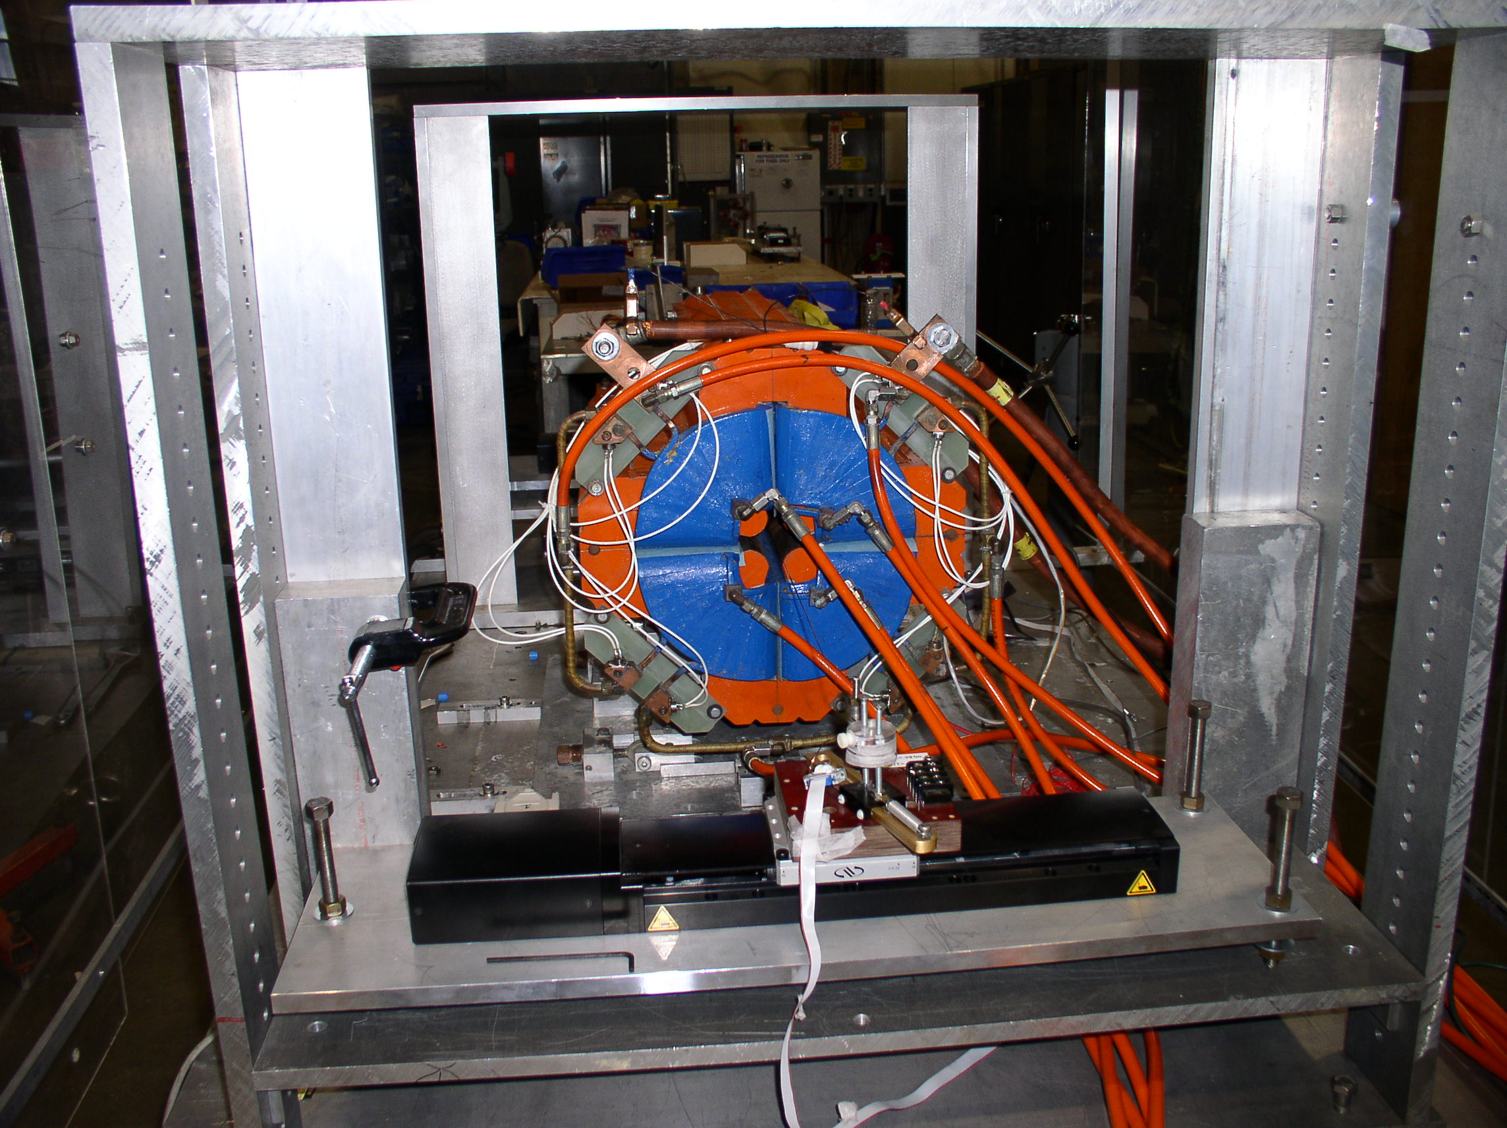
Quadrupoles And Higher Multipoles Moving Wire Fiducialization
Quadrupole:
B_{x} = G y
B_{y} = G x
Move the wire to the location where ∫B_{y} dz = 0 and ∫B_{x} dz = 0.
Locate the wire relative to the tooling balls.
(May need to take out pitch and yaw for some applications.)
Quadrupole center position accuracy estimate: ~10 µTm / 100 T = small.
Accuracy dominated by locating wire and locating tooling balls.

Slide 23
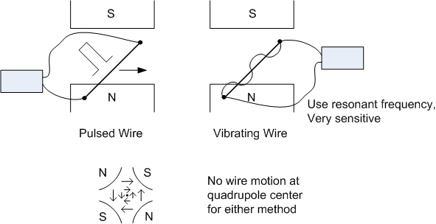
Pulsed Wire, Vibrating Wire
The wire has a force on it and moves when a current flows through
the wire in the presence of a magnetic field.
*

Slide 24
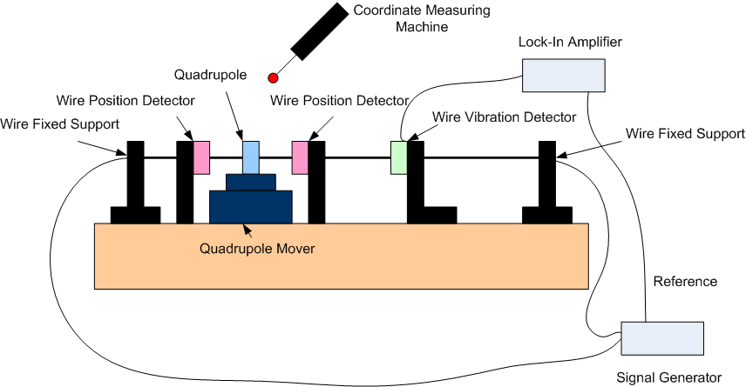
Quadrupoles And Higher Multipoles Vibrating Wire

Slide 25
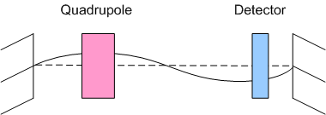
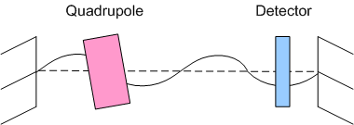
Vibrating Wire
If the ac current carrying wire goes
through a magnetic field, the force
excites a mechanical vibration of
the wire.
An optical detector gives
a signal that the wire is vibrating.
The vibration stops when the wire
is at the center of the quadrupole.
This method can also detect pitch and
yaw of the quadrupole.

Slide 26
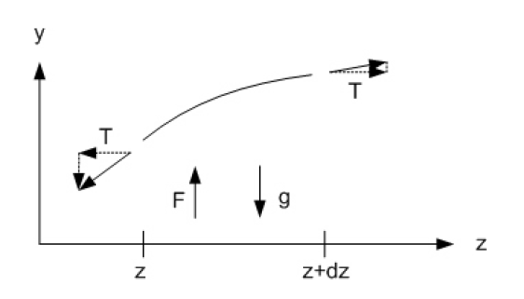







Vibrating Wire
Equation of motion of the wire
Solution for the wire motion

Slide 27
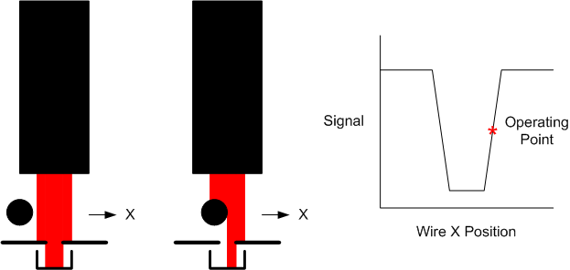
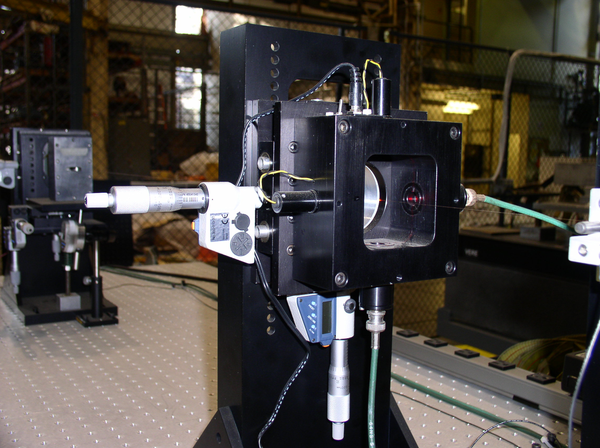
Wire Vibration Detector
Optical sensors
detect wire vibration.

Slide 28
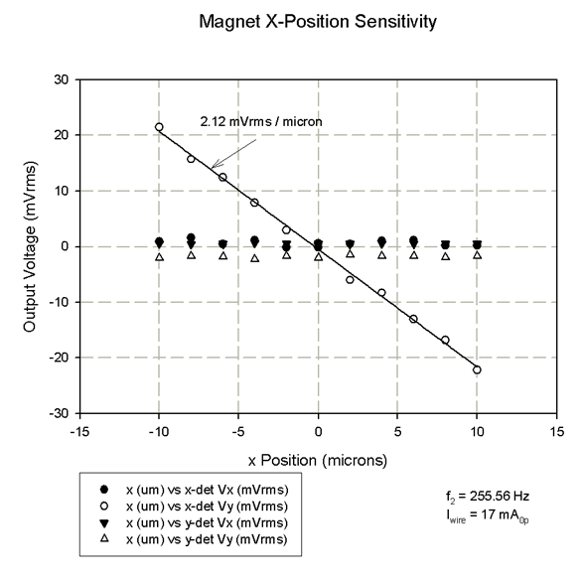
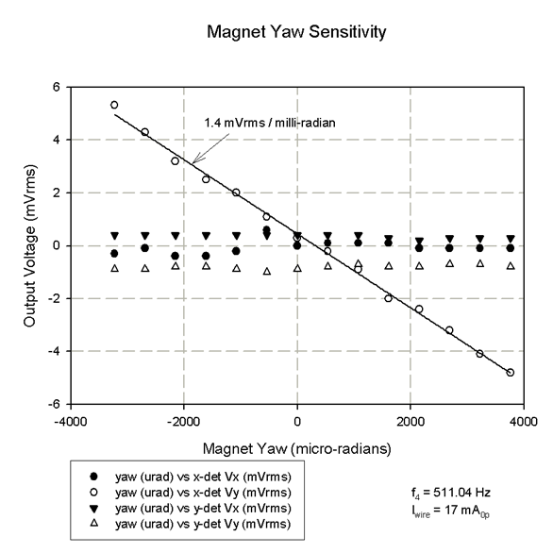
Vibrating Wire Signals
Examples:
Amplitude of signal from wire vibration sensor vs quadrupole x-position
and quadrupole yaw.

Slide 29
Quadrupoles Rotating Coil

Slide 30
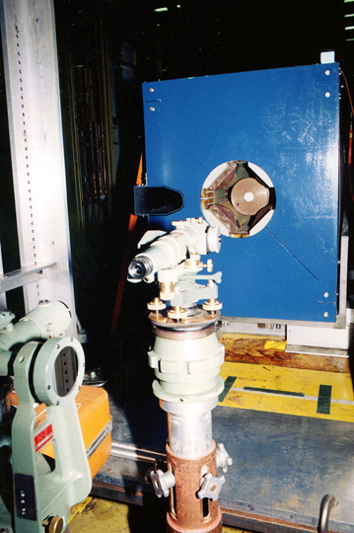
Quadrupoles And Higher Multipoles Rotating Coil
Locate axis of rotation from shaft ends.
Locate tooling balls relative to axis of rotation.
Harmonic feed down gives magnetic center
location relative to axis of rotation.
From these, calculate tooling ball location
relative to magnetic center.
Can also use short coils.
Move coil until dipole signal
goes to zero.

Slide 31
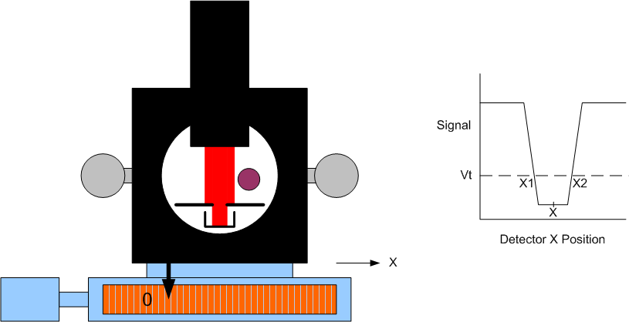
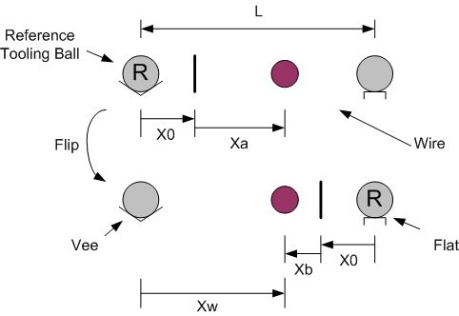
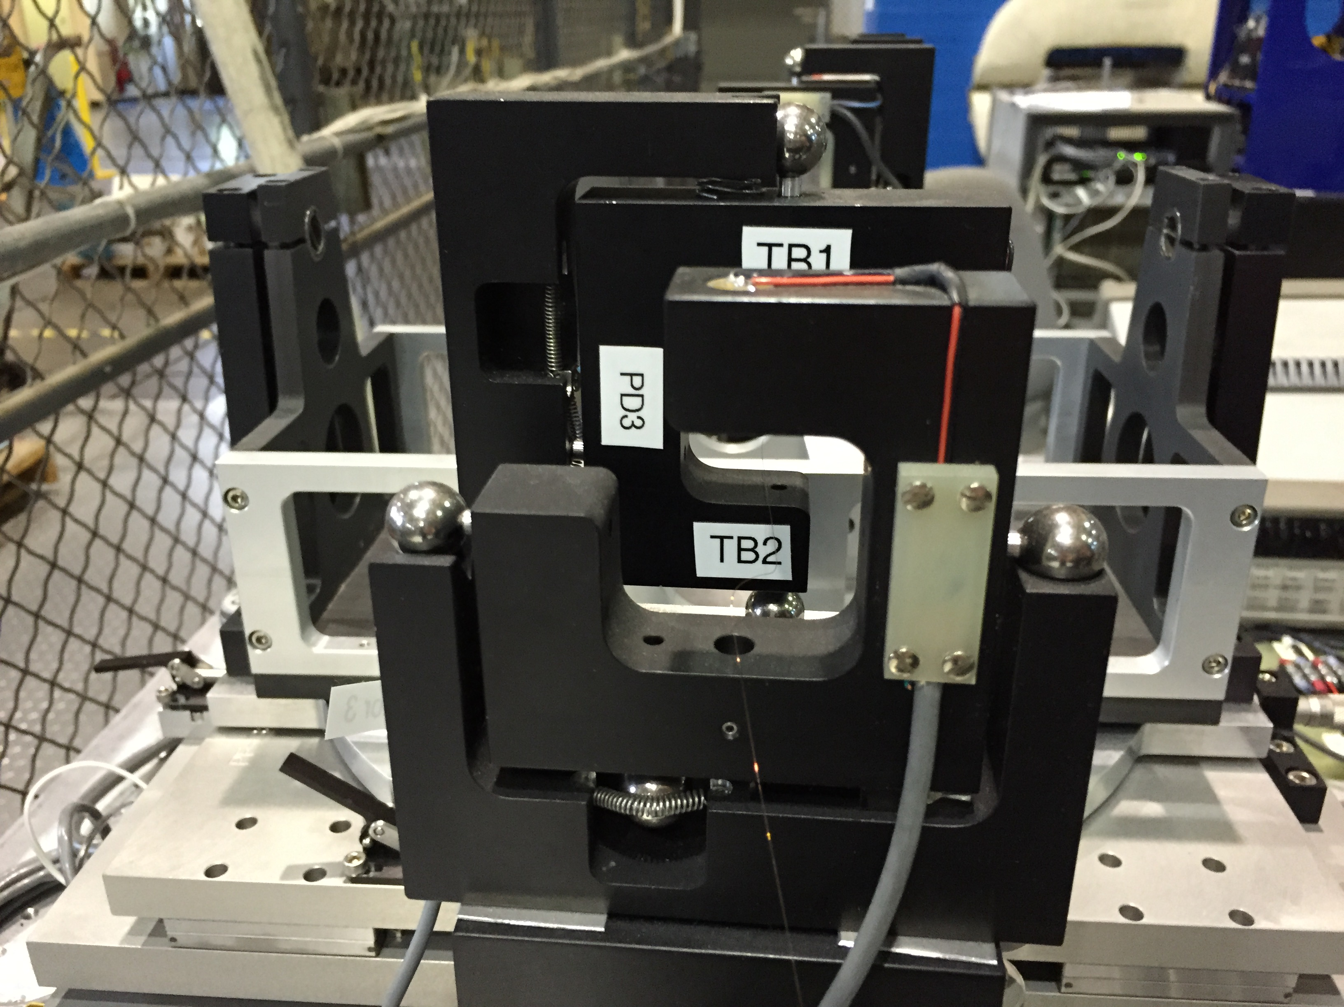
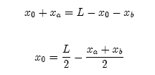
How To Locate A Wire
Find the center of the wire by
finding its edges.
Calibrate the scale offset by
flipping the detector in a
kinematic mount.

Slide 32
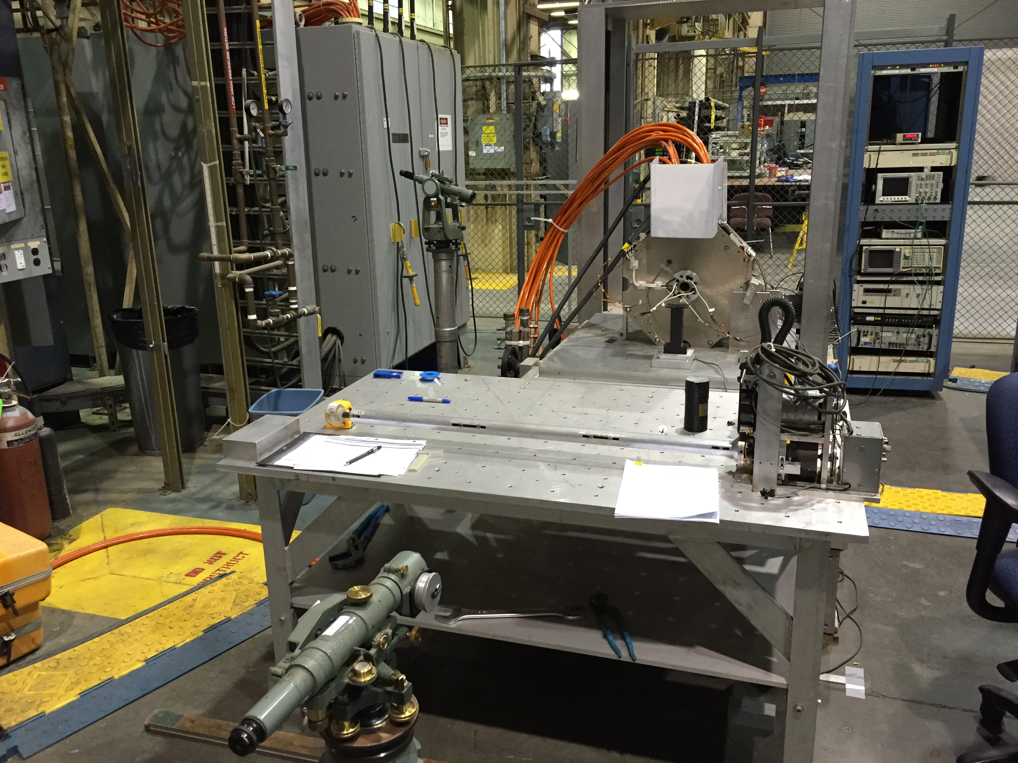
Solenoid Fiducialization Pitch and Yaw
A small rotating coil in the center of
the solenoid can be used to align the
field to the axis of rotation.

Slide 33
Solenoid Fiducialization X and Y
At the end of the solenoid, the rotating coil gives
zero voltage out when the axis of rotation is on
the magnetic center line.

Slide 34
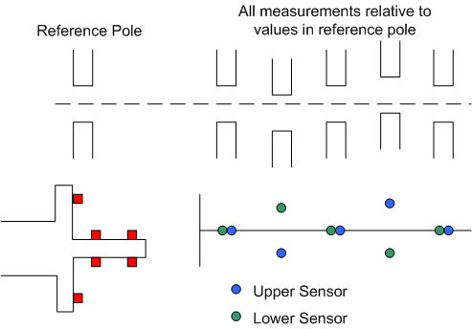
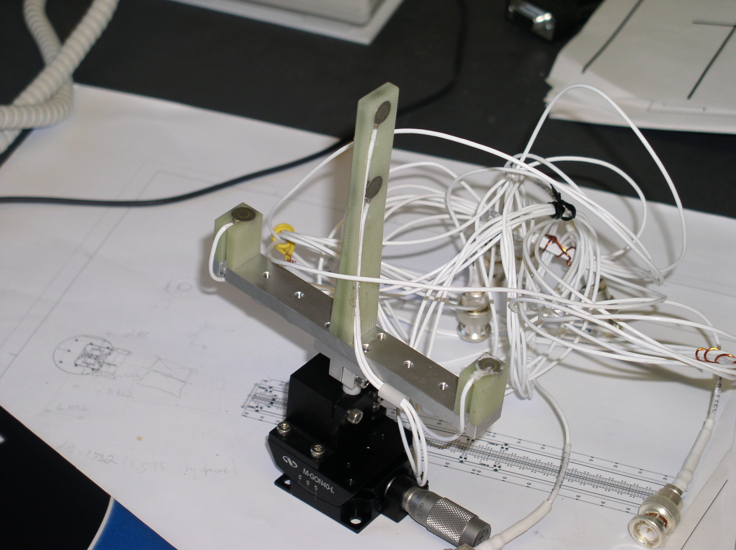
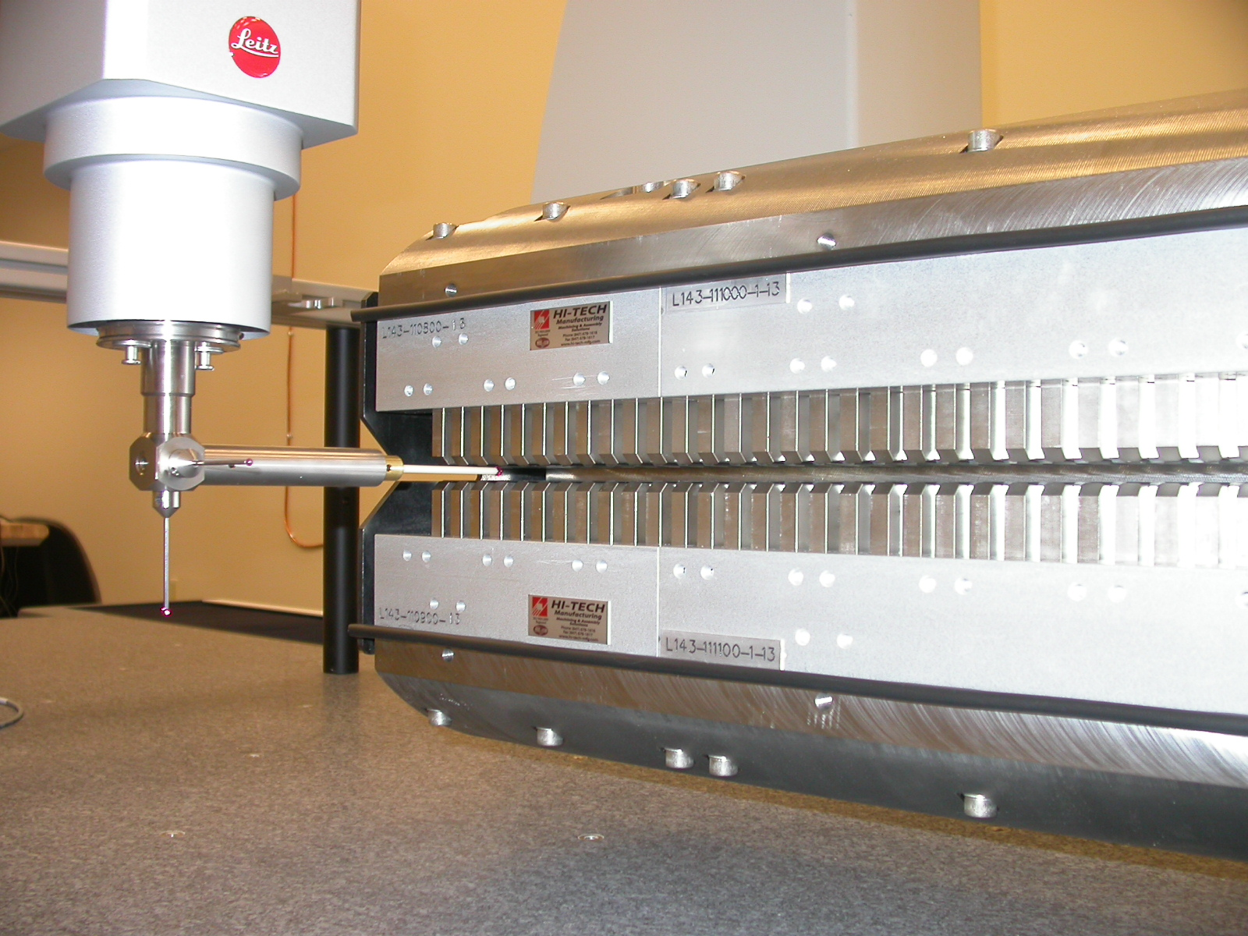
Undulator Mechanical Alignment
Capacitive sensors can be used to mechanically align a hybrid undulator
to a reference pole. Alternatively, a CMM can be used.

Slide 35
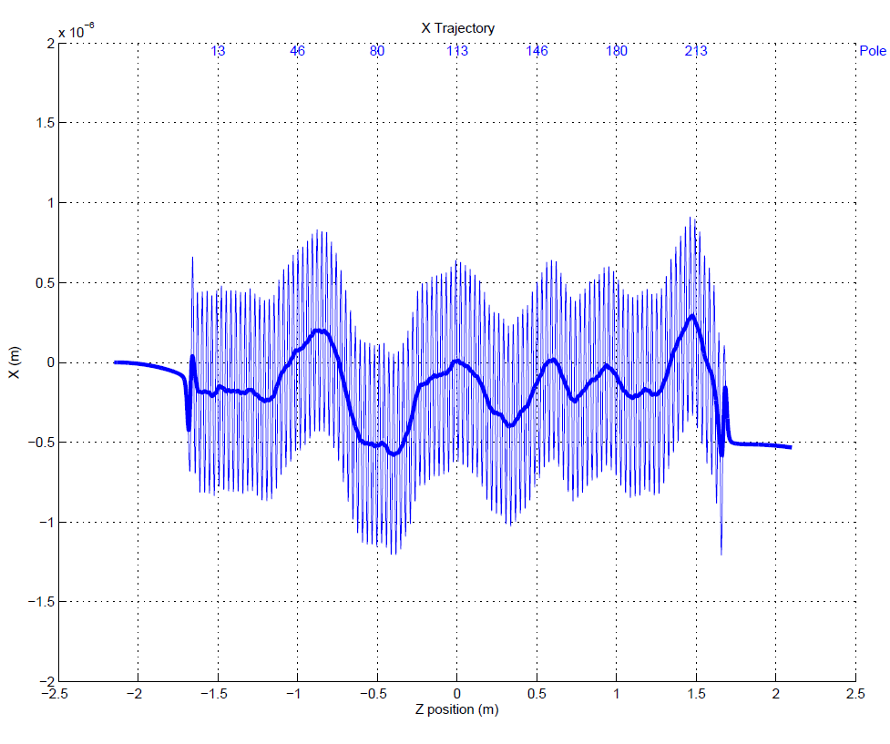
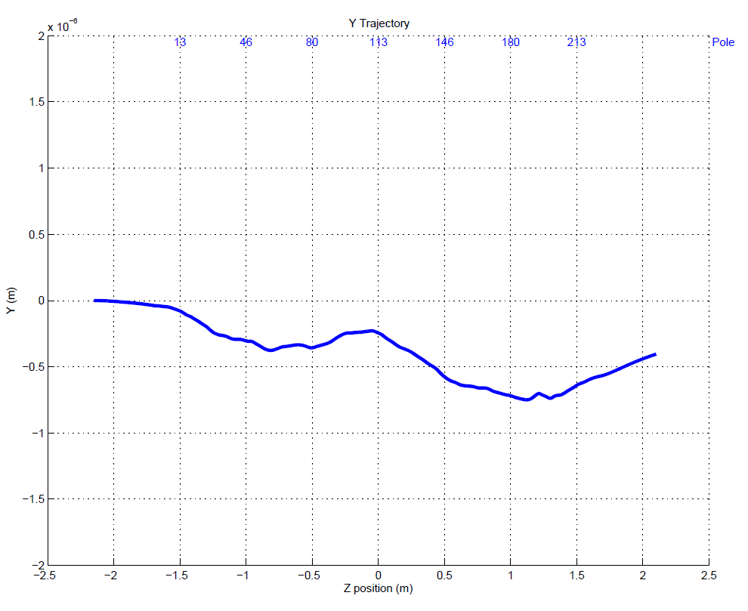
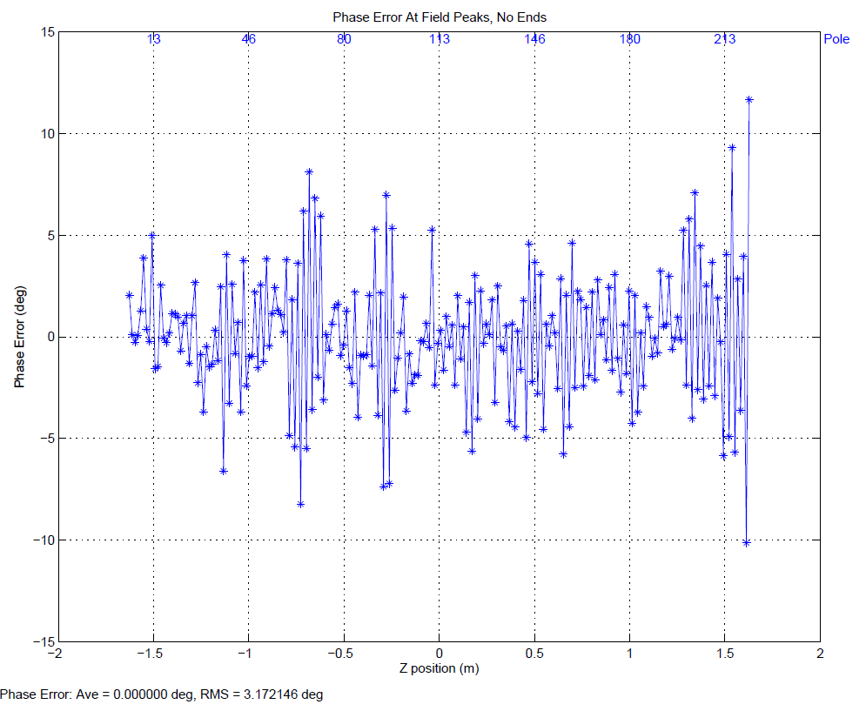
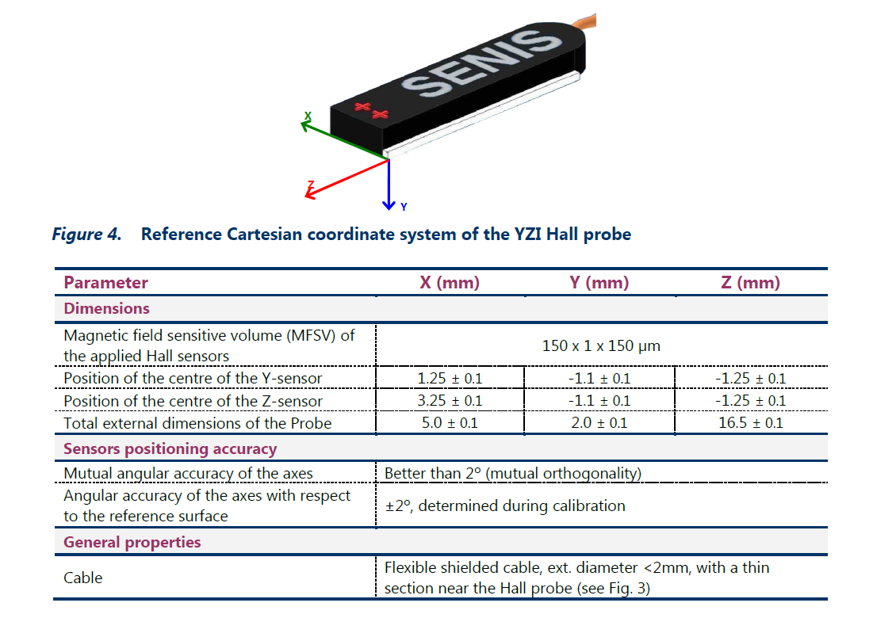
Undulator Magnetic Alignment
Fiducialization tolerance
40 microns.
Probe position given to
100 microns in specs.
After undulator is tuned:
X trajectory good.
Y trajectory good.
Phase errors good.
Want the beam to go where
the Hall probe is measuring.
But where is the Hall probe
actually measuring?

Slide 36
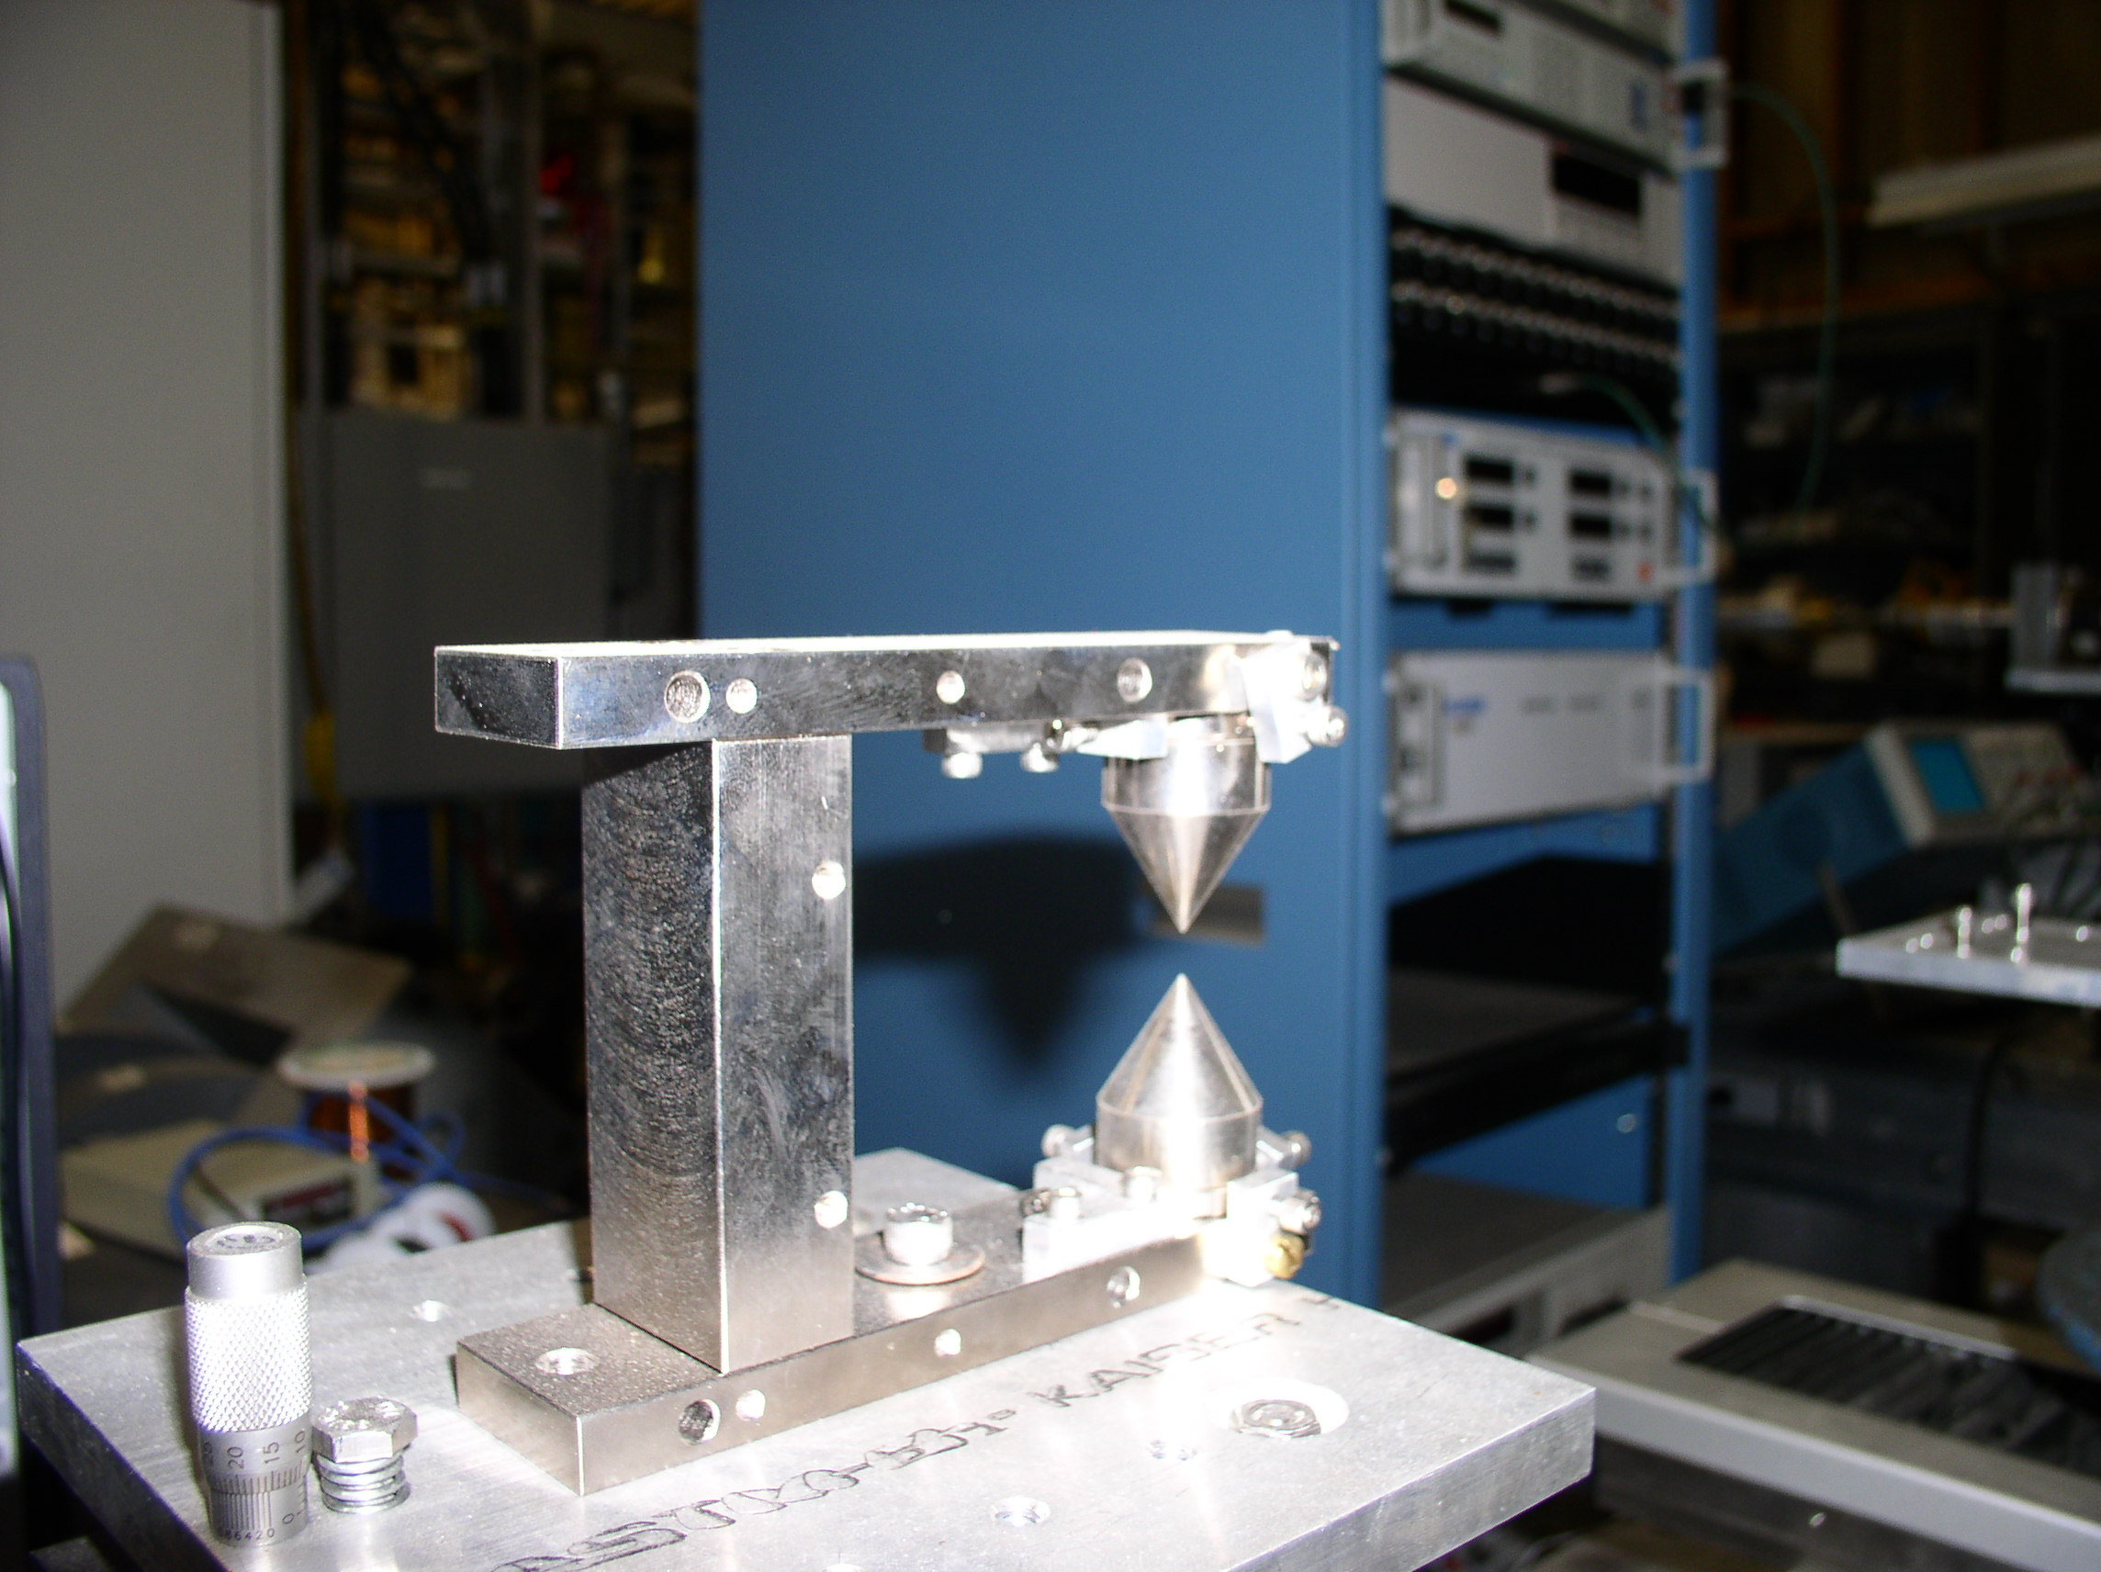
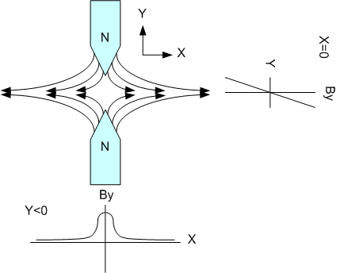
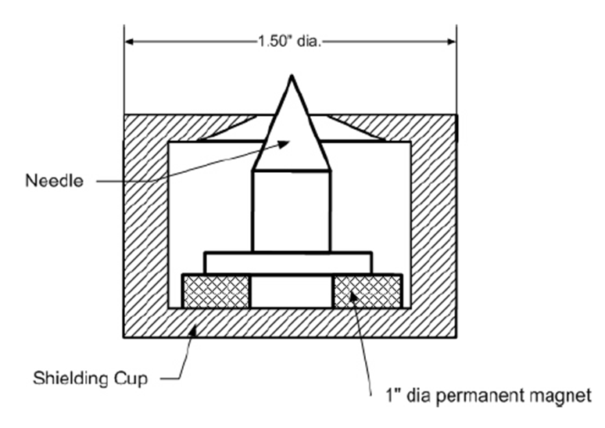

Where is the Hall probe measuring?
Pointed magnets give a magnetic location that can be found repeatably.
Attach to undulator ends, measure offsets

Slide 37
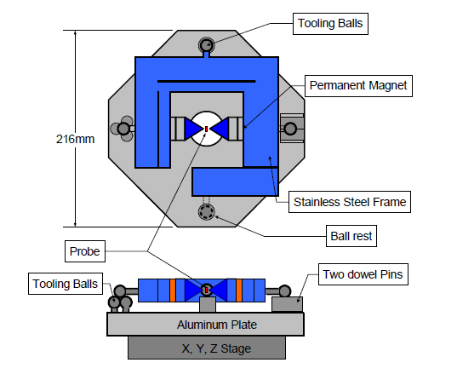


Pointed Magnet Calibration
Flip magnet in fixture. Distance zero field
point moves gives zero field position
relative to tooling balls.
Yurii Levashov

Slide 38

Undulator Fiducialization
Want D
D1 : Magnetic Measurement
D2 : Calibration
D3 : CMM
D = D1 + D2 + D3

Slide 39




Undulator Fiducialization

Slide 40




Check Fiducialization With Simple Techniques
Check fiducialization.
Use telescopes, pointed magnets,
optical sensor to locate Hall probe

Slide 41

End

