Slide 1
LCLS-II Undulator Commissioning Measurements
Zachary Wolf
Commissioning Review
March 8, 2017

Slide 2
Outline
LCLS-II Commissioning
Undulator tuning plan
K vs gap fits
Phase matching
Radiation damage plans
Earth field strategy
Phase shifter measurements

Slide 3
LCLS-II Undulator Tuning Overview
22 SXR undulators (production plus spare)
33 HXR undulators (production plus spare)
3 measurement benches, 2 at SLAC, 1 at LBNL
All final data sets will be done at SLAC with the undulator in the same orientation as in the tunnel
For each undulator line, all final data sets will be done on the same bench and have the same set of systematic errors

Slide 4
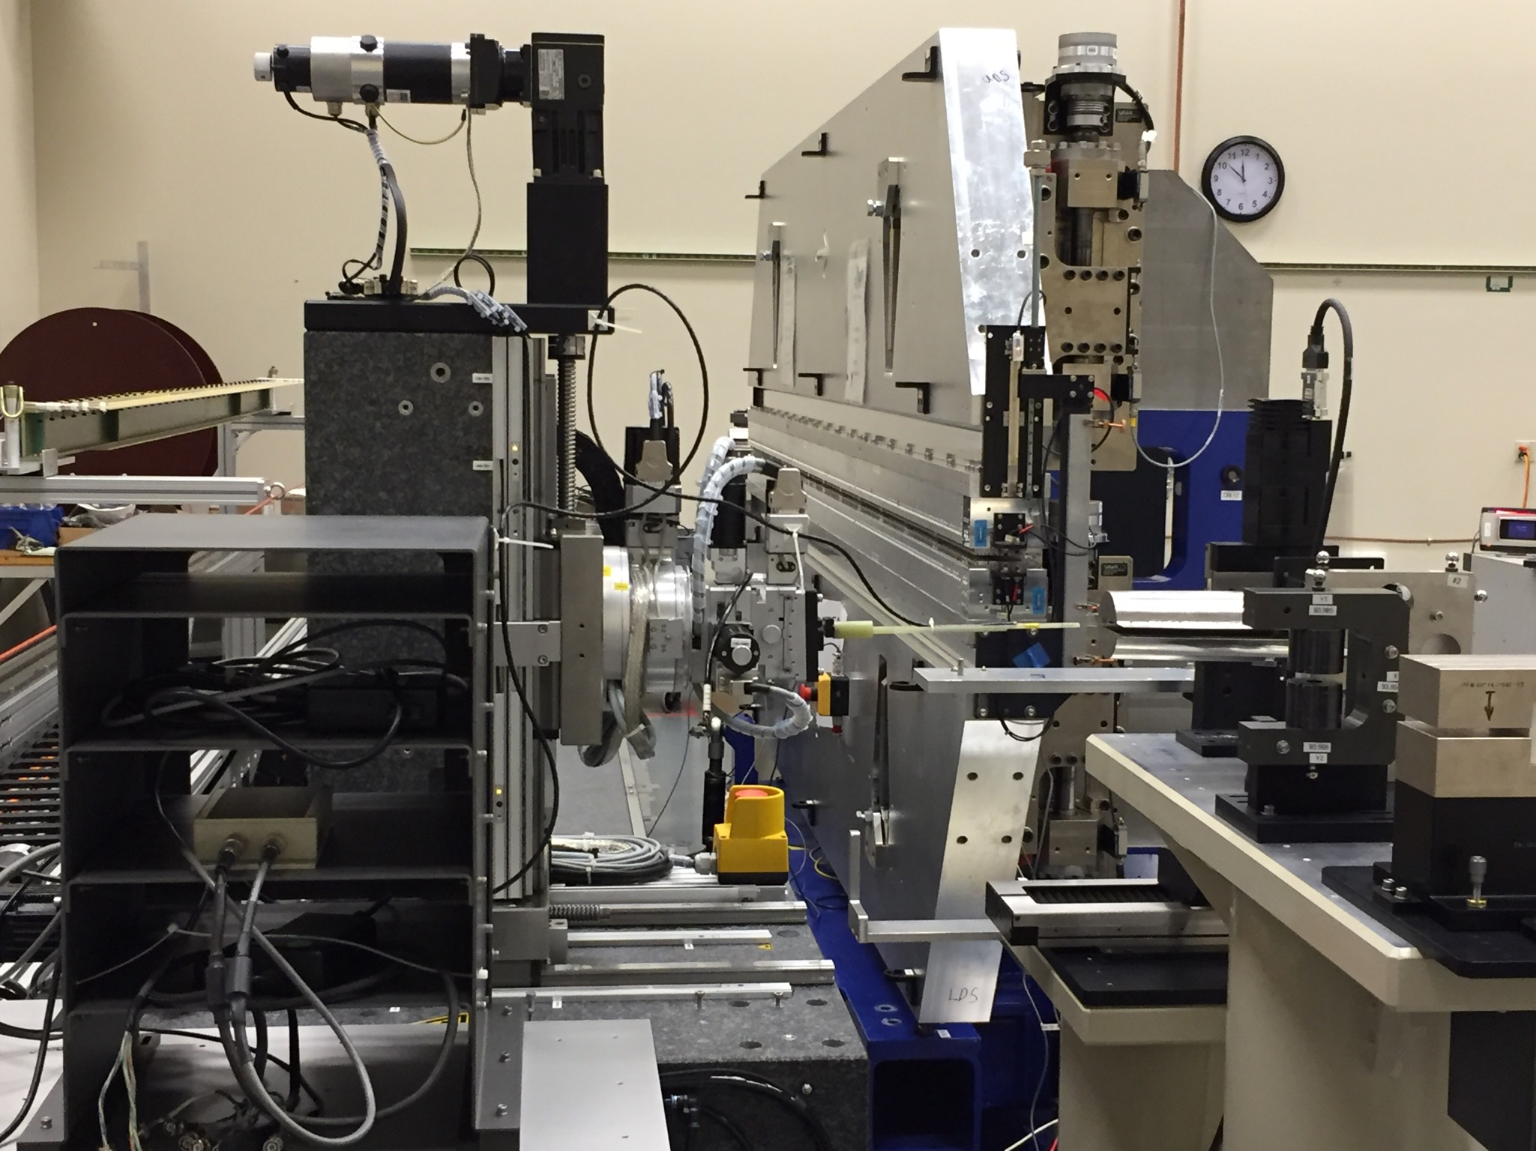
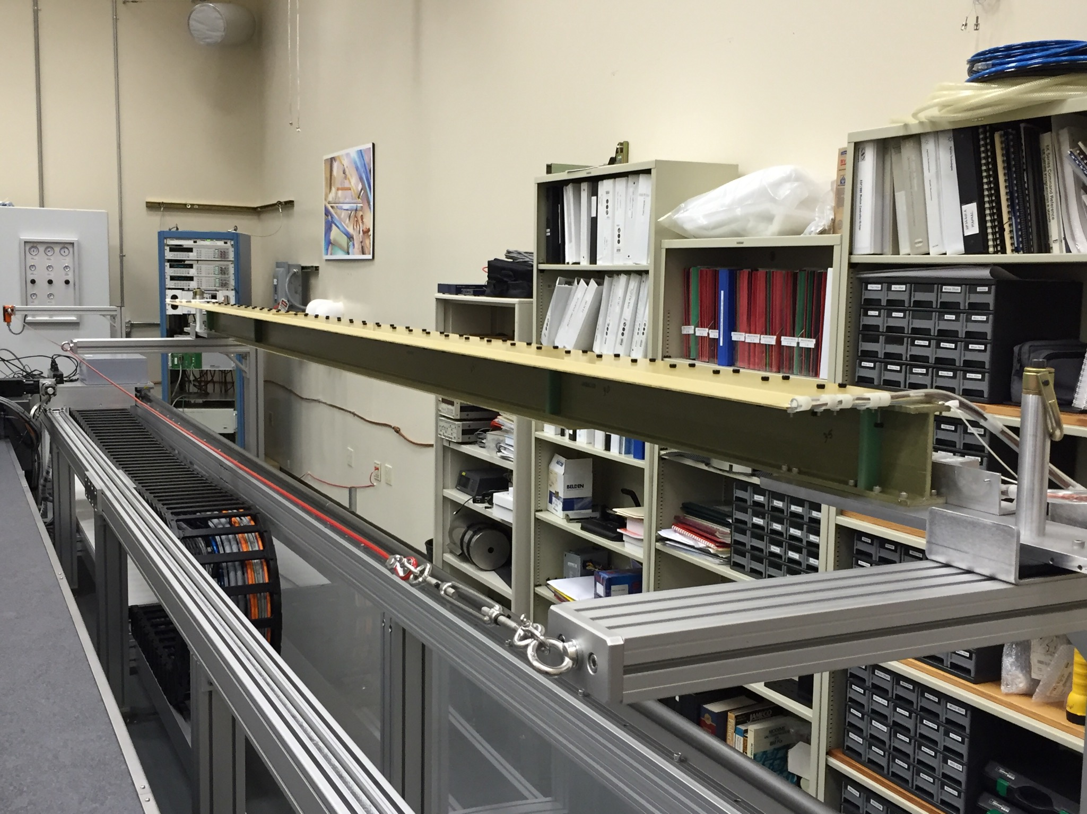
SXR Measurements With The HXU32 Prototype
Hall probe measurements are done with the Kugler bench.
Field integrals are measured with a long coil.

Slide 5
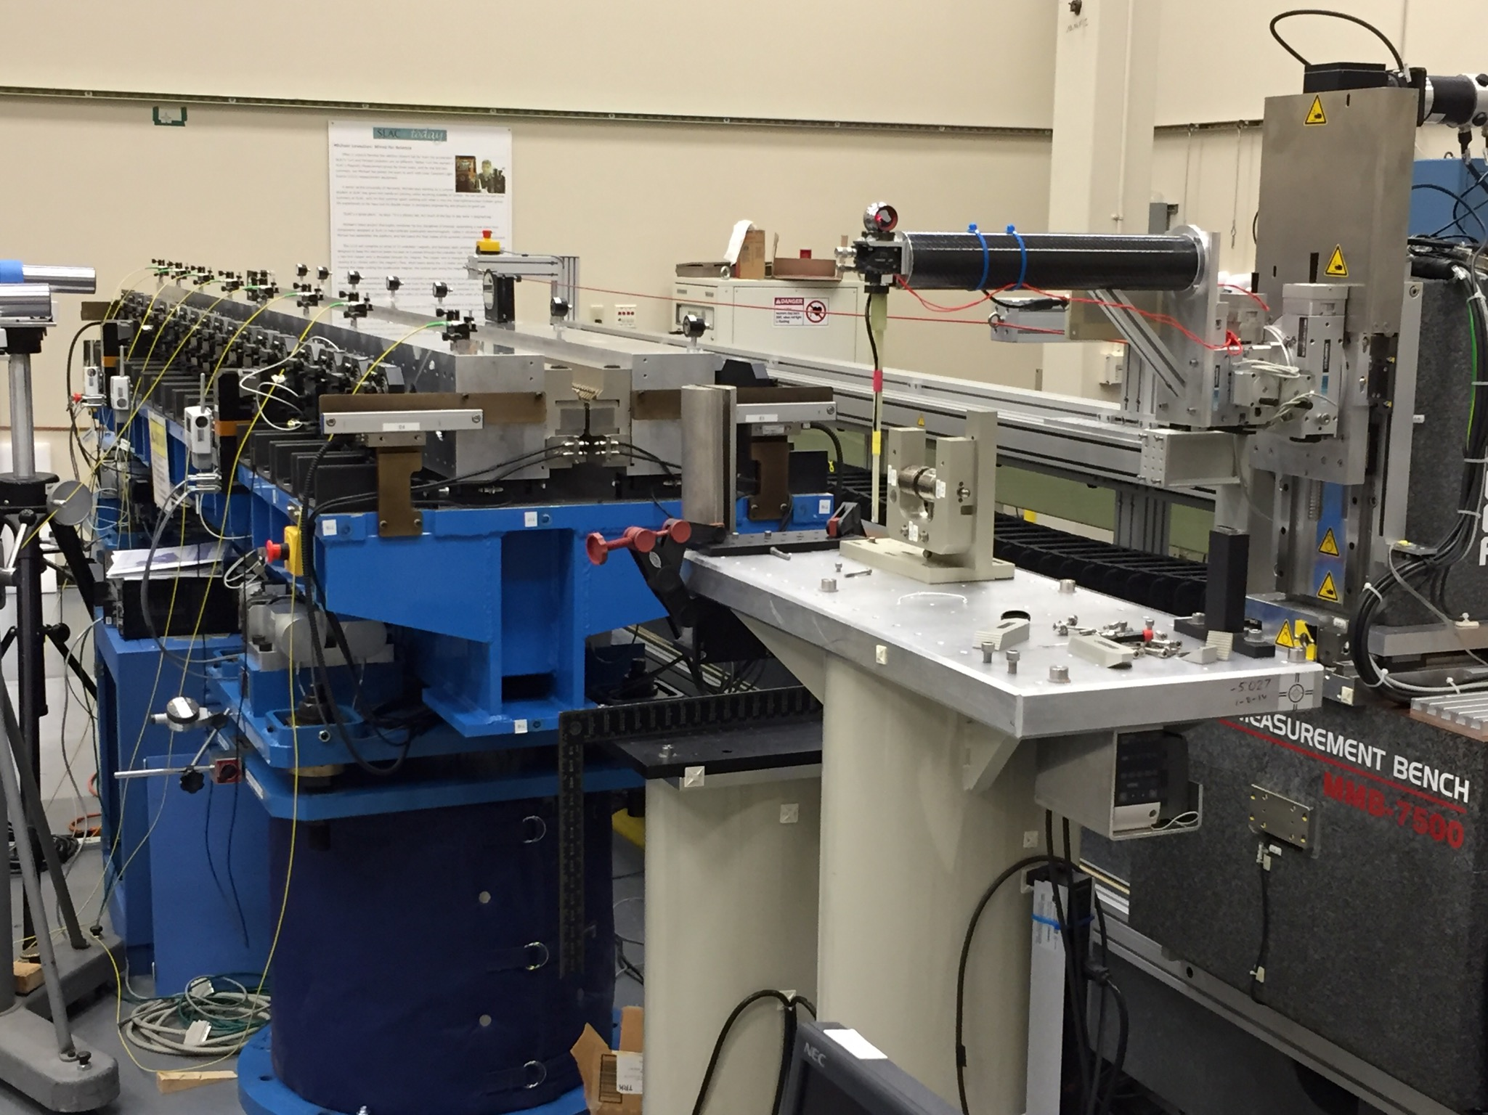
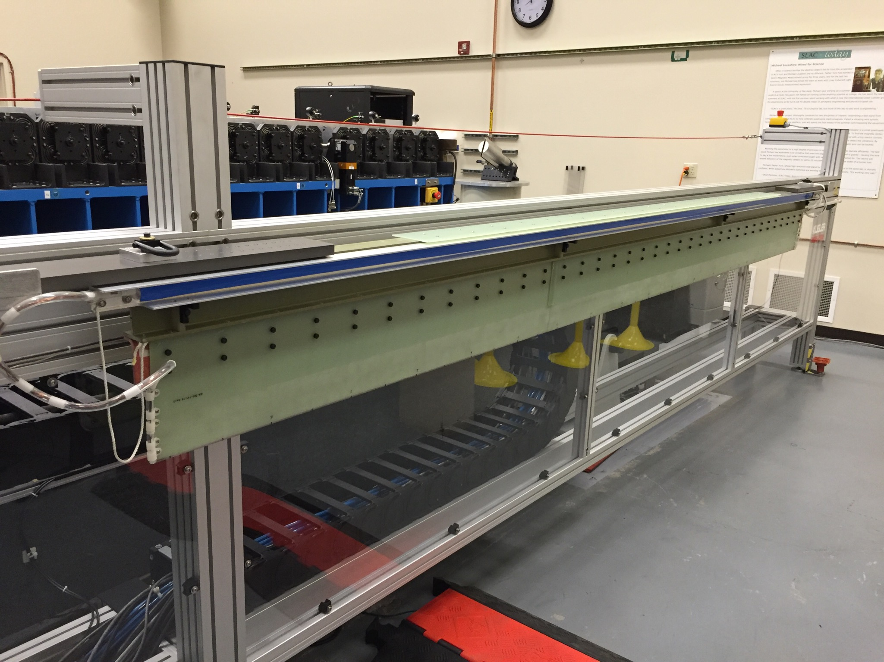
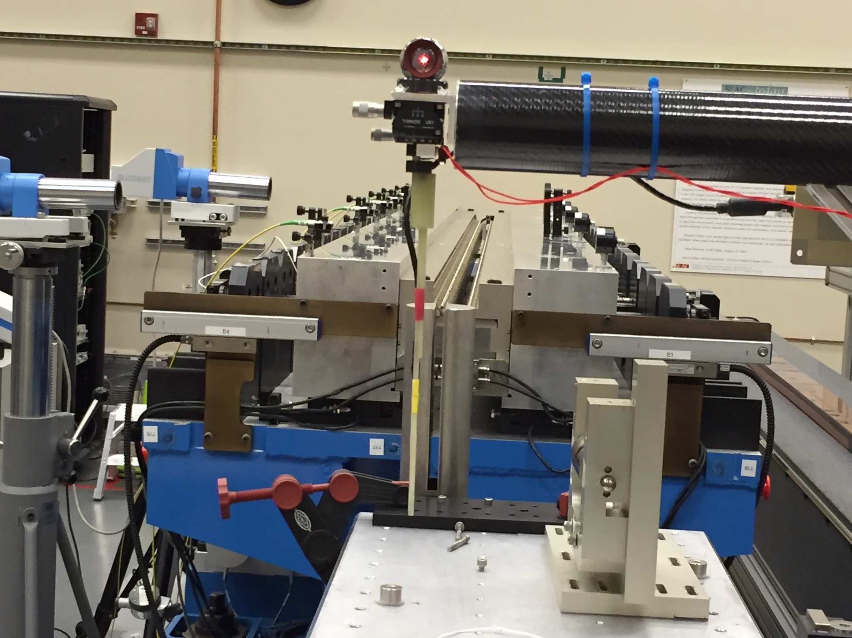
HXR Measurements With The HGVPU Prototype
Long coil measurements will be done with a vertical coil.
Hall probe measurements are done with the probe at the end of a large carbon fiber tube.

Slide 6
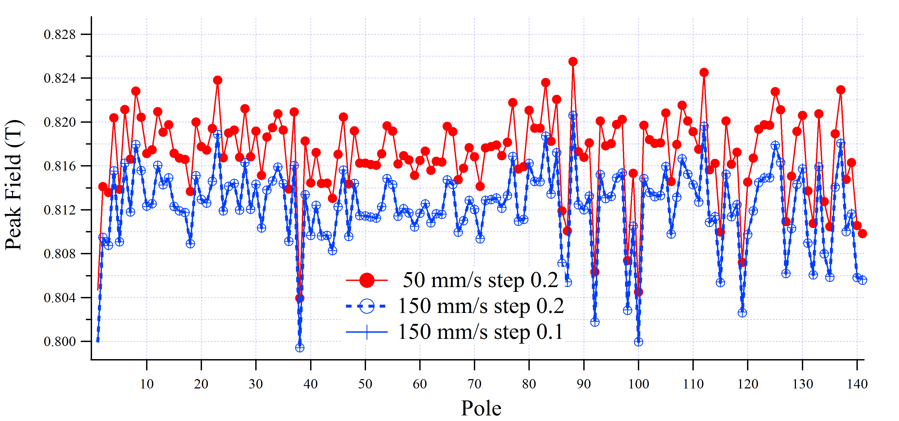
Hall Probe Speed Dependence
Yurii’s measurements
Signal frequency (Hz) Senis 118-114 peak field (T) Sentron 463 peak field (T)
0.33 1.276085 1.276314
0.67 1.274817 1.276309
1.33 1.273279 1.276304
2.67 1.269586 1.276329
Max rel. difference: 5·10-3 2·10-5
The new Senis probes seem to have a problem.
For now we will use our Sentron probe.
Isaac’s measurements

Slide 7
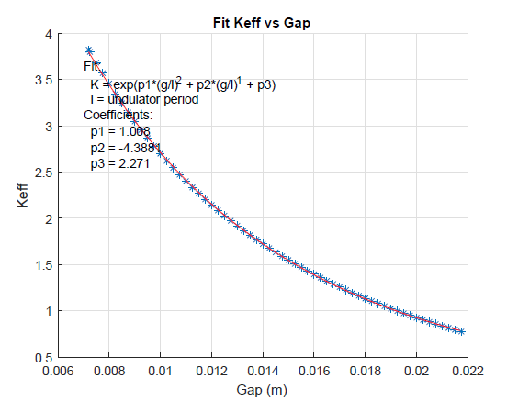
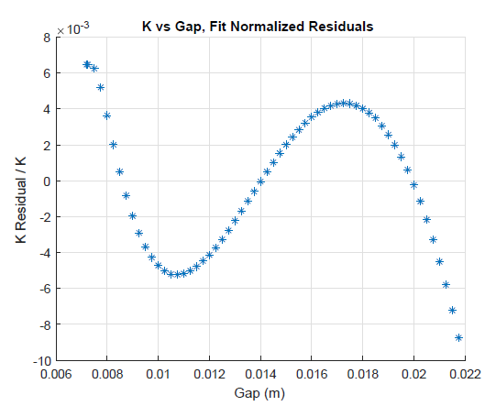
K Fit Tests
HXU32
Halbach formula
Fit only odd points, find residuals for even and odd points

Slide 8
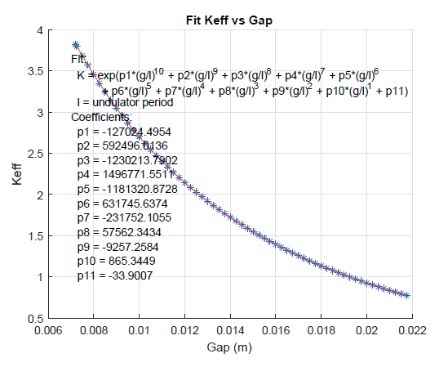
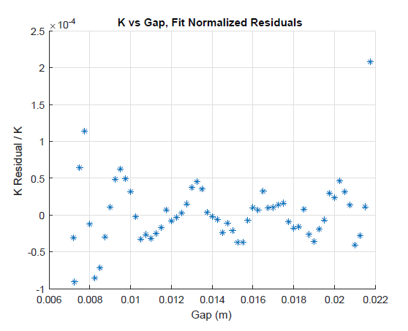
K Fit Tests
HXU32
Extended Halbach formula
Fit only odd points, find residuals for even and odd points

Slide 9
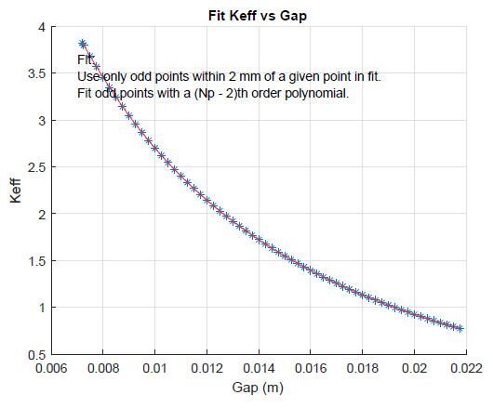
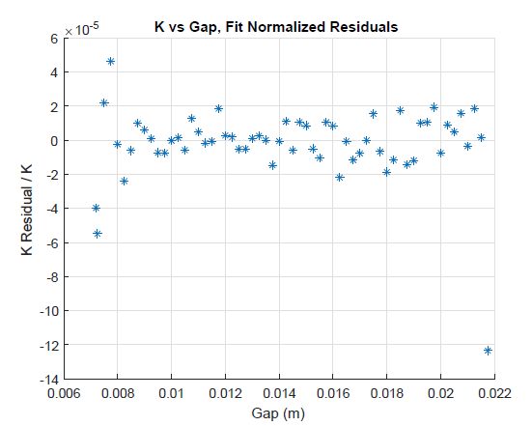
K Fit Tests
HXU32
Local polynomial fits
Fit only odd points, find residuals for even and odd points

Slide 10
K Fit Tests
HXU32
Spline fit
Fit only odd points, find residuals for even and odd points

Slide 11
Phase Matching
LCLS-TN-16-3
Phase shims set the phase matching error to zero at one K value.
This lets us commission the undulators without phase shifters.
The entrance phase shifter makes the phase matching error in the undulator center a multiple of 2π.
The exit phase shifter makes the phase error at the exit cell boundary a multiple of 2π.
The actual phase shifter has the phase of the sum of the entrance plus previous exit phase shifters.

Slide 12
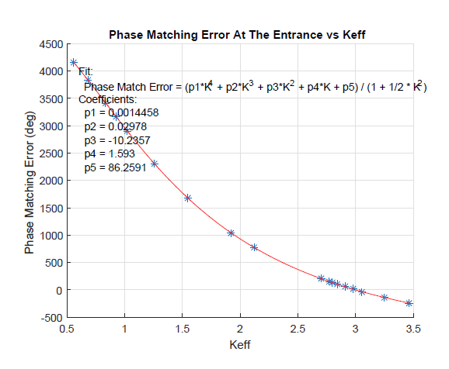
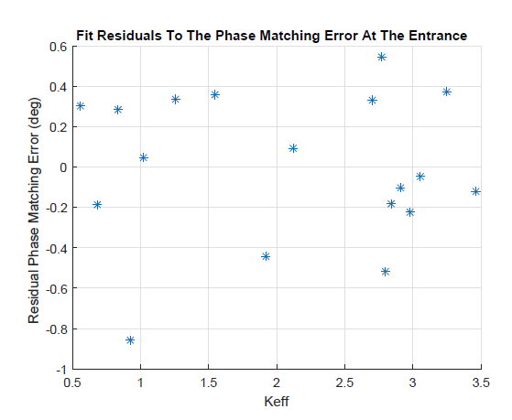
Phase Matching Fits
HXU32 Measurements
We plan to use fits to determine the phase shifter settings between measured points.

Slide 13
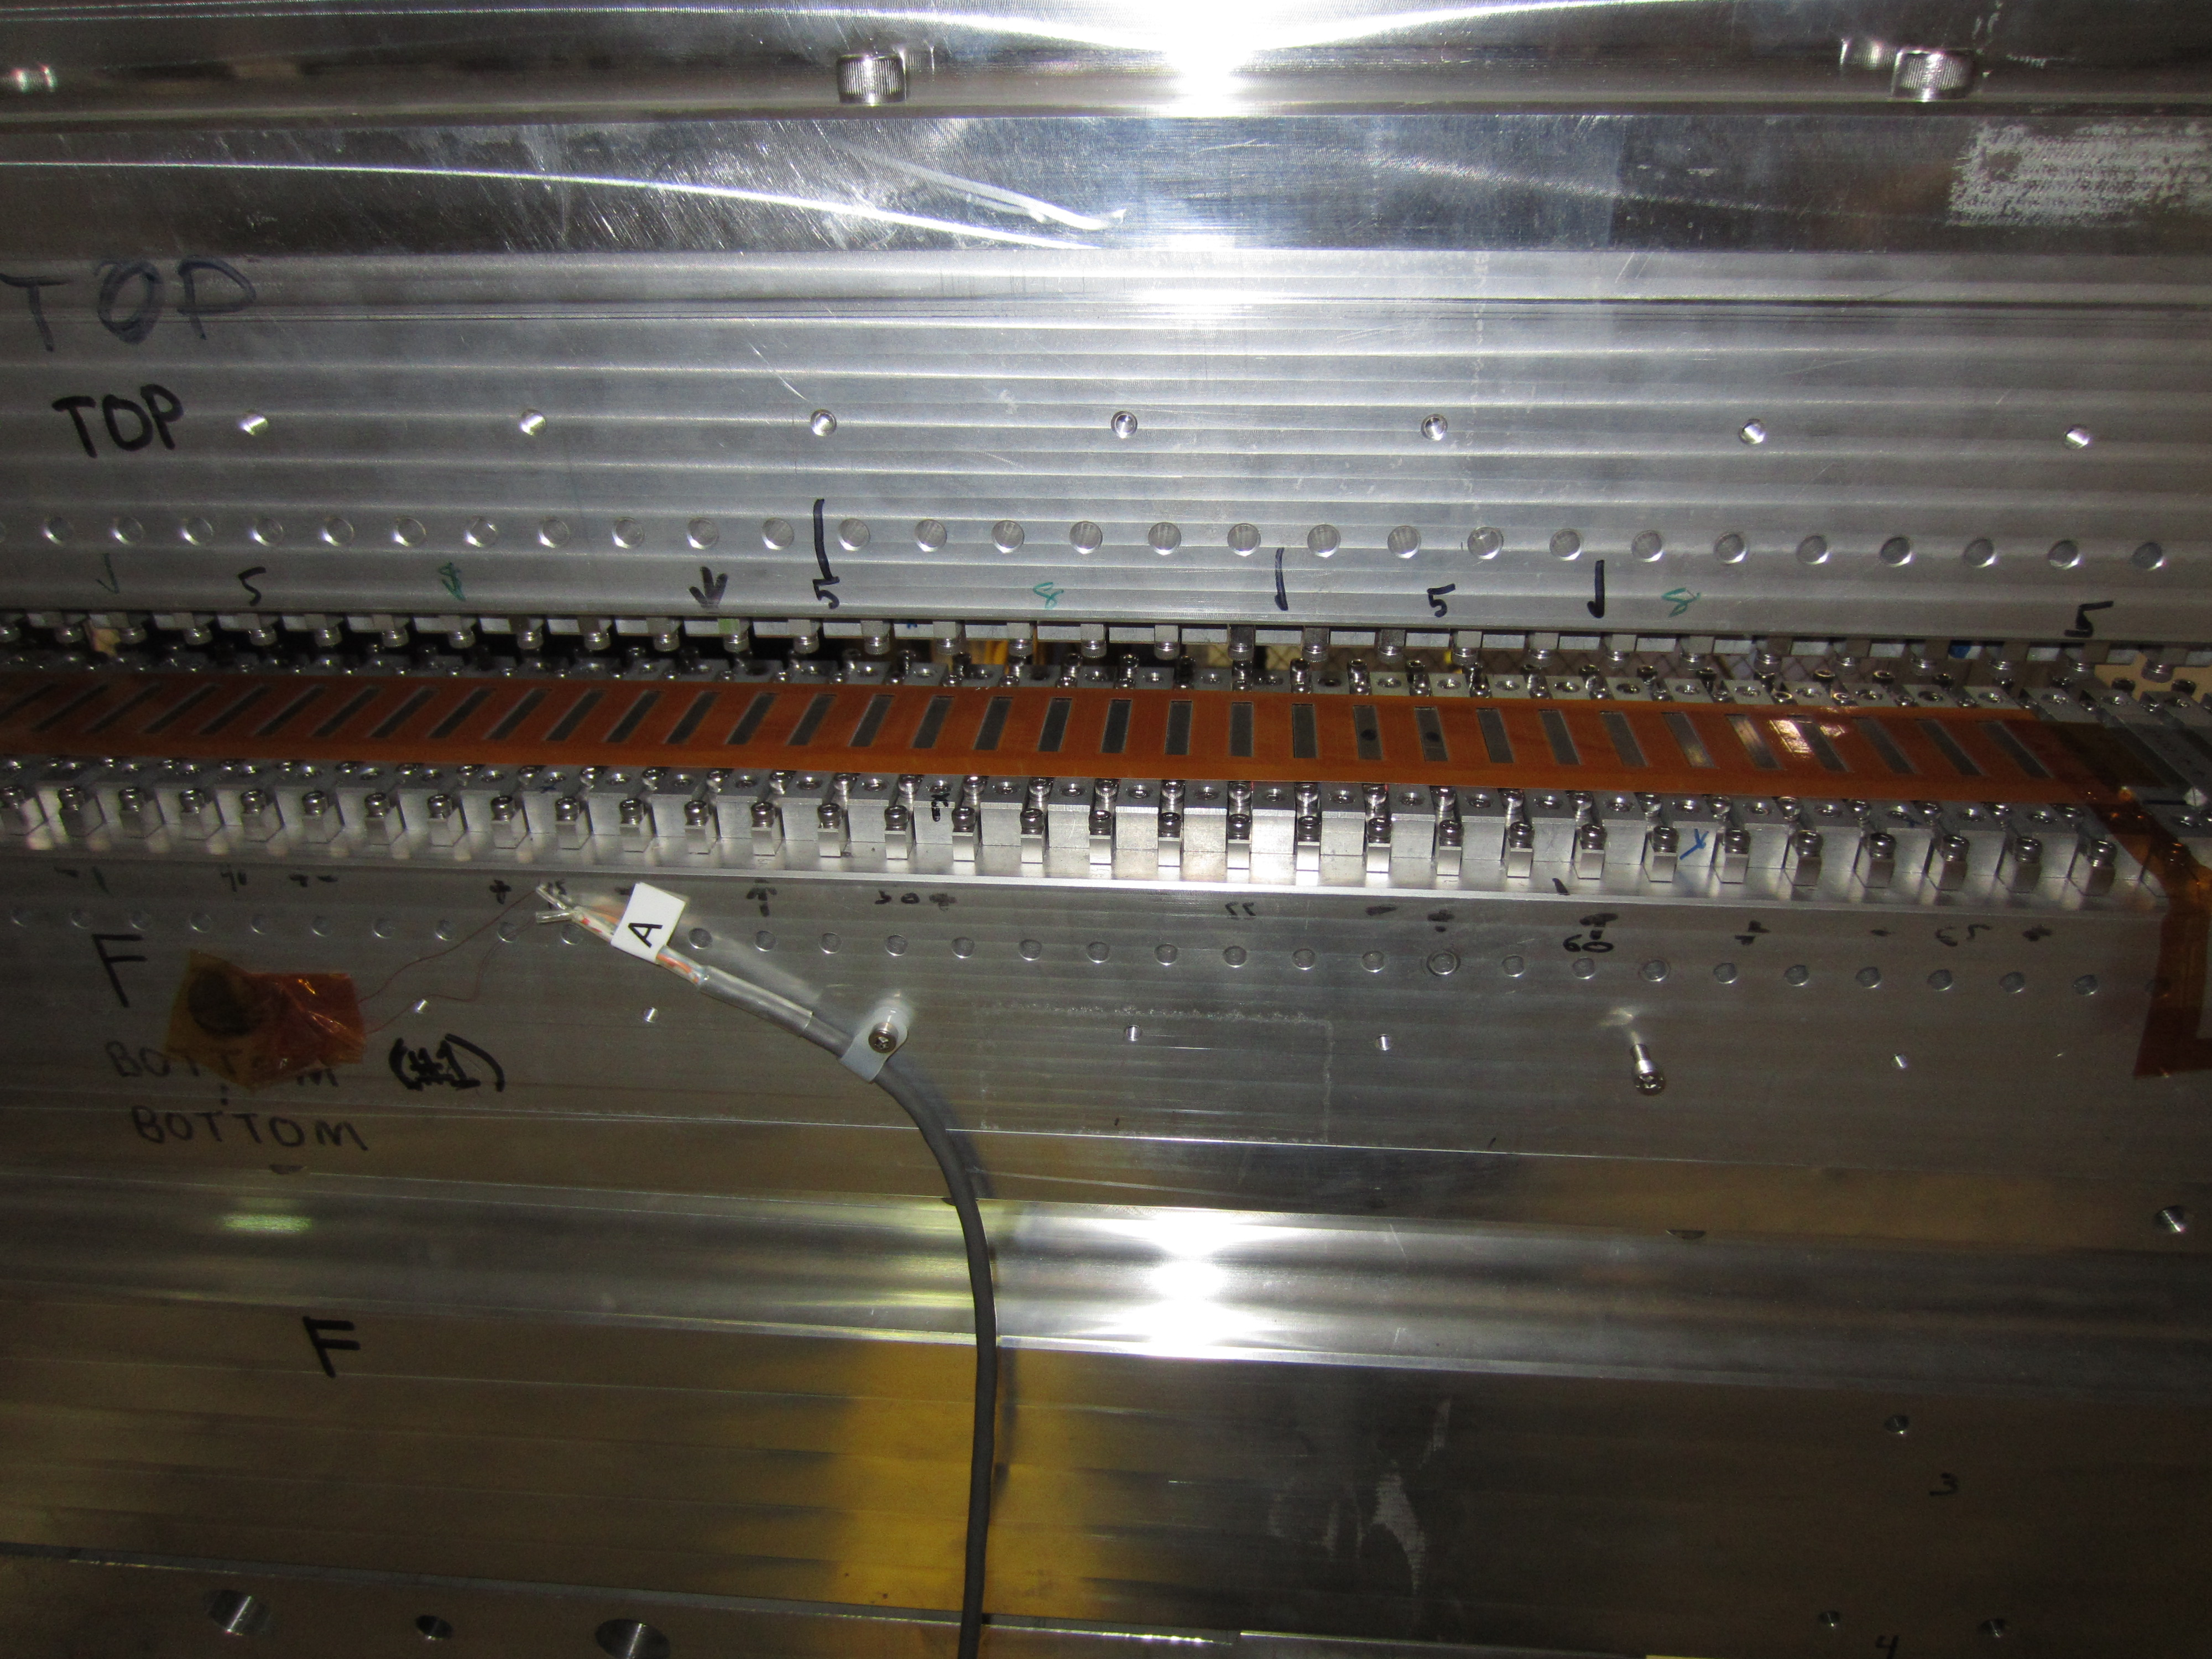
Magnet Radiation Damage Measurement Plan For The Tunnel
S. Anderson
Kapton
1 m long
125 microns thick
2 layers
36 turns per pole
0.1 VS signal
We are testing thin printed circuit coils that sit on the magnets with the poles sticking through holes in the kapton substrate.
The coil voltage is integrated to give the flux change as the gap is changed between two values. Changes in the flux measurement will indicate radiation damage.

Slide 14
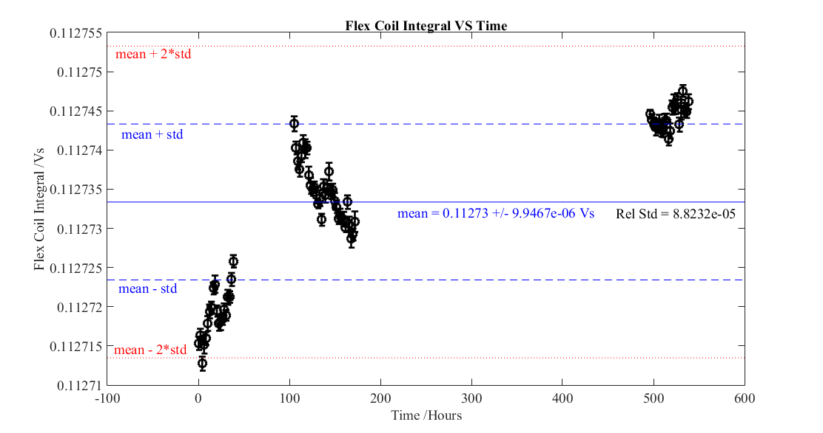
Repeatability Of Coil Measurements
S. Anderson

Slide 15
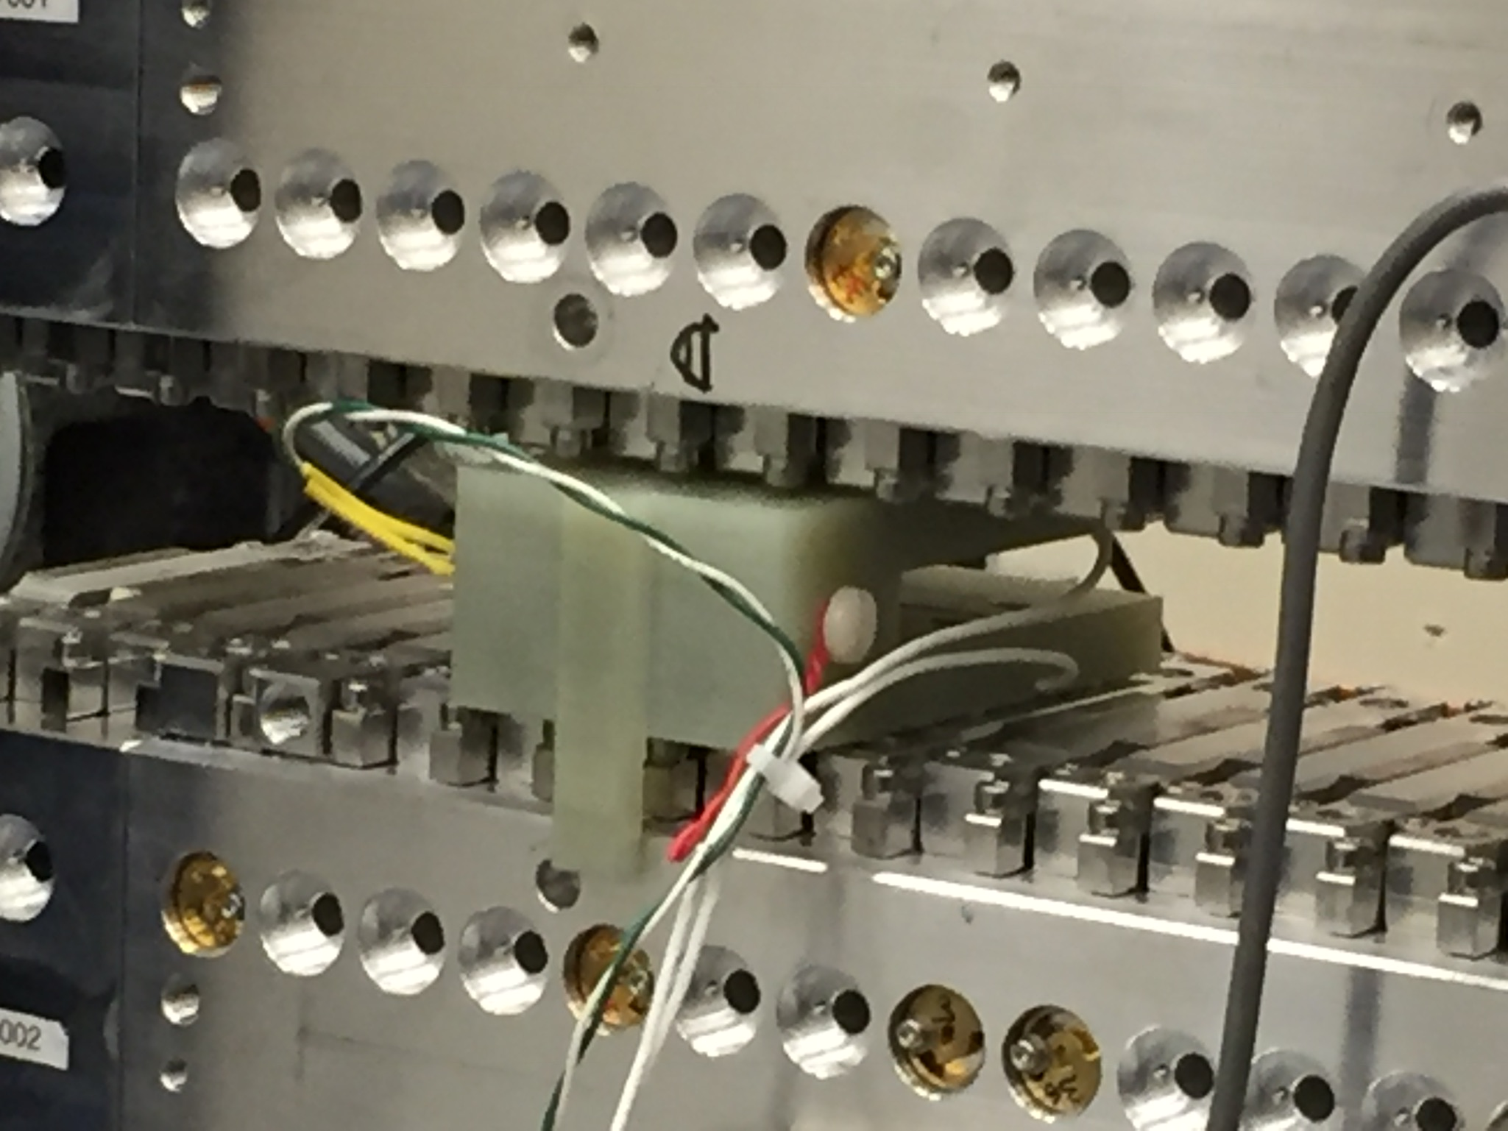
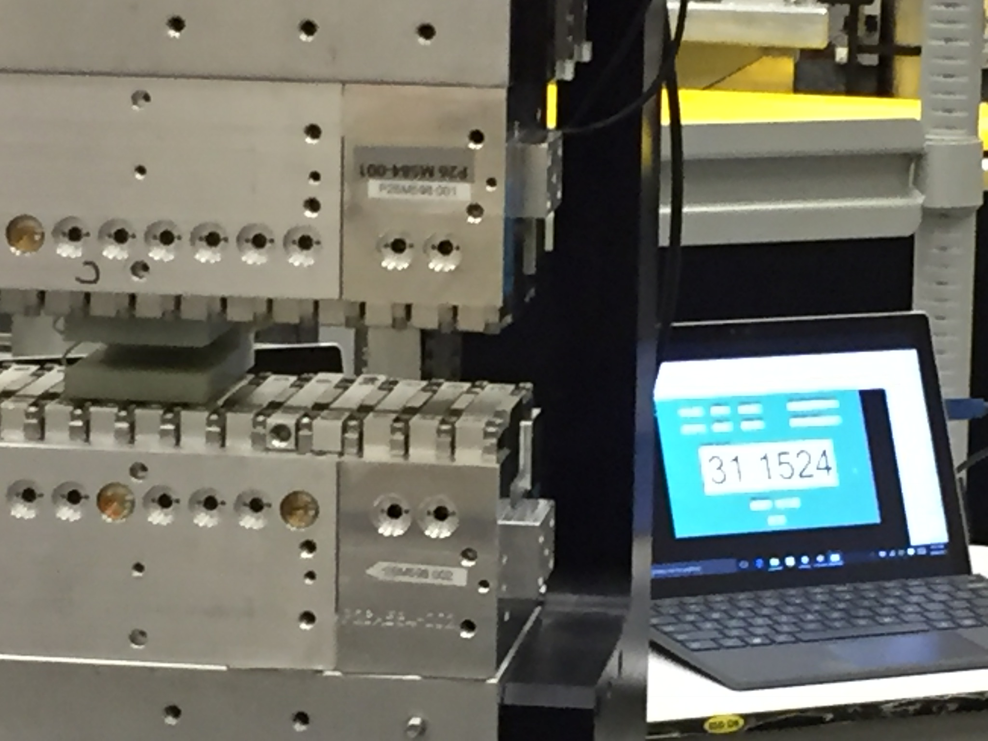
Gap Encoder Radiation Damage
Set the undulator gap to the same value as a reference piece using capacitive sensors.
Record encoder readings.
If an encoder fails, repeat the procedure and set the new encoder offset to give the same encoder reading.

Slide 16
Earth Field
Plan:
The undulators will be measured with the same orientation as they will have in the tunnel.
The fields in the tunnel will be mapped.
Correctors on the beam pipe will account for differences between the Earth field in the tunnel and in the lab.
We will construct a Helmholtz coil to simulate the Earth field differences between the tunnel and the lab.
We will determine current settings for the corrector coils based on the Helmholtz coil measurements and the tunnel map.
We will check the current settings in the tunnel using a portable vibrating wire system.

Slide 17
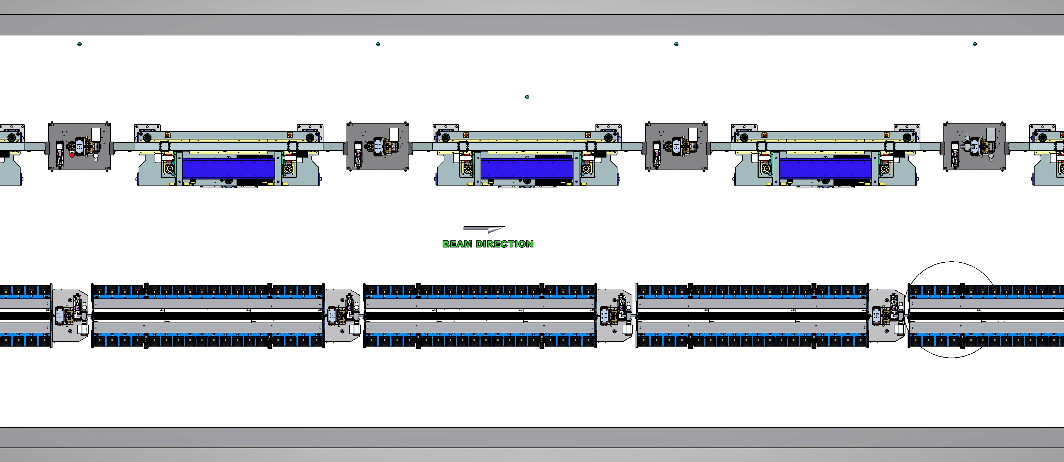
Earth Field At SLAC And LBNL
SLAC
LBNL
X = perpendicular to bench
Y = up
Z = along bench
SLAC
Bx = +0.269 G
By = -0.343 G
LBNL
Bx = +0.126 G
By = -0.335 G
LCLS-II
LBNL tuning won’t need major corrections at SLAC.

Slide 18
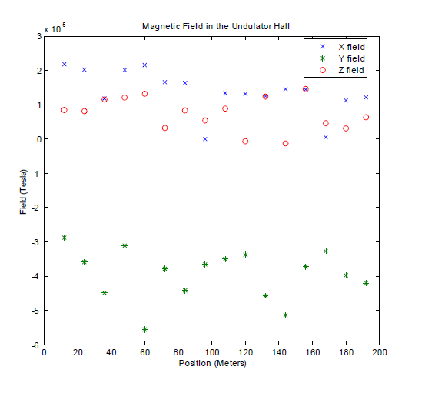
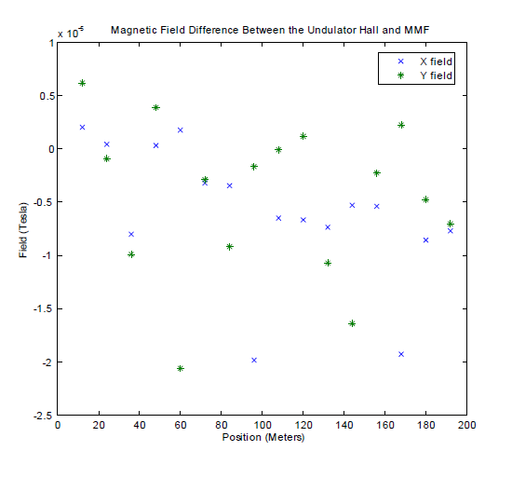
LCLS Tunnel Fields Measured For LCLS-I
0.3 G
0.1 G
-0.6 G
-0.25 G

Slide 19

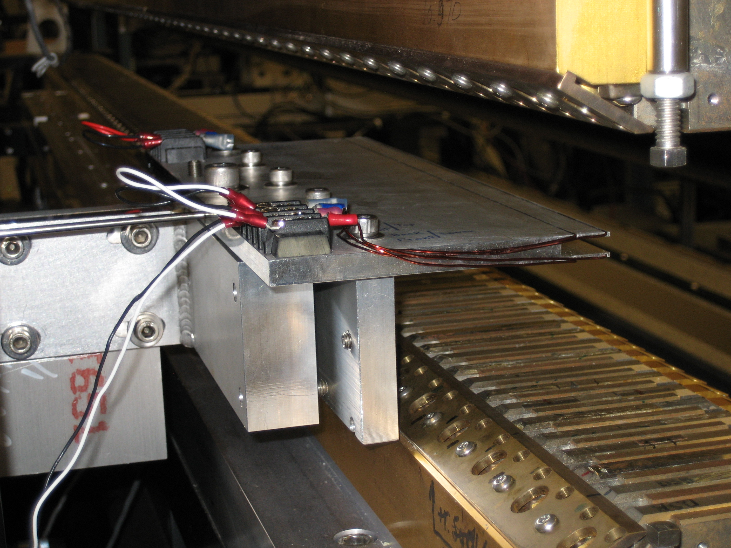
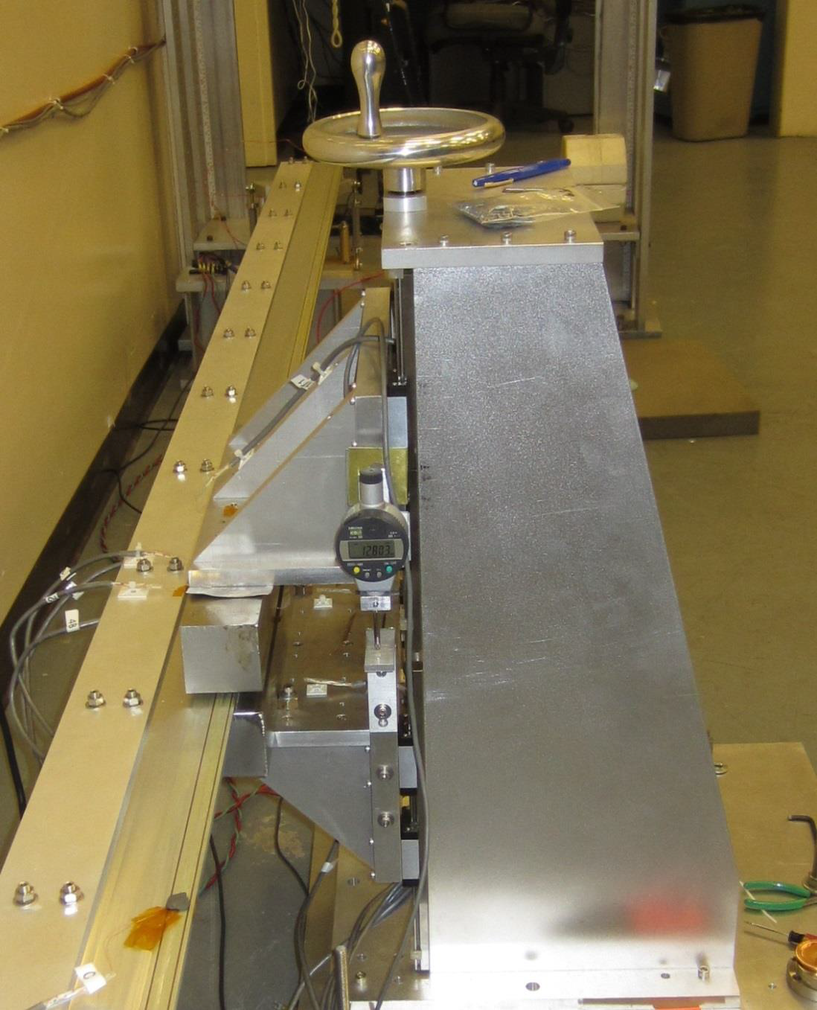
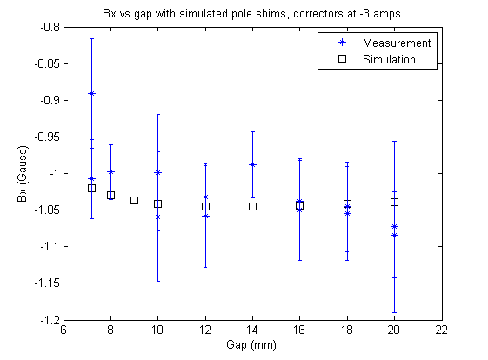
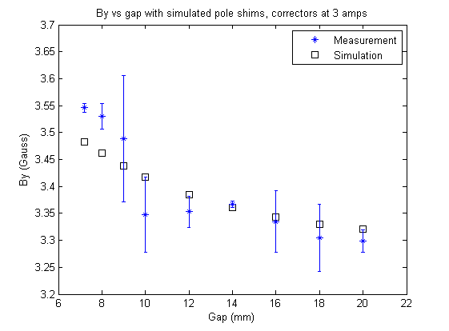
Correct Earth Field Difference With Beam Pipe Corrector Coil
I = 1 A
I = 3 A
Pole steel simulated by image currents.

Slide 20
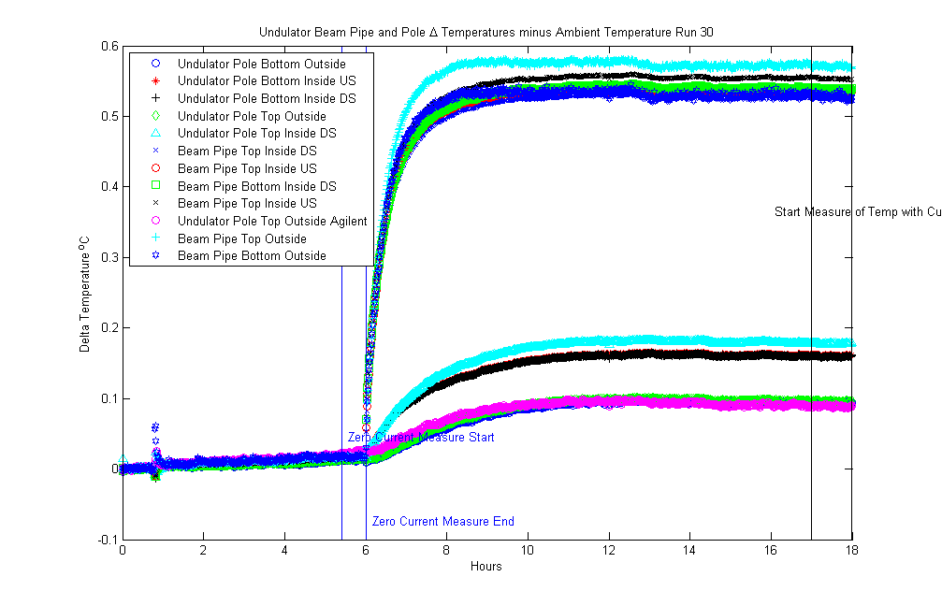
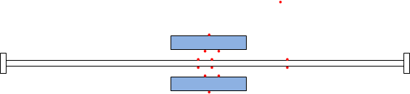
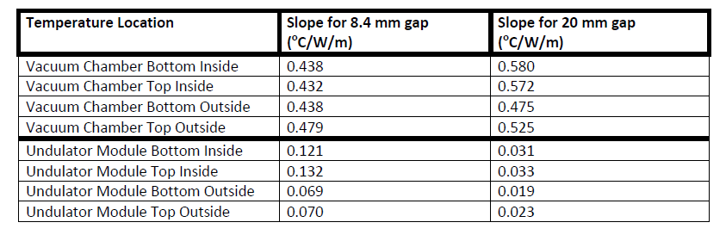
Beam Pipe And Magnet Array Heating
Temperature rise of beam pipe
Small thermistors on beam pipe and “undulator”
Temperature rise of “undulator jaws”
1 W/m corrector currents
plus
1 W/m heater (beam current)
Need water cooled chamber so we don’t change the K value.

Slide 21
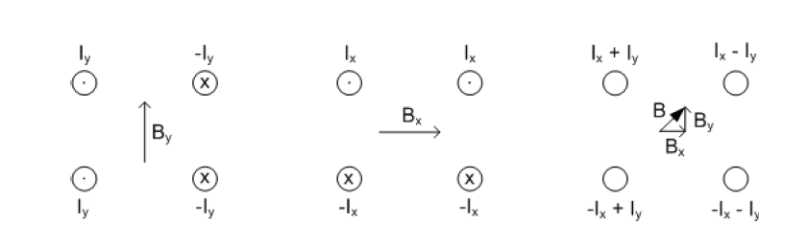
Helmholtz Coil To Simulate Earth Field Difference Between MMF And Tunnel
Coils
I₂
I₁
Two power supplies for two coils on diagonals.
Truss structure
-I₁
-I₂

Slide 22
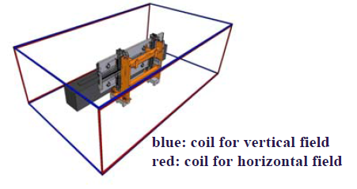
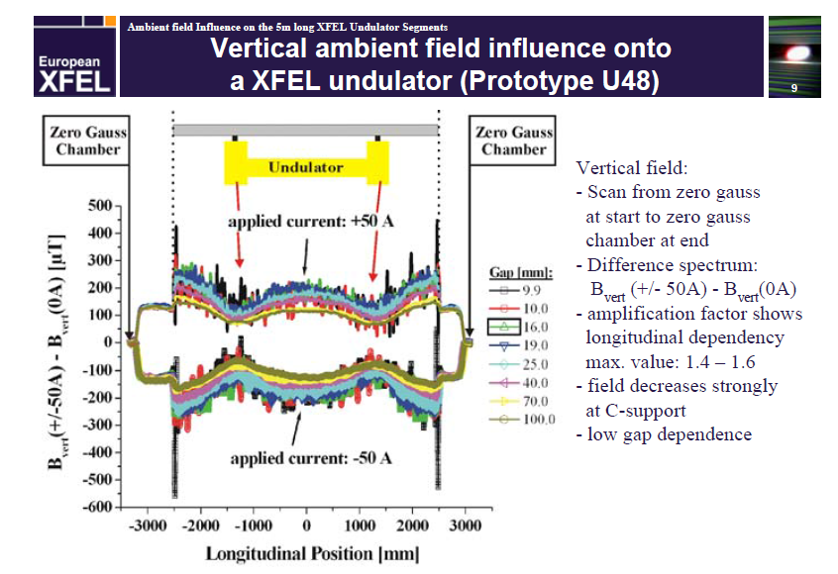
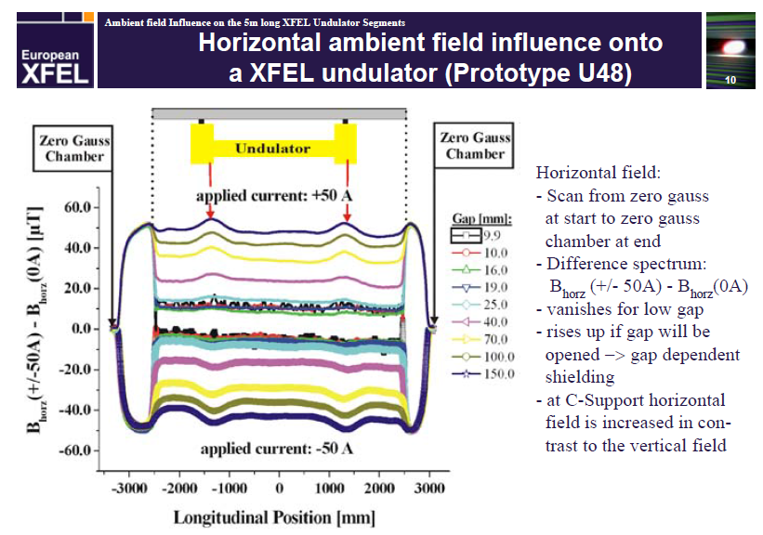
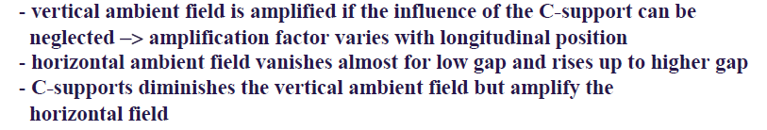
XFEL Earth Field Studies
Uwe Englisch

Slide 23
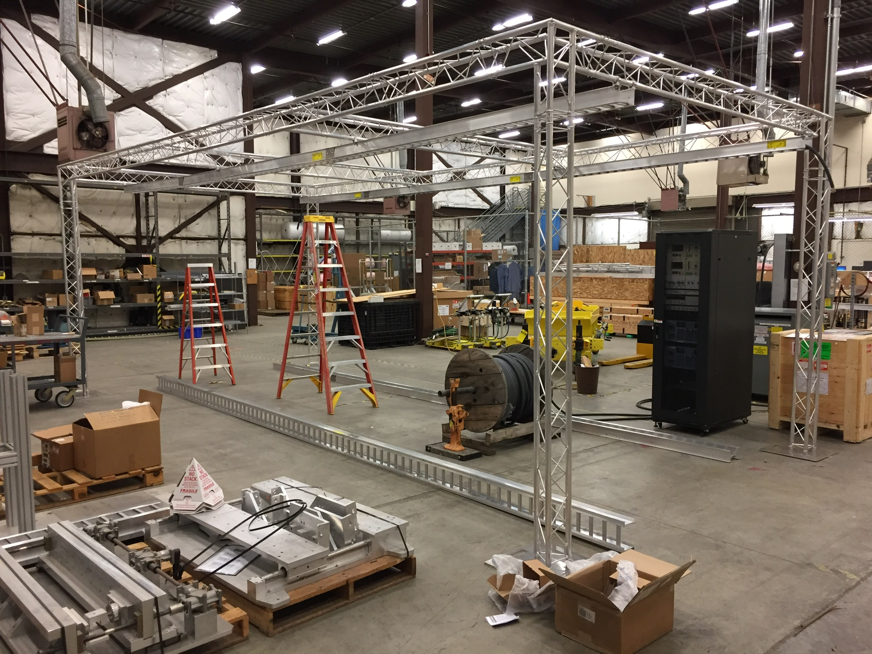
Helmholtz Coil

Slide 24
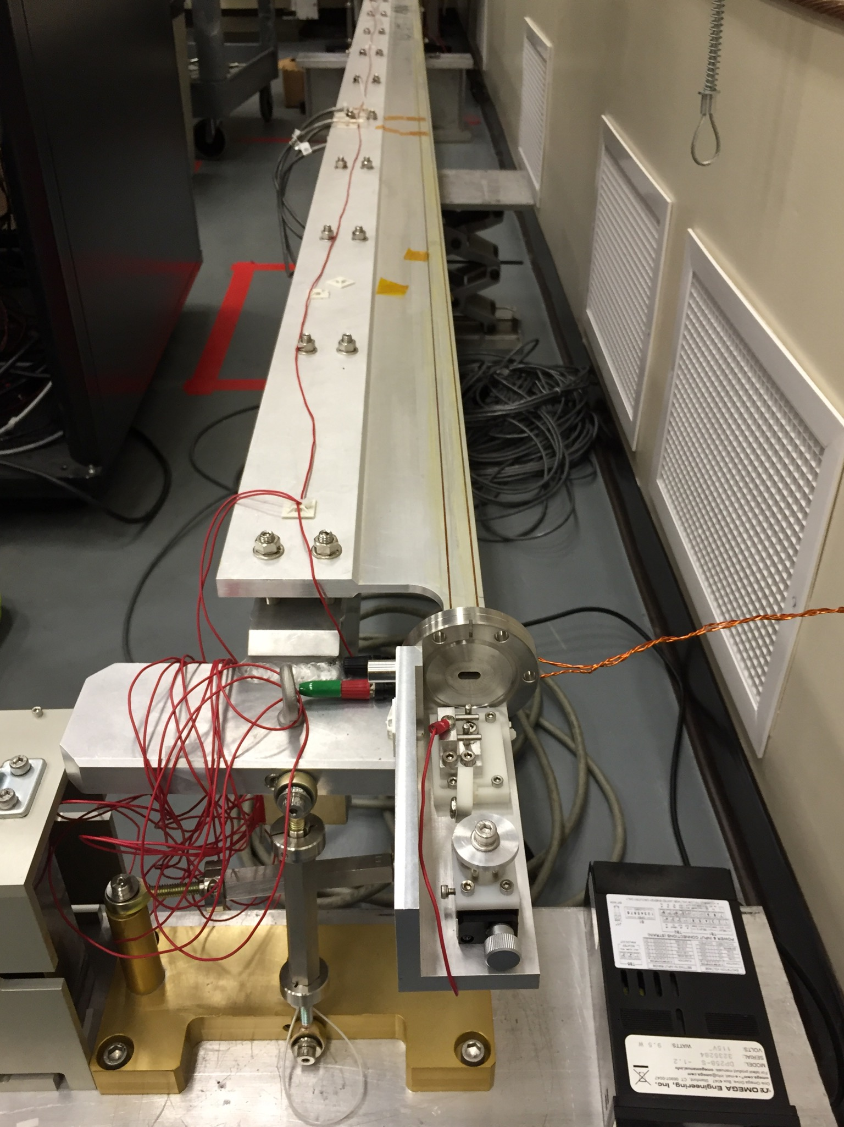
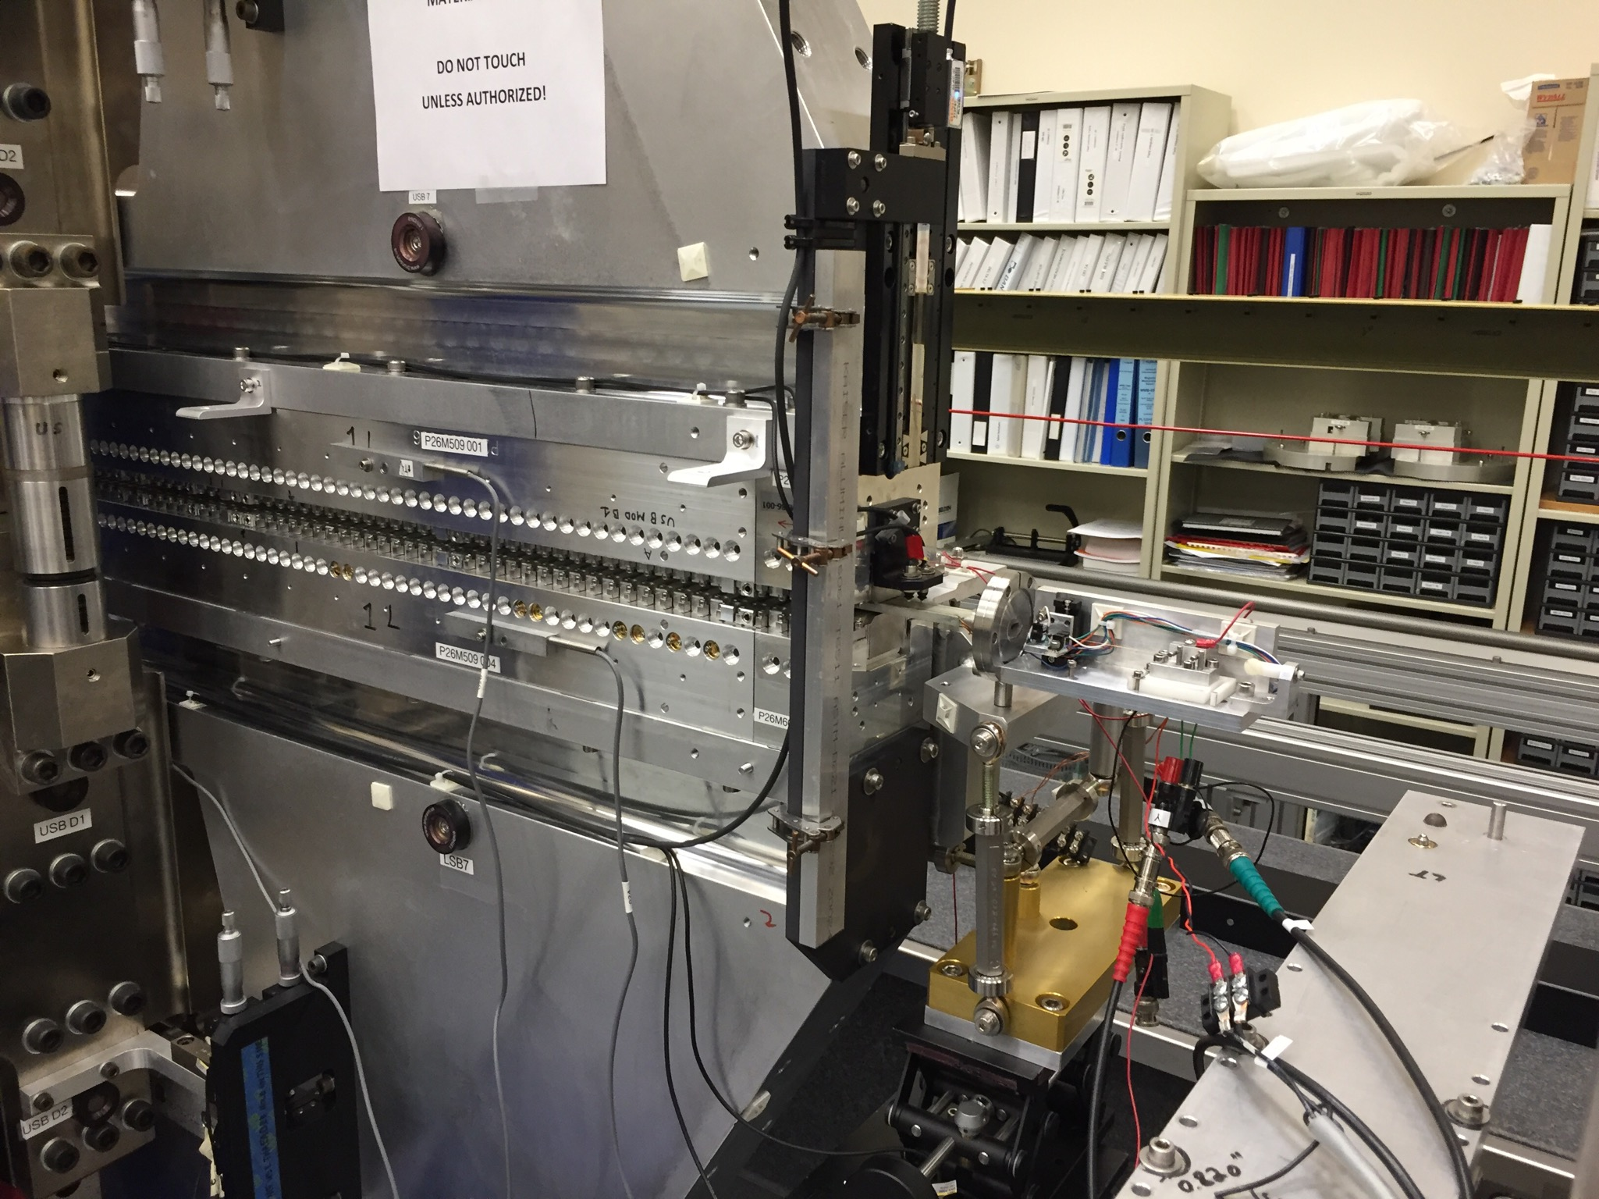
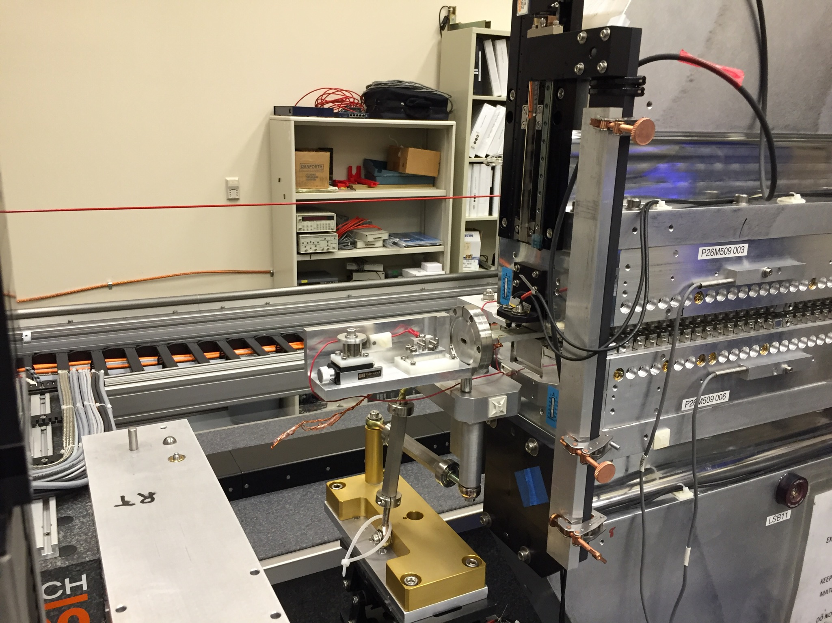
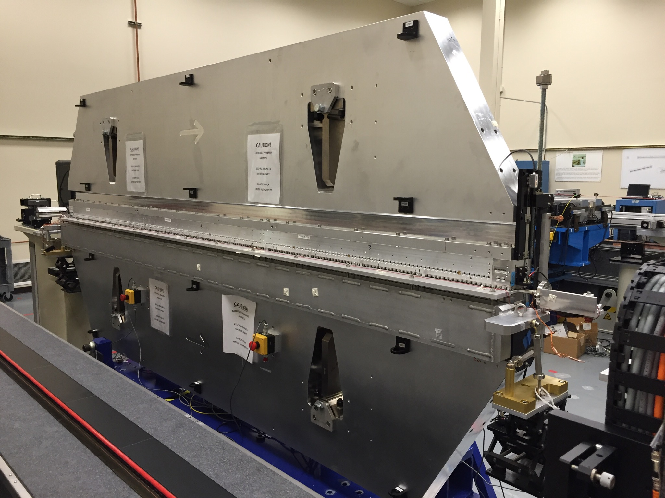
Field Integral Measurements In The Tunnel
Y. Levashov
Use beam pipe with corrector coils and a vibrating wire system at the beam position. The system is currently being tested.

Slide 25
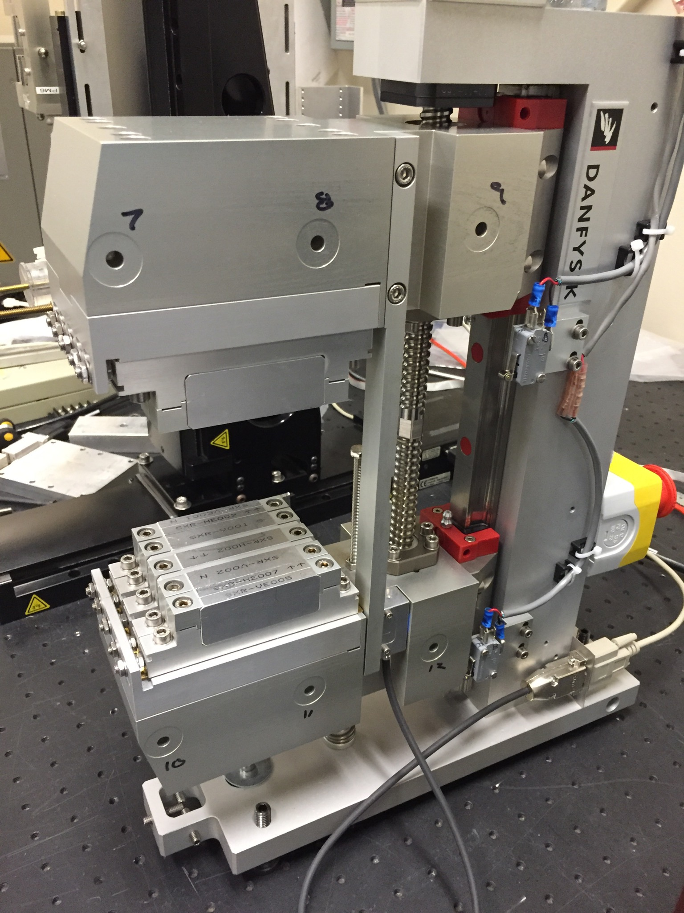
Phase Shifter Measurements
The SLAC measurements agree
with the Danfysik measurements.
All strength and field integral requirements were met.

Slide 26
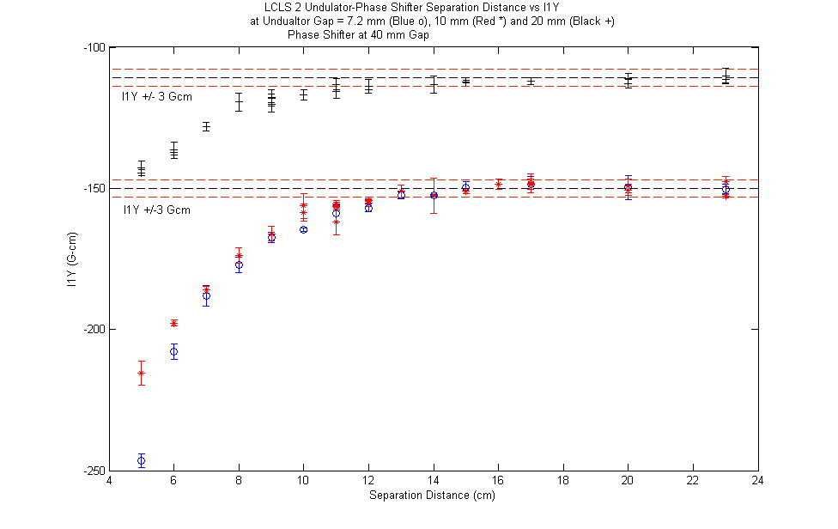
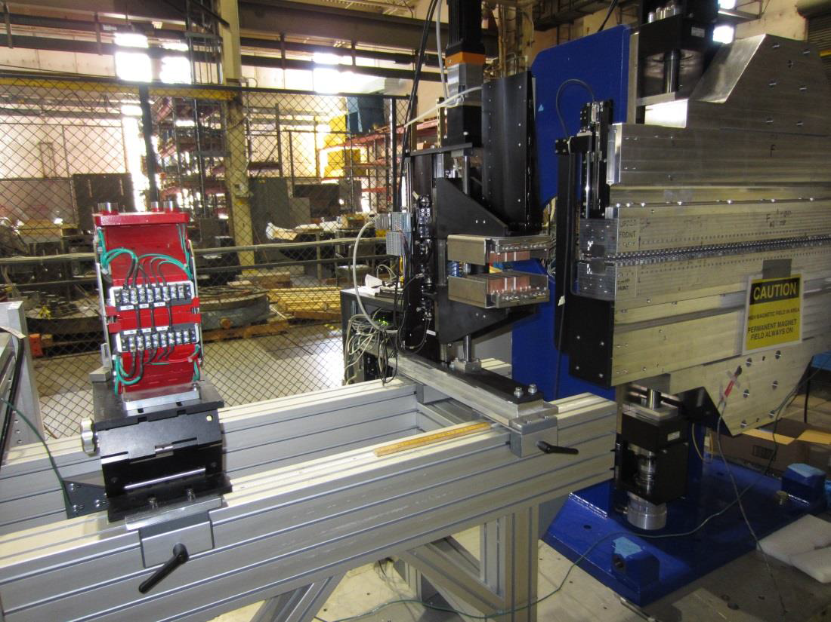
Phase Shifter Crosstalk Measurements
The edge of the phase shifter must be 14 cm from the last pole
of the undulator (using the 3 Gcm criterion, no mirror plates).
The current design meets this requirement.

Slide 27
Summary
We have a plan for sharing the LCLS-II tuning work with LBNL.
We have started to fit the phase matching errors and the K value so that we can determine what density of measurements are required for the phase shifters and the undulators.
We are testing a scheme to monitor radiation damage in the tunnel.
We are dealing with the Earth’s magnetic field by measuring the undulators in the same orientation as in the tunnel, mapping differences in the Earth’s field between the MMF and the tunnel, and using corrector coils on the beam pipe to compensate the differences.

