Slide 1
Delta Undulator Measurements At SLAC
Zachary Wolf
SLAC
IMMW20
June 4-9, 2017

Slide 2
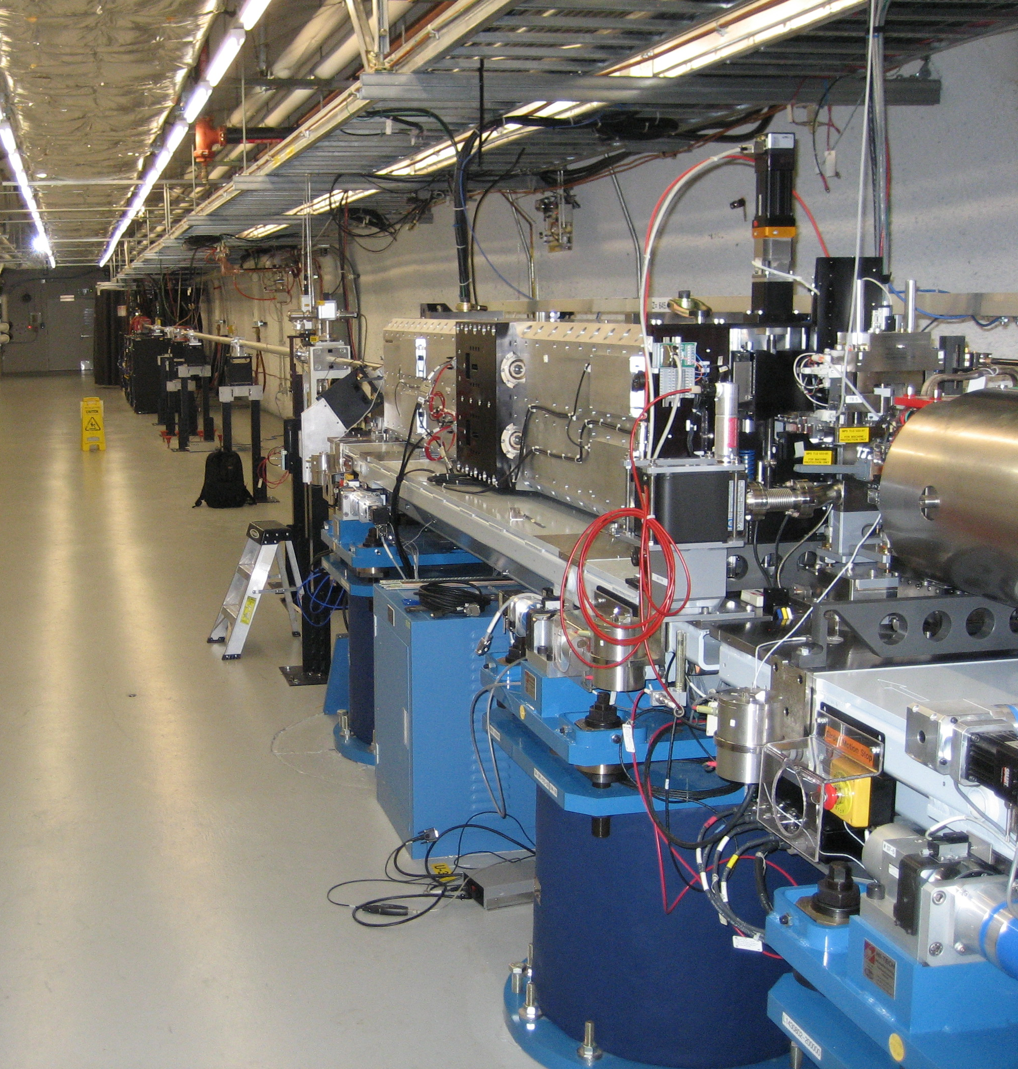
Delta Undulator
Produces elliptically polarized light.
Placed at end of LCLS. Uses the microbunched beam.

Slide 3
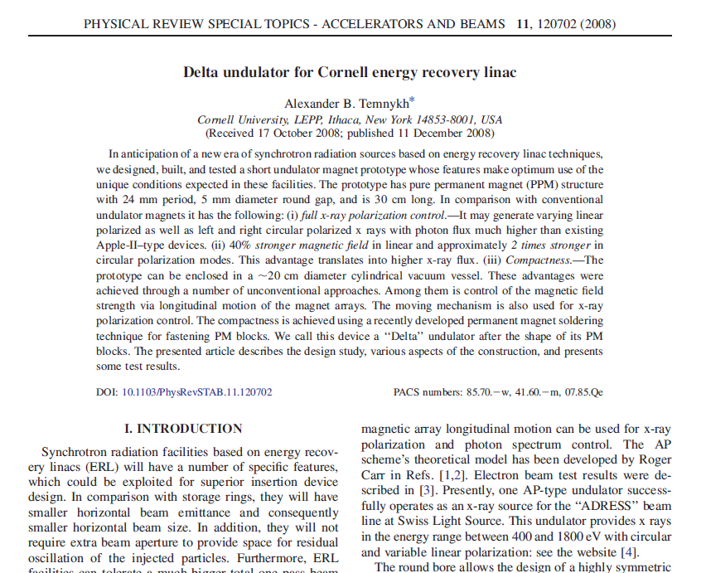
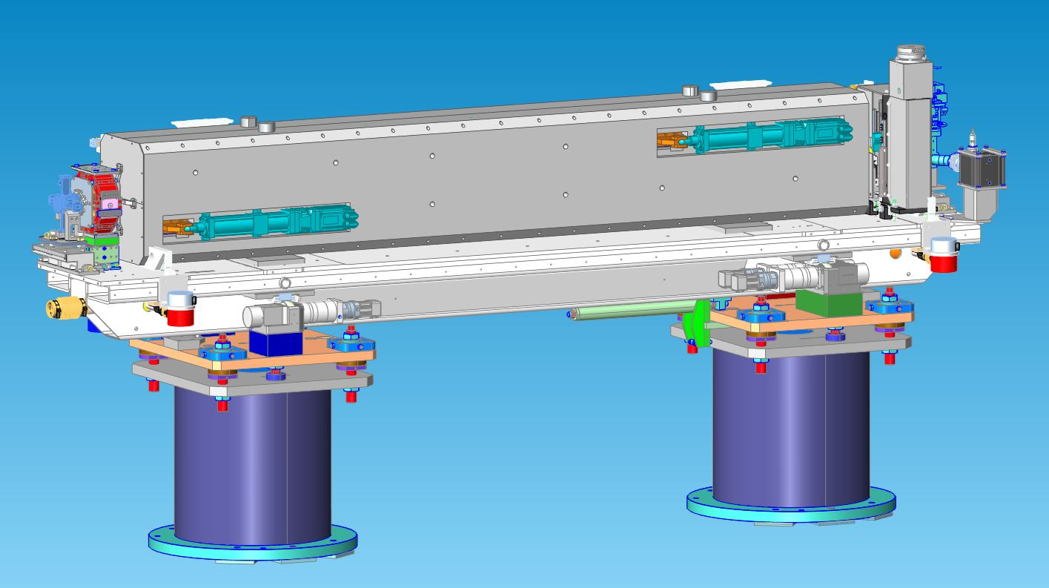
Delta Undulator
EPU in a package compatible with LCLS
Use same alignment strategy. Undulator
and quadrupole on the same girder.

Slide 4
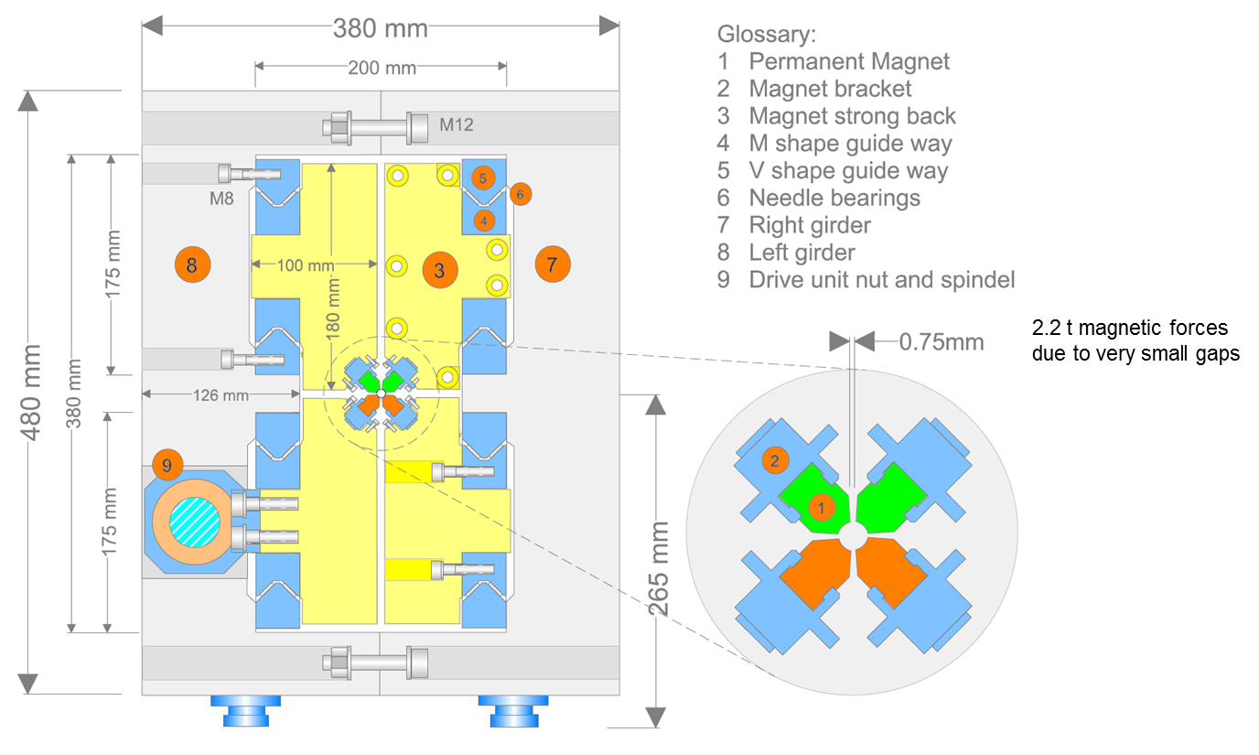
Delta Cross Section
Franz Peters

Slide 5
Delta Undulator
Benefits:
Very compact source of elliptically polarized light
Costs:
Can’t tune after assembly
  Tune quadrants, use superposition
Very tight assembly tolerances
Measurements can only be done from the ends in a 6 mm diameter tube
Difficult to achieve the tolerances to required to make an FEL out of Delta undulators.

Slide 6
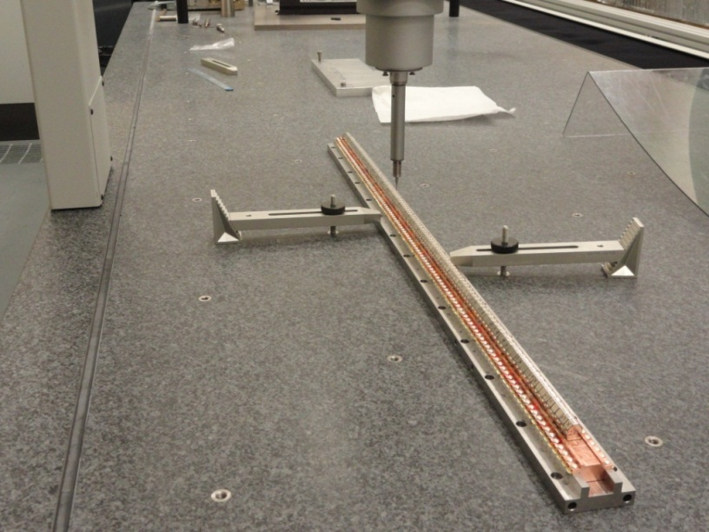
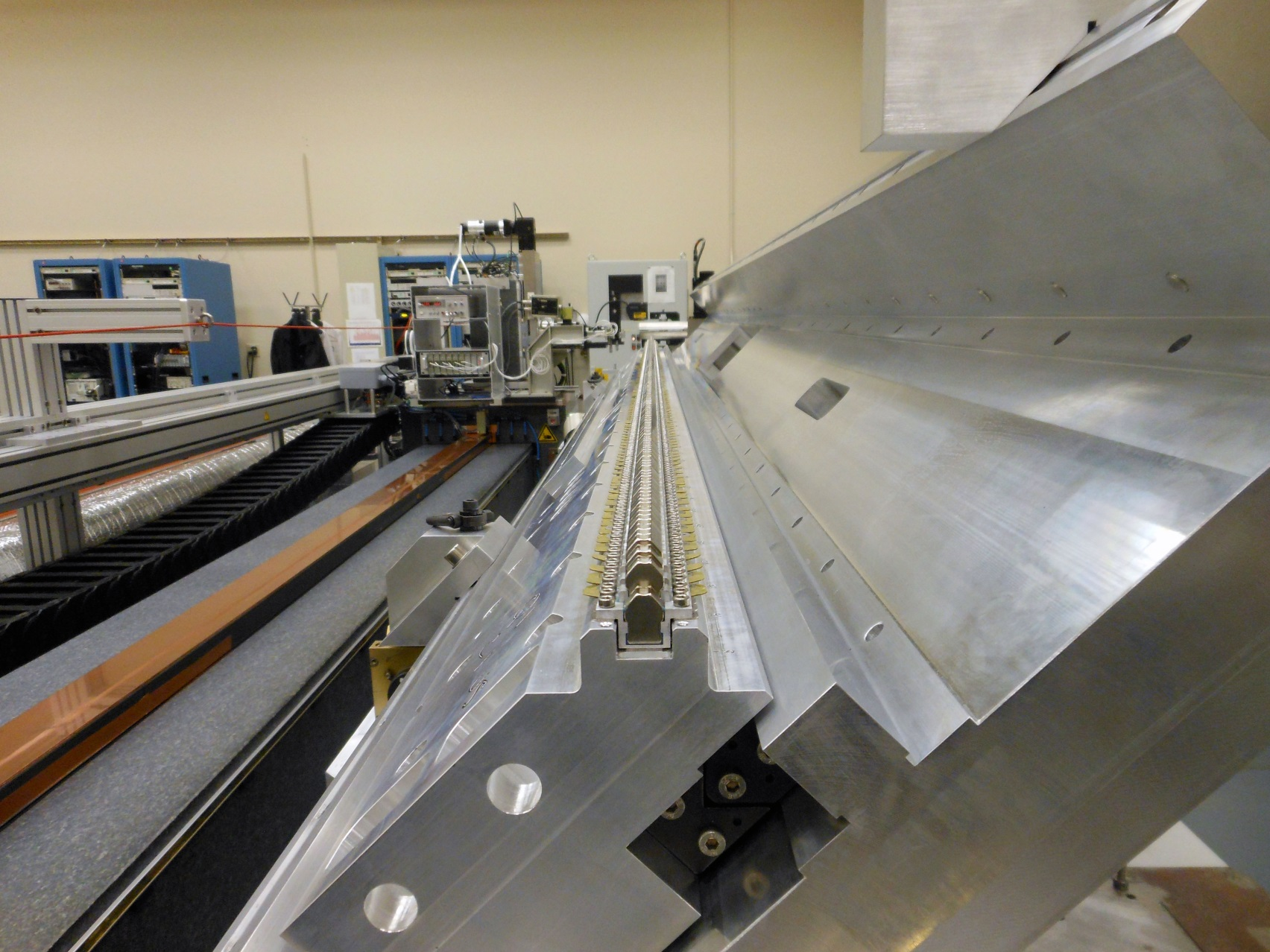
Delta Quadrant Assembly And Tuning
Mechanically align blocks
using CMM.
Move blocks using magnetic
measurements to straighten
trajectories and minimize
phase errors.

Slide 7
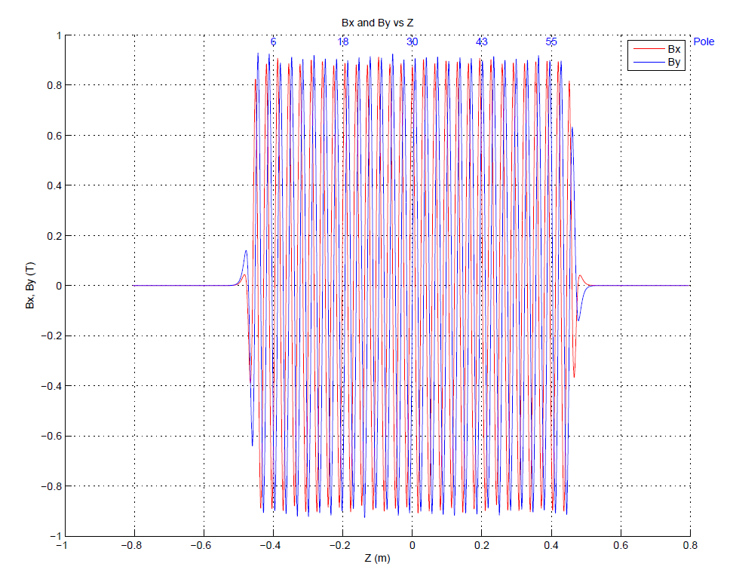
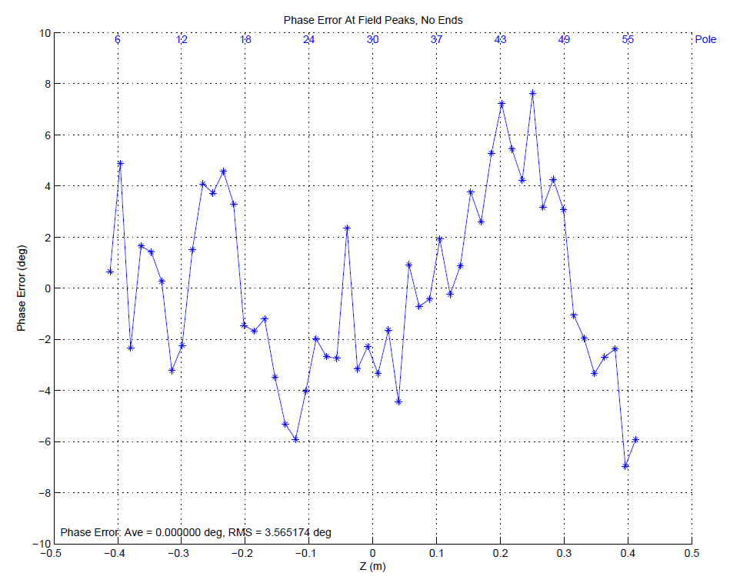
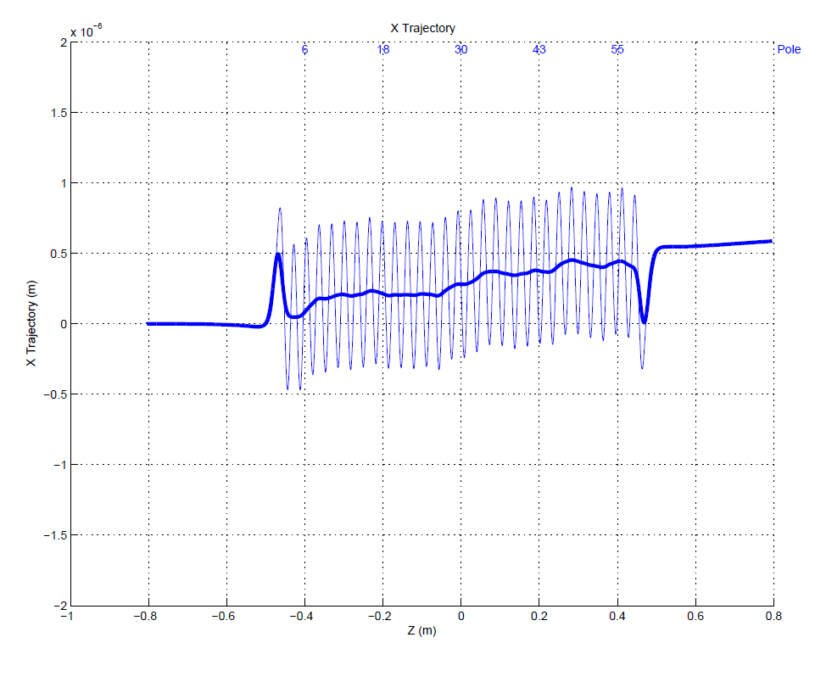
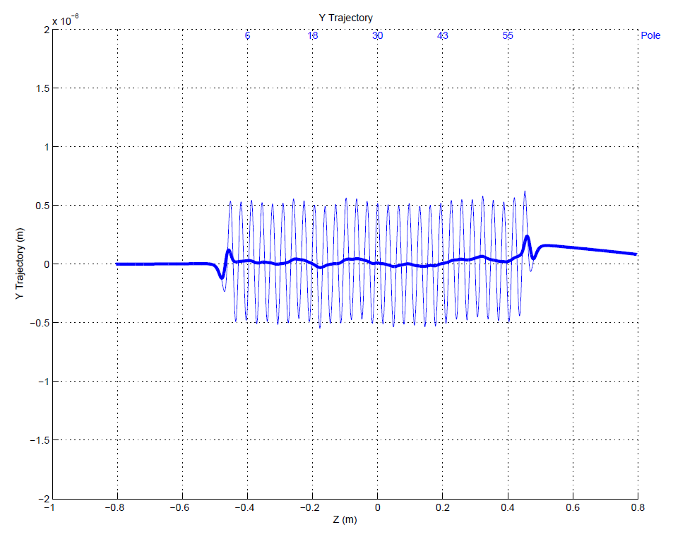
In Software Superpose Quadrant Fields To Simulate Assembled Undulator, Correct If Necessary
Example CP+. Expect undulator within tolerance, but no permeability effects in superposition.
(Prototype)

Slide 8
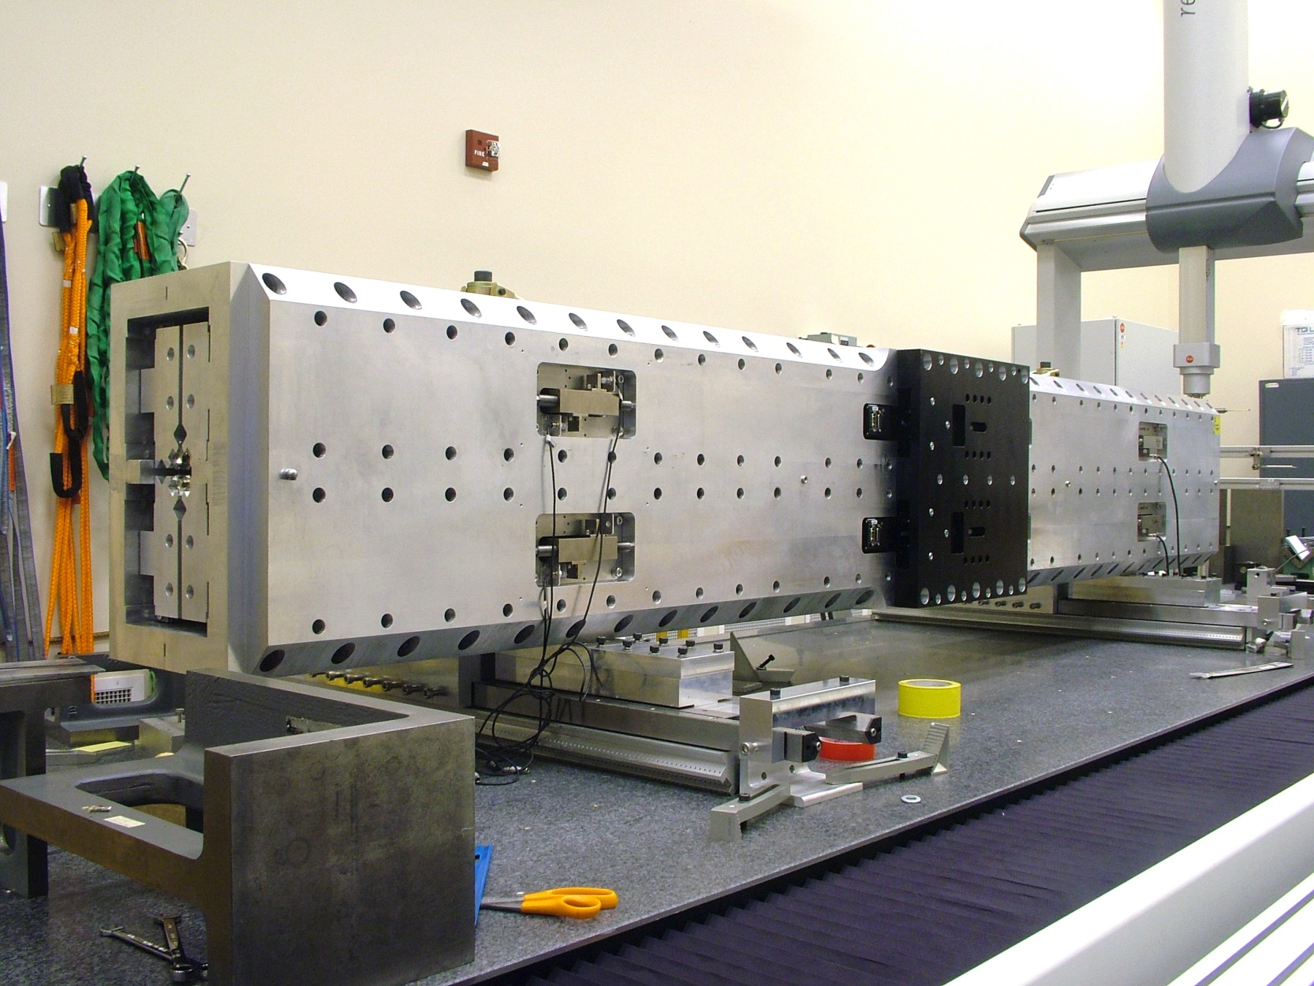
Delta Assembly

Slide 9
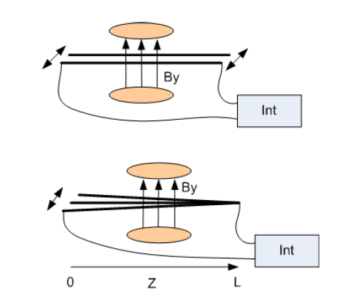
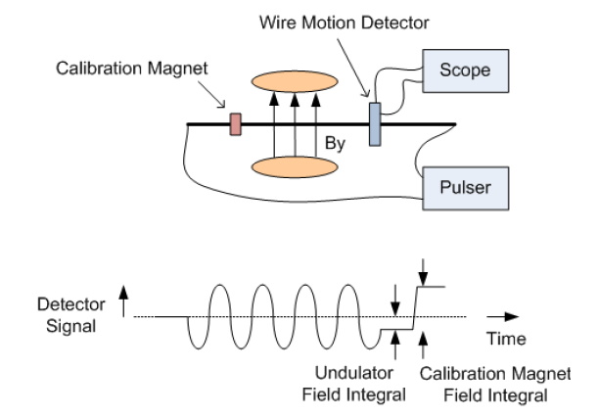
Delta Field Integrals
Moving Wire
Pulsed Wire

Slide 10
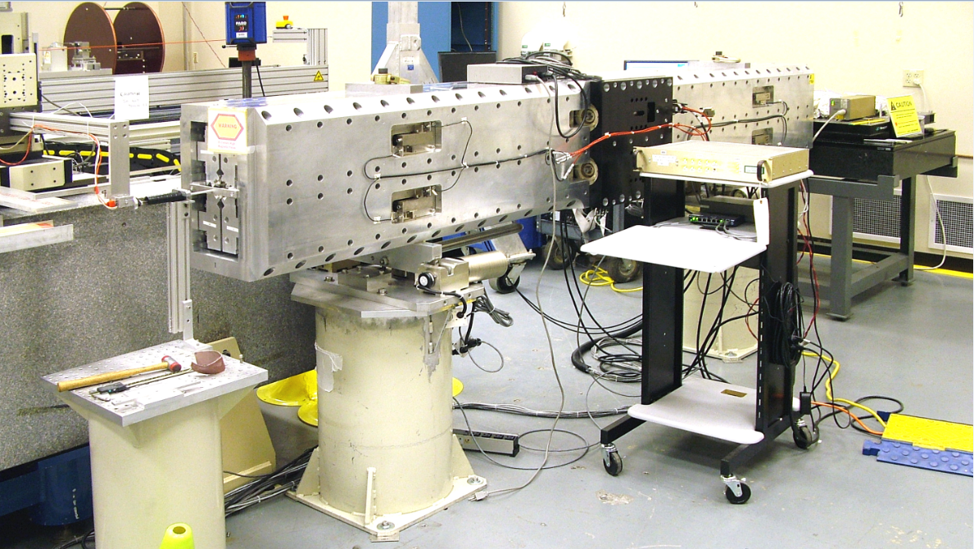
Hall Probe Measurements
The only access for measurements is
through the end of the beam pipe.

Slide 11
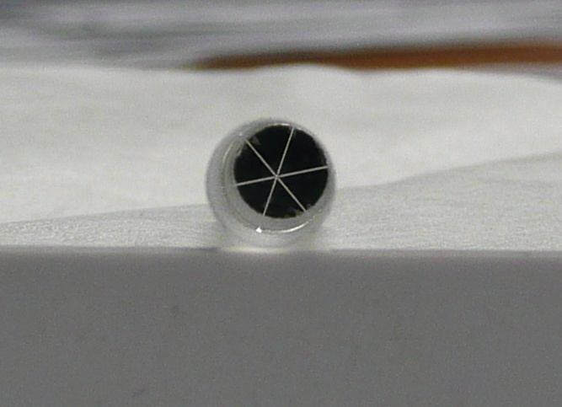
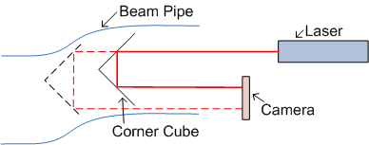
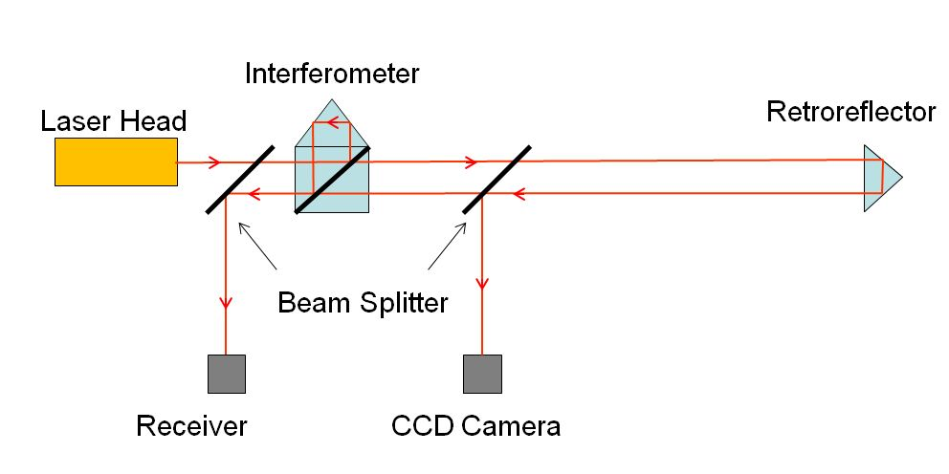
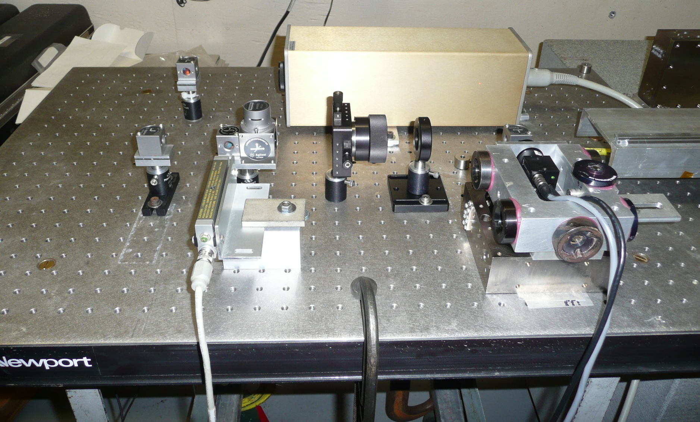
Measure Probe Position
Transverse location from corner cube. Longitudinal location from interferometer.
Georg Gassner

Slide 12
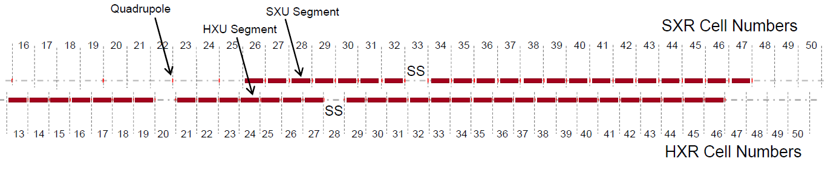
New Project
LCLS-II, Delta-II
Space for 2-stage HXRSS
Location for upgraded HXRSS
Space for SXRSS
Space for 3 Polarization Control Undulators

Slide 13
Delta-II
  Challenges/Improvements
    Position dependence of the K value
    Assembly tolerance to minimize phase errors
    Measurement/assembly plan on CMM
    Measurements of assembled undulator

Slide 14
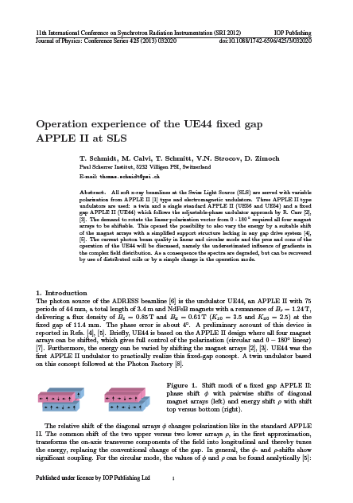
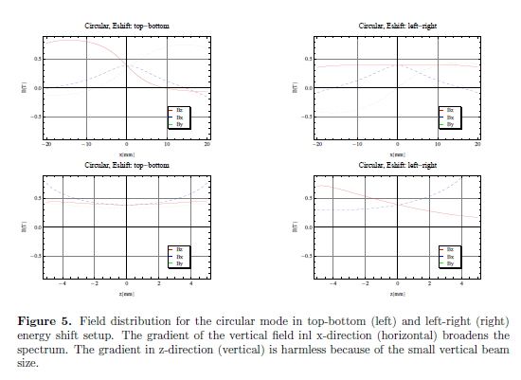
Delta-II K Value Position Dependence
Swiss Light Source

Slide 15
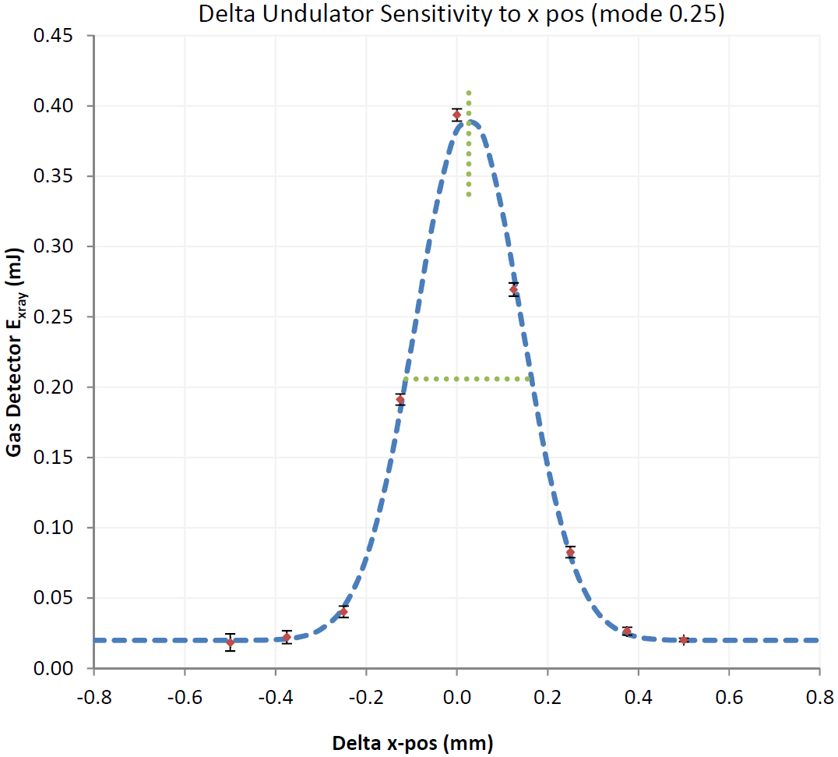
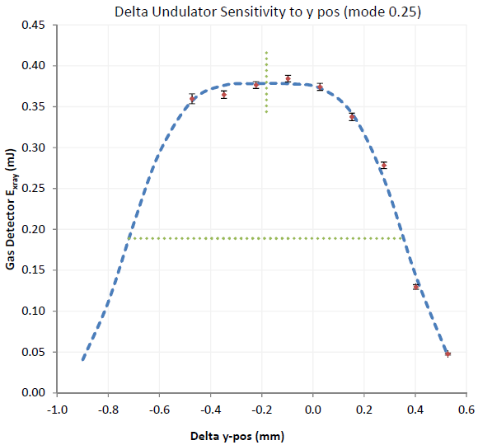

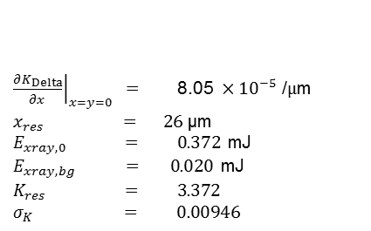

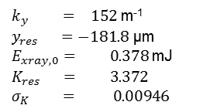





Delta: Horizontal and Vertical Position Sensitivity
LCLS MD 11/17/2015
Heinz-Dieter Nuhn
$K_{Delta,res}$ / $K_{Delta,max}$ = 0.942
$$E_{ph}=\text{530 }\text{eV}$$
LCLS MD 11/17/2015
LCLS MD 11/17/2015
$\text{FWHM}=277$ µm
$\text{FWHM}=1074$ µm
$$E_{xray}=E_{xray,0} e^{− \frac{{\left({\left.\frac{∂K_{Delta}}{∂x}\right|}_{x=y=0}\left(x−x_{res}\right)\right)}^{2}}{2 {σ_{K}^{}}^{2}}}+E_{xray,bg}$$
$$E_{xray}=E_{xray,0} e^{− \frac{{\left(K_{res} \cosh\left(k_{y} \left(y−y_{res}\right)\right)−K_{res}\right)}^{2}}{2 {σ_{K}^{}}^{2}}}+E_{xray,bg}$$
${\left.\frac{∂K_{Delta}}{∂x}\right|}_{x=y=0} =$ $\text{8}\text{.}\text{0}\text{5 }×{10}^{−5}\text{ /}μ\text{m}$
$x_{res} = 26$ µm
$E_{xray,0} = 0.372$mJ
$E_{xray,bg} = 0.020$mJ
$K_{res} = 3.372$
$σ_{K} = 0.00946$
$k_{y} = 152$ m⁻¹
$y_{res} =−181.8$ µm
$E_{xray,0}= 0.378$mJ
$K_{res} = 3.372$
$σ_{K} = 0.00946$
[compare to $129.0$ m⁻¹ from model]*
*Alexander Temnikh, private communication

Slide 16
K Gradients In Delta
What causes the asymmetric position dependence of K?
There is only hyperbolic cosine position dependence in the model of two crossed adjustable phase planar undulators.
What are the alignment tolerance effects on Delta-II?
Is there a model to help explain this behavior so that we can make predictions for Delta-II?
Are there design changes that can minimize this effect?

Slide 17
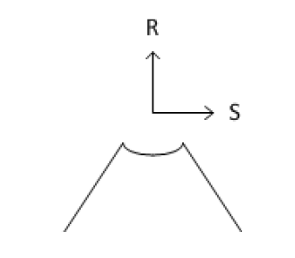

A Model To Explain The
Delta-II K Value Position Dependence
Add field rolloff to the model of two crossed, planar, adjustable phase undulators.
Model to explain the position dependence of K
LCLS-TN-16-1
For one quadrant
Delta Measurements:
k_{u} = 196 1/m
k_{r} = 270 1/m
k_{s} = 186 1/m
Potential decreases exponentially away from the quadrant, decreases away
from the center line, varies sinusoidally in z, obeys Laplace’s equation.
This potential can be considered the dominant term in a Fourier expansion.

Slide 18
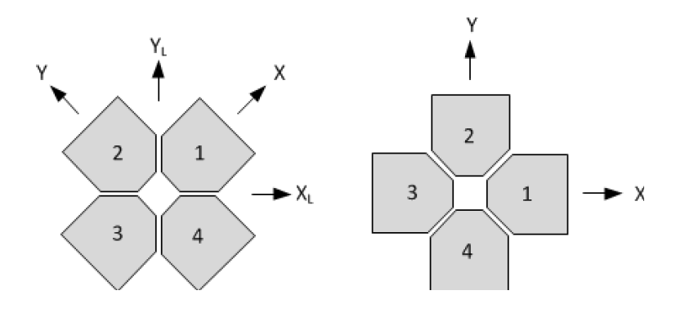
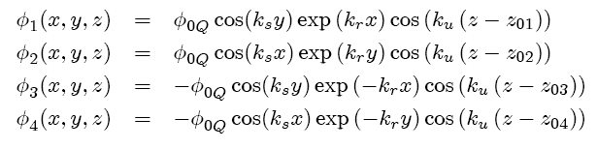
Delta-II K Value Position Dependence
Lab Frame
Undulator Frame
Potential for each quadrant:
Do calculations in the undulator frame.

Slide 19
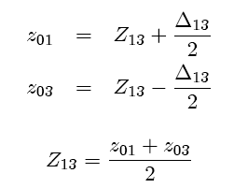
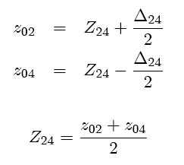


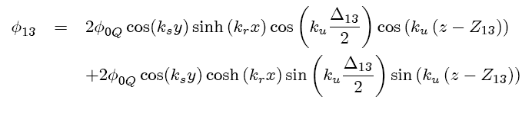
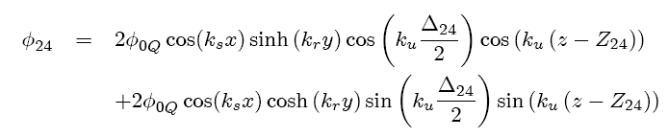
Delta-II K Value Position Dependence
Combine quadrants 1 and 3, also 2 and 4.
Two crossed adjustable phase undulators.

Slide 20
Example Position Dependence Of Fields
Circular mode
Krel = 0.9
Bx changes 5% per mm.

Slide 21
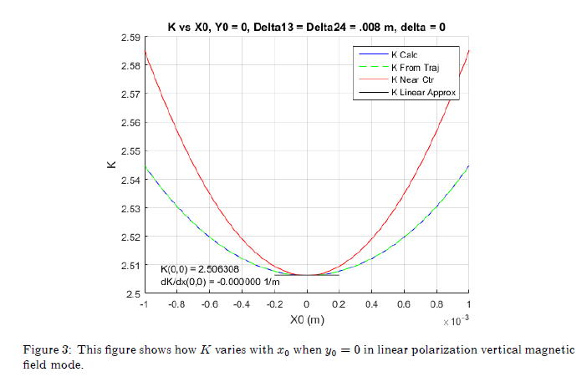
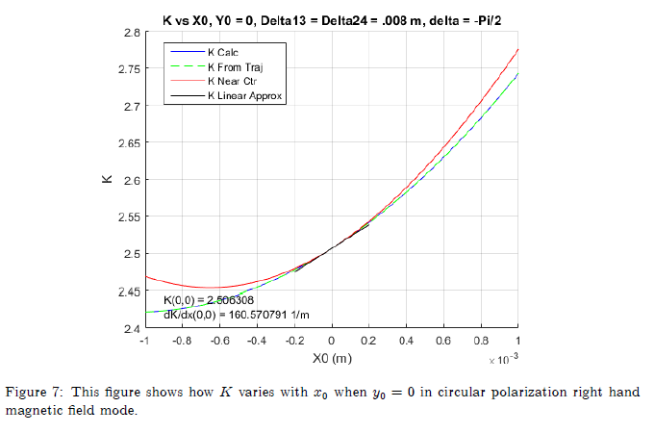
Delta-II K Value Position Dependence
Undulator frame.
LCLS-TN-16-1
Linear mode
Approximate K
near center
Circular mode
Full formula for K
In the linear modes K vs x does not have a slope at the beam axis. In the circular modes, however, K vs x does have a slope at the beam axis.
This can make setting several undulators to the same K value almost impossible using calibration and alignment techniques.

Slide 22
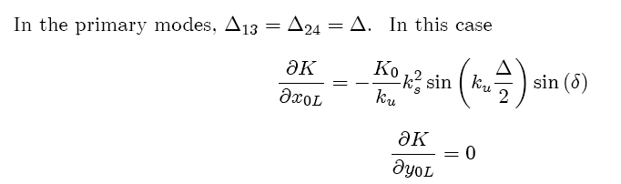





Delta-II K Value Position Dependence
LCLS-TN-16-1
Going to the laboratory frame and setting the relative shifts of the two
variable phase undulators to be the same, the formula simplifies.
There is a gradient in x, but not in y.
Note that the gradient comes from the field rolloff k_{s}. It grows as the row shift Δ increases. It is largest in the circular modes where δ = π/2.

Slide 23
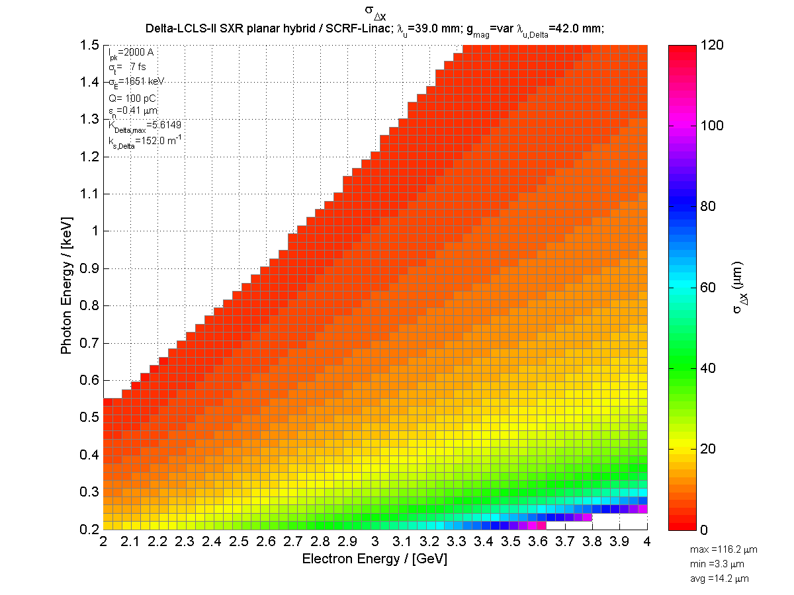
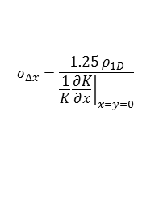
With A Delta-like Undulator
Predicted DELTA-II RMS X-Resonance Width
Heinz-Dieter Nuhn
$$σ_{Δx}=\frac{1.25 ρ_{1D}}{{\left.\frac{1}{K}\frac{∂K}{∂x}\right|}_{x=y=0}}$$
No gap change.
Change K by shifting rows.

Slide 24
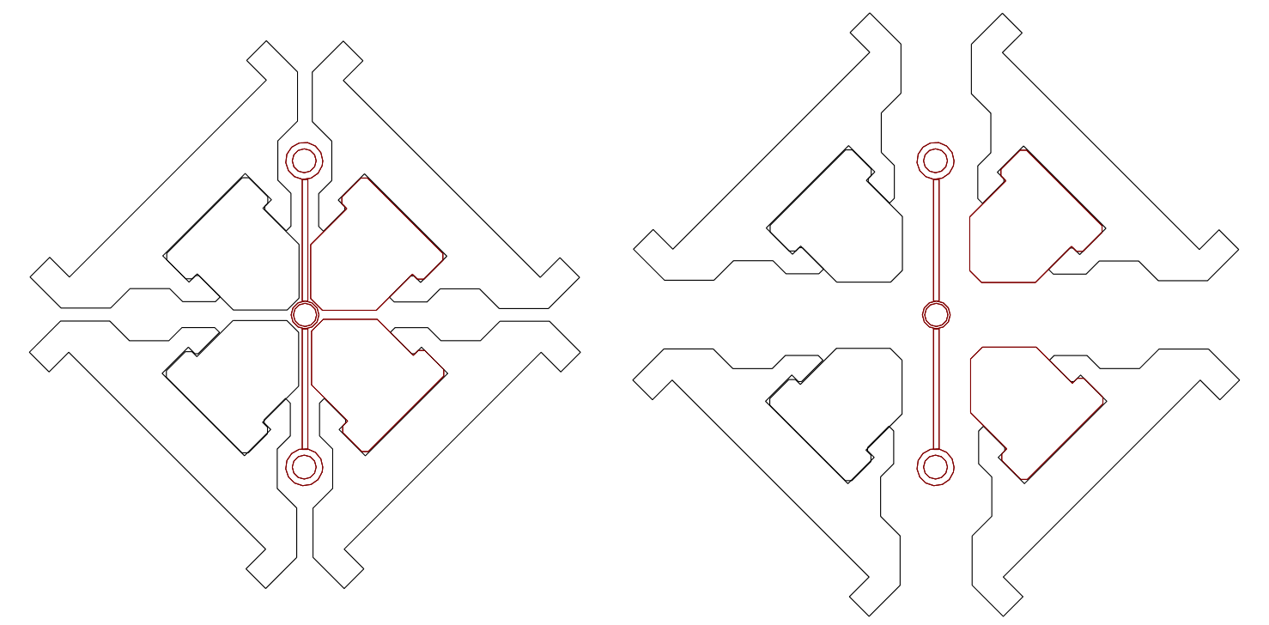
Delta-II K Value Position Dependence
The gradient depends on k_{s}. It is zero for crossed planar undulators.
The gradient gets bigger as the row shift gets bigger, or as the K value gets smaller.
The gradient is zero in the linear modes, and is largest in the circular modes.
The gradient will cause alignment problems with the three Delta-II undulators.
Remedy:
Franz Peters’ design
Tried to shape magnets to minimize k_{s}, but no success. Limited by block size.
Operate at small relative row shift and increase the gap to adjust K.

Slide 25
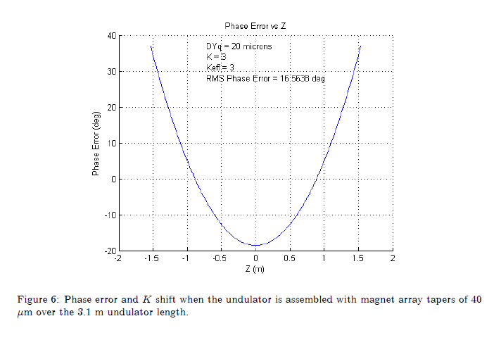
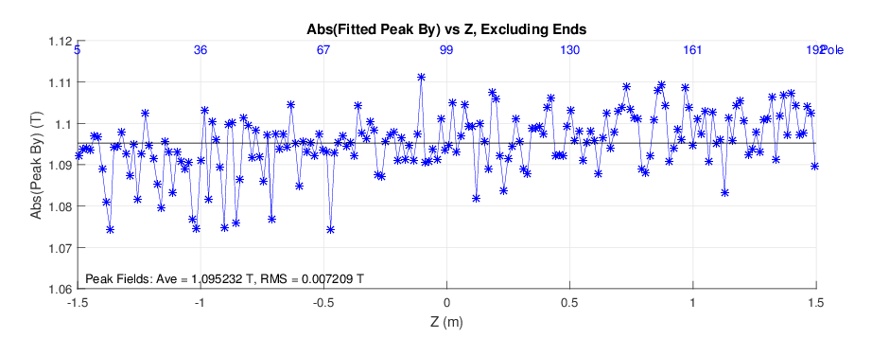
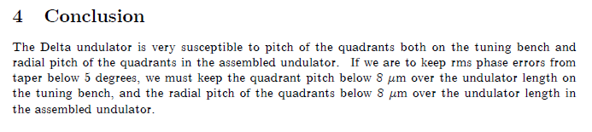
Delta-II Construction Tolerances
LCLS-TN-15-2
Delta Measured Peak Fields, LPVMF mode, Krel = 0.9

Slide 26
Delta-II Assembly Plan
Build Delta-II On A CMM
Move the blocks in order to move the magnet mechanical axis
to the fiducialized geometric axis of the strongback.

Slide 27
Measure On Line Between Pointed Magnet Centers
Line radial taper less than 8 microns.
Line radial bow less than 18 microns.
‘Pointed magnets’ make the connection between CMM probe position and Hall probe position.
We purchased software to move the CMM in a straight line and generate triggers uniformly spaced.
Move blocks to tune quadrant.

Slide 28
Assembled Undulator
Flats on E set Y and pitch.
Use tooling balls on E to set X and yaw.
Need tooling balls at ends to determine Y after assembly. (Green)

Slide 29
Measurements Of The Assembled Undulator
Requirements:
Measure at many gaps
Measure at many row shifts
Measure in many modes
Measure the fields on-axis and off-axis
Possible Solutions:
Safali --- We are trying to fit a Safali rail system into the mechanical design.
Probe Array --- An array of probes is very difficult to calibrate and it is hard to get all the cables out. Plus, corrections have to be made when the probe array goes off a straight line. Enough measurements need to be made to characterize the field and do the corrections.
Delta-I --- We can measure in a beam pipe centered on the beam axis, but this is not an ideal solution.
Safali --- We can possibly move a beam pipe to keep the probe moving on a straight line.

Slide 30
Conclusion
A Delta undulator was successfully built and used in LCLS-I
Modifications must be made for LCLS-II
  The K gradient must be reduced (by moving the magnet arrays radially)
  Tighter construction tolerances must be met
  We are looking for a better way to measure the assembled undulator.

