Slide 1
LCLS-II Undulator Measurements
Zachary Wolf
LCLS-II FAC Status Review
March 6-7, 2018

Slide 2
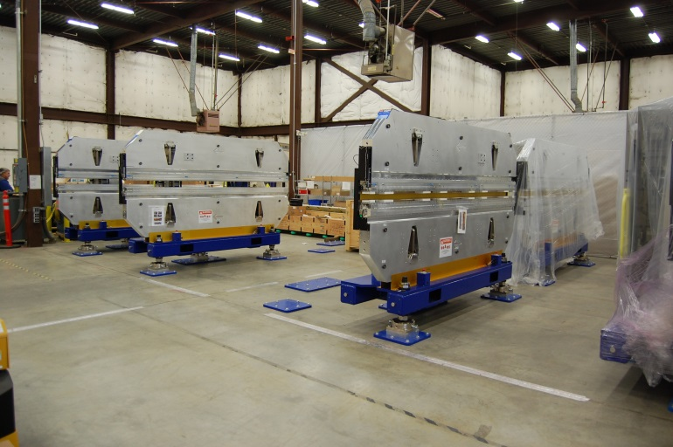
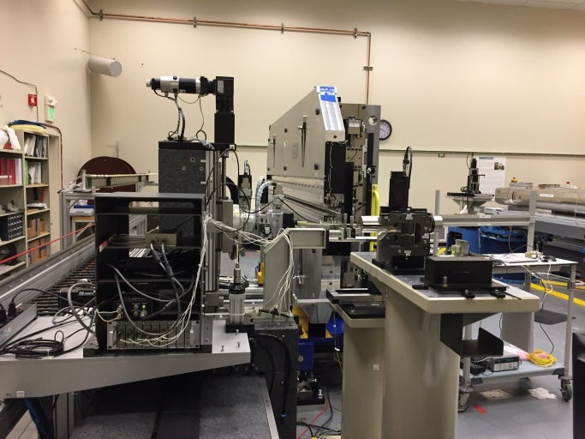
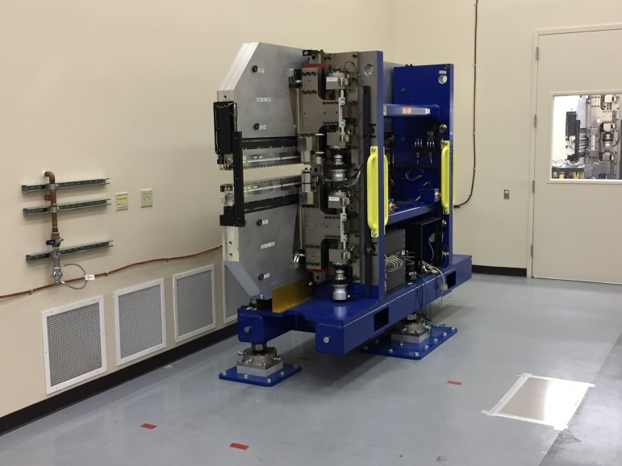
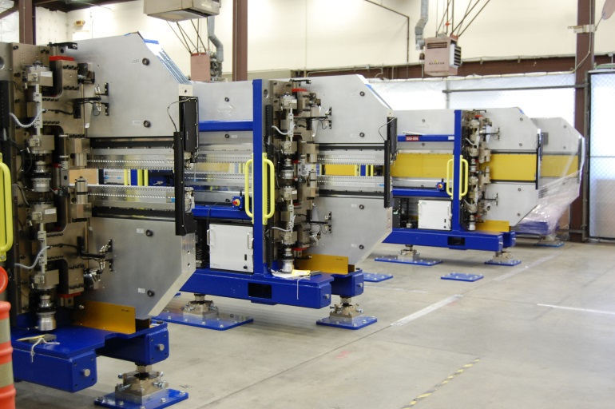
SXU Tuning Logistics
Receive Undulators / Store
Tune / Final Data Set
Bring Undulator to 20 deg C
Store Undulators ±15 deg C

Slide 3
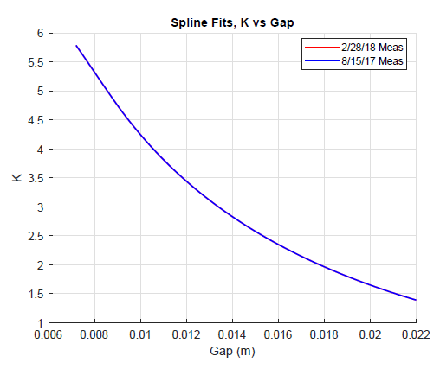
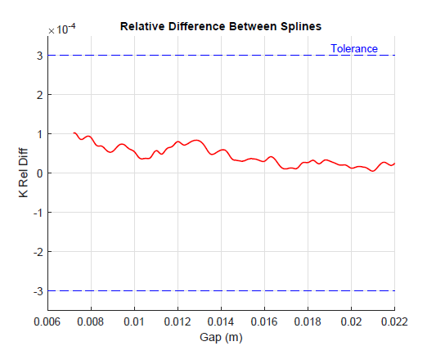
SXU-001 Repeat Measurements After Storing 6 Months
Preliminary Result:
Storing the SXR undulators does not seem to affect their calibration.

Slide 4
SXU Tuning Time, Issues
SXU-001
7/12/17 to 8/17/17, ~5 weeks
unlubricated leveling screws, missing fiducials, centerline shift with gap,
could not close gap, tuning rotor holes wrong size
SXU-002, many problems, sent to LBNL
At LBNL
could not close gap, missing drive screw key, large field integrals
SXU-003
9/25/17 to 10/18/17, ~4 ½ weeks
rust on poles, hit hard stop, limit switch not adjusted, centerline shift with gap
SXU-004
10/27/17 to 12/5/17, ~5 weeks
hit hard stop, limit switch not adjusted, tilt switches not set,
centerline shift with gap, jaws pitch as gap opens, open/close shift difference
SXU-005
2/5/28 to 2/23/18, ~3 weeks
large field integrals, centerline shift with gap
SXU-006
12/11/17 to 1/18/18, ~3 weeks
hard stops not set properly, centerline shift with gap
With time, the undulators are having fewer problems.
We are getting better at dealing with the problems.

Slide 5
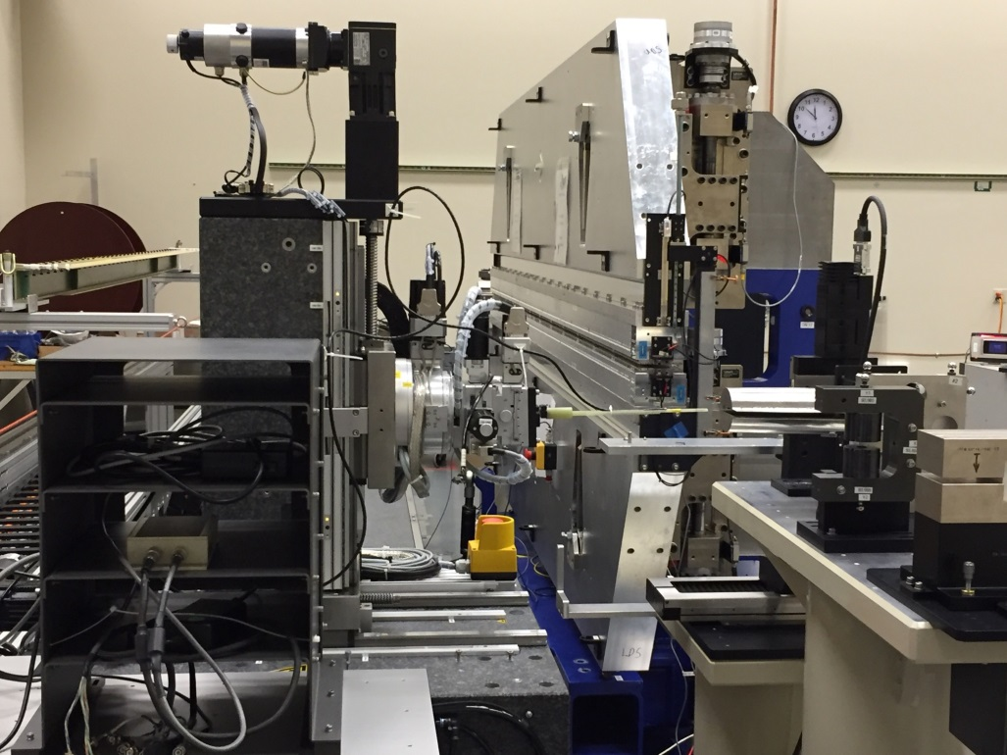
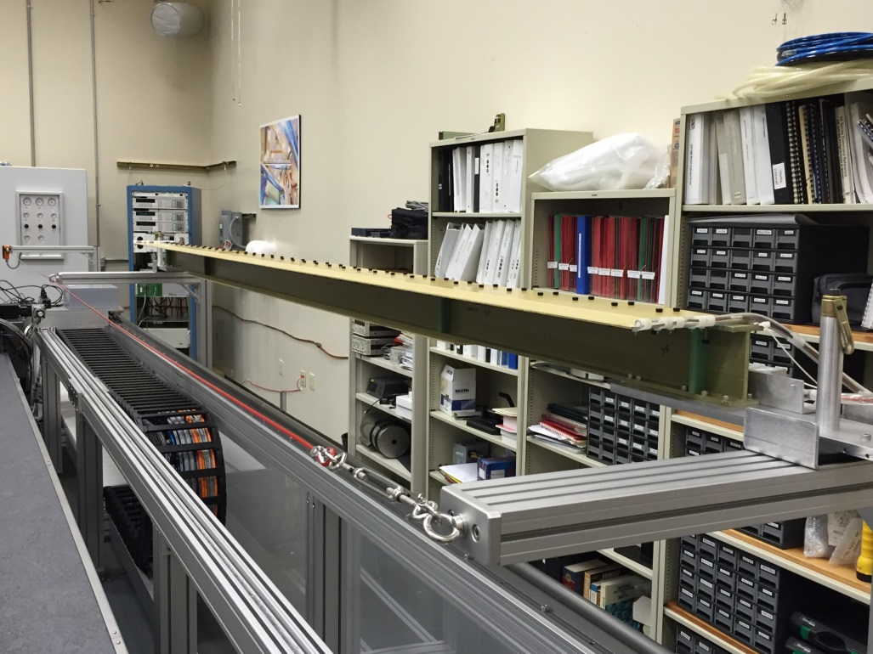
SXR Measurements
Yurii Levashov
Hall probe and touch probe measurements are done with the Kugler bench.
Field integrals are measured with a long coil.

Slide 6
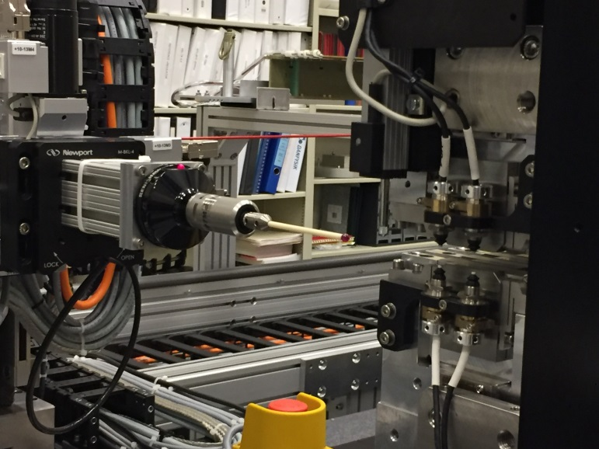
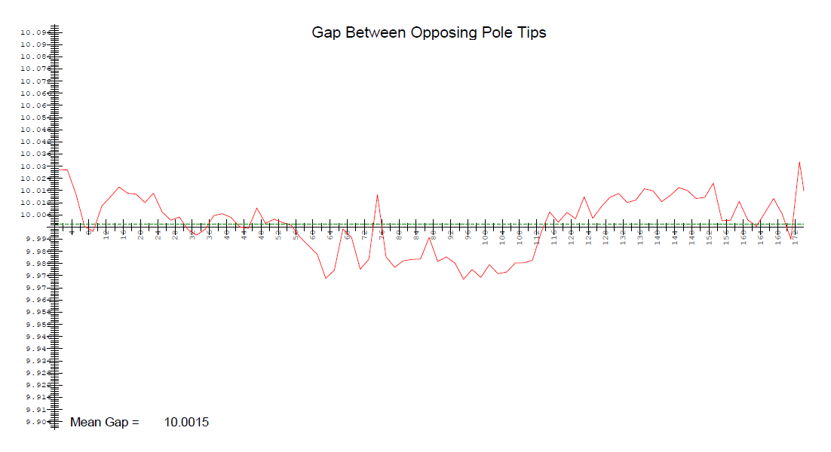
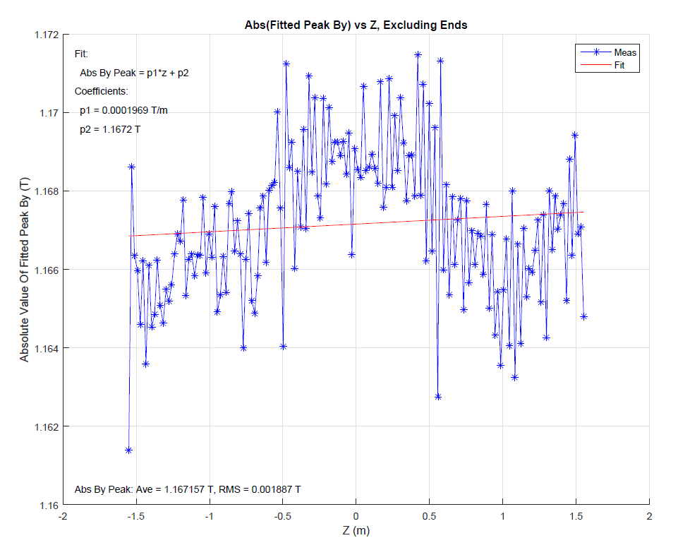
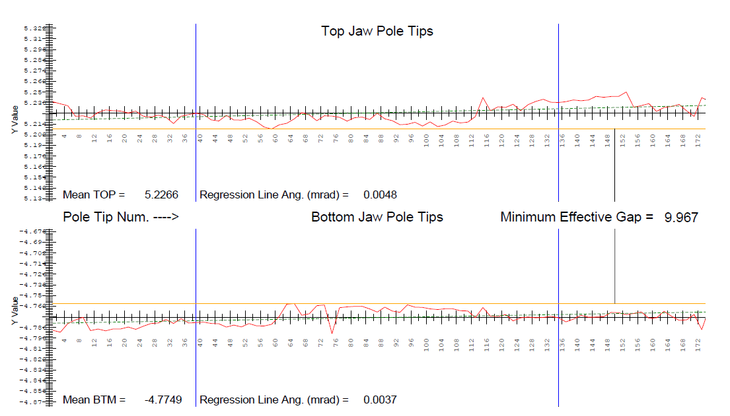
Touch Probe Measurements
Ed Reese
Bob Pushor
Gap
Top / Bottom Pole Tip Positions
Peak Fields

Slide 7
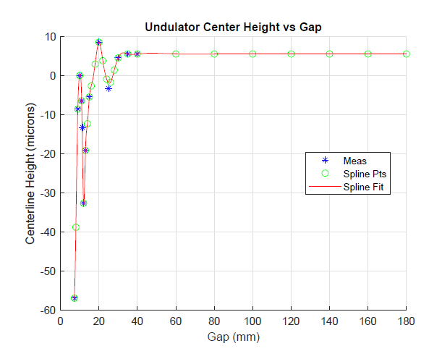
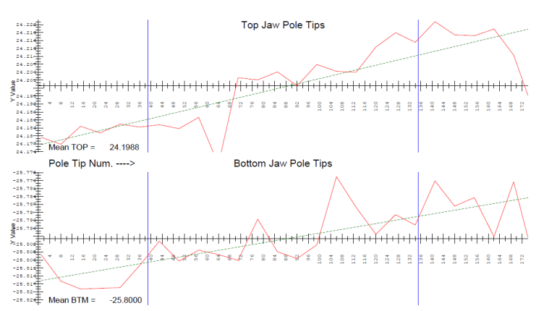
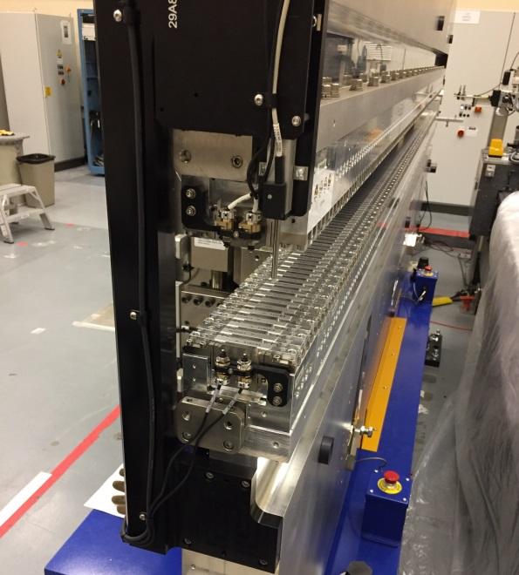
Touch Probe Measurements: Centerline Shift With Gap
Both the undulator
center line height
and pitch need to
be corrected before
measuring.
Springs
Potentiometer not available

Slide 8

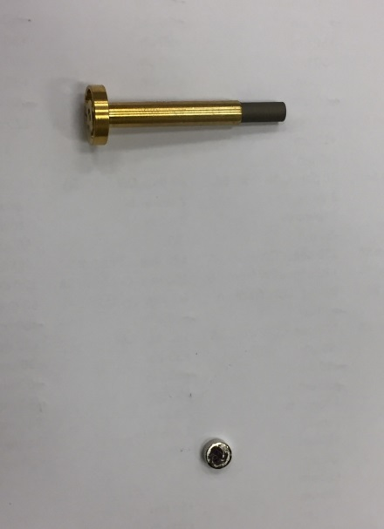
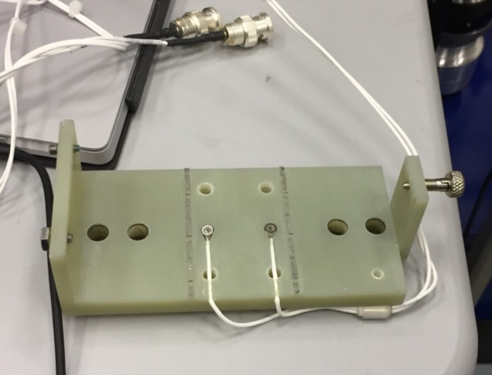
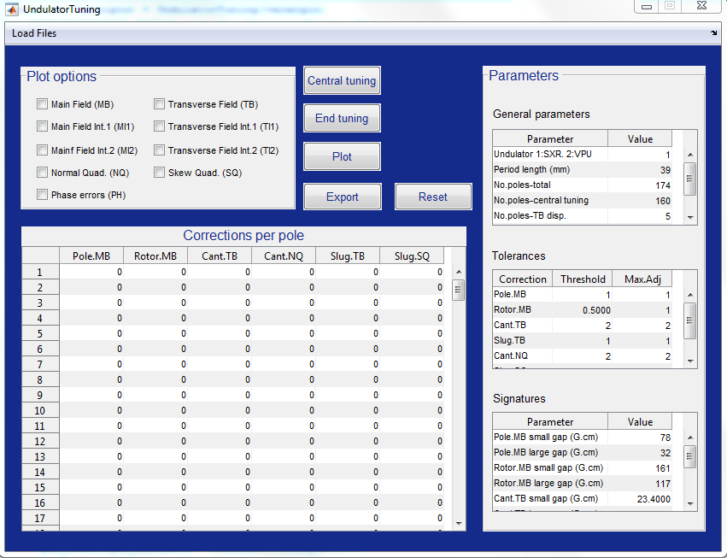
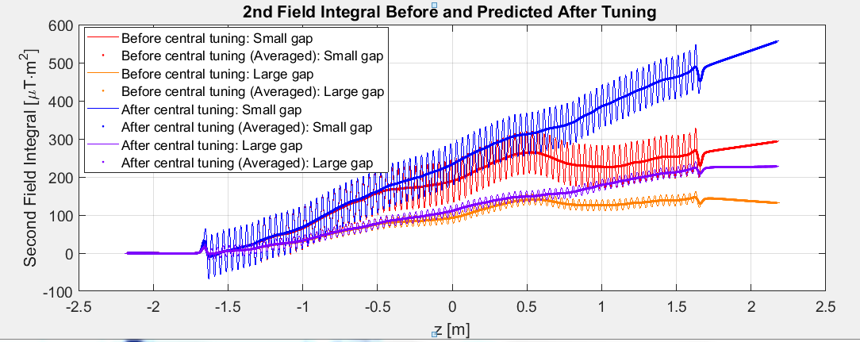
Tuning, Hall Probe Measurements
Diego Arbelaez
Laura Garcia Fajardo
Capacitive Sensors
To Move Poles
Rotors, Slugs

Slide 9
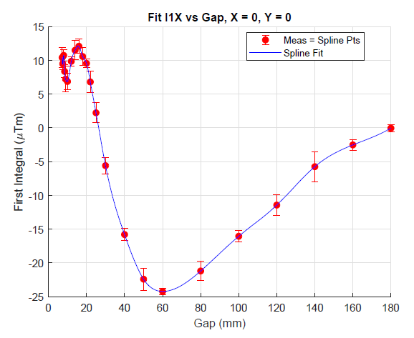
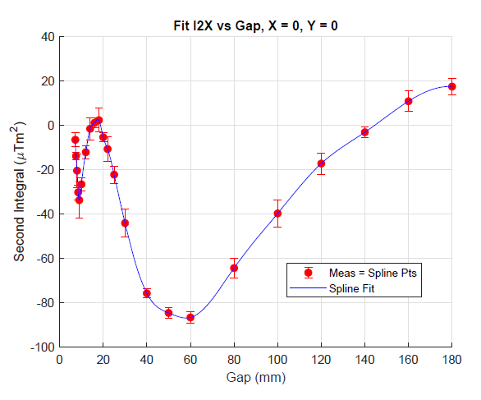
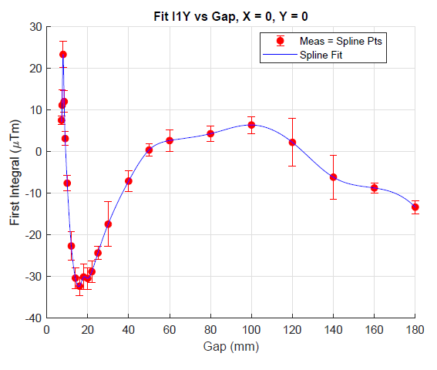
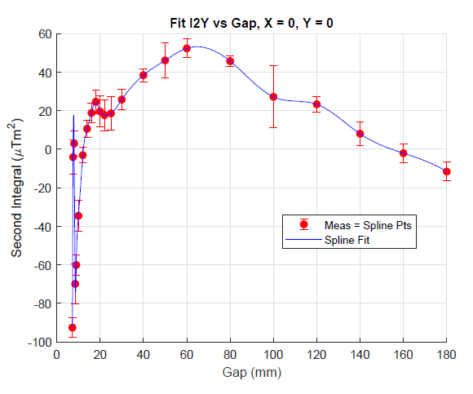
Final Data Set Field Integrals
Spline fits are used to interpolate between measured points.

Slide 10
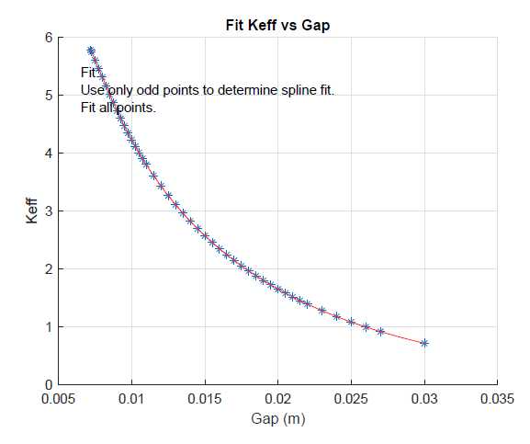
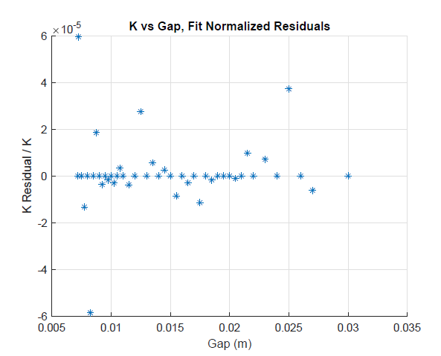
Final Data Set K Fits
Use spline fits with many data points.
Fit only odd points, find residuals for even and odd points
In use, the Controls group will do a spline fit to all the measurements.

Slide 11
K Hysteresis
Tolerance
The K value at a given gap depends on whether the gap is opening
or closing. The calibration is done with the gap opening. The difference
is typically within the tolerance.

Slide 12
Phase Matching
LCLS-TN-16-3
Phase shims set the phase matching error to zero at one K value.
This lets us commission the undulators without phase shifters.
The entrance phase shifter makes the phase matching error in the undulator center a multiple of 2π.
The exit phase shifter makes the phase at the exit cell boundary a multiple of 2π.
The actual phase shifter has the phase of the sum of the entrance plus previous exit phase shifters.

Slide 13
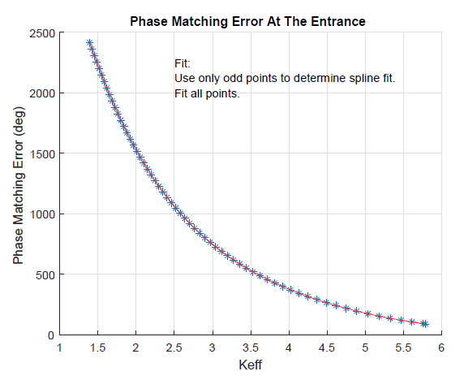
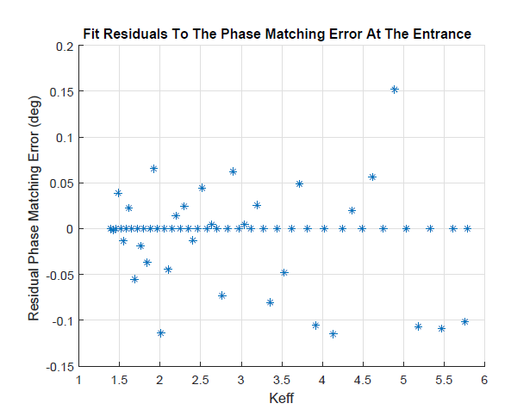
Final Data Set Phase Matching Fits
Use spline fits
Use every other point for the fit, find residuals for all points.
In use, every point will be used in the fit.

Slide 14
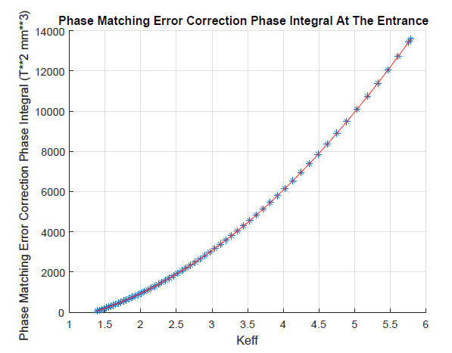
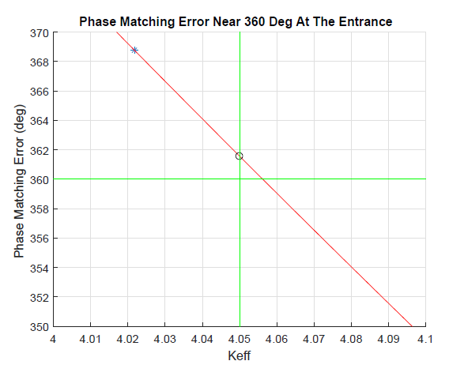
Final Data Set Commissioning Phase Matching Correction
A phase shifter is set using the required phase integral at the entrance
plus the required phase integral from the exit of the previous undulator.
At K = 4.05, a phase shim is added so no phase shifters are needed.

Slide 15
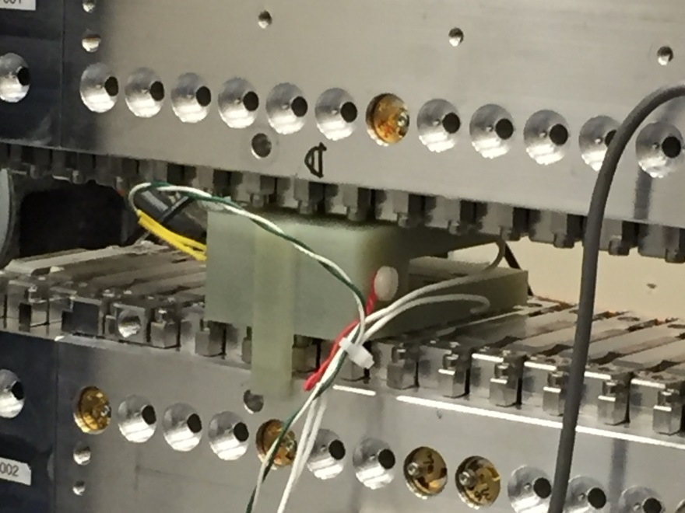
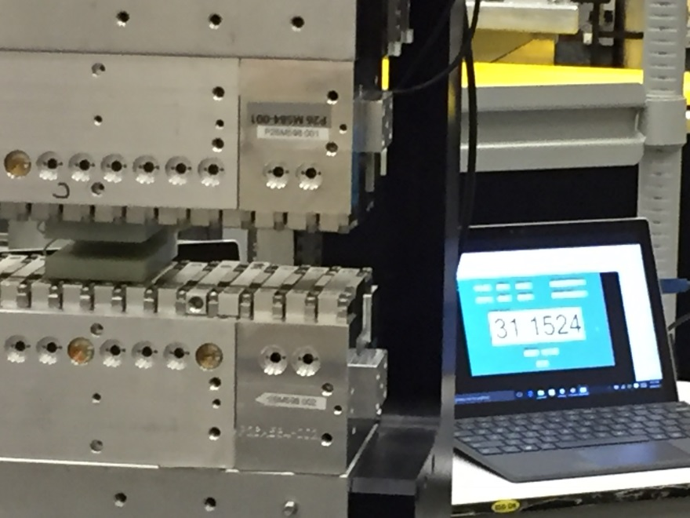
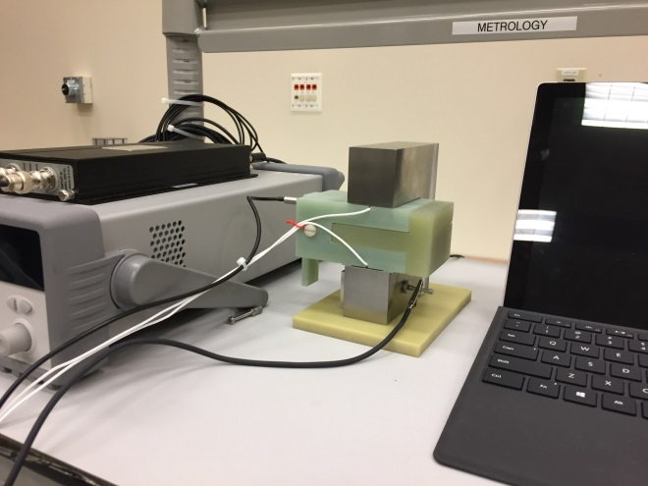
Final Data Set Gap Measurements
Record the gap of the reference.
Record encoder readings and gap values at poles in the undulator.
Record the gap of the reference.
If an encoder fails, repeat the procedure and set the new encoder offset to give the same encoder reading at the same gap settings.

Slide 16
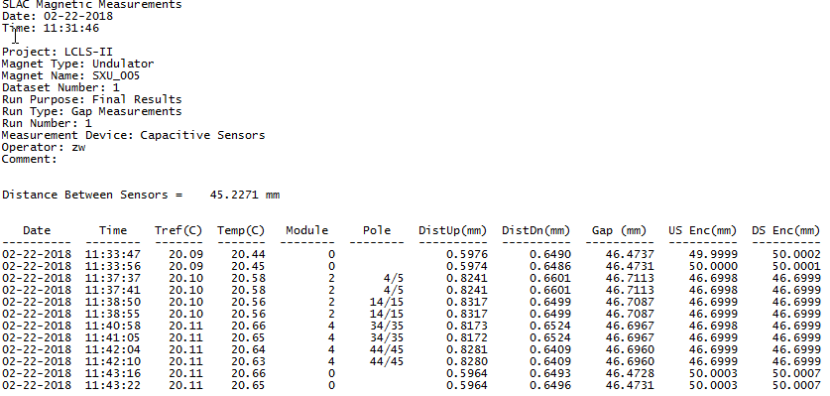
Gap Measurements
Measurements in reference

Slide 17
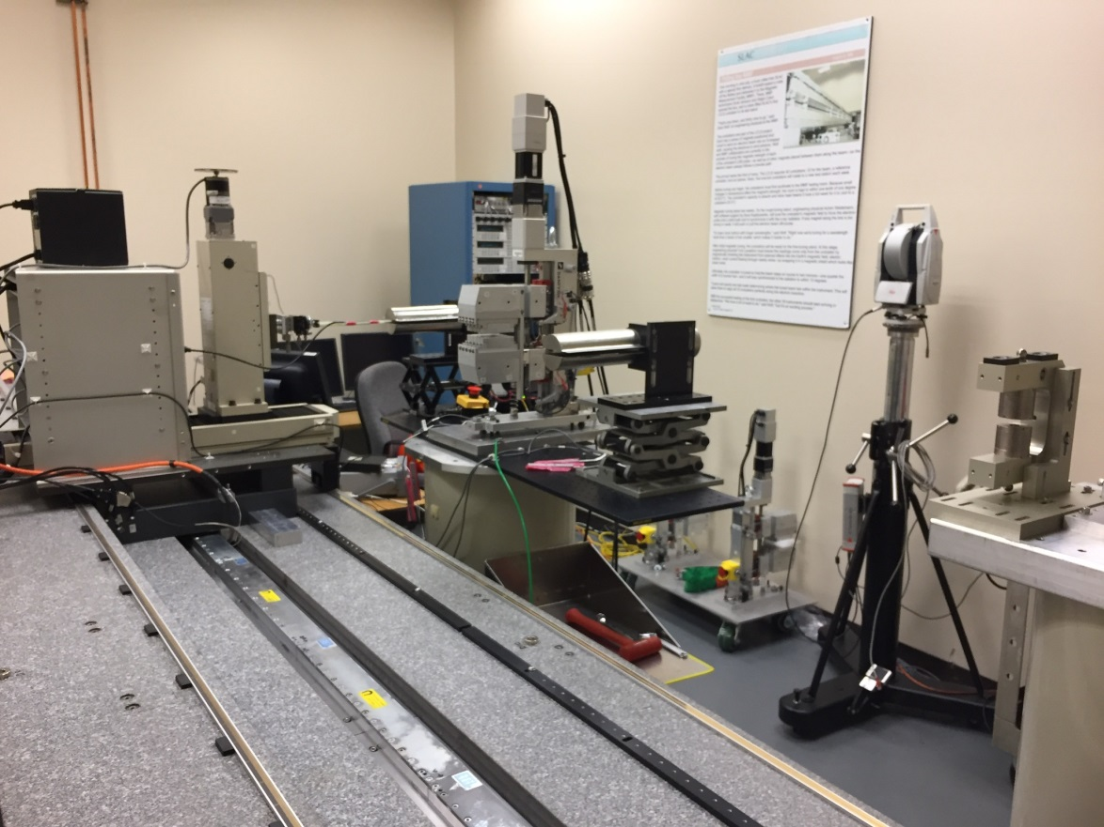
Phase Shifter Measurements
Bob Pushor
The Danfysik phase shifters meet our requirements, however, SLAC needs to measure a final data set.
SXR phase shifters have their phase integral measurements complete.
HXR phase shifter measurements have started.

Slide 18
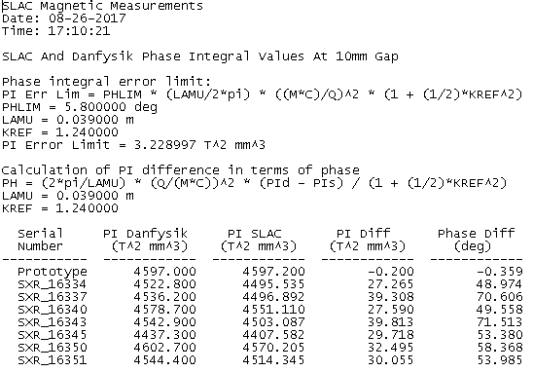
SLAC And Danfysik Phase Integrals
Compare phase shifts at 10 mm gap.

Slide 19
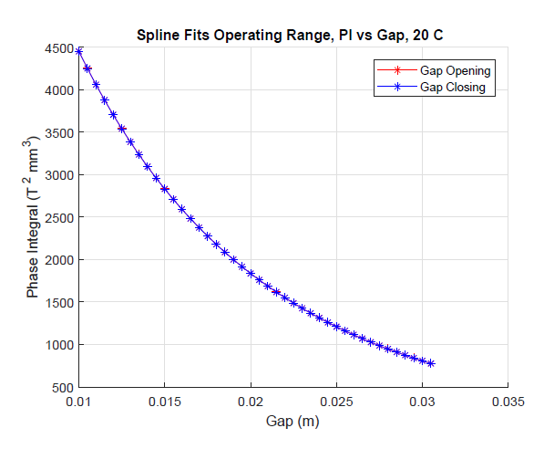
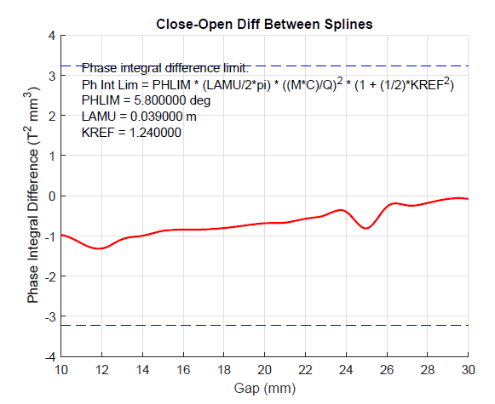
Fit PI vs Gap
Measurements are made as the gap opens and also as the gap closes. The difference is typically small. Two phase shifters showed large hysteresis and those need further investigation.

Slide 20
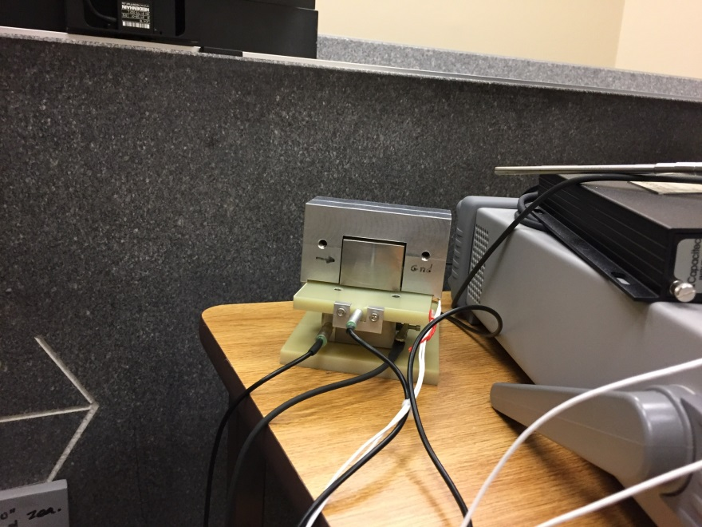
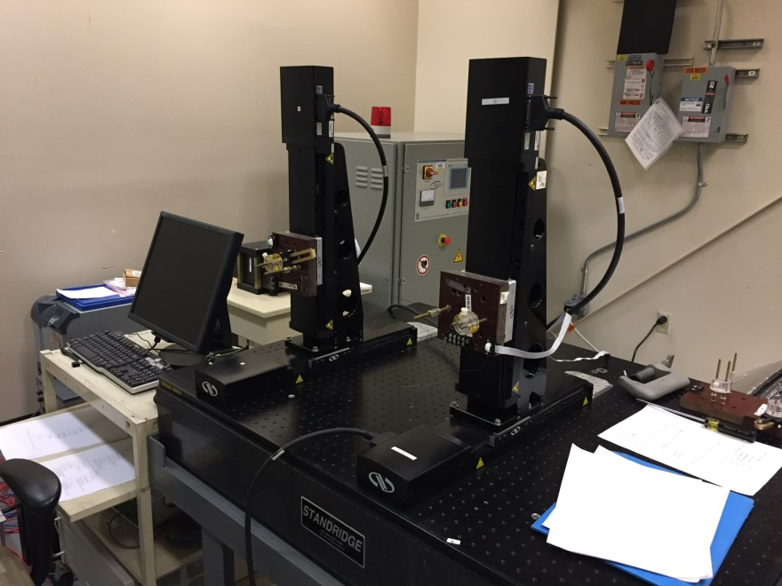
Gap Measurements, Field Integral Measurements
The gap of each phase shifter is
measured using capacitive sensors.
The gap is recorded along with the
encoder reading. A reference gap
is included in the measurements.
We are setting up to do field integral
measurements using a stretched
wire bundle. The errors on the
Hall probe field integrals were large
(~20 G cm).

Slide 21
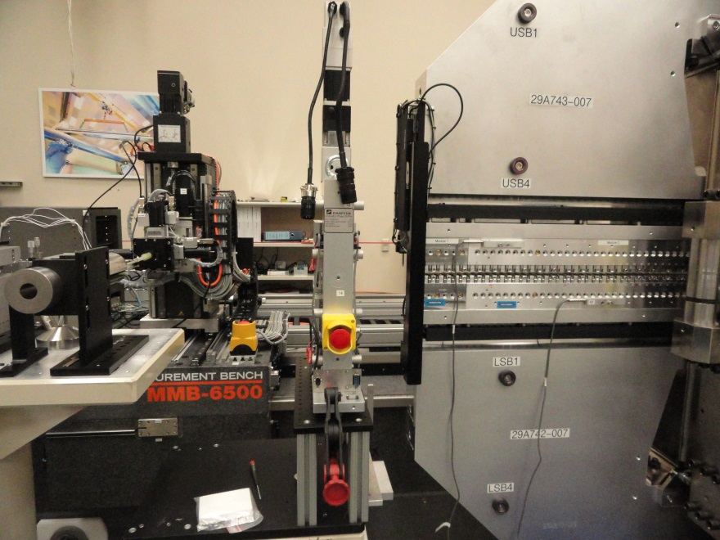
Test Phase Shifter With Undulator
LCLS-TN-18-1
Test cross calibration of Dover bench and Kugler bench.
Test calculations of phase matching error in undulator and phase
integral in phase shifter.
Test jumps in phase shifter setting.

Slide 22
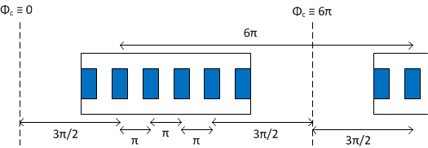
Undulator Phase Matching
Nominal phase provides a solution to phase matching.
Nominal Phase:
cell phase 2πN
symmetric ends
π per pole in core
Phase
The difference between the phase
and the nominal phase is the phase
matching error.
Nominal phase

Slide 23
Phase Matching Error Correction
2πn
Phase shifter

Slide 24
Phase Matching Error and Correction vs K
Measured phase matching error
and spline fit.
Required phase integral to correct
the phase matching error.

Slide 25
Phase Shifter Jumps
The phase shifter is not strong enough to cover the entire required phase
integral range. Instead, use 2πn phase jumps.

Slide 26
Measurements For Test
Circles: uniformly spaced in K, cover phase integral range
Squares: measurements near a jump

Slide 27
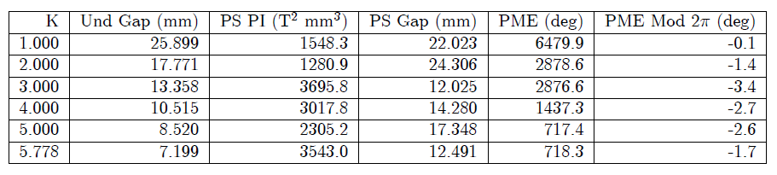
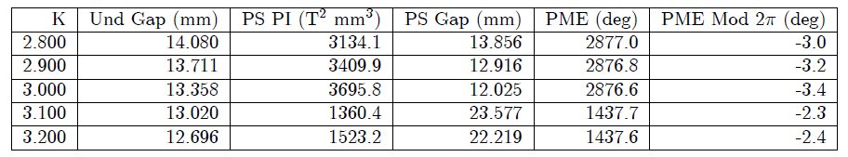
Test Results
Uniform Spacing
Near Jump
The phase shifter made the proper correction within tolerance.

Slide 28
Commissioning K Value
Add phase matching shims so that at K=4.05 no phase shifters are required.
The phase shifter is turned off

Slide 29
Undulator Taper Studies
LCLS-TN-18-2
The SXR undulators have flexures which allow the gap to be tapered.
Peak fields, 8 mm gap with 0.3 mm taper
8 mm
8.3 mm

Slide 30
Linear Taper To Compensate Energy Loss
LCLS used a step taper. LCLS-II can use a linear taper.
Does the taper increase the phase errors?
How do we do phase matching?
Can we use the untapered measurements?

Slide 31




Linear Taper Requirement
constant
wavelength

Slide 32
Phase Errors In Tapered Undulator
The phase errors did not change significantly from the untapered case.

Slide 33
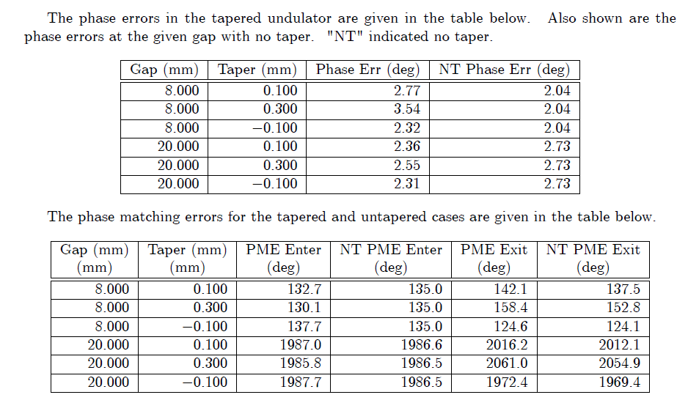
Tapered Undulator Measurement Summary
Small change
in phase errors
Small change in phase matching errors.
Can set phase shifters using untapered measurements.

Slide 34
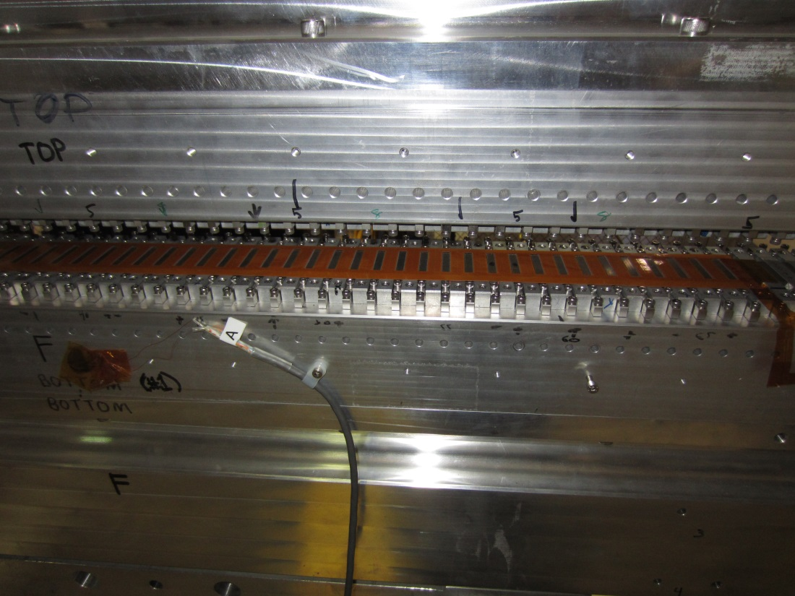
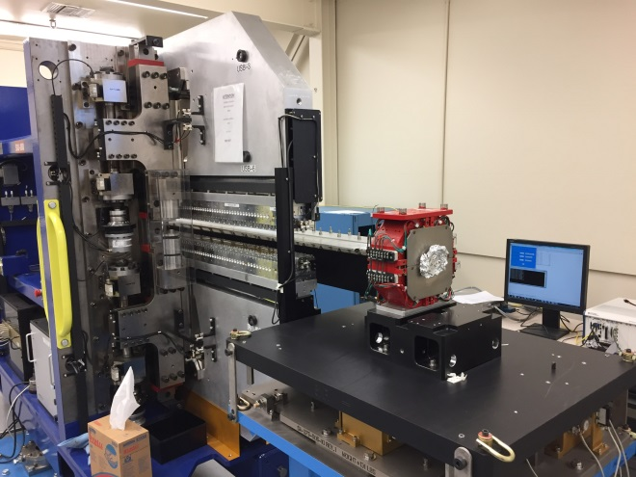
Magnet Radiation Damage Measurements For The Tunnel
Scott Anderson
Johann Baader
Kapton
1 m long
125 microns thick
2 layers
36 turns per pole
0.1 VS signal
LTT lab
We are testing thin printed circuit coils that sit on the magnets with the poles sticking through holes in the kapton substrate.
The coil voltage is integrated to give the flux change as the gap is changed between two values. Changes in the flux measurement will indicate radiation damage.

Slide 35
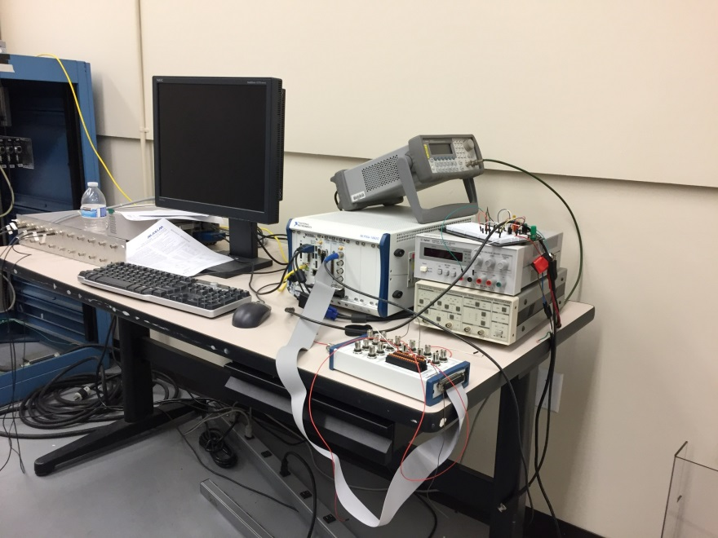
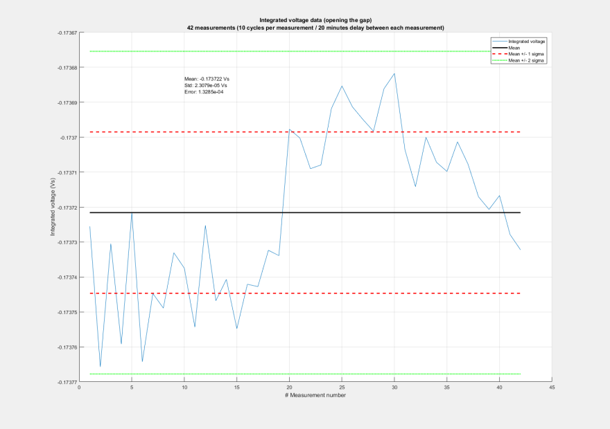
Magnet Radiation Damage Measurements Test Results
Using PXI to build a multichannel system.
Short term measurements give ~10⁻⁴ repeatability.

Slide 36
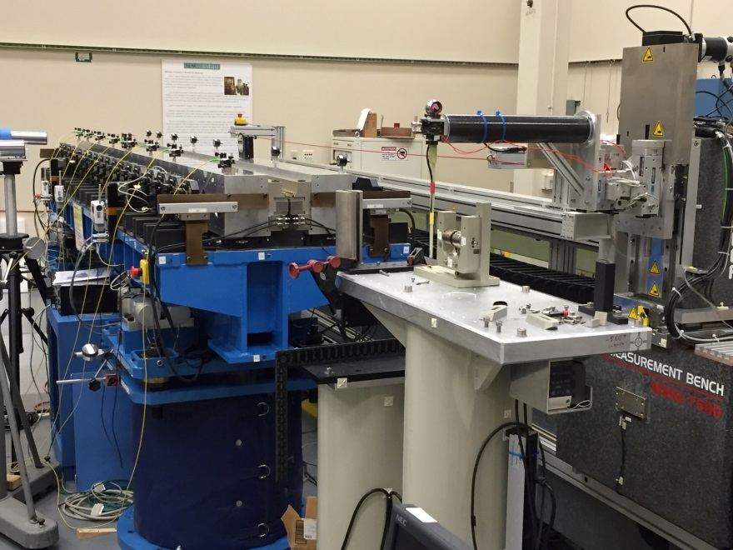
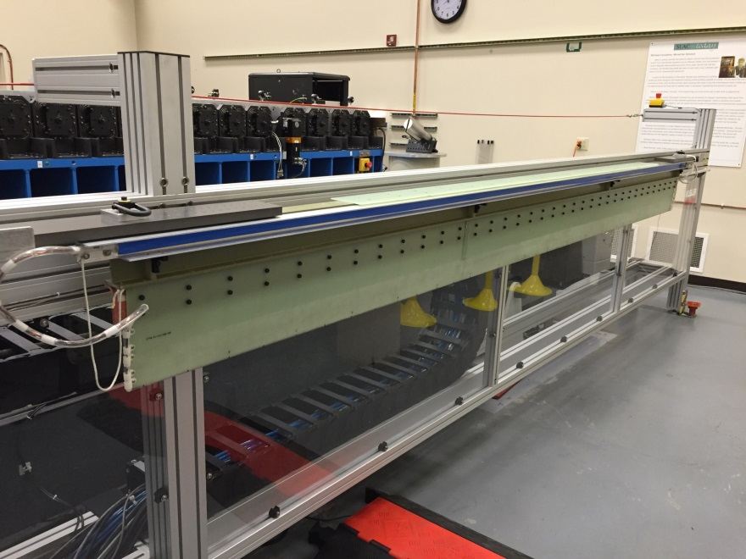

HXR Measurements
Long coil measurements will be done with a vertical coil.
Hall probe measurements are done with the probe at the end of a large carbon fiber tube.

Slide 37




First ‘Production’ HXR Undulator
Ed Reese
Initial CMM measurements

Slide 38

Setting Up Long Term Test Lab
Lifetime tests
Test SXR tracking of beam pipe
Test effect of beam pipe water temperature on magnet temperature
Radiation damage detection system tests

Slide 39


Tests After Production Measurements Are Complete
LCLS-TN-09-4
Build Helmholtz coil around bench
and undulator.
Determine the effect of changes
in the ambient magnetic field
on the undulators.
Measure the effect of temperature
changes on the undulators.

Slide 40
Summary
The SXR undulator measurements are ongoing. We are getting better at fixing problems and getting better at tuning with a variable gap.
The final data set measurements on the phase shifters are ongoing. The measurements are cross calibrated with the undulators.
HXR undulator measurements are starting.
Tests are starting in the Long Term Test Lab.

