Slide 1
LCLS-II / -II-HE Undulator Beam Pipe Water Cooling
Zachary Wolf
XFEL Meeting
May 4, 2022

Slide 2
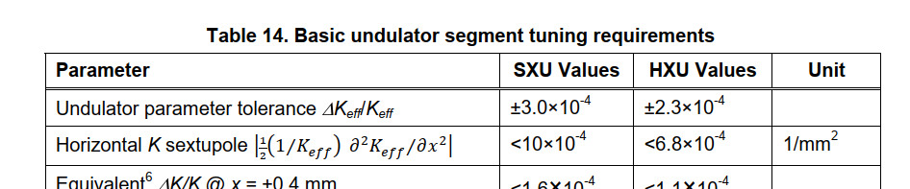
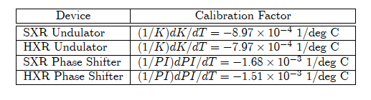

Starting Point Of Temperature Discussions: K Requirements
Undulator System PRD, H.-D. Nuhn
We don't want to use the entire error budget on temperature errors. Set the upper limit on the K error due to temperature uncertainty as
∆K/K ≈ 1x10⁻⁴
The undulator K value temperature coefficient is approximately
1/K ∆K/∆T ≈ 1x10⁻³ 1/deg C
We need to control (measure and apply corrections) the magnet temperature to better than
∆T = (∆K/K) / (1/K ∆K/∆T) ≈ 0.1 deg C
LCLS-TN-21-5
LCLS-TN-20-1

Slide 3
Do We Need To Cool The Undulator Beam Pipes?
Expensive,
messy, hoses,
water leaks, …
7.2 mm gap
5 A in beam pipe
corrector windings
12 W in beam pipe
No water
(Heinz-Dieter estimates a beam pipe heat load of 3.3 W/m with the high repetition rate beam and corrector windings.)
The beam pipe gets ~1.1 deg C hotter.
The magnets get ~0.7 deg C hotter.
Tolerance ~0.1 deg C.
Long time constant. Continual correction.
Yes, we need to cool the beam pipes.

Slide 4
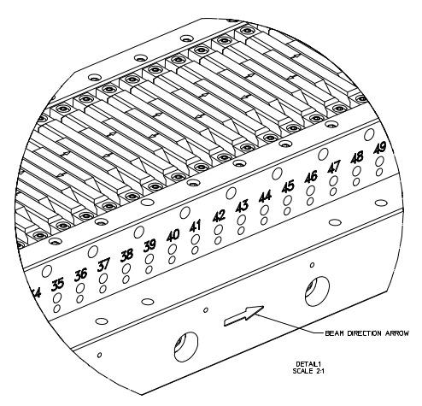
Magnet Temperature Measurement In The Tunnel
In the tunnel,
RTDs are mounted on the magnet keepers.
They measure the magnet + air temperature.
For small beam pipe heating, they measure the magnet temperature (= air temperature).
With beam pipe heating, there are temperature gradients in the magnets, and the RTDs do not measure a magnet temperature.
RTD
Last slide: During the transient, we need continual K value temperature correction. There are temperature gradients in the magnets, and we don't accurately know the magnet temperature to use for the correction. This won't work.
1 Day

Slide 5
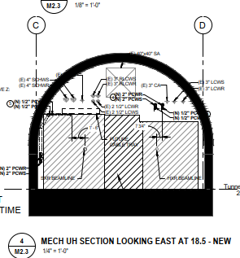
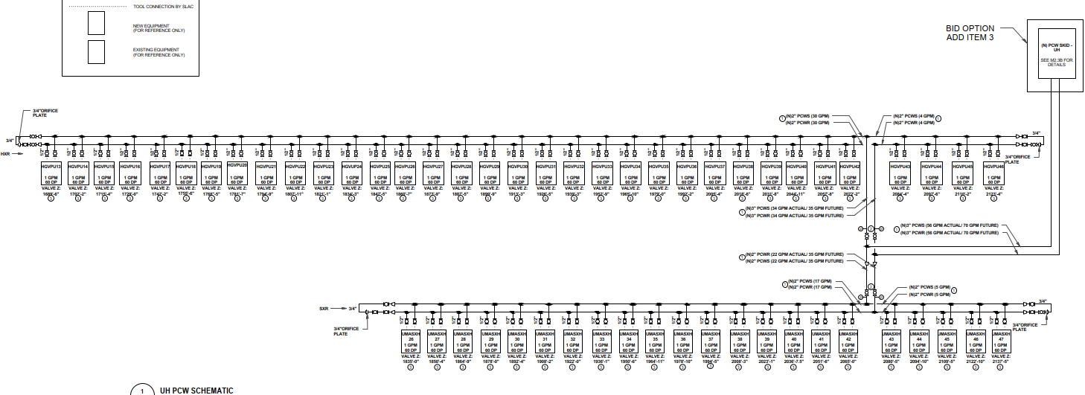
The Need For Beam Pipe Cooling Was Anticipated
Installed, pressure tested, never used (because of low rep rate beam).
Chilled water lines for beam pipe cooling
are installed in the tunnel.
But chilled water alone is not sufficient, as we will see…

Slide 6

Study Beam Pipe Temperature Effects
Beam pipe cross section
Magnet recess allows extra
space for sensors
Thermistor diameter 0.3 mm
Schematic of test system
Thermistor attachment method

Slide 7
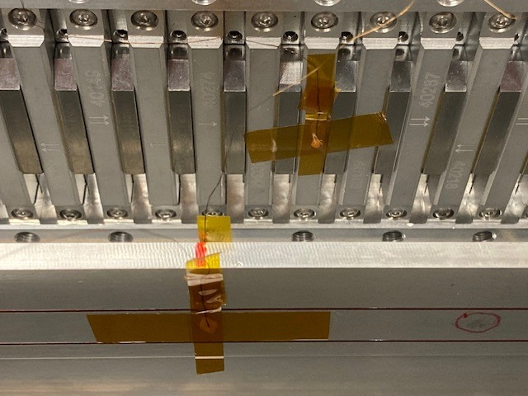
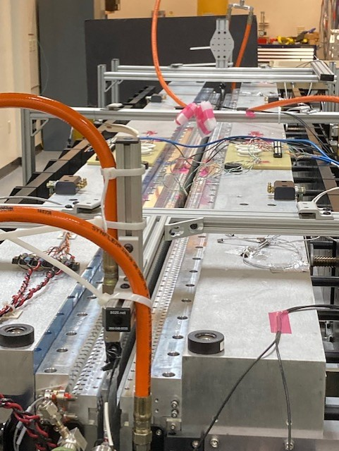
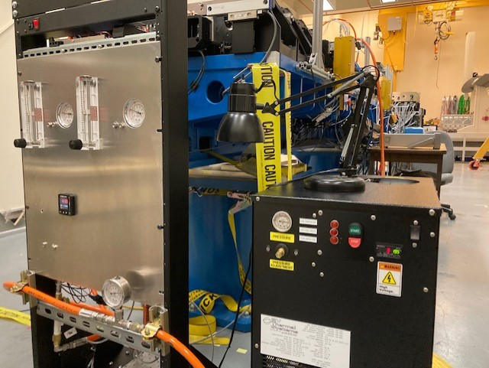
Proof Of Principle Test System
Test heating chilled water to the local
air temperature.
The heater heats the water to the air temperature.
Simulates water supplied in the tunnel at a fixed temperature

Slide 8
Magnet Response To Beam Pipe Temperature
7.2 mm gap
Chiller water temperature change
No water heater
No current in trim windings
∆T_{mag} / ∆T_{bp} ≈ 0.7 at 7.2 mm gap
Air at small gap is not a good insulator.
As the gap is opened, the magnets go from approximately the beam pipe temperature to the air temperature. We need to keep the beam pipe at the air temperature for the magnet temperature to remain constant.

Slide 9
Beam Pipe Temperature Control
The beam pipe must be at the local air temperature so that the magnet temperature doesn't change as the gap is opened or closed.
The water temperature rise along the beam pipe is only 0.03 deg C, which is negligible. This means that the problem of beam pipe temperature control is a problem of making the water temperature equal to the local air temperature.
T_{water in}
T_{water out}
T_{air}

Slide 10
The Whole Undulator Changes Temperature Along With The Beam Pipe
The HXUs are thermally connected. (The reference temperature for the water must be the air temperature, not a temperature measured on the undulator.)

Slide 11
Controller Requirements
The controller must keep the cooling water going into the beam pipe at the local air temperature to 0.1 deg C / 0.7 = 0.14 deg C
The controller must keep the beam pipe water temperature at the local air temperature despite water flow variations and input water temperature variations.
The controller does not need to compensate for the water temperature rise along the beam pipe.

Slide 12
The Controller Keeps The Water Temperature At The Local Air Temperature
The air temperature increases down
the tunnel. The controller will keep the
beam pipe water temperature equal to
the local air temperature.
The controller kept the water temperature
equal to the air temperature during daily
room temperature variations.

Slide 13
Magnet Temperature vs Beam Pipe Power
Baseline:
G = 7.2 mm
F = 1.8 gpm
T_{in} = 19.5 deg C
T_{out} = T_{air}
P = 0 W
P = 0
P = 12 W
P = 0
Putting 12 W of power into the beam pipe
had no effect on the magnet temperatures.

Slide 14
Magnet Temperature vs Water Flow Rate
Baseline:
G = 7.2 mm
F = 1.8 gpm
T_{in} = 19.5 deg C
T_{out} = T_{air}
P = 0 W
F = 1.8
F = 1.6
F = 1.8 GPM
Changing the water flow rate from 1.8 gpm to 1.6
gpm had no effect on the magnet temperatures.

Slide 15
Magnet Temperature vs Incoming Water Temperature
Baseline:
G = 7.2 mm
F = 1.8 gpm
T_{in} = 19.5 deg C
T_{out} = T_{air}
P = 0 W
T = 19.5
T = 19.0
T = 19.5 deg C
Changing the incoming water temperature from 19.5 deg C
to 19.0 deg C had no effect on the magnet temperatures.

Slide 16
Magnet Temperature vs Undulator Gap
Baseline:
G = 7.2 mm
F = 1.8 gpm
T_{in} = 19.5 deg C
T_{out} = T_{air}
P = 0 W
G = 7.2
G = 25
G = 7.2 mm
Changing the undulator gap from 7.2 mm to 25 mm
had minimal effect on the magnet temperatures.

Slide 17
Proof Of Principle Test Conclusions
The undulator beam pipes must be held at the local tunnel air temperature in order for the magnet temperatures to not change with gap.
Bringing in slightly chilled water and heating it to the local air temperature is an effective solution.
The magnet temperature is sensitive to the beam pipe temperature at small undulator gap.
The water absorbs 12 W with negligible temperature rise.
The water heater controller keeps the beam pipe water temperature equal to the air temperature despite water flow changes and input water temperature changes.
When the beam pipe is at the local air temperature, the magnet temperature remains constant as the undulator gap is changed.
Detailed results are in LCLS-TN-22-4.

Slide 18
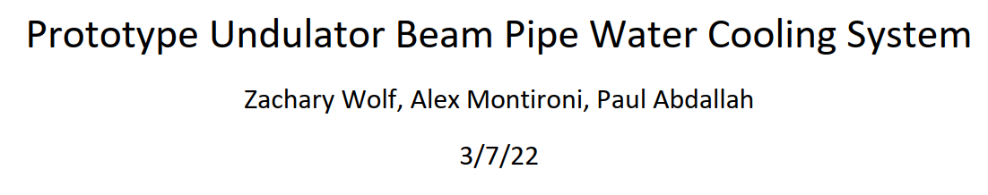
Next Steps
Bring in experts.
We proposed to build a prototype system to test in the tunnel.
A stand-alone controller heats chilled water to the local air temperature.
A stand-alone monitoring system records the performance in the LCLS control system.
Panel

Slide 19
Monitoring System
The monitoring system records
Input water temperature
Beam pipe temperature supply side
Beam pipe temperature return side
Beam pipe water supply pressure
Beam pipe water return pressure
Beam pipe water flow
Local air temperature
The accuracy of the temperature measurements should be better than 0.1 deg C.
The accuracy of the flow and pressure measurements should be better than 5%.
It is desirable for the monitoring system to talk to the water temperature
controller to set and record its parameters.

Slide 20
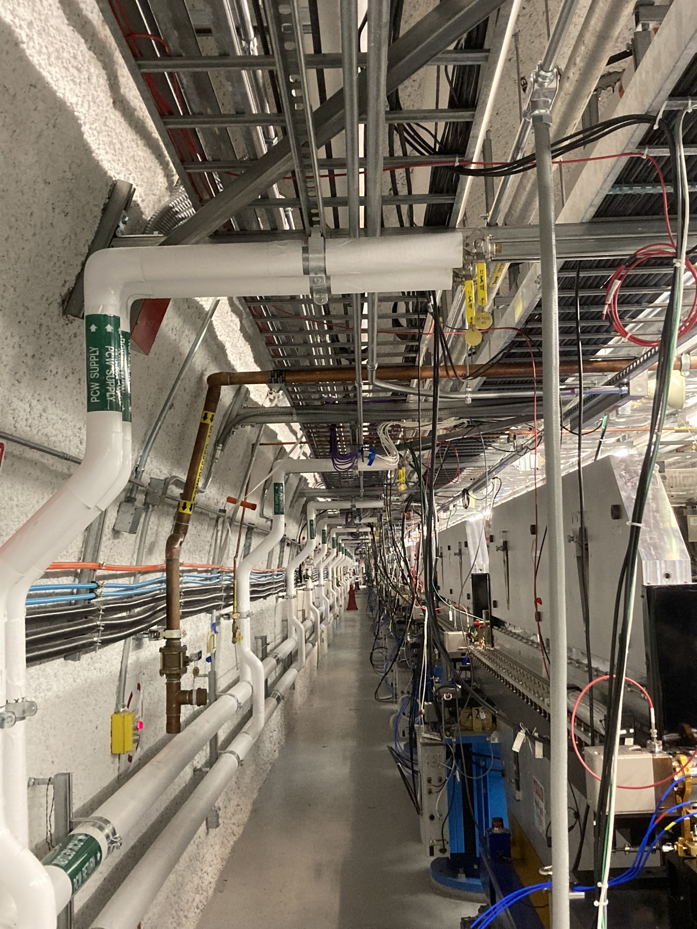
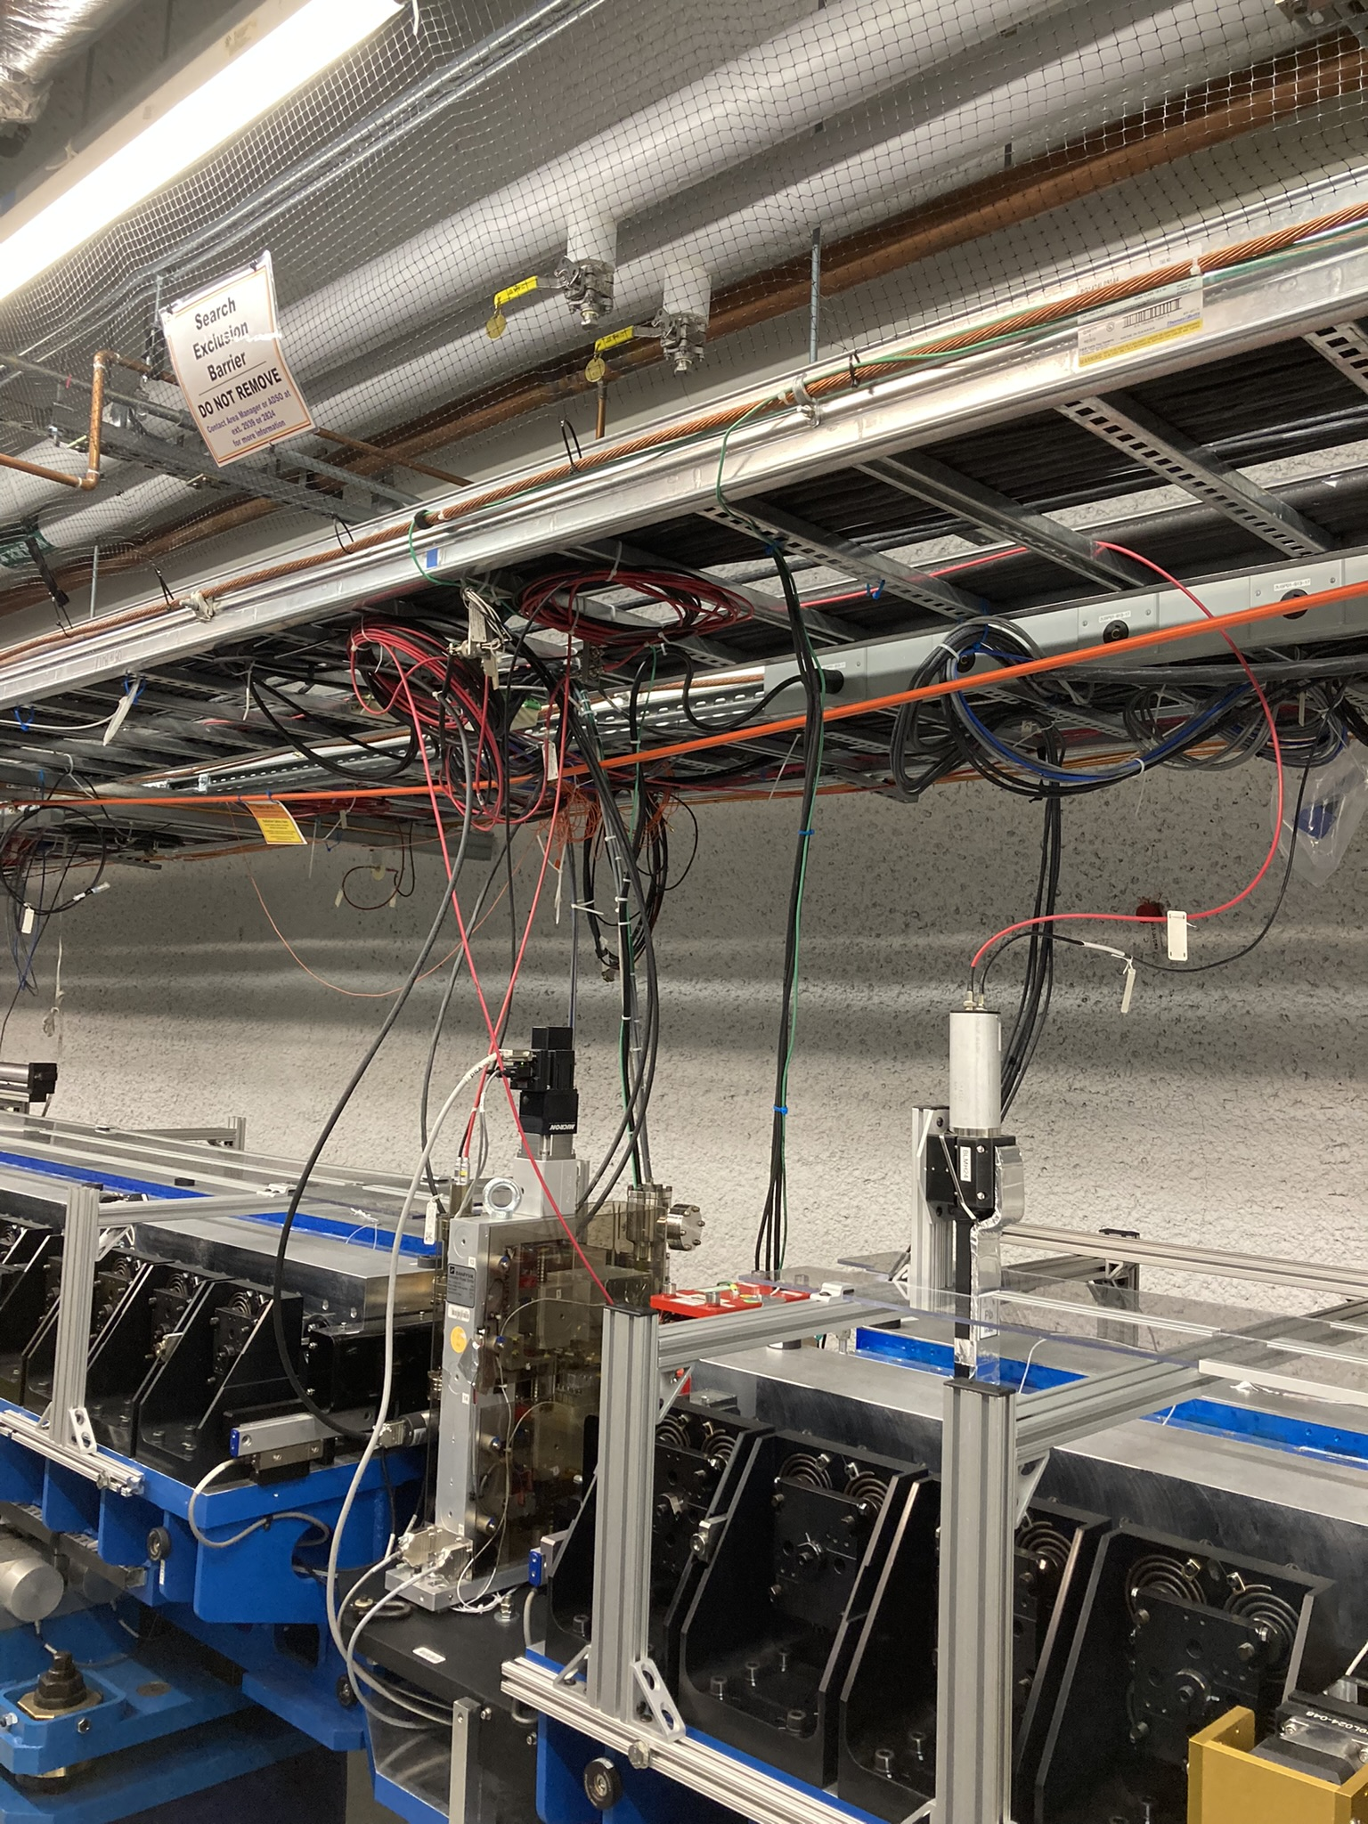
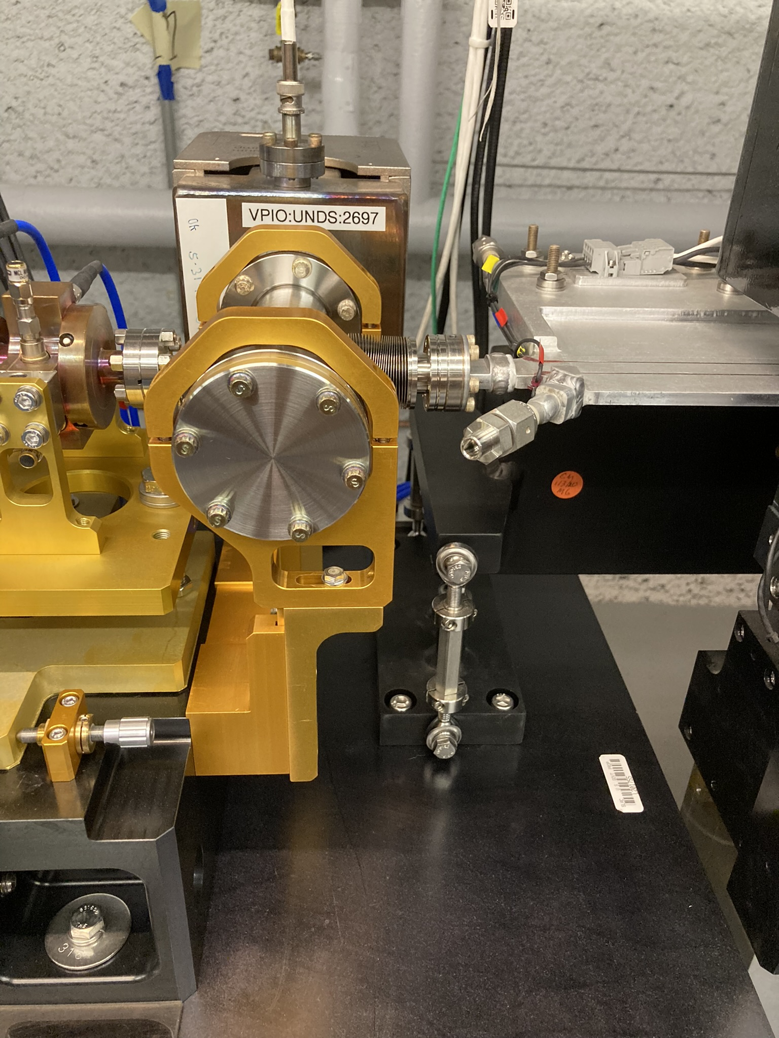
Use The Prototype To Figure Out Logistical Problems
How to route the hoses?
How to strain relieve the hoses?
Where to mount the water heaters?
Where to mount the flow interlocks, pressure regulators, flow gauges, pressure gauges?
SXU
HXU

Slide 21
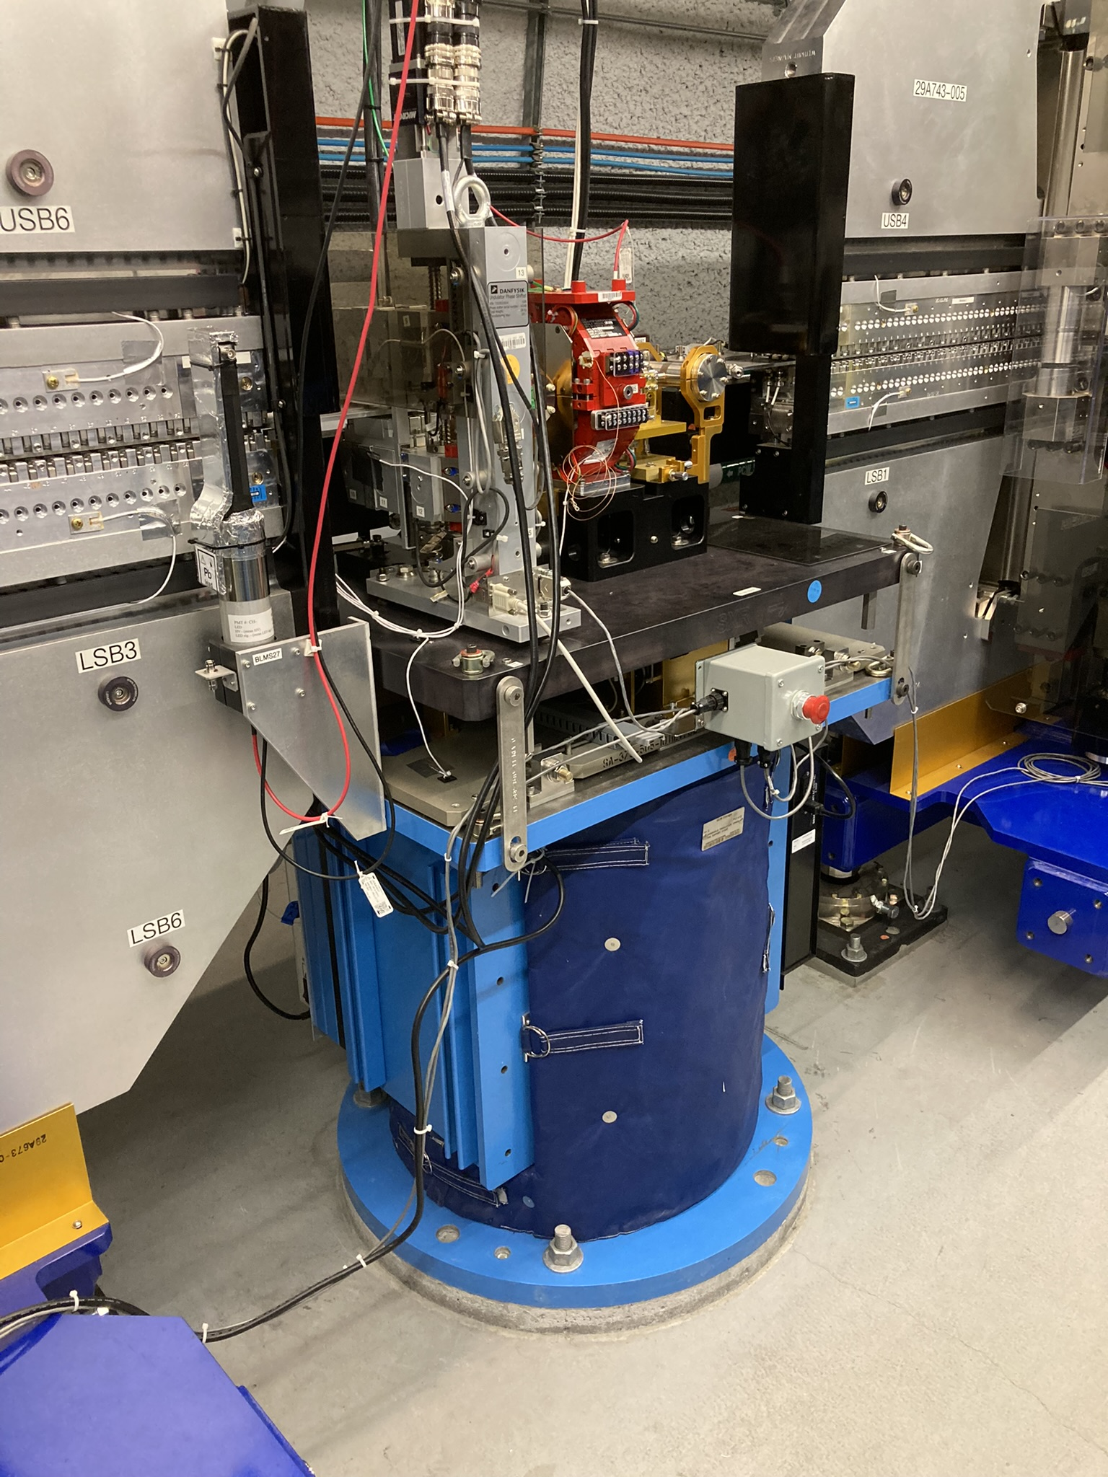
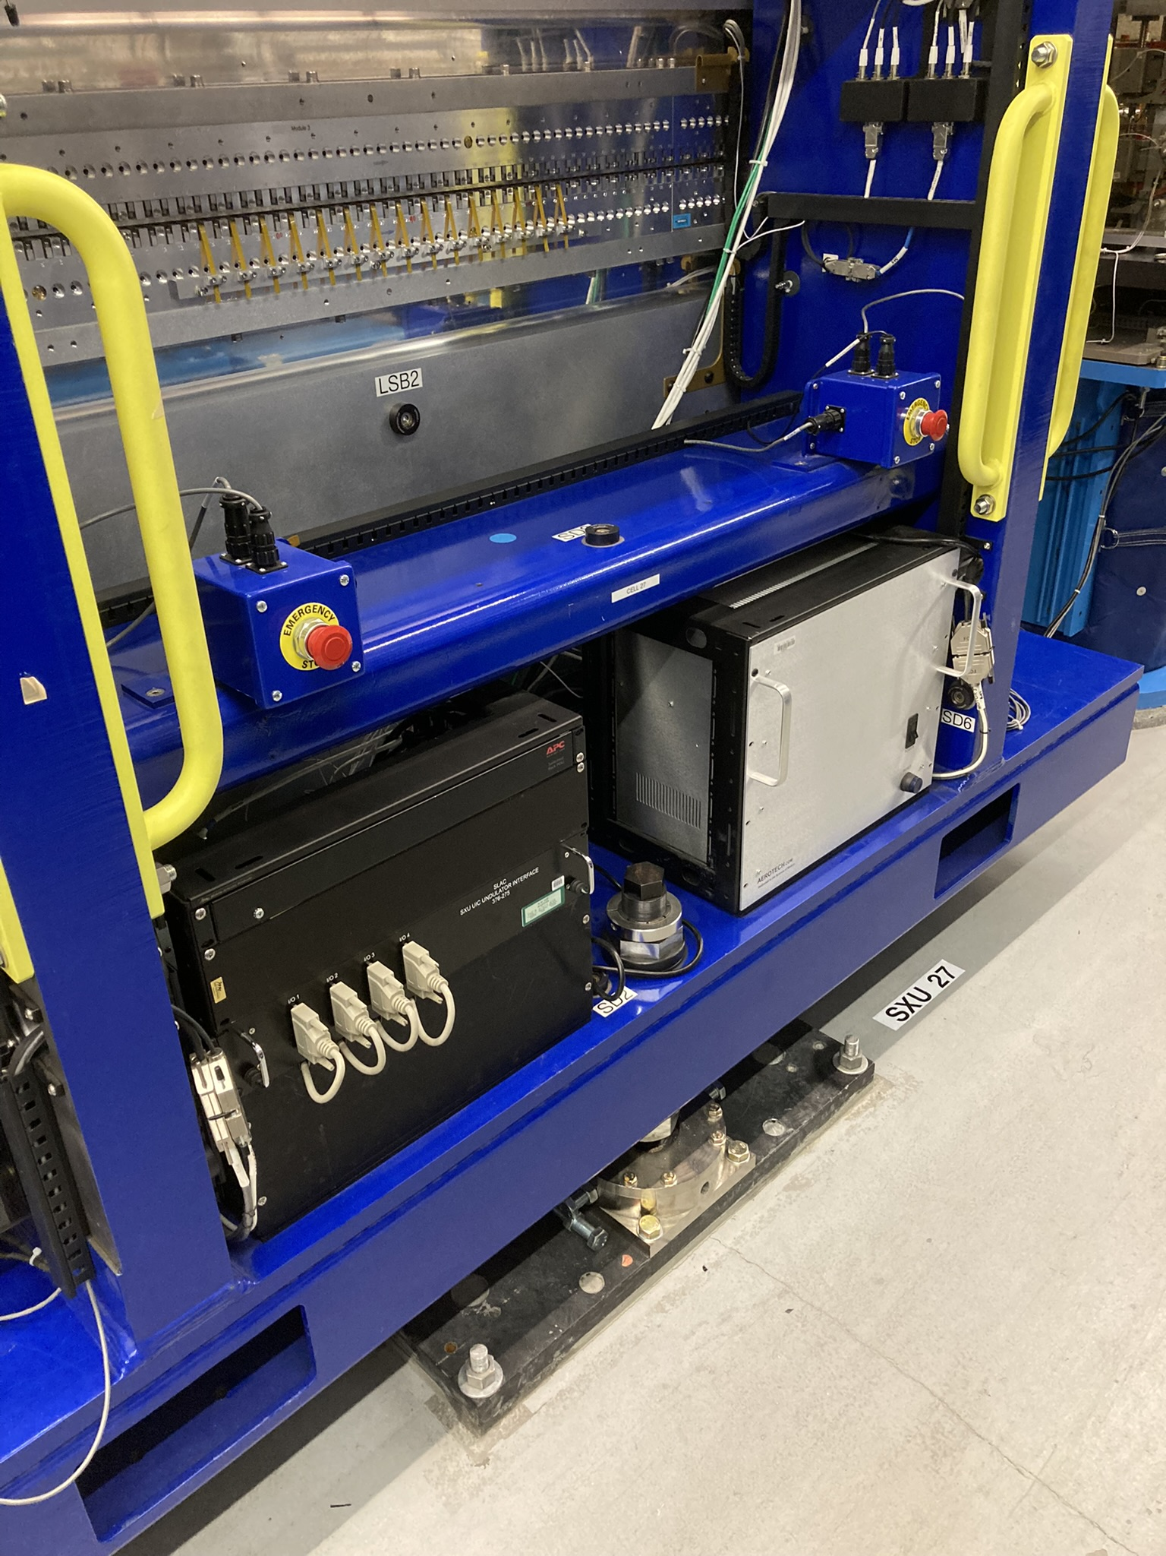
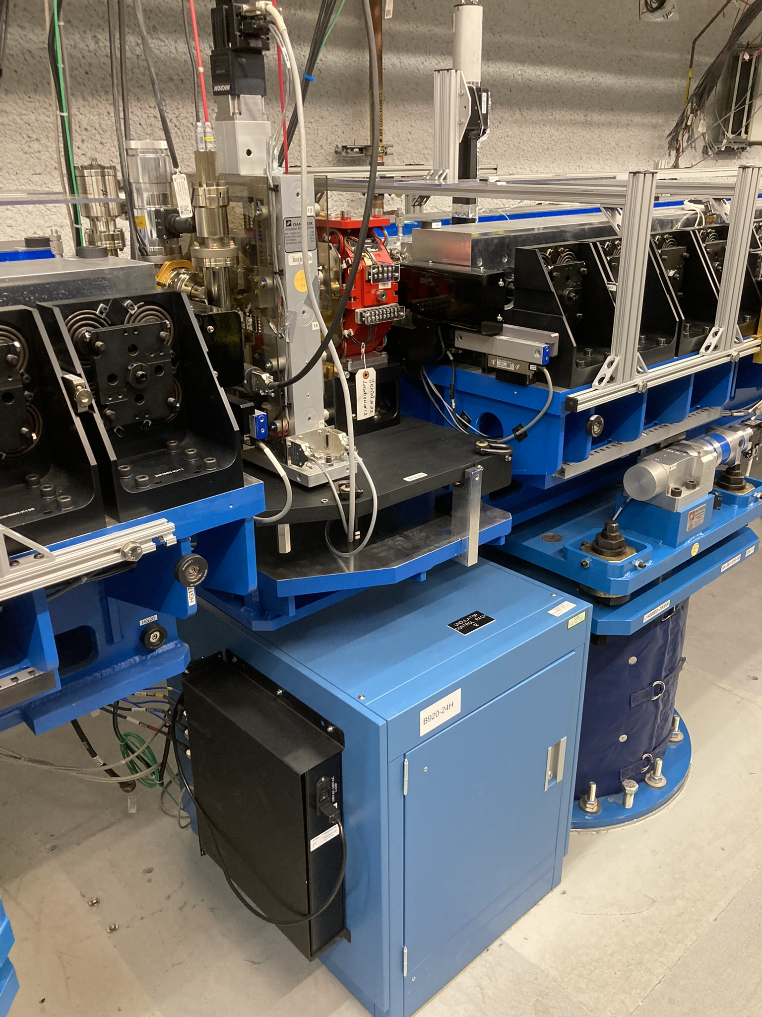
Use The Prototype To Figure Out Logistical Problems
Where to mount the heater controllers?
Where to mount the monitoring systems?

Slide 22
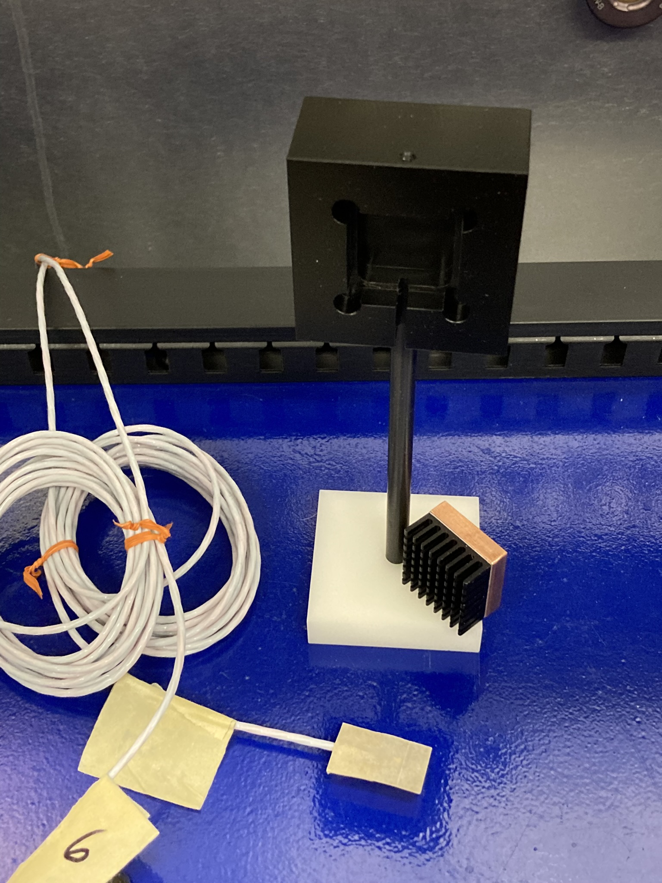
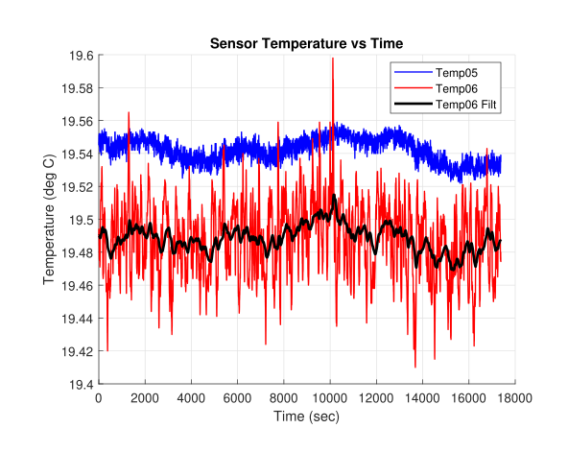
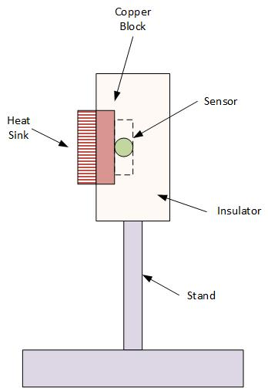
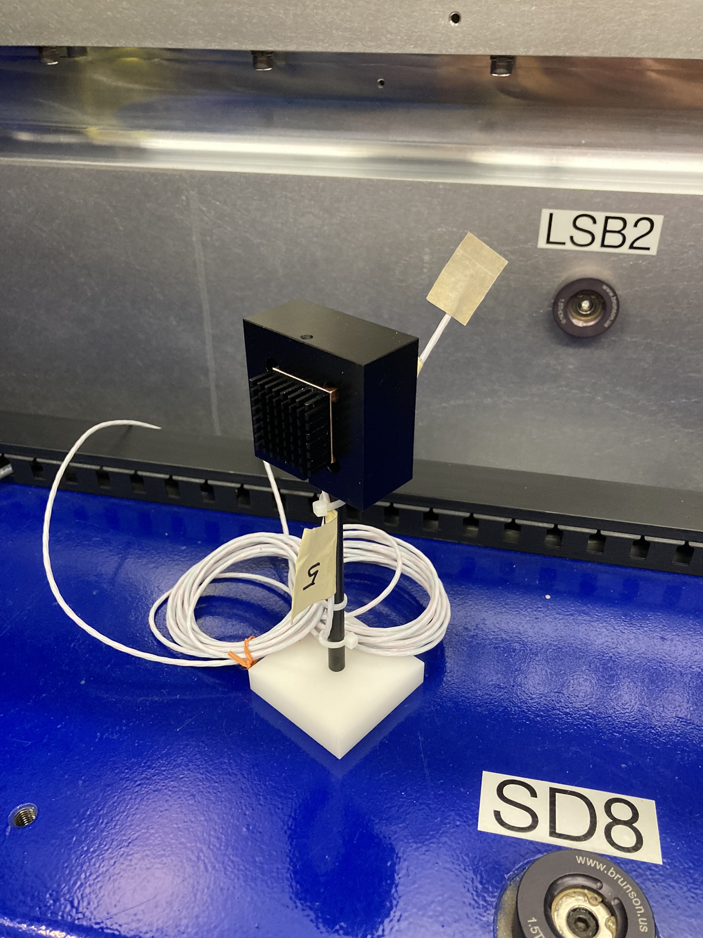
Pre-Prototype Developments
Air Temperature Sensor
Thermal mass
Bare sensor
Digital filter
Installed on SXU-006

Slide 23
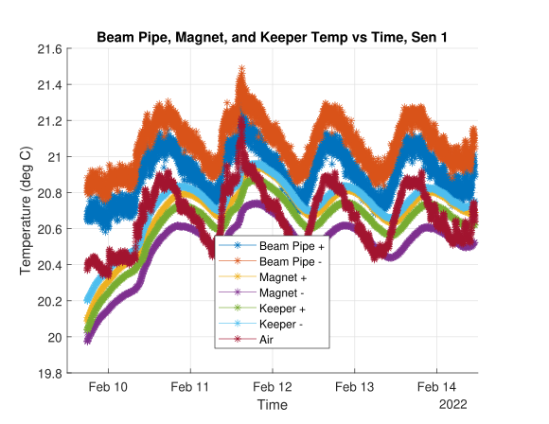
Pre-Prototype Developments
Water Temperature Fluctuations
Original
Add a buffer tank
Adding the buffer tank reduced the fluctuations from ~±0.1 deg C to ~±0.06 deg C.

Slide 24
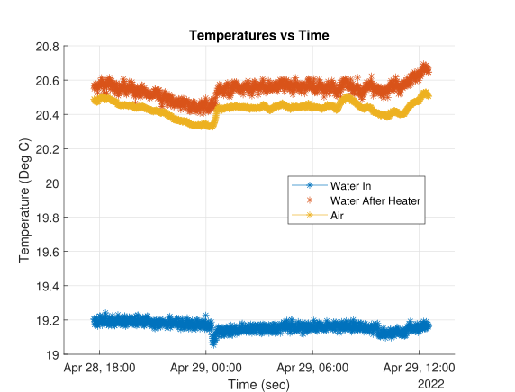
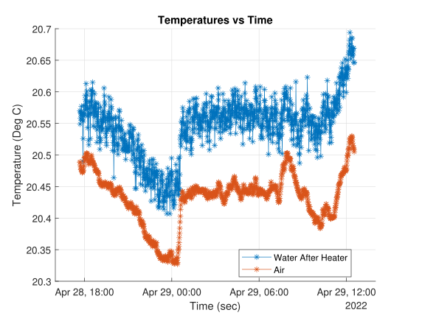
Pre-Prototype Developments
Reduce PID Control
Original
Reduce PID
No buffer tank
Reducing the PID parameters reduced the fluctuations from ~±0.1 deg C
to ~±0.03 deg C.
The original system met all requirements but can be improved.
With reduced PID control, the system will be more sensitive to disturbances, but disturbances in the tunnel
might be small.

Slide 25
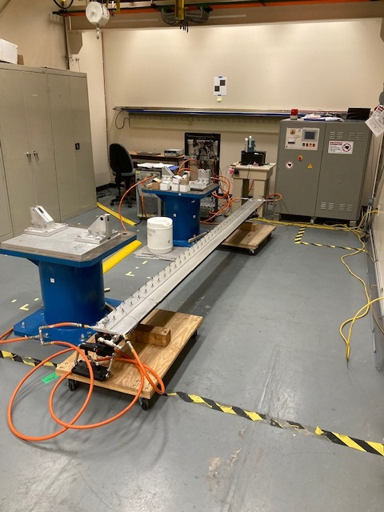
Pre-Prototype Developments
Reduce PID Control, Continued
Disturbance:
The input water temperature from the chiller was increased by about 0.4 deg C.
The output water after the heater showed a temperature transient for about 4 minutes, but then went back to the air temperature.
Reduced control gives more stability but increases sensitivity to disturbances.

Slide 26
Conclusion
A proof of principle test showed that cooling the beam pipes with chilled water heated to the local air temperature is a solution to the beam pipe heating problem that we will have with the high repetition rate beam.
There are many logistical problems that must be solved before a full beam pipe cooling system can be installed in the tunnel.
A prototype system should be installed in the tunnel and debugged in order to solve problems before the full implementation begins.

