Slide 1
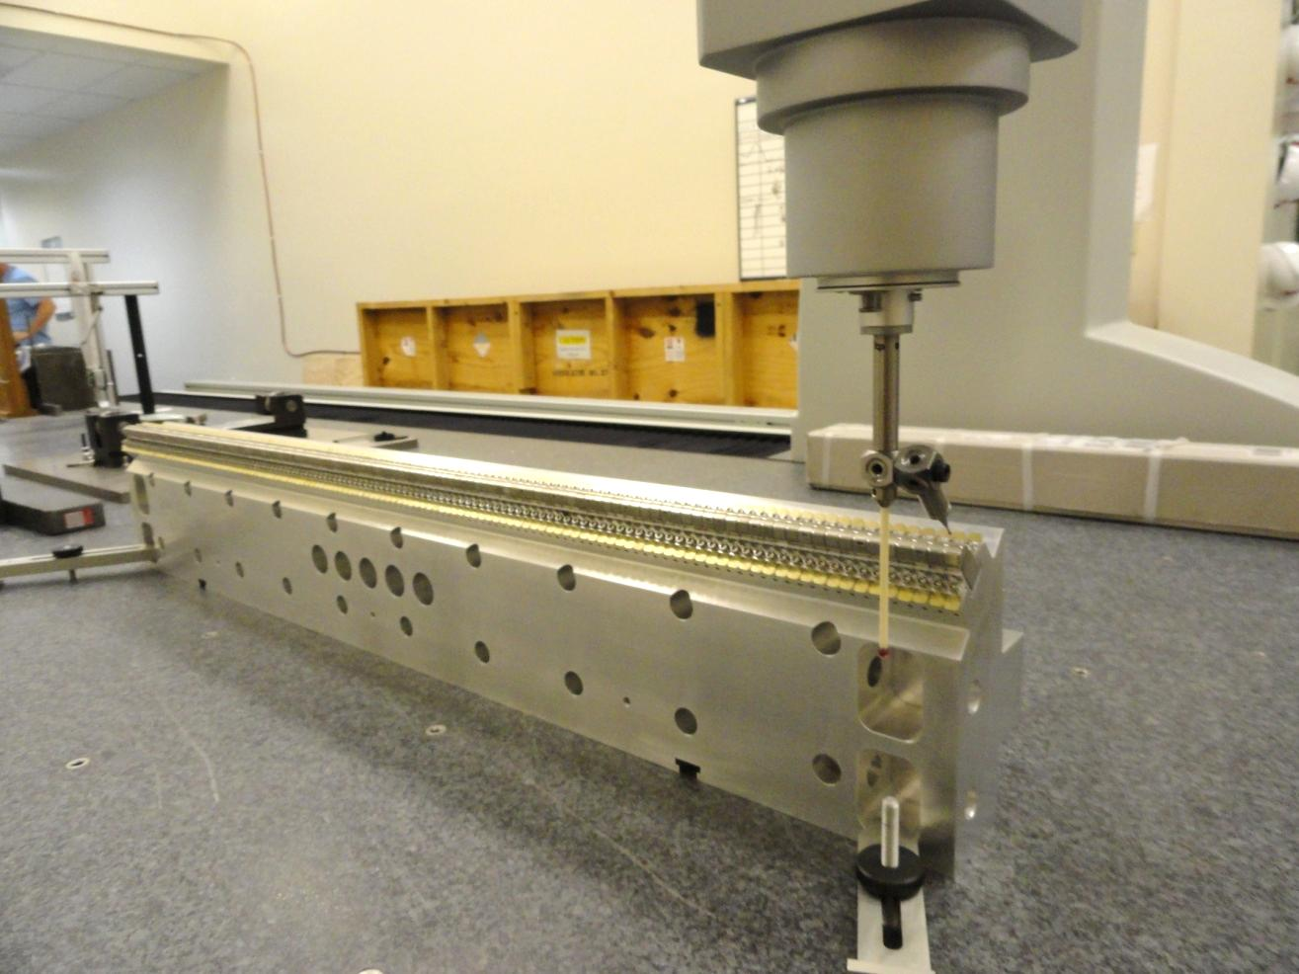
Carrier 1, Quadrant 2 on CMM
(S/N 03)

Slide 2
0.5mm
Y
X
Magnetic axis
Nominal distance Magnetic Axis to magnet = 3.3mm.
Radius of magnet surface = 3.8mm.
Fit a circle of 7.6mm diameter. Shift the center by 0.5mm in –Y.

