Slide 1
Moving Wire, Pulsed Wire and Long Coil Measurements on the SSRL Beam Line 5 EPU
Scott Anderson
SLAC Magnetic Measurements

Slide 2
Moving Wire
100 μm Single CuBe Wire 5.45 meters in length.
Newport ILS stages with 0.1 μm resolution linear scales.
Agilent 3458A Digital voltmeter.
Wire is moved a known distance at each point. Voltage signal is sampled during the movement and then integrated. Voltage offset is corrected.
Voltage offset is important since integrated voltage levels are on the nanovolt-sec level.
Movement is +/-250 μm, 6 times back and forth centered at each point.

Slide 3
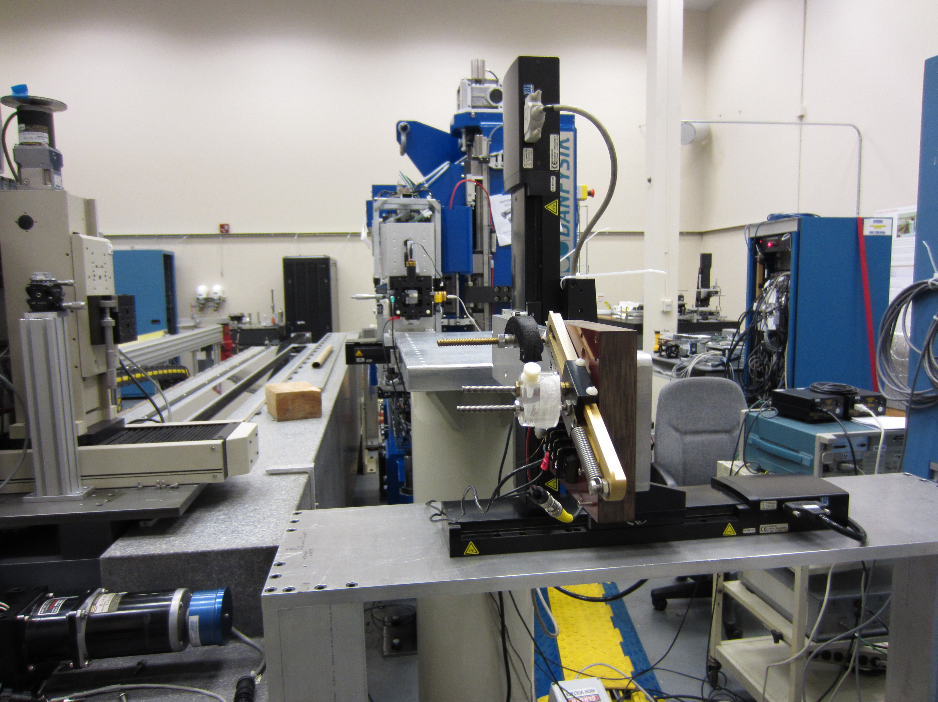
Moving Wire Setup Upstream End

Slide 4
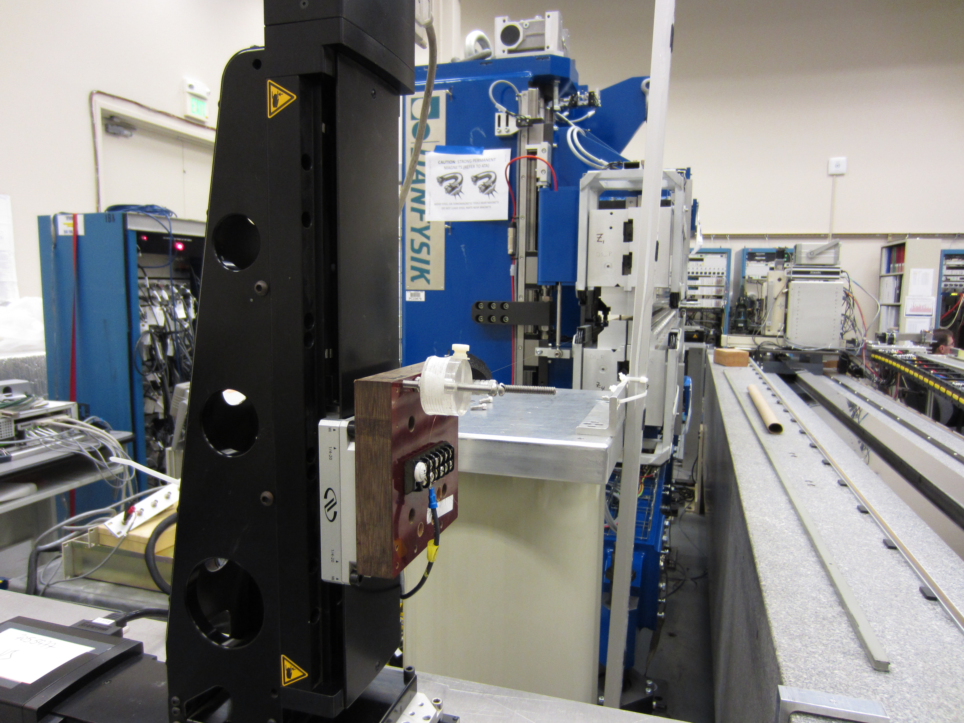
Moving Wire Setup Downstream End

Slide 5
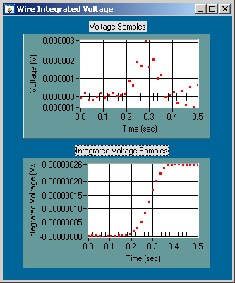
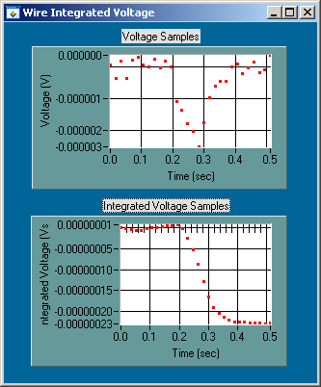
Moving Wire Signal

Slide 6
Moving Wire and Danfysik 1st Integral Measurement Comparisons at 13 mm gap.
Danfysik measurements were made using a 5 mm flip coil and the background subtraction was done using 120 mm (fully open) gap measurements.
Background subtraction was done using 120 mm (fully open) gap measurements.
4 modes are compared CP+, CP-, VP+ and HP modes.

Slide 7
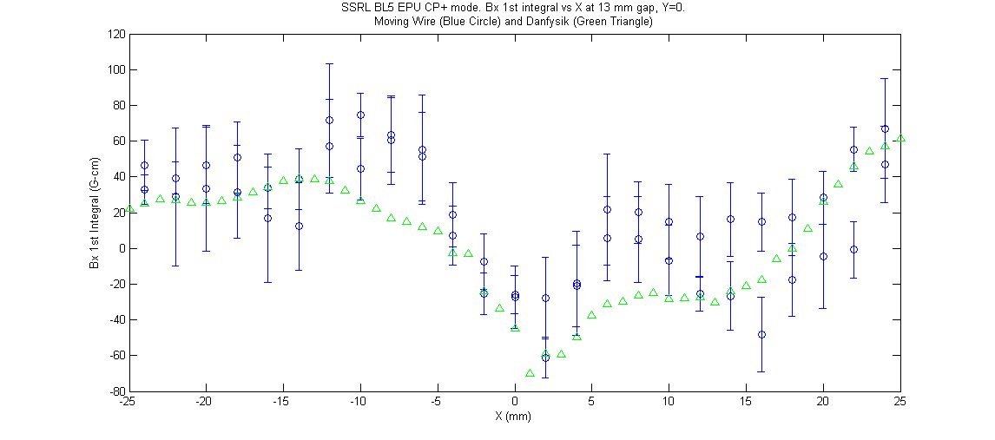
Bx 1St Integral CP+ Mode

Slide 8
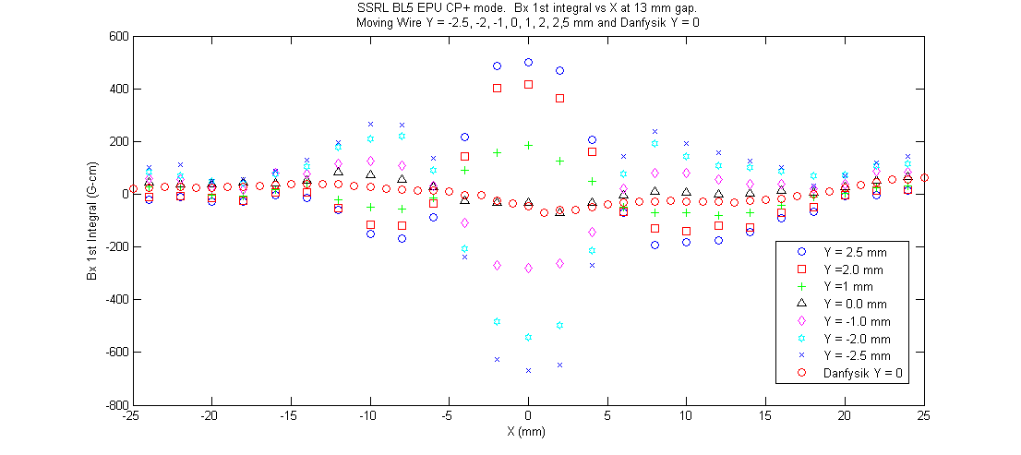
Bx 1St Integral CP+ Mode at Y +/-2.5, 2, 1 and 0 mm

Slide 9
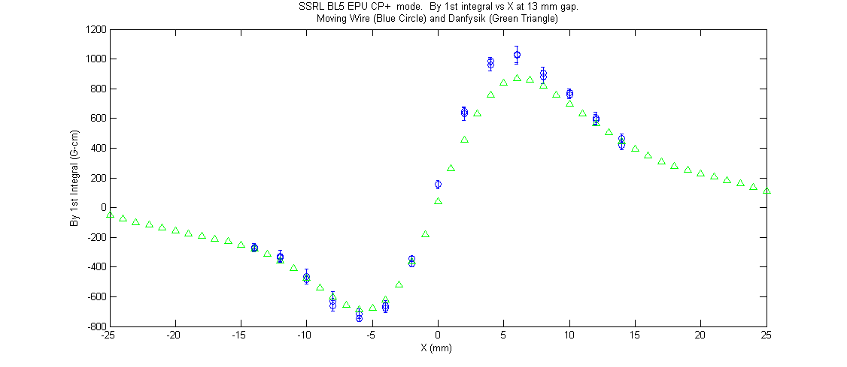
By 1St Integral CP+ Mode

Slide 10
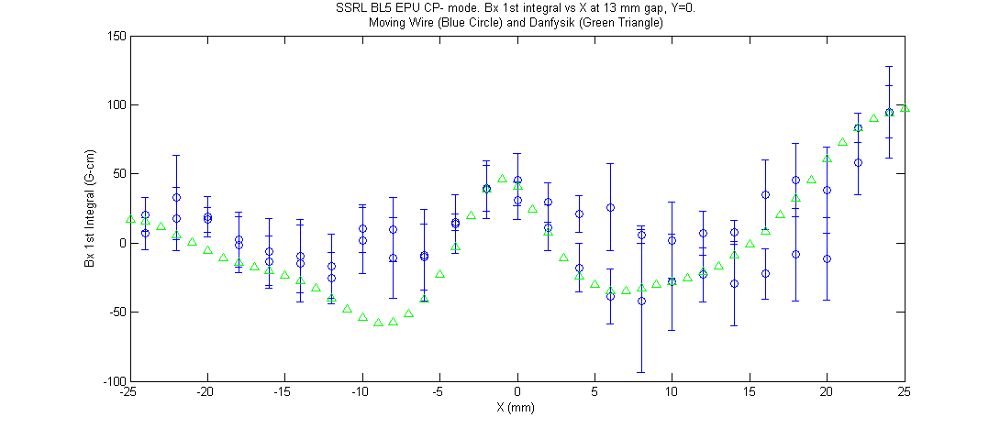
Bx 1St Integral CP- Mode

Slide 11
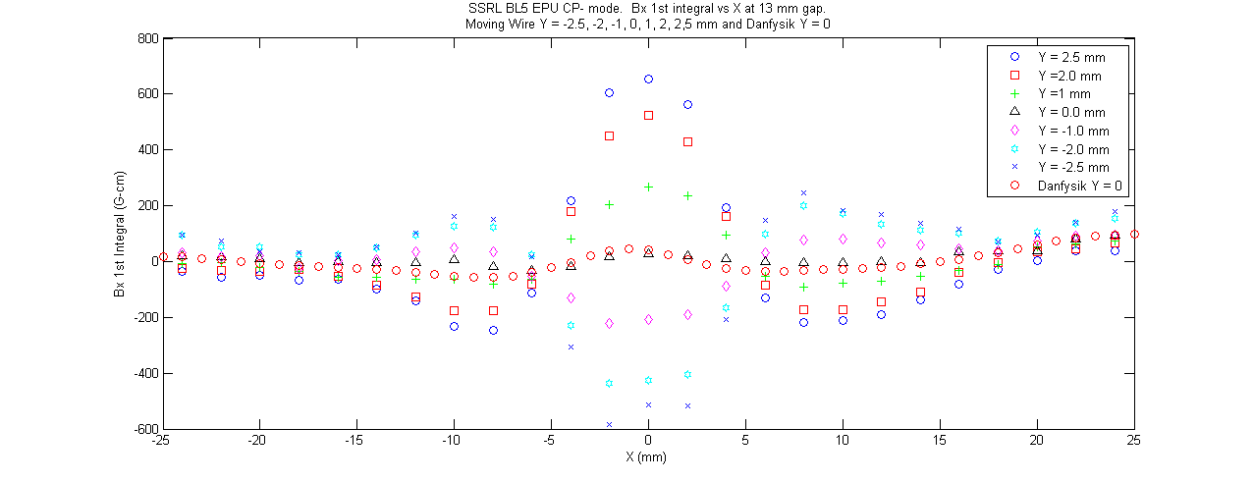
Bx 1St Integral CP- Mode at Y +/-2.5, 2, 1 and 0 mm

Slide 12
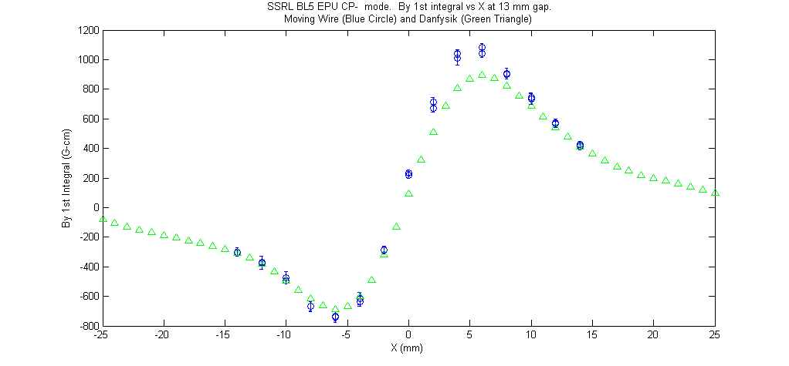
By 1St Integral CP- Mode

Slide 13
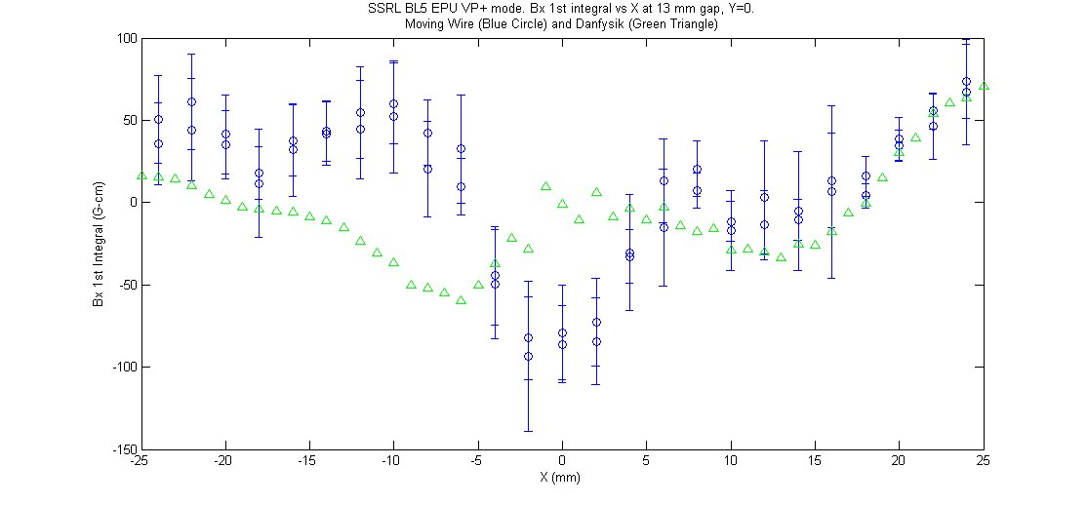
VP+ Mode Bx 1st Integral

Slide 14
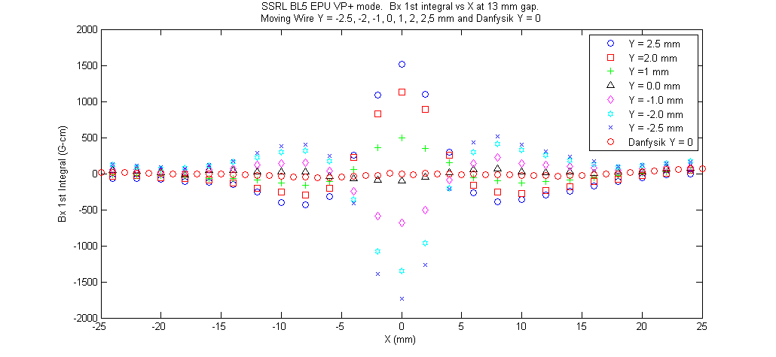
Bx 1St Integral VP+ Mode at Y +/-2.5, 2, 1 and 0 mm

Slide 15
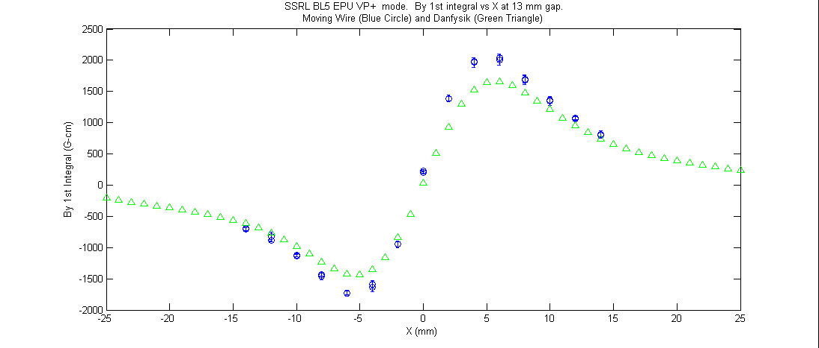
By 1St Integral VP+ Mode

Slide 16
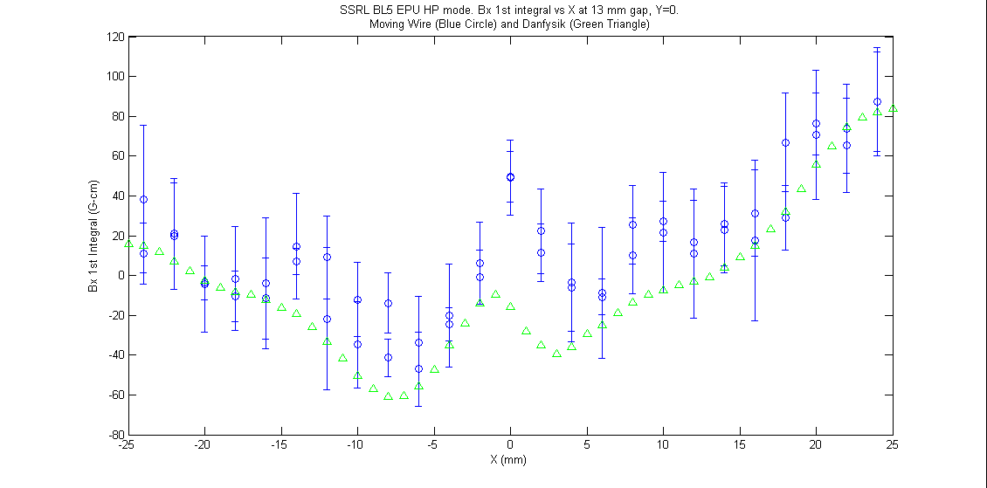
Bx 1St Integral HP Mode

Slide 17
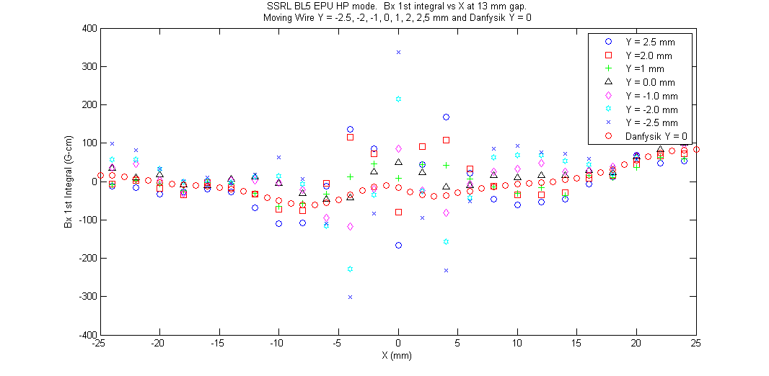
Bx 1St Integral HP Mode at Y +/-2.5, 2, 1 and 0 mm

Slide 18
By 1St Integral HP Mode

Slide 19
Cross Check of Moving Wire Data
Measurements satisfy Maxwell’s equation dBx/dy = dBy/dx
  VP+ mode: dBx/dy = 0.62, dBy/dx = 0.58, within 7.3%
  VP- mode: dBx/dy = 0.61, dBy/dx = 0.67, within 7.9%
  CP+ mode: dBx/dy = 0.24, dBy/dx = 0.25, within 4%
  CP- mode: dBx/dy = 0.24, dBy/dx = 0.24, within 0.2%
  HP mode: dBx/dy = -0.038 , dBy/dx = -0.031 , within 28%
  Pulsed Wire Measurements were also made as a check.
  First experience using Pulsed Wire with an undulator

Slide 20
Pulsed Wire Setup
100 μm Single CuBe Wire 5.45 meters in length.
HV pulser. 5 μsec square pulse at 600 VDC
Laser/ 25 μm Slit Detector measures sub micron motion of wire.
Signal readout on Oscilloscope.
Voltage-Field Integral calibration made by using calibration magnets.
Large noise is caused by vibration of supports.
Cross check of moving wire measurements

Slide 21
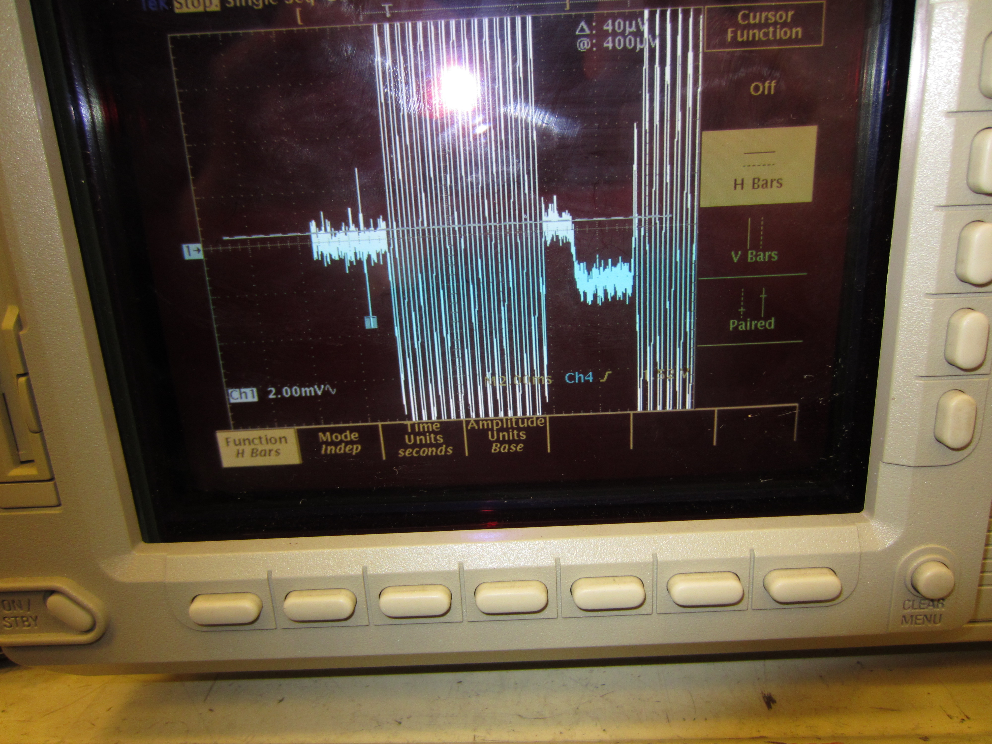
Pulsed Wire Signal with Calibration Magnet

Slide 22
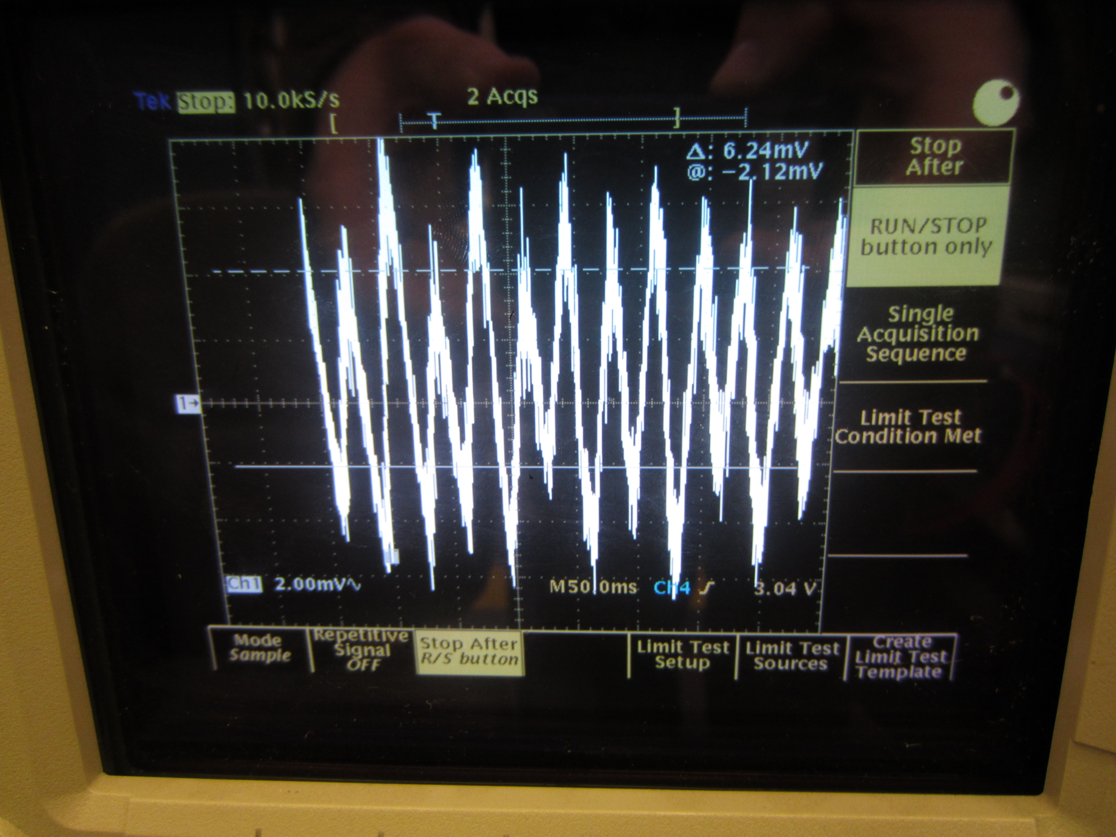
Pulsed Wire Noise

Slide 23
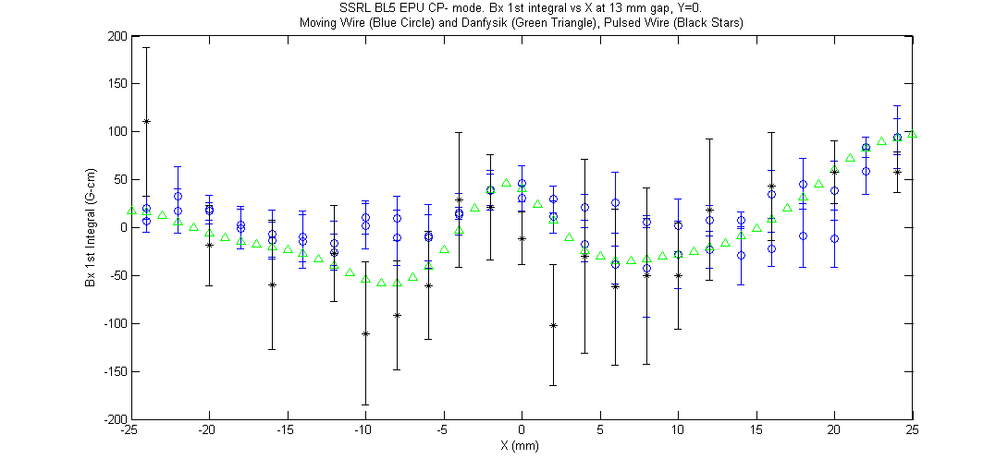
Bx 1St Integral CP- Mode Pulsed Wire

Slide 24
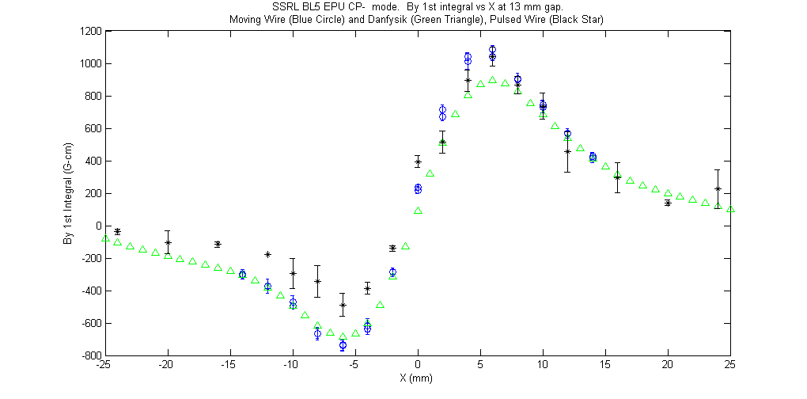
By 1St Integral CP- Mode Pulsed Wire

Slide 25
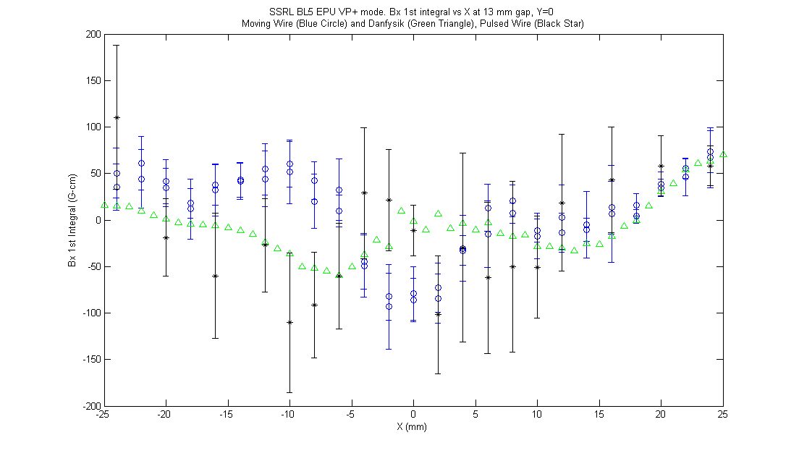
Bx 1St Integral VP+ Mode Pulsed Wire

Slide 26
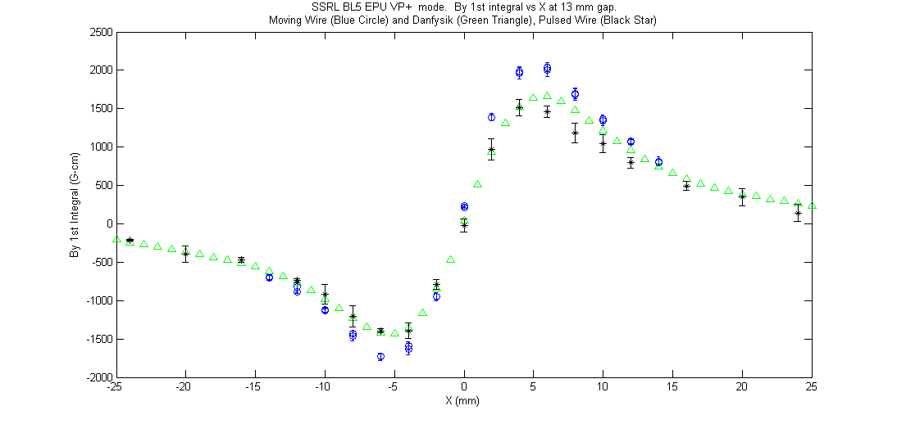
By 1St Integral VP+ Mode Pulsed Wire

Slide 27
Z2 Jaw Control Problem
On February 6th Z2 jaw motor driver found to be not moving and sitting at its zero point.
Motor driver was tripped due to overheating.
After motor was restored subsequent measurements of Bx 1st integrals for CP+, CP-, VP+, VP- changed from previous.
Z2 jaw was set to zero point on purpose and the measurements made in this state matched the measurements made previous to the Z2 motor drive being reset.

Slide 28
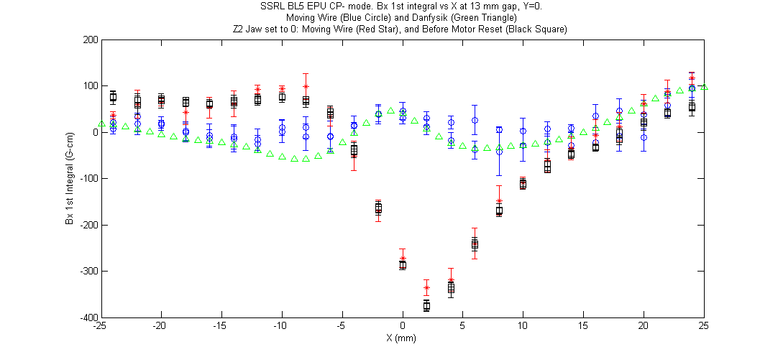
Z2 Jaw at 0 and nominal, CP- mode

Slide 29
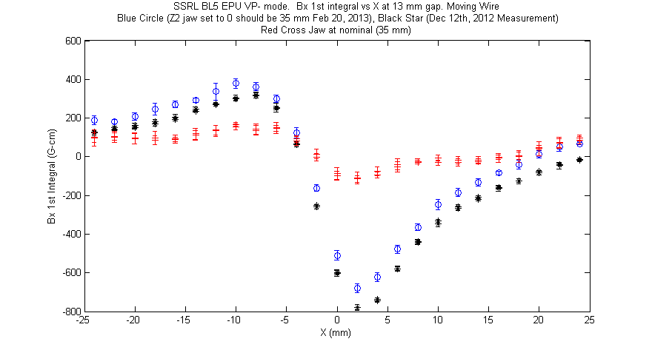
Z2 Jaw at 0 and nominal, VP- mode

Slide 30
Long Coil Measurements
A long coil was originally used to measure the integrals of the EPU.
The long coil has 350 turns and gives larger signals than a single moving wire.
The By 1st integrals match Danfysik data, but the Bx 1st integral measurements do not, except for the HP mode. The CP and VP mode long coil Bx 1st integrals show large integral values away from x = 0.

Slide 31
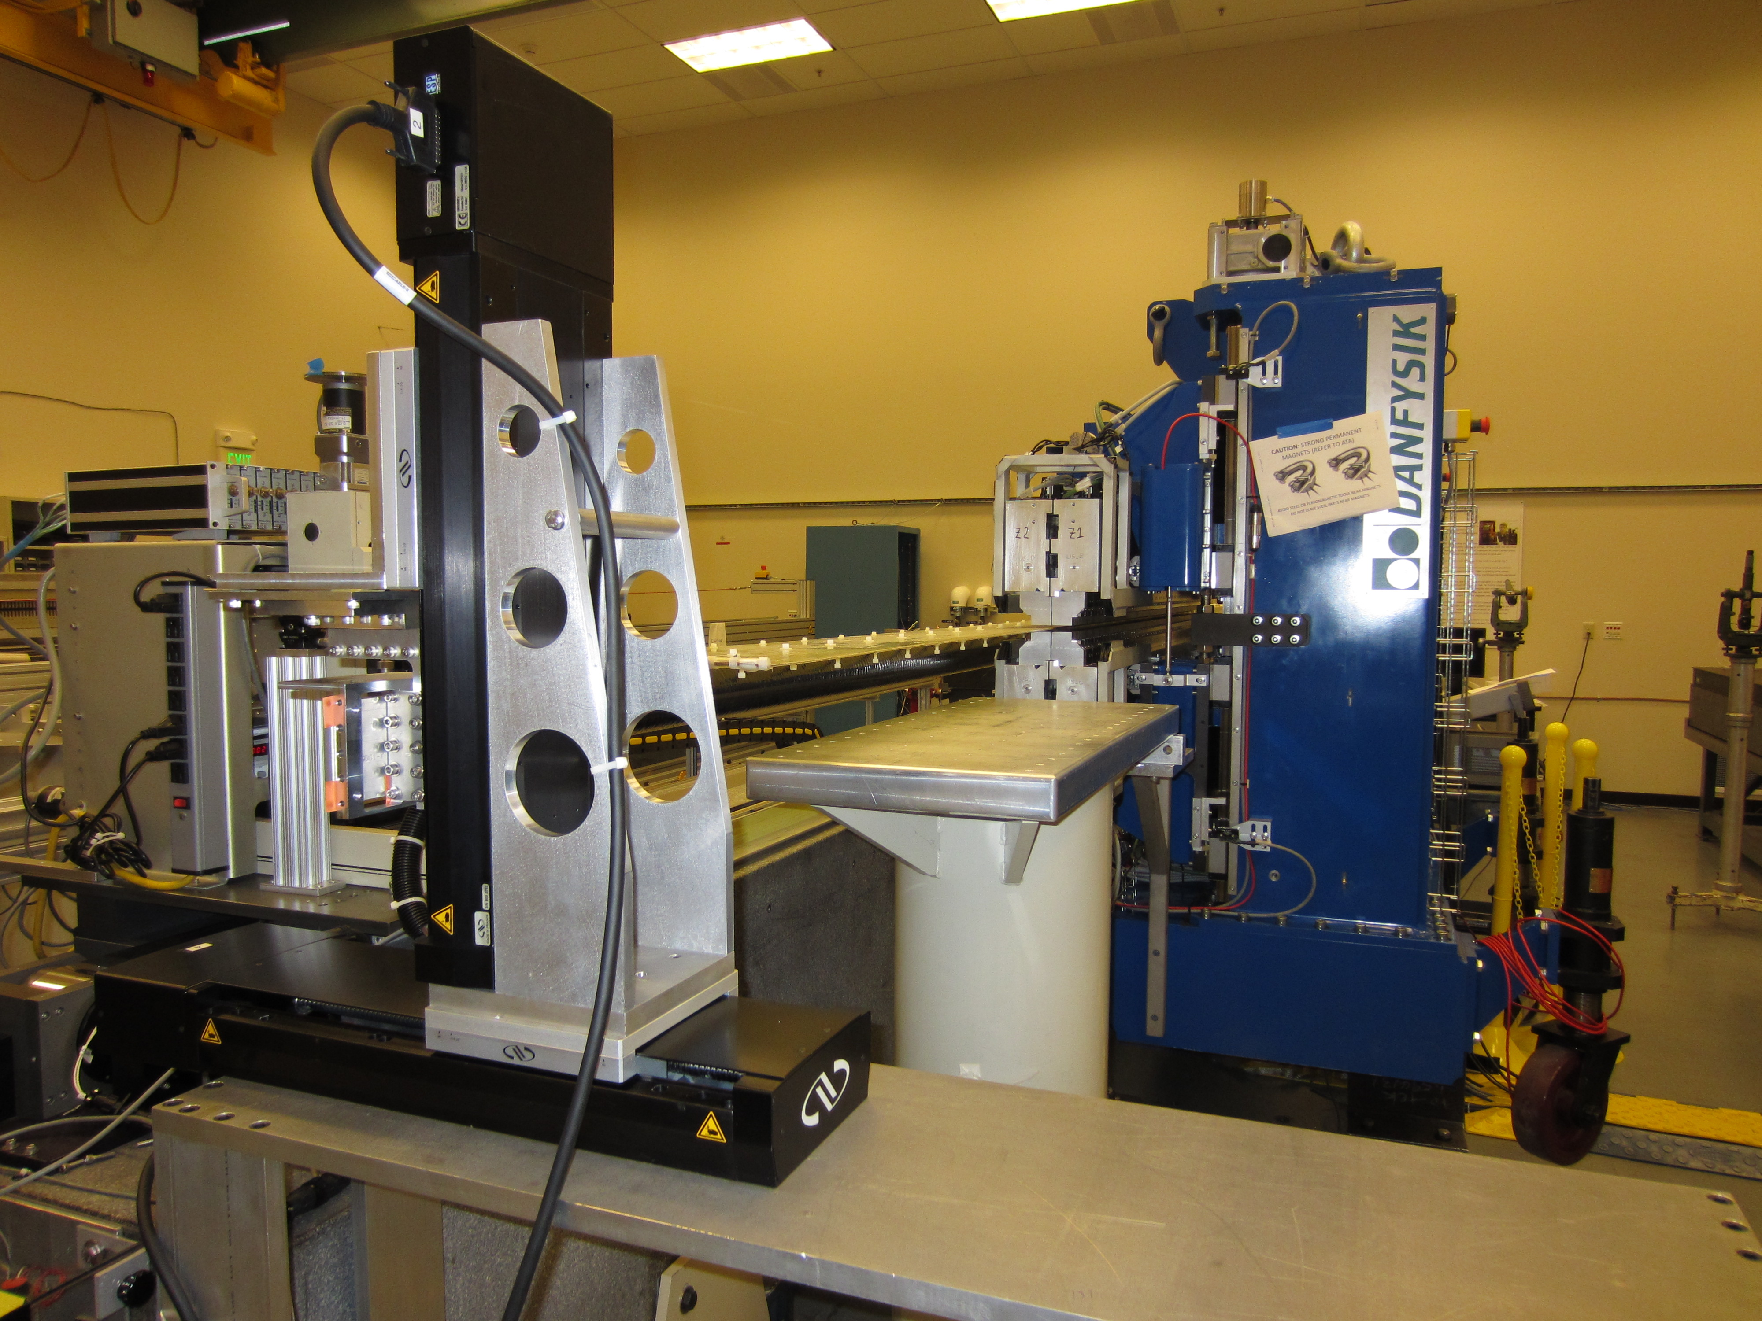
Long Coil Setup

Slide 32
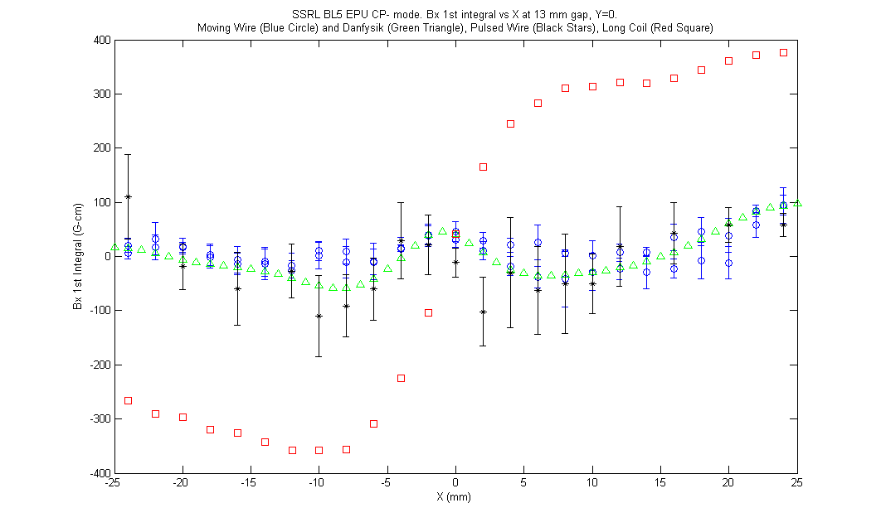
Long Coil Bx 1St Integral CP- Mode

Slide 33
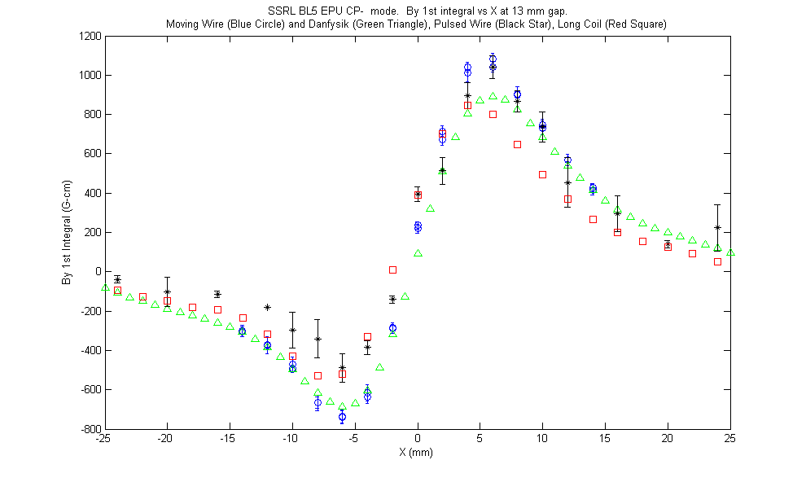
Long Coil By 1St Integral CP- Mode

Slide 34
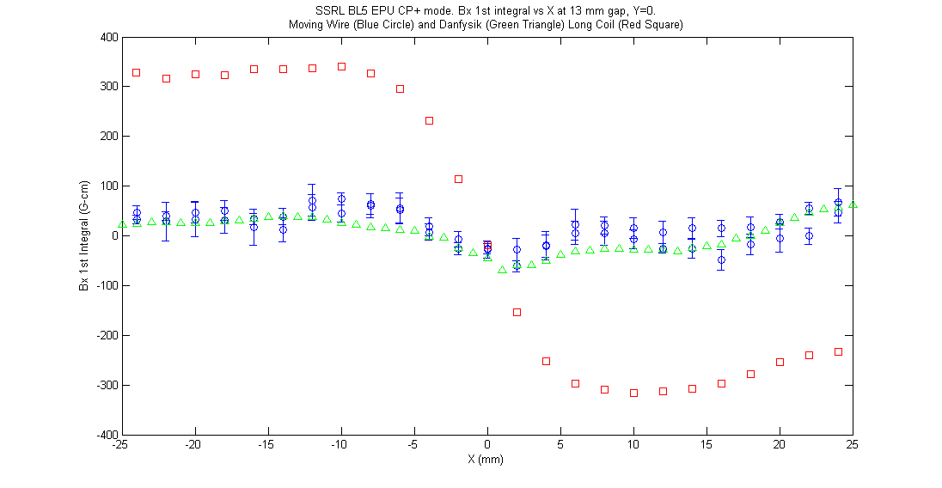
Long Coil Bx 1St Integral CP+ Mode

Slide 35
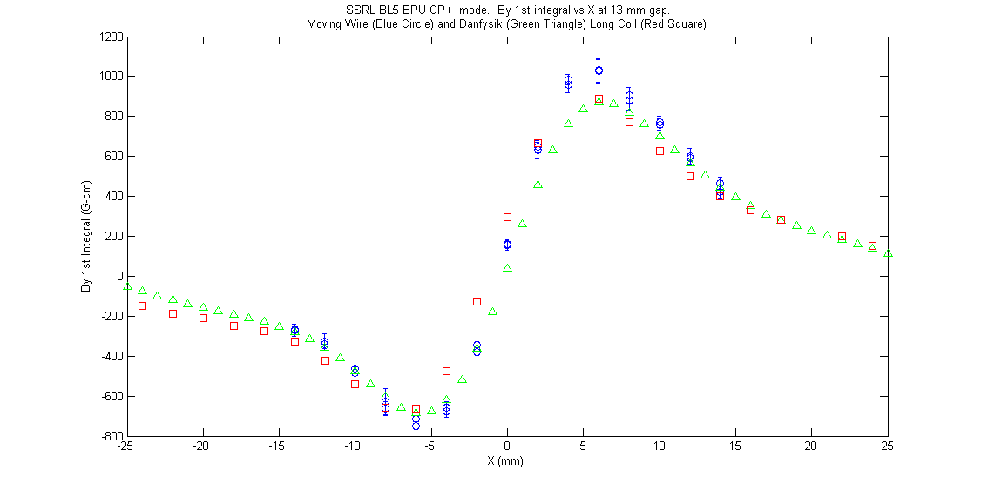
Long Coil By 1St Integral CP+ Mode

Slide 36
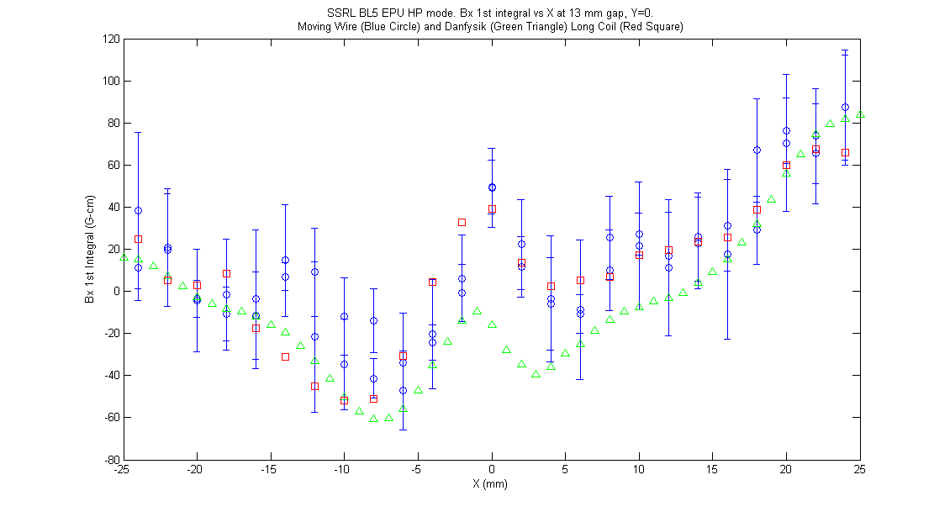
Long Coil Bx 1St Integral HP Mode

Slide 37
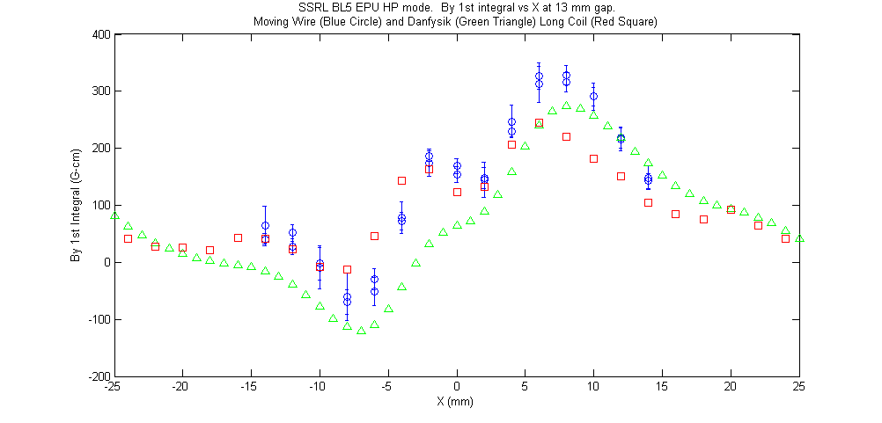
Long Coil By 1St Integral HP Mode

Slide 38
Long Coil Bx integral Investigation
Long Coil back on measurement bench.
Working to determine source of the Long Coil Bx integral errors for the CP and VP modes by systematically checking each component of the system.
  Swap each component of the long coil system with a moving wire component to isolate the source of the error in the long coil system.

Slide 39
Discussion

