Slide 1
Measurement and Assembly Procedure for DELTA Undulator
Ed Reese
FDR, Dec. 11, 2013

Slide 2
Focus of Presentation
This presentation will focus on the areas of the assembly process for the Delta Undulator were the measurement of key components and assemblies will ensure that the tight tolerances needed for the device to function correctly are maintained. It will not provide a step by step narrative for the assembly of the device.

Slide 3
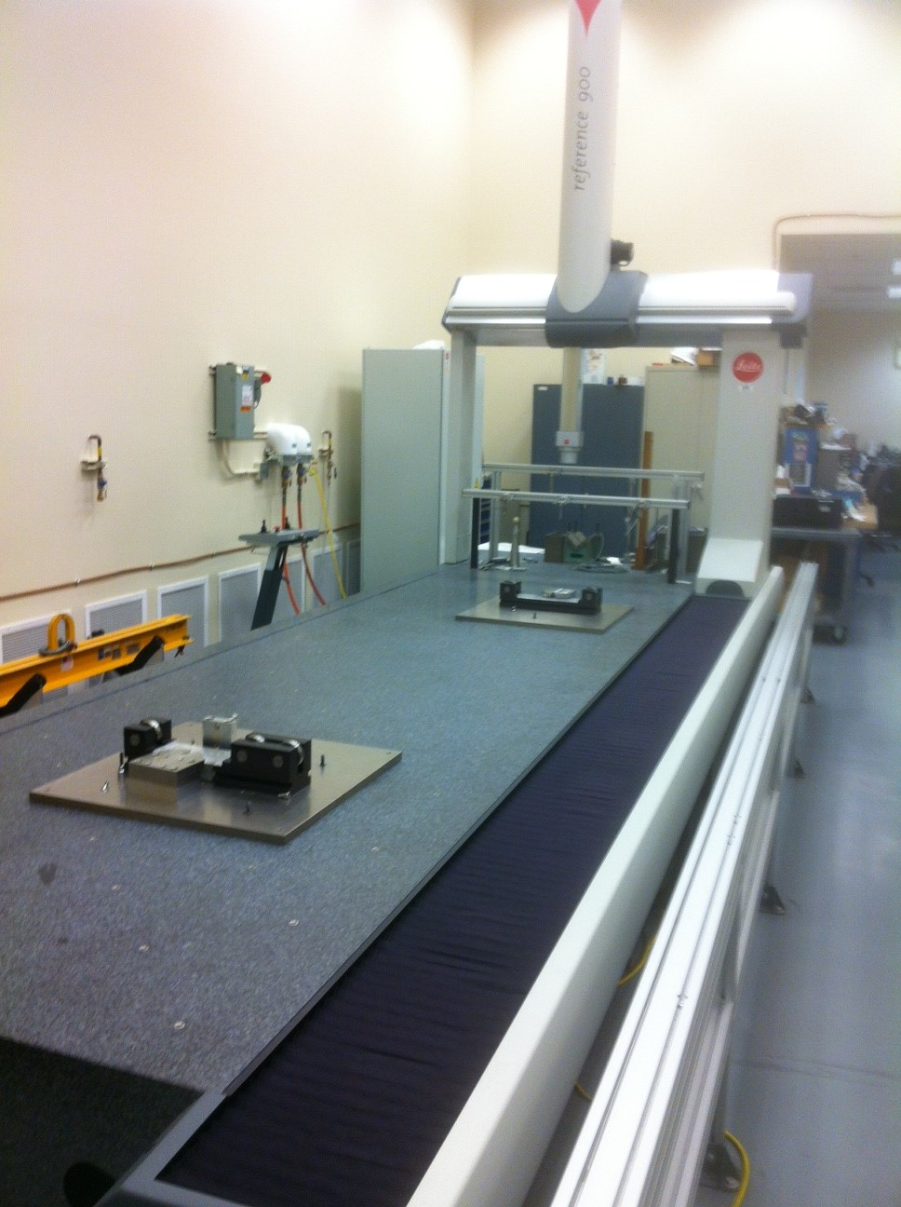
Measurement of all large components will be done on the LEITZ CMM in the MMF
CMM has measuring range of
X axis = 4500 mm
Y axis = 1200 mm
Z axis = 900 mm
Volumetric Measurement Uncertainty = 1.5+l/350
All components fit on CMM

Slide 4
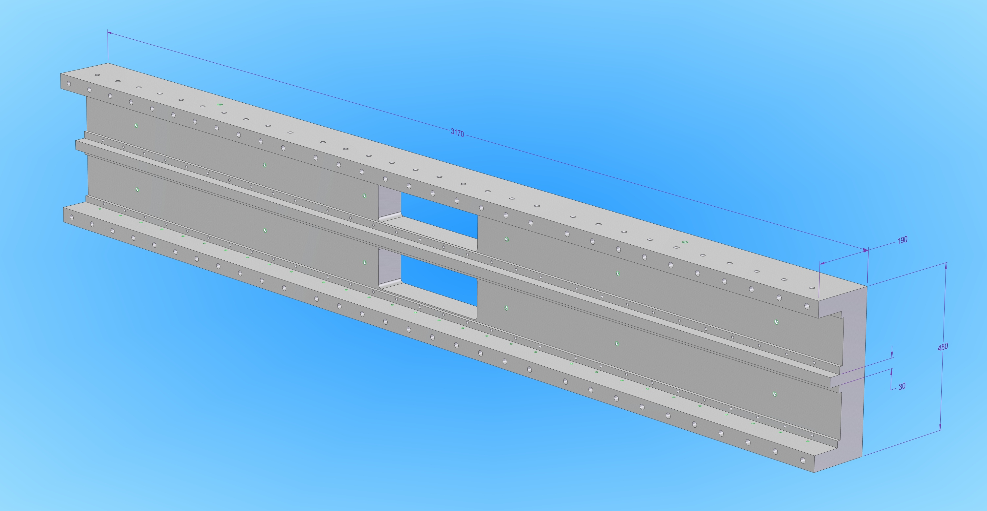
Machined Strongback E Sections

Slide 5
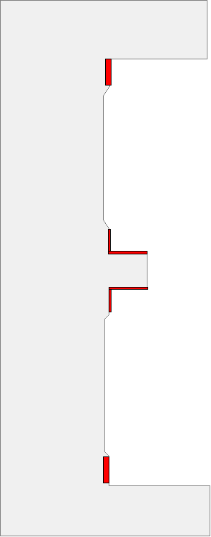
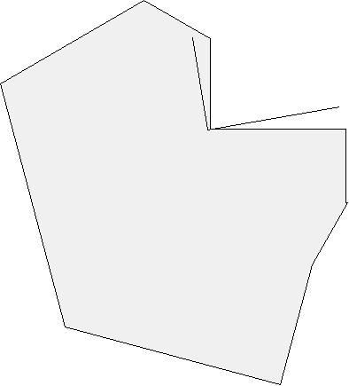
Critical Strongback E Section Measurements
Red surface areas need to be machined precisely
± 0.1 µm/mm
Parallelism < ± 25 µm/m

Slide 6
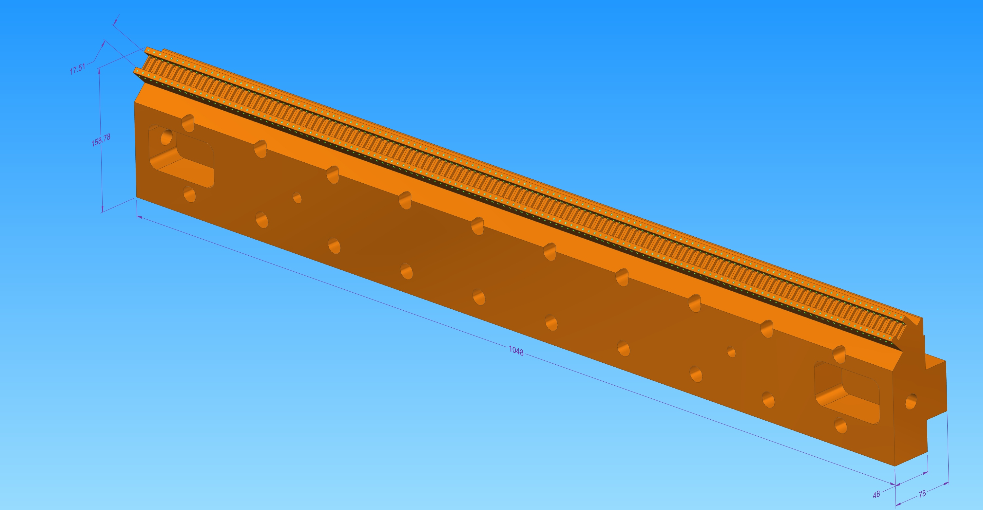
Machined Carrier

Slide 7
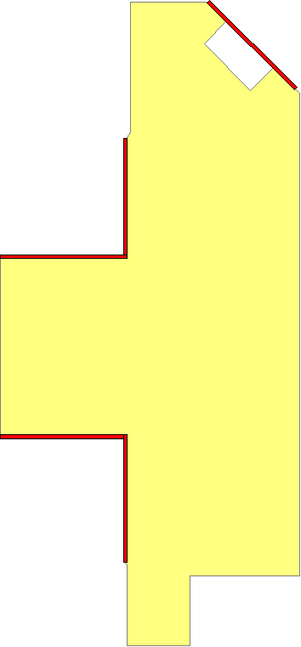
Critical Dimensions on Carrier
Beam axis
Red surface areas need to be machined precisely
Angular tolerance
= ± 0.5 µm/mm
Angular tolerance = ± 0.1 µm/mm
Parallelism < ± 25 µm/m

Slide 8
Carrier First Piece Validation
Measure Critical Dimensions on first Carrier Machined.
Magnet Mounting and Adjustment Features are not
Machine at this point.
Evaluate and Verify Location of Magnet Mounting Plane in Relation to Rail Mounting Surfaces.
If Mounting Plane is in correct location no additional machining steps needed.
If not in correct location, reevaluate process, consider measuring each Carrier before final machining to determine corrections needed.

Slide 9
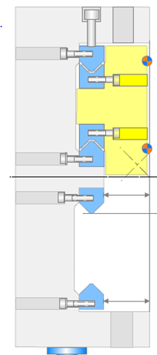
Test Assemble Strongback with Rails and Carriers
Strongback is test assembled
With Rails and Carriers, but without
Magnets, to verify final assembly
dimensions

Slide 10
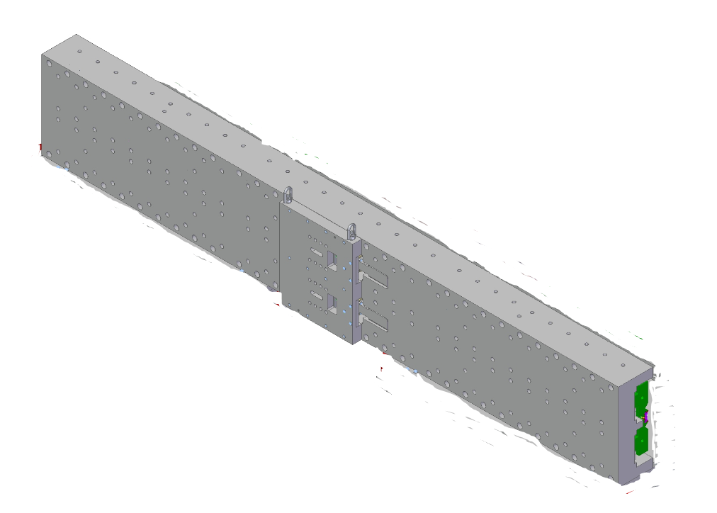
Attach Drive Units to Strongback Carrier Assembly
Drive units are attached to Strongback E sections with Carriers and Rails installed to
test fit and operation.
Drive Unit

Slide 11
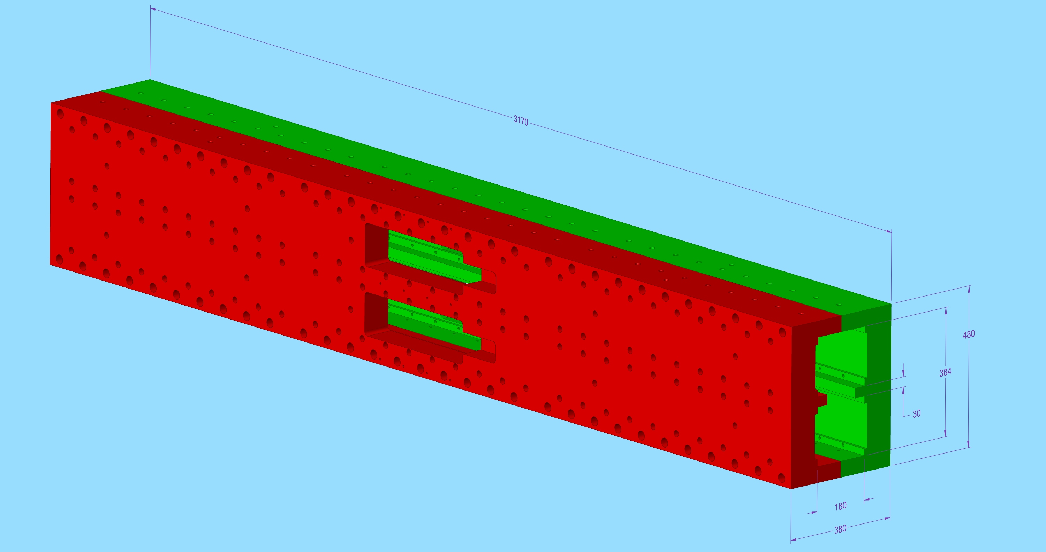
Fit Mounting Feet to joined Strongback Sections
Mounting Feet are attached to joined Strongback sections to calculate machining needed to correctly position Undulator centerline. Values calculated from archive data for Girder in position #33.

Slide 12
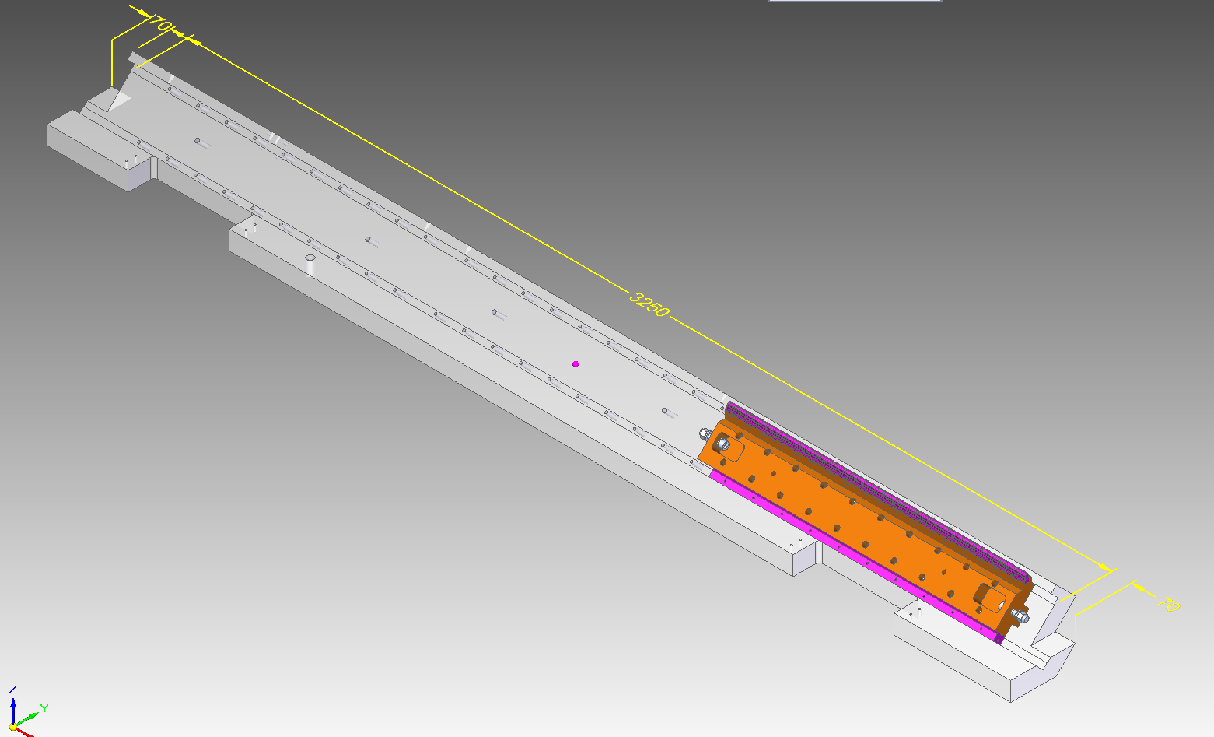
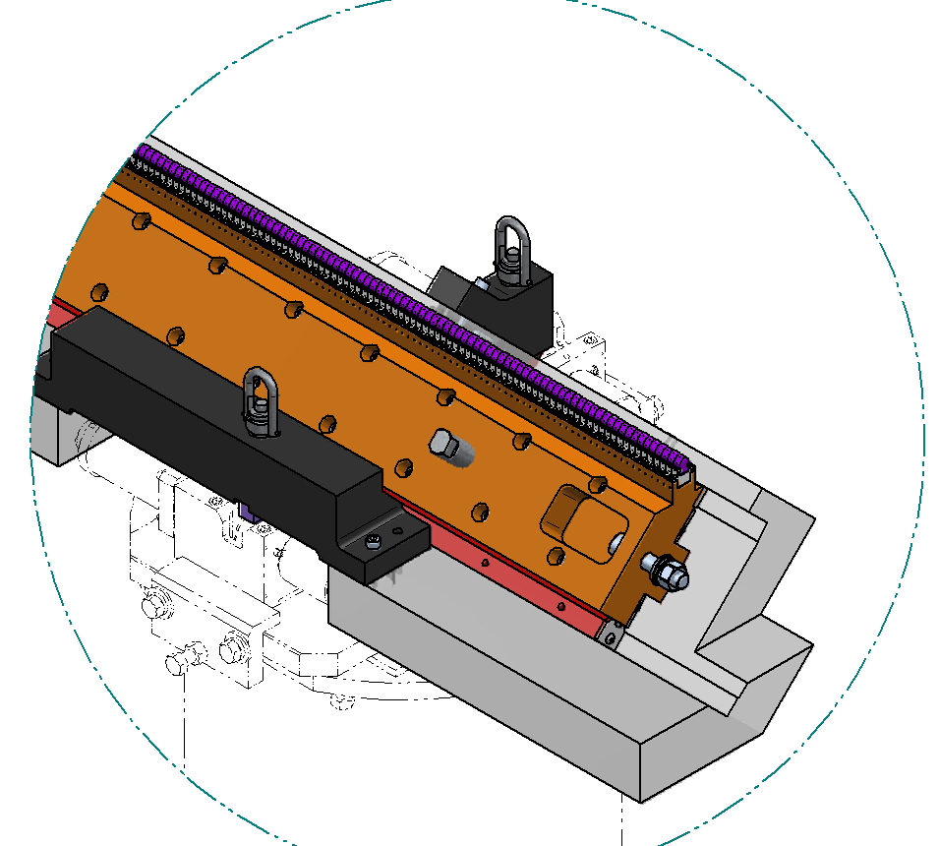
Verify critical dimensions on Calibration Fixture
The critical surfaces on the Calibration Fixture have the same dimensions and tolerances as one half of the Strongback E section. The fixture is inclined
45 deg so that the magnets, when installed will be in a vertical orientation.
Critical Surfaces

Slide 13
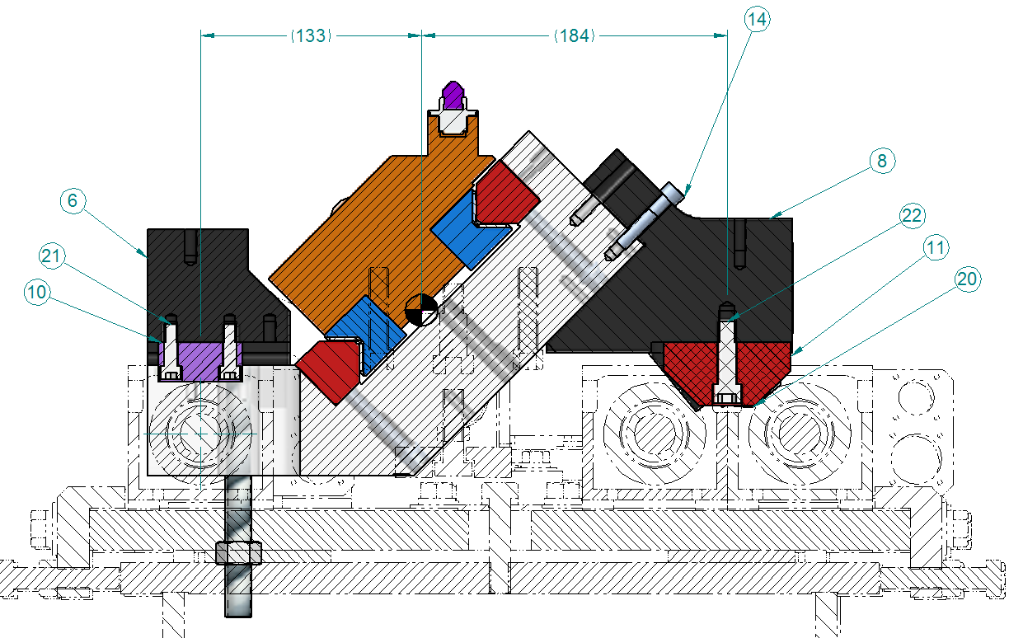
Install Carrier/Rail assemblies on Fixture and verify alignment of reference surfaces for Keyence sensors
Reference Surface will be used to adjust pitch of fixture on Kuglar Bench
Reference Surface

Slide 14
Install Magnets onto Carriers

Slide 15
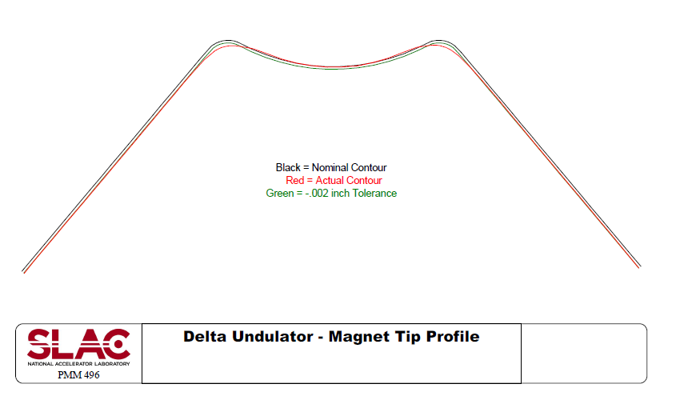
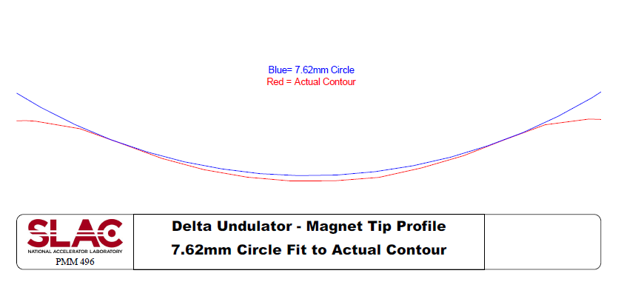
Move Tuning Fixture to CMM and measure Tip circle location of each magnet
The Tip of each magnet is scanned by the CMM. A circle of fixed diameter is fit to the scanned point set giving the center location of the magnet.

Slide 16
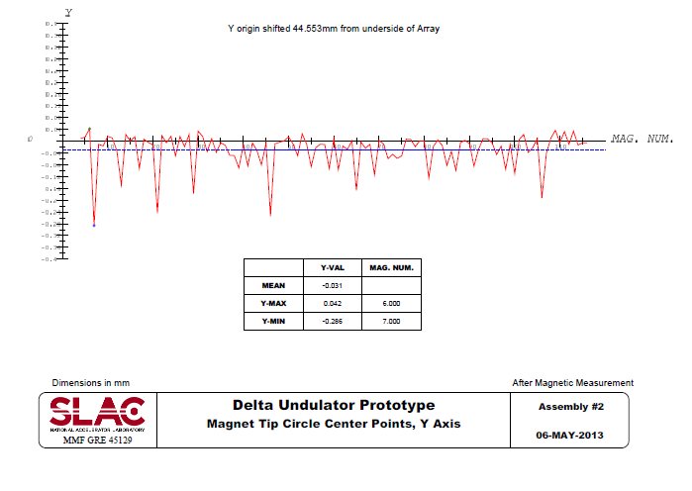
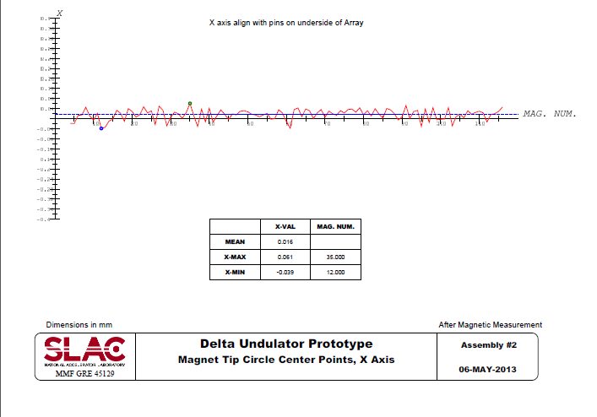
Evaluate mechanical alignment of Magnets installed on Carrier
The center points all magnets are collected and their deviation in the YZ and XZ planes of the nominal centerline are calculated

Slide 17
Tuning Fixture moved to Kuglar Bench for Magnetic Measurement
After initial CMM measurement the Tuning Fixture with Magnet/Carriers installed is moved to the Kuglar Bench for Magnetic Measurement.
After Magnetic Measurement the magnets may be adjusted with shims in the Y direction or shifted with set screws in the X direction. This process may go through several iterations.
After Magnetic Measurement is complete the Tuning fixture will be returned to the CMM for a final measurement on magnet positions.

Slide 18
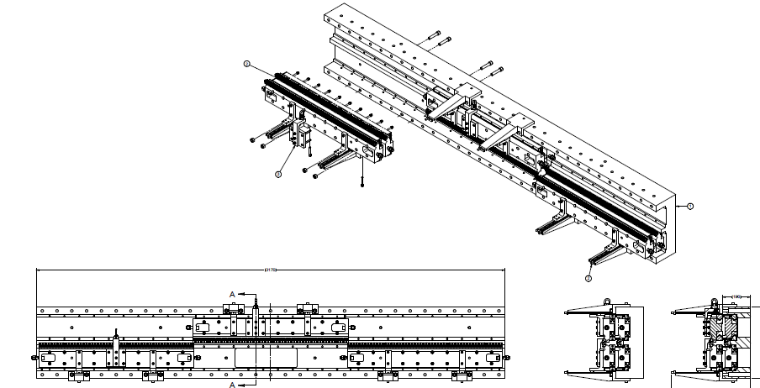
Installation of Carrier assemblies to Strongback

Slide 19
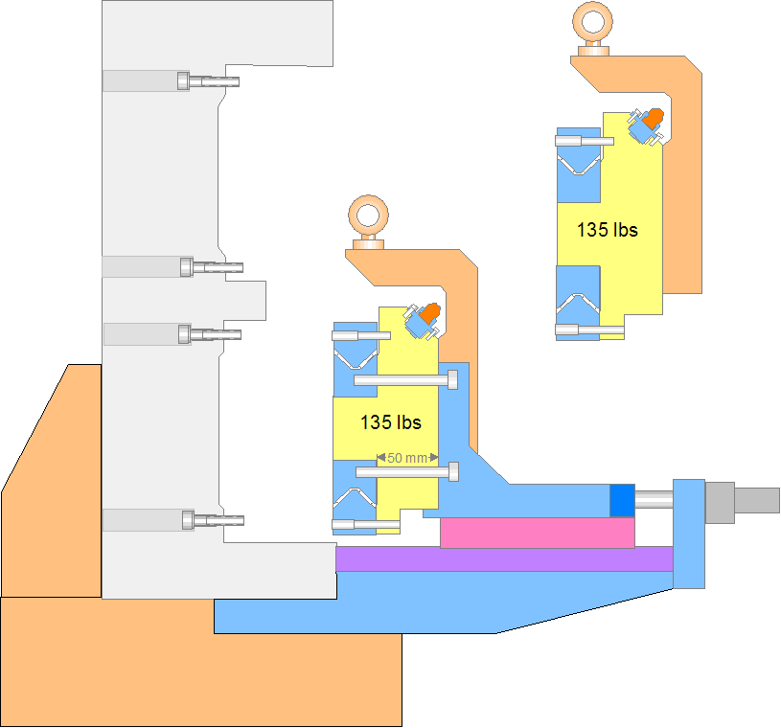
Installing Lower Carrier assemblies
Strong back
Rigging one magnet carrier
Support
Translation stage
connected to the strong back

Slide 20
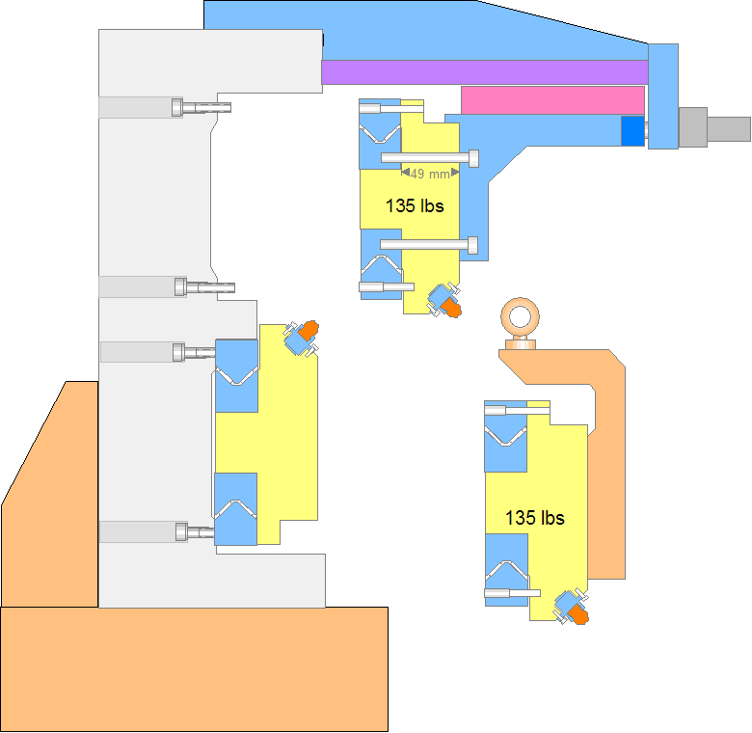
Installing Upper Carrier assemblies

Slide 21
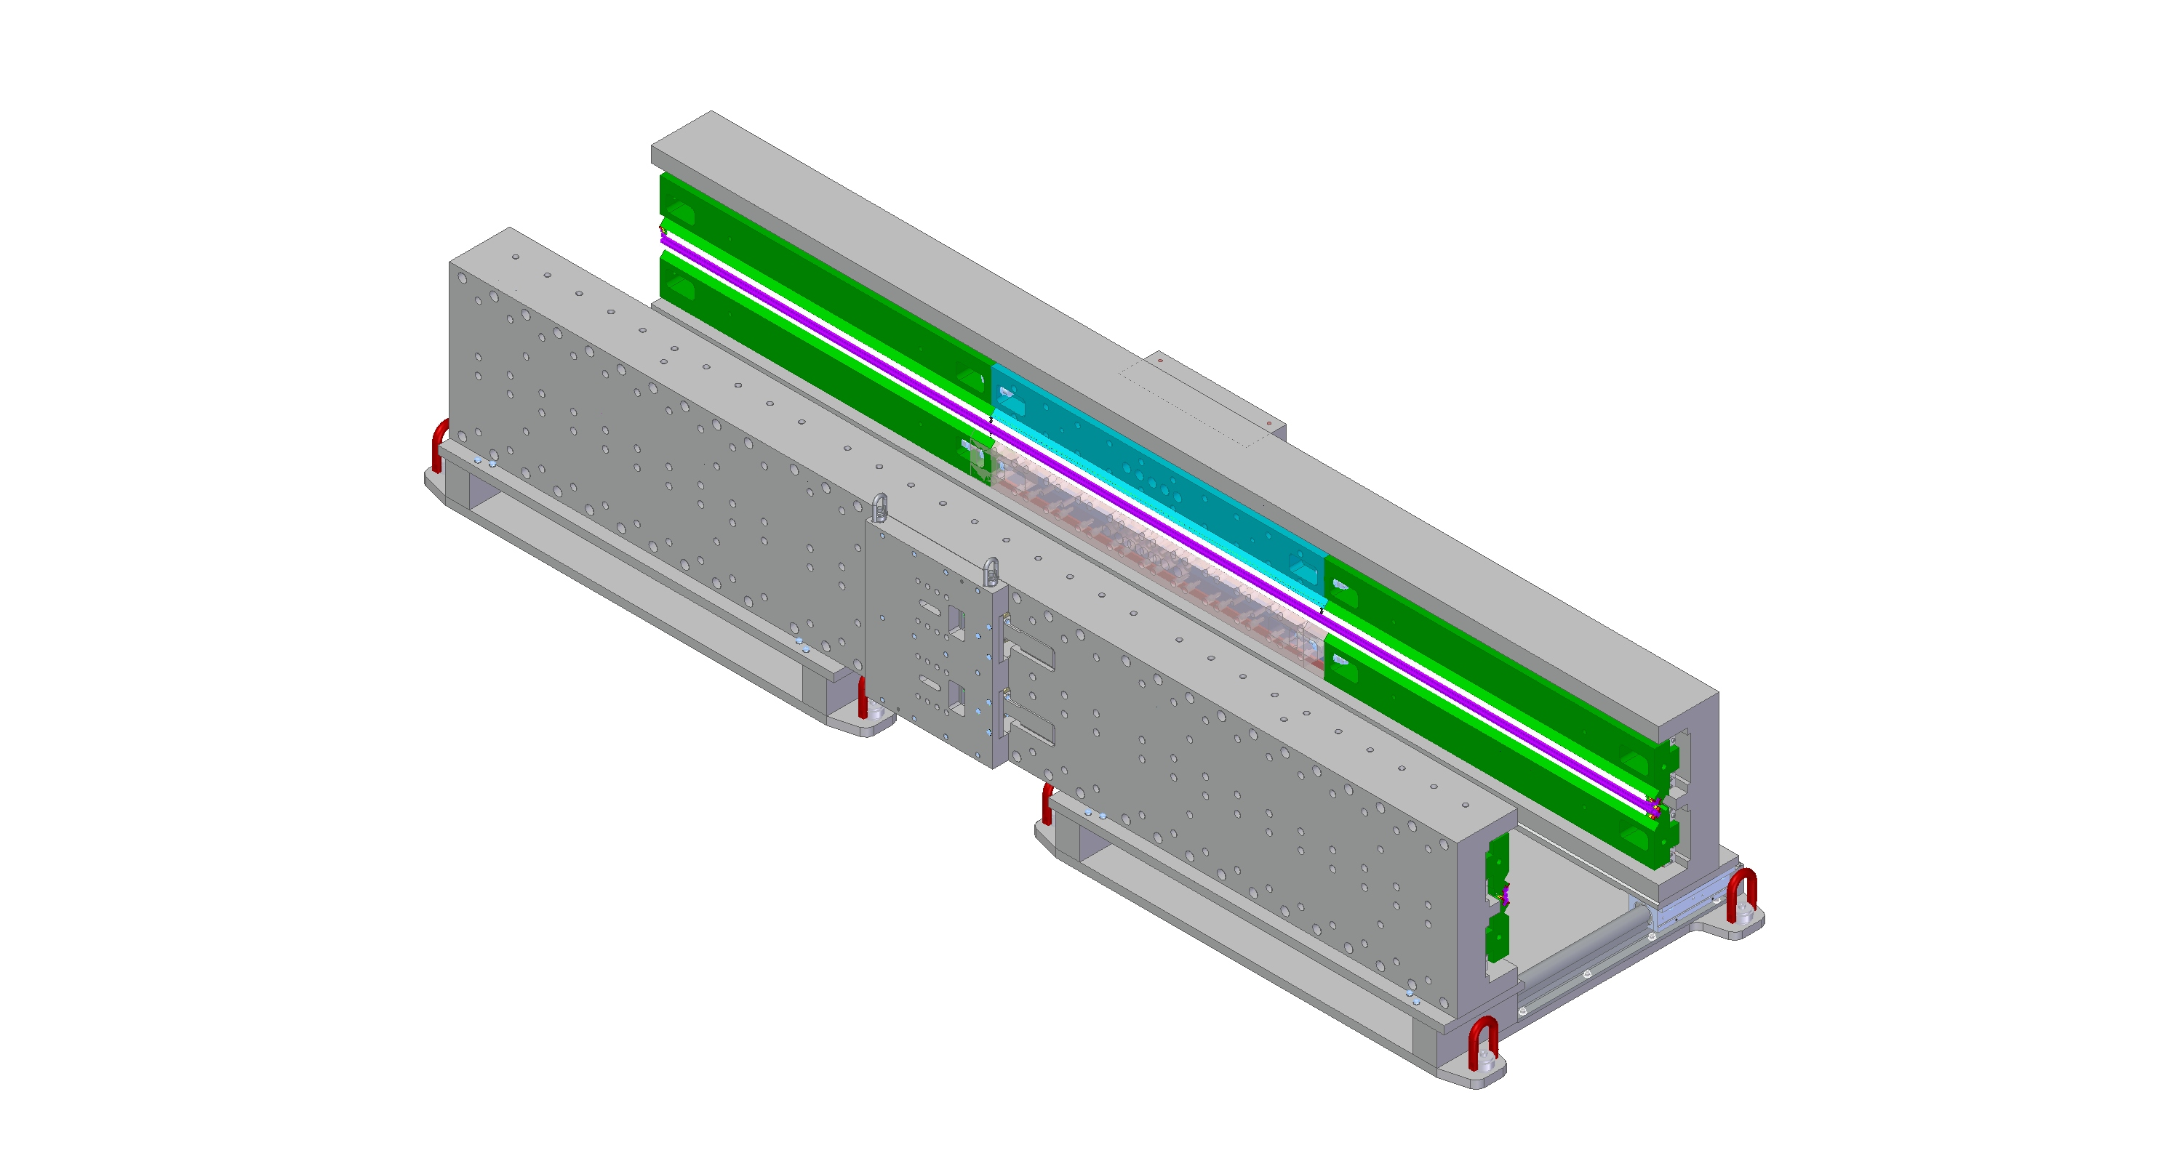
Joining fully assembled Strongback halves together
The two Strongback sections will be mounted onto sliding fixtures. These fixture will be used to control the magnetic forces as the two halves are brought together.
Strongback sections
Sliding Fixtures

