Slide 1
magnet type: laser heater undulator
engineering type: N/A
SLAC drawing number: SA-380-326-01
SLAC magnet bar-code: 4095
vendor serial number: LHU-002
when measured: 21-May-2021
when analyzed: 06-Jun-2021
MAD assignment: UMHTR
EPICS device name: USEG:HTR:650

Slide 2
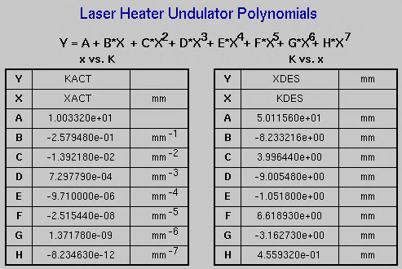
LCLS

Slide 3
V:\MET\MagServe\MagData\LCLS-II
\Undulator\LHU-0002\DATASET0001
\Final Results\Z Scans
\On Axis\pid_fit_k.mat
Gap(mm) → K
Gap_{meas} | K_{meas} | K_{fit} | Gap_{fit}
24.6147 | 2.4936 | 2.4936 | 24.6148
32.0892 | 1.5782 | 1.5783 | 32.0894
34.0174 | 1.4000 | 1.3998 | 34.0195
36.5047 | 1.1995 | 1.1998 | 36.4960
39.5132 | 0.9971 | 0.9967 | 39.5206
41.1638 | 0.9001 | 0.9007 | 41.1816
43.0922 | 0.8005 | 0.8002 | 43.0679
50.0023 | 0.5217 | 0.5219 | 50.0104
59.9537 | 0.2813 | 0.2815 | 59.9537
K → Gap(mm)
(K_{fit} – K_{meas})/K_{meas}
Gap_{fit} - Gap_{meas}

Slide 4
V:\MET\MagServe\MagData\LCLS-II\Undulator\LHU-0002\DATASET0001\Final Results\Z Scans
\Good Field Region\Run 001\pid_fit_k_off-axis.mat

Slide 5
V:\MET\MagServe\MagData\LCLS-II\Undulator\LHU-0002\DATASET0001\Final Results\Z Scans
\On Axis\pid_fit_i12xy.mat

