Slide 1
HXR Reference re-measurement results:
9/17/26
DS/ Run | Date | Temp. (ºC) | I1Y (µTm) | I2Y (µTm²) | I1X (µTm) | I2X (µTm²) | Phase RMS (º) | K (corrected) | ΔK/K (vrt. DS01) | Ref. ( ΔB/B) | HP calibration
001/02 | 10/16/17 | 20.08 | +2 | -25 | -8 | -2 | 3.0 | 3.376900 | Initial | N/A | 10/6/17
002/10 | 5/22/19 | 20.01 | (+2) | (-20) | (+40) | (+98) | 3.2 | 3.376598 | -9⋅10⁻⁵ | Initial | 5/22/19
03/06* | 6/26/19 | 20.01 | -4-? | -25-? | -4-? | -3-? | 3.1 | 3.376926 | +1⋅10⁻⁵ | -8⋅10⁻⁵ | 6/10/19
04/02 | 8/14/19 | 19.96 | +10 | +5 | +36 | +100 | 3.1 | 3.377141 | +7⋅10⁻⁵ | -5⋅10⁻⁵ | 6/10/19
05/06** | 10/7/19 | 19.98 | +19 | +29 | +21 | +75 | 3.0 | 3.376885 | -4⋅10⁻⁶ | -9⋅10⁻⁶ | 10/4/19
06/04 | 11/19/19 | 19.96 | -3 | -13 | +28 | +95 | 3.0 | 3.377147 | +7⋅10⁻⁵ | -7⋅10⁻⁵ | 10/7/19
06/06 | 11/26/19 | 19.99 | -3 | -13 | +28 | +95 | 3.0 | 3.376761 | -3⋅10⁻⁵ | -1.4⋅10⁻⁴ | 1/20/19
07/04 | 7/06/20 | 19.89 | -4 | -12 | +24 | +30 | 3.0 | 3.376758 | -4⋅10⁻⁵ | -1.4⋅10⁻⁴ | 6/9/20
08/08 | 8/27/20 | 19.93 | -15 | -41 | +28 | +86 | 2.8 | 3.376743 | -5⋅10⁻⁵ | -1.6⋅10⁻⁴ | 8/13/20
09/04 | 11/6/20 | 19.90 | -13 | -42 | +27 | +98 | 2.8 | 3.376878 | -1⋅10⁻⁵ | -1.5⋅10⁻⁴ | 10/30/20
10/09 | 09/24/21 | 19.99 | -15 | -55 | +31 | +105 | 2.8 | 3.376792 | -3⋅10⁻⁵ | -1.7⋅10⁻⁴ | 8/23/21
12/03 | 09/27/22 | 20.00 | -15 | -55 | +31 | +105 | 2.8 | 3.376891 | -3⋅10⁻⁶ | -1.2⋅10⁻⁴ | 9/26/22
13/17 | 9/10/26 | 19.97 | -11 | -46 | +26 | +100 | 2.8 | 3.377486 | +1.7⋅10⁻⁴ | +1.1⋅10⁻⁴ | 9/9/26
14/02 | 9/17/26 | 19.95 | -11 | -46 | +26 | +100 | 2.8 | 3.377532 | +1.9⋅10⁻⁴ | +1.5⋅10⁻⁴ | 9/15/26
+0.9⋅10⁻⁴
+1.2⋅10⁻⁴
+0.5⋅10⁻⁴
+1.4⋅10⁻⁴
+1.1⋅10⁻⁴
+1.0⋅10⁻⁴
+1.1⋅10⁻⁴
+1.4⋅10⁻⁴
+1.4⋅10⁻⁴
+1.1⋅10⁻⁴
+0.6⋅10⁻⁴
+0.4⋅10⁻⁴

Slide 2
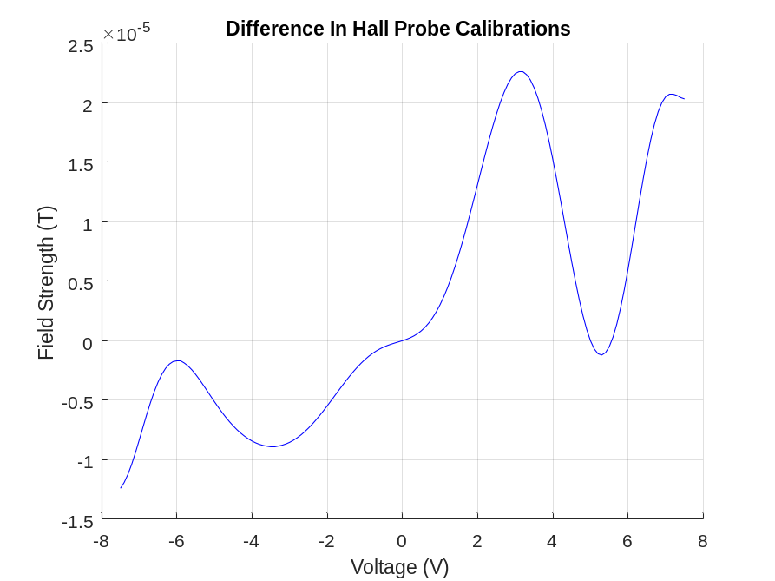
Hall probe calibration difference.
DS006 – DS005
NMR check:
NMR1 - 0.3677076
NMR2 - 0.3677081
Both NMRs recalibrated in 2025

Slide 3
CMM gap measurements
Average gap change = 0.3µm

Slide 4
Probe positioning in Calibration magnet
Hall Probe
NMR Probe

