Slide 1
Fast Wire Scanner Shielding Measurements Results
Comparison of shielding with 15 A supply with and without bottom magnetic shield.
Scott Anderson 1/31/2017

Slide 2
Bx and By Fields with 15 A Power Supply Measurement Setup
Bx and By field measurements were made with wire scanner moving in the up direction. This gives the maximum current.
Bx and By analog output of the gaussmeter was measured during at 15 points at x and y = 0, from z = -14 to +14 cm (2 cm steps). The maximum field change was calculated at each step and then these steps were integrated.

Slide 3
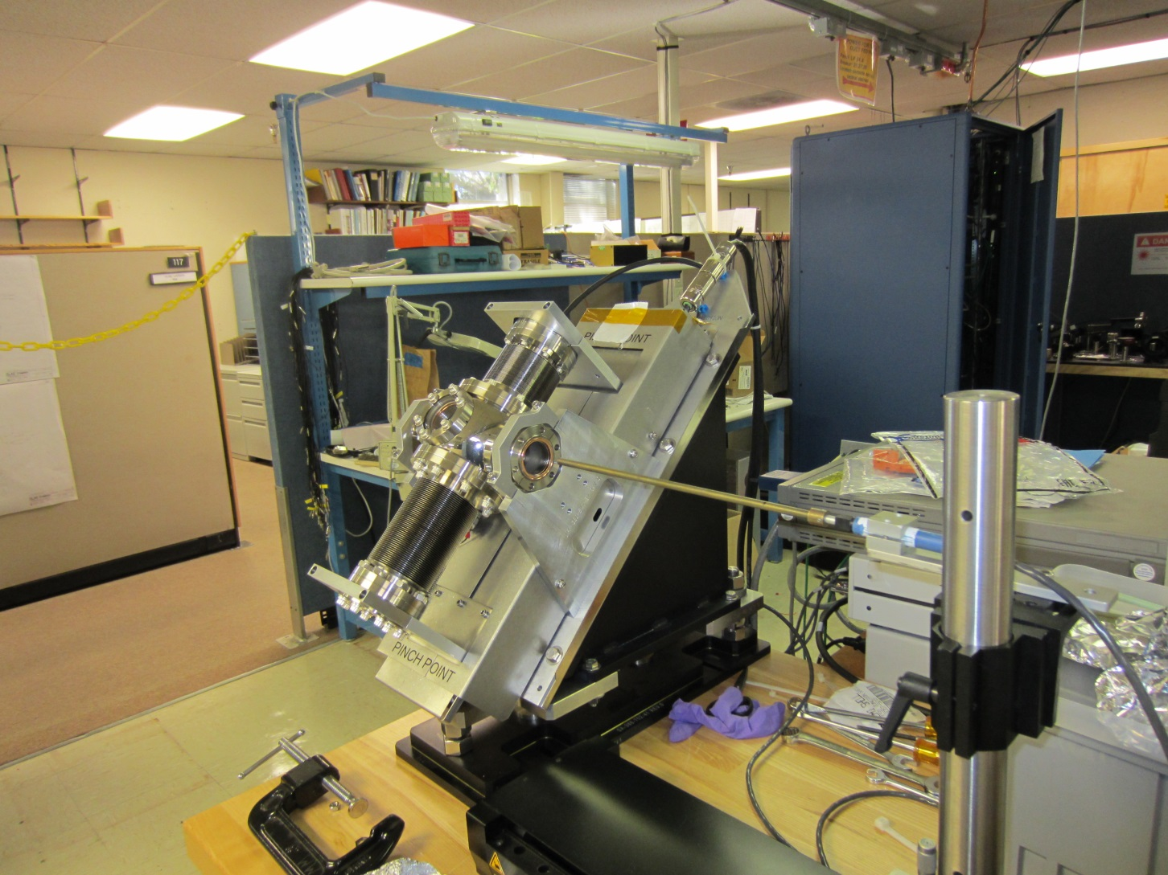
FWS Setup

Slide 4
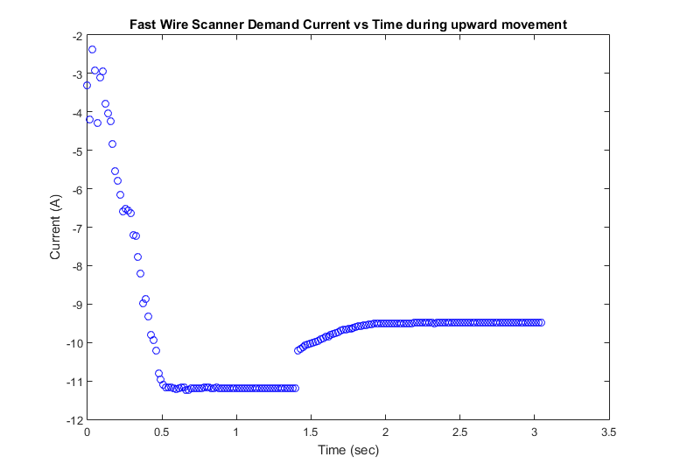
Wire Scan Current vs Time

Slide 5
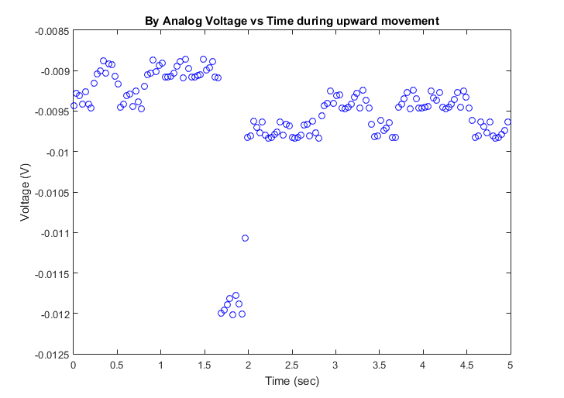
By Analog Voltage Measurement
Notes:
Measurements were made on a +/- 10 G/V scale.
Field (G) = (max(Volt) – min(Volt))*10

Slide 6
Analog to Field Conversion
Measurements were made on a +/- 10 G/V scale.
Field (G) = (max(Volt) – min(Volt))*10

Slide 7
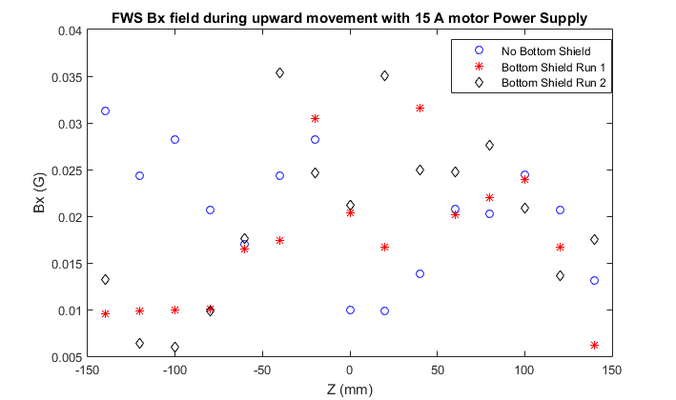
Bx vs X Measurements
Notes:
Measurements were made on a +/- 10 G/V scale.
Field (G) = (max(Volt) – min(Volt))*10

Slide 8
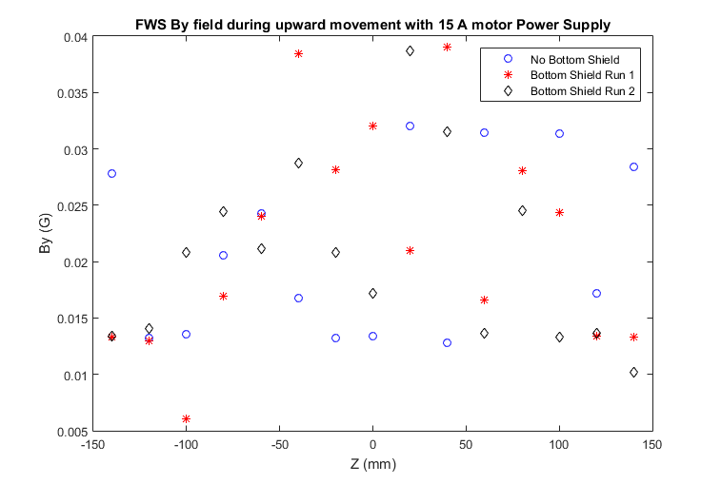
By vs Z Measurements
Notes:
Measurements were made on a +/- 10 G/V scale.
Field (G) = (max(Volt) – min(Volt))*10

Slide 9
Integral Fields
Bx Integral Field (G-cm) | By Integral Field (G-cm) | Bx Integral Field w/ Bottom Shield (G-cm) | By Integral Field w /Bottom Shield (G-cm)
0.57+/- 0.04 | 0.61 +/- 0.03 | 0.54 +/- 0.04 | 0.61 +/- 0.03

Slide 10
Calibration Check
Used now magnet to check field calibration
Hall probe measured 1.4 to 0.3 G changing field.
Field measured = 1.1 G
Integral Field measured = 8.5 G-cm
Both measurements agree with second hall probe measurements.

Slide 11
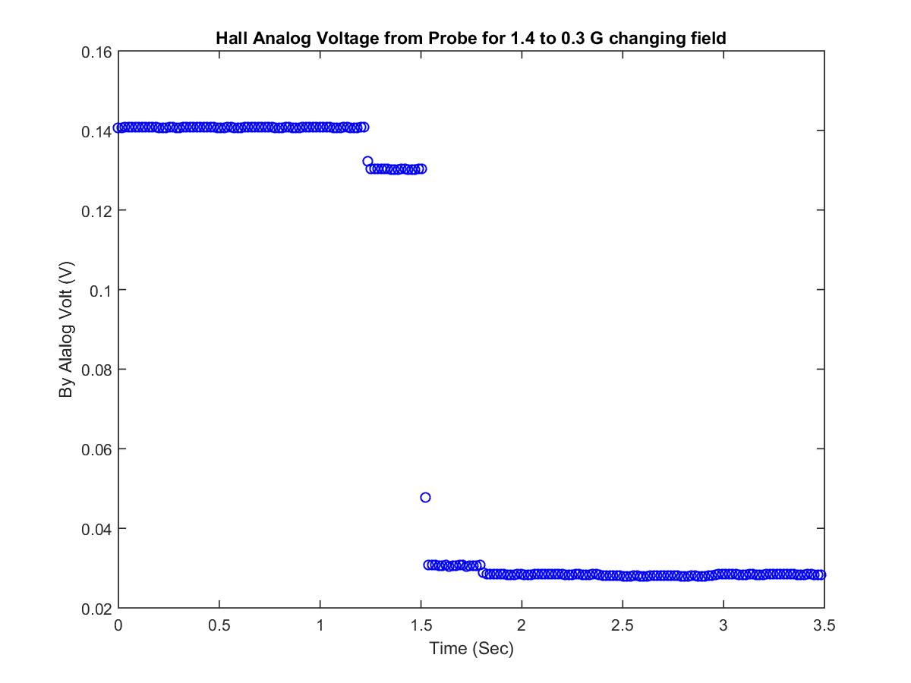
Analog Voltage vs Time

