Slide 2
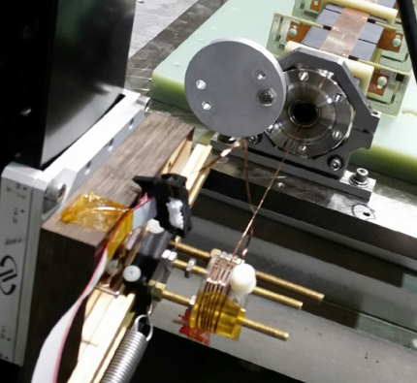
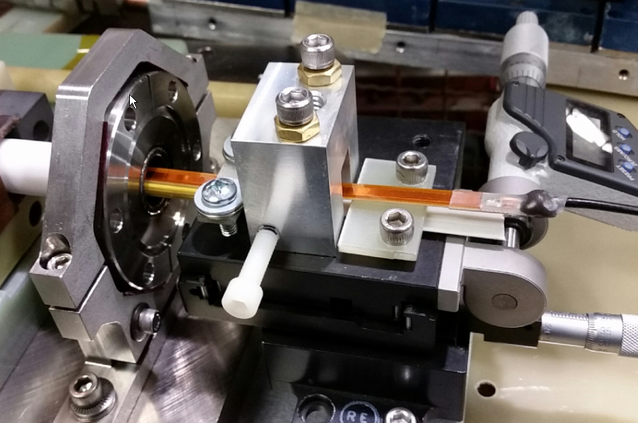

Magnetic Measurements
Stretched wire measurement made with DC current value equal to ~60% of required pulsed current.
    Integrated magnetic gain, Bgain, measured at 60µTm/A.
    Maximum transverse error in y scanned between +/-2 mm is 0.48%. y is kick direction.
Bdot measurement made with ~50 Ω 1/32” thick probe.
    Used shimming alignment technique for probe.
    Averaged 10 waveforms for each position and subtracted DC offset using MATLAB.
Bdot probe
shims
beampipe cross section
LCLS-II Kicker FDR, November 15, 2017

Slide 3
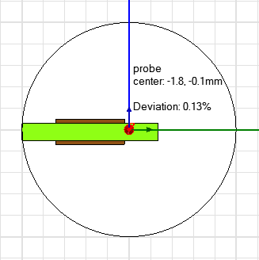
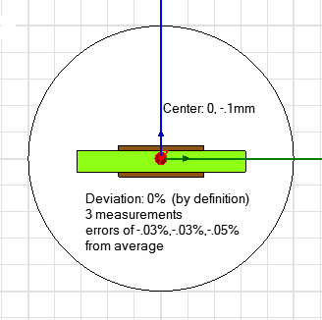
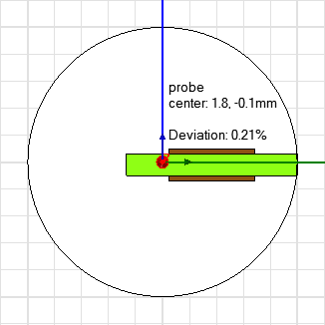
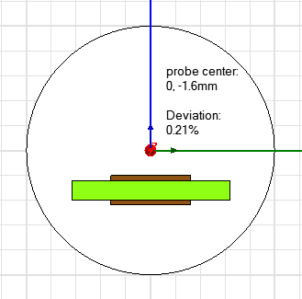
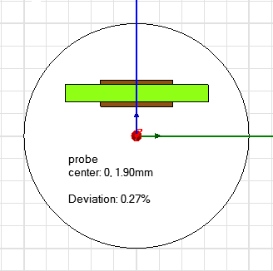
Pulsed Transverse Field Measurements with Bdot
Chamber cross section
-
-
Bdot probe
-
+
LCLS-II Kicker FDR, November 15, 2017

