Slide 1
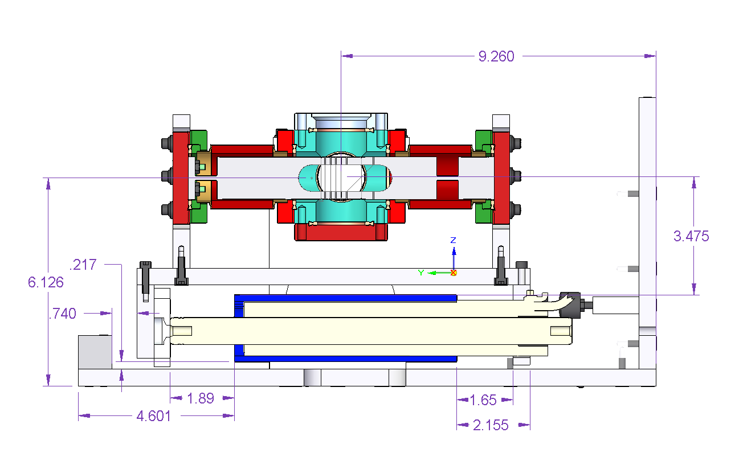
Measurements at Y = +/- 8 and +/- 9 cm
above and below Beam Axis.
+Y
+Z
+X
Measurement Coordinates
X = +8 cm

