Slide 1
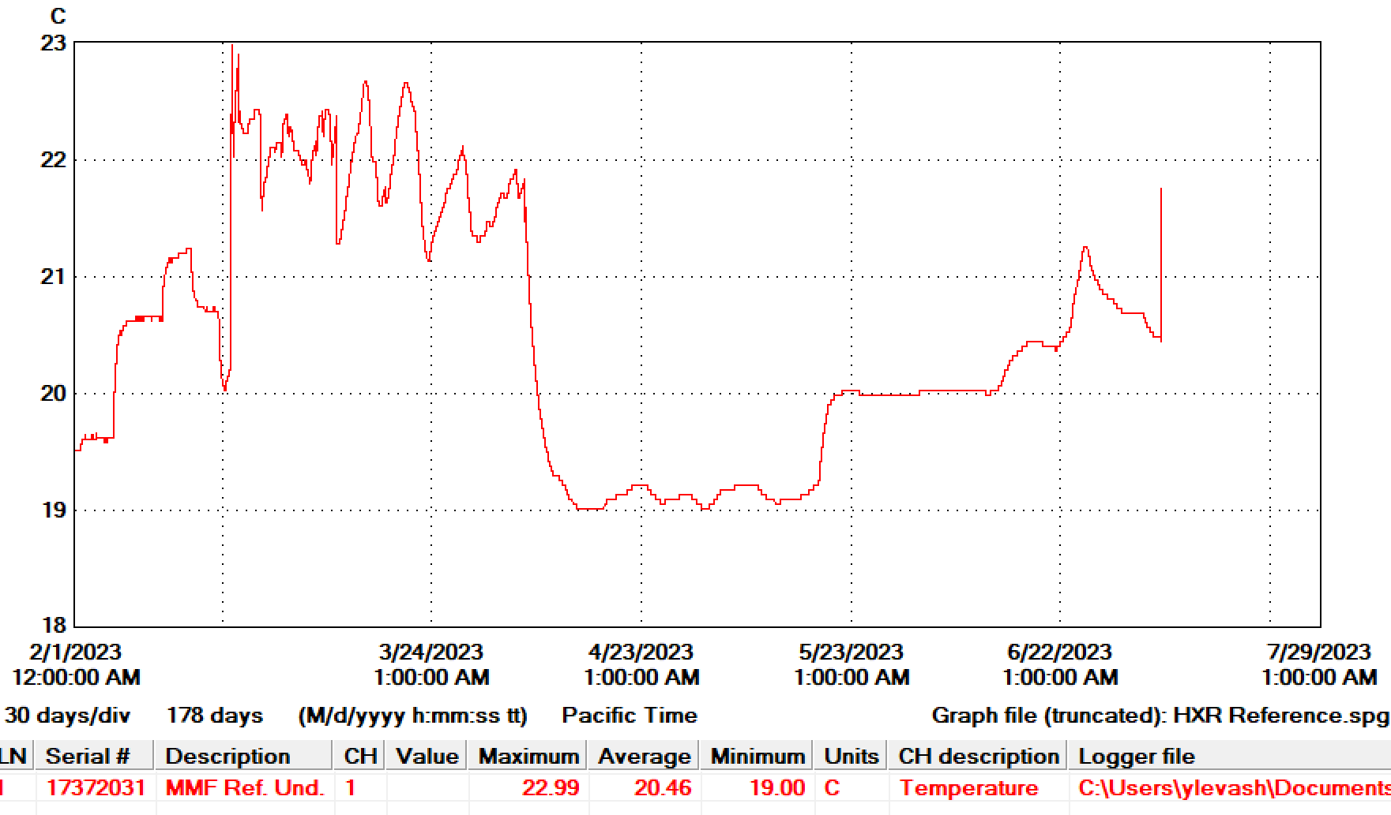
HXR Undulator temperature Log

Slide 2
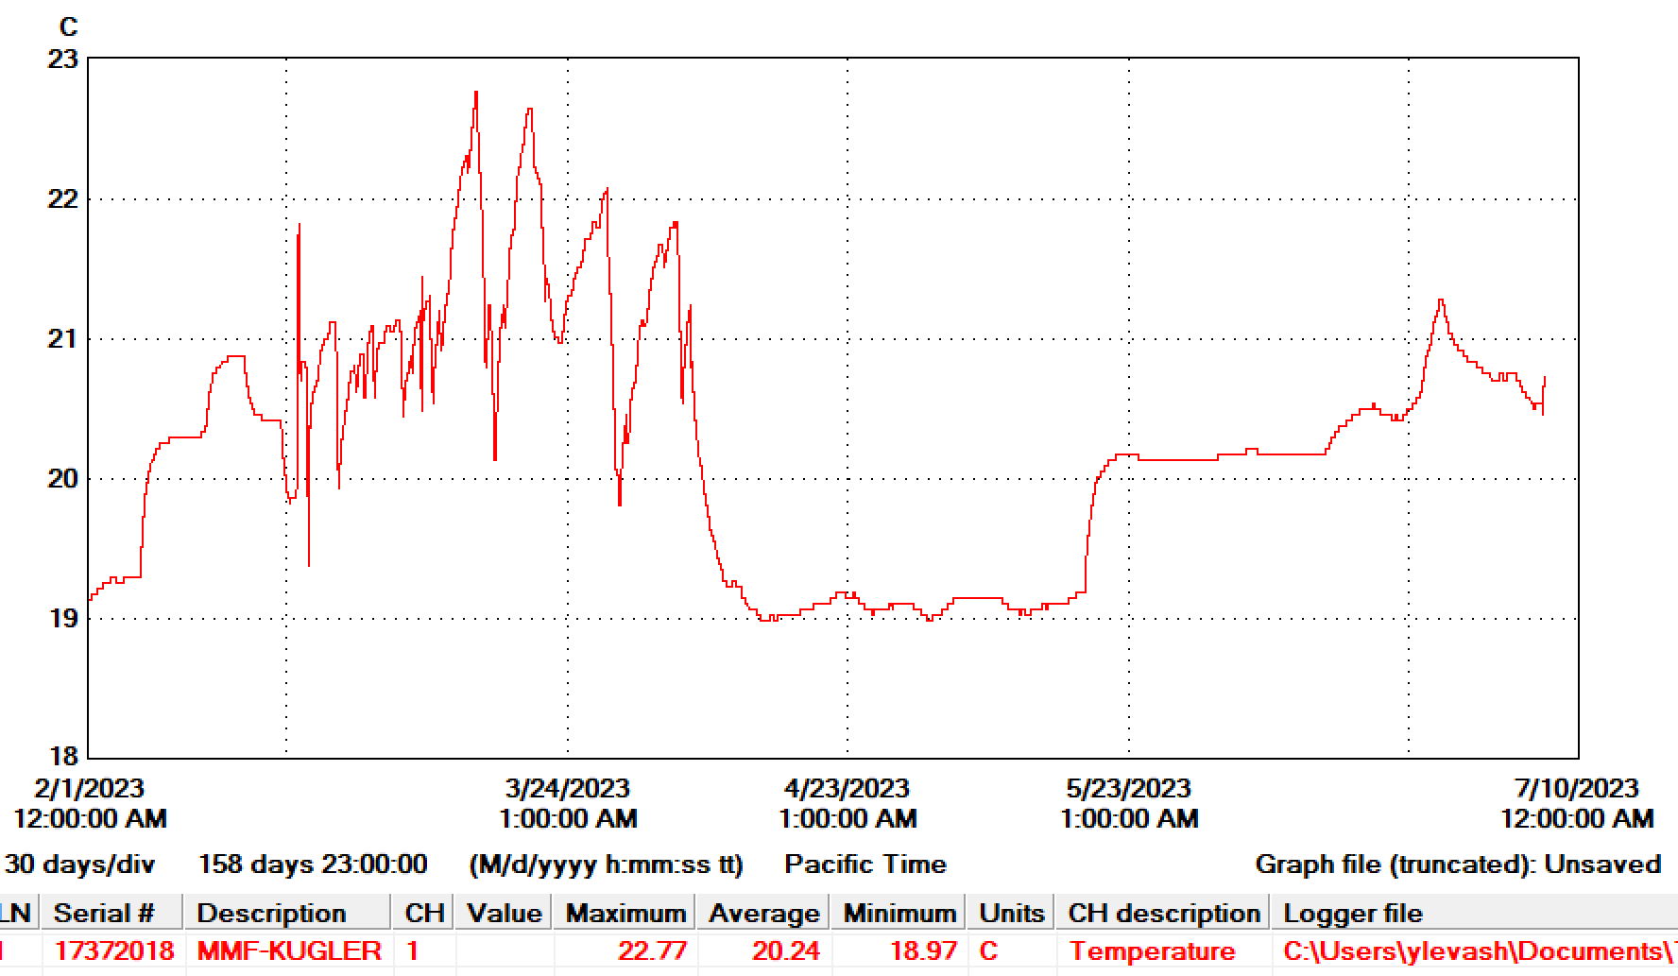
SXR Undulator temperature Log

