Slide 1
Tuning results
of HE-SXU-023
Yurii Levashov
07/09/2024

Slide 2
Outline
Field integrals
Hall probe measurements
MMF temperature
Midplane stability

Slide 3
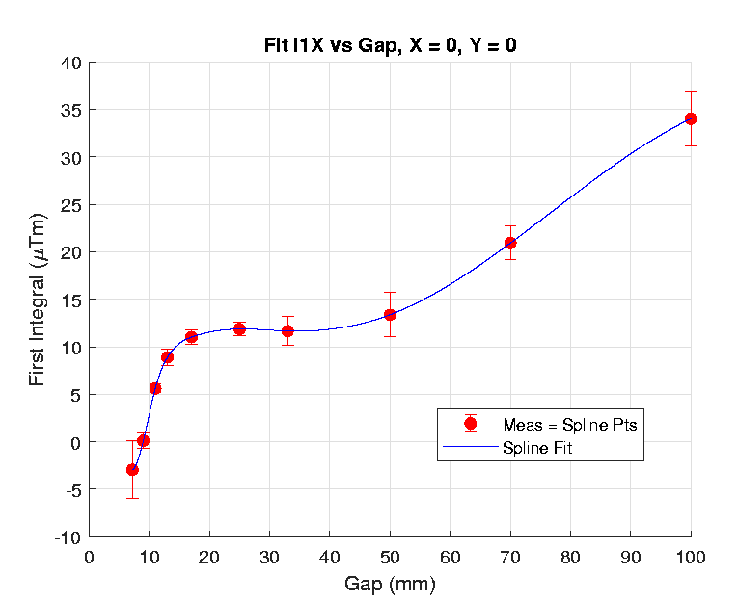
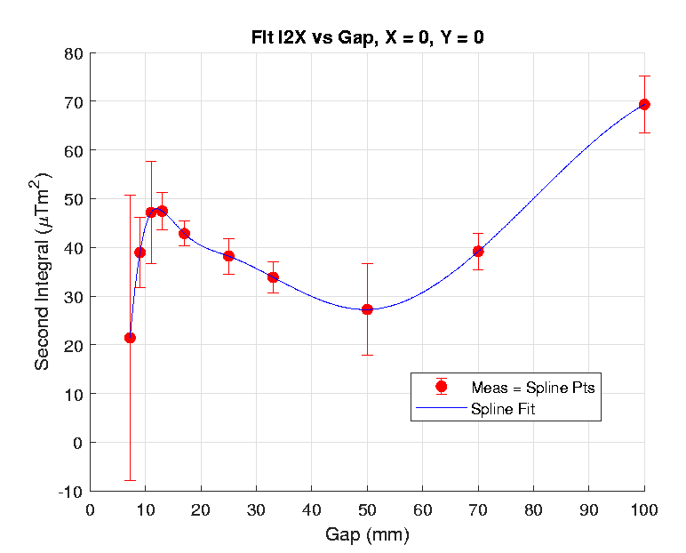
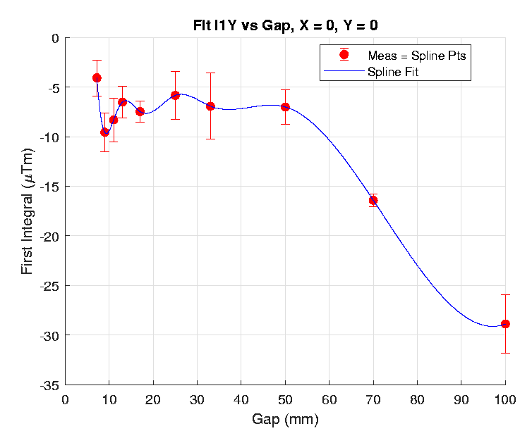
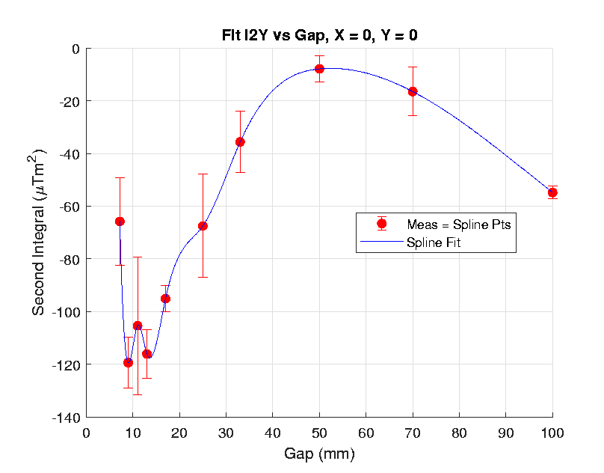
Field integrals
Tolerances:
First ±50µTm
Second ± 200µTm²

Slide 4
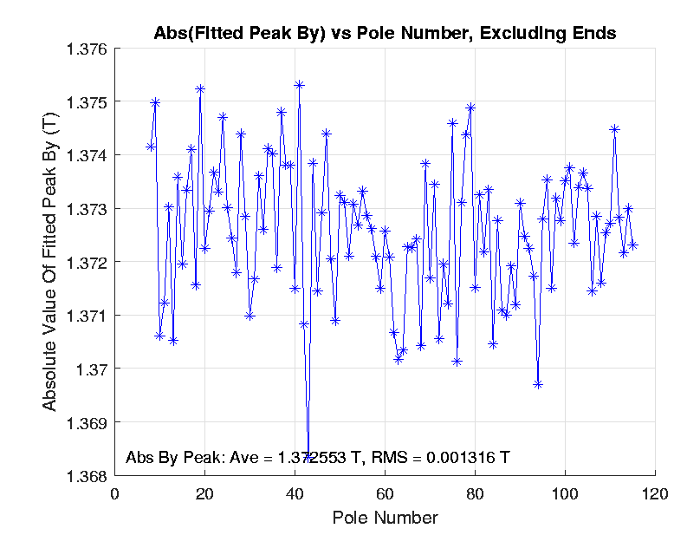
Hall probe measurements (10mm gap)
Peak field shake < 0.1% ( <0.25%)
Spacing between Field Peaks =27.999mm ( 28mm)
R.M.S < 20µm

Slide 5
Hall probe measurements (trajectories)

Slide 6
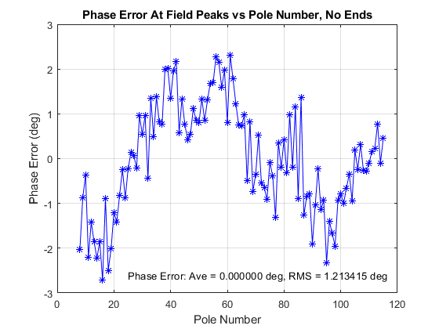
Hall probe measurements (phase errors)
Phase matching errors (<10°):
US = +2.3°
DS = -0.7°

Slide 7
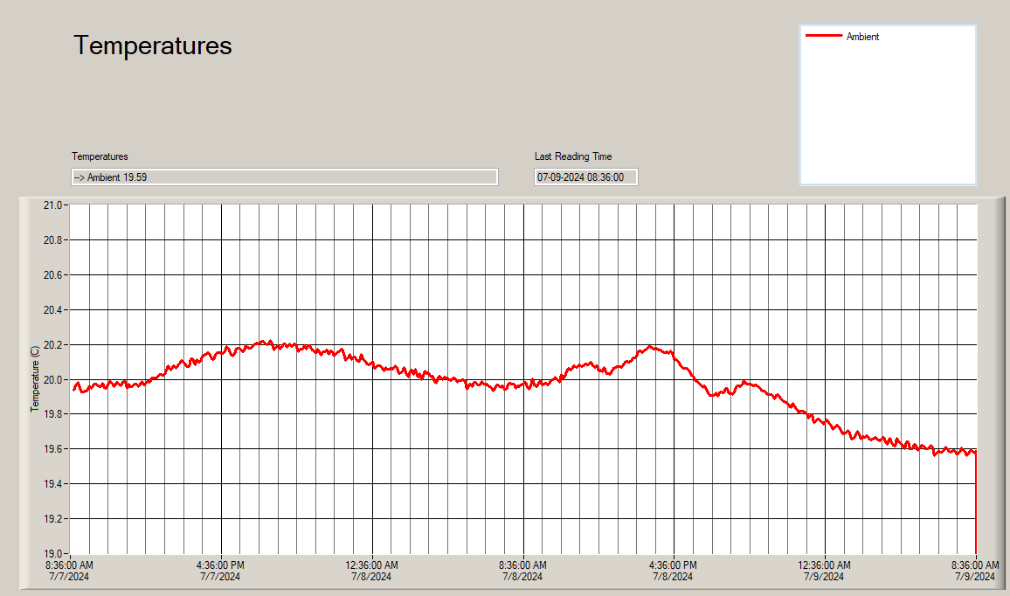
MMF temperature
Cannot do calibration measurements yet!

Slide 8
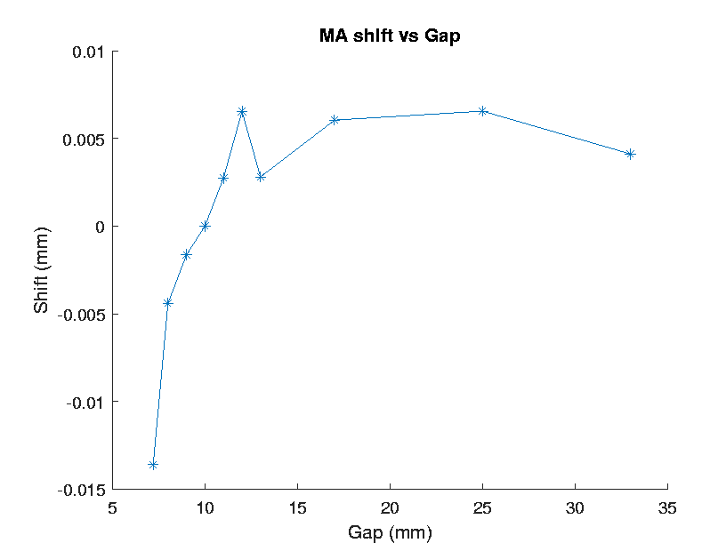
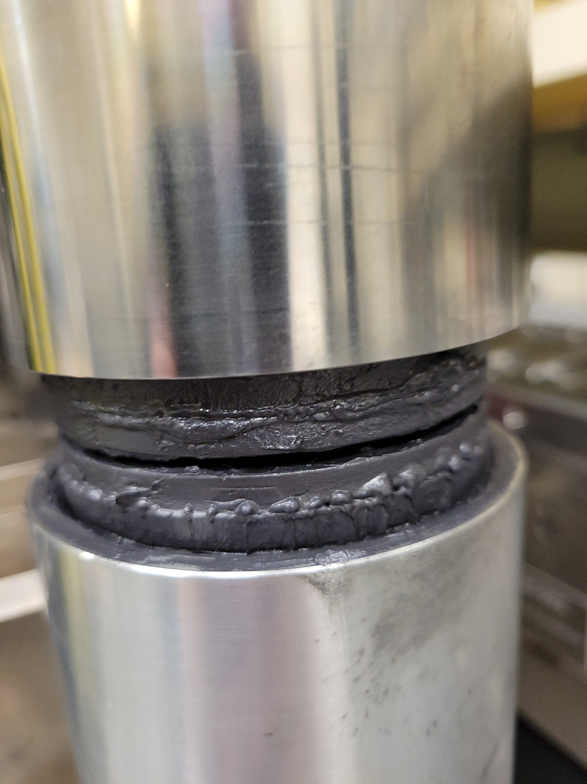
Midplane stability (corrections applied)
Extra gap cycling (4,500 gap settings) helped.

