Slide 1
First measurements
of HE-SXU-023
Yurii Levashov
06/04/2024

Slide 2
Outline
Mechanical measurement and alignment
Midplane encoder’s check
Magnetic measurements

Slide 3
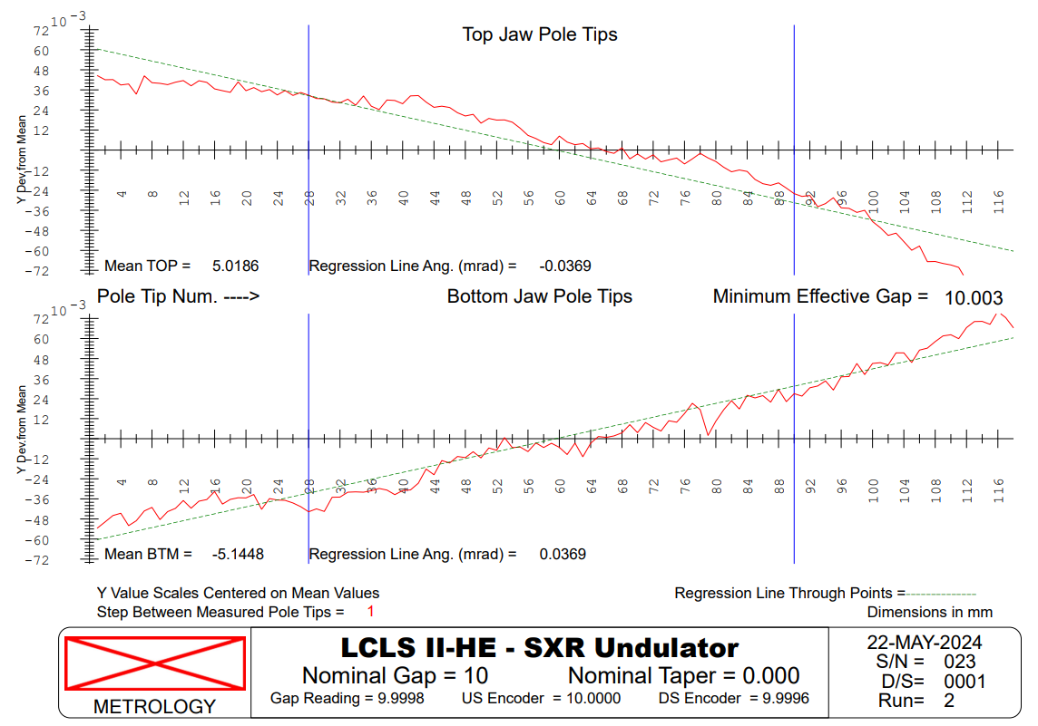
Mechanical measurements with touch probe,
Kugler bench.
After initial alignment on Kugler bench, first measurement
Corrected by motor encoders’ offsets

Slide 4
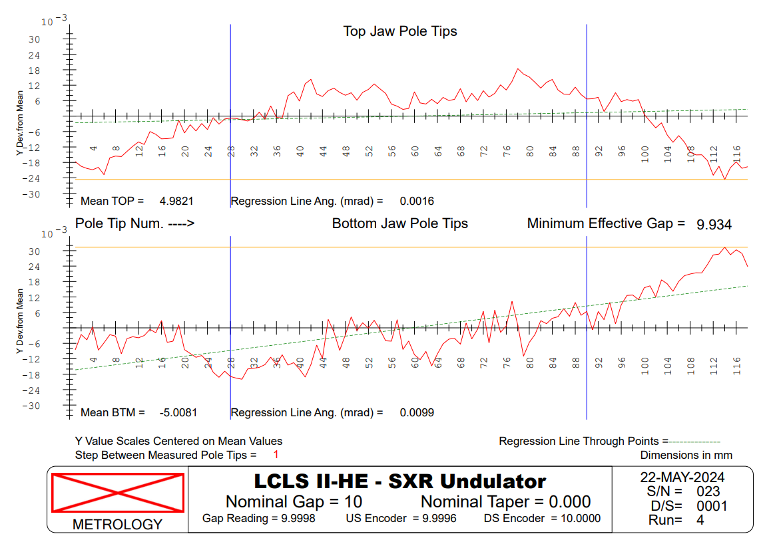
Mechanical measurements with touch probe, continue.
Pitch and taper corrected by changing encoders’ offsets.
Removing shims
between magnet
keepers and strongback
~25µm or less

Slide 5
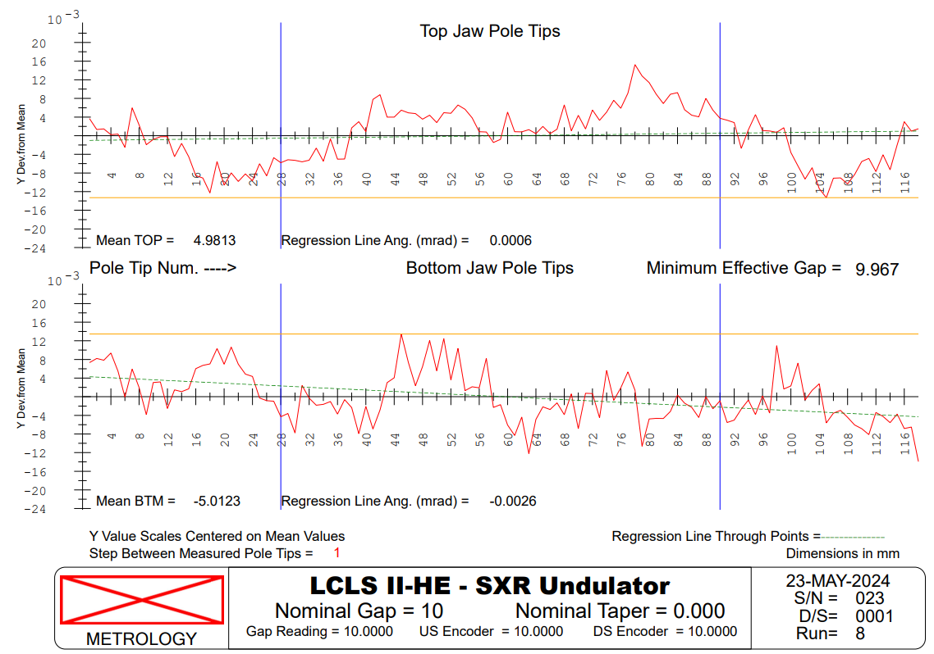
Mechanical measurements with touch probe, continue.
Final measurement
Jaws straight to
± 12µm.
Gap deviations
± 20µm.

Slide 6
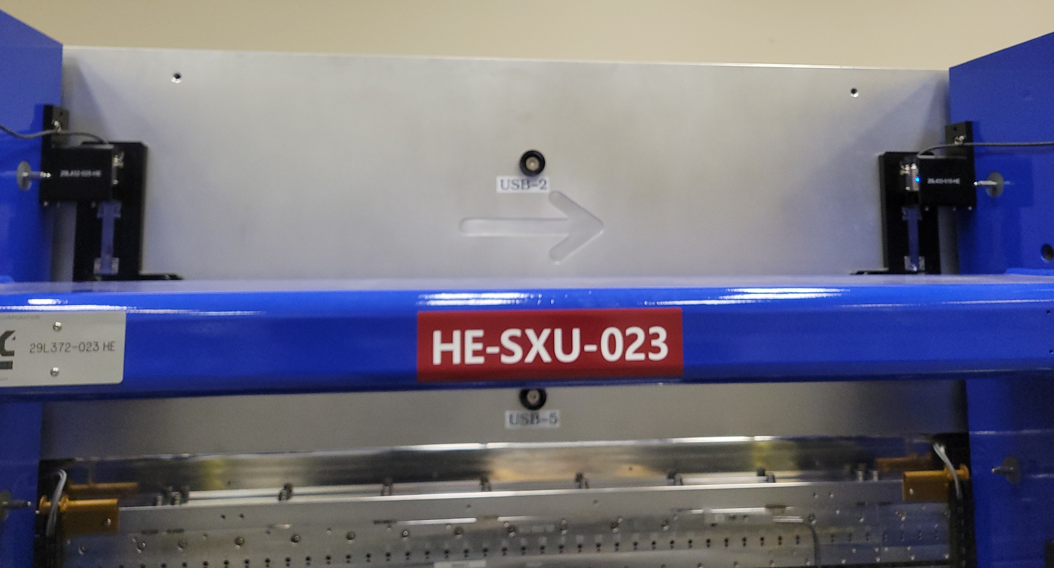
Midplane encoder’s test
Midplane encoders
Midplane encoders used to correct for undulator midplane shift vs. gap. By changing the gap offset.
Gap offset is calculated based on the difference between midplane encoders and gap encoders. Offset is corrected by a factor of 1.40
LCLS-TN-22-8 Z. Wolf, "HE-SXU Midplane Position Errors and Corrections." (October 2022)

Slide 7
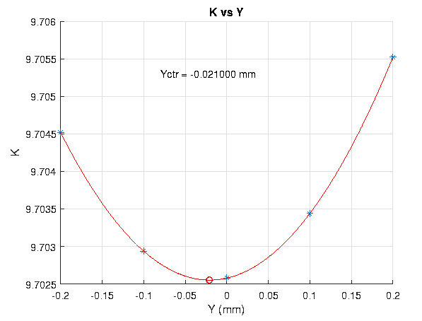
Midplane shift vs. gap
Not real, due to bad data fit.
Backlash in the drive system when motion direction reverses.

Slide 8
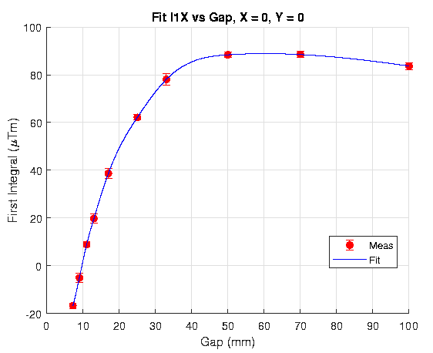
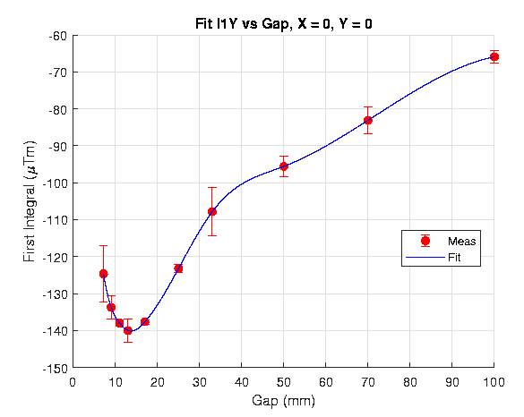
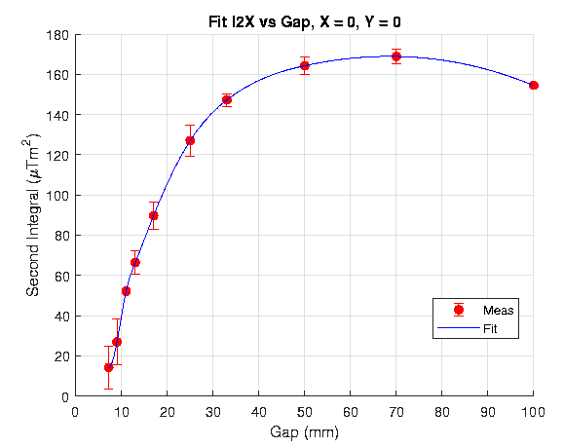
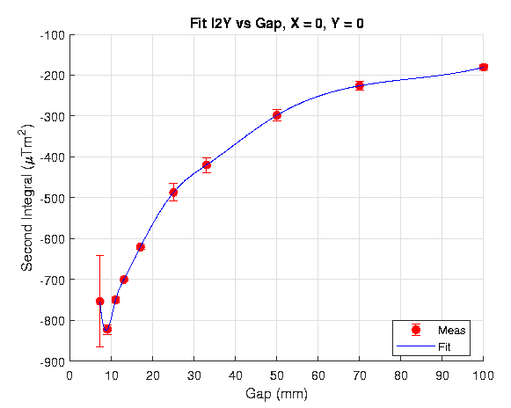
Magnetic Measurements, Field integrals
Bx
By
First integral tolerance:
±50 µTm
Second integral tolerance:
±200 µTm²

Slide 9
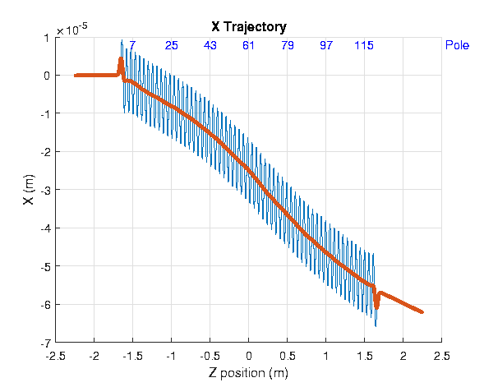
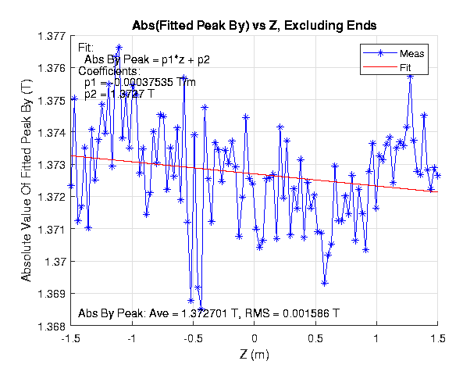
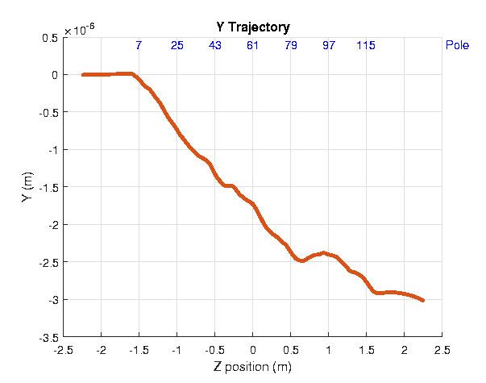
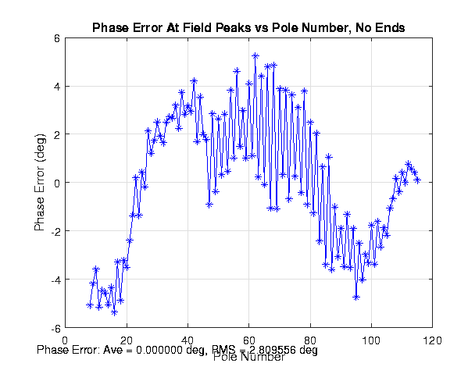
Magnetic Measurements, Hall probe, 10mm gap
RMS 0.12%,
tolerance <0.25%
Excellent sorting and mechanical assembly!
RMS 2.8°,
tolerance < 5°

Slide 10
Tuning

Slide 11
Tuning, continue
First round
6/3/2024
Location | Type of correction | Lower-Bench(Blue) | Lower-Aisle(Red) | Upper-Bench(Blue) | Upper-Aisle(Red)
Pole :5- Module#1 :Pole :5 | Pole Adjust: TB | +6 um | -6 um | -6 um | +6 um
Pole :6- Module#1 :Pole :6 | Pole Adjust: MB | +25 um | +25 um | +25 um | +25 um
Pole :18- Module#1 :Pole :18 | Pole canting: NQ | -25 um | +25 um | -25 um | +25 um
Pole :21- Module#1 :Pole :21 | Pole Adjust: MB | -25 um | -25 um | -25 um | -25 um
Pole :22- Module#1 :Pole :22 | Pole Adjust: MB | -25 um | -25 um | -25 um | -25 um
Pole :23- Module#1 :Pole :23 | Pole canting: NQ | +25 um | -25 um | +25 um | -25 um
Pole :45- Module#2 :Pole :3 | Pole Adjust: MB | +25 um | +25 um | +25 um | +25 um
Pole :46- Module#2 :Pole :4 | Pole Adjust: MB | +25 um | +25 um | +25 um | +25 um
Pole :80- Module#2 :Pole :38 | Pole canting: NQ | +25 um | -25 um | +25 um | -25 um
Pole :82- Module#3 :Pole :2 | Pole Adjust: MB | +25 um | +25 um | +25 um | +25 um
Pole :83- Module#3 :Pole :3 | Pole Adjust: MB | +25 um | +25 um | +25 um | +25 um
Pole :84- Module#3 :Pole :4 | Pole canting: NQ | -25 um | +25 um | -25 um | +25 um
Pole :86- Module#3 :Pole :6 | Pole Adjust: MB | +25 um | +25 um | +25 um | +25 um
Pole :87- Module#3 :Pole :7 | Pole Adjust: MB | +25 um | +25 um | +25 um | +25 um
Pole :91- Module#3 :Pole :11 | Pole Adjust: MB | +19 um | +19 um | +19 um | +19 um
Pole :94- Module#3 :Pole :14 | Pole canting: NQ | -25 um | +25 um | -25 um | +25 um
First round
6/3/2024
Location | Type of correction | Lower-Bench(Blue) | Lower-Aisle(Red) | Upper-Bench(Blue) | Upper-Aisle(Red)
Pole :7- Module#1 :Pole :7 | Small slugs: MB | 3 slugs, away | 3 slugs, away | 3 slugs, towards | 3 slugs, towards
Pole :15- Module#1 :Pole :15 | Slugs: TB Ver | 2 towards | 2 away | 2 towards | 2 away
Pole :46- Module#2 :Pole :4 | Small slugs: MB | 3 slugs, away | 3 slugs, away | 3 slugs, towards | 3 slugs, towards
Pole :73- Module#2 :Pole :31 | Slugs: TB Ver | 2 towards | 2 away | 2 towards | 2 away
Pole :98- Module#3 :Pole :18 | Slugs: TB Ver | 2 towards | 2 away | 2 towards | 2 away

