Slide 1
HE-SXU-023 final measurement results
Yurii Levashov
08/13/2024

Slide 2
Outline
Tuning
Measurement results
Peak fields and trajectories
Phase errors
K vs gap
Field Integrals vs gap
Phase errors vs gap
Summary

Slide 3
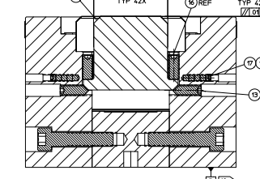
Tuning
Started: 5/20/2024 Finished: 8/8/2024
Five tuning iterations required
(remembering how to do it and technician training).
Poles adjusted: 49 x 2 (top & bottom) = 98
Slugs installed: Large – 11 places x 2 x 4 = 66
Small – 6 places x 3 x 4 = 72
Midplane shift solved by cycling the gap
(~5000 gap settings).
Adjustment screws
Locking screws
Two SS shims 0.006” thick used to keep poles in place.

Slide 4
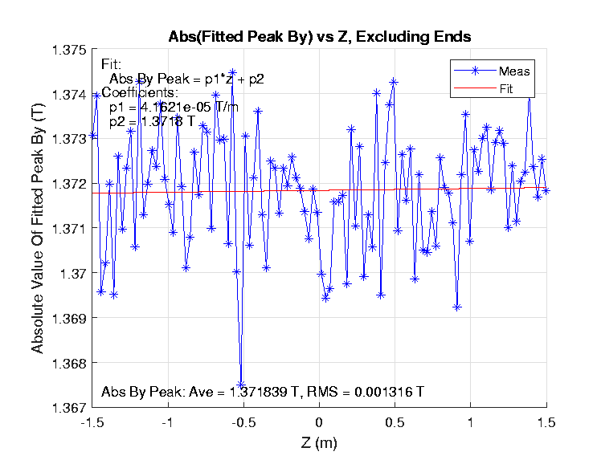
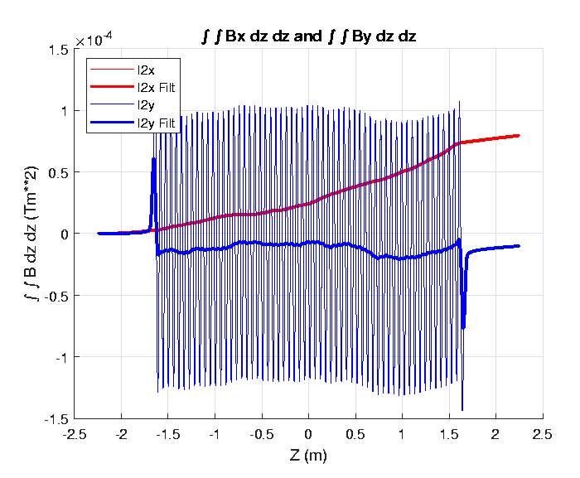
Peak fields and trajectories
Gap = 10mm (tuning gap)
Taper is small = 0.4G/m B_{y} Peak shake = 0.096% (tolerance 0.25%)
Peak Field Spacing: Ave = 0.027999 m, RMS = 0.000016 m Average Undulator Period = 0.055998 m

Slide 5
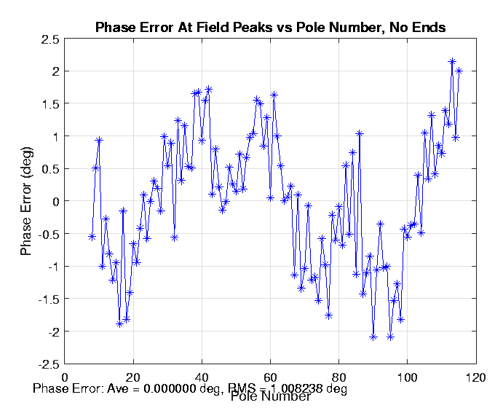
Phase errors
Gap = 10mm (tuning gap)
Phase matching:
commissioning gap = 16.580mm
K = 4.2899 (nominal = 4.29)
Phase error entrance = +1.5°
Phase error exit = +0.6°

Slide 6
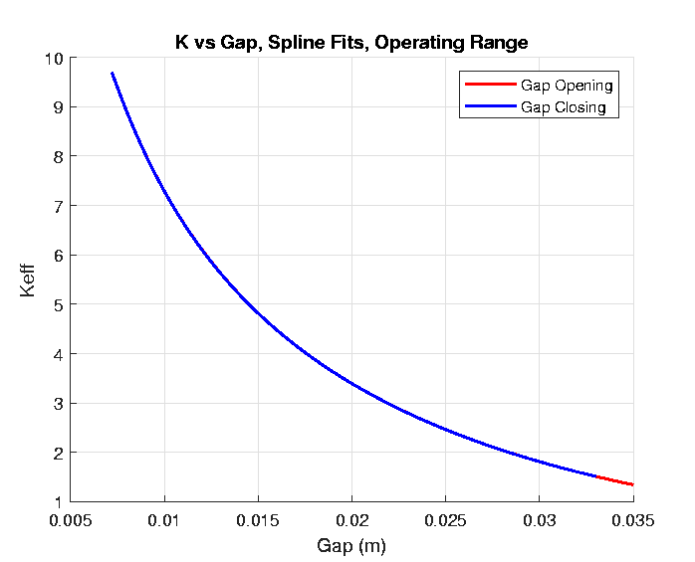
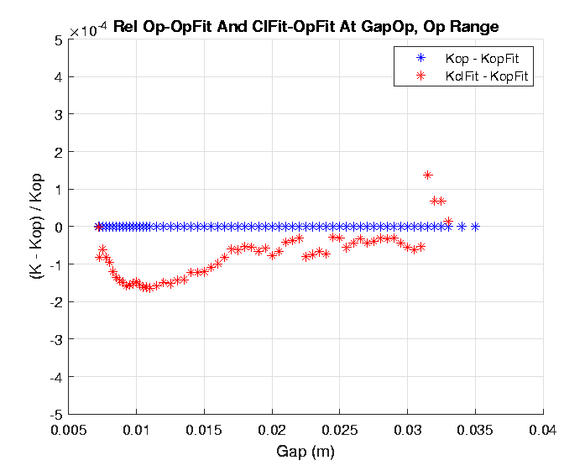
K vs gap
At 7.2mm gap K = 9.6977 (nom. 9.26; 4.7%)
K roll-off at 7.5mm gap = 3.4 ∙10⁻⁴ (<5 ∙10⁻⁴)
Hysteresis is small. For SXUs - up to 4∙10⁻⁴

Slide 7
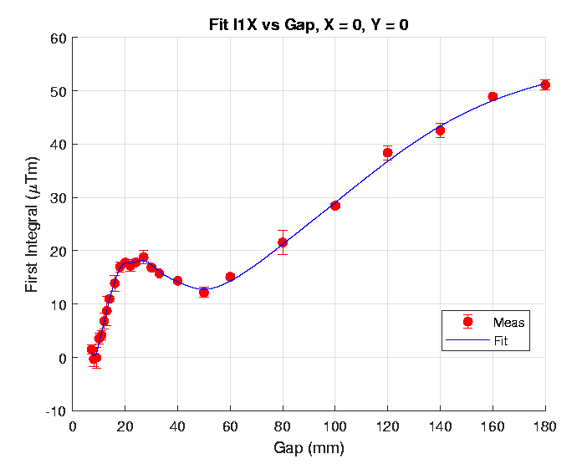
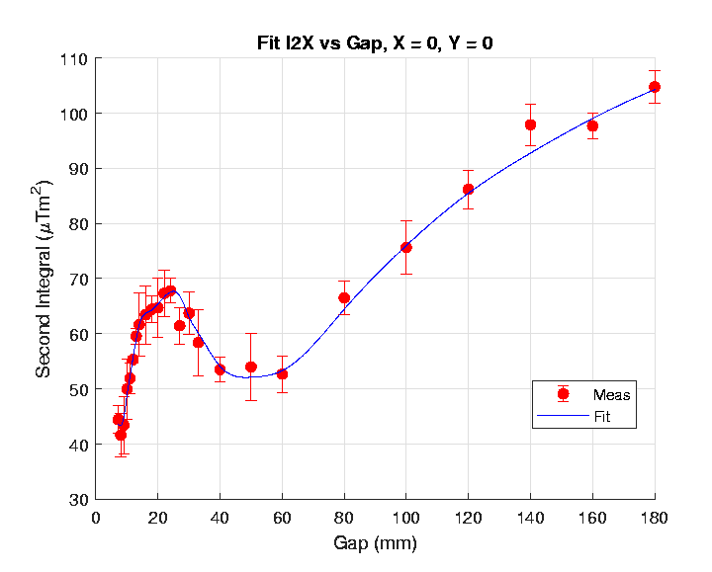
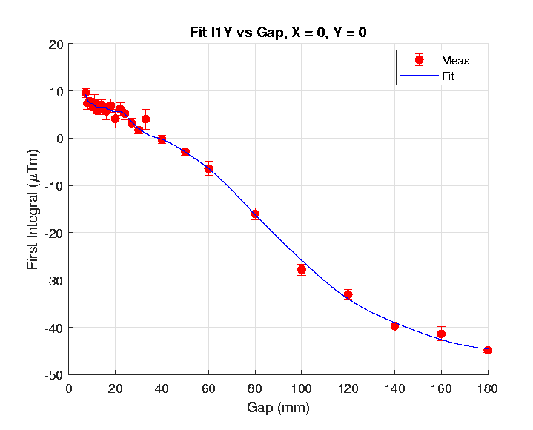
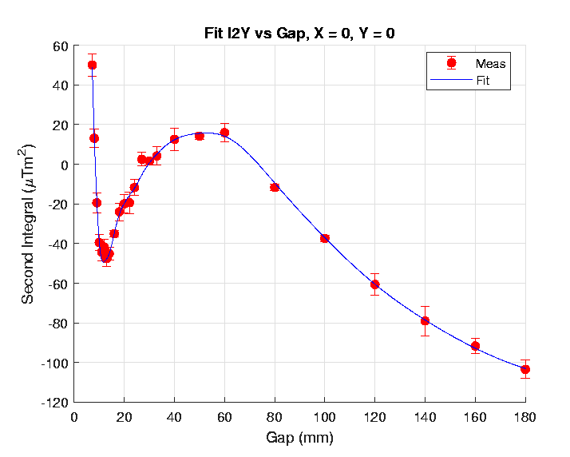
Field integrals
Tolerances (operational gap range 7.2÷33mm) :
First Integral < ±50µTm
Second Integral < ± 200µTm²

Slide 8
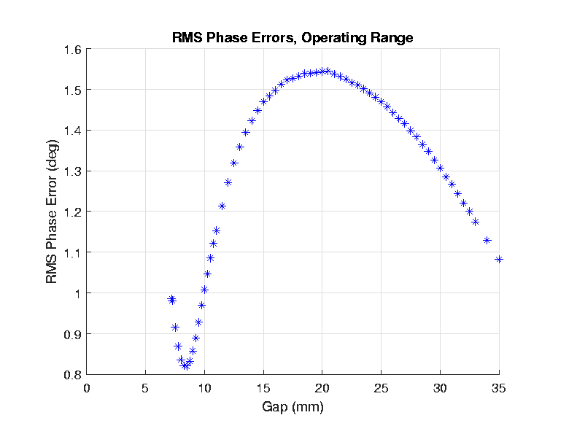
Phase errors vs gap
Tuned at 10mm gap

Slide 9
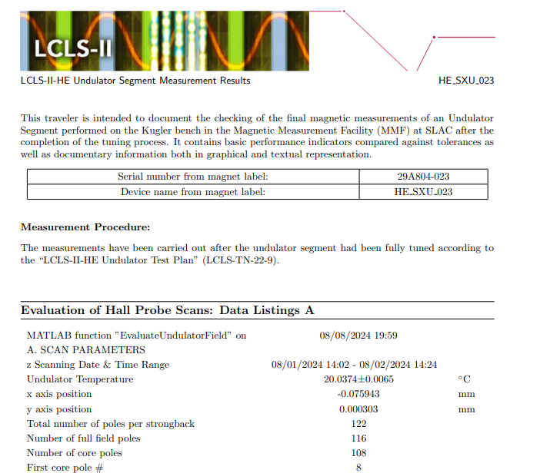
Summary
The HE-SXU-023 is tuned to tolerances and calibrated.
It required 5 tuning iterations. No issues.
Gap cycling (5,000 gap changes) added to tuning procedure.
Final report is on SLAC v-drive:
V:\MET\MagServe\MagData\LCLS-II-HE\Undulator\ HE_SXU_023\ DATASET0001\Final Results\ 2024-08-08 HE-SXU-023 Tuning Results Traveler_signed.pdf
By: H-D. Nuhn

