Slide 1
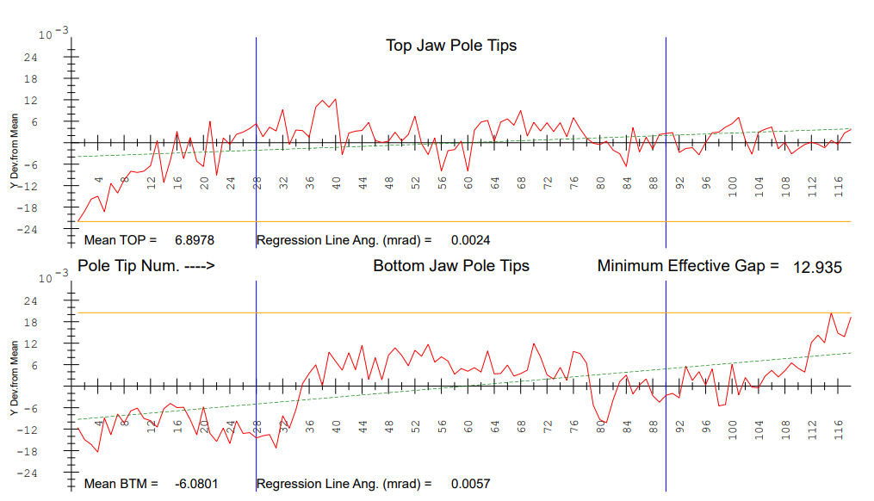
CMMM measurements agree well with touch probe measurements
Frame support postions
Touch Probe after pitch correction
Corrected by shimming

Slide 2
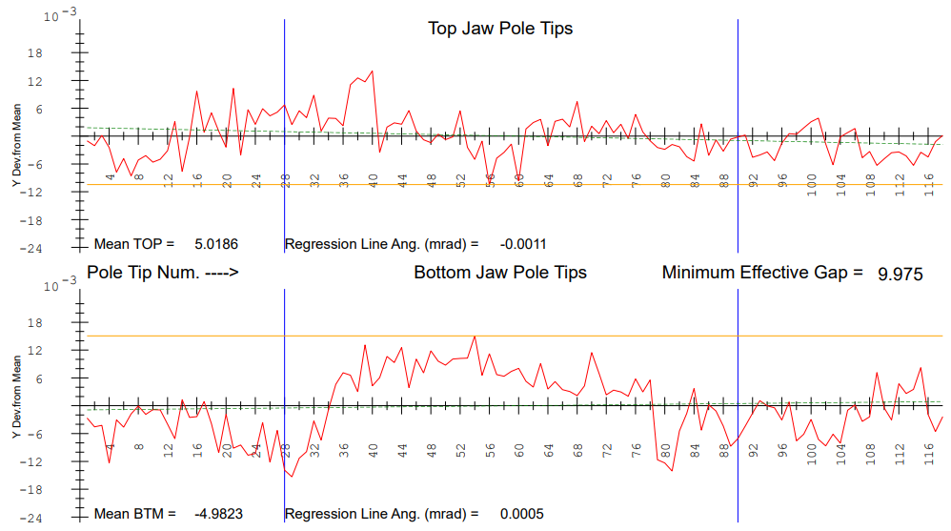
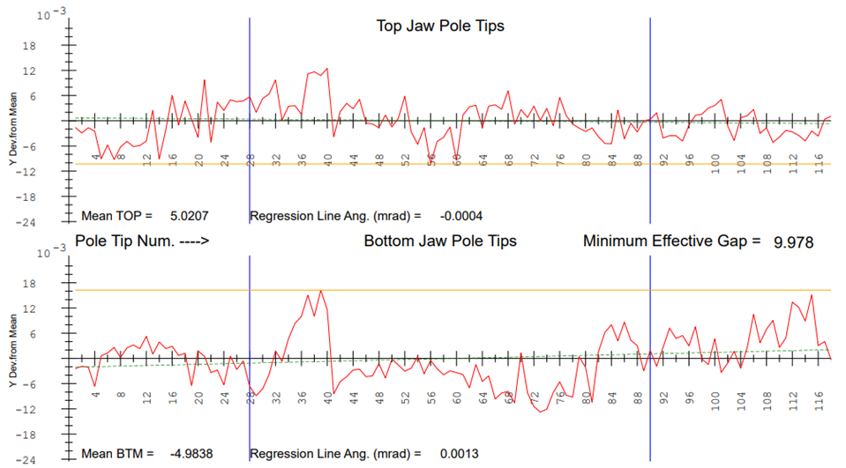
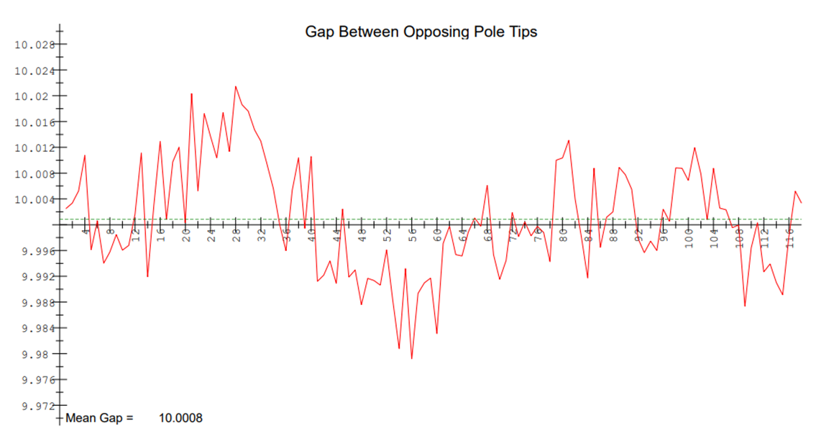
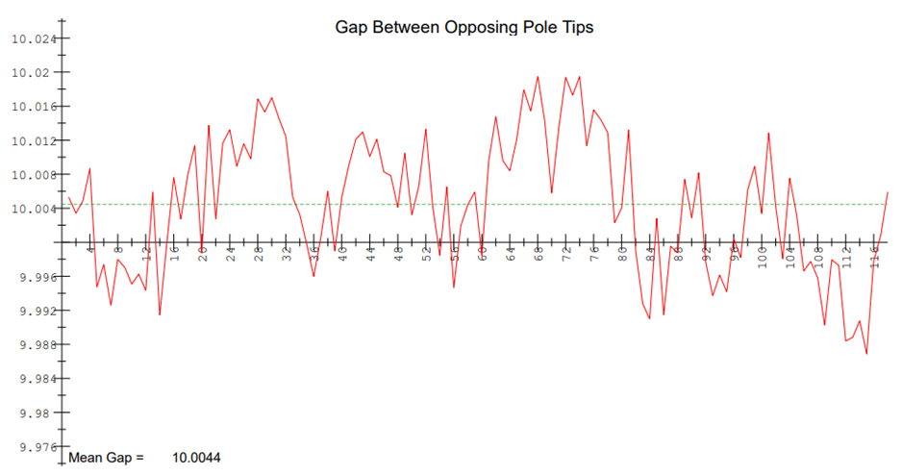
Touch Probe after ends correction
Touch Probe final
Corrected to remove gap waviness
No Access to screws to correct

Slide 3
1. Gap center shift is
~ 100µm as expected.
2. Pitch is small.
3. Change in average gap indicates the strongbacks bending.
4. Taper is at the measurement error level.

