Slide 1
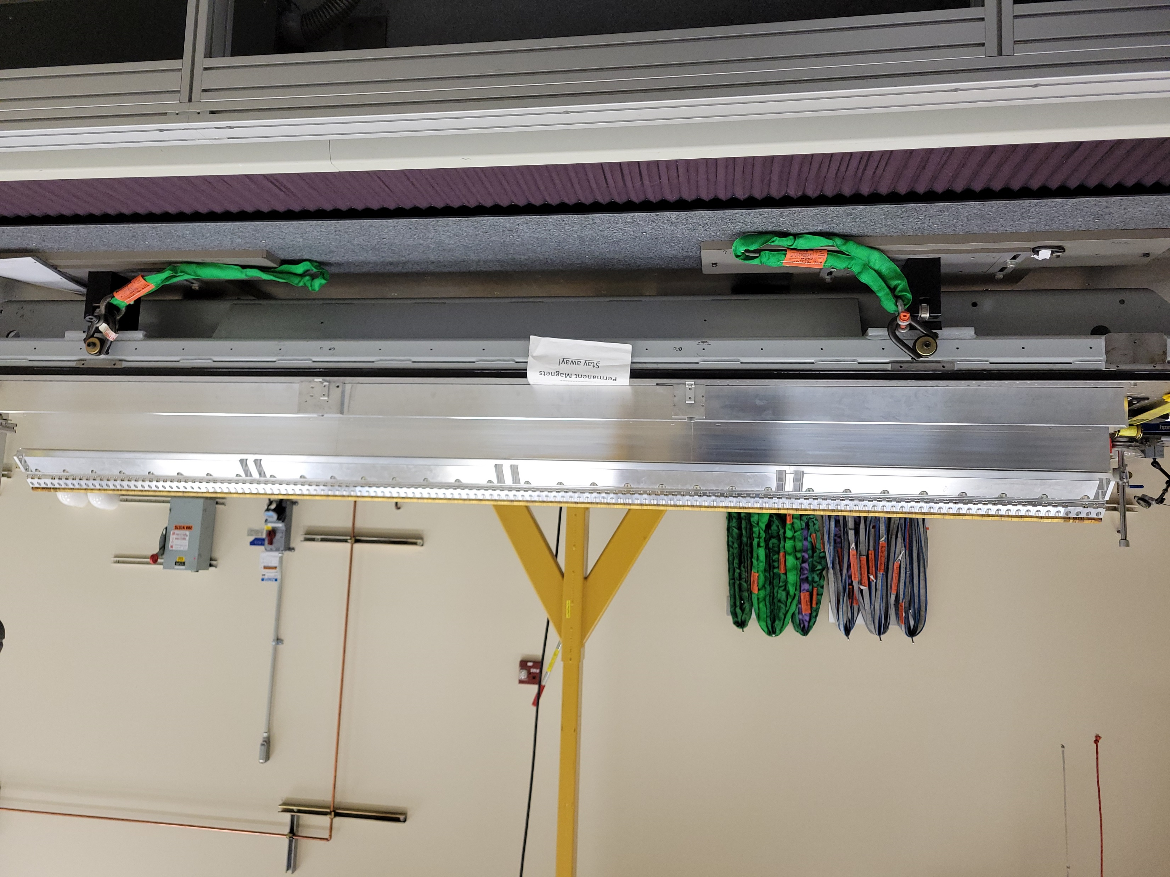
DS
Y
Y
Y
Y
Y
Y
Y
Y
Y
US
+Z
X
X
X
X
X
X
X
X
X

Slide 2
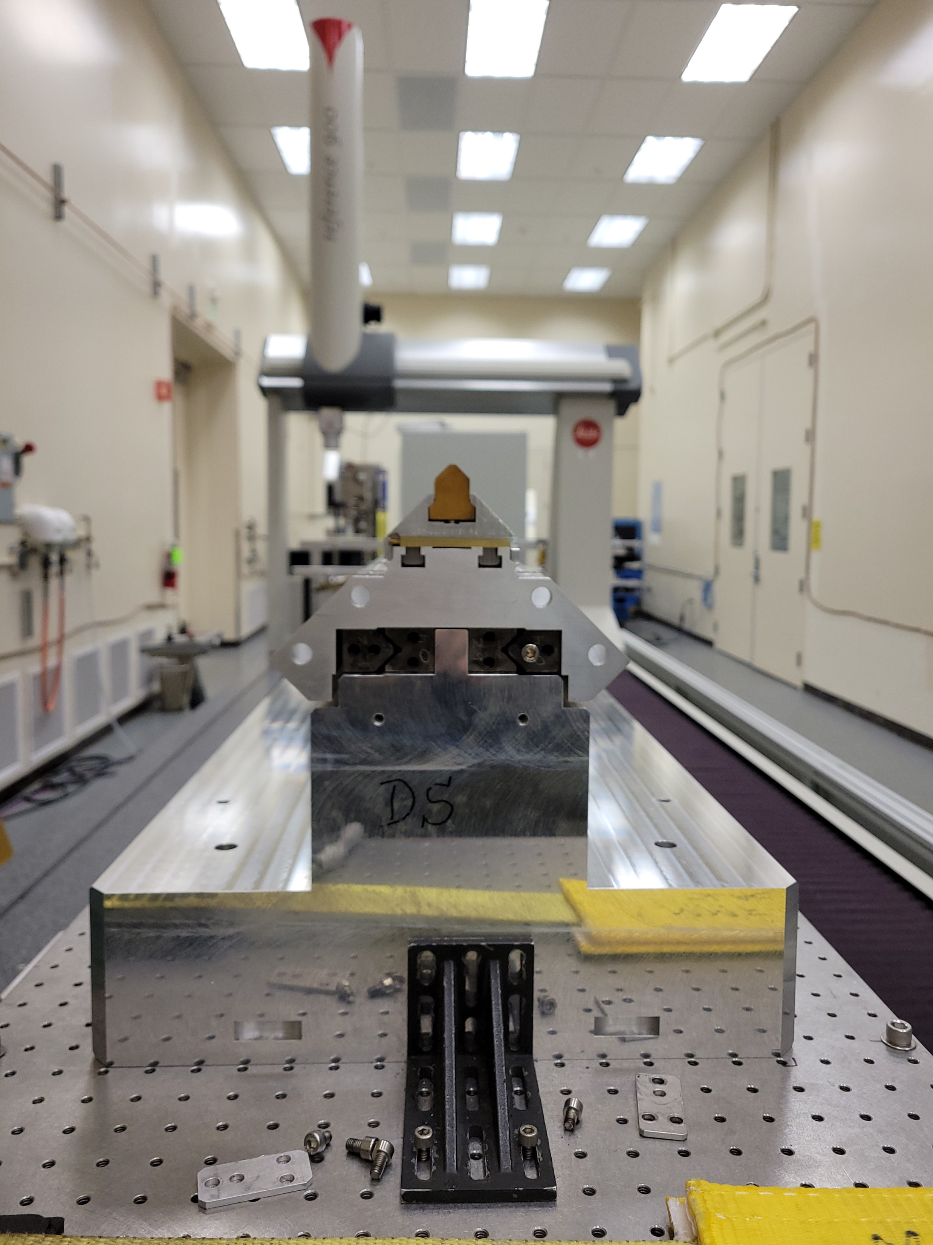
Reference surfaces
Pre-loading screws
-Y
+X
-X
-Y

Slide 3
Shims added (from 0.006” to 0.0025”)
Carrier 1
Carrier 2
Carrier 3
Carrier 4
Tuning fixture
Tuning fixture
Tuning fixture

