Slide 1
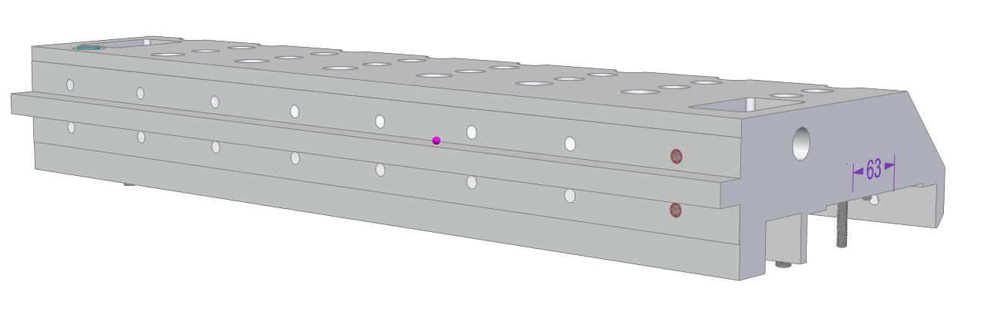
Step 1
Install 16 x Key Locking Inserts M8 x 1.25 / M12 x 1.25
Check nothing sticks out, if then please flatten the surface
Check the hole deepness using an M8 x 1.25 x 30 mm screw

Slide 2
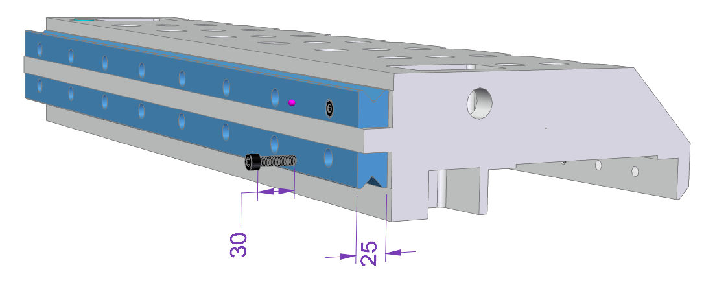
Step 2
Leave this hole open
Install two M-rails (25 mm version)
Using 15 x McMaster 91290A434 Class 12.9 Head Cap Screws M8 x 1.25 x 30mm
Torque: 12-15 Nm, before tightening, squeeze the rails together with a clamp

Slide 3
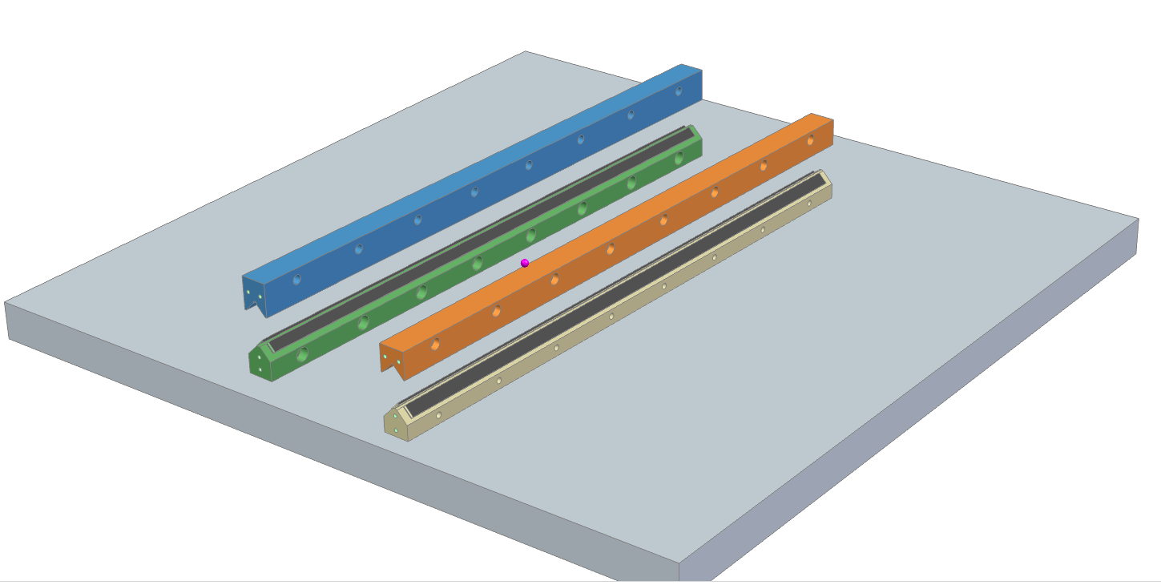
Step 3
Put a set of rails on a granite table
Install one needle cage with motion control between each pair
Rail 74 x 35 Type M
Rail 60 x 35 type M
Rail 74 x 35 Type V
Rail 60 x 35 Type V
Linear Bearing Cage
Needle (d=3 mm)
With Motion Control *
Linear Bearing Cage
Needle (d=3 mm)
With Motion Control *

Slide 4
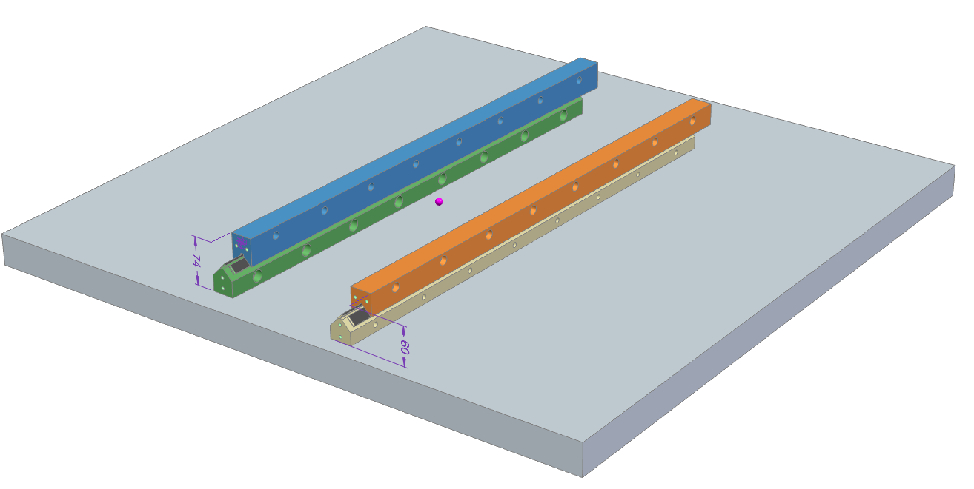
Step 4
Move the upper rails + - 40 mm and check the needle cage motion is correct
The needle cage moves 20 mm, if the upper rail moves 40mm
You should not see the needle cages
outside as it is shown here !

Slide 5
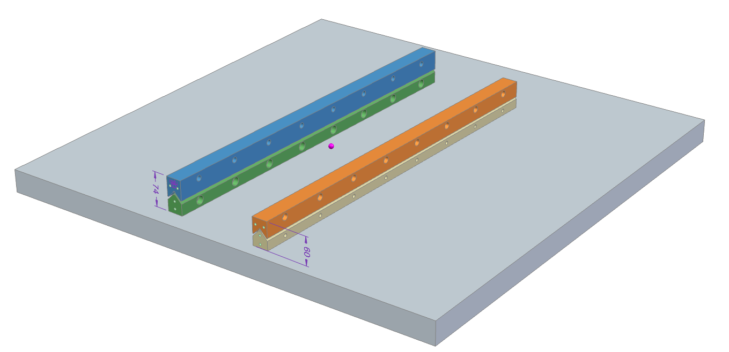
Step 5
The needle cages should be centered
Which means on both sides the same space to the rail ends
Be aware of the rail counter bore hole directions!

Slide 6
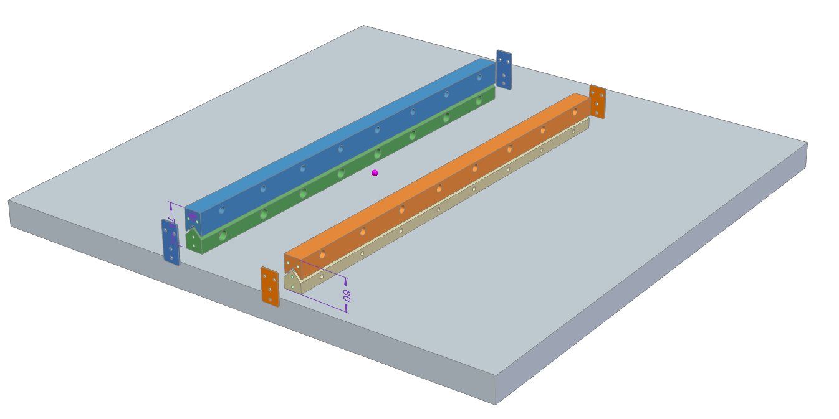
Step 6
Install four temporary end plates
and fix the rail pairs together.
We need to fabricate the four
end plates. I will send a drawing to Ralf

Slide 7
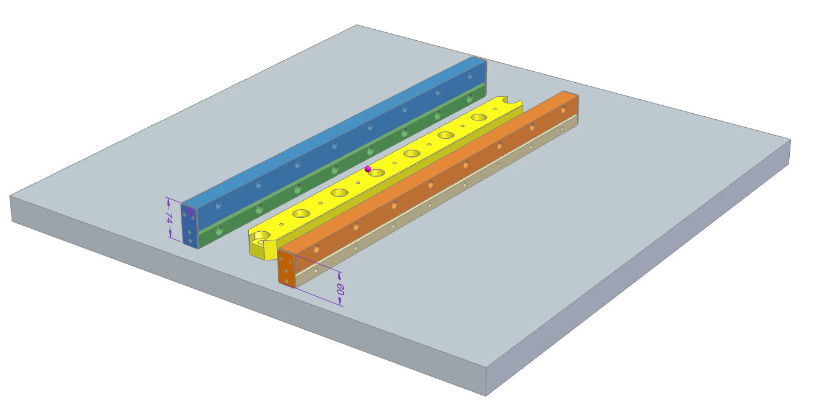
Step 7
Use a rail spacer between the rails

Slide 8
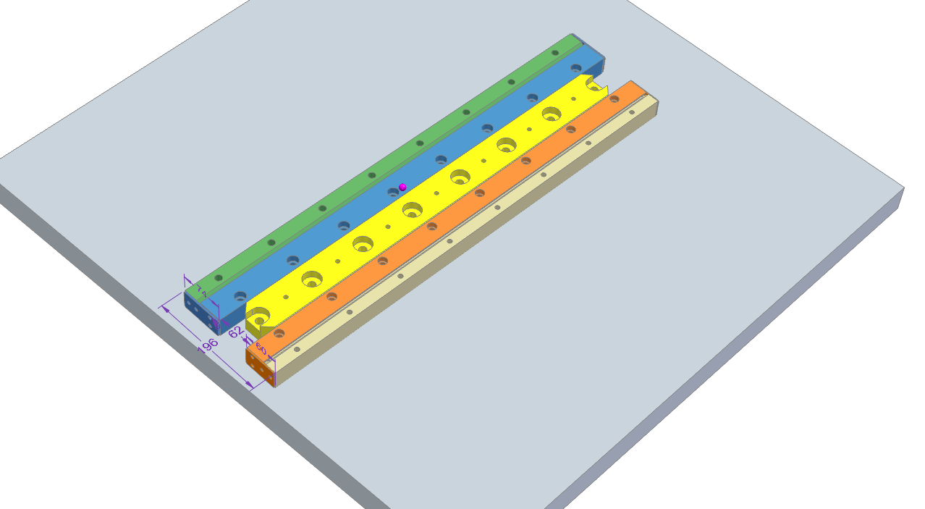
Step 8
Turn the rail sets as shown and move them to the rail spacer
The distance > side to side < is now 196 mm

Slide 9
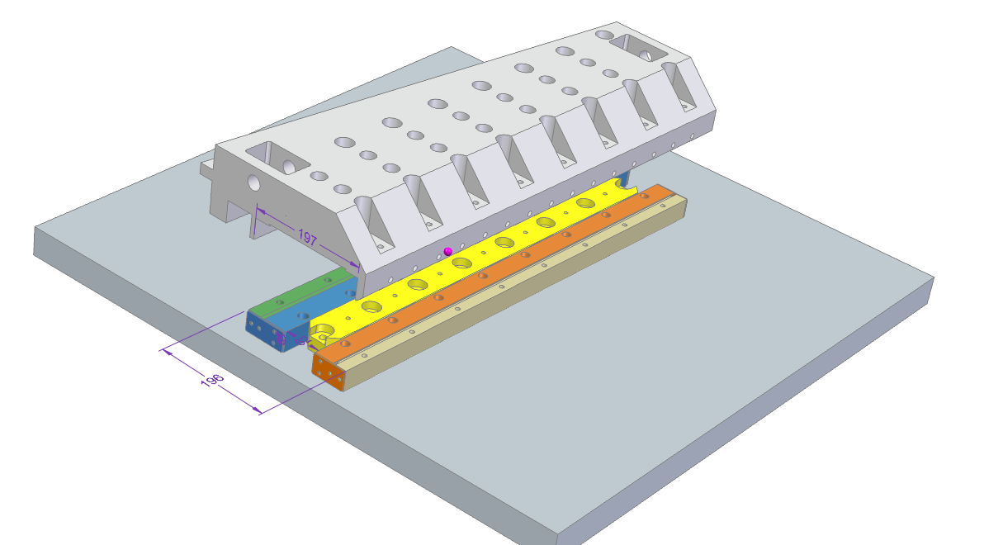
Step 9
Drop the main carrier (100 lbs.)
Down to the granite block
“We should use some kind
of lifting tool??”

Slide 10
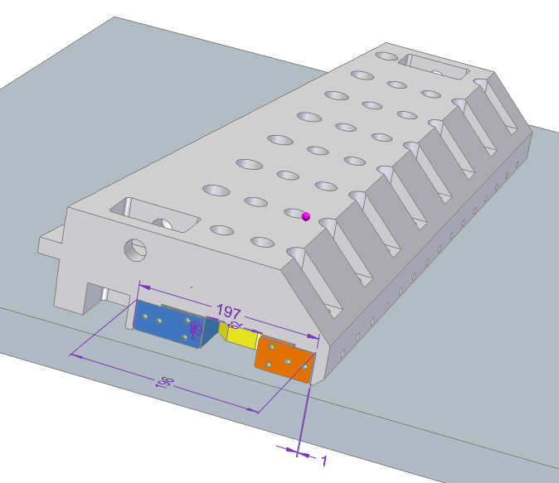
Step 10
The main carrier rest on the granite block
and may be on the rails too.

Slide 11
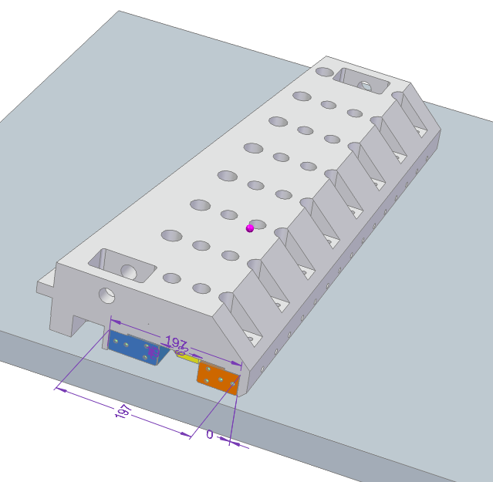
Step 11
Move the rail set (60 x 35) to the right
Until it hits the carrier inside wall
The 1 mm space is now between the
rail spacer and the 60x 35 mm rail set

Slide 12
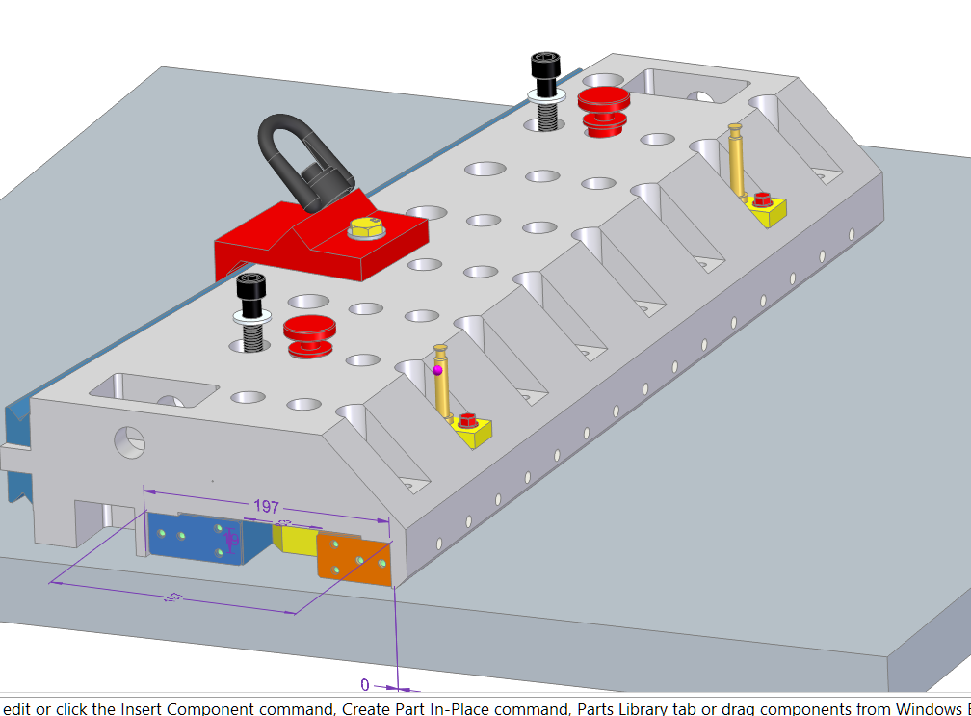
Step 12
Install the Yellow, Black and Red parts to connect
the rail sets with the carrier
Install the lifting bracket
Ralf has made these parts
McMaster 91280A798 M14 x 2 x 120
Ralf has made these parts

Slide 13
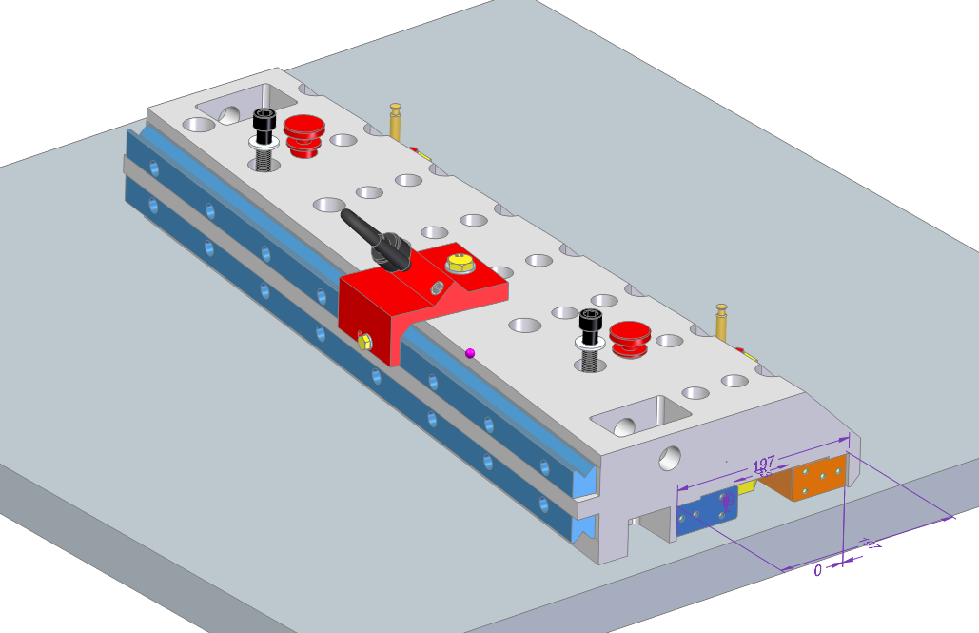
Step 13
Just another view to show how the lifting bracket is connected
McMaster 3005T720 STL hoist ring
McMaster 91290A475
Class 12.9 M14 x2 x 60
McMaster 91455A470 steel
Washer ID 15, OD 28
McMaster 91280A798 M14 x 2 x 120
McMaster 91287A154
M8 x 1.25 x 45
McMaster 91290A475
Class 12.9 M14 x2 x 60
McMaster 91455A470 steel
Washer ID 15, OD 28

Slide 14
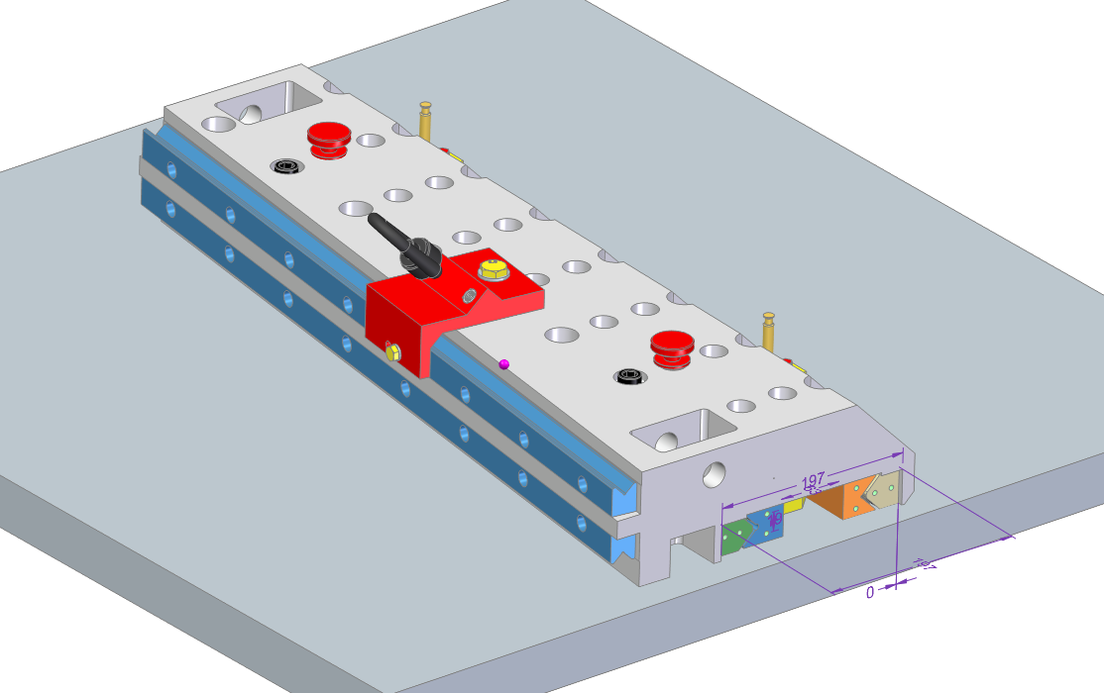
Step 14
Remove the four temporary rail plates from
both ends of the rail sets.

Slide 15
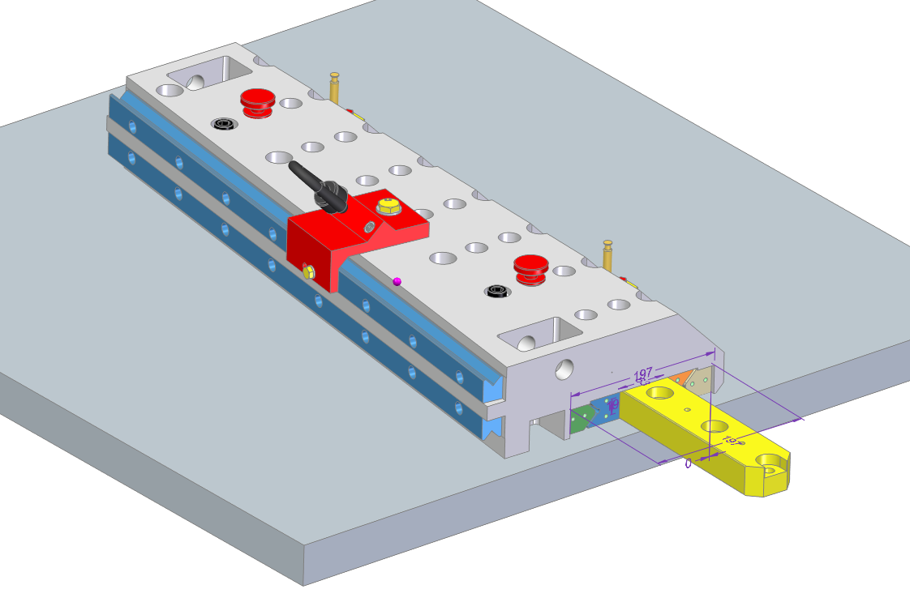
Step 15
Take the rail spacer away

Slide 16
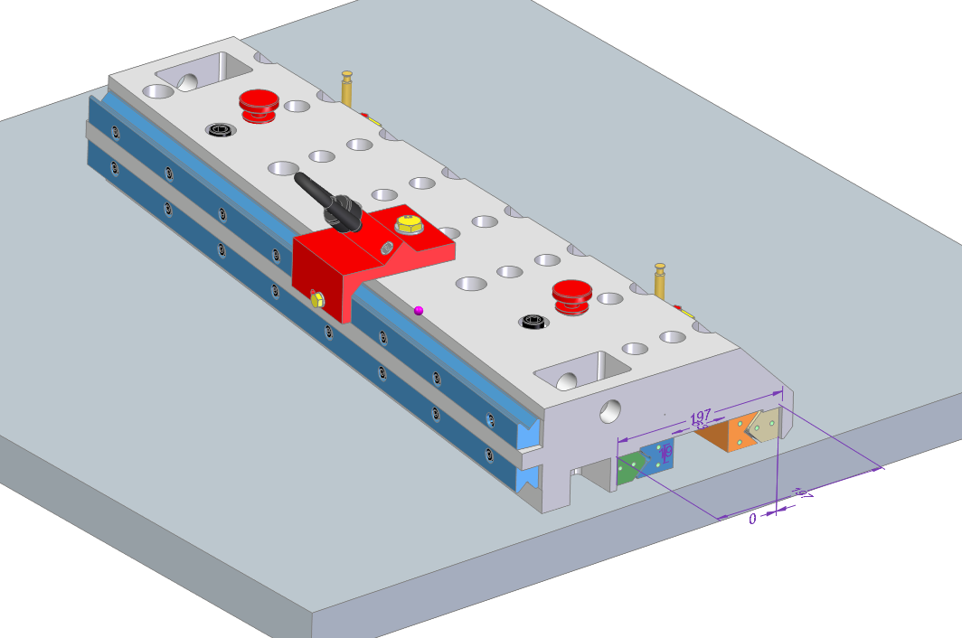
Step 16
The carrier is ready to be lifted and can be installed at the strong back
Weight is 80 kg or 175 lbs.

