Slide 1
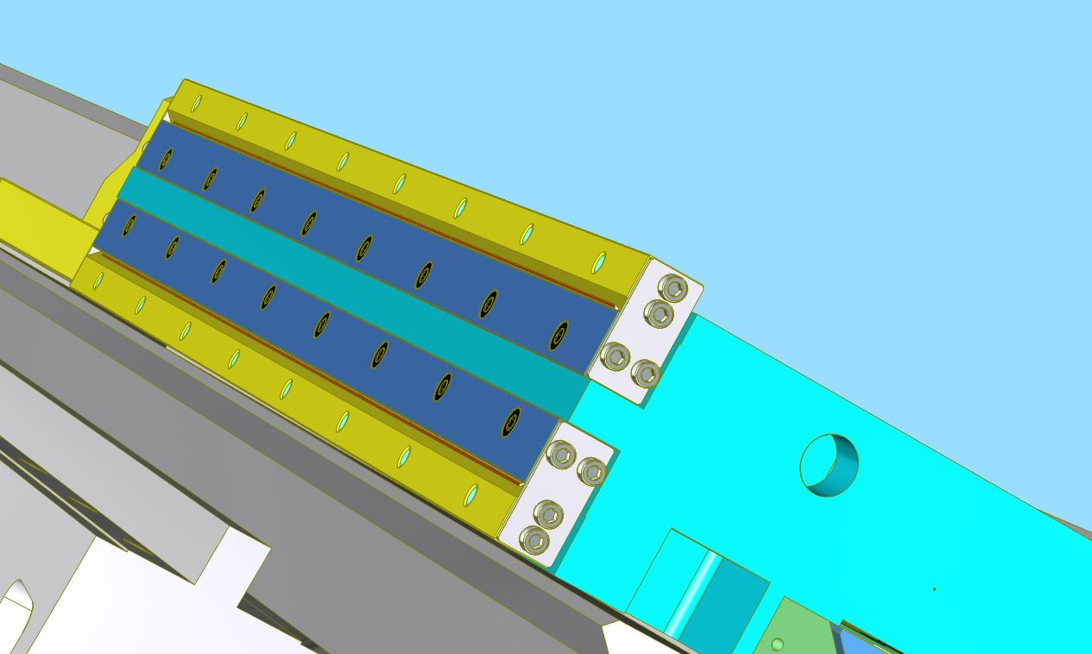
Install the needle sticks with the motion control wheels inside.
Install the 25 x 52 V-Type rails, using Ralf’s rail combine brackets
Hole threads on top side

Slide 2
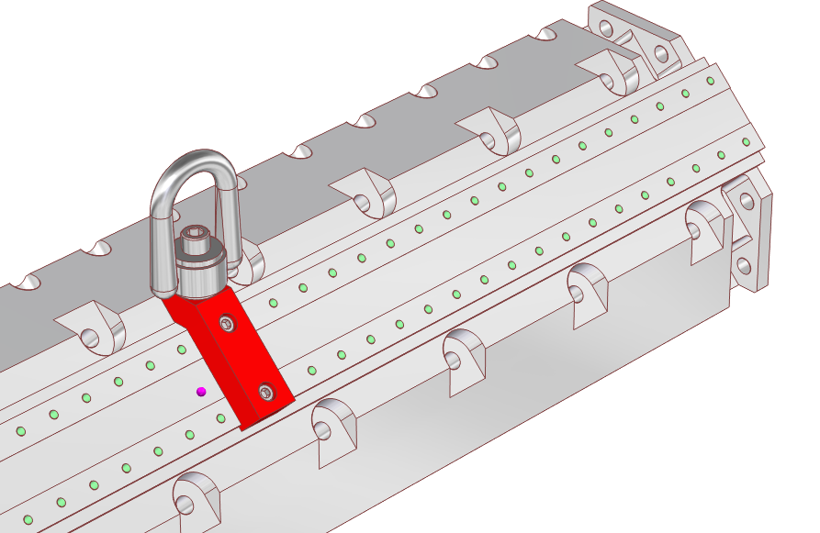
Lifting bracket connection 2 x M6 x 1 x 20 mm
Set screw side

Slide 3
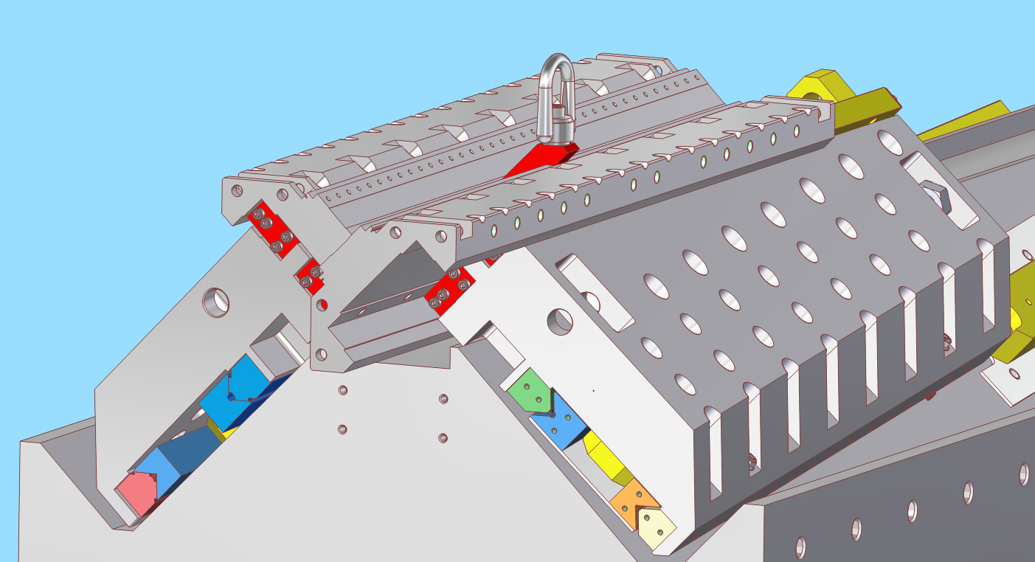
The second-row magnet carriers need to be installed
in Z-direction due to space interferences with the
installed first-row.
Move the magnet carrier in Z- direction

Slide 4
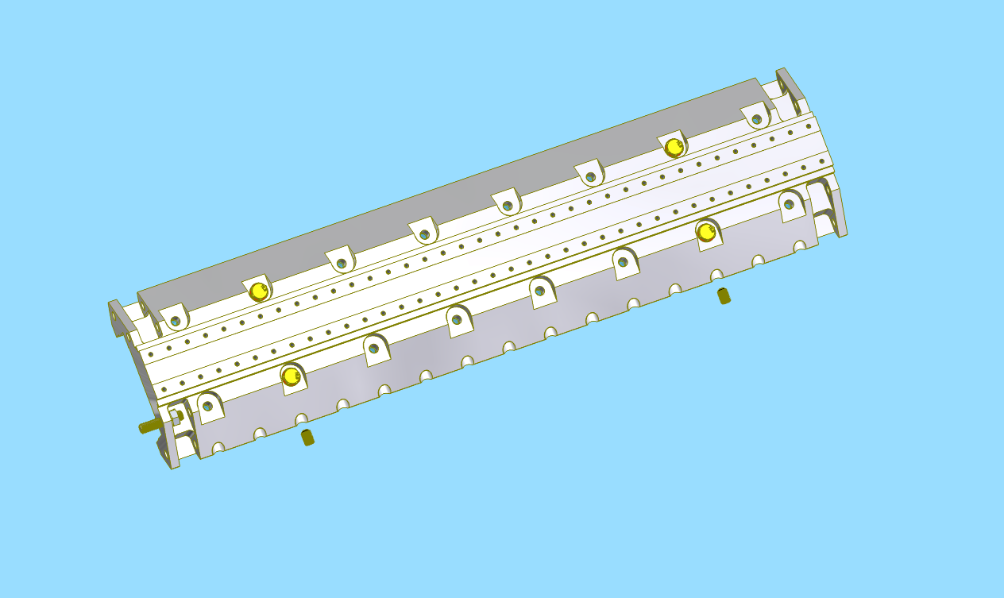
Magnet carrier to main carrier connections.
Tighten the two set screws until the magnet carrier is hard to move by hand up to + - 40 mm.
Then tighten the four yellow screws with ~ 15 Nm.
Check the magnet carrier is moveable similar as before.
95327A618
Zinc Yellow-Chromate Plated Steel Hex Head Screw, High-Strength, M10x1.5 mm Thread, 35 mm Long,
91455A140
Steel General Purpose Washer for Class 8.8,
Zinc-Plated, for M10 Screw Size, 10.5 mm ID, 20
99642A160
Alloy Steel Cup-Point Set Screw, Fine-Thread,
M10 x 1 mm Thread, 16 mm Long,
94223A103
Extreme-Strength Steel Hex Nut, Class 12,
M10 x 1.5 mm Thread,
1077N137
Very-High-Strength Class 12.9 Steel Threaded
Rod, M10 x 1.50 mm Thread Size, 50 mm Long

