Slide 1
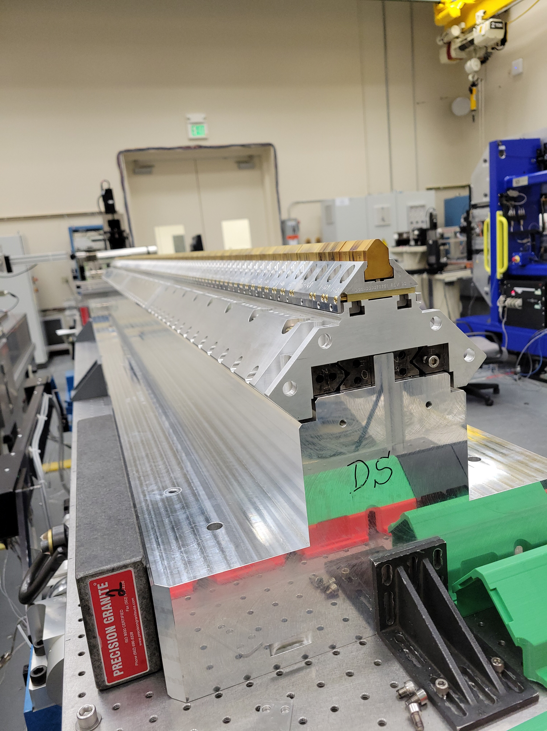
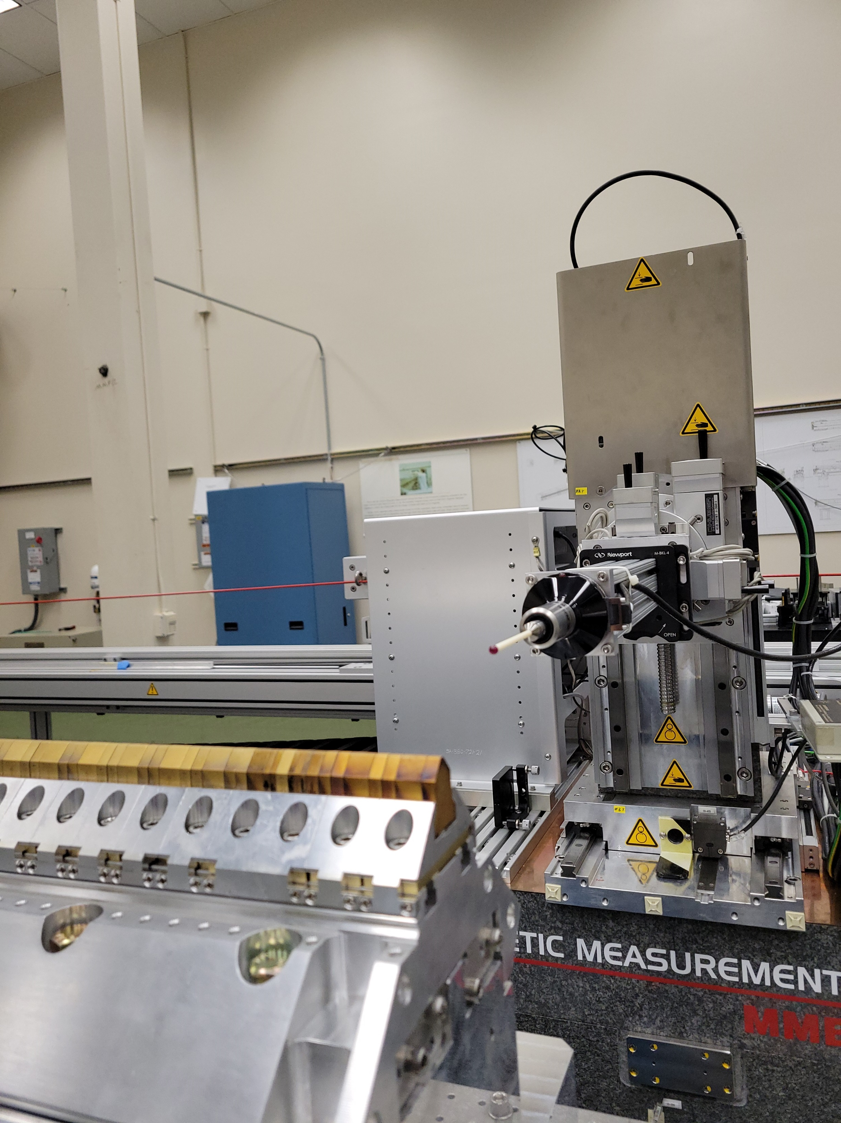
X
Y

Slide 2
Carrier
Tuning fixture

