Slide 1
HE-SXU-000 Transportation & Storage test Results
Initial measurements (October 12, 2022)
Transportation test (Test- October 20, 2022; Measurements Nov.2, 2022)
Storage test (Dec. 6, 2022 – Jan. 17, 2023)
Temperature test (Jan. – Feb. 2023), in progress
Z. Wolf, Y. Levashov. LCLS-II-HE SXR Undulator Transportation Test Results. LCLS-TN-22-10

Slide 2
HE-SXU-000 Tuning Results
  Summary:
  Field integrals tuned to tolerances in operational range 7.2mm to 33mm.
  Phase errors tuned well below tolerance in operational range.
  The K-value at 7.2mm gap is 9.7355 (~5% higher than required).

Slide 3
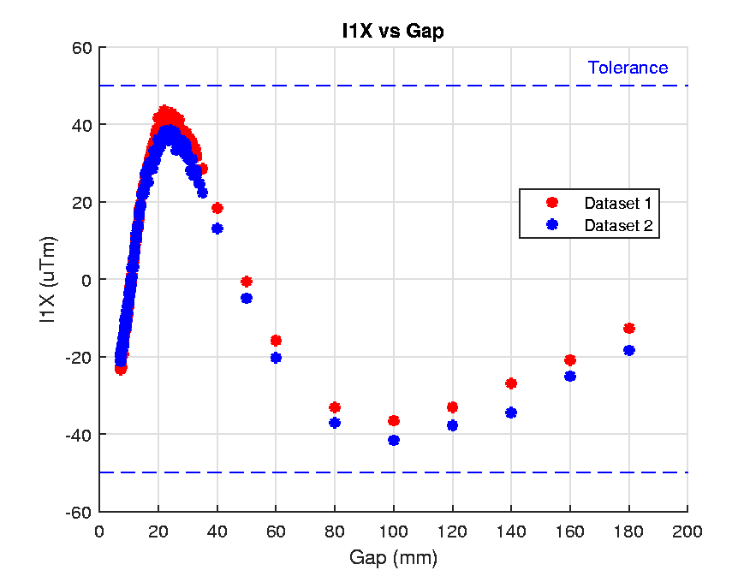
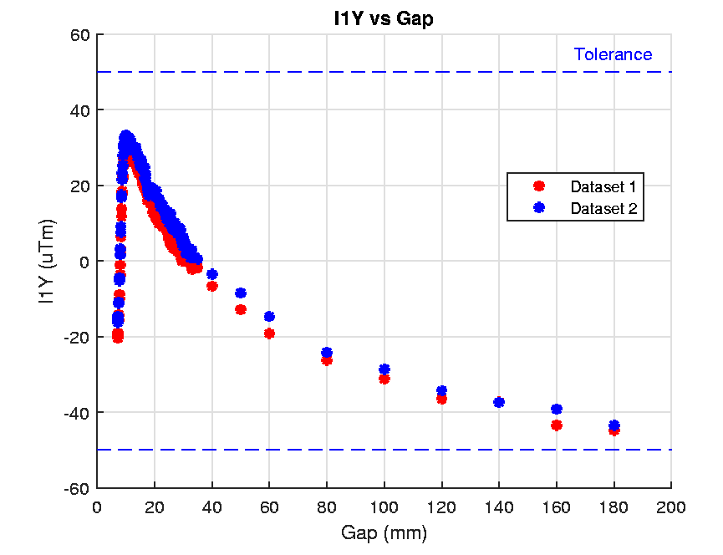
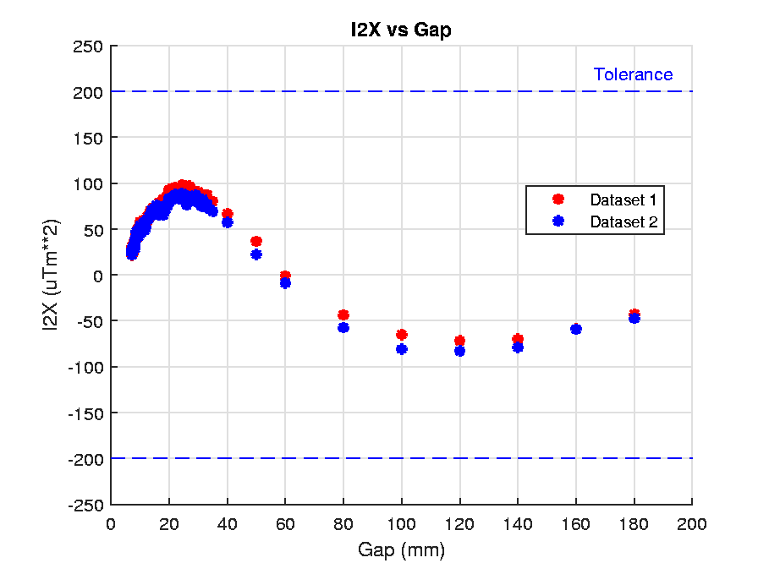
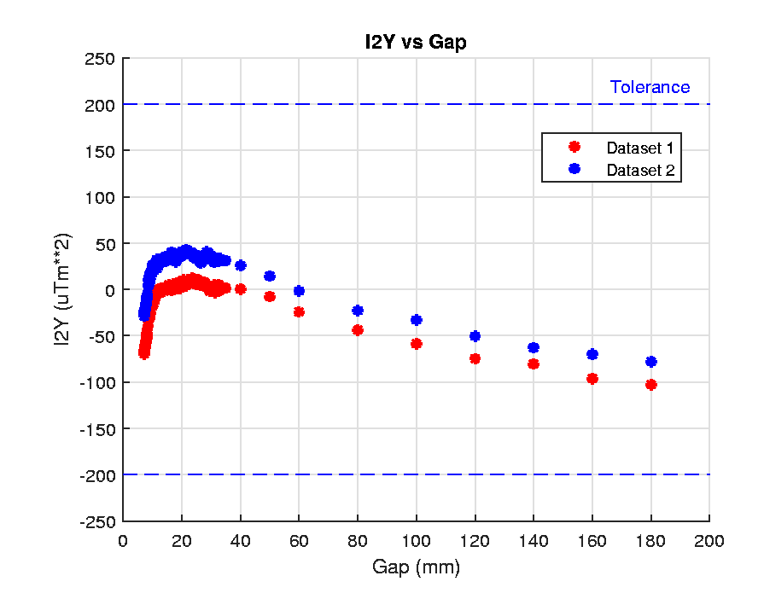
Transportation Test
The undulator was moved to the tunnel and brought back the same day. After the transportation, the undulator was in the temperature stabilization area for 2 days, then moved to the Kugler bench for measurements.
Dataset 1 - Initial calibration
Dataset 2 – After the test

Slide 4
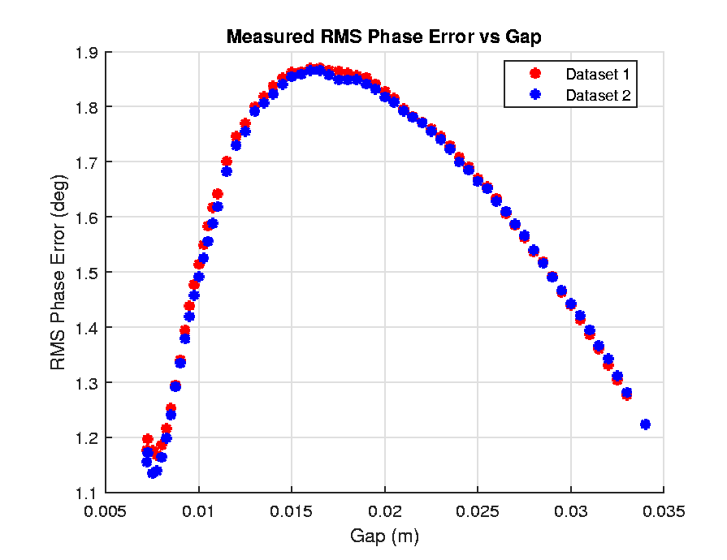
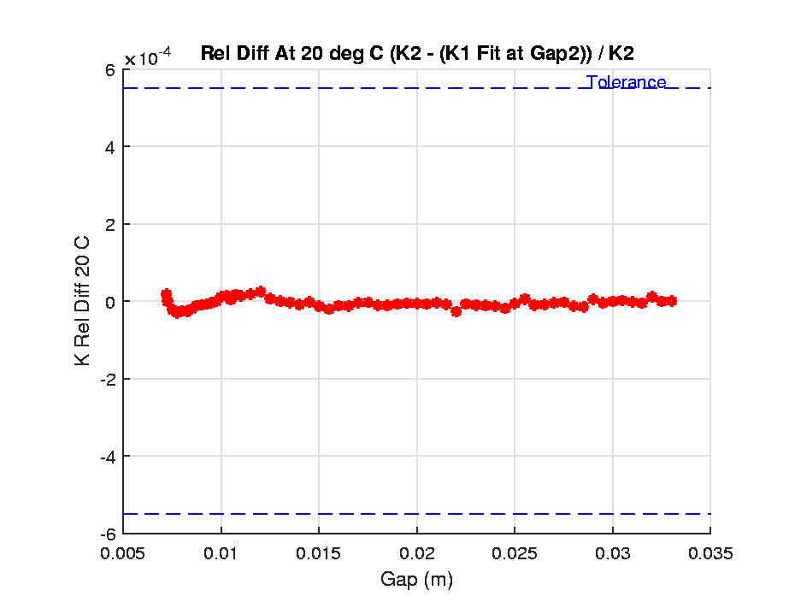
Transportation Test, cont.

Slide 5
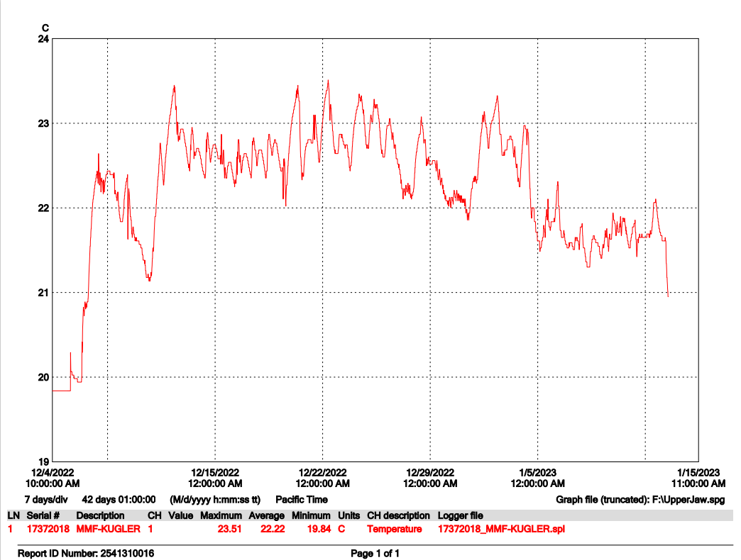
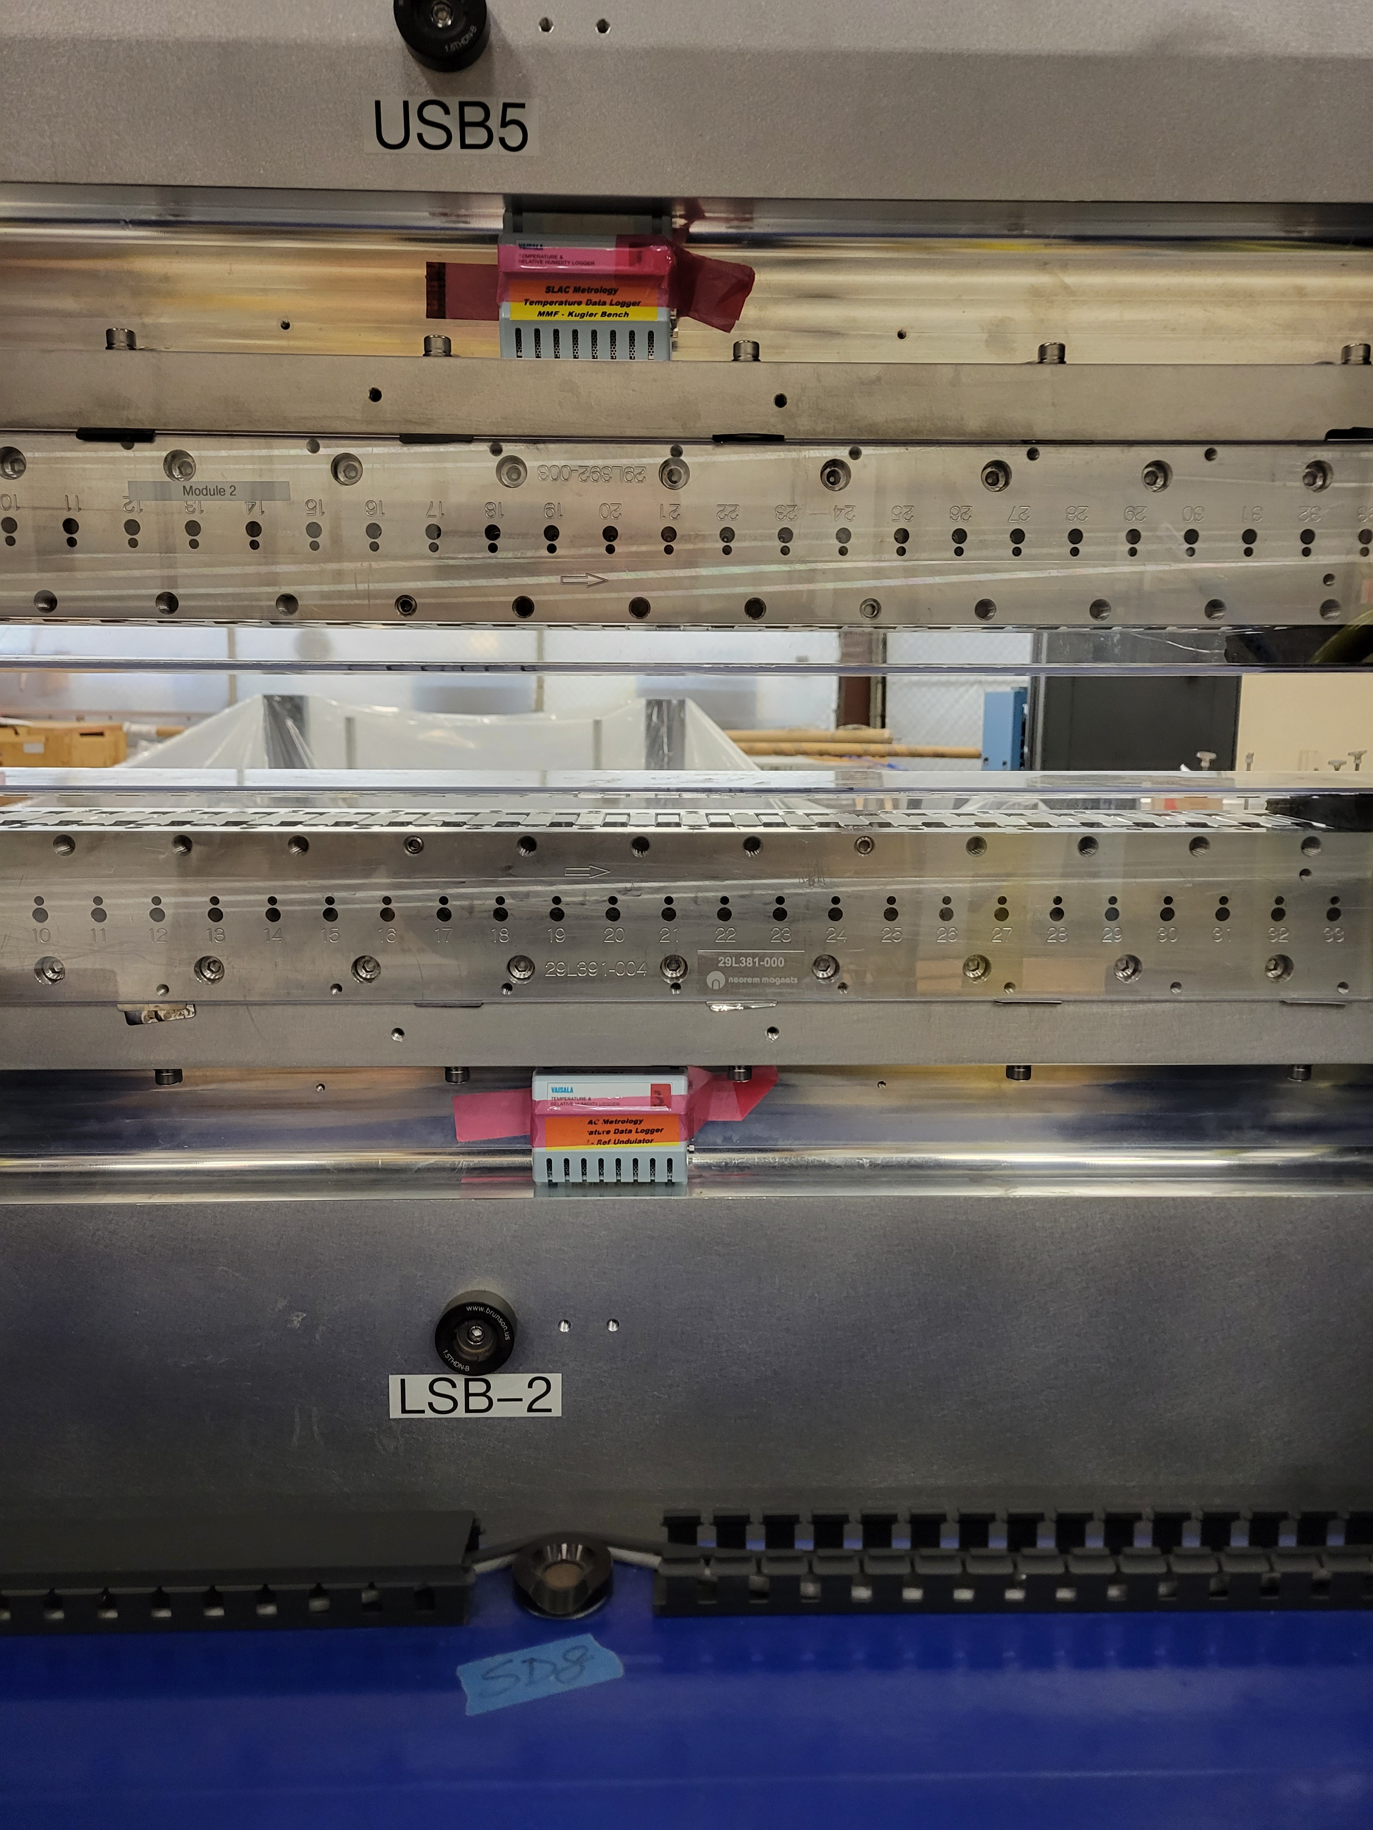
Storage test
The undulator was moved to the storage area in December 2022 and was back for measurements in 5 weeks.
Two temperature loggers were attached to the upper and lower jaws to record the temperature change.
Temp.
Loggers
The room heaters were running all the time by shipping/receiving .

Slide 6
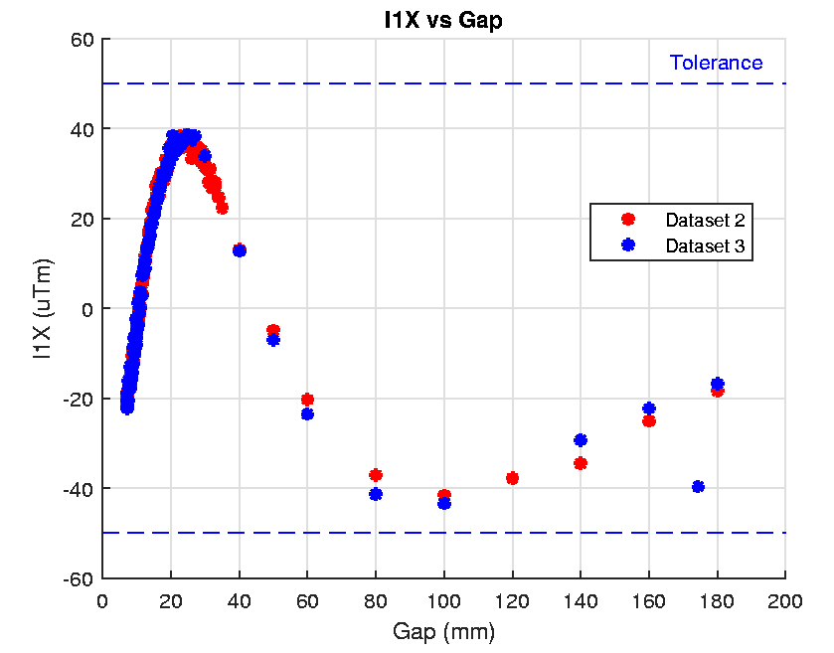
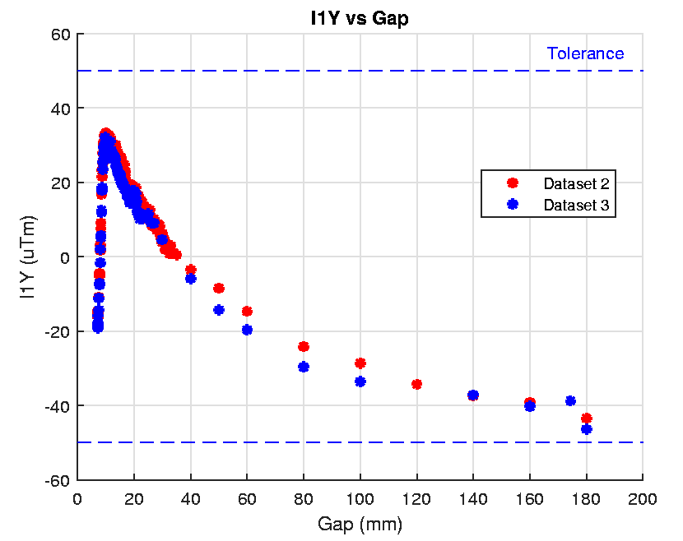
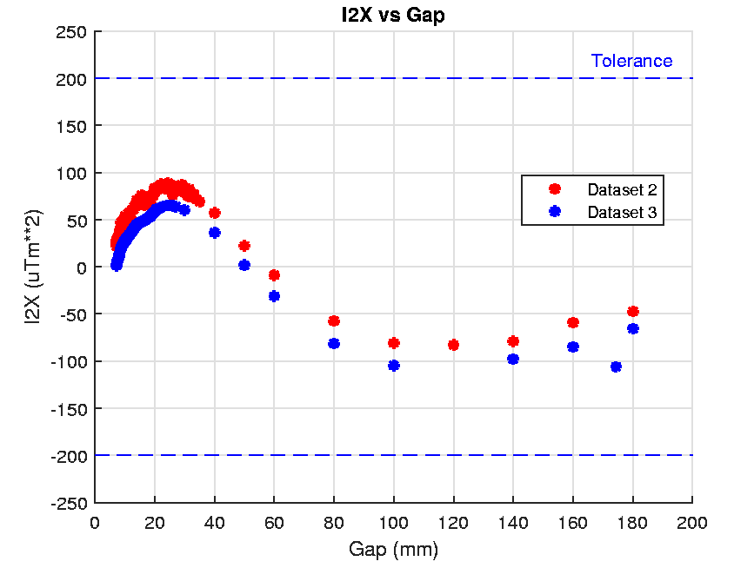
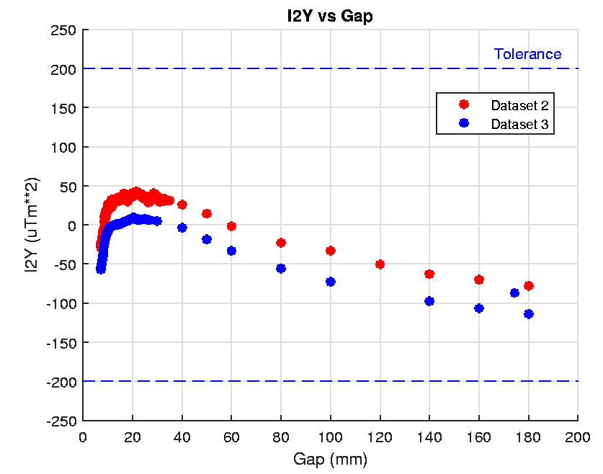
Storage test, continue
Dataset 2 - After transportation test
Dataset 3 – After the storage test

Slide 7
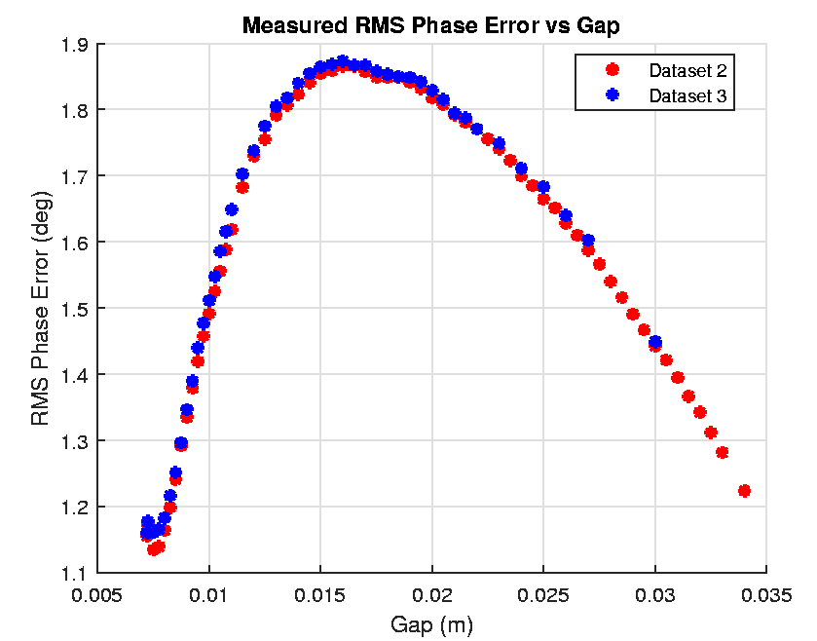
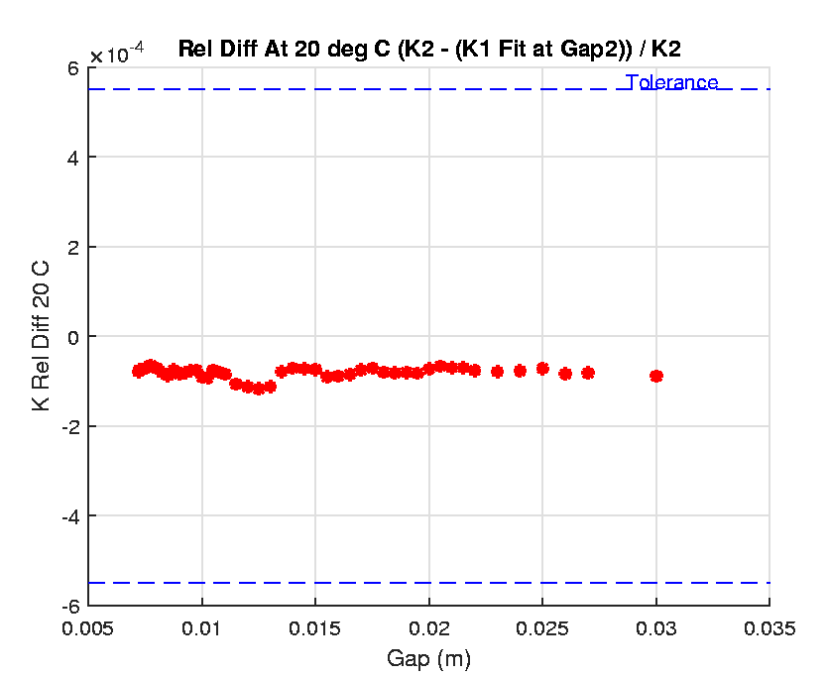
Storage test, continue

Slide 8
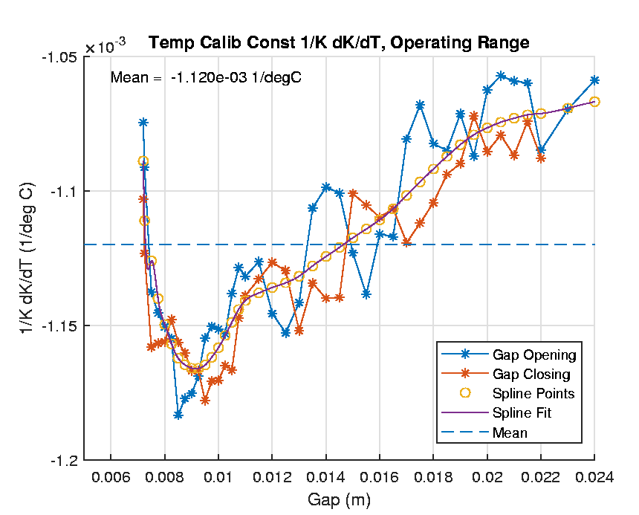
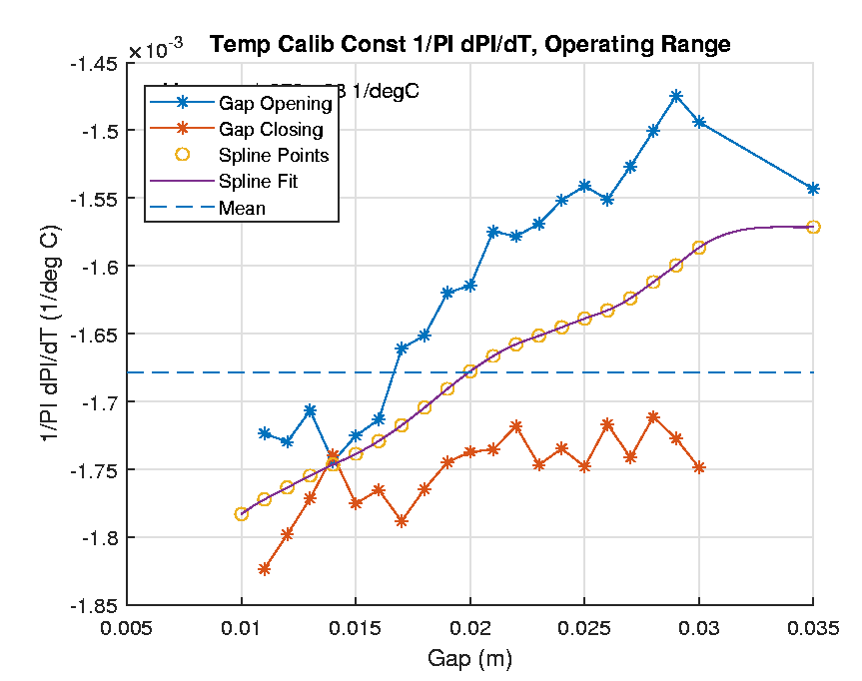
Next test, temperature calibration
The temperature calibration test (measuring temperature coefficients of phase shifter and undulator) is in progress. We’ll do it for one undulator and one phase shifter.
Five temperature points, 6 measurements: 20.0C, 19.0C, 19.5C, 20.5C, 21.0C, 20.0C.
Hall probe re-calibration, bench granite re-alignment, and bench scale adjustment at each temperature.
On-axis Hall probe measurements (K and phase errors).
The first 3 points are done. The temperature in MMF is 20.5C now. We’re waiting for the instrument’s acclimatization.
HE-SXU-000 average coefficient
SXHEPS-000 average coefficient

