Slide 1
LCLS-II-HE SXU short prototype measurements
Yurii Levashov, Engineer
LCLS-II-HE 2022 Director’s Status Review​
February 8-11, 2022

Slide 2
Outline
New, 56 mm period magnet structure were designed by LBNL. The structures were optimized for max magnetic field and minimum pole saturation. The goal for tests:
1. Confirm that the new magnetic design meets all the PRD tolerances on magnetic field.
2. Get hands-on experience working with the new magnetic structure; be prepared in advance for the full-scale prototype tuning.
Tests:
  Evaluate magnetic structure design. Measure the prototype with calibrated Hall probe, analyze the fields. Measure field integrals vs. gap.
  Study shim signatures and saturation effects. Evaluate if shims are adequate for tuning.
  Study Hall probe measurements at Kugler bench and Hall probe calibration. Make sure the measurement accuracy meets the tolerances on undulator K (<20% of total tolerance).
  Study magnet crosstalk between SXU-HE undulator and new SXR-HE phase shifter. Find the minimum distance at which the change in field integrals is insignificant (< 3G-cm).

Slide 3
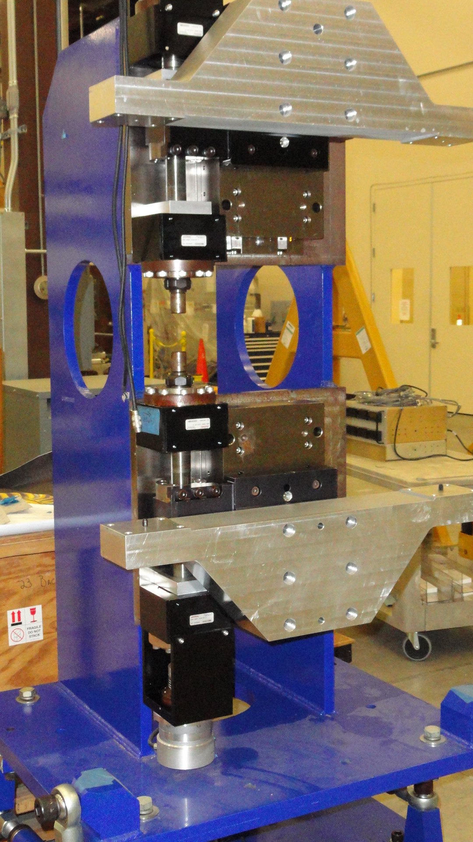
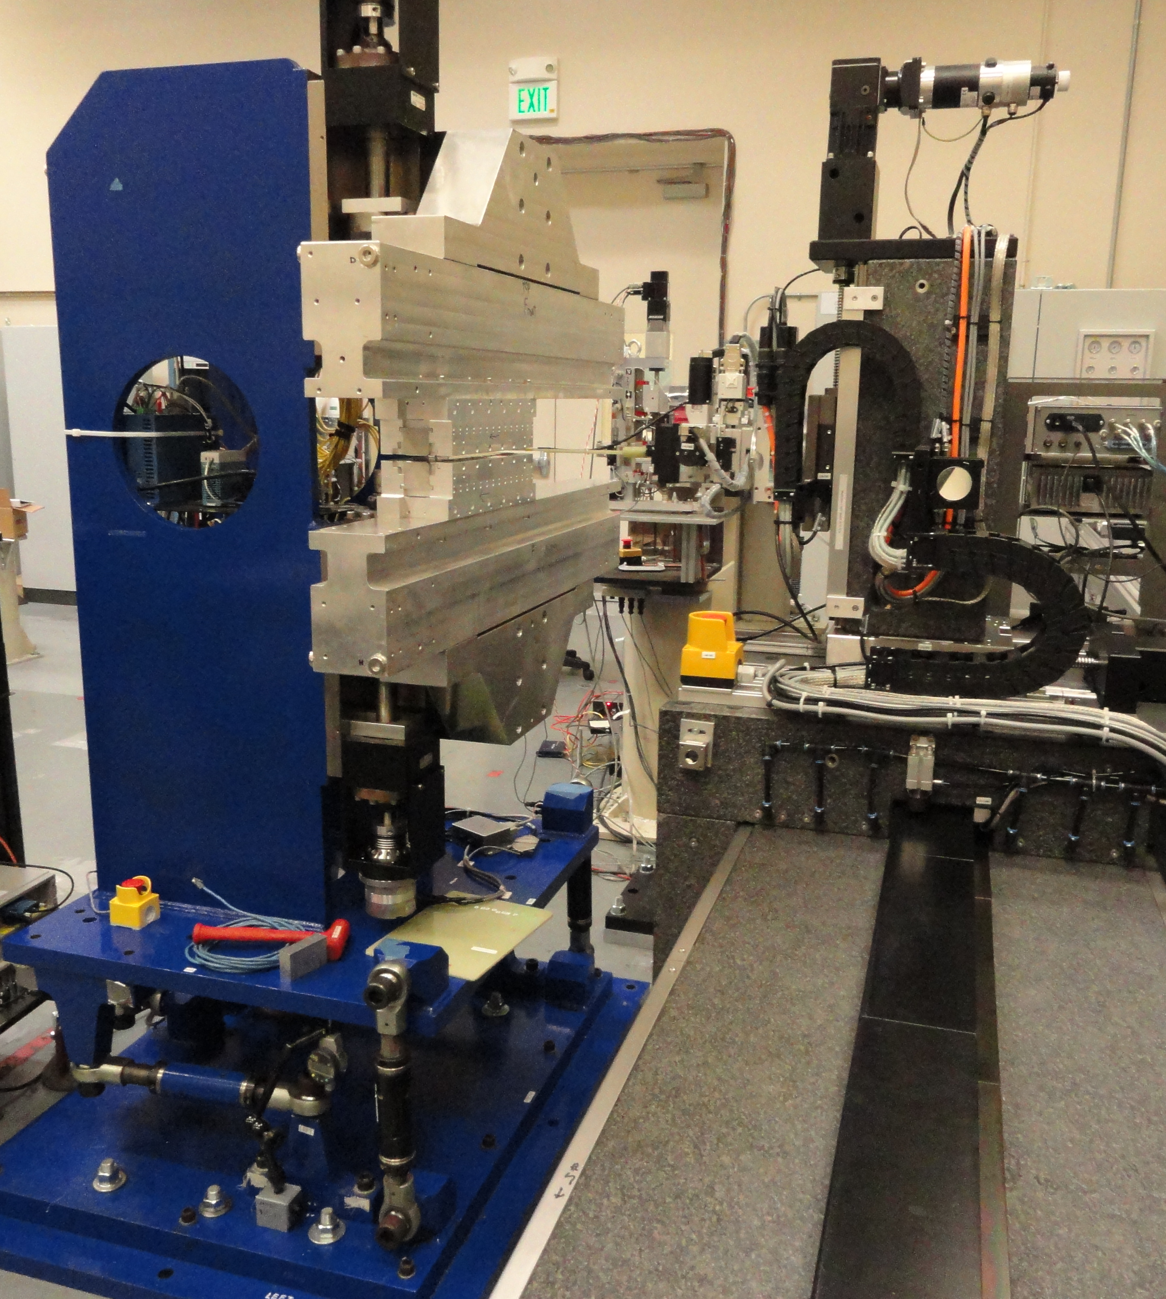
Set-up
Two 14 poles, 36cm long magnet structures ordered, assembled and mechanically tested at LBNL.
At SLAC we assembled the structures on a 1m long prototype frame, leftover from LSLC-II project, to make a short prototype of LCLS-HE undulator.
No gap encoders; the motor encoders’ offsets set at 7.2mm gap with the use of a ceramic block. Accuracy of setting the gap with motor encoders was enough for the tests.
The prototype tested at SLAC MMF on SXU measurement bench. Magnet structures aligned to each other and to the bench granite with the use of a laser tracker.
The taper in the magnetic field along the beam axis corrected by inserting shims in between the magnets’ keepers and supporting strongbacks.
The same Sentron 2-D Hall probe used to measure fields, as for LCLS-II SXUs.
Stretched wire technique used to measure field integrals. The same device used for LCLS-I and LCLS-II field integral measurements (long coil, 150 turns).

Slide 4
Evaluation of magnetic structure design, requirements.
The requirements related to field quality are specified in LCLSII-HE-1.3-PR-0049-R1
  Minimum operational gap 7.2mm
  Maximum operational gap 33mm
  On-axis vertical effective field at minimum gap >1.76T
  Keff at minimum gap >9.21
  Horizontal K sextupole (roll-off) < 5·10⁻⁴ (1/mm²) or equivalent ΔK/K at x = ±0.4mm <8·10⁻⁵
  Phase shake (rms) < 5°
  First filed integrals (B_{y} and B_{x}) <50µTm
  Second filed integrals (B_{y} and B_{x}) <200µTm²

Slide 5
Measurements with Hall probe
  First measurements (before tuning):
  Average Undulator Period = 0.056031 m ± 0.000070 m
  The K at 7.2mm gap = 9.69 ( 9.21 PRD); 5% stronger!
  B_{x} field is small, below 10G:
  No large magnetization errors in the magnets,
  pole alignment is good,
  magnet sorting is good.
  Phase shake = 2.4° (<5°)
  Magnetic field roll-off = 3.5·10⁻⁴ 1/mm² (< 5·10⁻⁴ )
  Saturation starts at gaps below 8mm and is small.
~25µTm² jumps after each end section in the same direction, ~50µTm² in total, agree with simulations done by LBNL (<200µTm²).

Slide 6
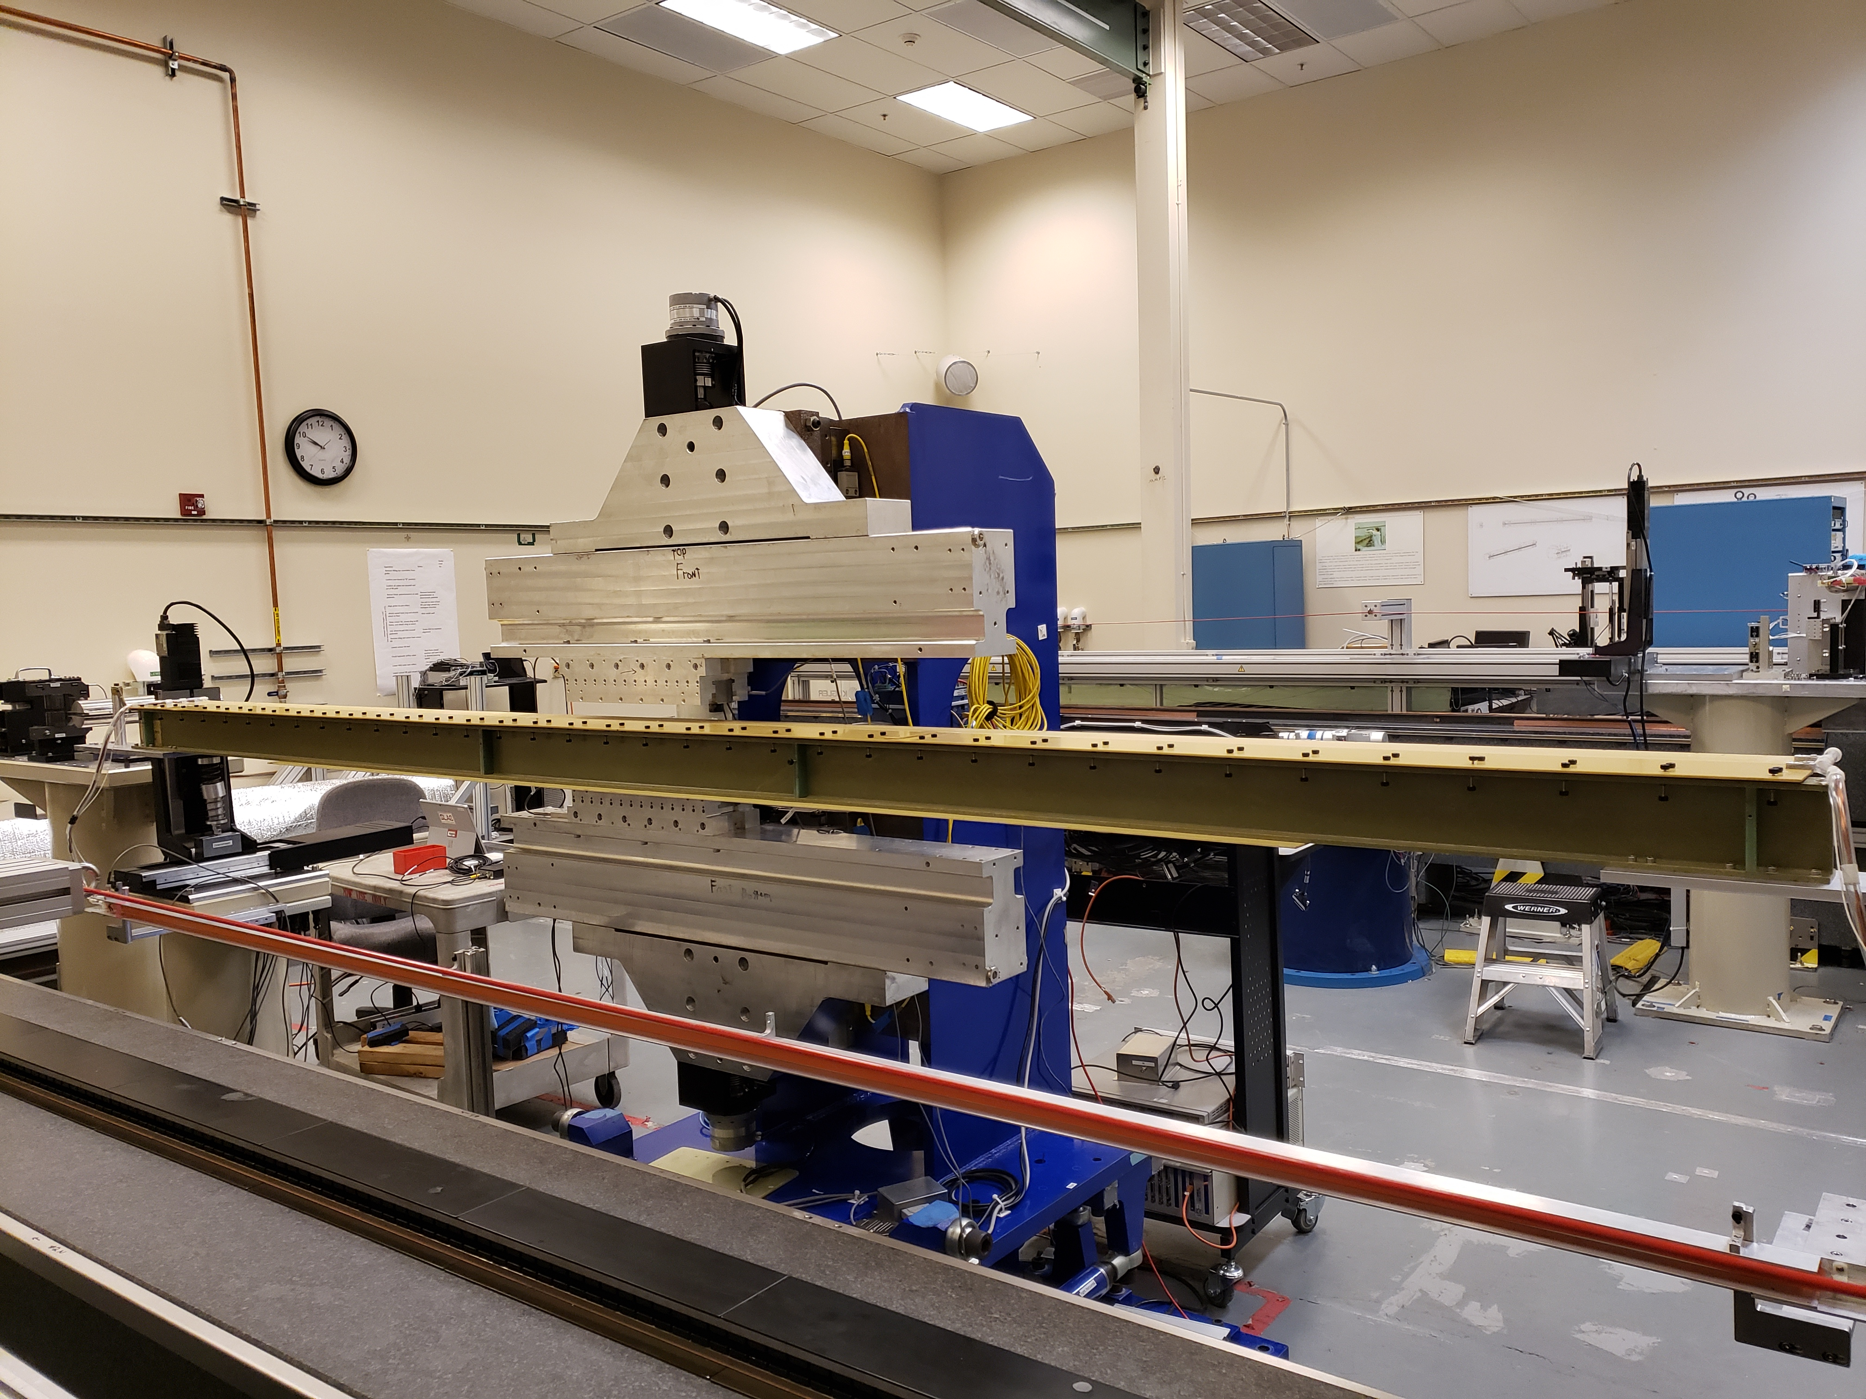
Field integrals vs Gap
The device is short, only the first field integrals measured.
Background field integrals subtracted from all measurements.
Measurement errors 3G-cm.
The sharp change in B_{y} field integral at ~ 9mm gap is due to pole saturation effects and magnetization errors.
Goal: Find shim signature with a similar shape.

Slide 7
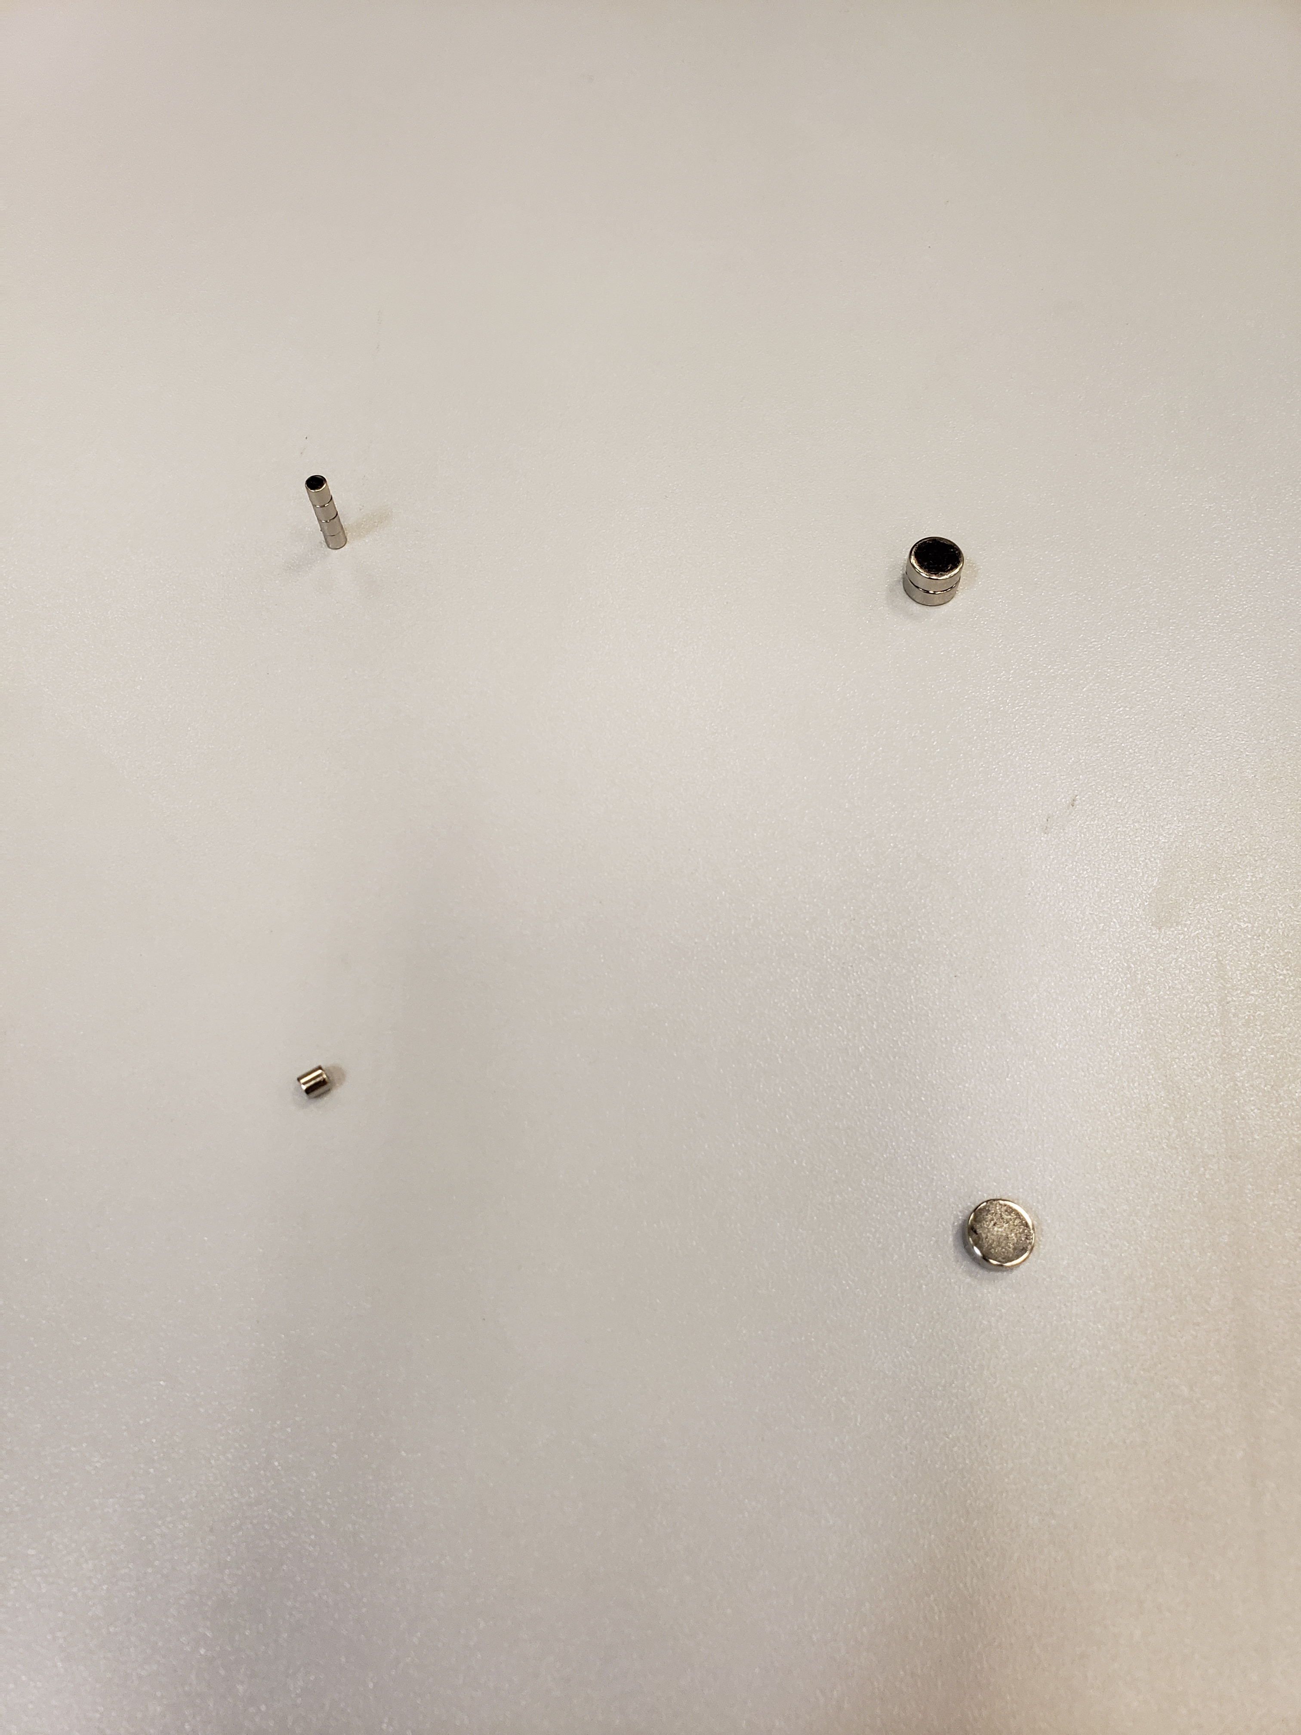

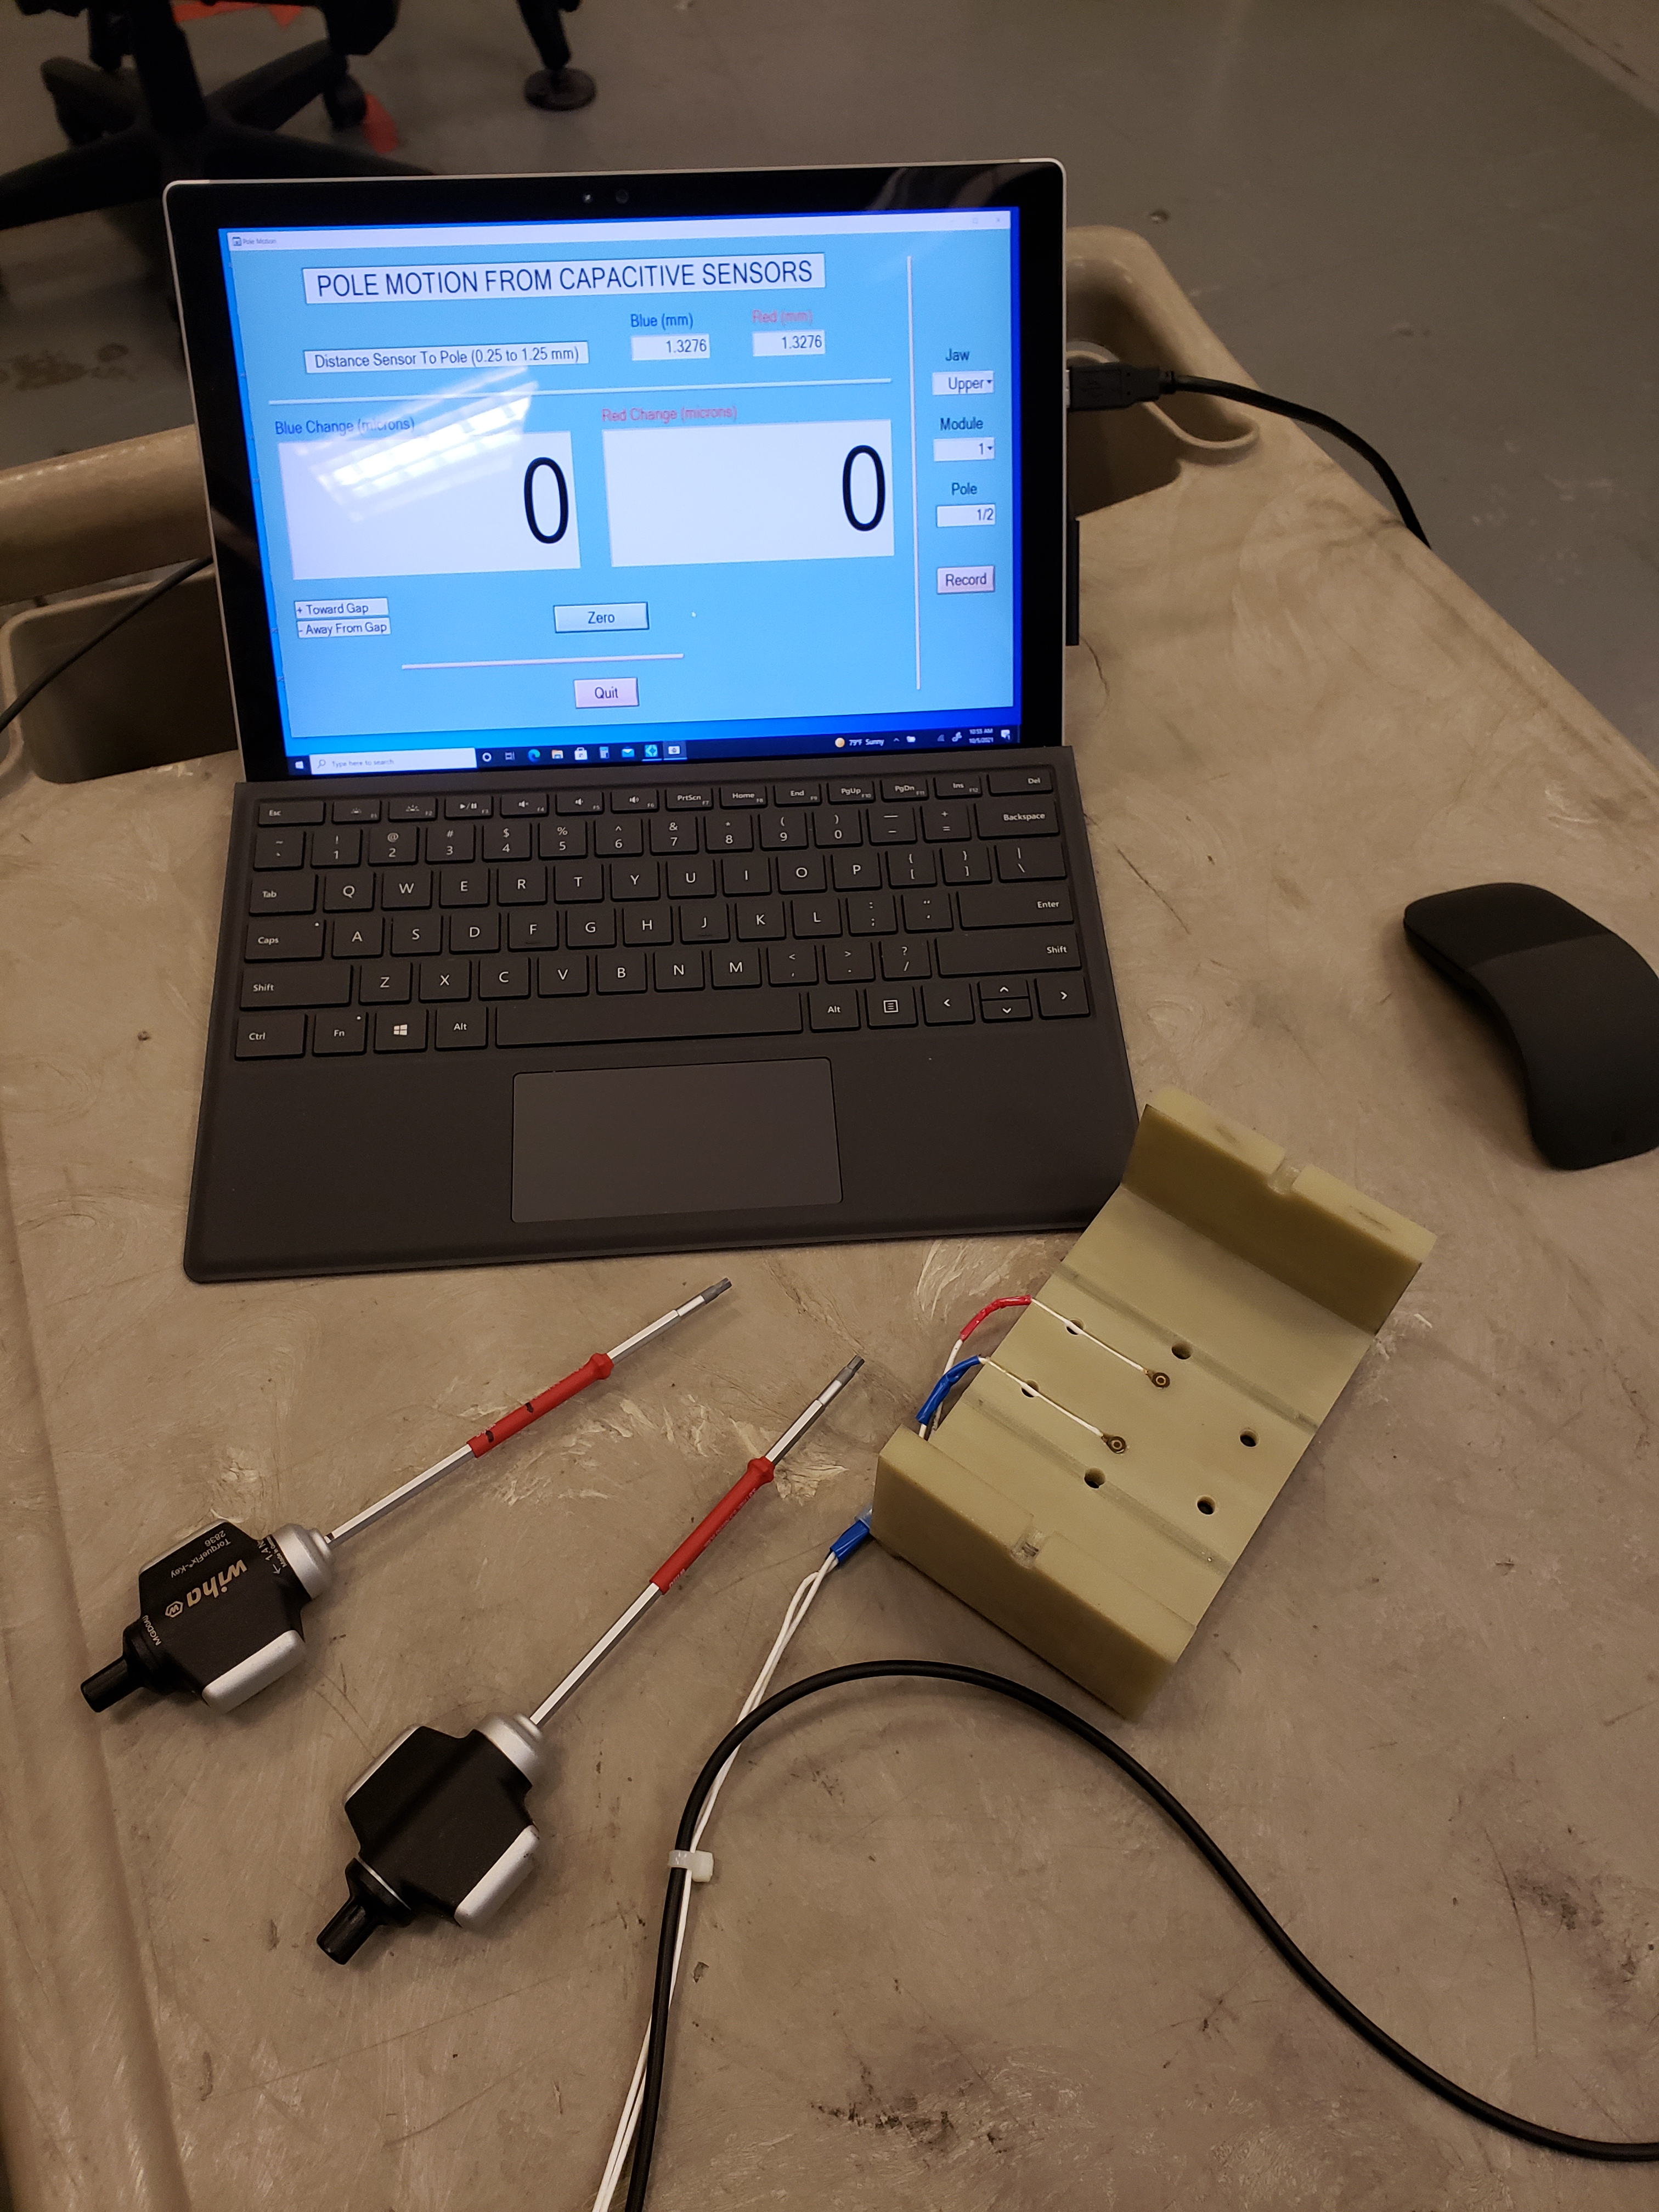
Shim signatures; options for tuning
Shim signature shows how installation of a shim changes field integrals vs gap. (How a shim strength changes vs. gap.) Ideal shim signature has the same gap dependence as field integral to be tuned.
Move poles vertically
Add magnet material
Ferromagnetic shim
Small ∅ 3mm
x 3mm slugs
Large ∅ 8mm
x 3mm slugs
Two capacitive sensors
Steel shim 7.5 x 15 x 0.17mm glued on top of a magnet
Pole motion: The main dipole, the transverse dipole and normal quadrupole.
Slugs = pole motion + Skew quadrupole.
Ferromagnetic shims = slugs + Sextupole components.
Combinations of different types of shims used to get the correct shim signature.

Slide 8
Main field signatures
Combination of pole motion with ferromagnetic shim produces a signature closest to the required field shape.

Slide 9
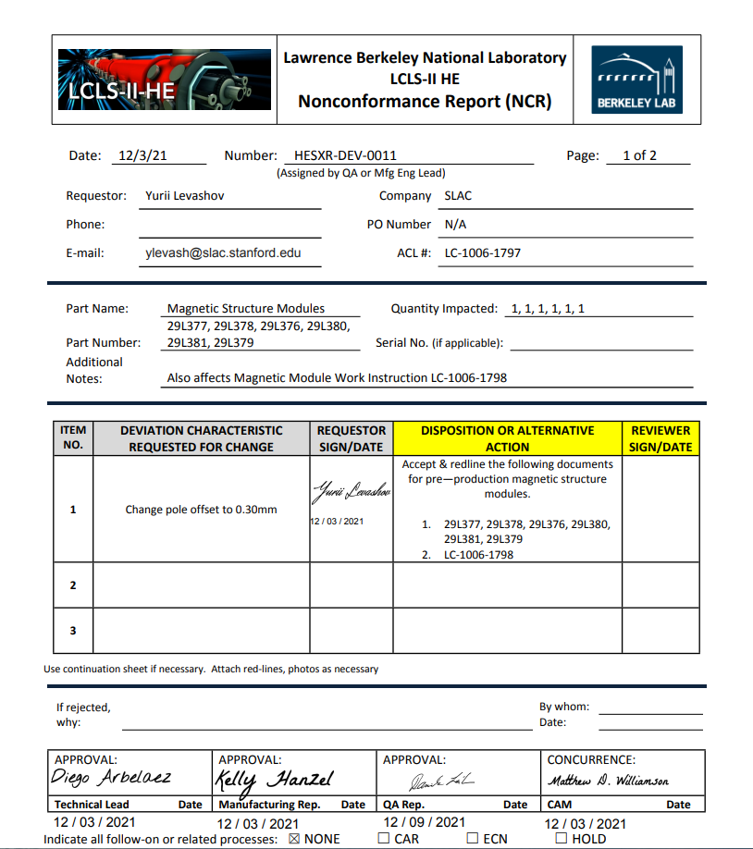
Magnet/pole recess
Pole
CMM measurements
Magnet
Magnet recess 0.14mm
Needs to be ≥ 0.3mm
Steel shim 0.17mm thick + glue
Magnet/pole recess in the magnetic structure increased from 0.140mm to 0.300mm, so that the installation of the ferromagnetic shims will not reduce the gap.
The main field reduced by ~0.5% from 1.85T to 1.84T (4%).
No change in phase shake or field integrals.

Slide 10
Shim signatures for other field components.
The prototype field integrals were tuned to tolerances (±10µTm) by applying combinations of shims.

Slide 11
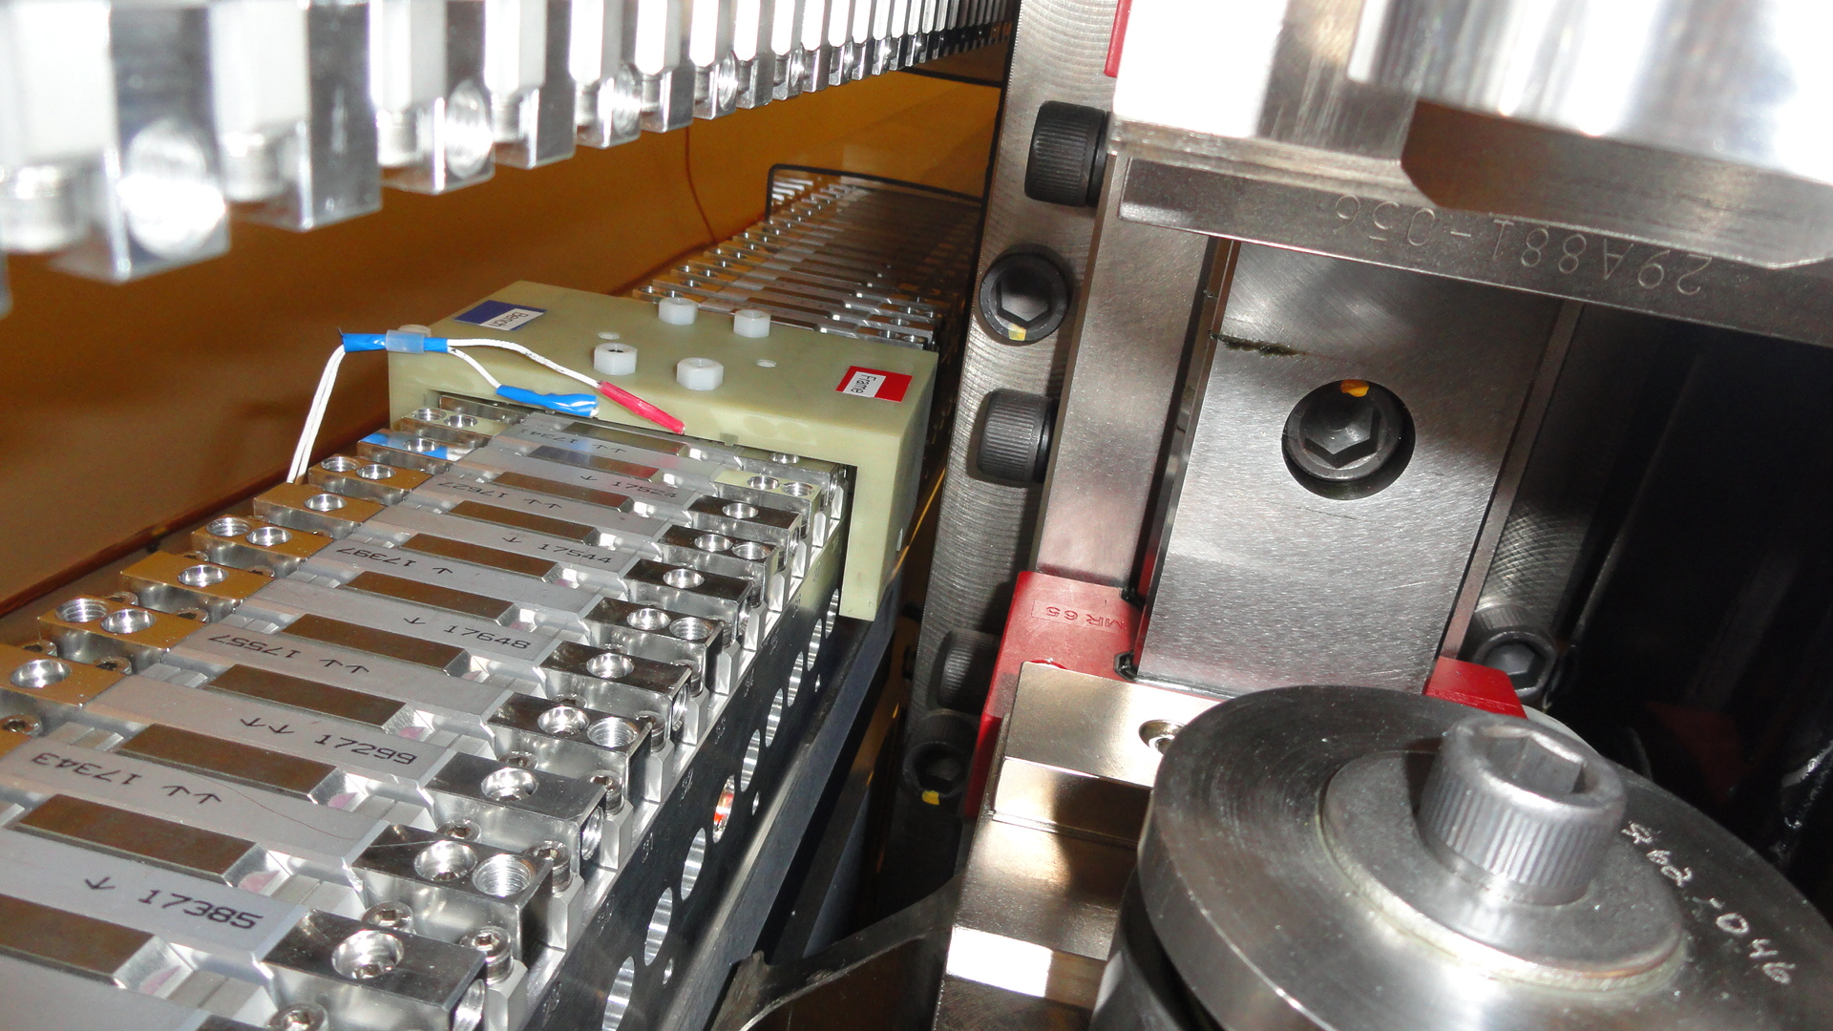
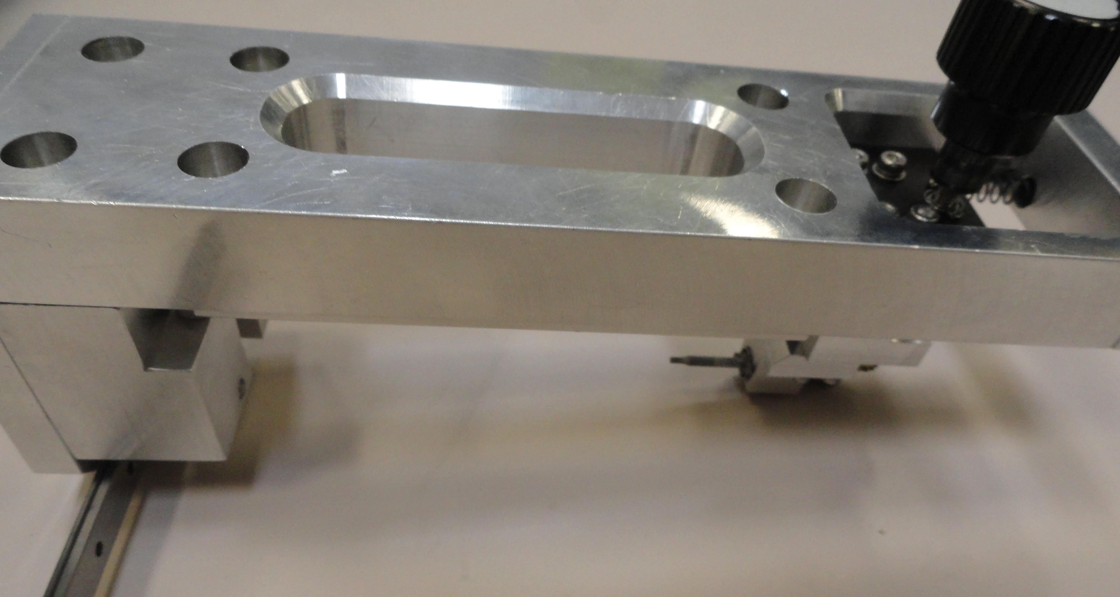
Tuning challenges
The pole adjustment works fine.
No access to the side screws near the frame vertical supports
(~ 2 x 0.46m top & bottom).
A special tuning fixture is needed, like a fixture for HXUs.
No issues with small slugs’ installation.
Large slugs are very difficult to work with. Large slug diameter to be reduced.

Slide 12
Hall probe calibration accuracy.
Project | B_{und}(T) | B_{calib}(T)
LCLS-I | 1.25 | 1.5
LCLS-II | 1.62 | 1.7
LCLS-II-HE | 1.76 | 1.9
The Hall probe has to be calibrated to higher field levels.
Probe output is very non-linear at fields above 1.5T. Cubic splines used to fit the calibration data.
The calibration magnet saturates reducing the good field region. Probes to be positioned with high accuracy.
The calibration accuracy is ±5·10⁻⁵ T.

Slide 13
Hall probe measurement accuracy
The measurement errors include the calibration, probe alignment, and the errors from the gap drift due to temperature change.
The measurement accuracy checked by measuring the prototype repeatedly. The test consists of alternate Hall probe recalibrations and the prototype re-measurements.
The gap of the prototype set to 7.3mm and was not changed during the test. The change in the gap was due to the gap drift under the magnetic field force and the gap change due to ambient temperature variations (±0.1C°).
First few measurements during the gap initial drift ignored. The deviations from the linear fit are less than ±9∙10⁻⁵ .
The Hall probe measurement accuracy meets the LCLS-HE requirements (<1∙10⁻⁴).

Slide 14
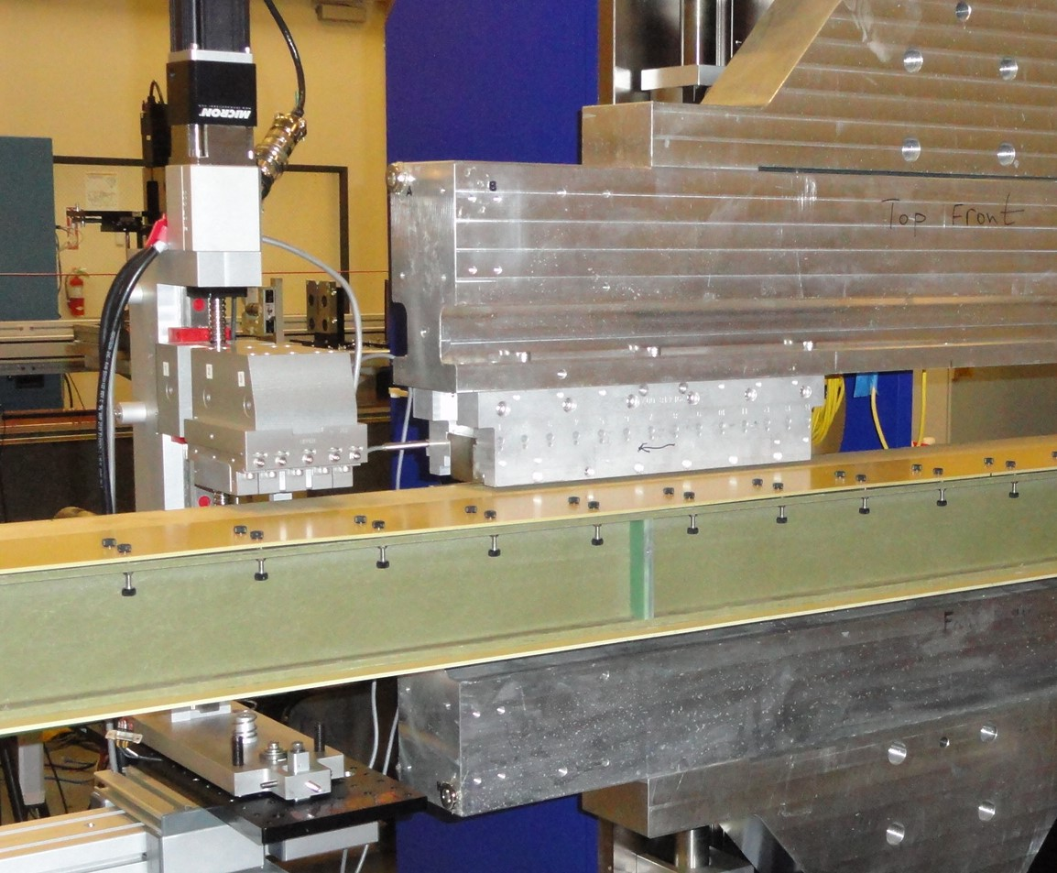
Crosstalk between undulator and the phase shifter.
SXHEPS prototype
13cm
Rail
Slide
Undulator gap = 7.2mm
Phase shifter gap = 35mm
Distance Undulator/Phase shifter in tunnel = 14cm.
Field integral change < 3G-cm at distance <13cm.
No cross-talk expected (< 2G-cm).

Slide 15
Summary.
The magnetic structure design meets the requirements. (The short prototype does not represent the full scale device. Only partial satisfaction of these requirements could be stated).
Pole saturation is small.
Shim signatures measured. Field shimming options are sufficient for tuning the field integrals to tolerances.
Magnet/pole recess increased from 0.140mm to 0.300mm for ferromagnetic shims installation.
Hall probe measurements accuracy is <1∙10⁻⁴ , meets the requirements on K measurements.
Undulator/phase shifter cross-talk starts at 13cm. No cross-talk in the tunnel (14cm).

