Slide 1
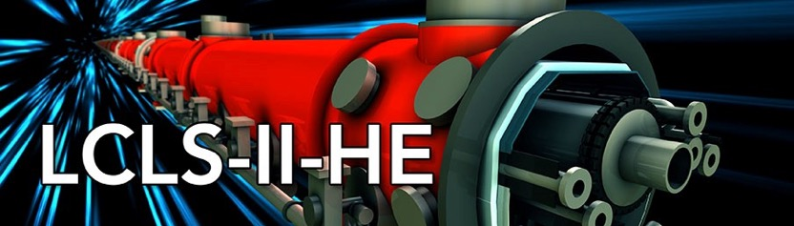





LCLS-II-HE SXU short prototype measurements
Yurii Levashov 2/11/2022

Slide 2
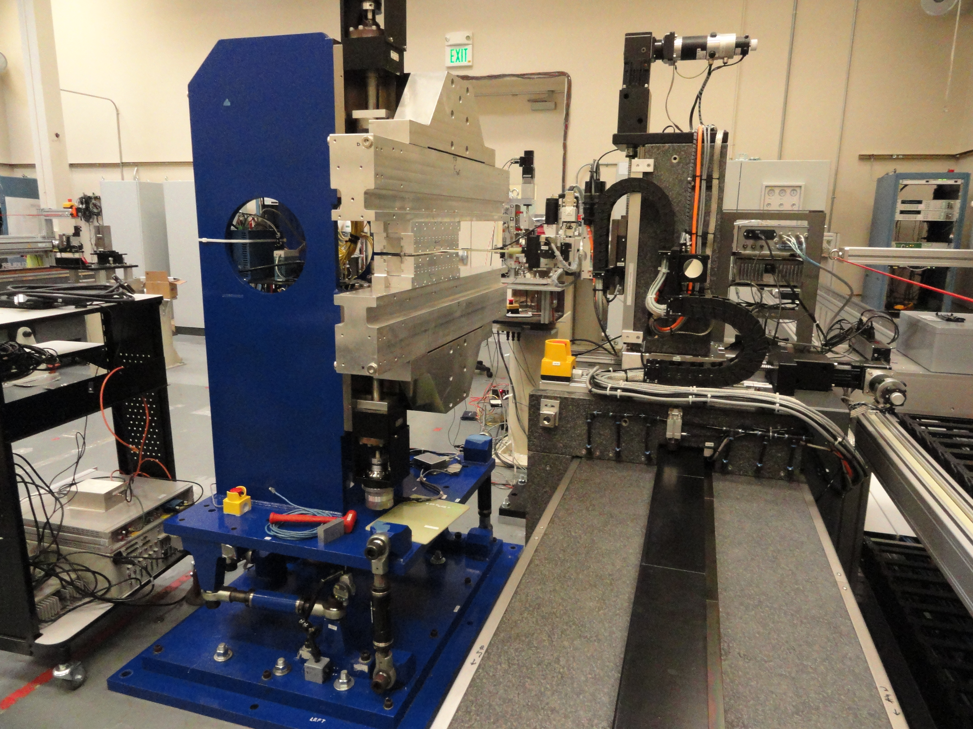
Introduction
Two new, 56 mm period, 14 poles, magnet structures were designed, assembled and mechanically tested at LBNL.
At SLAC we have the structures assembled on a 1m long prototype frame, leftover from LSLC-II project, to make a short prototype of new LCLS-HE undulator. The prototype was tested at SLAC MMF on SXU measurement bench.
There are no gap encoders; the motor encoders’ offsets were set at 7.2mm gap with the use of a ceramic block. Accuracy of setting the gap with motor encoders was enough for the tests.
Magnet structures were aligned to each other and to the bench granite with the use of a laser tracker. The taper in the magnetic field along the beam axis was corrected by inserting shims in between the magnets’ keepers and supporting strongbacks.

Slide 3
Motivation & Scope
Evaluate the new magnetic design, confirm that it meets all the PRD tolerances on magnetic field.
Get hands-on experience working with the new magnetic structure; be prepared in advance for the full-scale prototype tuning.
Tests:
Evaluate magnetic structure design. Measure the prototype with calibrated Hall probe, analyze the fields. Measure field integrals vs. gap.
Study shim signatures and saturation effects. Evaluate if shims are adequate for tuning.
Study Hall probe measurements at Kugler bench and Hall probe calibration. Make sure the measurement accuracy meets the tolerances on undulator K.
Study magnet crosstalk between SXU undulator and new SXR phase shifter. Find the minimum distance at which the change in field integrals is insignificant.

Slide 4
Evaluation of magnetic structure design, requirements.
The requirements related to field quality are specified in LCLSII-HE-1.3-PR-0049-R1
Minimum operational gap 7.2mm
Maximum operational gap 33mm
On-axis vertical effective field at minimum gap >1.76T
Keff at minimum gap >9.21
Horizontal K sextupole (roll-off) < 5·10⁻⁴ (1/mm²) or equivalent ΔK/K at x = ±0.4mm <8·10⁻⁵
Phase shake (rms) < 5°
First filed integrals (B_{y} and B_{x}) <50µTm
Second filed integrals (B_{y} and B_{x}) <200µTm²

Slide 5
Evaluation of magnetic structure design
Initial measurements (before tuning):
The same Sentron 2-D Hall probe was used, as for LCLS-II SXUs. The K at 7.2mm gap = 9.69 ( 9.21 PRD); 5% stronger!
B_{x} field is small, below 10G. No large magnetization errors in the magnets, the pole alignment is good.
Phase shake = 2.4° (<5°)
Magnetic field roll-off = 3.5·10⁻⁴ 1/mm² (< 5·10⁻⁴ )
Saturation starts below 8mm gap and is small.
~30µTm² jumps after each end section in the same direction, ~60µTm² in total, agree with simulations done by LBNL (<200µTm²).

Slide 6
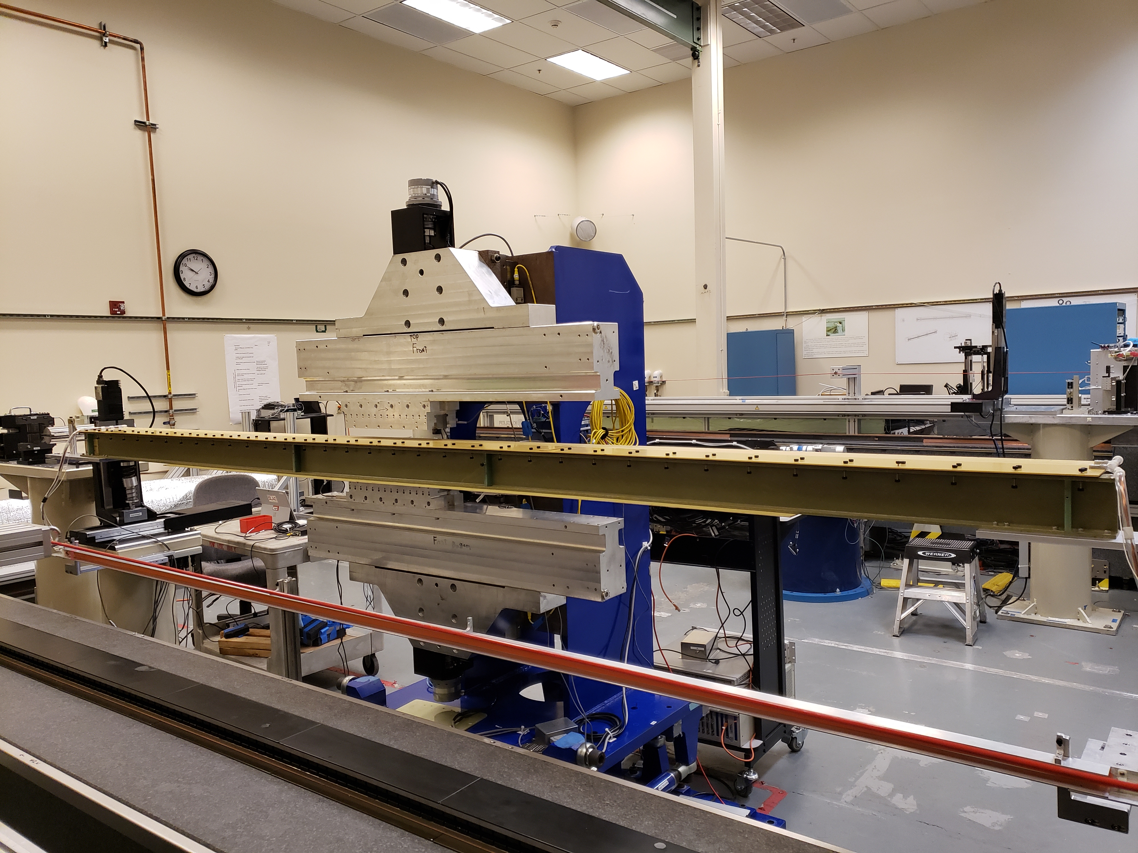
Field integrals vs Gap
Stretched wire technique used to measure field integrals.
Background field integrals measured without prototype and subtracted from all measurements.
Measurement errors estimated to be below 5G-cm.
The sharp change in B_{y} field integral at ~ 10mm gap is due to pole saturation effects and magnetization errors.
Goal: Find shim signature with a similar shape.

Slide 7
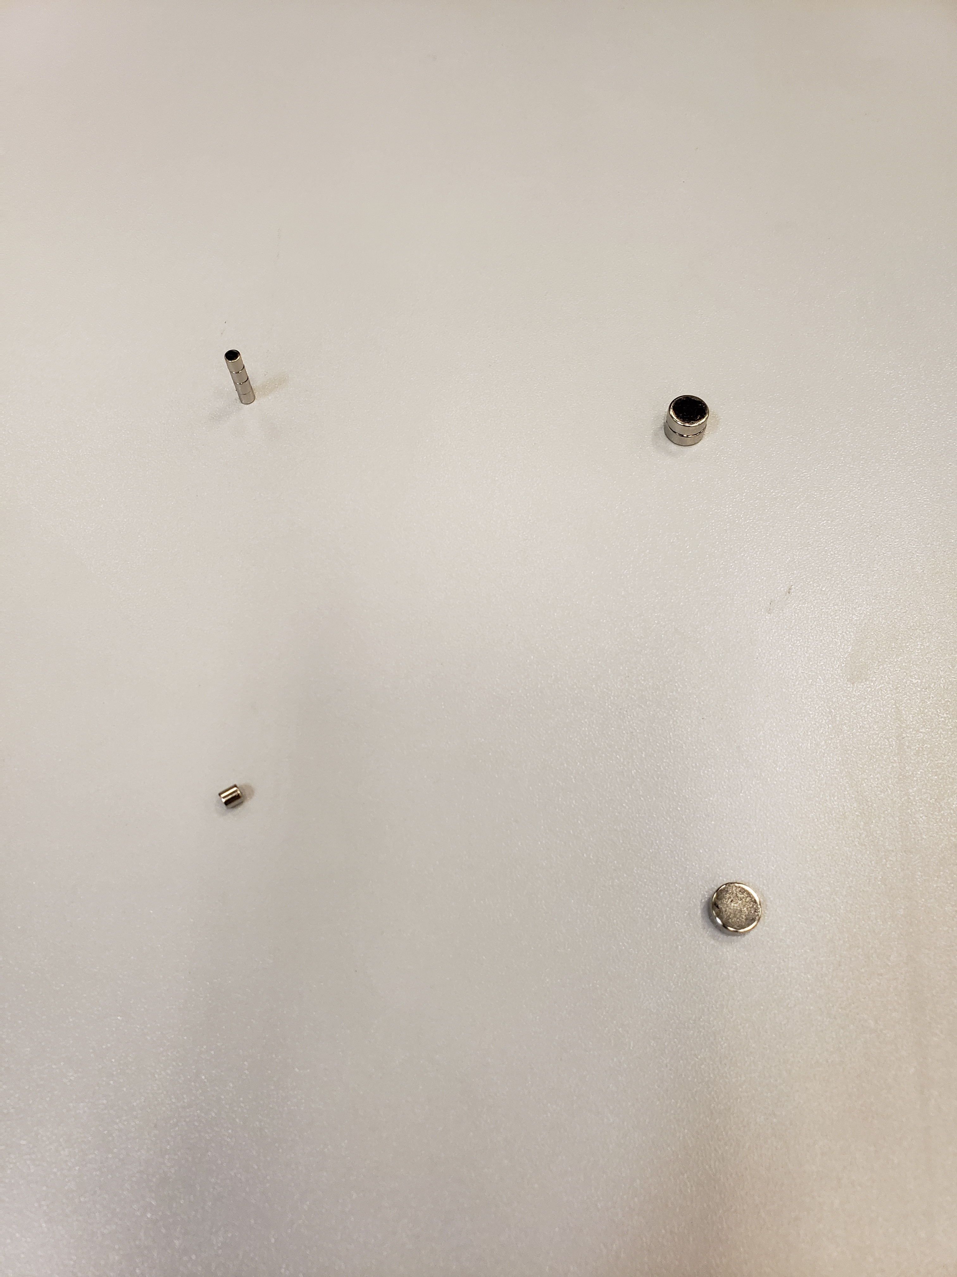
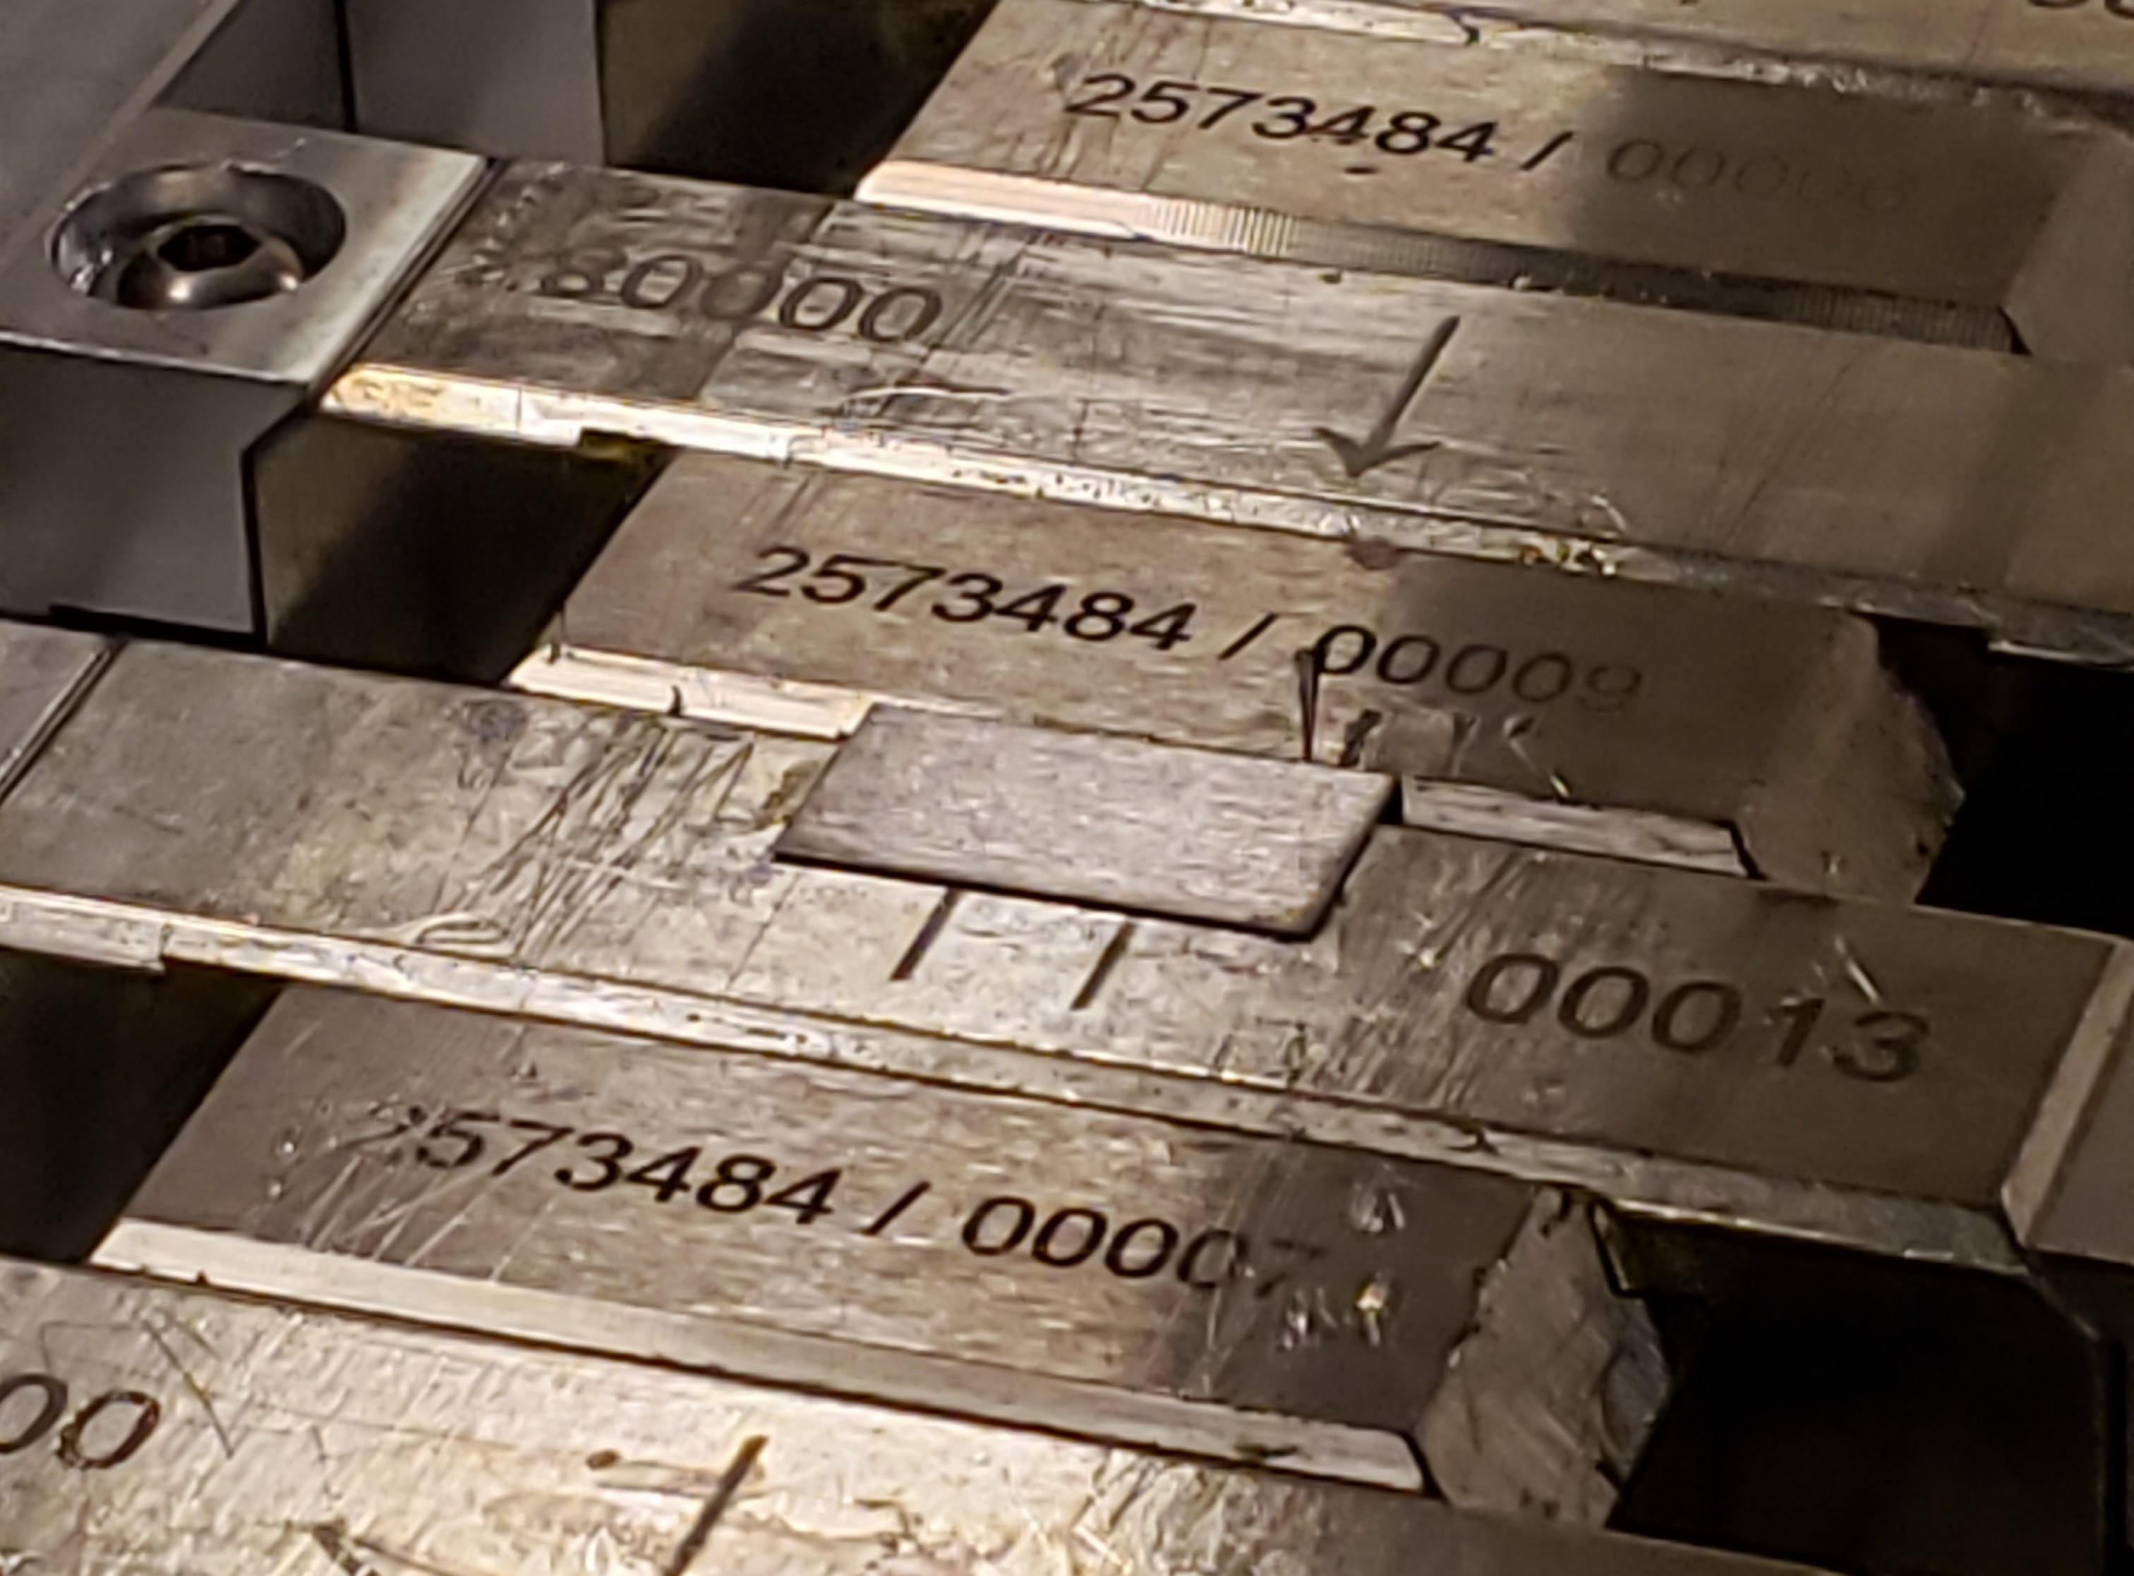
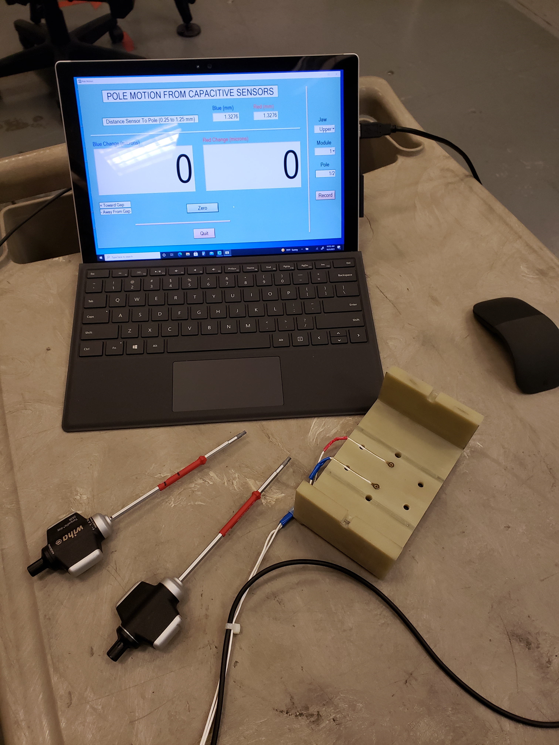
Shim signatures; options for tuning
Shim signature shows how installation of a shim or a few shims at the same time changes field integrals vs gap. (How a shim strength changes vs. gap.) Ideal shim signature has the same gap dependence as field integral to be tuned. Combinations of different types of shims used to get the correct shim signature.
Move poles vertically
Add magnet material
Ferromagnetic shim
Small ∅ 3mm
x 3mm slugs
Large ∅ 8mm
x 3mm slugs
Steel shim 7.5 x 15 x 0.17mm glued on top of a magnet
Two capacitive sensors
The main dipole, the transverse dipole and normal quadrupole could be corrected by pole shifts. With slugs skew quadrupole fields could be corrected also. Sextupole components could be corrected by ferromagnetic shims only.

Slide 8
Main field signatures
Combination of pole motion with ferromagnetic shim produces a signature closest to the required field shape.
Magnet recess in the magnetic structure increased from 0.140mm to 0.300mm, so that the installation of the ferromagnetic shims will not reduce the gap.
The main field reduced by ~0.5% from 1.85T to 1.84T.
No change in phase shake or field integrals.

Slide 9
Shim signatures for other field components.
The prototype field integrals were tuned to tolerances (±10µTm) by applying combinations of shims.

Slide 10
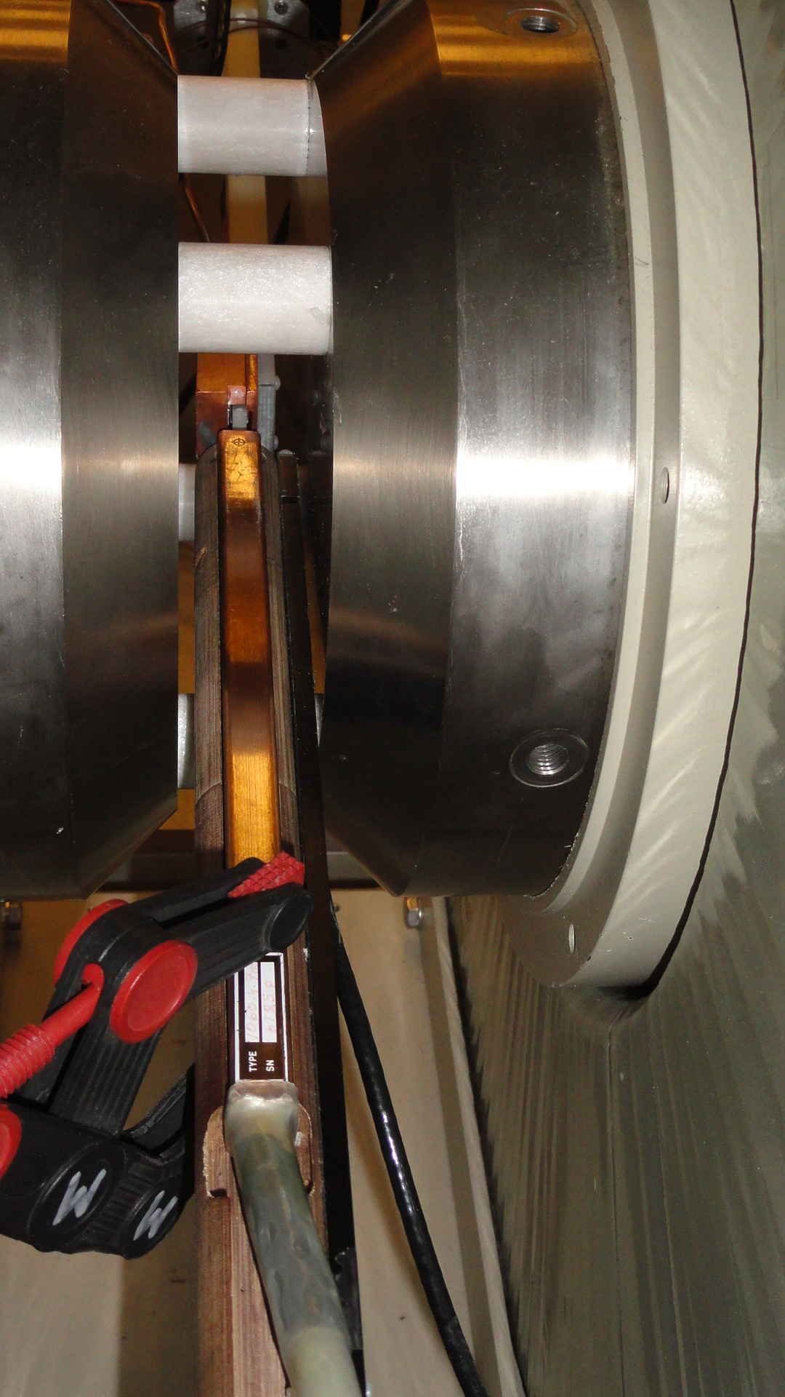
Hall probe calibration accuracy.
Project | B_{und}(T) | B_{calib}(T)
LCLS-I | 1.25 | 1.5
LCLS-II | 1.62 | 1.7
LCLS-II-HE | 1.76 | 1.9
The calibration magnet saturates reducing the good field region. Probes to be positioned with high accuracy.
The Hall probe has to be calibrated to higher field levels.
Hall Probe
No room to reduce the gap
NMR Probe
The calibration accuracy is ~5·10⁻⁵ (1G).
Probe output is very non-linear at fields above 1.5T.

Slide 11
Crosstalk between undulator and the phase shifter.
If the distance between an undulator and a phase shifter is too small the field integrals will change with gap change.
Set the prototype and a phase shifter next to each other at different spacing between them and measure field integrals vs. gap. Find the minimum distance at which the change in field integrals is insignificant.

