Slide 1
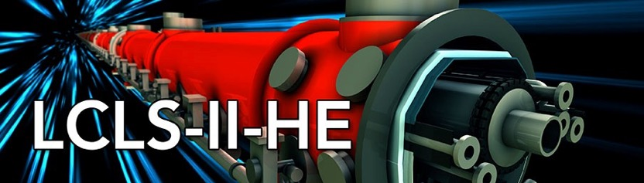





LCLS-II-HE SXU short prototype measurements at SLAC
Yurii Levashov & Zack Wolf
1/26/2021

Slide 2
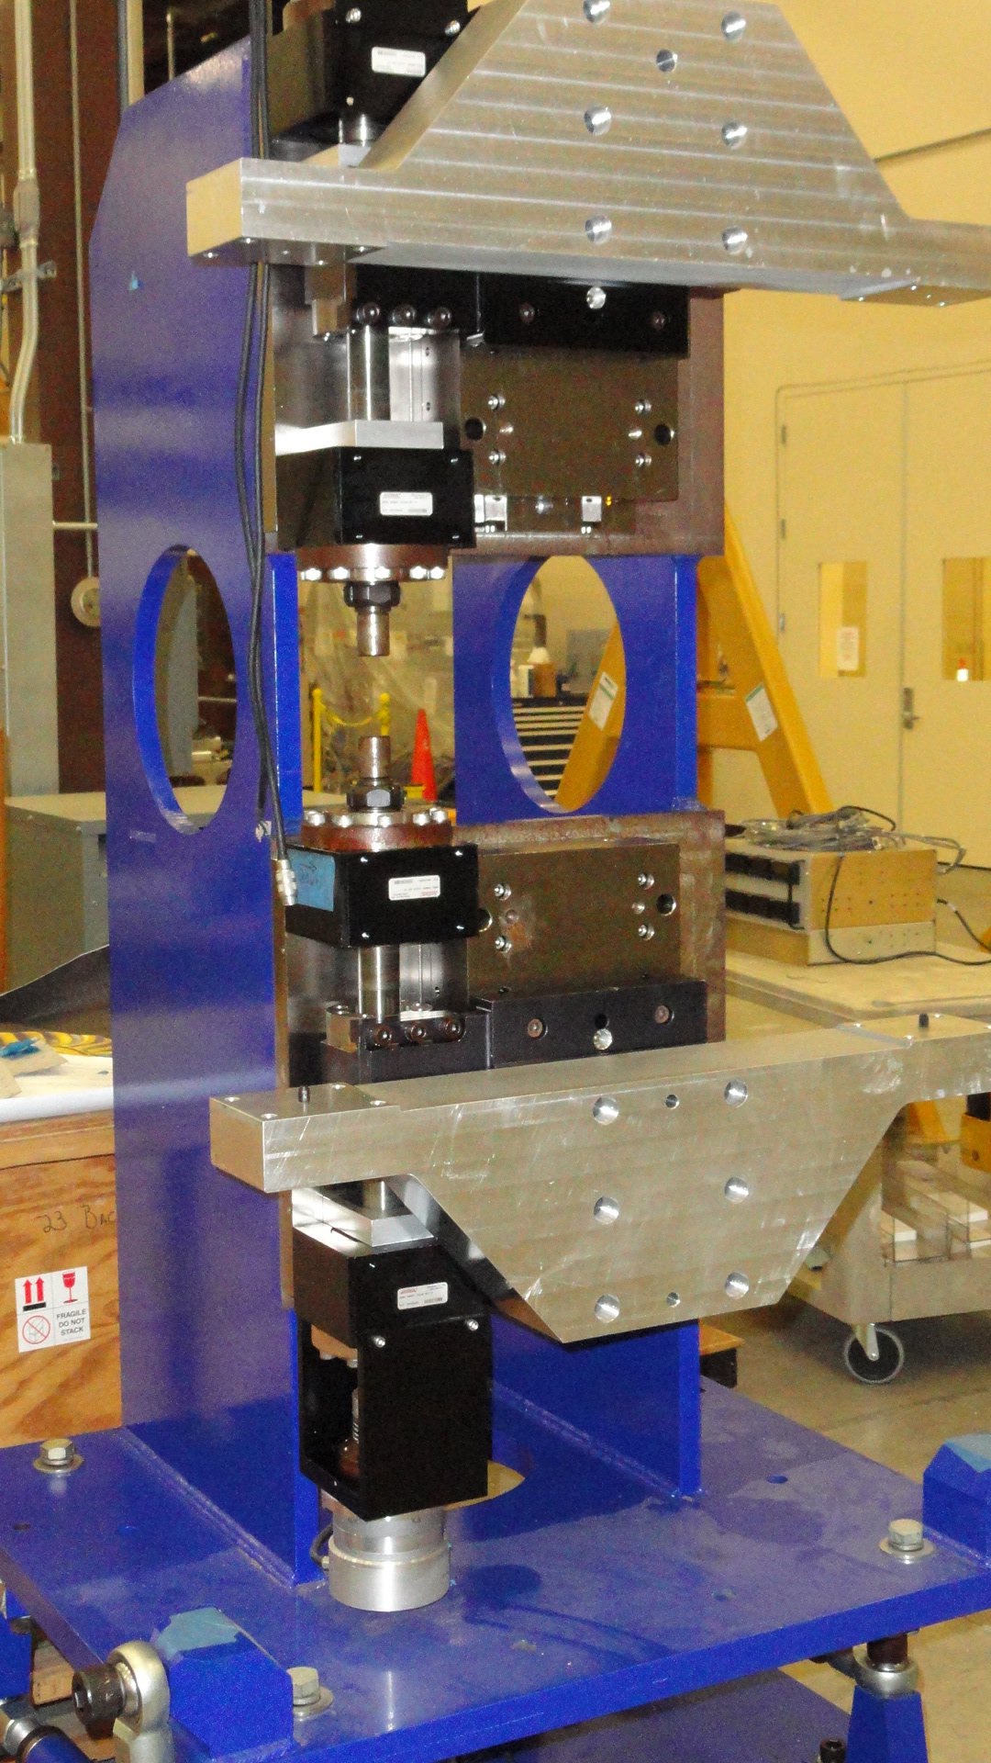
Outline
LBNL will make two short magnet structures instead of one and ship them to SLAC.
At SLAC we’ll assemble them on a 1m long prototype frame, leftover from LSLC-II project.
The frame to be evaluated and any required changes to be made in advance of receiving the magnet structures.
Tests will be performed on the short prototype at SLAC MMF.

Slide 3
Motivation & Scope
Evaluate the new magnetic design, confirm that it meets all the requirements. Get prepared in advance for the full-scale prototype tuning.
Tests:
Evaluate magnetic structure design.
Study shim signatures and saturation effects.
Evaluate effect of uniformity of magnetization of the magnet blocks.
Study Hall probe measurements at Kugler bench and Hall probe calibration.
Study magnet crosstalk between SXU undulator and the phase shifter.
Z.Wolf, Y.Levashov “10 Pole Prototype At SLAC”

Slide 4
Magnetic structure design
Evaluate end pole design (dimensions, strength and positioning of the magnets should not result in a noticeable beam trajectory kick and offset at all gaps in operational range), check if the peak field tolerance is met.
Test:
Measure the prototype with calibrated Hall probe, analyze the fields. Measure field integrals vs. gap.
It will take a week for initial installation, alignment, Hall probe calibration, touch probe and Hall probe measurements, and for small modifications to our measurement and simulations software.

Slide 5
Shim signatures and saturation effects.
Test: Measure the field integrals vs. gap, install a shim, measure again, and calculate shim signatures. Do it for poles with different strength and for different types of shims. Evaluate if shims are adequate for tuning.
~2 weeks.

Slide 6
Non-uniformity of magnetization of magnet blocks
Larger blocks lead to larger magnetization uniformities and error fields. Sorting will reduce the errors.
Shims and magnetization errors have different gap dependencies.
Test:
Have field integrals vs. gaps measured. Compare with shim signatures.
Evaluate any required strategies for dealing with magnetization errors.

Slide 7
Hall probe calibration accuracy.
The fields are higher than in previous undulators. The Hall probe has to be calibrated to higher field levels. The calibration magnet saturates reducing the good field region.
 | B_{und}(T) | B_{calib}(T)
LCLS-I | 1.25 | 1.5
LCLS-II | 1.62 | 1.7
LCLS-II-HE | 1.8 | 1.9
Challenge: The probes have to be positioned accurately in the magnet to be at the same field.

Slide 8
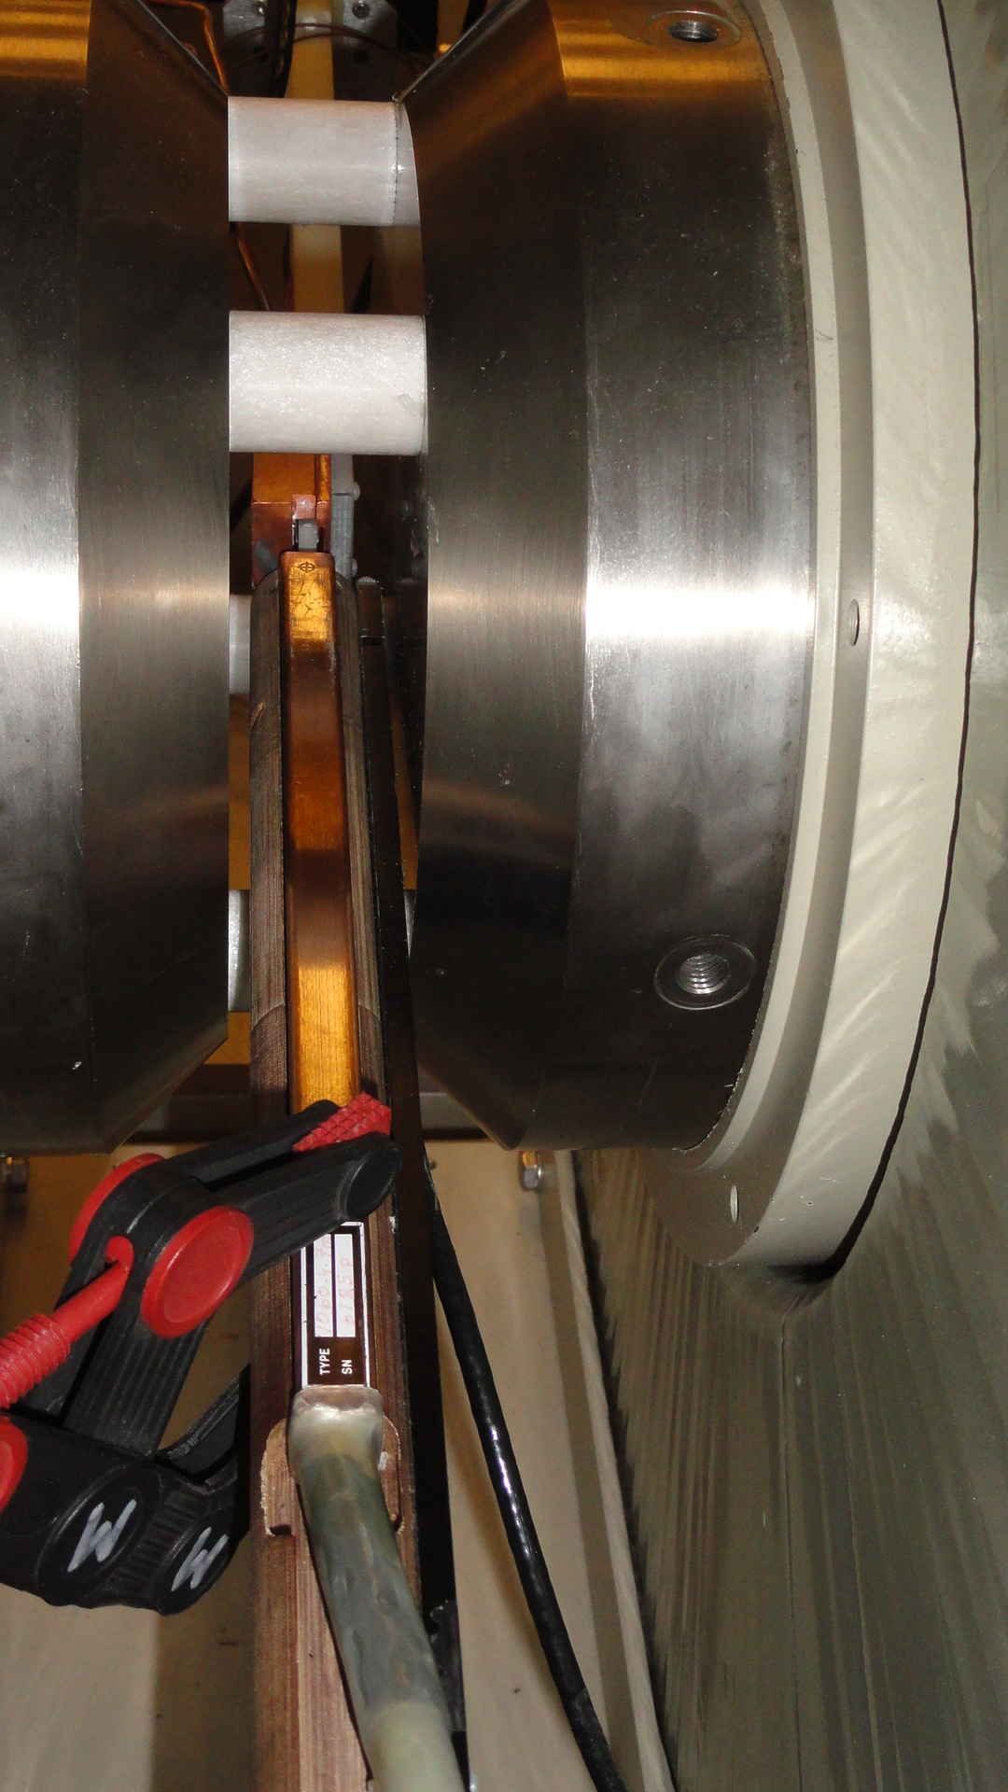
Hall probe calibration and measurements.
Hall Probe
NMR Probe
No room to reduce the gap
Test:
Calibrate the probe, measure the undulator prototype, calibrate probe again and so on.
The prototype set at the same minimum gap of 7.2mm.
The calibration plus measurements - two days; do it once a week for 4-5 weeks.

Slide 9
Crosstalk between undulator and the phase shifter.
If the distance between an undulator and a phase shifter is too small the field integrals will change with gap change.
Test:
Set the prototype and a phase shifter next to each other at different spacing between them and measure field integrals vs. gap. Find the minimum distance at which the change in field integrals is insignificant. The measurements will take ~ 2 weeks.

