Slide 1





Short prototype measurements
(shim signatures)
Yurii Levashov
10/12/2021

Slide 2
Outline
  Measurement set-up
  Field integrals’ gap dependence
  Options for shimming
  Main dipole field shims and corresponding signatures
  Skew quad shims
  Bx field shims
  Summary

Slide 3
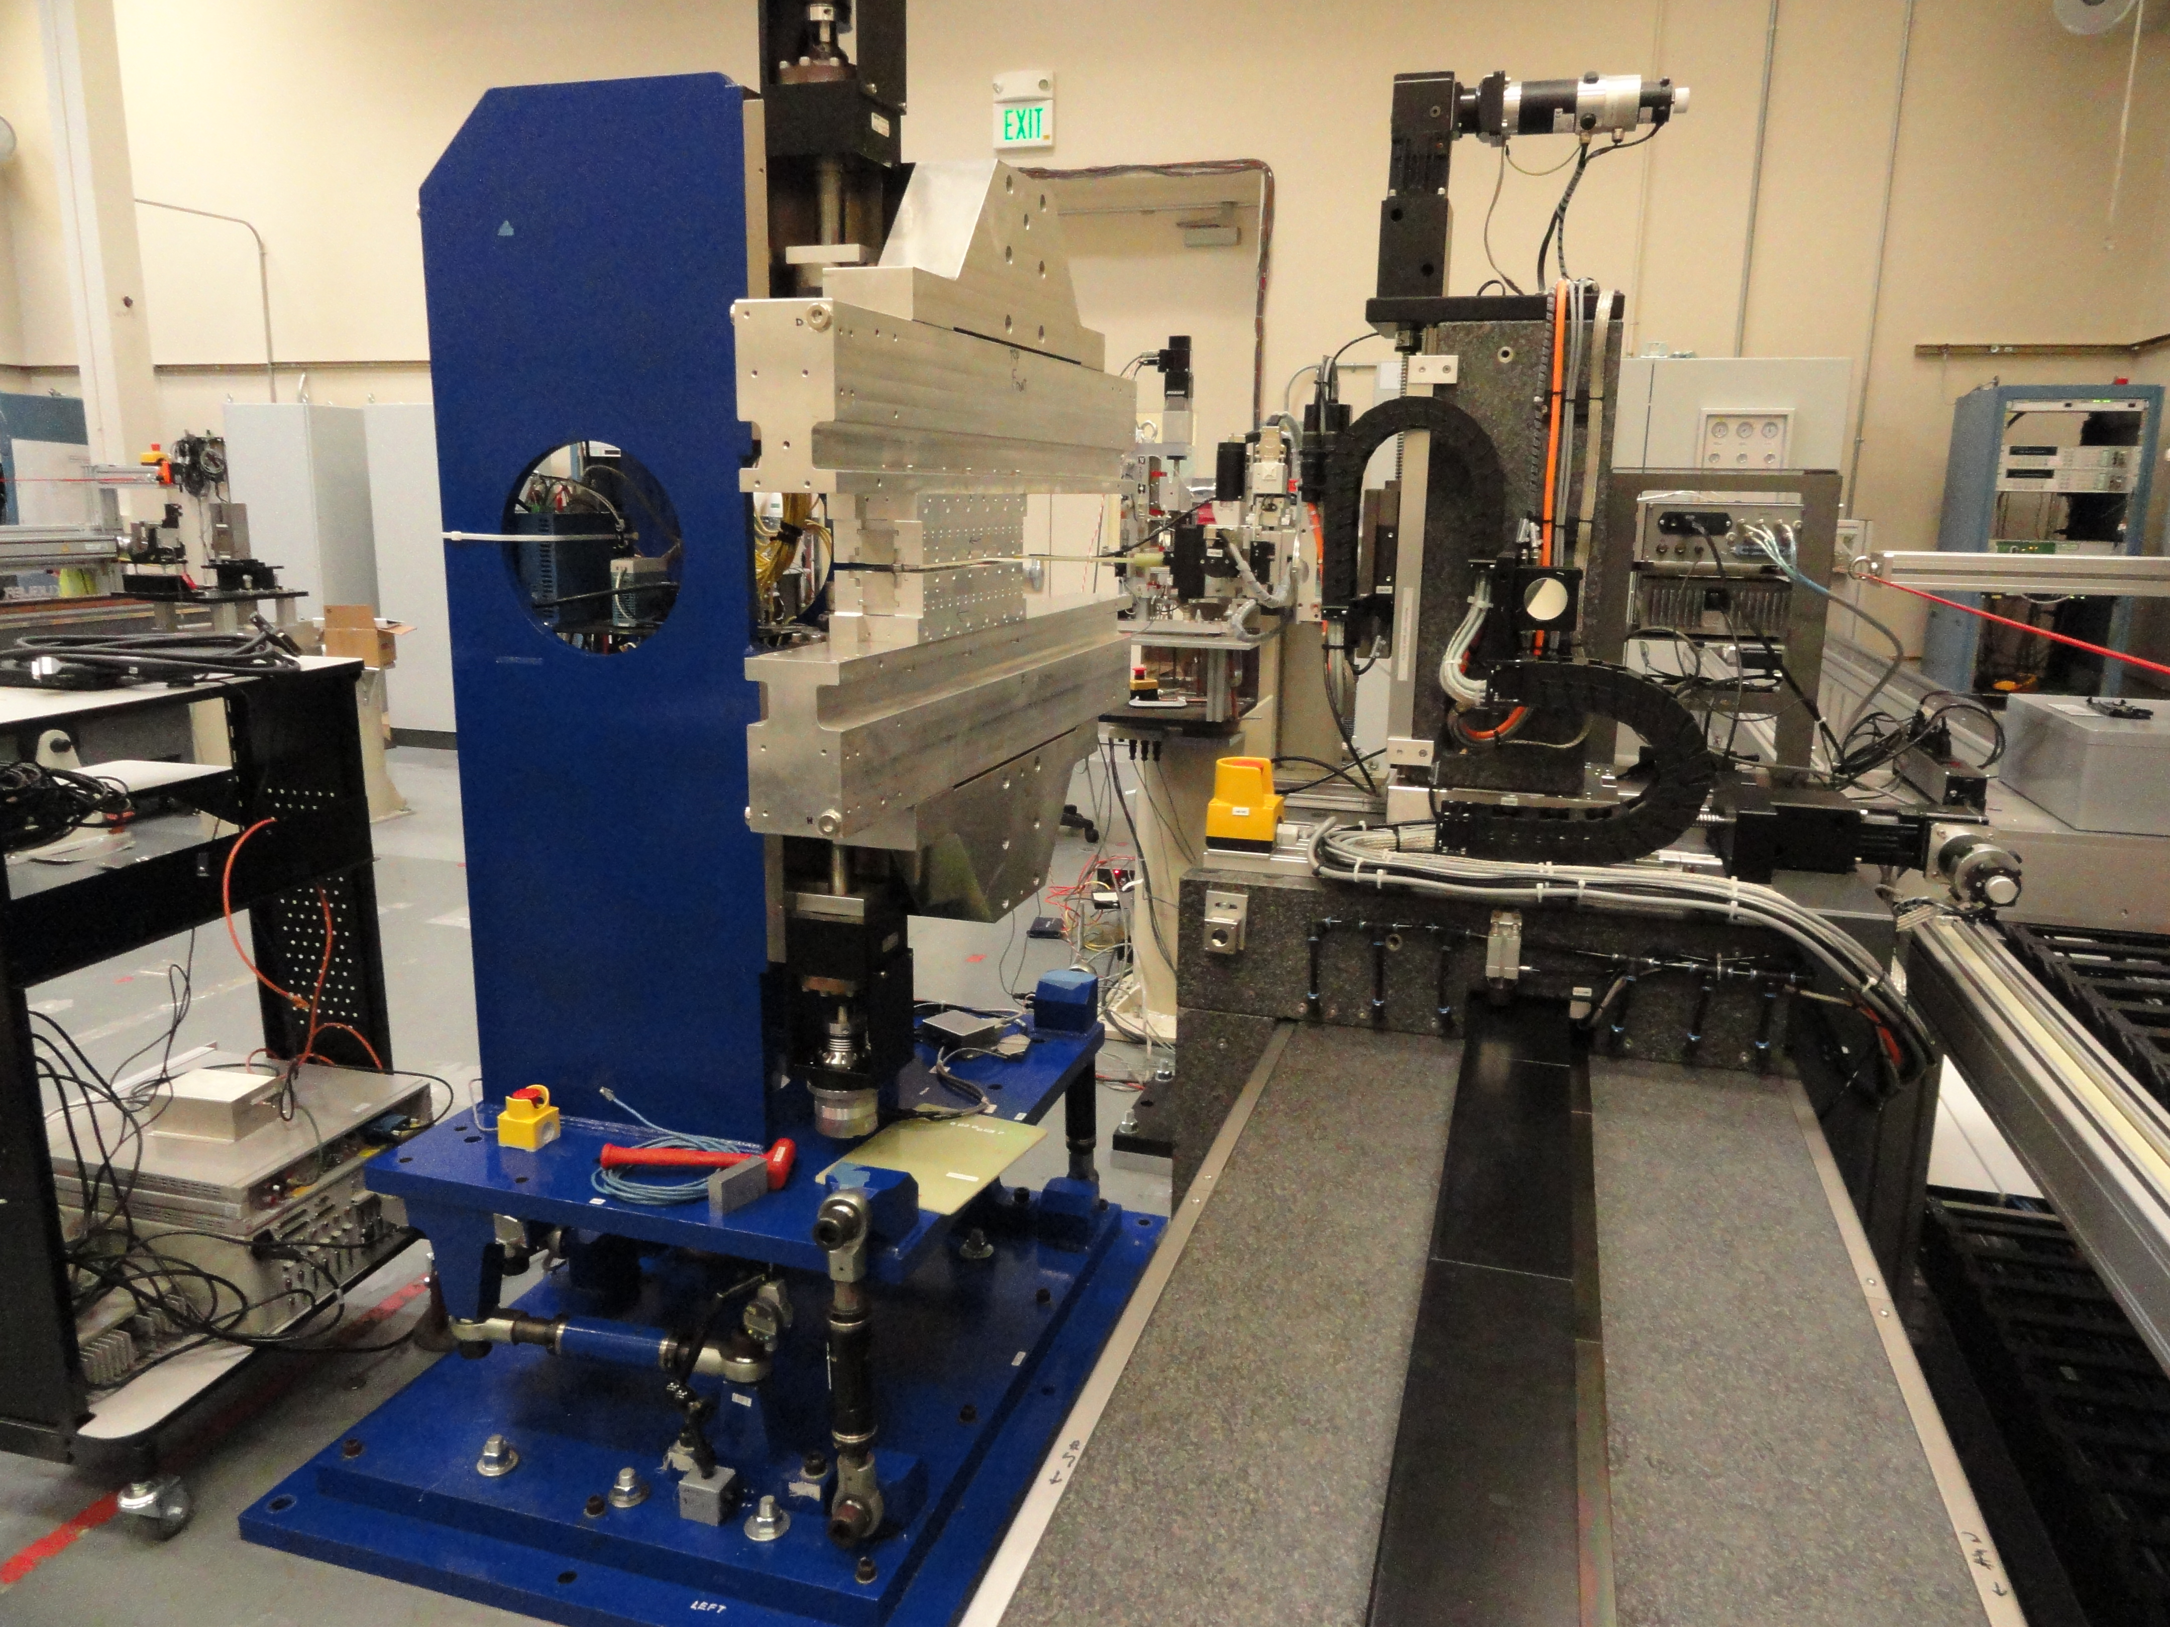
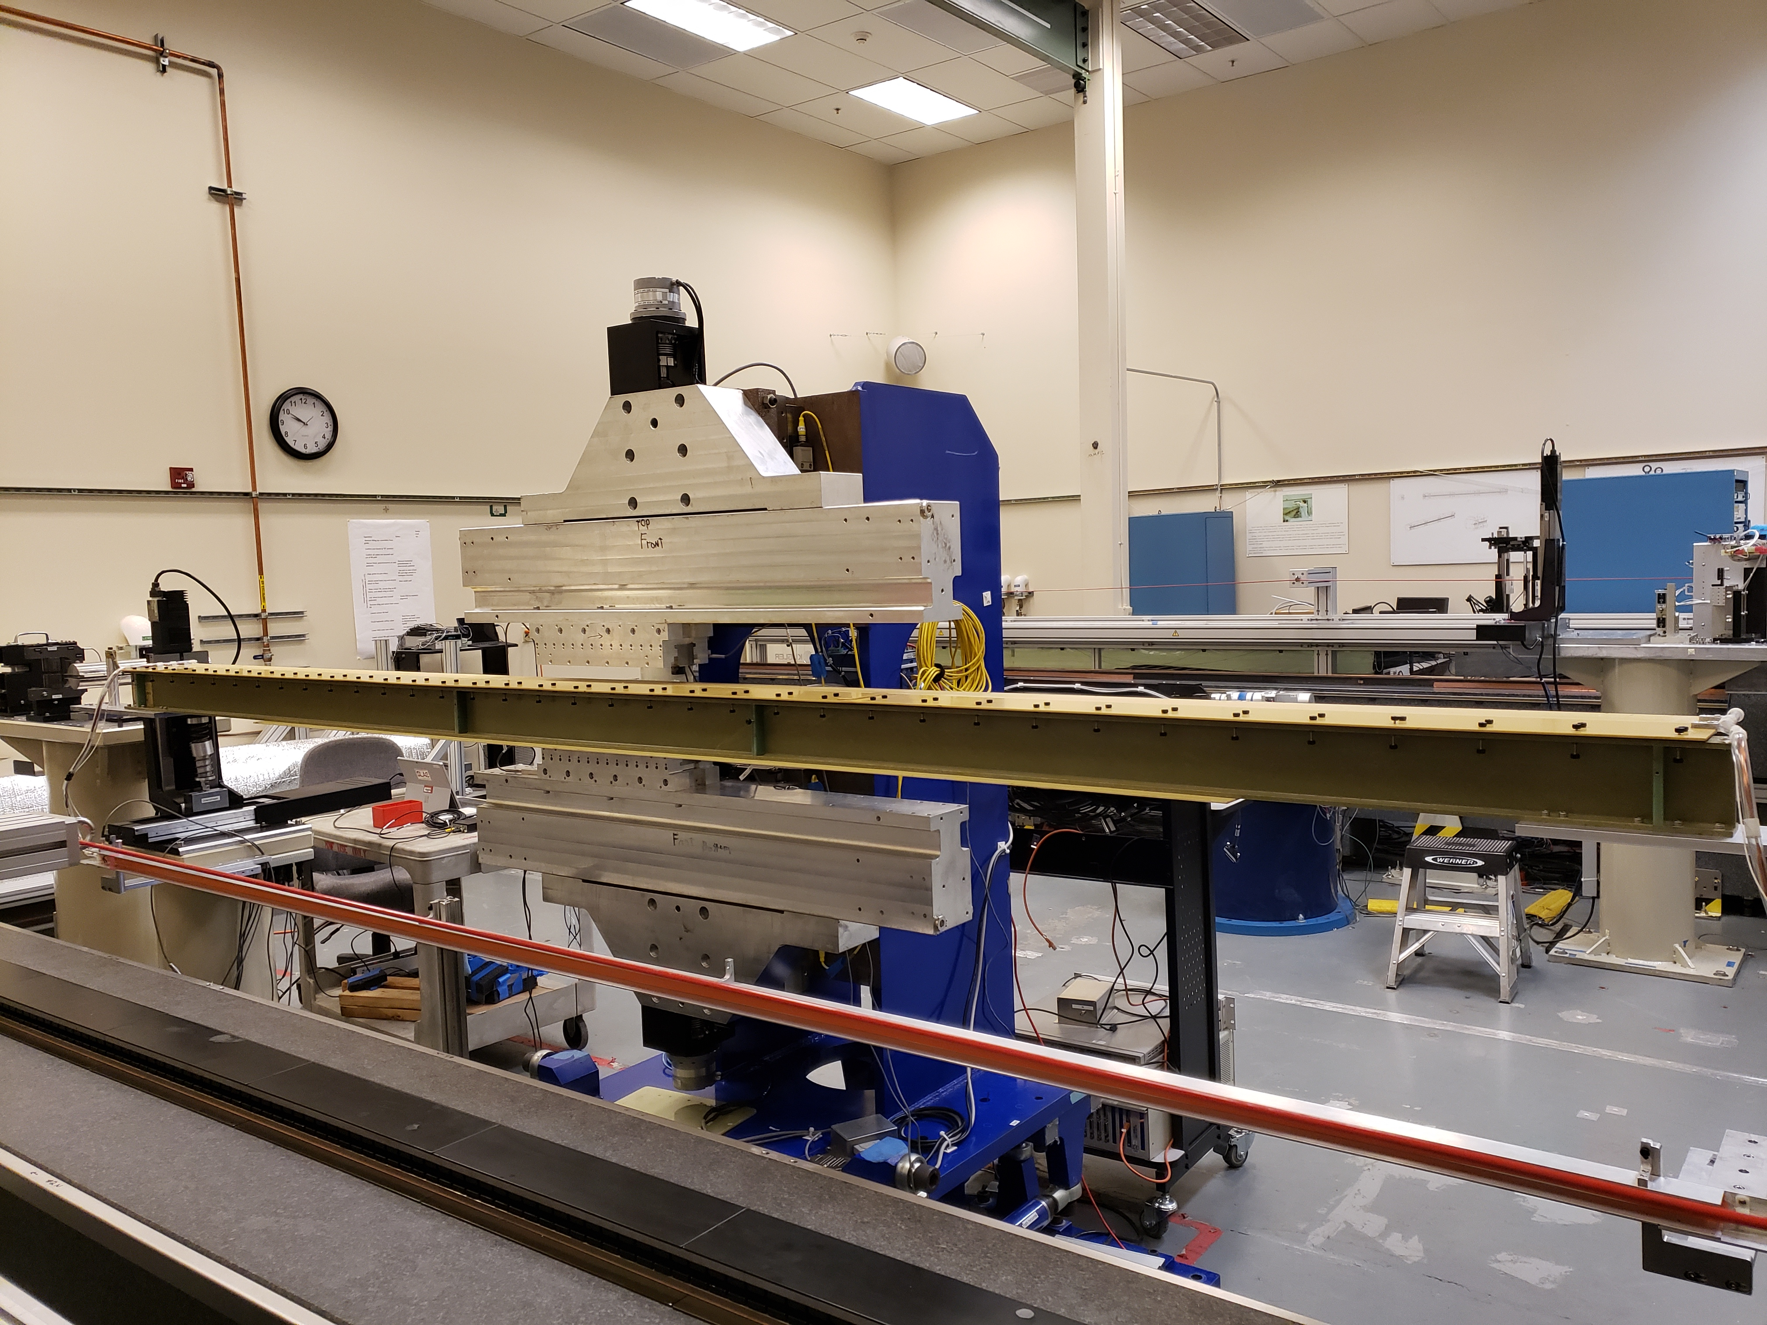
Measurement set-up
  Initial measurements by Sentron 2-D Hall probe.
  The K at 7.2mm gap = 9.69 ( 9.21 PRD); 5% stronger!
  Shim signature =
  difference in field integrals vs gap
  (Shim installed – No shim)
  Long coil used for measuring field integrals.

Slide 4
SXU field integral gap dependence
From LCLS-II experience the most challenging was the main field and the skew quad tuning.
SXU-017
SXU Short Prototype
We expect a similar gap dependence of field integrals for SXU-HEs .
The source of the field errors to be investigated.
Goal: Find a shim signature with a close shape.

Slide 5
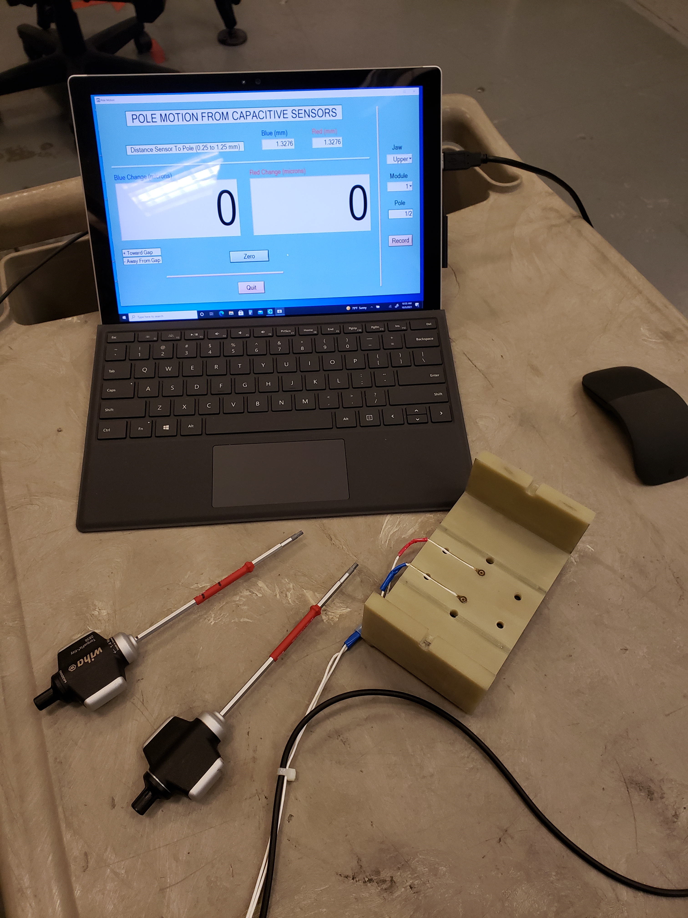
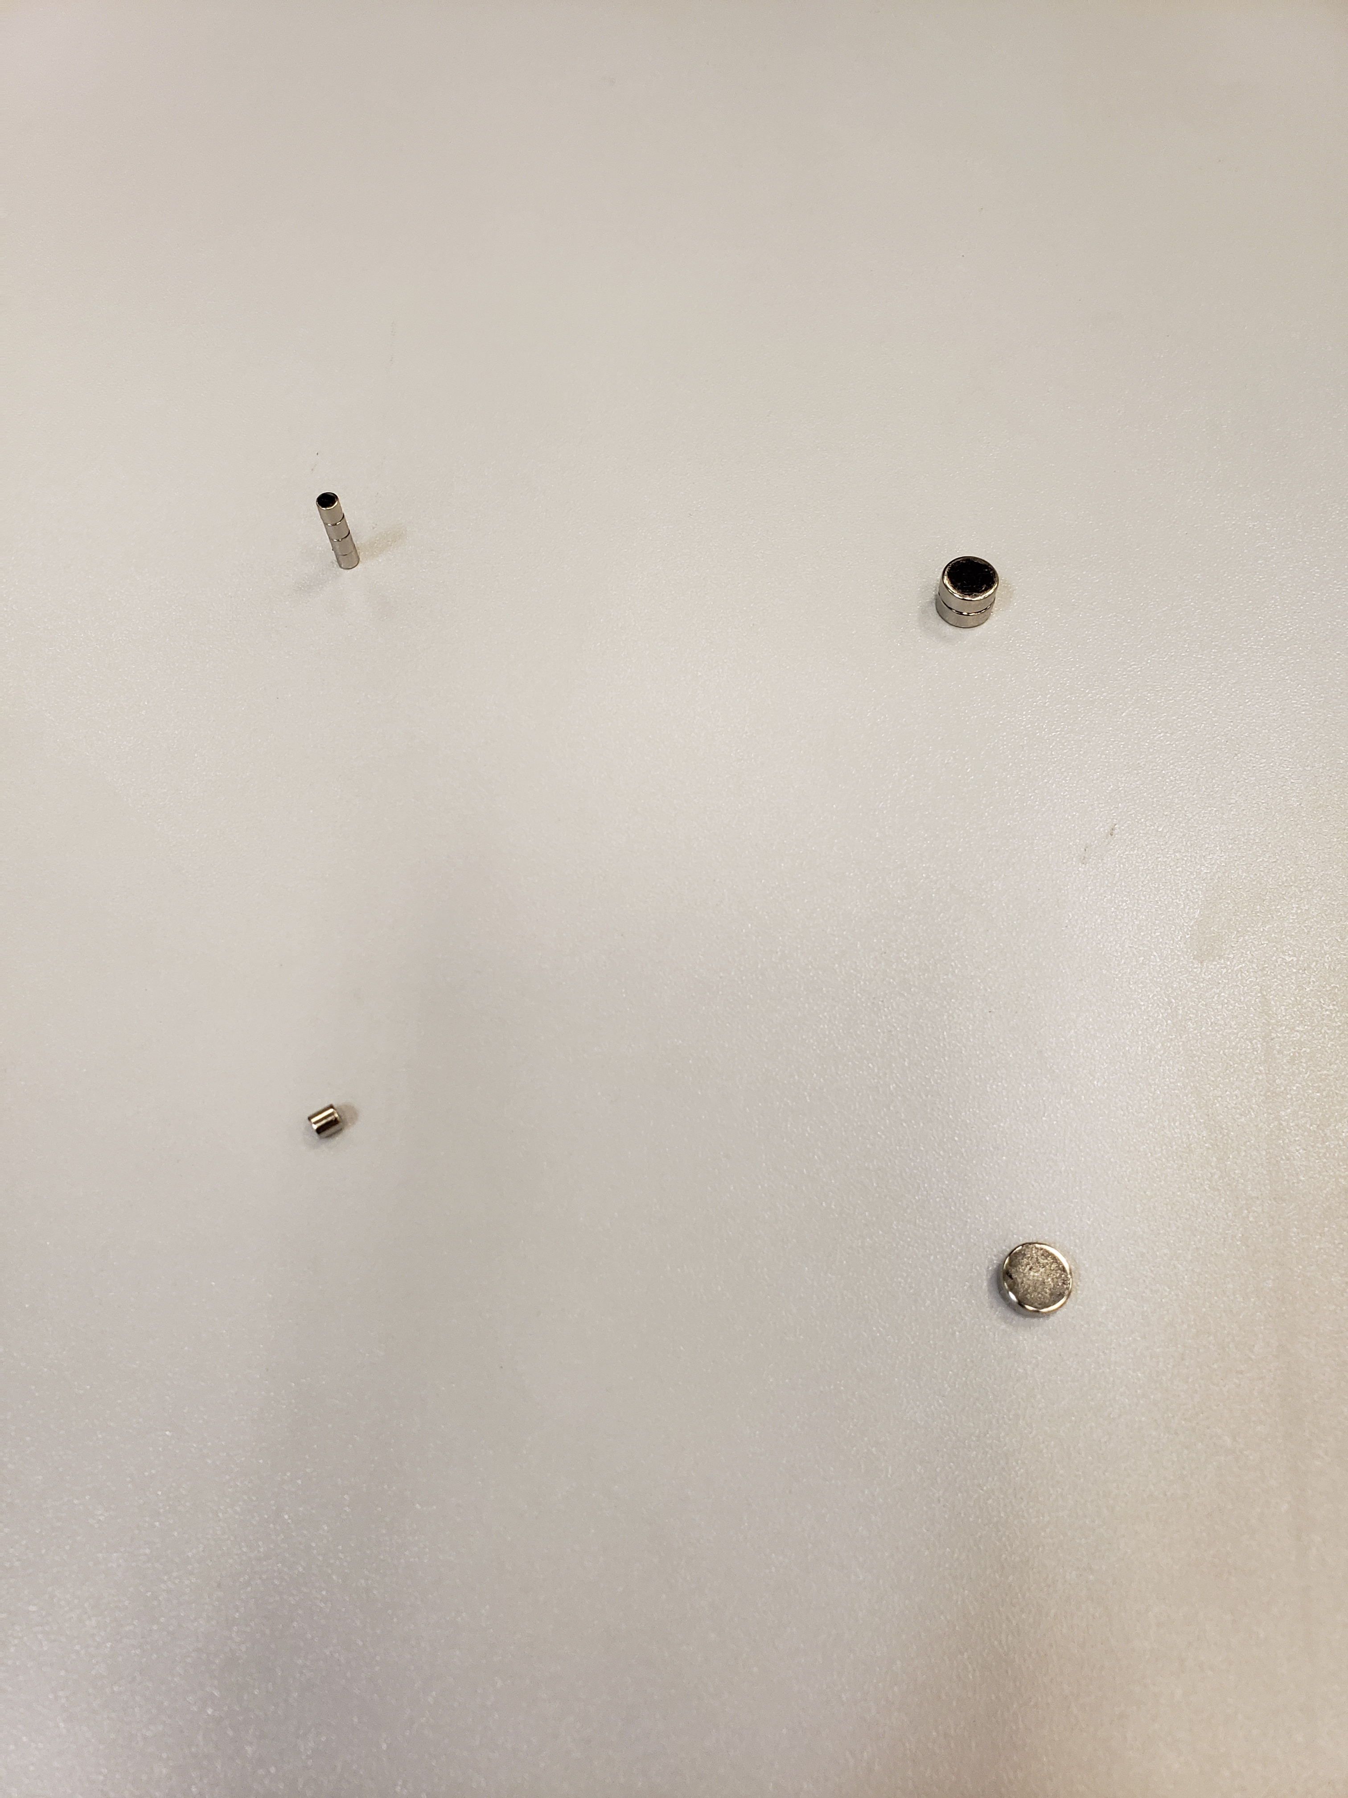
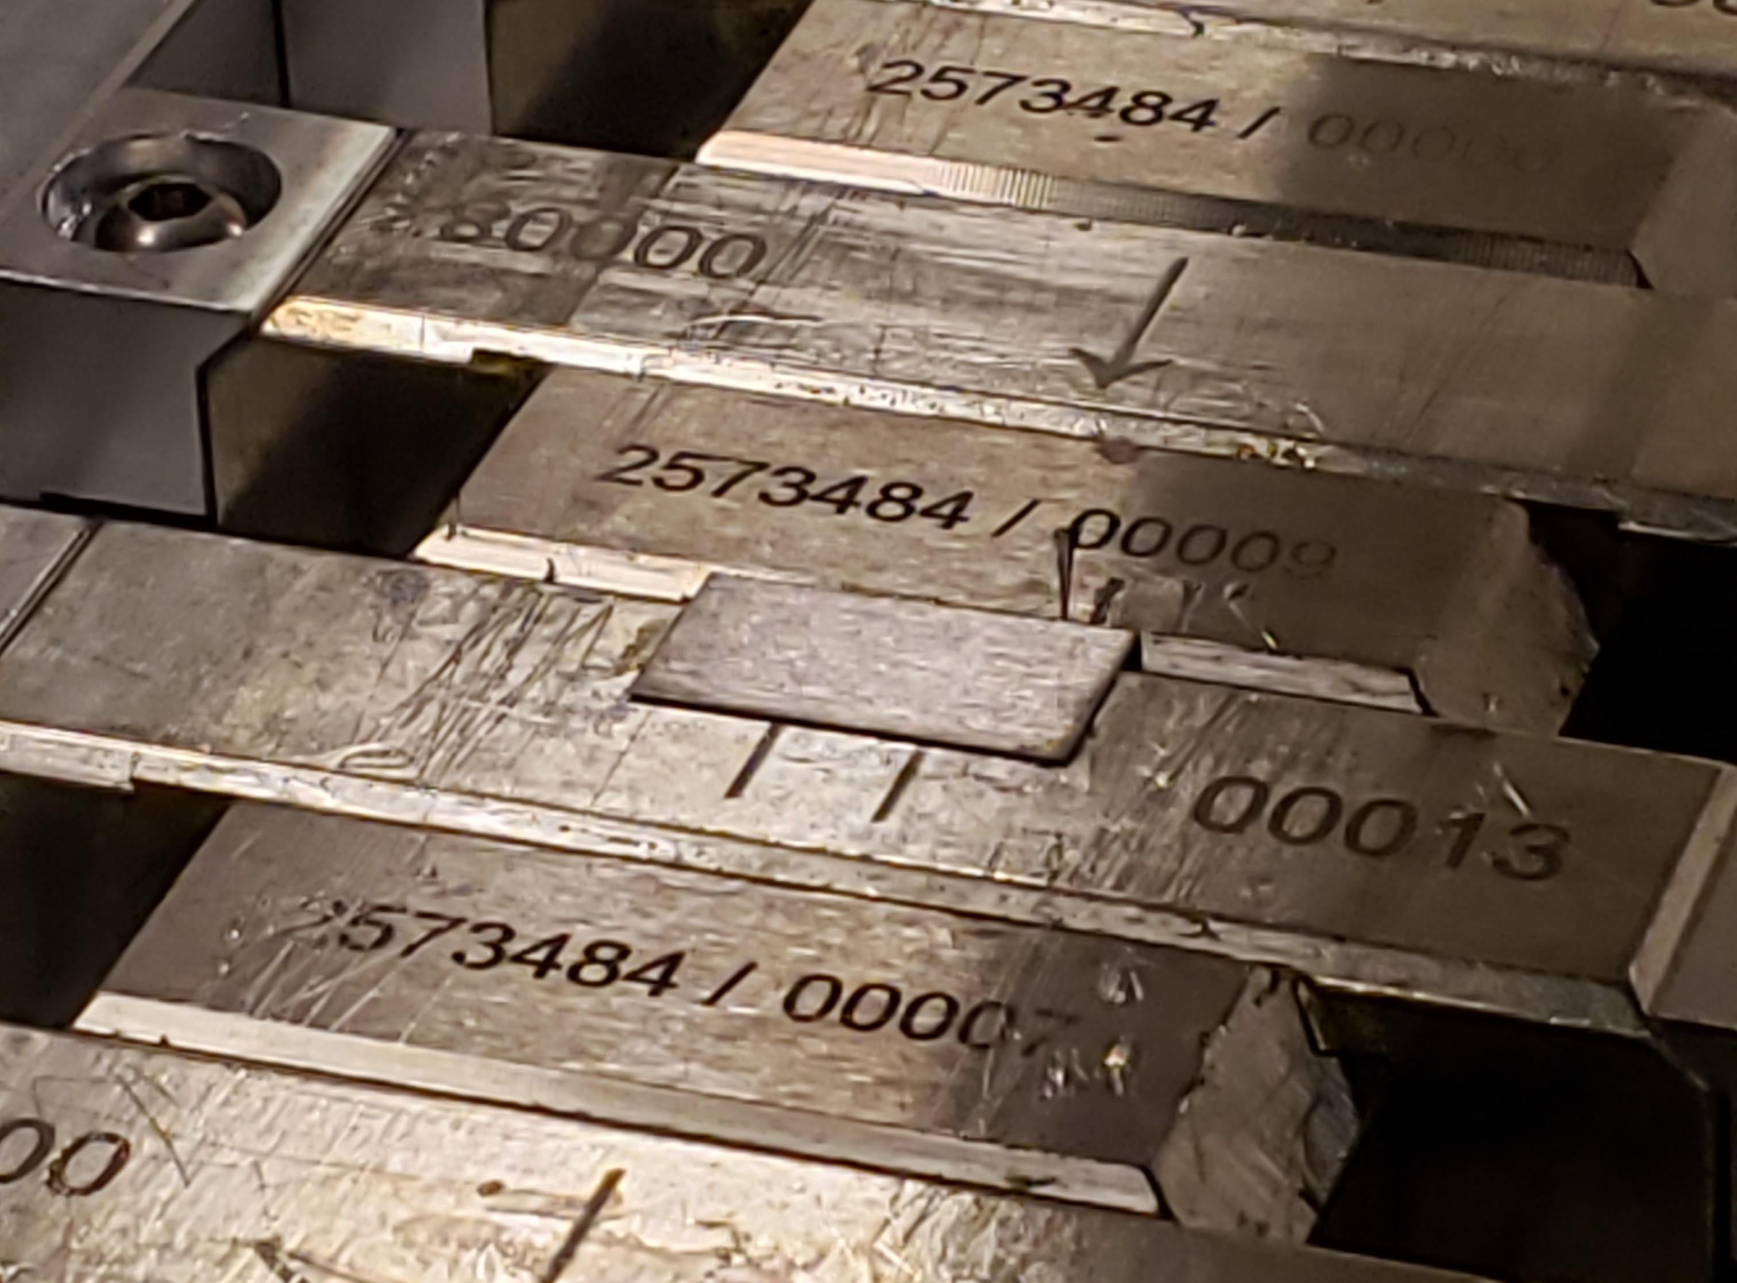
Options for field integral tuning
Change gap by
moving poles
Add magnet material
Add iron shim
Small ∅ 3mm
x 3mm slugs
Large ∅ 8mm
x 3mm slugs
Steel shim 7.5 x 15 x 0.17mm glued on top of a magnet
Two capacitive sensors

Slide 6
Main field shims
Pole
Pole shift
Small slugs
Large H-slugs
Large V-slugs
Magnet
Pole
Magnet
½ ∆G
Steel shim

Slide 7
Main field signatures

Slide 8
Skew quad shims
Small slugs
Large H-slugs
Large V-slugs
Pole
Magnet
Pole
Magnet
Steel shim

Slide 9
Bx field shims
Pole roll
Large H-slugs
Large V-slugs
Pole
Magnet

Slide 10
Summary
The main field on axis at 7.2mm gap is stronger than needed by ~5%.
The field integral gap dependence is similar to SXU undulators.
The pole saturation is small.
Skew quadrupole shims are weak. Steel shims are desirable for having correct shim signatures for the main field and the skew quadrupole.
To have steel shim option for tuning, the magnet should be recessed w.r.t. the poles by 0.250mm, minimum.
To test if the bigger magnet recess does not reduce the main field too much and if it will reduce the effect of magnetization errors , the following is planned:
Remove magnet arrays from the strongbacks (1 day).
Move all poles up by 150µm (technician training in pole adjustments, 1 day).
Check pole/magnet alignment on CMM (CMM programming for SXU-HE, 3 days).
Re-install magnet arrays/re-measure with Hall probe (~1 week).

