Slide 1
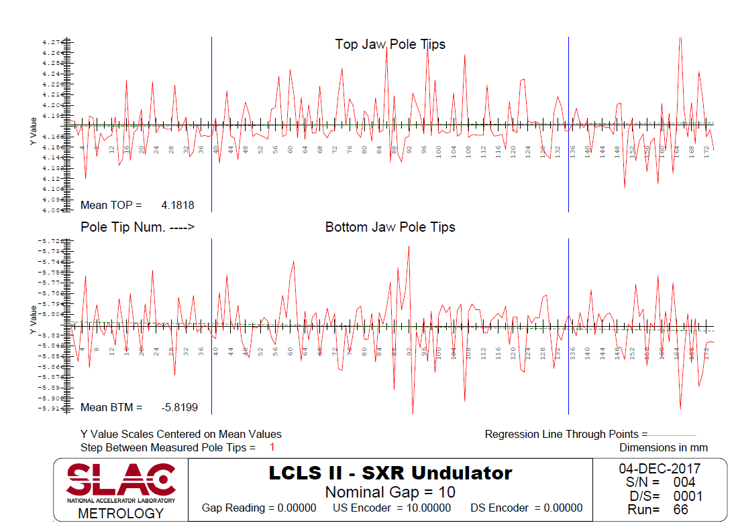
Taper = 0.011mm
Gap = 10.002mm

Slide 2
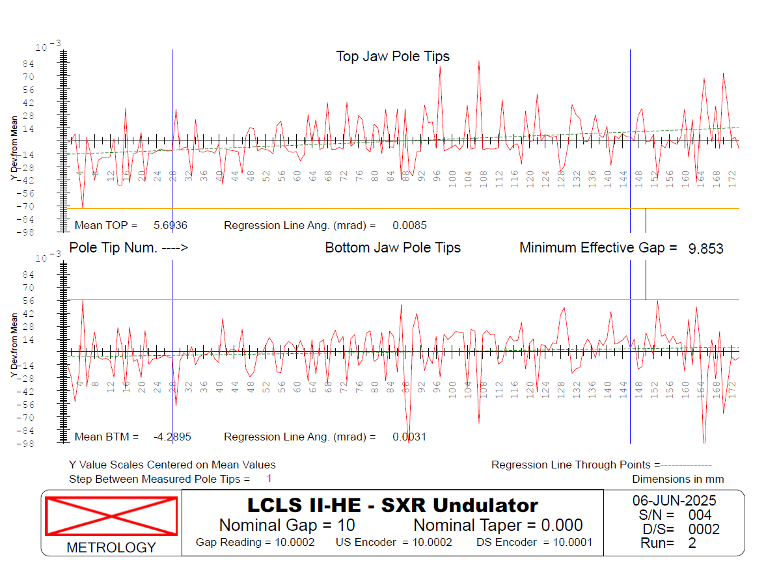
Taper = 0.022mm
Gap = 9.983mm
Δgap = -19µm+ (22-11)/2 ≈ - 13µm

Slide 3
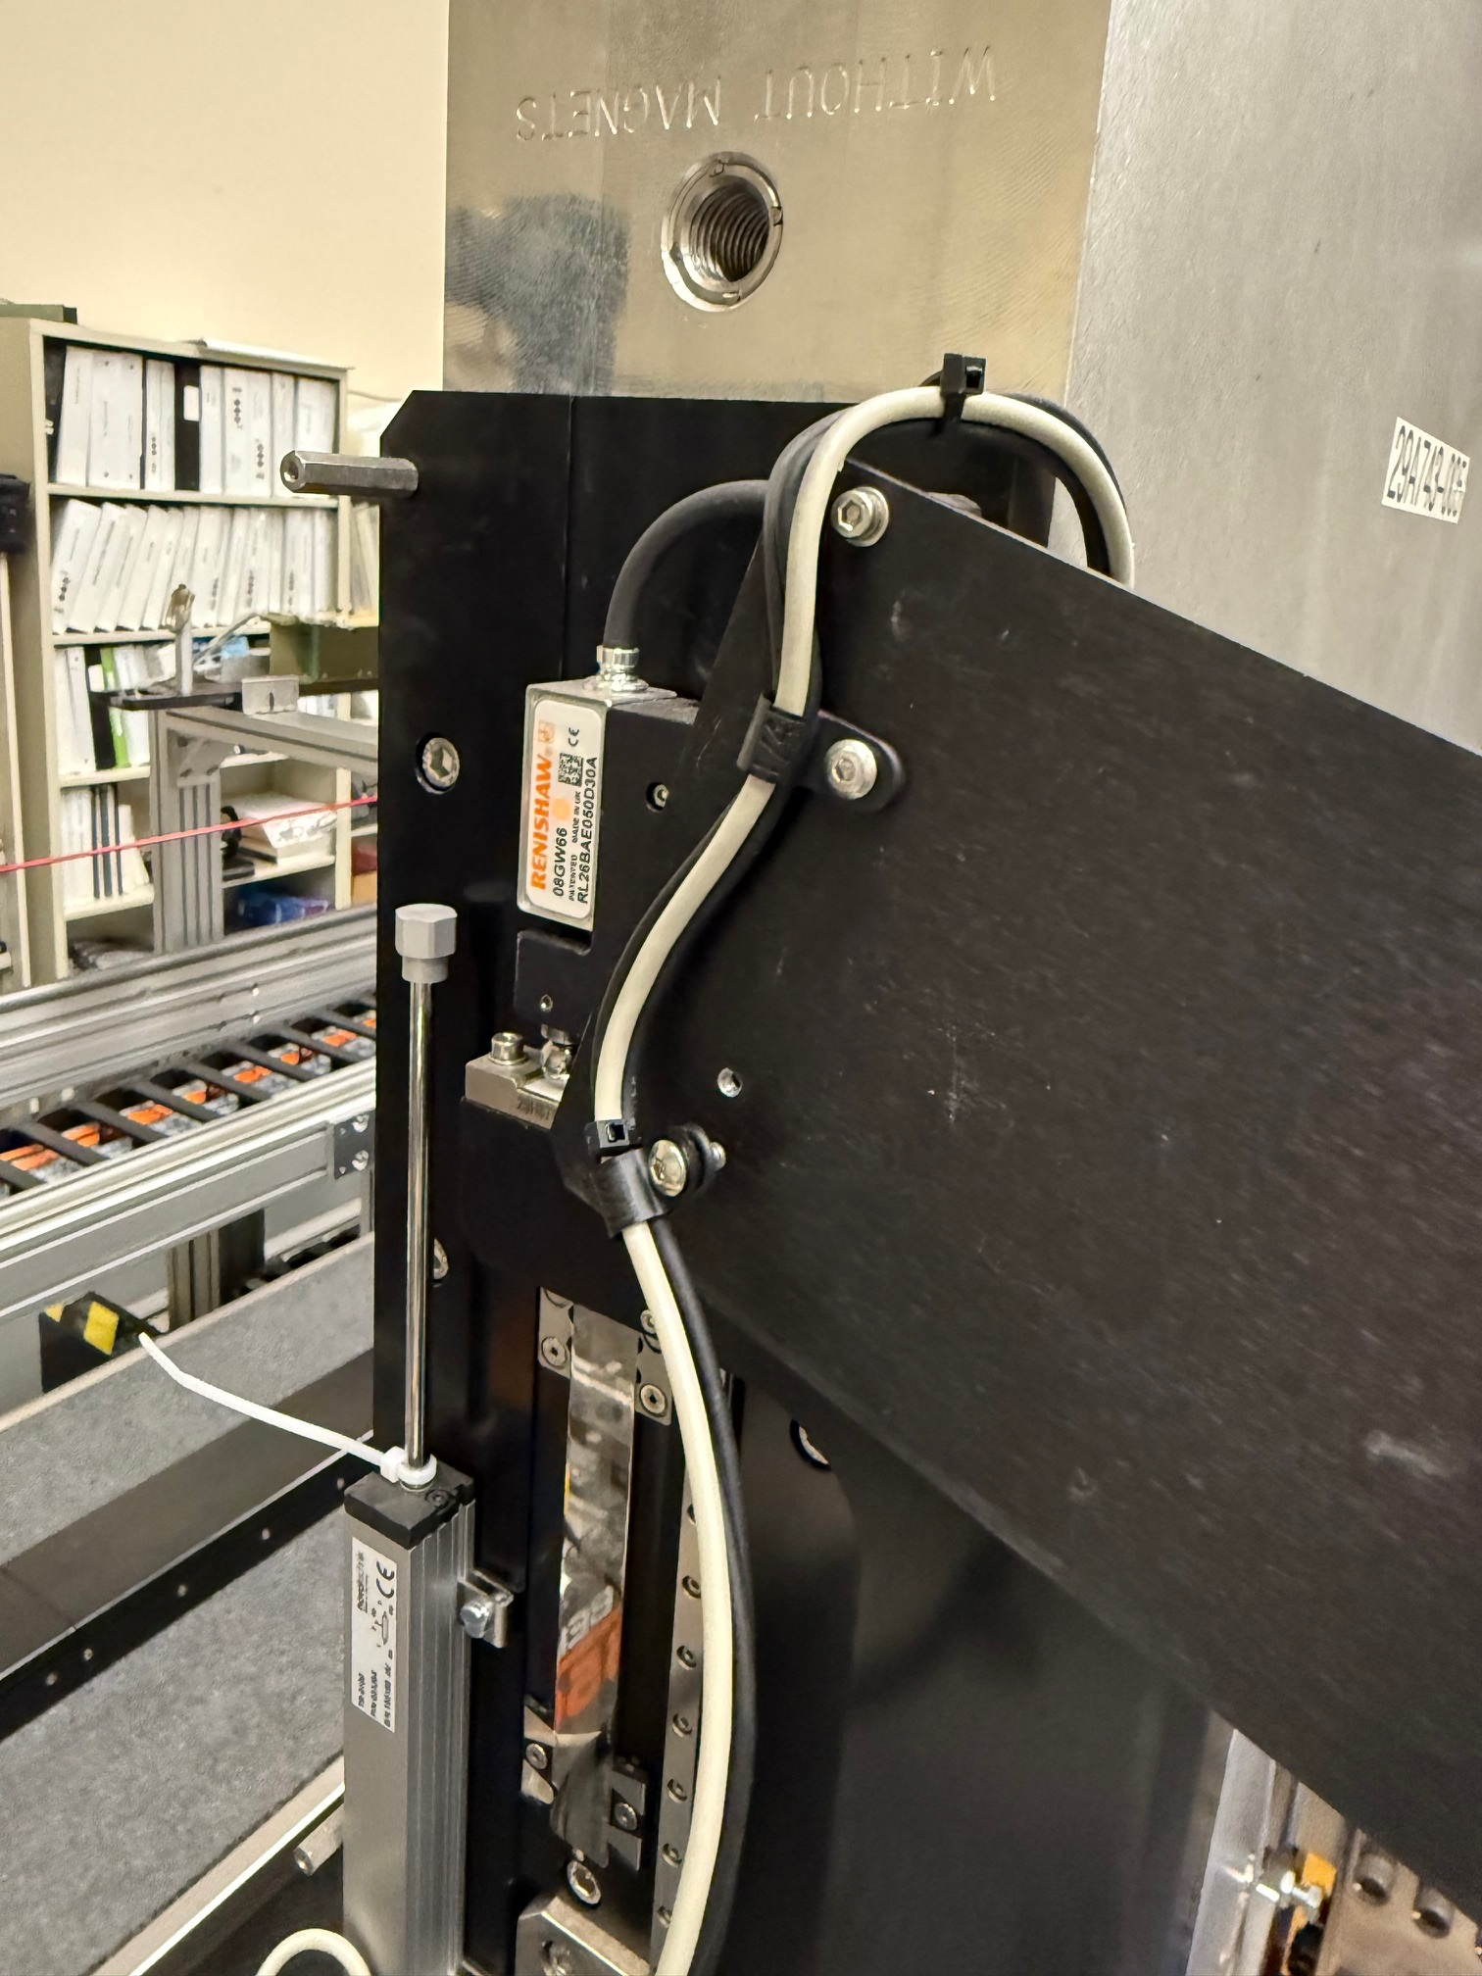
Must be blue or green

