Slide 1
HE-SXU-000 Transportation & Storage test Results
Calibration measurements (October 12, 2022)
Transportation test (Test - October 20, 2022; Measurements - Nov.2, 2022)
Storage test (Dec. 6, 2022 – Jan. 17, 2023, Measurements - Jan. 20)
Temperature test (Jan. – Feb. 2023), in progress
Z. Wolf, Y. Levashov. LCLS-II-HE SXR Undulator Transportation Test Results. LCLS-TN-22-10

Slide 2
HE-SXU-000 Tuning Results
Summary:
Field integrals tuned to tolerances in operational range 7.2mm to 33mm.
Phase errors tuned well below tolerance in operational range.
The K-value at 7.2mm gap is 9.7355 (~5% higher than required).

Slide 3
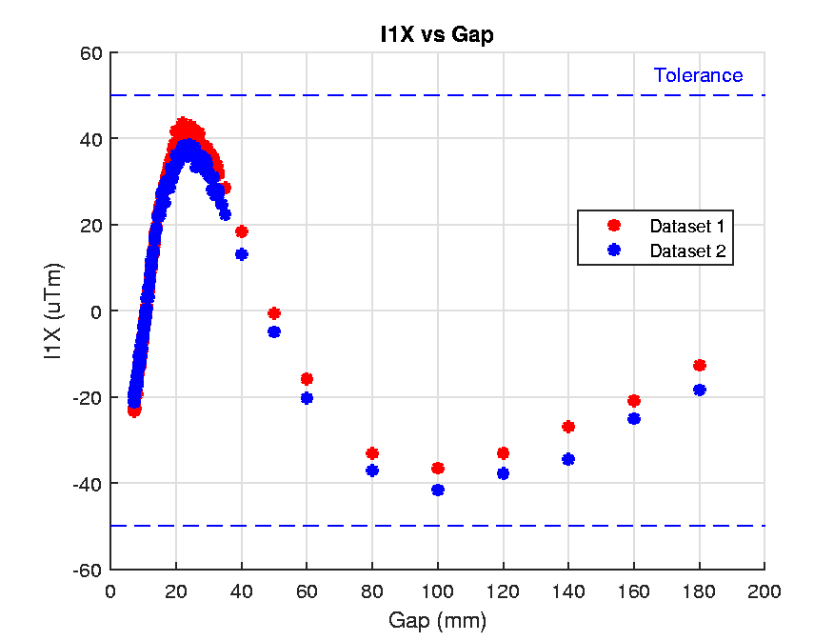
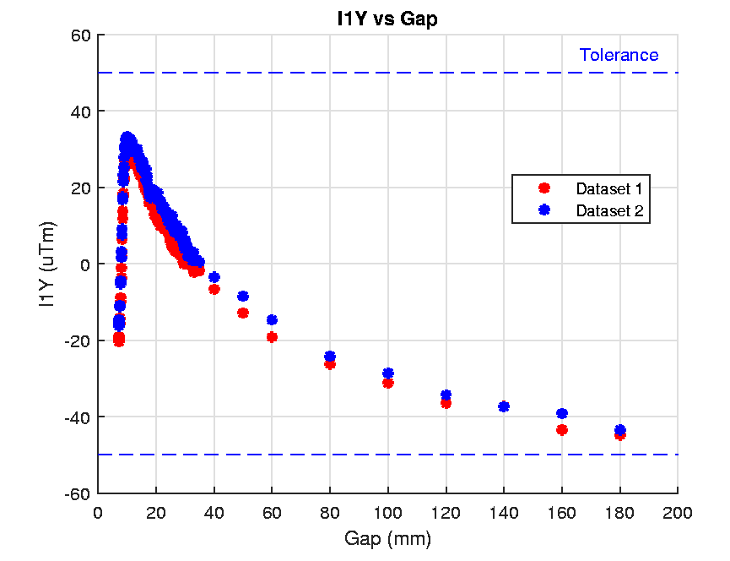
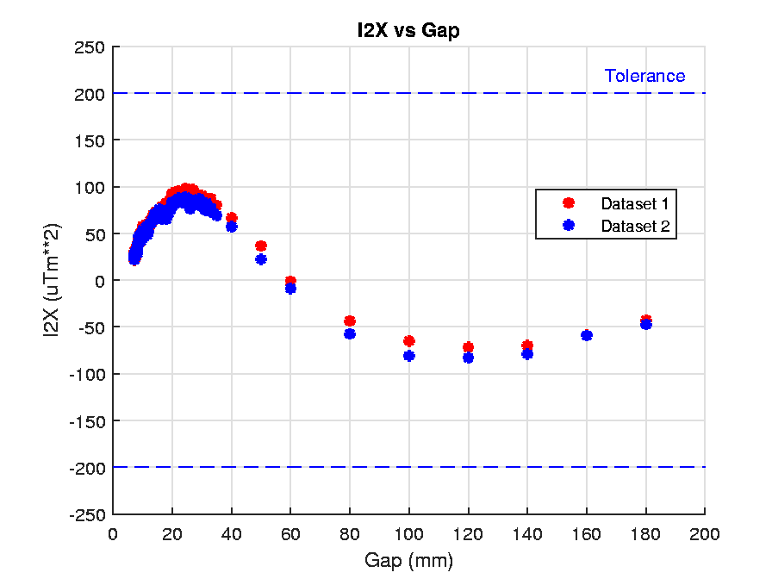
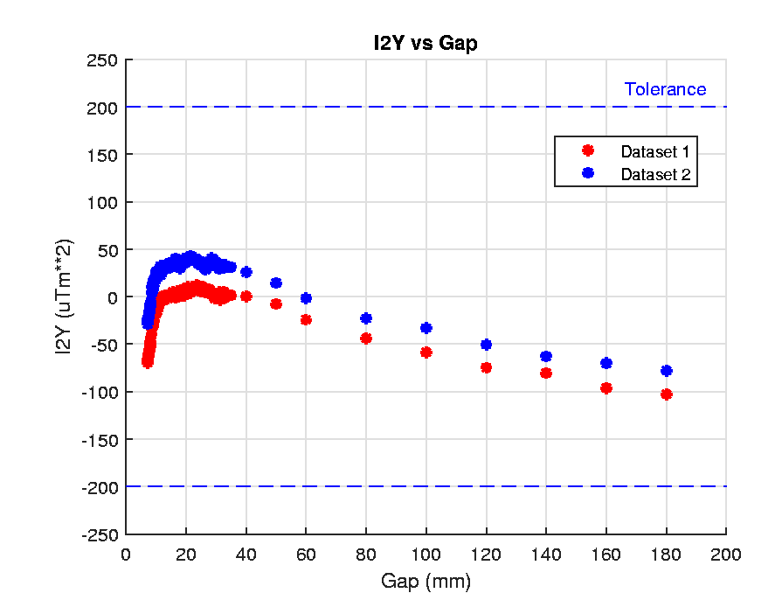
Transportation Test
The undulator was moved to the tunnel and brought back the same day. After the transportation, the undulator was in the temperature stabilization area for 2 days, then moved to the Kugler bench for measurements.
Dataset 1 - Initial calibration
Dataset 2 – After the test

Slide 4
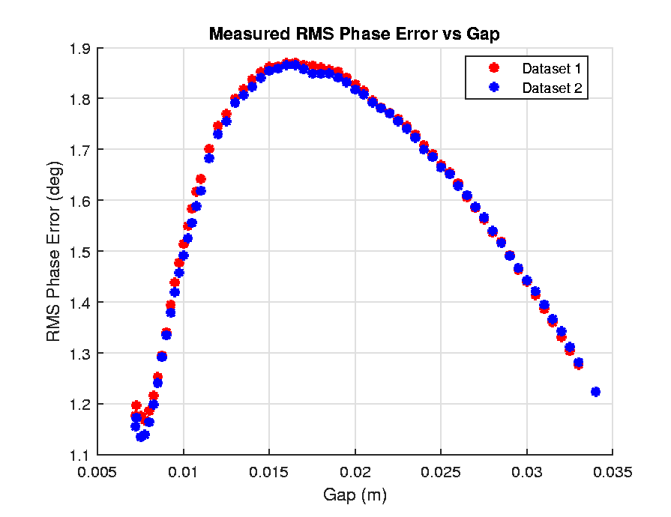
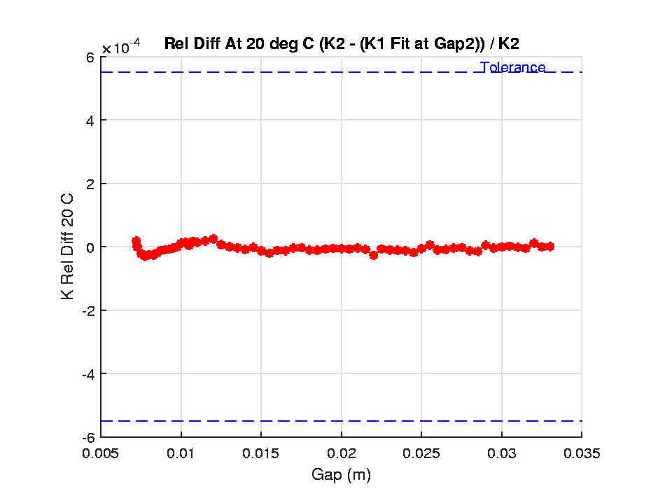
Transportation Test, cont.
No Change!

Slide 5
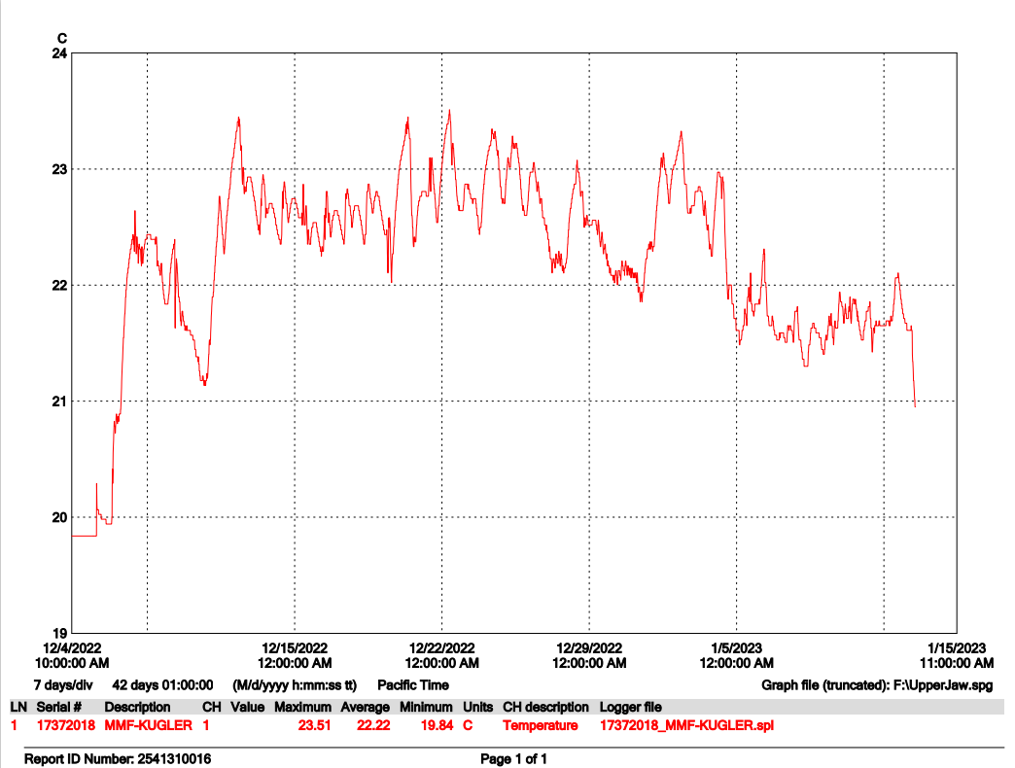
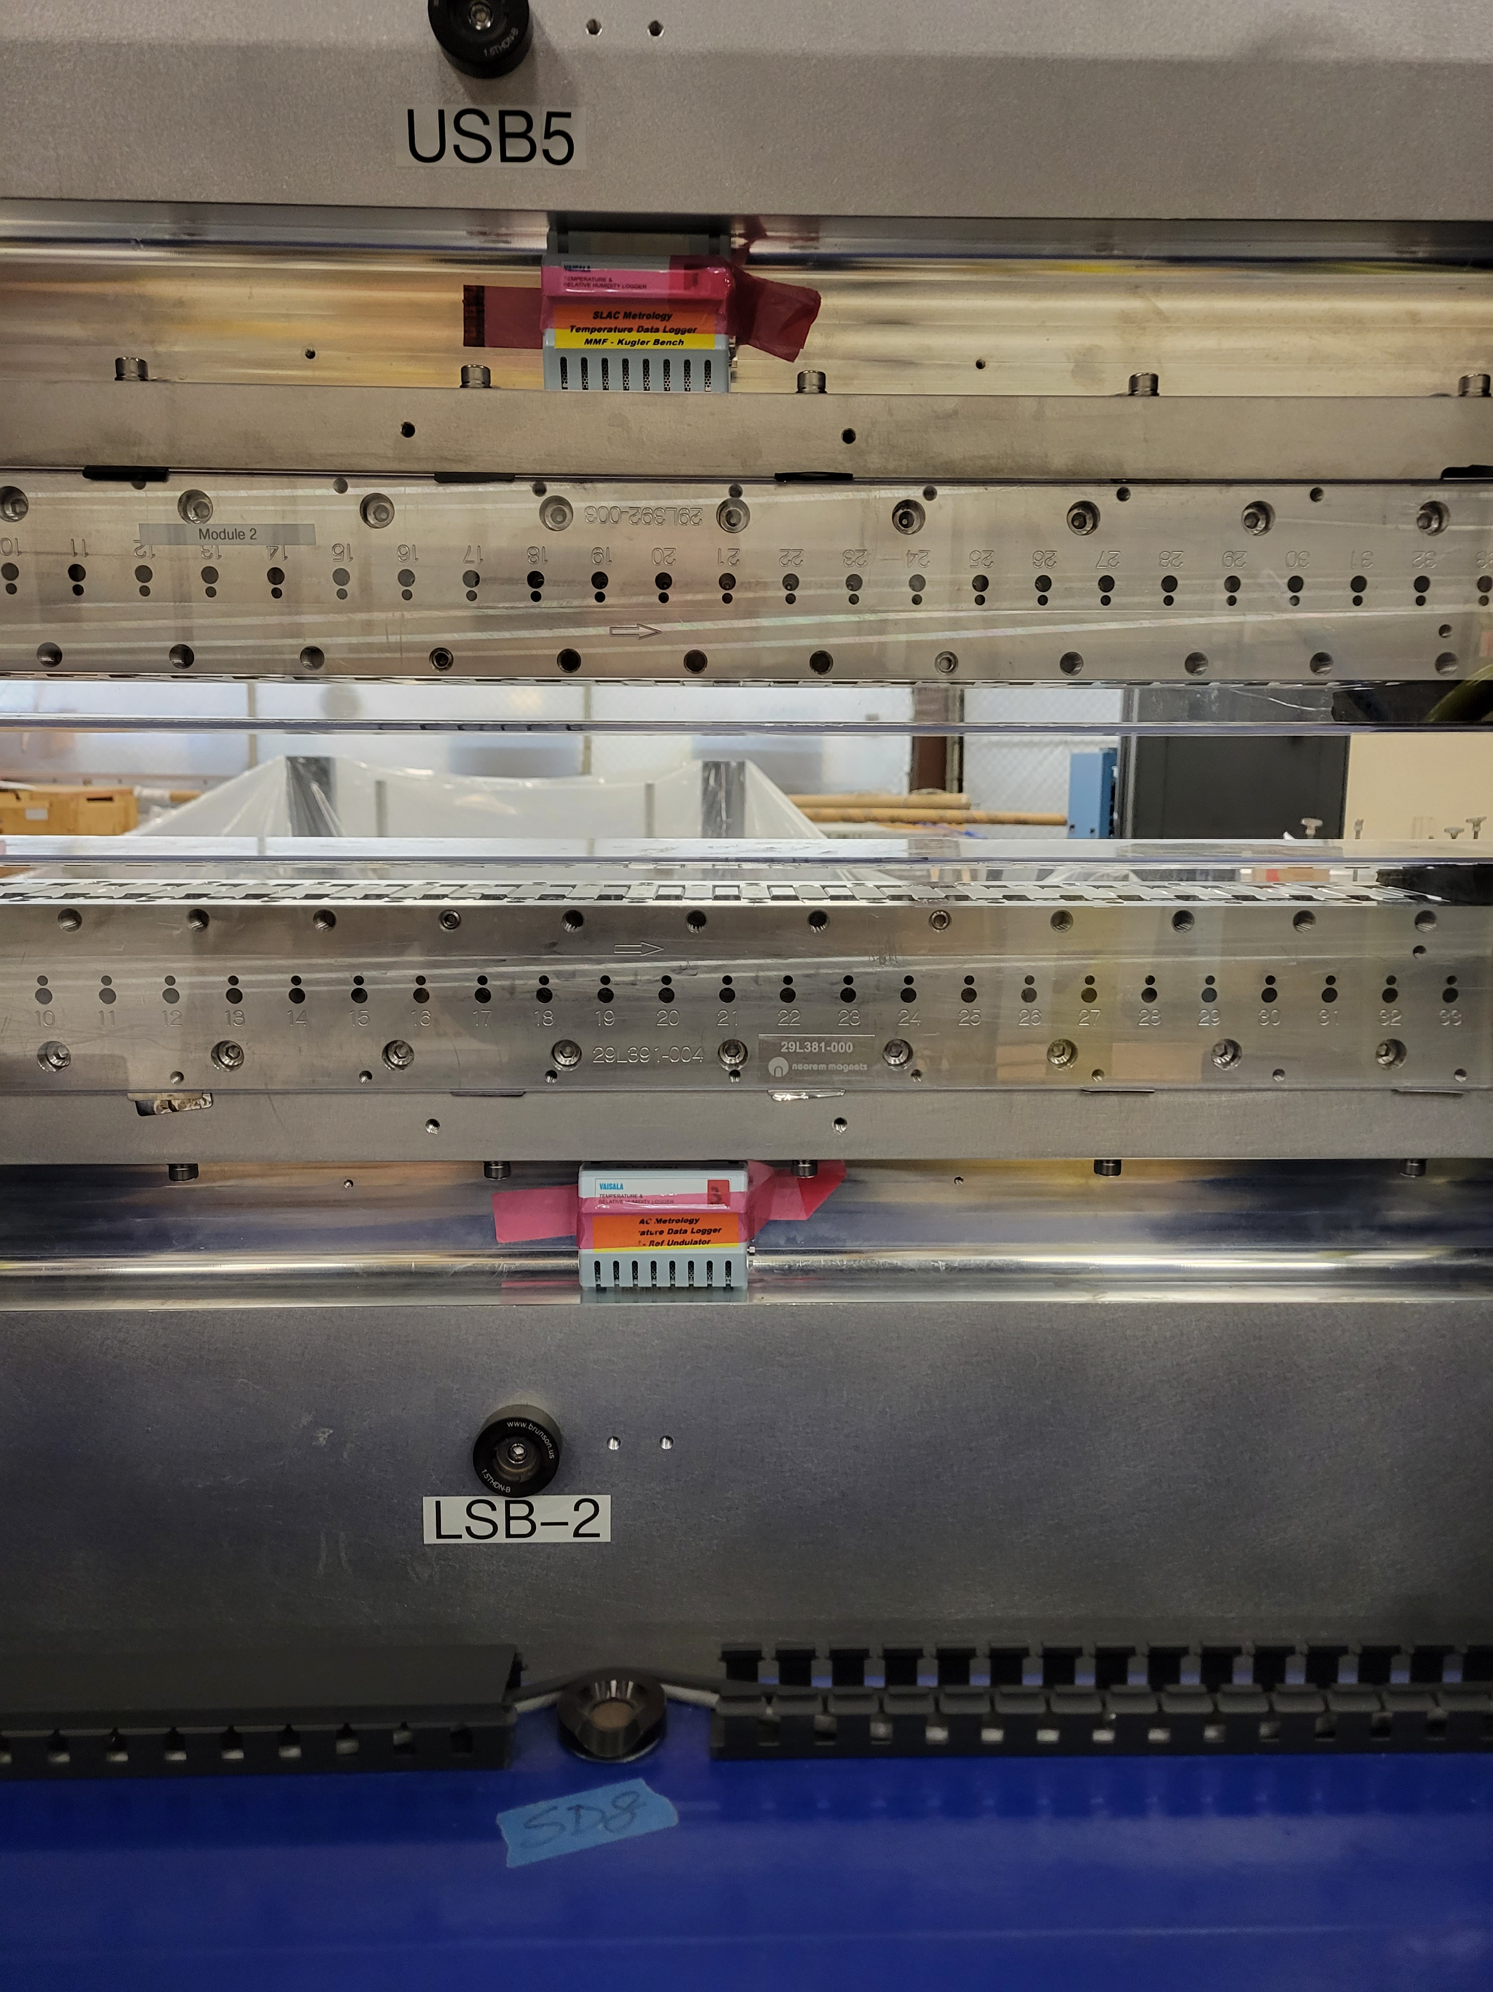
Storage test
The undulator was moved to the storage area in December 2022 and was back for measurements in 5 weeks.
Two temperature loggers were attached to the upper and lower jaws to record the temperature change.
Temp.
Loggers
The room heaters were running all the time by shipping/receiving .

Slide 6
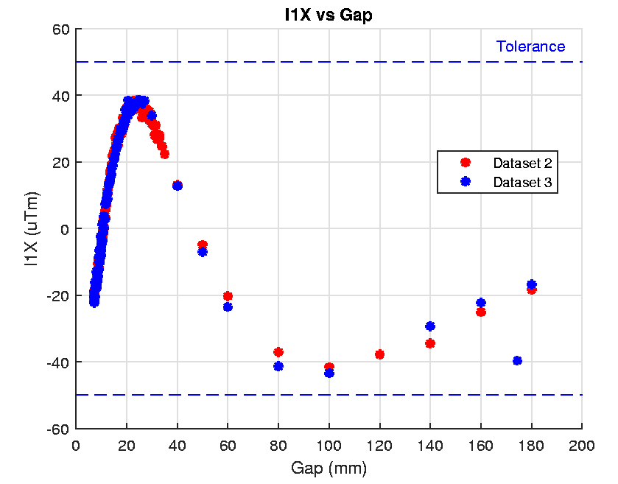
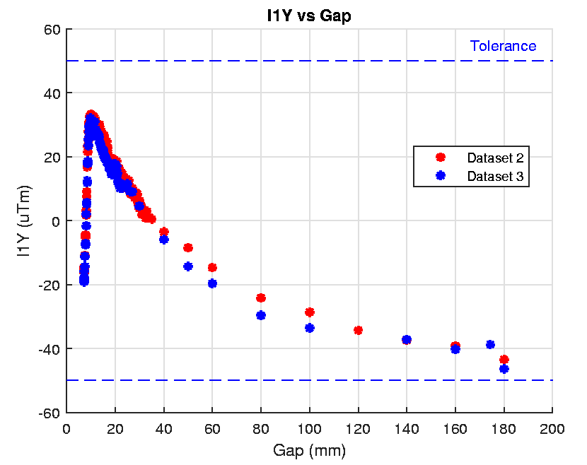
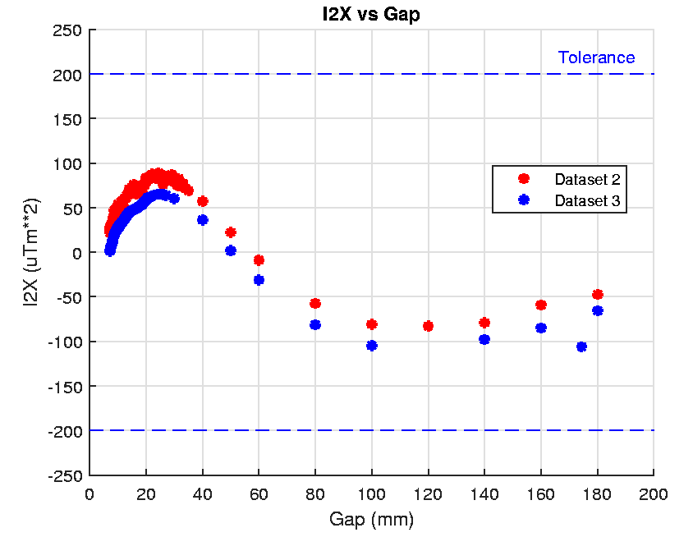
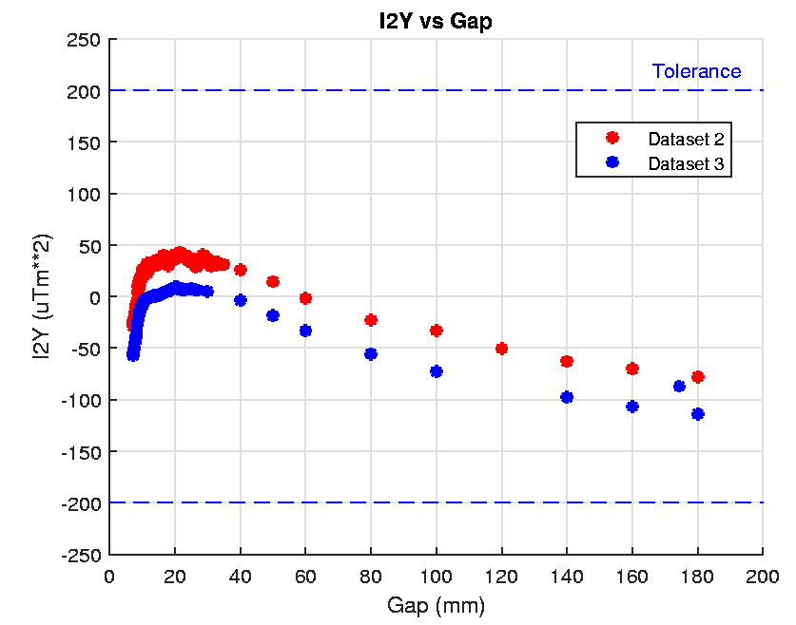
Storage test, continue
Dataset 2 - After transportation test
Dataset 3 – After the storage test

Slide 7
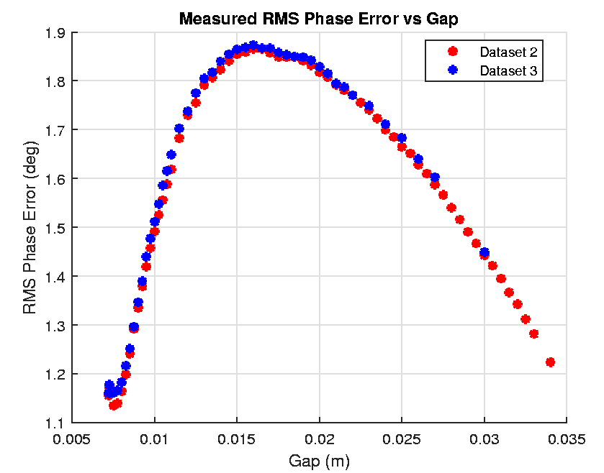
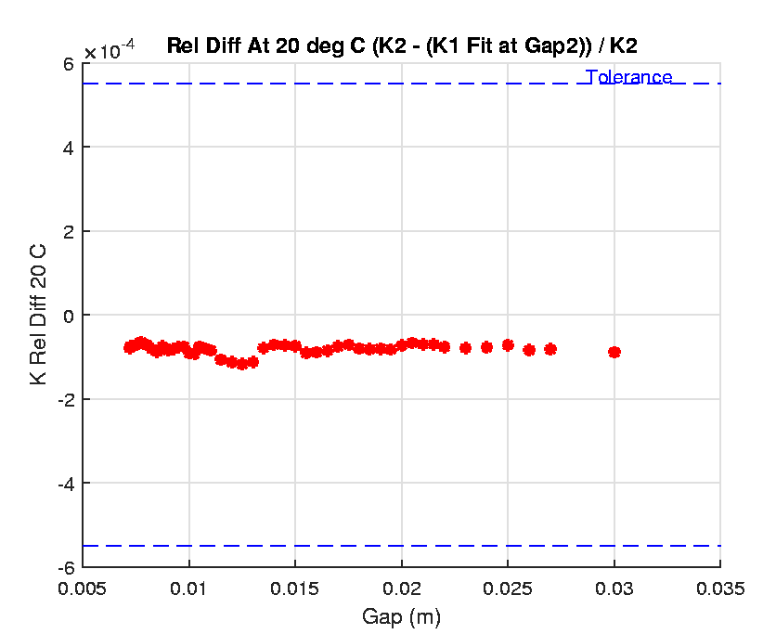
Storage test, continue
No Change!

