Slide 1





Short prototype measurements
(steel shims, poles re-positioning and tuning)
Yurii Levashov
11/2/2021

Slide 2
Outline
  Steel shims signatures
  Steel shim installation options
  Poles’ re-positioning
  Measurements
  Tuning challenges
  Summary

Slide 3
Steel shim signatures

Slide 4

Steel shim installation
If installed As Is, the shims will reduce the gap.
Options:
1. Set encoders offsets so that the real gap is bigger (significant reduction in the main field).
2. Modify the magnet keeper drawings so that the magnets will be recessed 300µm w.r.t. the poles.
(small reduction in the main field)
3. Assemble the magnet modules so that all poles are shifted up from the nominal position by 150µm.
Steel shim 7.5 x 15 x 0.17mm glued on top of a magnet
Pole
Magnet
Steel shim 0.17mm thick + glue
Magnet recess 0.14mm
Needs to be ≥ 0.3mm

Slide 5
CMM measurements

Slide 6
Measurements
Field integrals are the same.
Main field reduction is small.
Undulator K
PRD | Before | After
9.21 | 9.69 (5.2%) | 9.64 (4.7%)

Slide 7
Tuning

Slide 8
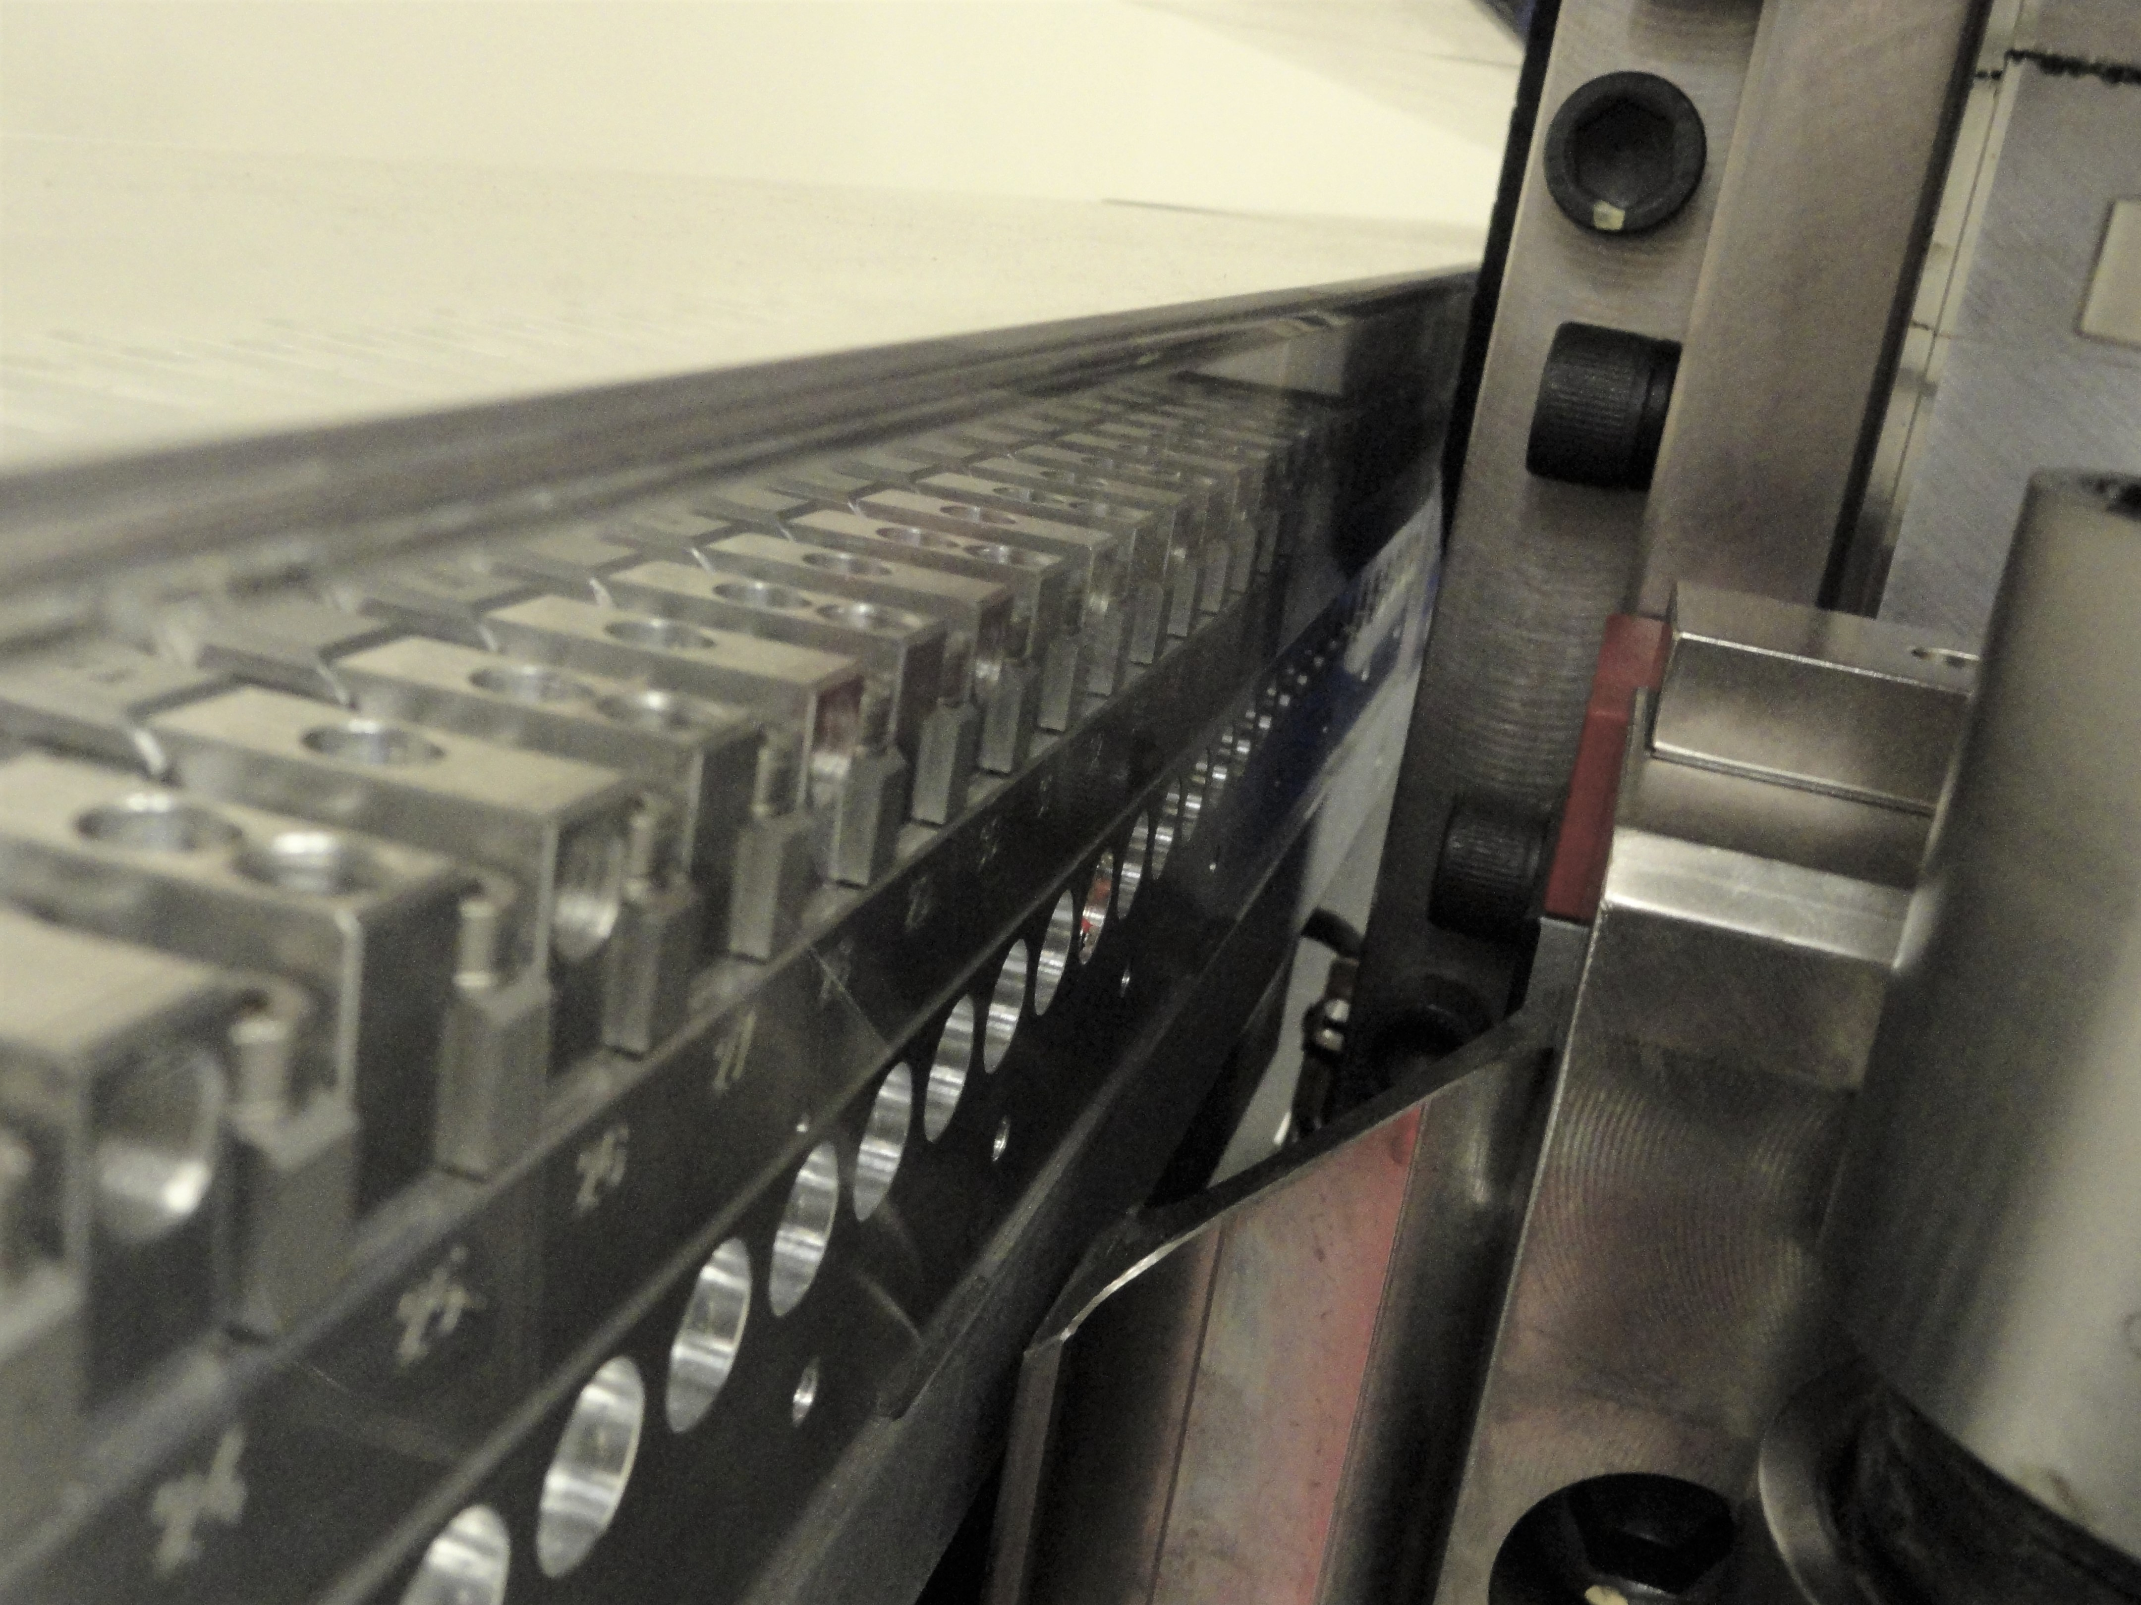
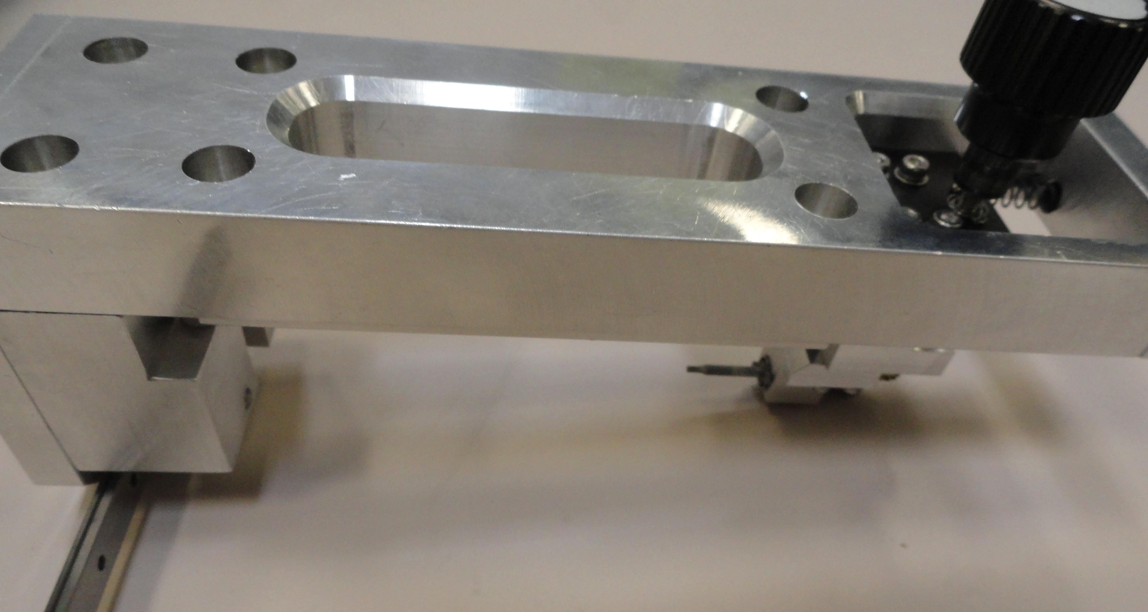
Tuning Challenges
The pole adjustment works fine. There will be no access to the side screws near the frame vertical supports. A special tuning fixture is needed, like a fixture for HXUs.
Small slugs’ installation is fine.
Large slugs are very difficult to work with, especially vertical ones. They are tending to flip over inside a hole and fly into the gap. We had one broken in half. We would like the slug diameter to be reduced and to have slugs with
height > diameter.
4. Steel shims are easy to install/glue because the force keeps them in place at large gap.

Slide 9
Summary
Steel shims are desirable because in combination with other shims the correct shim signatures for the main field and the skew quadrupole could be produced .
After moving the pole up by 150µm, the main field on axis at 7.2mm gap reduced by a 0.5% but is still stronger than needed by ~4.7%. The field integrals are the same.
The short prototype was successfully tuned using combinations of pole motion, slugs, and steel shims.
It is desirable to modify the magnet keeper drawing to make the pole/magnet recess of 300µm for steel shim use.
The large slugs are too big for safe work close to the gap. Reducing the slugs’ diameter would be desirable.
A tuning fixture like for HXUs is needed to adjust poles in areas close to the frame vertical supports.
7. The next step will be testing the Hall probe accuracy measurements.

