Slide 1
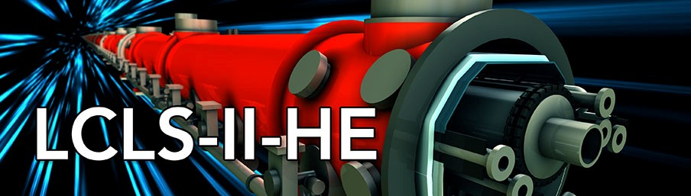




HE-SXU-000 Lifetime test
Yurii Levashov
SLAC 11/21/2023

Slide 2
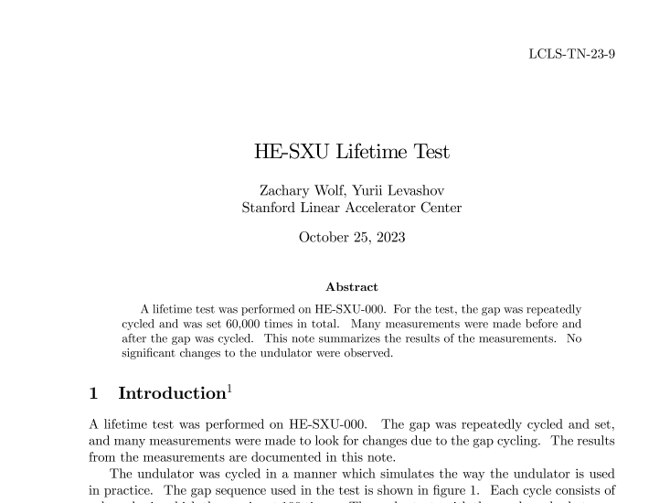
Motivation
Could mechanical and control systems handle many thousands of gap changes?
Will undulator be the same magnetically after many years in use?

Slide 3
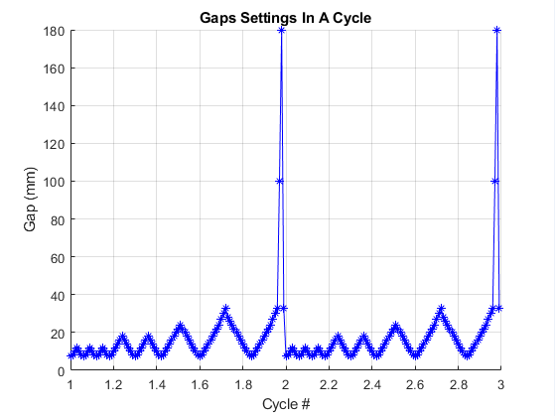
The test
Simulate the way the undulator is used; many settings at small gap with 2mm step size and occasionally opening to full gap.
Each cycle consists of 100 gap settings.
Total of cycles = 600 (60,000 gap settings) which corresponded ~ 10 years of use in the tunnel.

Slide 4
The test; continue
Full set of measurements before and after the cycling (Oct. 2023, DS003)
Touch probe
Hall probe
Long coil
Intermediate set of measurements after 162 cycles. No changes detected. Low noise from US top drive system.
Undulator moved to temperature stabilization area to allow reference undulator measurements. Cycling continued, noise persisted.
After 351 cycles the control system failure. US top motor reported encoder offset instead of encoder value. The undulator tilt limit switch tripped. The reason not identified.
Drive nuts lubricated to quiet the noise. Cycling continued to 600.

Slide 5
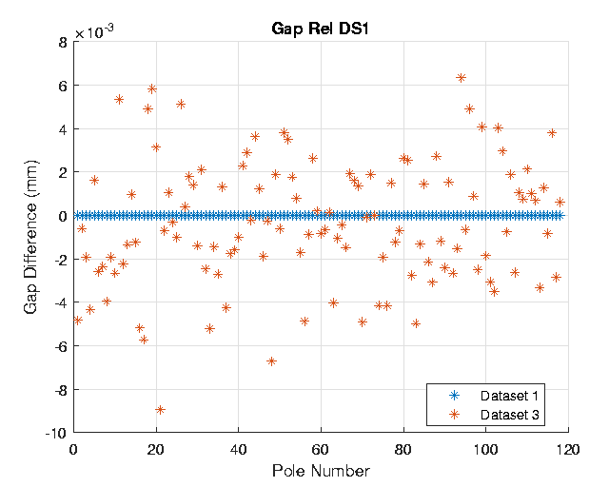
Measurements: Touch probe
Gap = 10mm.
Not CMM level of accuracy.
No systematic gap change
(average = -0.3µm).

Slide 6
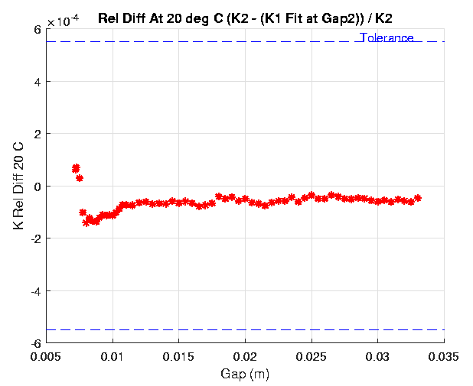
Measurements: Hall probe; K-value
K values corrected to 20ºC.
Small offset is due to Hall probe calibration drift.
No good explanation for changes at small gaps.
All differences are well below the tolerance limit.

Slide 7
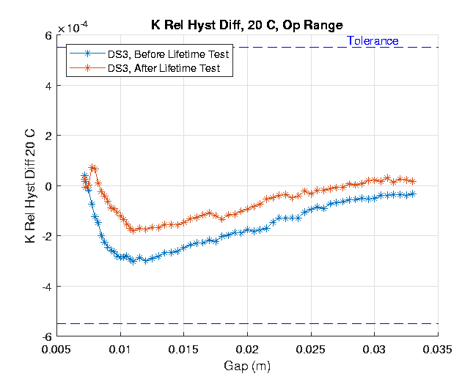
Measurements: Hall probe; K-hysteresis
Mechanical hysteresis increase could lead to increase in K-hysteresis.
For SXUs the hysteresis was -3·10⁻⁴ for the most undulators with a few above -4·10⁻⁴ .
Small (~30%) reduction in hysteresis is clear.
We suggest doing pre-cycling before taking the final dataset for the next few undulators to study this effect.

Slide 8
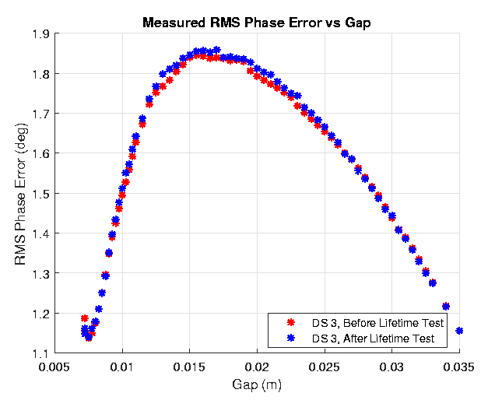
Measurements: Hall probe; Phase errors
Change in phase errors could indicate distortions in the gap (taper, bow, etc.).
No changes; the gap shape is stable.

Slide 9
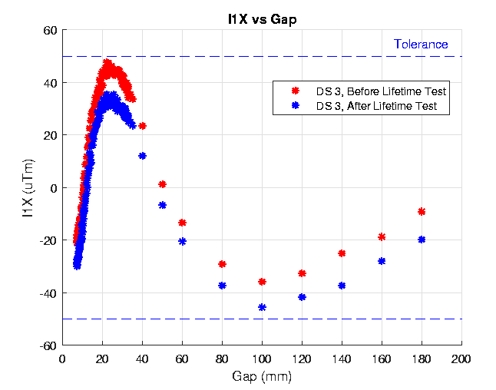
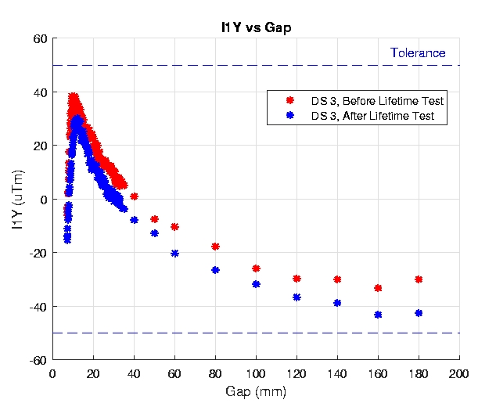
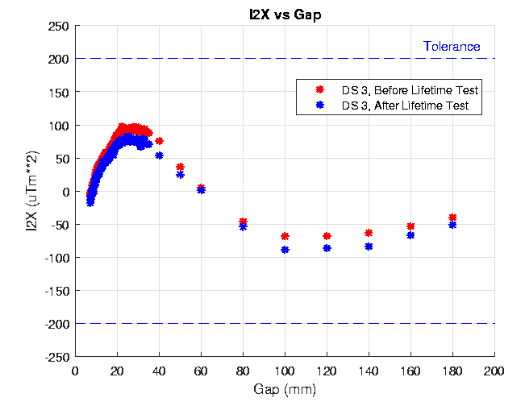
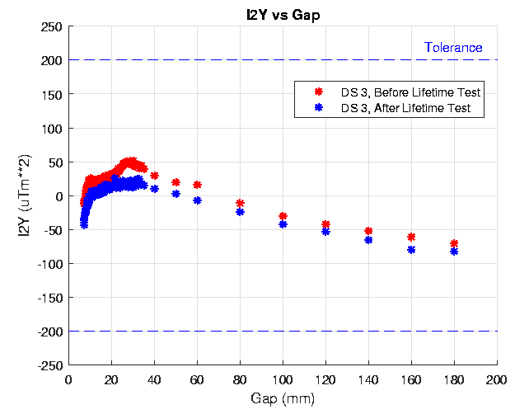
Measurements: Long coil; Field Integrals
Small changes ~ 10G-cm due to measurement errors.
No significant changes. All below the tolerances.

Slide 10
Conclusion
The gap was cycled 600 times (60,000 gap settings).
No significant changes in K value, phase errors, or field integrals.
The HE-SXUs are stable with use.
Both drive screws and drive nuts should be lubricated as part of refurbishing.
No remedy determined for control system failure.
Further studies will be desirable to determine if extra cycling the gap reduces K hysteresis.

