Slide 2
First Line
  Indent for bullets
    Indent for bullets
      Indent for bullets
        Indent for bullets

Slide 3
First Line
  Indent for bullets
    Indent for bullets
      Indent for bullets
        Indent for bullets

Slide 4
First Line
  Indent for #
    Indent for small letter
      Indent for #)
        Indent for small letter)

Slide 5
First Line
  Indent for bullet
    Indent for bullet
      Indent for bullet
        Indent for bullet
First Line
  Indent for bullet
    Indent for bullet
      Indent for bullet
        Indent for bullet

Slide 6
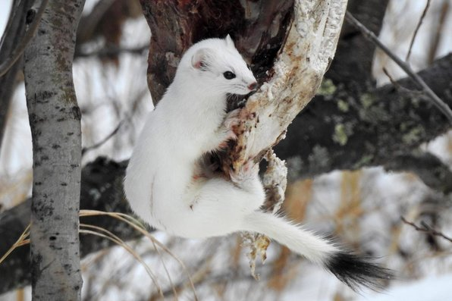
First Line
  Indent for bullet
    Indent for bullet
      Indent for bullet
        Indent for bullet

Slide 7


