Slide 1
LCLS-II-HE SXU Short Prototype
Measurements
Yurii Levashov, Engineer
LCLS-II-HE 2022 Director’s Status Review​
February 8-11, 2022

Slide 2
Outline
Measurement set-up
Requirements
Tests:
  Evaluate magnetic structure design. Measure the prototype with calibrated Hall probe, analyze the fields. Measure field integrals vs. gap.
  Study shim signatures and saturation effects. Evaluate if shims are adequate for tuning.
  Study Hall probe measurements at Kugler bench and Hall probe calibration. Make sure the measurement accuracy meets the tolerances on undulator K (<20% of total tolerance).
  Study magnet crosstalk between SXU-HE undulator and new SXR-HE phase shifter. Find the minimum distance at which the change in field integrals is insignificant (< 3G-cm).
Summary
*Yurii Levashov, Zack Wolf “Magnetic Measurements of SXU-HE short prototype”, LCLS-TN-22-3.

Slide 3
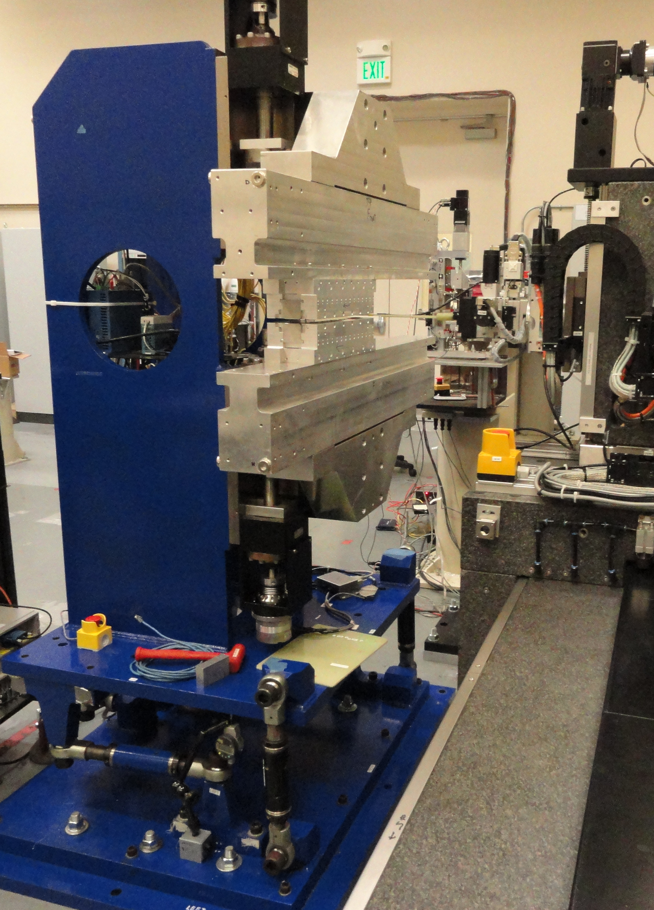
Measurement Set-up
Charge Question: 2.C, 3.B, 3.C
Shims
Two 14 poles, 36cm long magnet structures.
1m long prototype frame, leftover from LCLS-II project.
No gap encoders.
SXR measurement bench.
Laser tracker for alignment.
Magnetic taper corrected with shims.
The same equipment as the LCLS-II project:
  Sentron 2-D Hall probe to measure fields.
  Stretched wire to measure field integrals (long coil, 150 turns).

Slide 4
Evaluation of magnetic structure design, requirements.
Charge Question: 1.A, 3.A, 3.B
Requirement # | Parameter | Unit | Requirement | Verification | Test Results
PRD0049.4014 | Undulator period length | mm | 56 | Test | 56.031
PRD0049.4024 | Minimum operational magnetic gap | mm | 7.2 | Inspection | -
PRD0049.4025 | Maximum operational magnetic gap | mm | 33 | Inspection | -
PRD0049.4026 | On-Axis vertical effective field at min. oper. gap | T | >1.76 | Test | 1.85
PRD0049.4027 | Keff at minimum operational gap | - | >9.21 | Test/Analysis | 9.69
PRD0049.4033 | Undulator parameter tolerance ΔKeff/Keff | - | ±5.5×10⁻⁴ | Test/Analysis | -
PRD0049.4029 | Minimum operational K values | - | 1.51 | Test/ Analysis | 1.538 (at 33mm gap)
PRD0049.4034 | Horizontal K sextupole | 1/mm² | <5×10⁻⁴ | Test/ Analysis | 3.5×10⁻⁴
PRD0049.4038 | Phase shake (rms) over L_{cell} | deg Xray | <5.0 | Test/ Analysis | 2.4 (Before tuning)
PRD0049.4040 | First field integral of By per cell (abs) | μTm | <50 | Test/ Analysis | 20 (After tuning)
PRD0049.4041 | Second field integral of By per cell (abs) | μTm² | <200 | Test/ Analysis | -
PRD0049.4042 | First field integral of Bx per cell (abs) | μTm | <50 | Test/ Analysis | 20 (After tuning)
PRD0049.4043 | Second field integral of By per cell (abs) | μTm² | <200 | Test/ Analysis | -

Slide 5
Measurements with Hall probe
Charge Question: 2.C, 3.B, 3.C
PRD0049.4014
PRD0049.4026
PRD0049.4027
  First measurement results (before tuning):
  Average Undulator Period = 0.056031 m ± 0.000070 m
  The K at 7.2mm gap = 9.69 ( 9.21 PRD); 5% stronger!
  B_{x} field is small, below 10G:
  No large magnetization errors in the magnets
  pole alignment is good
  magnet sorting is good

Slide 6
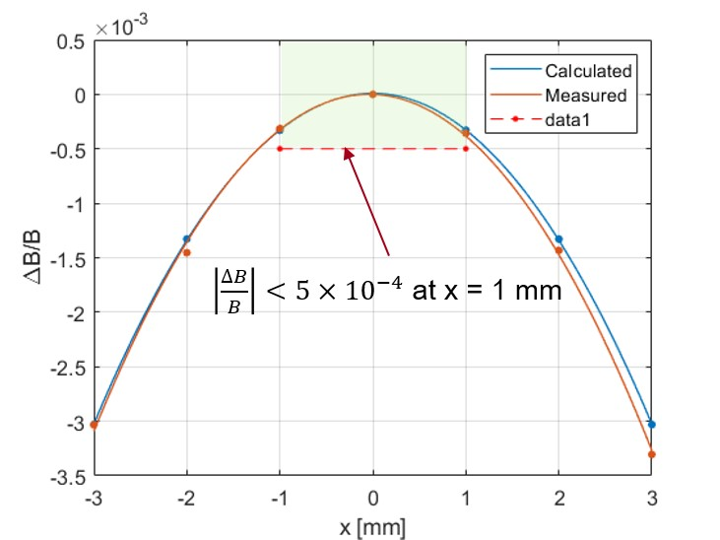
Measurements with Hall probe; continued
Charge Question: 2.C, 3.B, 3.C
PRD0049.4034​
PRD0049.4038
by D. Arbelaez
  Phase shake = 2.4° (<5°)
  Magnetic field roll-off = 3.5·10⁻⁴ 1/mm² (< 5·10⁻⁴ )
  ~25µTm² jumps after each end section in the same direction, 50µTm² in total, agree with simulations done by LBNL (<200µTm²).

Slide 7
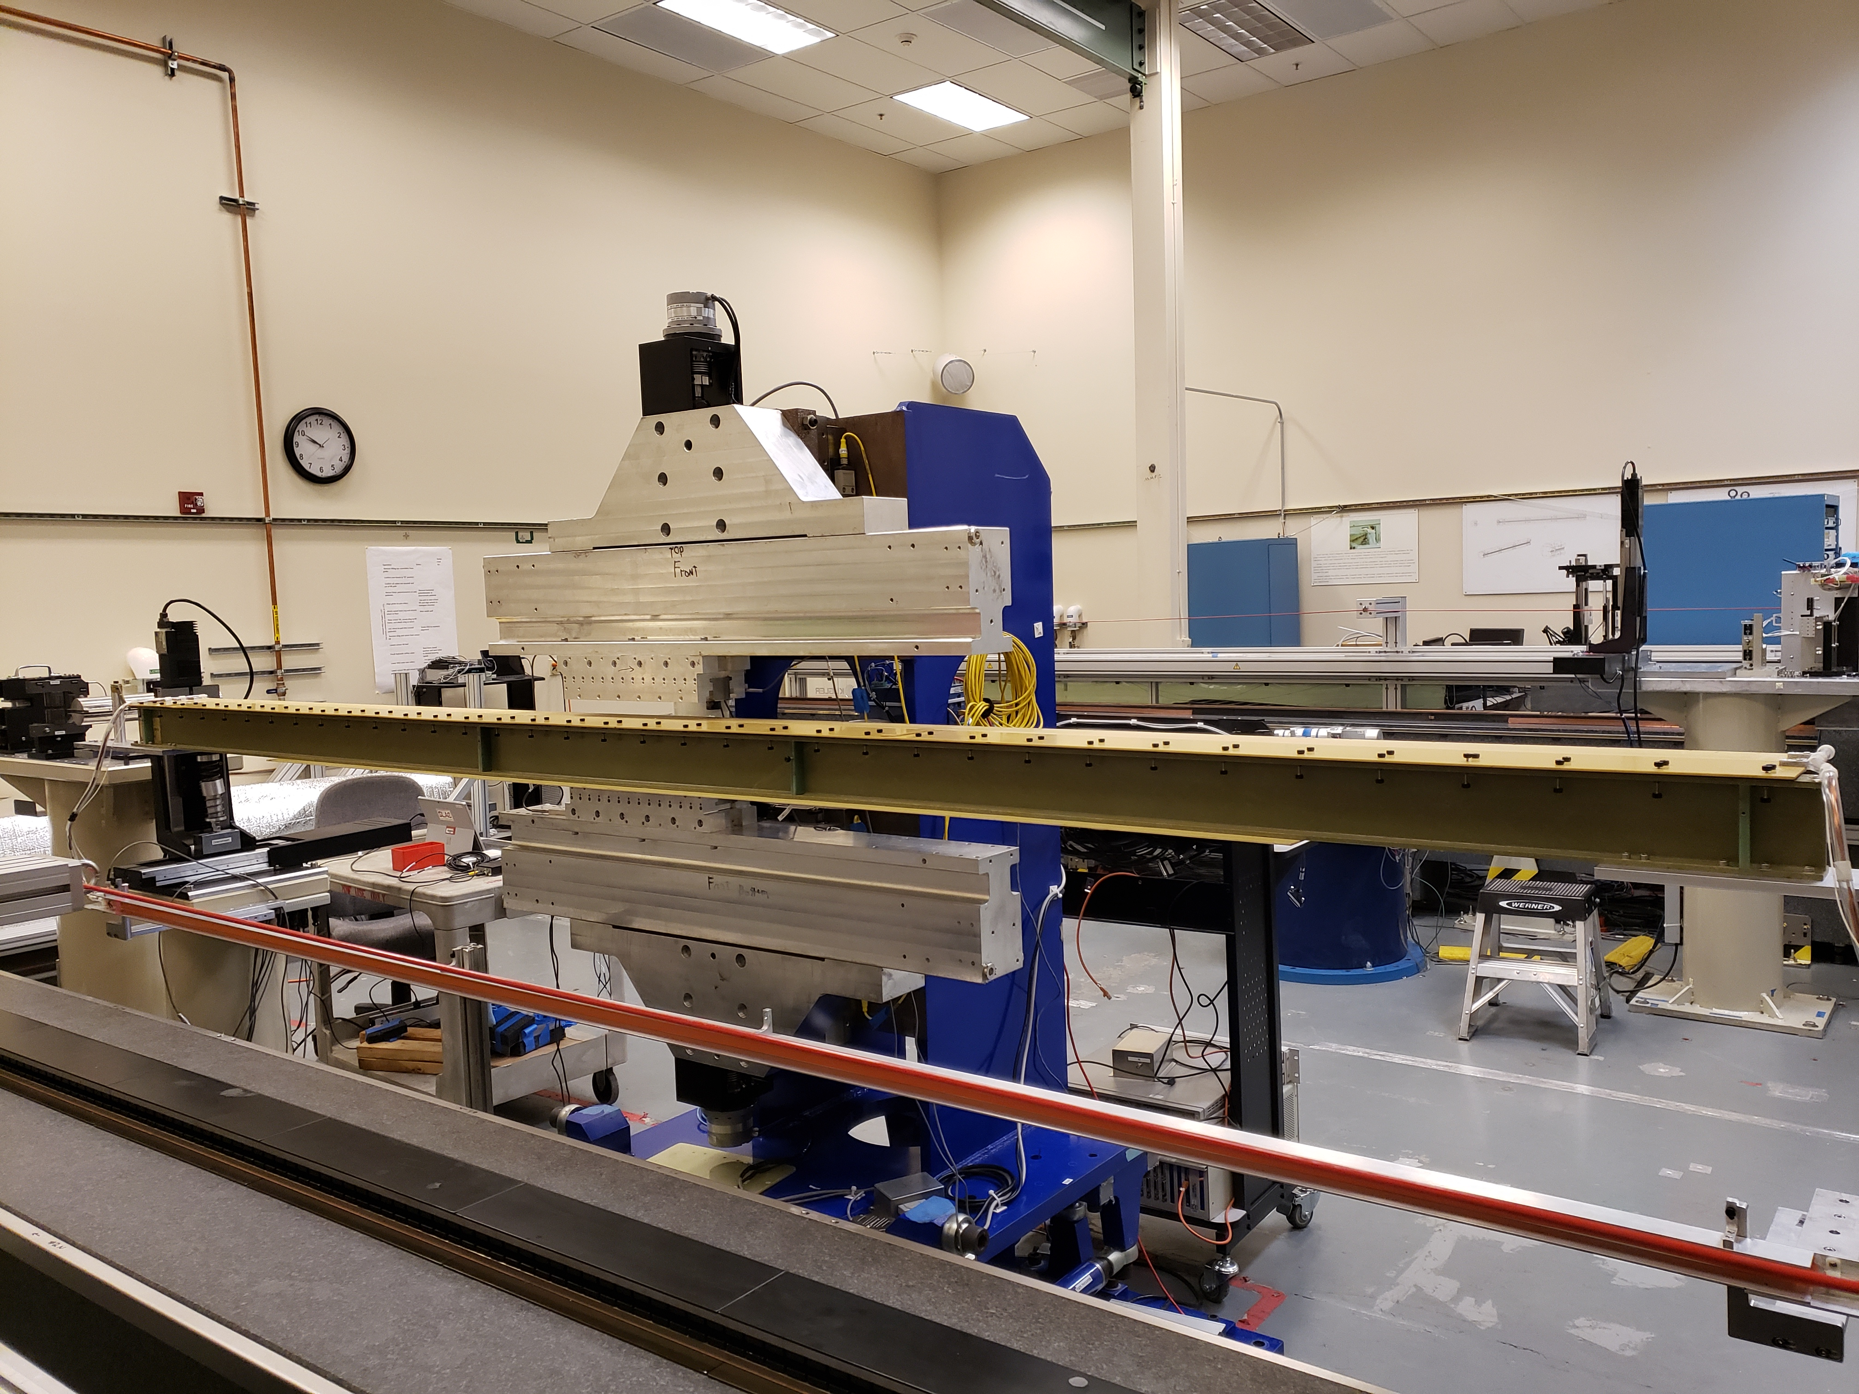
Field integrals vs Gap
Charge Question: 2.C, 3.B, 3.C
Only the first field integrals measured.
Background field integrals subtracted from all measurements.
Measurement error 3G-cm.
The sharp change in B_{y} field integral at ~ 9mm gap is due to pole saturation effects and magnetization errors.
Goal: Find shim signature with a similar shape.

Slide 8
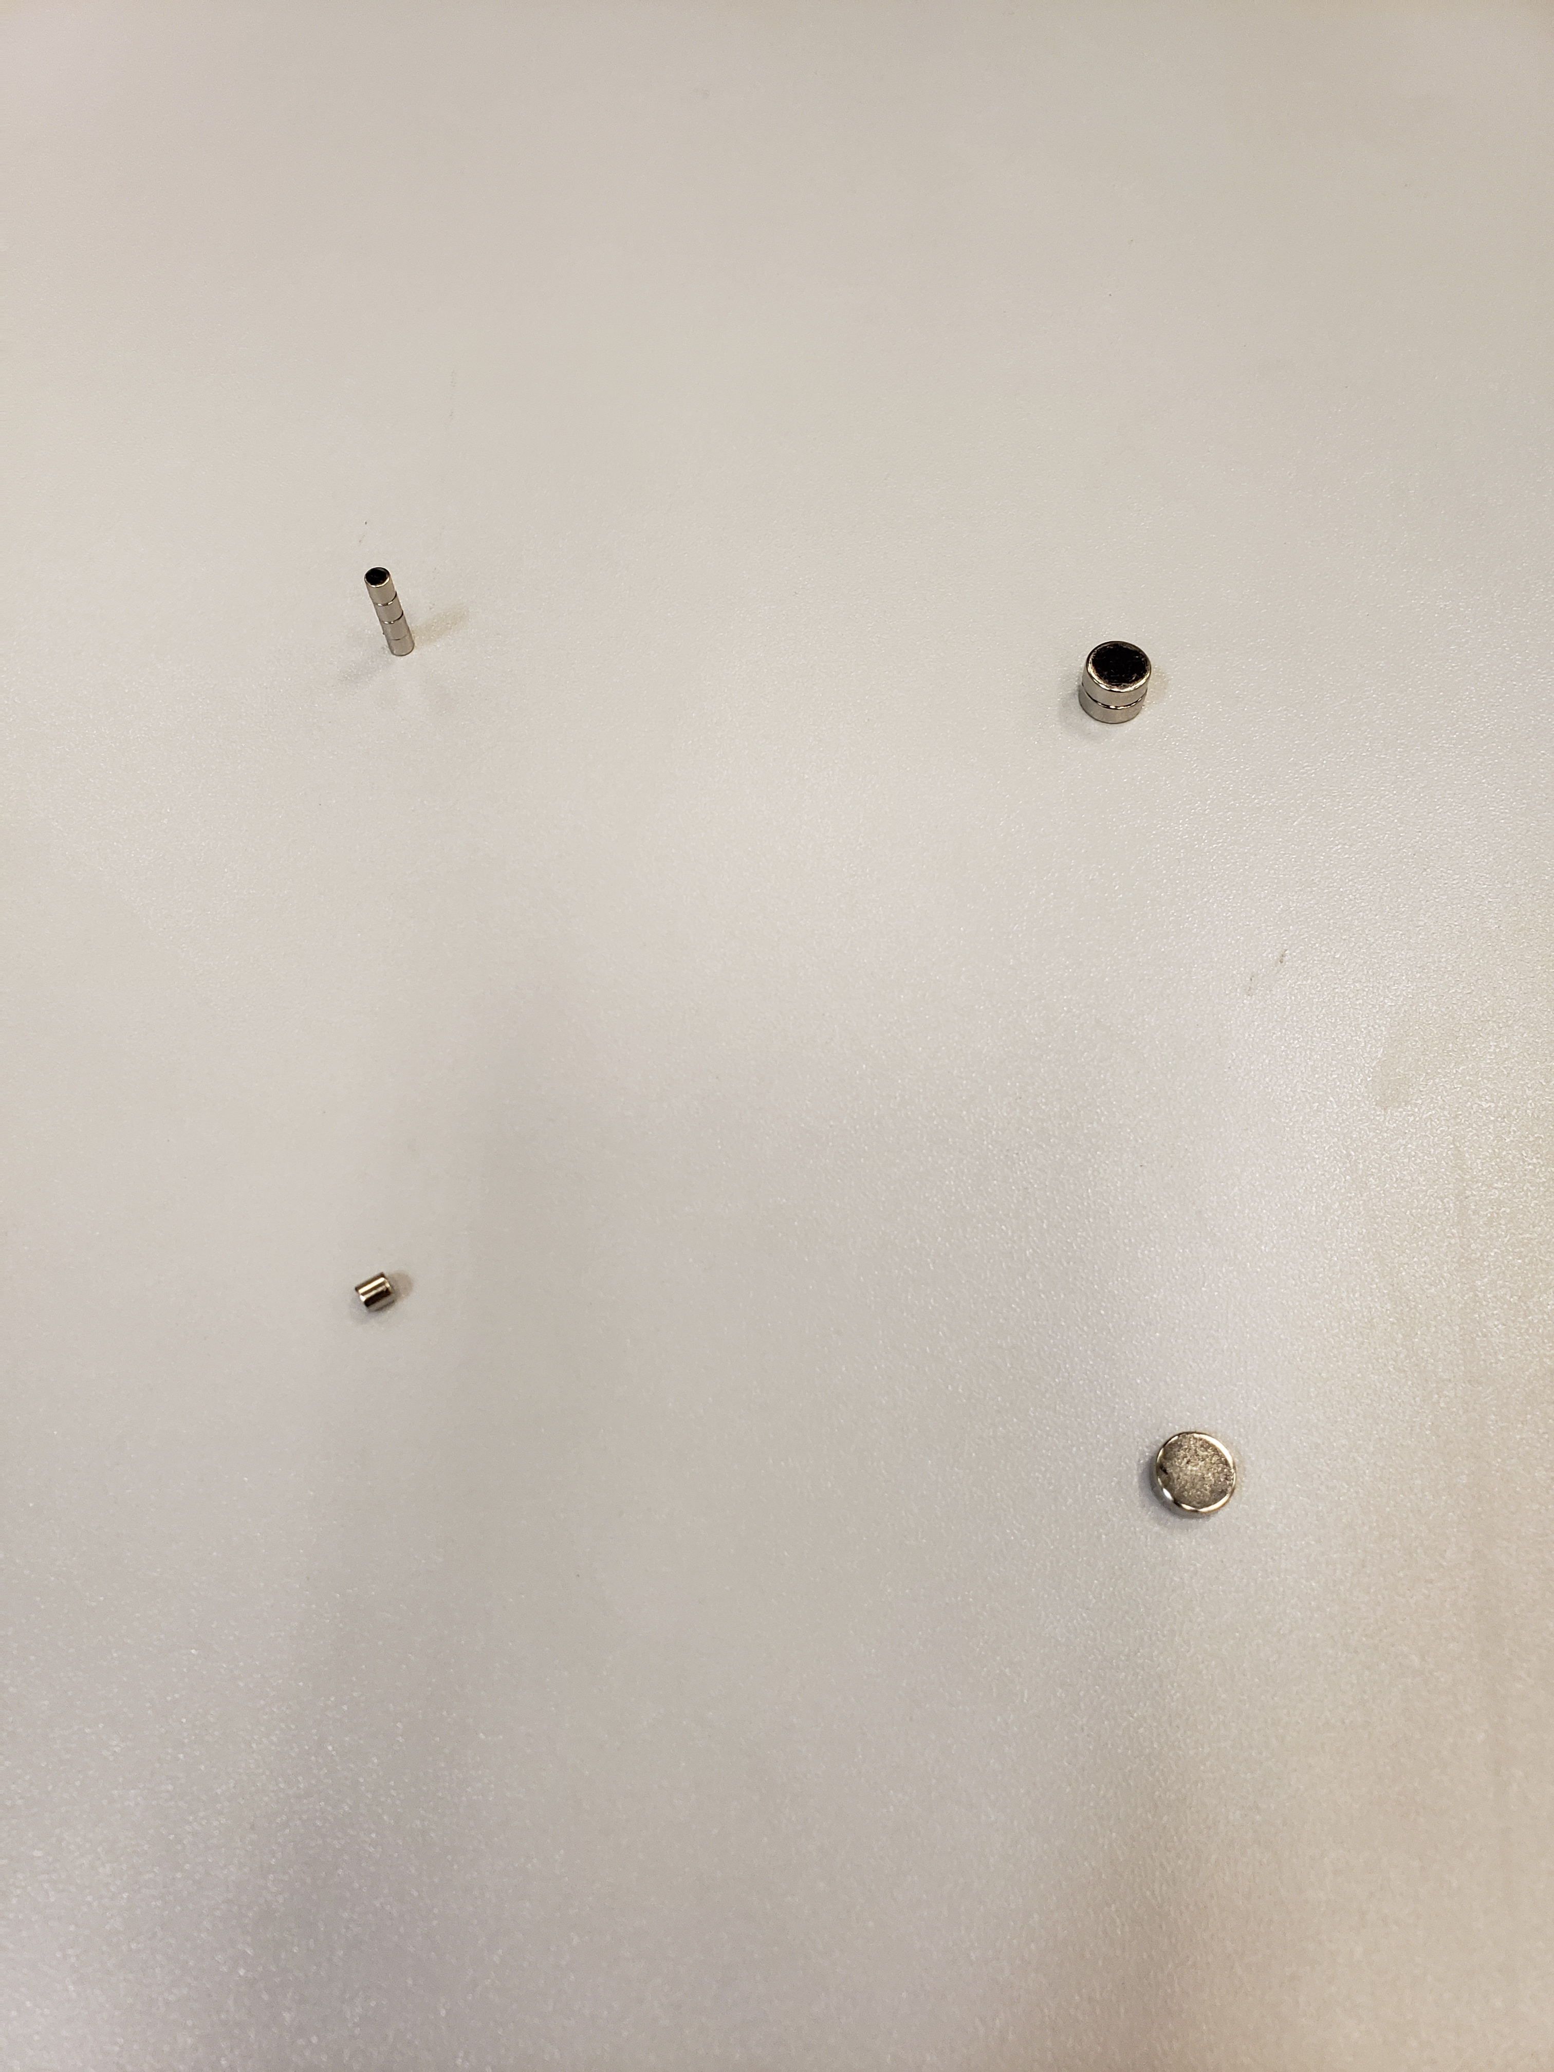
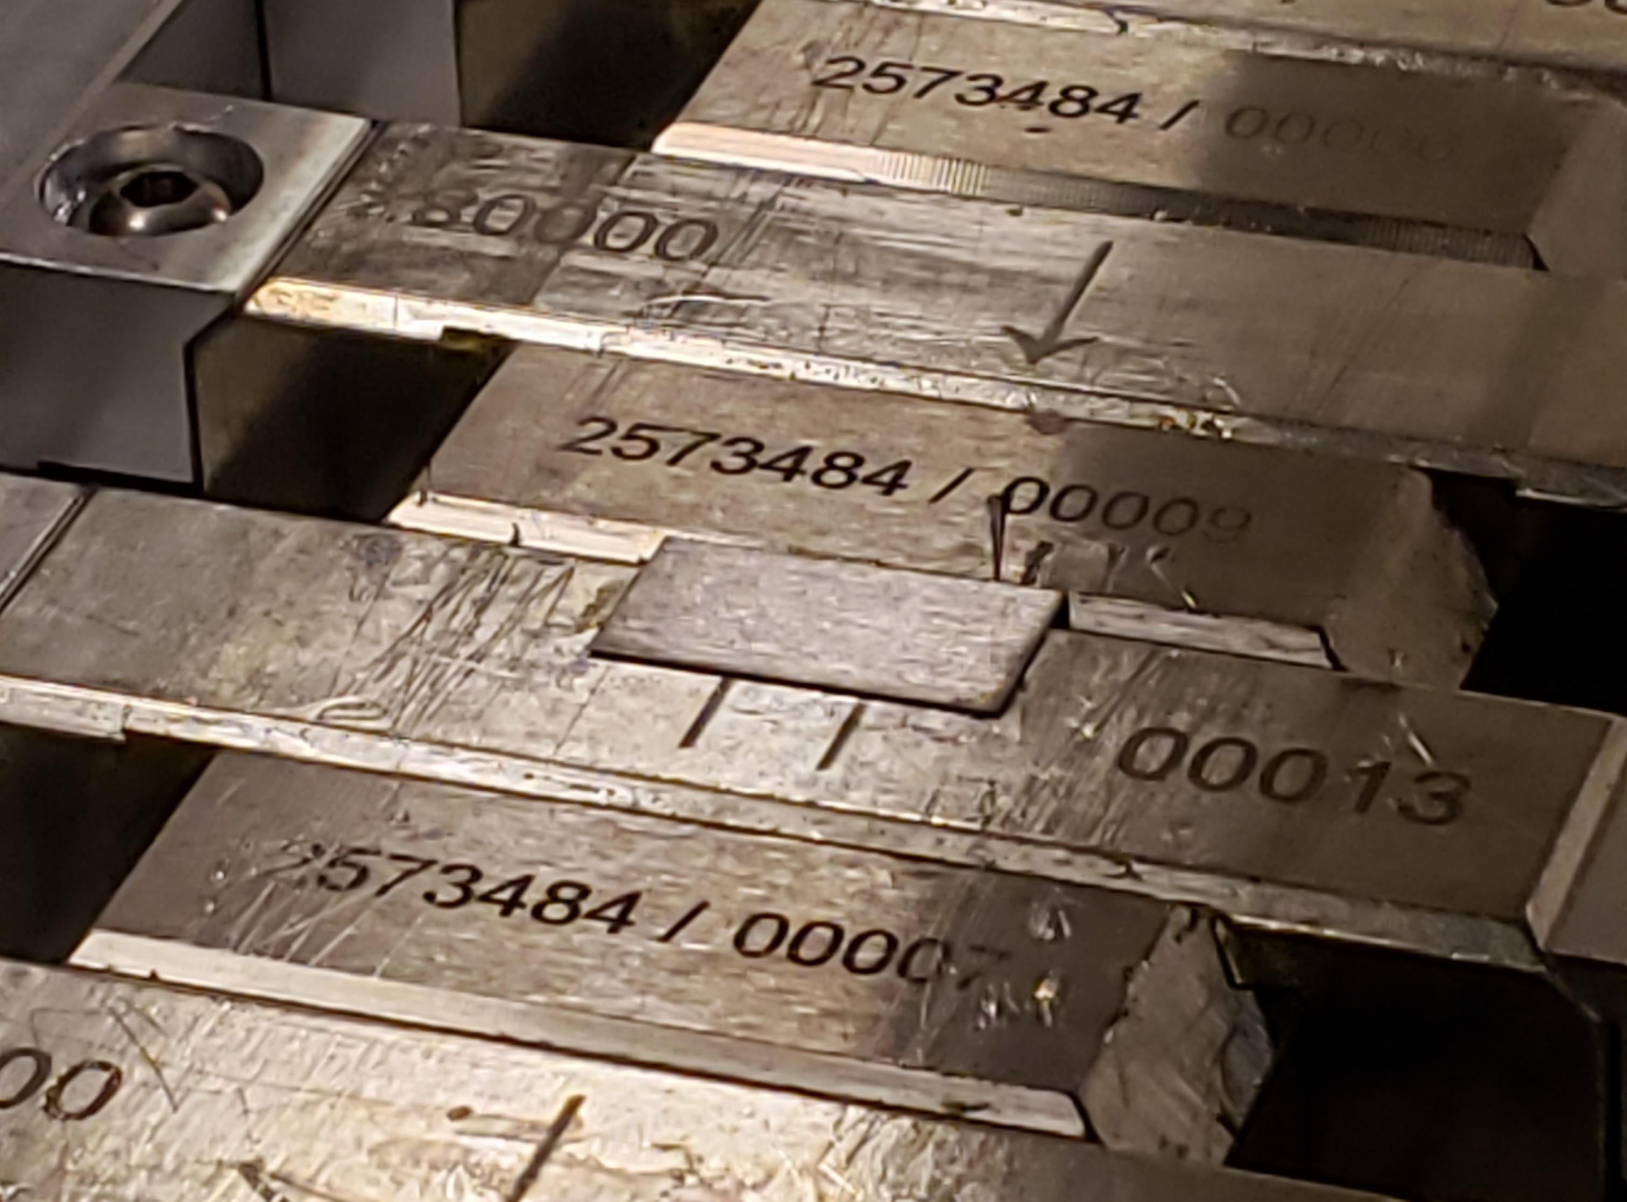
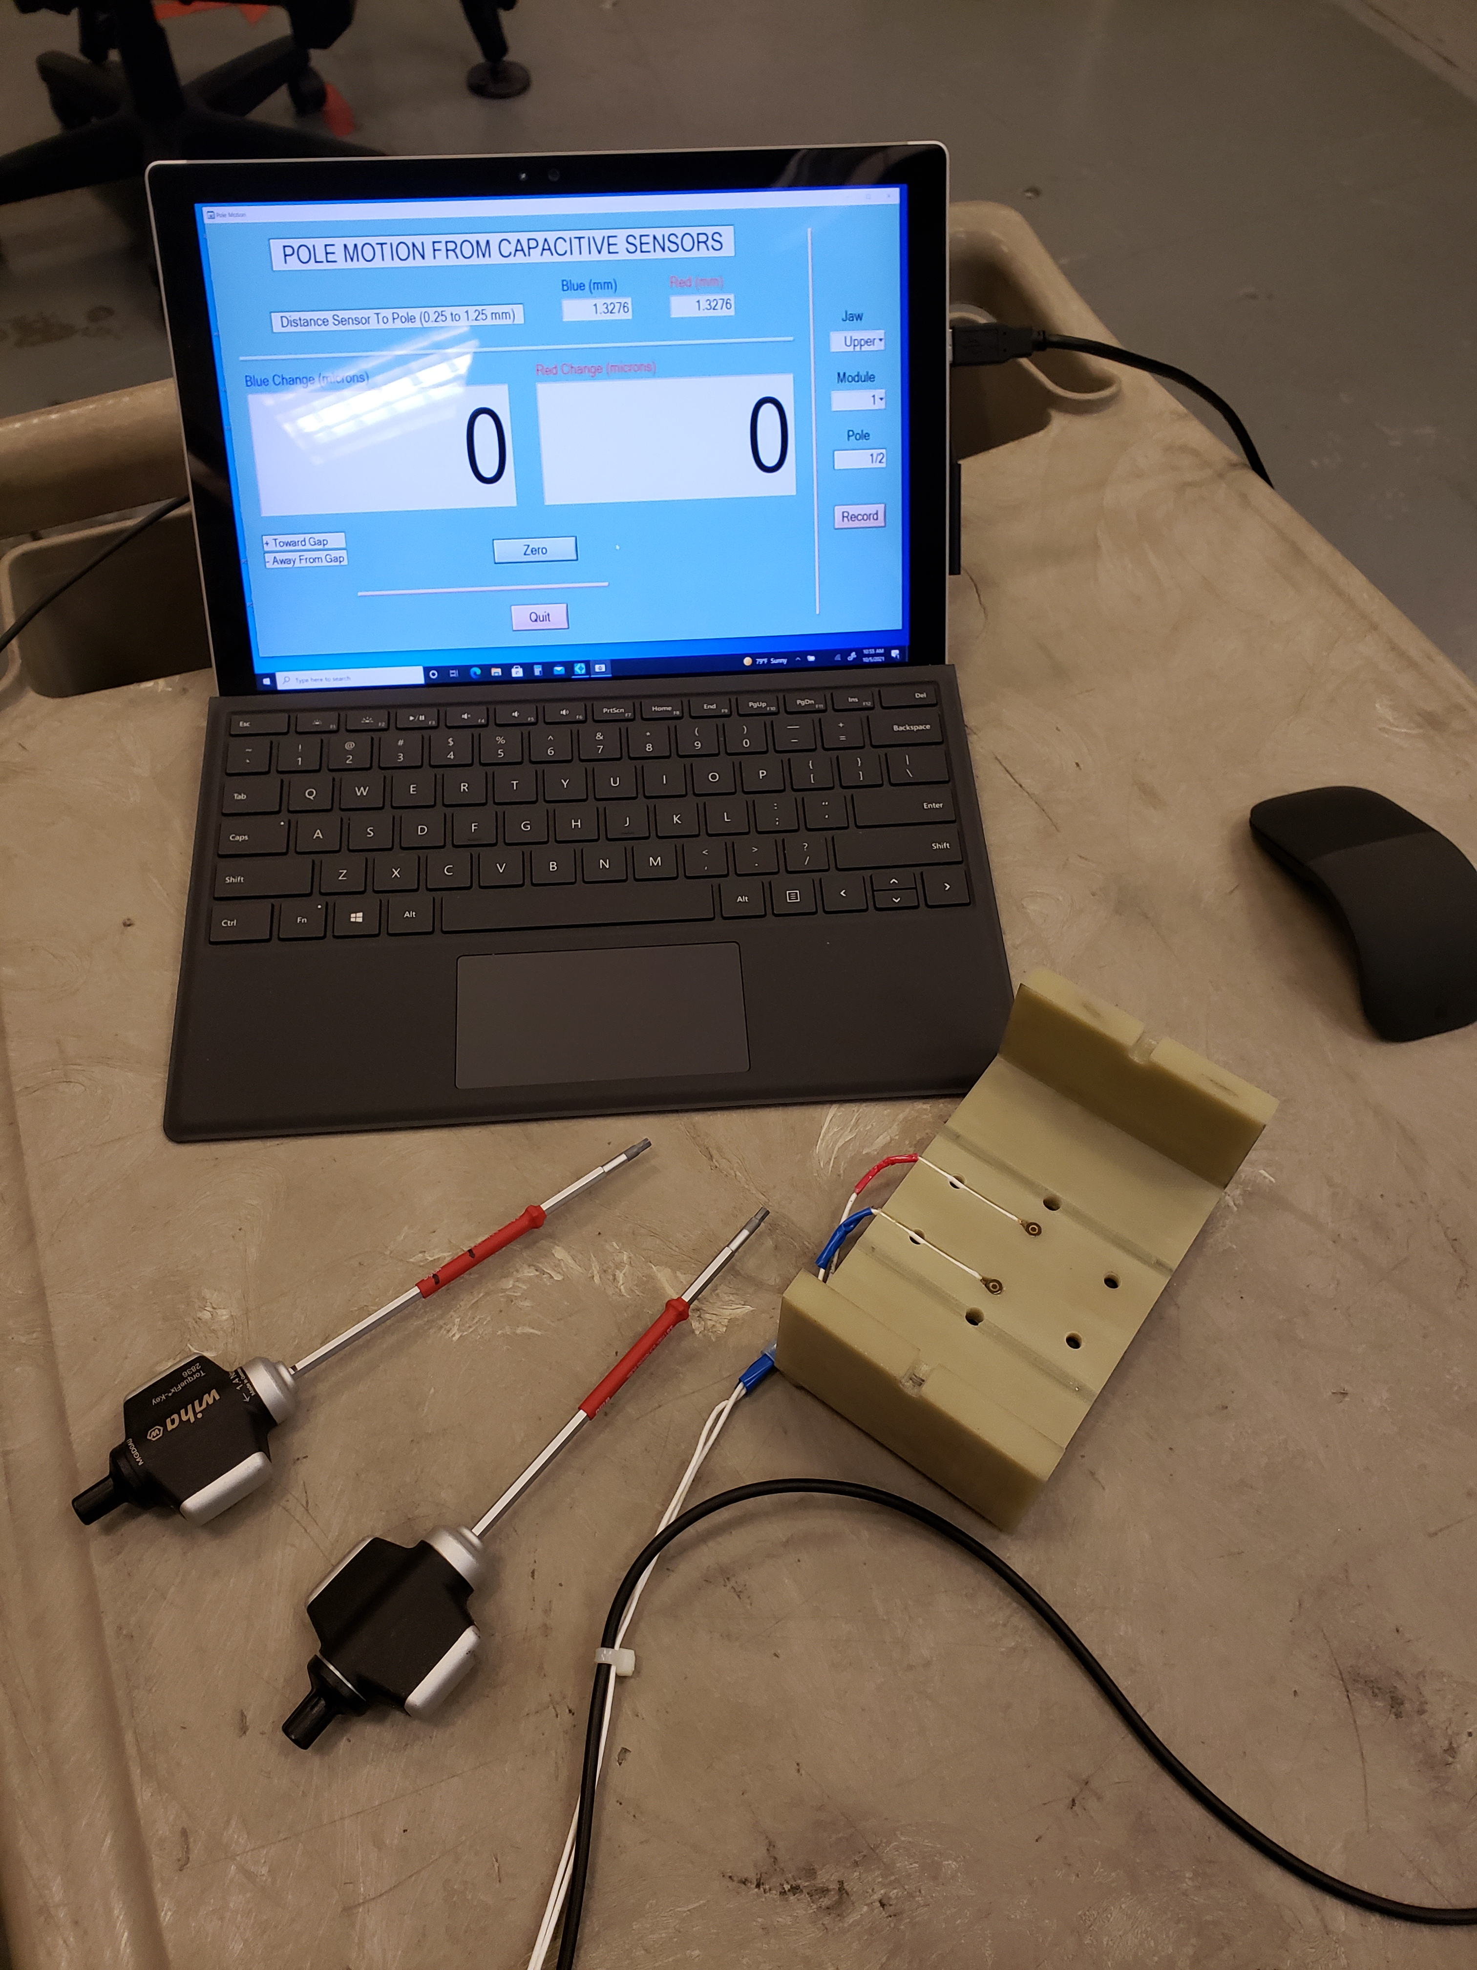
Shim signatures; options for tuning
Charge Question: 2.C, 3.B, 3.C
Move poles vertically
Add magnet material
Ferromagnetic shim
Small ∅ 3mm
x 3mm slugs
Large ∅ 8mm
x 3mm slugs
Two capacitive sensors
Steel shim 7.5 x 15 x 0.17mm glued on top of a magnet
Pole motion: The main dipole, the transverse dipole, normal quadrupole and phase errors.
Slugs = pole motion + Skew quadrupole.
Ferromagnetic shims = slugs + Sextupole components.
Combinations of different types of shims used to get the correct shim signature.

Slide 9
Main field signatures
Charge Question: 2.C, 3.B, 3.C
Combination of pole motion with ferromagnetic shim produces a signature closest to the required field shape.
No saturation effect visible at gaps < 8mm

Slide 10
Shim signatures for other field components
Charge Question: 2.C, 3.B, 3.C
Magnetic slugs are very weak.
Pole roll and ferromagnetic shims will be used.

Slide 11
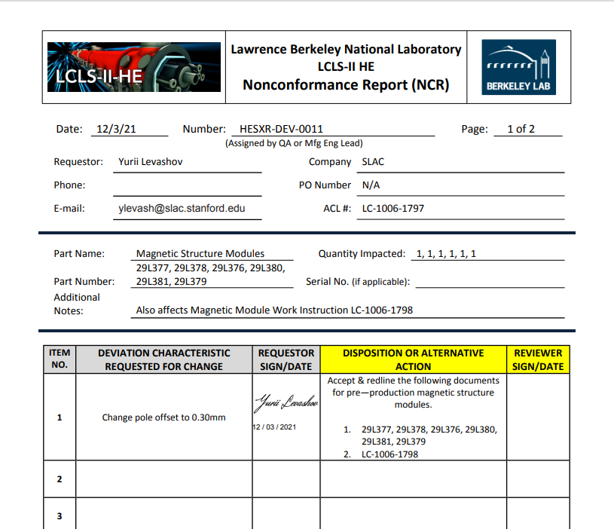
Magnet/pole recess
Charge Question: 1.A, 2.C, 3.B, 3.C
Pole
CMM measurements
Magnet
Magnet recess 0.14mm
Needs to be ≥ 0.3mm
Steel shim 0.17mm thick + glue
Poles moved by 0.150mm; checked on CMM.
The main field reduced by ~0.5% from 1.85T to 1.84T (4%).
No change in phase shake or field integrals.
Magnet/pole recess in the magnetic structure increased from 0.140mm to 0.300mm . Change request was generated.

Slide 12
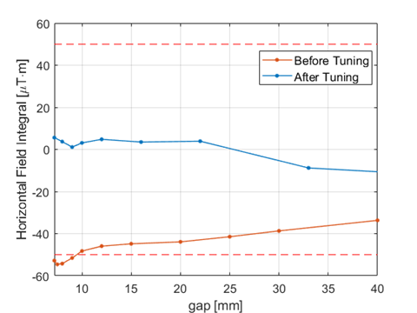
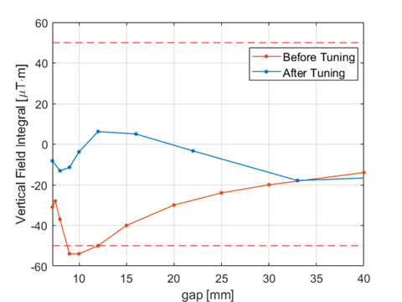
Prototype tuning
Charge Question: 2.C, 3
PRD0049.4040
PRD0049.4042
by D. Arbelaez
by D. Arbelaez
The prototype field integrals were tuned to ±20µTm by applying combinations of shims.

Slide 13
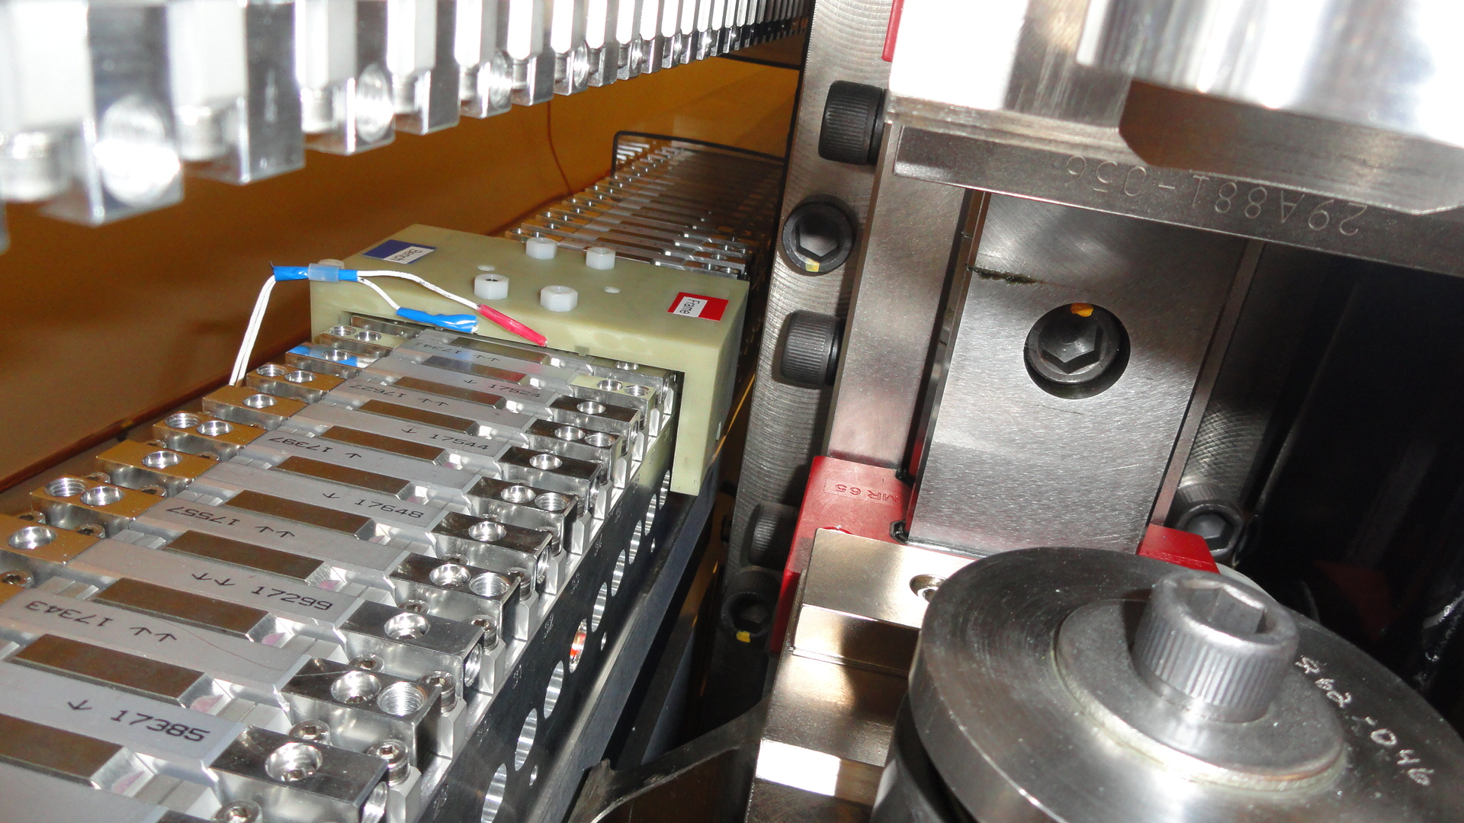
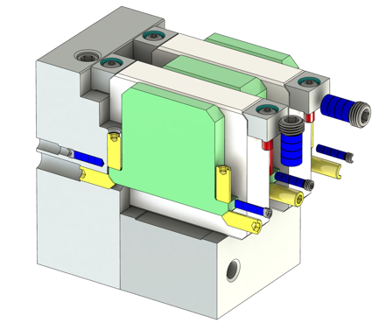
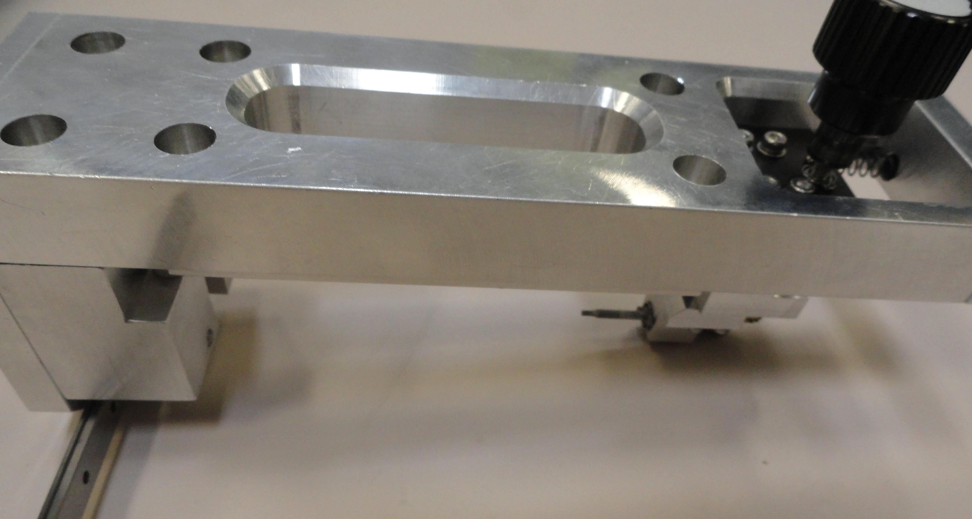
Tuning challenges
Charge Question: 2.C, 3.B, 3.C
LCLS-II SXU
Small slugs
HXU pole tuning fixture
Knob
90° Gear
Pole locking screw
Pole locking screws
Hex Tip
The pole adjustment works fine.
No access to the side screws near the frame vertical supports (~2 x 0.46m top & bottom).
A special tuning fixture is needed, like a fixture for HXUs.
No issues with installation of small slugs
Large slugs are very difficult to work with; slug diameter should be reduced.

Slide 14
Hall probe calibration accuracy.
Charge Question: 2.C, 3.B, 3.C
Project | B_{und}(T) | B_{calib}(T)
LCLS-I | 1.25 | 1.5
LCLS-II | 1.62 | 1.7
LCLS-II-HE | 1.86 | 1.9
The Hall probe must be calibrated to higher field levels.
Two challenges:
  Probe output is very non-linear at fields above 1.5T. Cubic splines used to fit the calibration data.
  The calibration magnet saturates reducing the good field region. Probes to be positioned with high accuracy.
The calibration accuracy is ±5·10⁻⁵ T.

Slide 15
Hall probe measurement accuracy
Charge Question: 2.C, 3
The measurement accuracy checked by measuring the prototype repeatedly. The test consists of alternate Hall probe recalibrations and the prototype re-measurements.
PRD0049.4033*
Gap of the prototype set to 7.3mm.
Ambient temperature variations (±0.1C°).
First 6 measurements during the gap initial drift ignored.
The deviations from the linear fit ±9∙10⁻⁵
Hall Probe calibrations
The Hall probe measurement accuracy meets the LCLS-II-HE requirements (<1∙10⁻⁴).

Slide 16
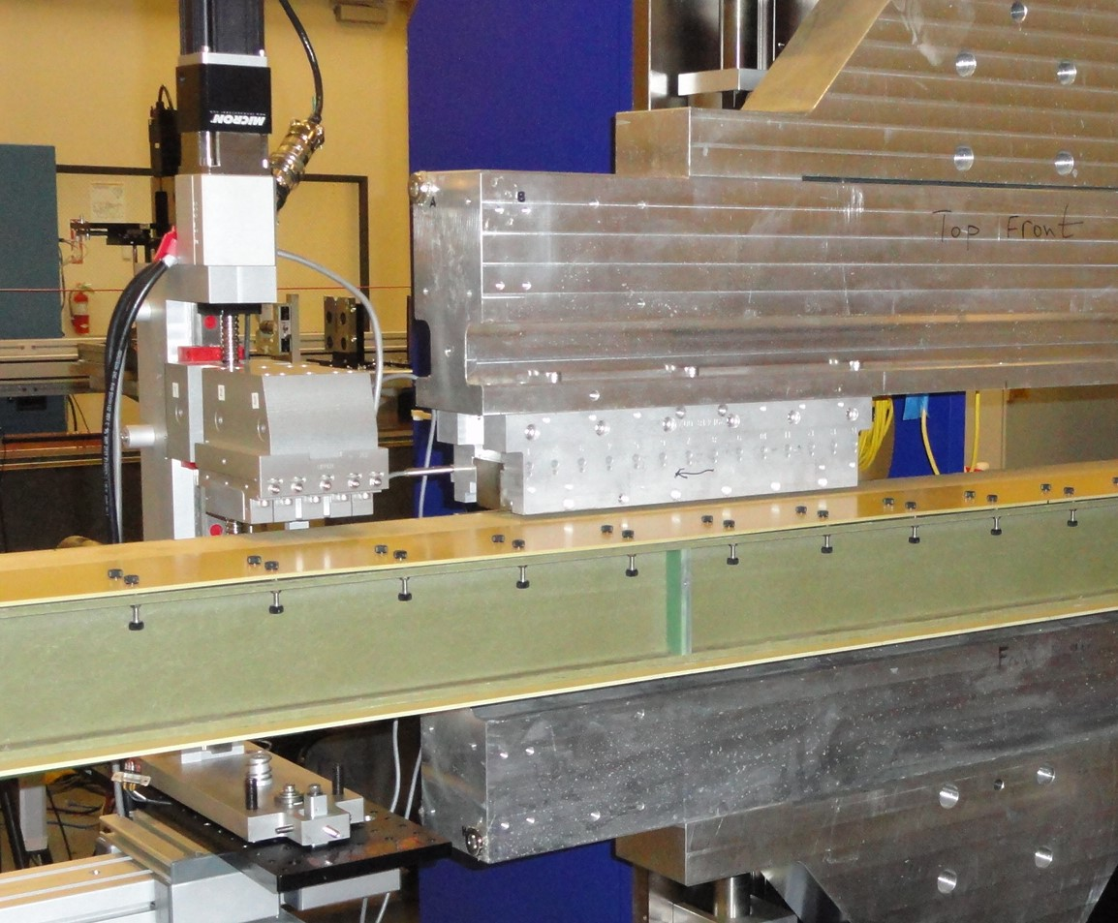
Crosstalk between undulator and the phase shifter
Charge Question: 2.C, 3
SXHEPS prototype
13cm
Rail
Slide
Undulator gap = 7.2mm
Phase shifter gap = 35mm
Distance Undulator/Phase shifter in tunnel = 14.4cm.
Insignificant cross-talk expected (< 2G-cm).

Slide 17
Summary
The magnetic structure design meets the requirements. (The short prototype does not represent the full-scale device. Satisfaction is only partial).
Pole saturation is small.
Shim signatures measured. Field shimming options are sufficient for tuning the field integrals to tolerances.
Magnet/pole recess increased from 0.140mm to 0.300mm for ferromagnetic shim installation.
Hall probe measurements accuracy is <1∙10⁻⁴ , meets the requirements on K measurements.
Undulator/phase shifter cross-talk starts at 13cm. No cross-talk in the tunnel (14.4cm).
Next Pre-production prototype (Starts Q3 2022):
    Tune
    Measure full final dataset
    Temperature calibration
    Beam pipe corrector calibration

